Slide 1
SDC Enhancements for Mapping
NS, VL, VNF, VDU and VF-Module
September 4th, 2020
Presented by: Byung-Woo Jun (Ericsson) & Ericsson SDC Dev Team
Fred Oliveira (Verizon)
Thinh Nguyenphu (Nokia)
Participating Companies
Ericsson
Verizon
AT&T
CMCC/ZTE
Huawei
Nokia
Others
Note:
The following is being implemented for the Guilin release:
SOL007 Design and SOL004 Onboarding
ONAP ETSI-Alignment Modeling Hierarchy (partially)
  NS Mapping
  NS-Level VirtualLink (between VNFs) Mapping
The following mapping will be implemented in the Honolulu release:
VNF Mapping
VDU and VFC Mapping
PNF Mapping
SOL001 VNFD and SDC AID DM VF Template Mapping
  VF-Module Deduction from SOL001 VNFD

Slide 2
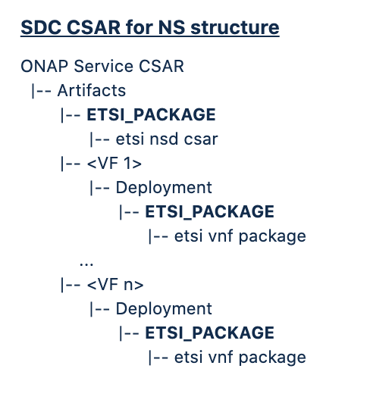
SOL007 Design and SOL004 Onboarding
SDC takes the vendor provided package and adds some files or changes files and meta data according to SDC procedure.
SDC NS/VNF/PNF Onboarding Procedure and Original Vendor VNF/PNF Package Handling
  SDC onboarding enhancement was made to the SDC Dublin to support SOL004 PNF/VNF onboarding with .zip and .csar file extensions. We continue to support the current onboarding mechanism with some enhancements.
  SOL007 NS onboarding (stretch goal for Guilin) will follow the same procedure; i.e., storing the vendor SOL007 NS package into the “ETSI_PACKAGE” directory.
  SOL007 NS design will allow users to build SOL007 NS package including SOL001 NSD from scratch
  SDC VSP and Resource csar files have the “ETSI_PACKAGE” directory, which will contain the original vendor VNF/NS/PNF package.
    The “ONBOARDED_PACKAGE” directory name will be changed to “ETSI_PACKAGE” as a common ETSI directory name. This change is necessary to support design of SOL007 package
    ONAP-ETSI Catalog Manager will be extracted the ETSI packages from the “ETSI_PACKAGE” directory.
    The VNFM and external NFVO use the original vendor VNF/NS/PNF packages through ETSI Catalog Manager.
SDC provides mapping from ETSI SOL001 NSD/VNFD/PNFD (PNF in the future) to SDC AID DM
  See the subsequent slides for mapping.
Note: ETSI 2.7.1 handling will be discussed separately.

Slide 3
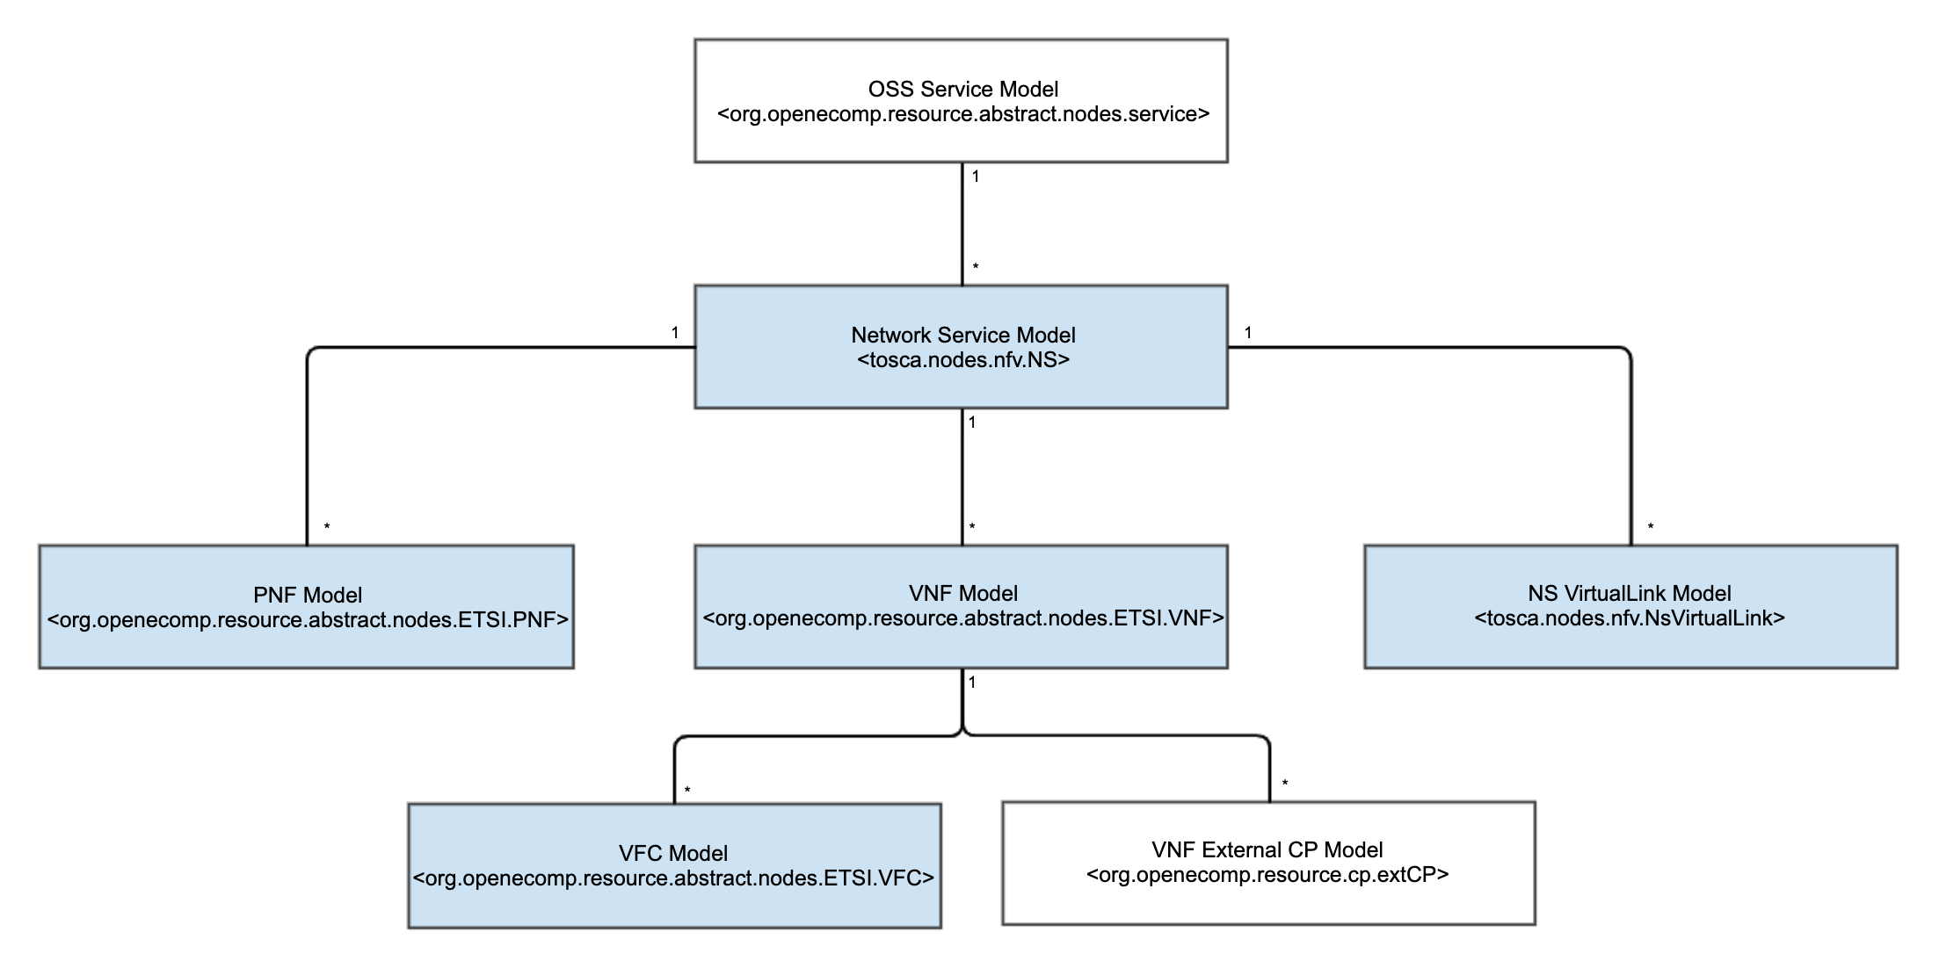
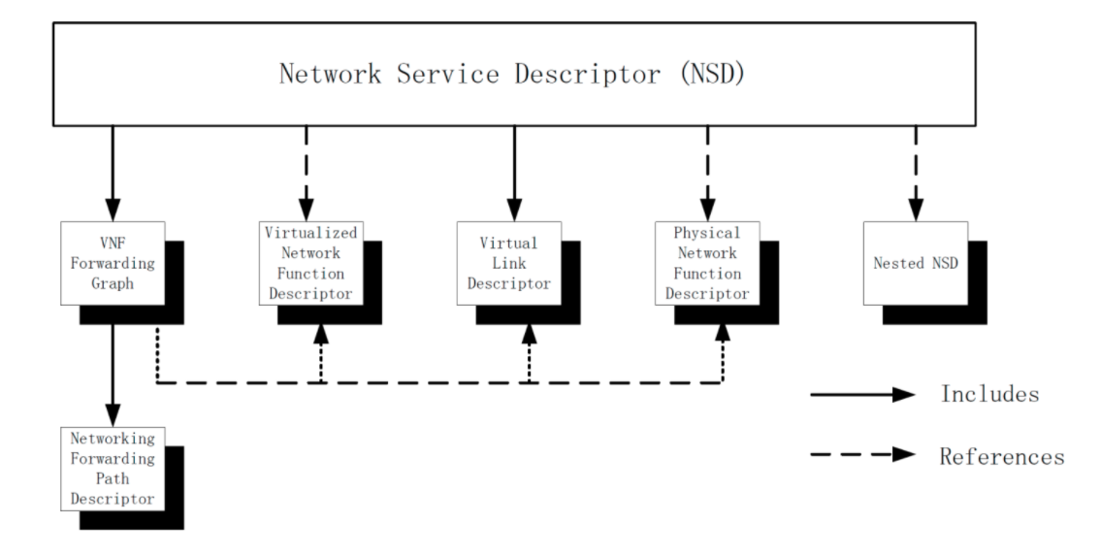
ONAP ETSI-Alignment Modeling Hierarchy
For OSS Service-level modeling, continue to use org.openecomp.resource.abstract.nodes.service
For NS modeling, use SOL001 tosca.nodes.nfv.NS as SDC AID DM NS node type
The OSS-Service model references/includes associated NSs (1:M)
In ONAP, tosca.nodes.nfv.NS references, a new VNF node type, org.openecomp.resource.abstract.nodes.ETSI.VNF (1:M) and a new PNF node type, org.openecomp.resource.abstract.nodes.ETSI.PNF (1:M) are used
  Note: VNF and PNF mappings are NOT part of Guilin.
In ONAP, tosca.nodes.nfv.NS includes SOL001 tosca.nodes.nfv.NsVirtualLink (1:M)
OSS Service Model
<org.openecomp.resource.abstract.nodes.service>
SDC AID DM
ETSI SOL001

Slide 4
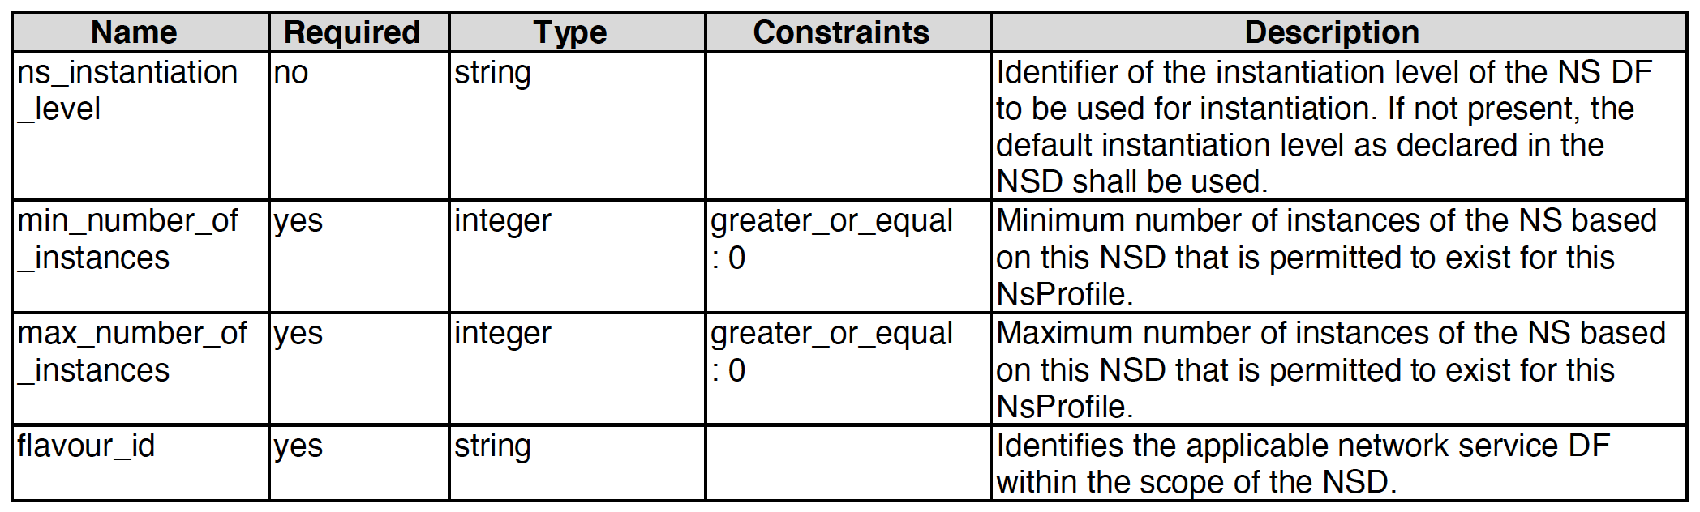
NS Mapping
SDC adopts SOL001 tosca.nodes.nfv.NS node type as the SDC NS node type; i.e., no mapping is necessary
  A new SDC SOL007 Design process generates SOL001 tosca.nodes.nfv.NS for the NS node type
  A new SDC SOL007 Onboarding process (stretch goal) copies the onboarded SOL001 tosca.nodes.nfv.NS contents to SDC AID DM tosca.nodes.nfv.NS contents
SOL001 NS (tosca.nodes.nfv.NS) - Chosen |  |  |  | SDC NSD org.openecomp.resource.vfc.NSD (not used for SOL007 design or onboarding)
name | required | type |  | name | required | type
descriptor_id | yes | string |  | nsd_id | true | string
designer | yes | string |  | nsd_designer | true | string
version | yes | string |  | nsd_version | true | string
name | yes | string |  | nsd_name | true | string
invariant_id | yes | string |  | providing_service_uuid | true | string
flavor_id | yes | string |  | providing_service_invariant_uuid | true | string
ns_profile | no | tosca.datatypes.nfv.NsProfile |  | providing_service_name | true | string
A decision to deprecate the current SDC NS node type, org.openecomp.resource.vfc.NSD for SOL007 design and onboarding
VFC impacts are being analyzed; expect to be minimal
SDC nfv-types directory is enhanced for hosting SOL001 NS node type.
SDC tosca data-types directory is enhanced for SDC AID DM changes
<tosca.datatypes.nfv.NsProfile>

Slide 5
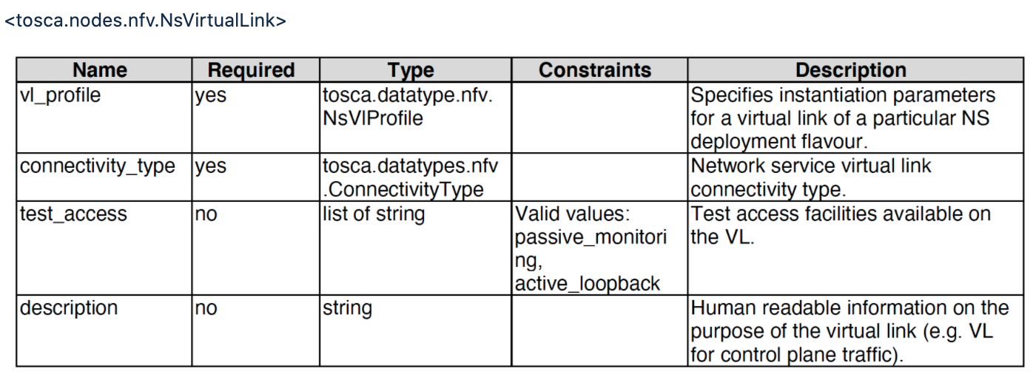
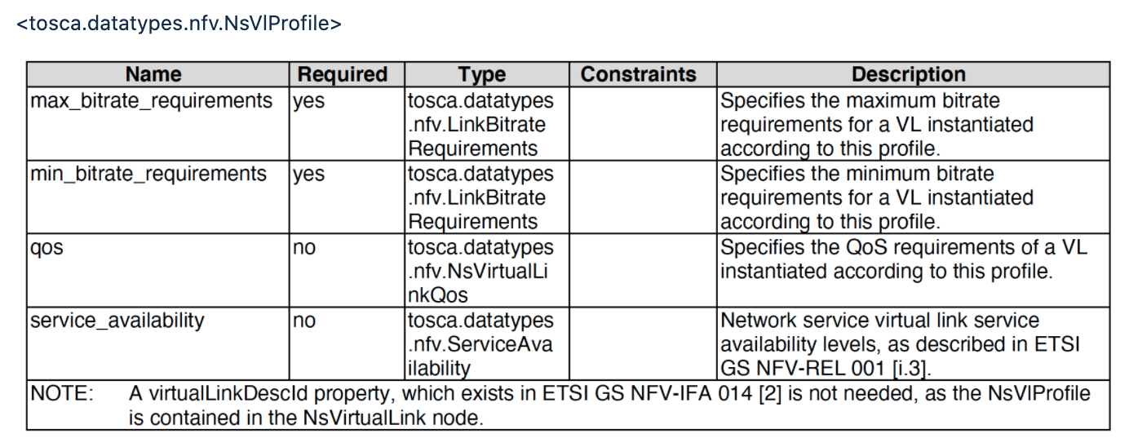
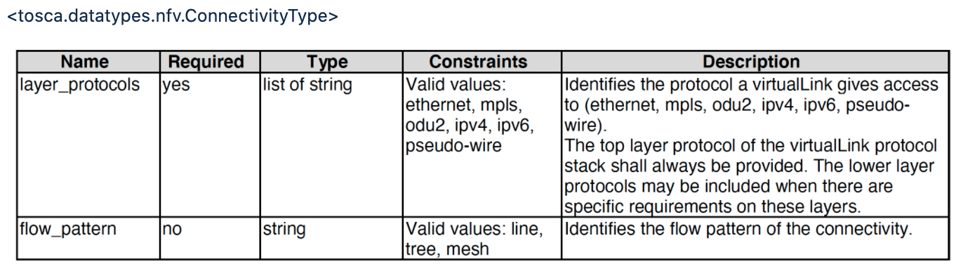
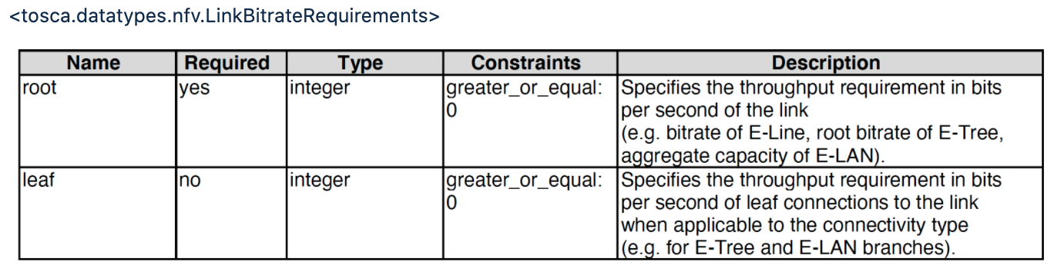
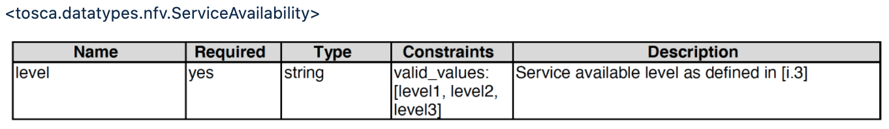
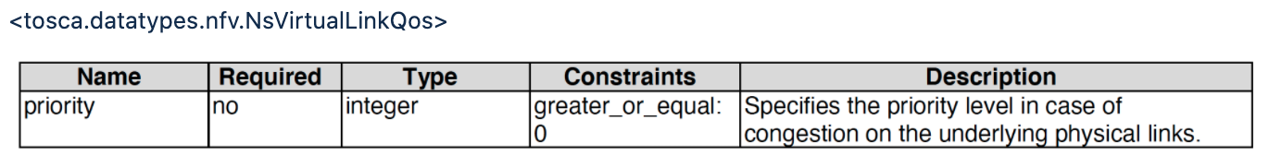
NS-Level VirtualLink (between VNFs) Mapping
SDC adopts SOL001 tosca.nodes.nfv.NsVirtualLink node type for the SDC NS-level VirtualLink node type; i.e., no mapping is necessary
  A new SDC SOL007 Design process generates SOL001 tosca.nodes.nfv.NsVirtualLink for the VirtualLink node type, and includes it in the NSD
  A new SDC SOL007 Onboarding process copies the onboarded SOL001 tosca.nodes.nfv.NsVirtualLink to SDC AID DM tosca.nodes.nfv.NsVirtualLink
  SDC deprecates vendor/operator-specific VLs from SOL007 design and onboarding

Slide 6
VNF Mapping (not for Guilin)
SOL001 VNF (tosca.nodes.nfv.VNF) |  |  | Mapping | New SDC AID DM VNF (org.openecomp.resource.abstract.nodes.ETSI.VNF) derived from org.openecomp.resource.abstract.nodes.VF
name | required | type |  | name | required | type
<SOL001 tosca.nodes.nfv.VNF attributes > |  |  |  | <SOL001 tosca.nodes.nfv.VNF attributes >
descriptor_id | yes | string | <--> | descriptor_id | yes | string
descriptor_version | yes | string | <--> | descriptor_version | yes | string
provider | yes | string | <--> | provider | yes | string
product_name | yes | string | <--> | product_name | yes | string
software_version | yes | string | <--> | software_version | yes | string
product_info_name | no | string | <--> | product_info_name | no | string
vnfm_info | yes | list of string | <--> | vnfm_info | yes | list of string
localization_languages | no | list of string | <--> | localization_languages | no | list of string
default_localization_language | no | string | <--> | default_localization_language | no | string
configurable_properties | no | tosca.datatypes.nfv.VnfconfigurableProperties | <--> | configurable_properties | no | tosca.datatypes.nfv.VnfconfigurableProperties
modifiable_attributes | no | tosca.datatypes.nfv.VnfInfoModifiableAttributes | <--> | modifiable_attributes | no | tosca.datatypes.nfv.VnfInfoModifiableAttributes
lcm_operations_configuration | no | tosca.datatypes.nfv.VnfLcmOperationsConfiguration | <--> | lcm_operations_configuration | no | tosca.datatypes.nfv.VnfLcmOperationsConfiguration
monitoring_parameters | no | list of tosca.datatypes.nfv.VnfMonitoringParameter | <--> | monitoring_parameters | no | list of tosca.datatypes.nfv.VnfMonitoringParameter
flavour_id | yes | string | <--> | flavour_id | yes | string
flavour_description | yes | string | <--> | flavour_description | yes | string
vnf_profile | no | tosca.datatypes.nfv.VnfProfile | <--> | vnf_profile | no | tosca.datatypes.nfv.VnfProfile
 |  |  |  | <SDC AID DM VF attributes that are inherited from org.openecomp.resource.abstract.nodes.VF>
<the following are being considered> |  |  |  | nf_function | no | string
requirements | Yes |  |  | nf_role | no | string
interfaces | Yes | tosca.interfaces.nfv.VnfLcm |  | nf_type | no | string
 |  |  |  | nf_naming_code | no | string
 |  |  |  | nf_naming | no | org.openecomp.datatypes.Naming
 |  |  |  | availability_zone_max_count | no | integer
 |  |  |  | min_instances | no | integer
 |  |  |  | max_instances | no | integer
 |  |  |  | multi_stage_design | no | boolean
 |  |  |  | sdnc_model_name | no | string
 |  |  |  | sdnc_artifact_name | no | string
 |  |  |  | skip_post_instantiation_configuration | no | boolean (default true) constraints: true, false
 |  |  |  | controller_actor | no | string (default: SO-REF-DATA) constraints: SO-REF-DATA, CDS, SDNC, APPC
SDC adopts a new VNF node type, org.openecomp.resource.abstract.nodes.ETSI.VNF, which is derived from org.openecomp.resource.abstract.nodes.VF.
  Merge of SOL001 VNF SDC VF node type attributes
  Non-ETSI modeling continues to use the existing org.openecomp.resource.abstract.nodes.VF
  ETSI VNF Design/Onboarding process uses the new VNF node type, org.openecomp.resource.abstract.nodes.ETSI.VNF as SDC AID DM VF
  For SOL001 VNF to SDC AID DM VNF mapping, SDC copies SOL001 VNF attributes to the corresponding attributes in the org.openecomp.resource.abstract.nodes.ETSI.VNF.
  SOL001 VNF attributes in SDC AID DM will be visible from SDC UI, so those attributes can be changed by SDC UI.
    But the onboarded vendor ETSI package will not be changed by the SDC UI users in Guilin.
    In Honolulu, the sync-up behavior will be be considered.
  For the reverse mapping, only the corresponding SOL001 VNF attributes will be copied
  In Guilin, SO NFVO, VFC and SVNFM get the SOL 001 attributes from descriptors, not from AAI
    AAI schema changes are not expected in Guilin

Slide 7
VDU and VFC Mapping (not for Guilin)
SOL001 VDU |  |  | Mapping | org.openecomp.resource.abstract.nodes.ETSI.VFC (derived from org.openecomp.resource.abstract.nodes.VFC)
Name | Required | Type | <--> | Name | Required | Type
name | yes | string | <--> | name | yes | string
description | yes | string | <--> | description | yes | string
boot_order | no | boolean | <--> | boot_order | no | boolean
nfvi_constraints | no | map of string | <--> | nfvi_constraints | no | map of string
monitoring_parameters | no | list of tosca.datatypes.nfv.VnfcMonitoringParameter | <--> | monitoring_parameters | no | list of tosca.datatypes.nfv.VnfcMonitoringParameter
configurable_properties | no | map of tosca.datatypes.nfv.VnfcConfigurableProperties | <--> | configurable_properties | no | map of tosca.datatypes.nfv.VnfcConfigurableProperties
boot_data | no | tosca.datatypes.nfv.BootData | <--> | boot_data | no | tosca.datatypes.nfv.BootData
vdu_profile | yes | tosca.datatypes.nfv.VduProfile | <--> | vdu_profile | yes | tosca.datatypes.nfv.VduProfile
sw_image_data | no | tosca.datatypes.nfv.SwImageData | <--> | sw_image_data | no | tosca.datatypes.nfv.SwImageData
 |  |  |  | <SDC AID DM VFC attributes that are inherited from the org.openecomp.resource.abstract.nodes.VFC>
 |  |  |  | nfc_function | no | string
 |  |  |  | high_availability | no | string
 |  |  |  | vm_image_name | no | string
 |  |  |  | vm_flavor_name | no | string
 |  |  |  | nfc_naming_code | no | string
 |  |  |  | vm_type_tag | no | string
 |  |  |  | nfc_naming | no | org.openecomp.datatypes.Naming ONAP_generated_naming: yes: boolean naming_policy: no: string instance_name: no: string
 |  |  |  | min_instances | no | integer
SDC adopts a new VFC node type, org.openecomp.resource.abstract.nodes.ETSI.VFC, which is derived from org.openecomp.resource.abstract.nodes.VFC
  Non-ETSI modeling continues to use the existing org.openecomp.resource.abstract.nodes.VFC
  ETSI VNF Onboarding process uses the new VDU node type, org.openecomp.resource.abstract.nodes.ETSI.VFC for SDC AID DM VFC
    SDC copies SOL001 VDU attributes to the corresponding attributes in the org.openecomp.resource.abstract.nodes.ETSI.VFC.
SOL001 VDU attributes in SDC AID DM will be visible from SDC UI, so those attributes can be changed by SDC UI.
    But the onboarded vendor ETSI package will not be changed by the SDC UI users in Guilin.
    In Honolulu, the sync-up behavior will be be considered.
  In Guilin, SO NFVO, VFC and SVNFM get the SOL 001 attributes from descriptors, not from AAI
    AAI schema changes are not expected in Guilin
Note: org.openecomp.resource.abstract.nodes.VFC represents design-time VFC, not VFC instances

Slide 8
Mapping between SOL001 Data Model and SDC AID DM
Overall Mapping Summary
SOL001 Data Model | SDC AID DM | Description | Release
N/A | org.openecomp.resource.abstracts.nodes.service | represents the OSS Service-level model
tosca.nodes.nfv.NS | tosca.nodes.nfv.NS | NS; use of SOL001 NS as SDC AID DM NS | Guilin
tosca.nodes.nfv.NsVirtualLink | tosca.nodes.nfv.NsVirtualLink | NS VirtualLink; use of SOL001 VL as SDC AID DM VL | Guilin
tosca.nodes.nfv.Vnf | org.openecomp.resource.abstract.nodes.ETSI.VNF | Represent VNF | Plan for Honolulu
tosca.nodes.nfv.vdu | org.openecomp.resource.abstract.nodes.ETSI.VFC | ETSI VDU and the corresponding SDC VFC | Plan for Honolulu
tosca.nodes.nfv.VirtualLink | org.openecomp.resources.vl | VNF VL | Plan for Honolulu
tosca.nodes.nfv.VduCp | org.openecomp.resources.cp | VDU CP | Plan for Honolulu
N/A | org.openecomp.resource.allottedResource | allotted resource; could not find any from SOL001
tosca.nodes.nfv.Pnf | org.openecomp.resource.abstract.nodes.ETSI.PNF | Represent PNF | Plan for Honolulu (the SDC AID DM node type is under discussion)

Slide 9
SOL001 VNFD and SDC AID DM VF Template Mapping
(not for Guilin)
SOL001 VNFD |  |  | SDC AID DM VFD
Name | Grammar |  | Name | Grammar
tosca_definitions_version | String (tosca_simple_yaml_1_2) |  | tosca_definitions_version | String (tosca_simple_yaml_1_2)
description | string |  | description | string
metadata | map of <string> |  | metadata | map of <string>
imports | Single-line grammar |  | imports | Identifies the lower level models (VFC, CP, VL, heat)
data_types | <data_type_name>: |  | data_types | <data_type_name>:
node_types | <node_type_name>: |  | node_types | <node_type_name>:
topology_template | topology_template |  | topology_template | similar, but the following are different node_templates contents groups and workflows
description | string |  | description | string
inputs |  |  | inputs | <parameter name>:
node_templates | vnf: tosca.nodes.nfv.Vnf vdu: tosca.nodes.nfv.Vdu vl: tosca.nodes.nfv.VnfVirtualLink vduCp: tosca.nodes.nfv.VduCp vduCompute: tosca.nodes.nfv.Vdu.Compute |  | node_templates | vfc: type: org.openecomp.resources.vfc.<> vl: type: org.openecomp.resources.vl.<> cp: type: org.openecomp.resources.cp.<> allotted_resource: type: org.openecomp.resource.allottedResource.<>
 |  |  | workflows | <workflow name>
policies scaling aspect | tosca.datatypes.nfv.ScalingAspect |  | groups | list of VF Modules VFModule_Base: type: org.openecomp.groups.VfModule VFModule_Expansion: type: org.openecomp.groups.VfModule
 |  |  | policies | Optional list of policies
substitution_mappings |  |  | substitution_mappings
node_type |  |  | node_type
capabilities | <capability_type_name>: |  | capabilities | <capability_type_name>:
requirements |  |  | requirements
group | not defined |  | group | <group_type_name>:
policy | only the Abstract.SecurityGroupRule policy type is defined not sure if we can map this into SDC AID DM |  | policy | <policy_type_name>:
relationship | tosca.relationships.nfv.VirtualBindsTo tosca.relationships.nfv.AttachesTo |  | relationship | <relationship_type_name>:
 |  |  | annotation_type | <annotation_type_name>:
 |  |  | annotation | <annotation_name>:
Templates between SOL001 VNFD and SDC AID DM are similar, but the contents of node_templates and groups are different

Slide 10
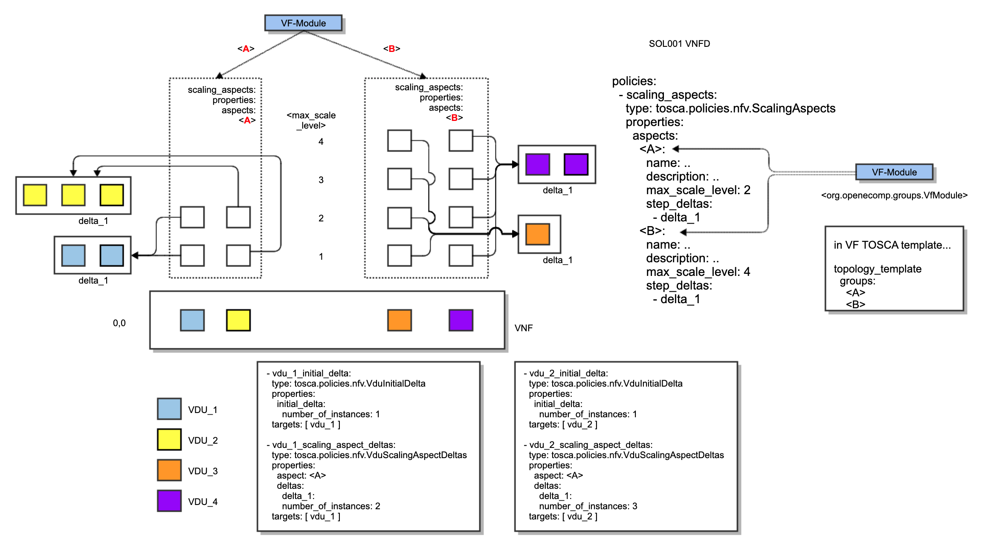
VF-Module Deduction from SOL001 VNFD (not for Guilin)
SDC deduces the VF-Module from the SOL001 VNFD Policies>scaling_aspects>properties>aspects
Additional VF-Module attributes are deduced as the following table
SOL003 Adapter may need to transform the VF-Module back to the SOL001 VNFD policies for the scaling and healing requests from VNFM(s) – not part of Guilin
Name | Required | Type | SOL001 VNFD Policies
vf_module_type | yes | string valid values: Base, Expansion | Base default: Base
vf_module_label | yes | string | aspects: <A>
min_vf_module_instances | yes | integer | initial_delta: 0
max_vf_module_instances | no | integer | max_scale_level
initial_count | yes | integer | initial_data: number_of_instances
vf_module_description | no | string | aspects: description
volume_group | yes | Boolean | Default to false
group_naming | no | org.openecomp.datatypes.Naming | Optional field, leave it empty

Slide 11
References
SDC Enhancements in Guilin, https://wiki.onap.org/display/DW/ETSI+Package+Management+%28SDC+Enhancements%29-+Guilin

Slide 12
Thank you!

