Slide 1
Developing ONAP API Documentation
Andy Mayer, Ph.D. (AT&T)
Septermber 2019

Slide 2
Development and Documentation Go Hand in Hand
From Writing API Documentation -> Developing API Documentation
Make it easy to create by designers and developers
Make it easy to access and relevant to developers
  Developer engagement
Make it easy to use: Sample Calls and Code are essential
  Try It For Yourself (TIFY) Examples
  Panes on page with prose, sample code, and navigation / search
  Keep simple and easy to understand
  Copy and paste friendly
  Target languages (and code generation)

Slide 3
Topics
Who Uses API Documentation?
Current Approach(es) in ONAP
What Is Good API Documentation?
API Development / Documentation Tools
Proposed Approach and Next Steps

Slide 4
Who Uses API Documentation?
Exasperated Developers: If the documentation is poor!
On the other hand, if documentation is good and useful:
  Happy and Productive Developers
  Designers
  Modelers
  Architects
  Integrators
  Users
  Potential project contributors
  The list goes on!
Notes:
We’ve been discussing layers that sit on top of kubernetes and delegate to kubernetes
DCAE Controller
Multi-cloud
Kubernetes is the lowest common denominator

Slide 5
Current API Documentation Approaches in ONAP
There are TOO MANY ways APIs are documented in ONAP today!!
  JSON or YAML Swagger / OpenAPI files
    This is Great!! (May need to consider OpenAPI Spec v3.0)
  Various formats of .doc and .pdf files
  Wiki only documentation
  A few using Doc Generation Tools (Swagger2Doc, Swagger CodeGen, etc.)
  A variety of Text table with request response examples
Many without usage and conceptual documentation
No common documentation structure / approach
  See Examples on next few slides
Difficult to navigate
Not many “Try It For Yourself” (TIFY) examples.

Slide 6
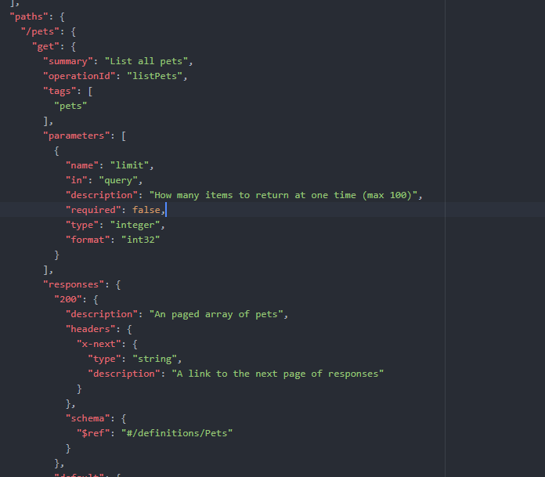
JSON Swagger / OpenAPI Example
This is really the API spec, not documentation
But it is essential for describing the API
Can be used as input for API Documentation tools
API authors should make use of Summary and Description fields!

Slide 7
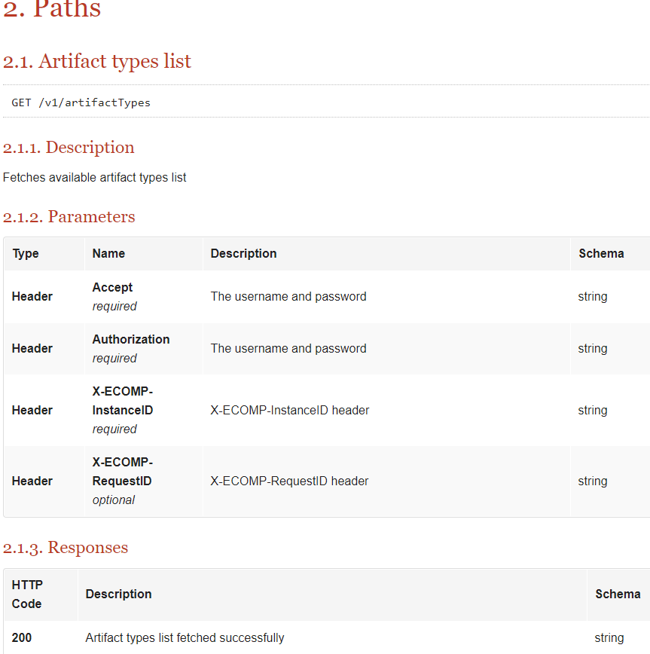
One example of ONAP API documentation

Slide 8
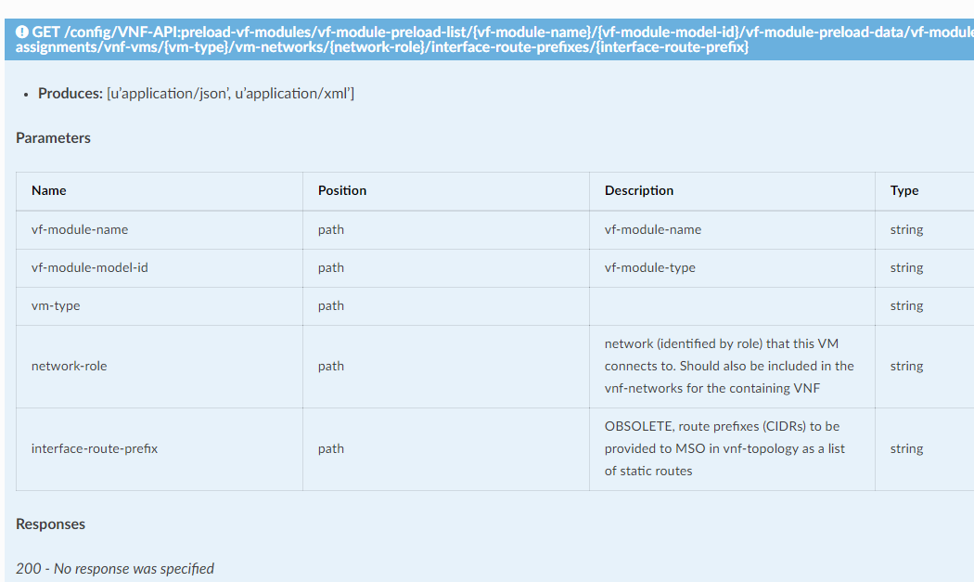
Another Table example
(Swagger2Doc)

Slide 9
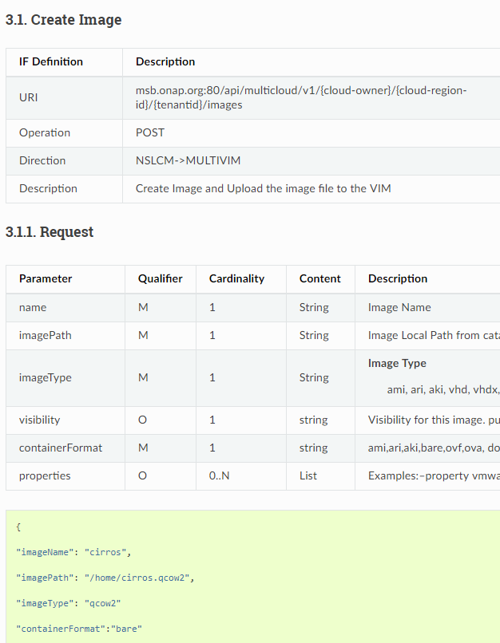
Another Sample that is Action Based with good descriptions and examples

Slide 10
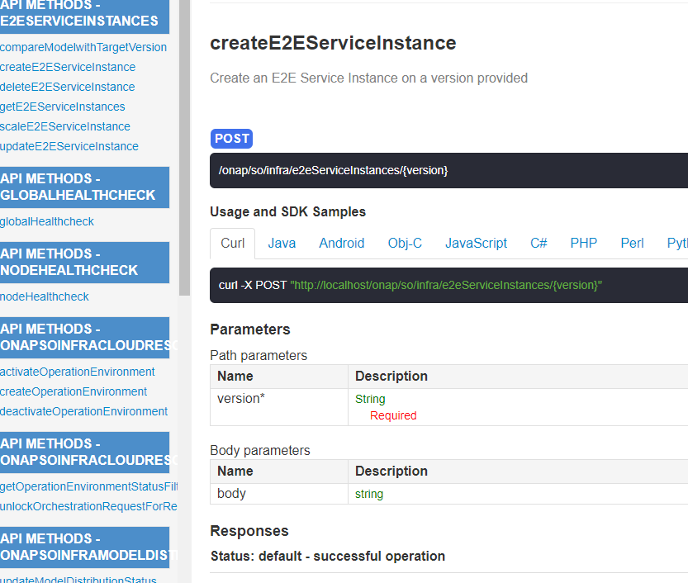
Excellent Example with Code samples
(but little description)
(swagger-codegen)

Slide 11
What is Good API Documentation?
Developer Friendly
Non-Developer Friendly
Easy to Find & Easy to Navigate
Common and Uniform Documentation Structure and Approach
Provides Information on Using the API (e.g., quick start)
Try It For Yourself (TIFY) Examples

Slide 12

The API Documentation Factory
4. Can also use other tools to exercise APIs
(e.g., Postman, CURL)
API Conceptual Documentation
API Reference
Swagger / OpenAPI File
Other Tools
(Postman, Etc.)
1. Start with the developed Swagger / OpenAPI “code” (JSON and/or YAML)
3. Create consistent Conceptual Documentation to supplement API Reference with handy information about using the API. (e.g., Description, Getting Started, Security, etc.)
2. Use tools to generate much of the API Reference from the OpenAPI file

Slide 13
Proposed Conceptual API Documentation Structure
API Overview
  General Description (short); What the API does; Who should use the API; Why use the API
Getting Started with the API (Hello World)
  Get Credentials and access token; Creating accounts; Making REST API Calls (e.g., sandbox vs live) (where); Try it for yourself (e.g., CURL / Postman sample)
Security on the API
  Authentication; Authorization
Response Codes
  The meaning of Status Codes & Errors
Rate Limits and Thresholds
  Requests per unit time allowed; Pagination
Examples
  Interaction Examples
  Sample Client Code (generally CURL): Focus on Why not What; Keep simple; Cut and paste ready
  Tutorials
SDKs and Sample Apps (Or How does a client app use this)
Quick Reference with one-line summaries of each endpoint/resource
Payload data structures
Glossary

Slide 14
Proposed Approach and Next Steps
Modeling Subcommittee should discuss and recommend to the TSC a common API Documentation approach for ONAP. For example:
  Use Swagger toolset to develop and publish Swagger API Specs (in JSON or YAML) (e.g., SwaggerHub)
  Select a generation tool and generate API Reference documentation directly from Swagger / OpenAPI files (using Redoc for example which creates a consistent standalone HTML file)
  Create common and uniform Conceptual API Documentation describing each API and provides quick start and usable TIFY(try it for yourself) samples
    Start with a common ONAP RST template, instructions, and examples

Slide 15
Additional Related Topics
API Catalog / Explorer: Capture, search, and explore APIs
Service (API) Registration / Discovery: For example an ONAP specific registry for publishing services that are available. May provide enhanced functionality.
Data Dictionary: Common repo of attribute specific schema definitions, characteristics, and constraints
Also worth exploring TM Forum API Tooling

Slide 16
Tool Generated API Reference
Swagger2Doc
  https://github.com/openconnectivityfoundation/swagger2doc
Swagger Codegen
  https://github.com/swagger-api/swagger-codegen
Swagger UI
  https://github.com/swagger-api/swagger-ui
Redoc
  https://github.com/Redocly/redoc
Spectacle
  https://sourcey.com/spectacle
Others…
Notes:
file:///C:/SwaggerTools/Swagger-UI/index.html
file:///C:/Users/am803u/AppData/Roaming/npm/node_modules/redoc-cli/Docs/ONAP-ServiceOrder.html#tag/ServiceOrder

