Slide 1
A1 Adapter in ONAP
(DMAAP Listener, CCSDK/SDNR)
January 2020
Sandeep.Shah@ibm.com

Slide 2
Agenda
A1 Interface Architecture (Mediator/Adapter)
A1 DMAAP Listener/REST Adapter High Level Design
  YANG Model/RPC's/DG's
The Current Status
Solution Flexibility
Next Steps
2

Slide 3
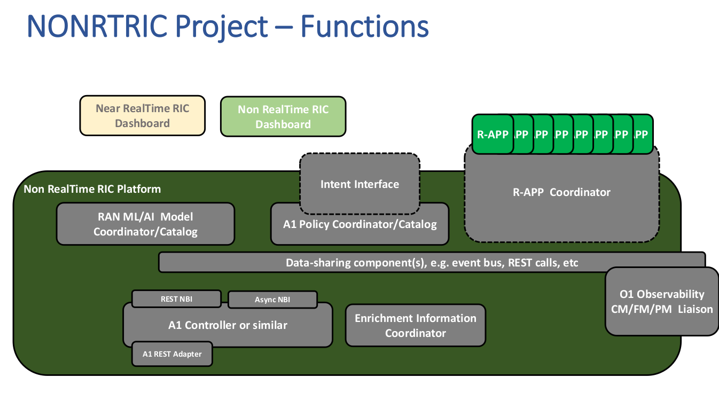
High-Level Architecture (DMAAP <--> SDNR/A1 REST Adapter <--> A1 Mediator)
ONAP Components
A1 Mediator

Slide 4
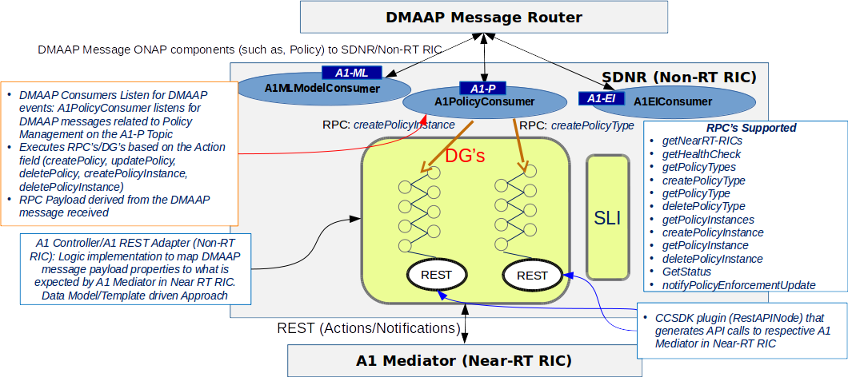
A1 DMAAP Listener/A1 REST Adapter High Level Design
4

Slide 5
SDNR/DMAAP Listener to Support A1 Adapter (NonRTRIC)
YANG Model (ver1) - (Tree, RPC's)
Leveraged existing ONAP components – CCSDK/SDN-C and DMAAP-Listener
Refined and Integrated A1-ADAPTER-API YANG model
  11 RPC's defined
Leveraged DG Builder and JSON/Velocity templates to implement logic for REST transactions
  11 DG's (10 invoked through DMAAP Listener and 1 tentatively planned to be invoked by CURL/postman)
Open Items:
  Integrate/Test bug fixes introduced in Frankfurt (in December) to address issues in REST API Adapter
  Refinement of YANG model/DG's accordingly
Create a Karaf Feature “a1Adapter” (SDNC Docker)
Repo: CCSDK/features; Folder: features/sdnr/northbound
sdnr is a component-meta feature
Implement SLI RPC’s/DG’s to support:
  DMAAP events from Policy to initiate policy management related REST actions against A1 Mediator in RT-RIC
  REST Notifications from A1 Mediator
  Required update of JAVA provider/client classes
Update DMAAP-Listener Docker
Support new A1 Policy DMAAP topics for consumption/publishing
SDN-C Docker Build (based on CCSDK docker image)
DMAAP-Listener Docker Build
A1 Mediator Installation for Integration Testing

Slide 6
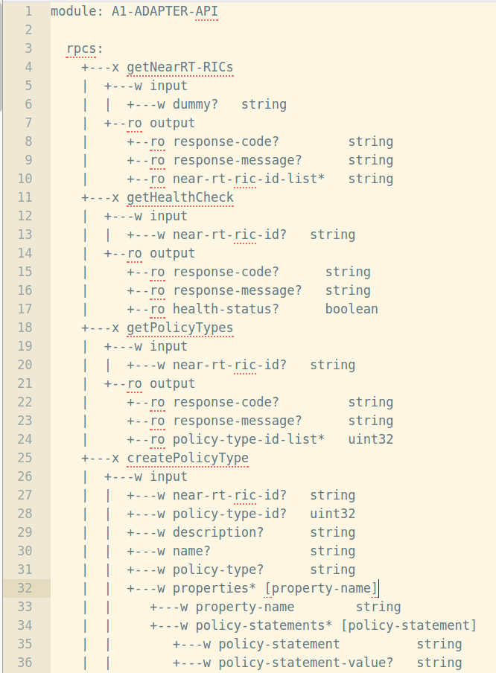
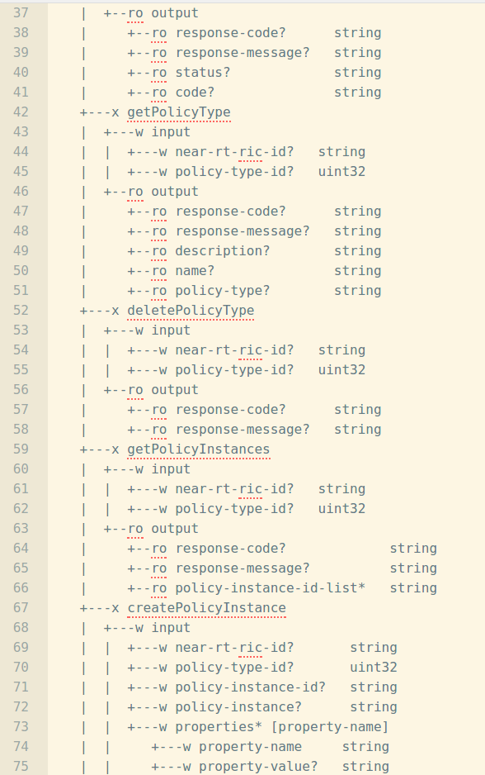
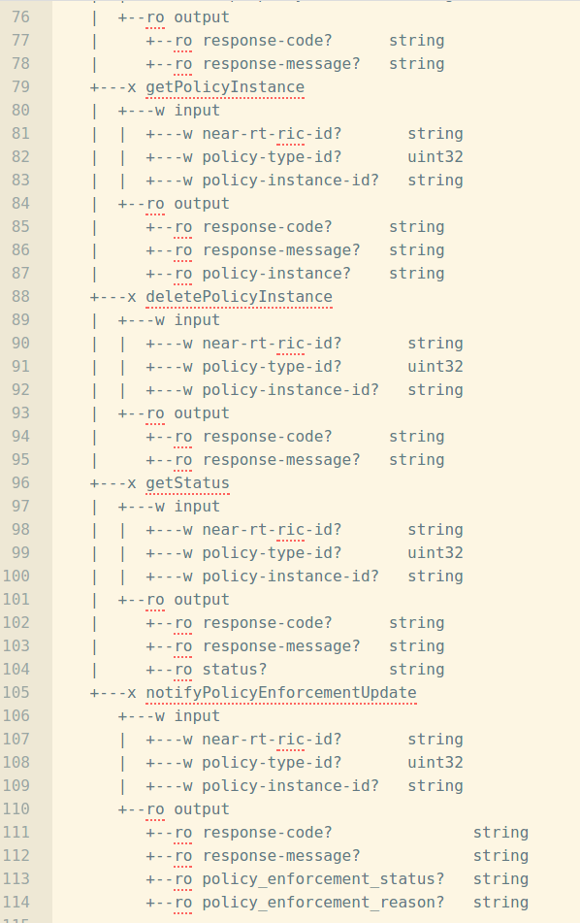

A1-ADAPTER-API YANG Model
0
8
4
1
9
5
2
6
10
3
7
11
6

Slide 7
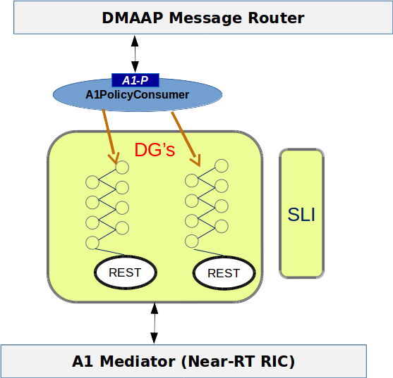
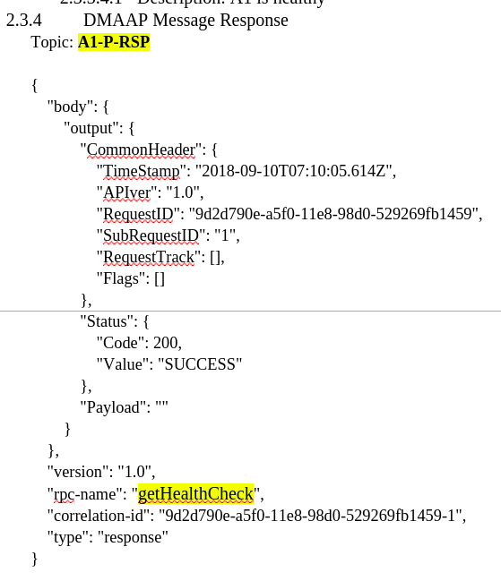
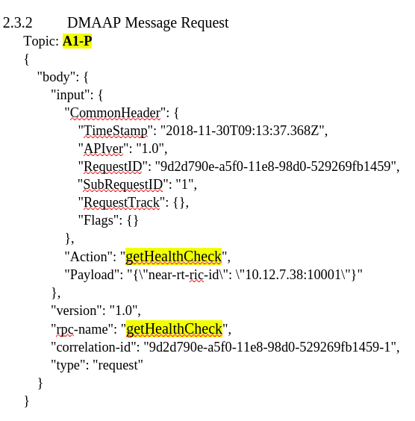
DMAAP Message/RPC/API Flow
A
D
B
Directed Graphs Invoked by RPC's
C
A1 Mediator (OpenAPI YAML)
A1 Mediator OpenAPI YAML: https://gerrit.o-ran-sc.org/r/gitweb?p=ric-plt/a1.git;a=blob;f=a1/openapi.yaml;h=f35a742c89a3c642f21d238e9b467f815691e914;hb=refs/heads/master​
​
7

Slide 8
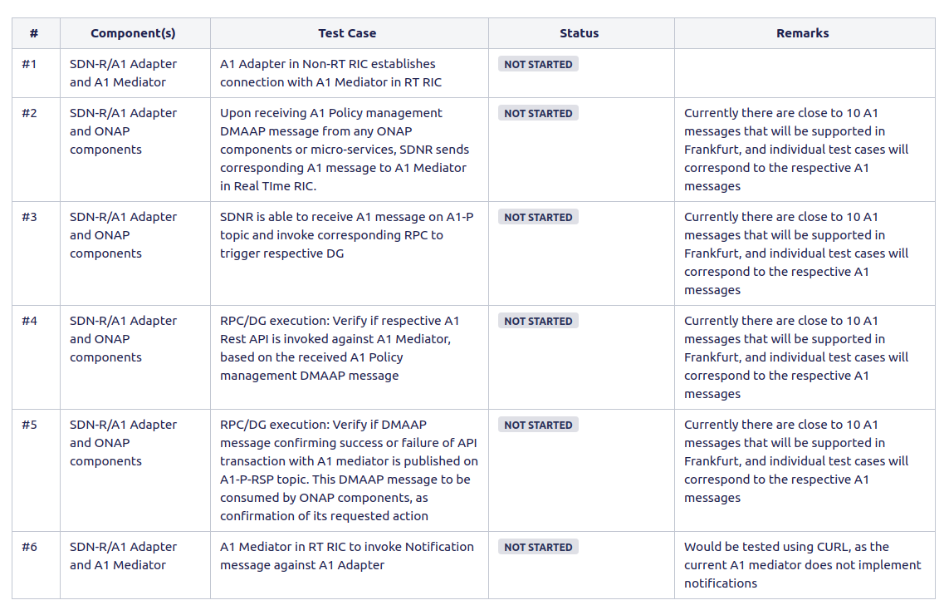
DMAAP Message/RPC/API Flow & Testing Plans
A
D
B
A
B
C
D
C
C
https://wiki.onap.org/pages/viewpage.action?pageId=71837463
8

Slide 9
The Current Status
The code has been merged in Nov/December, and waiting for the latest docker availability through Jenkins for further integration testing/bug fixing
The Windriver environment is being shifted to a new data center, and we will demo in next 1-2 weeks
https://gerrit.onap.org/r/q/owner:Sandeep.Shah%2540ibm.com+status:Merged
9

Slide 10
Demo Setup (Installed using OOM/HELM/K8s)
DMAAP POD (dev-dmaap-message-router-0)
SDNC/MariaDB Galera
dev-sdnc-sdnc-dmaap-listener
Postman/CURL
dev-sdnc-sdnc-0
dev-mariadb-galera-mariadb-galera-0
A1 Mediator (Deployed in VM)
10

Slide 11
Solution Flexibility
Support Use cases that involve both A1 and O1 interfaces
End to end system engineering
  YANG RPC payloads embedded in DMAAP payloads
  Conform to existing DMAAP standard payloads, used in ONAP
Model driven approach – YANG models and DG's can be refined quickly, per new requirements or changes in requirements
11

Slide 12
Next Steps
Integration Testing and Bug Fixing
Refinements required in alignment with improvements/changes in A1 Mediator
Specs for notifications from A1 Mediator
  At this time, in the ONAP/CCSDK/SDNC context, CCSDK/SDNC can work with only already defined ODL RPC's, and as long as A1 Mediator can support such notifications defined in YANG files, we are good
12

Slide 13
Backup

Slide 15
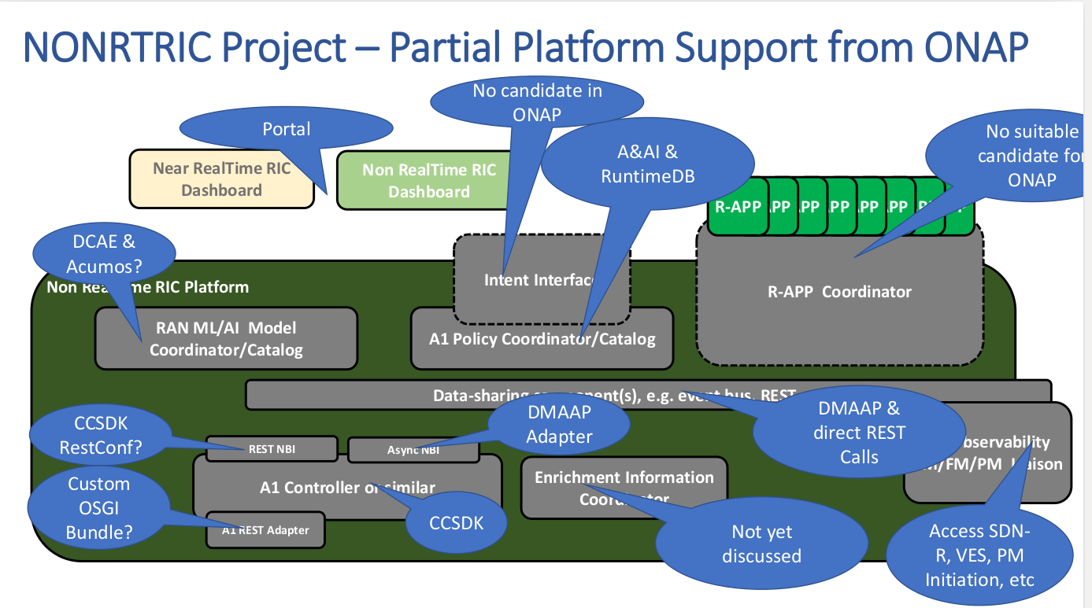

Slide 16
