Slide 1


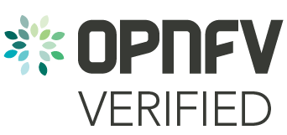



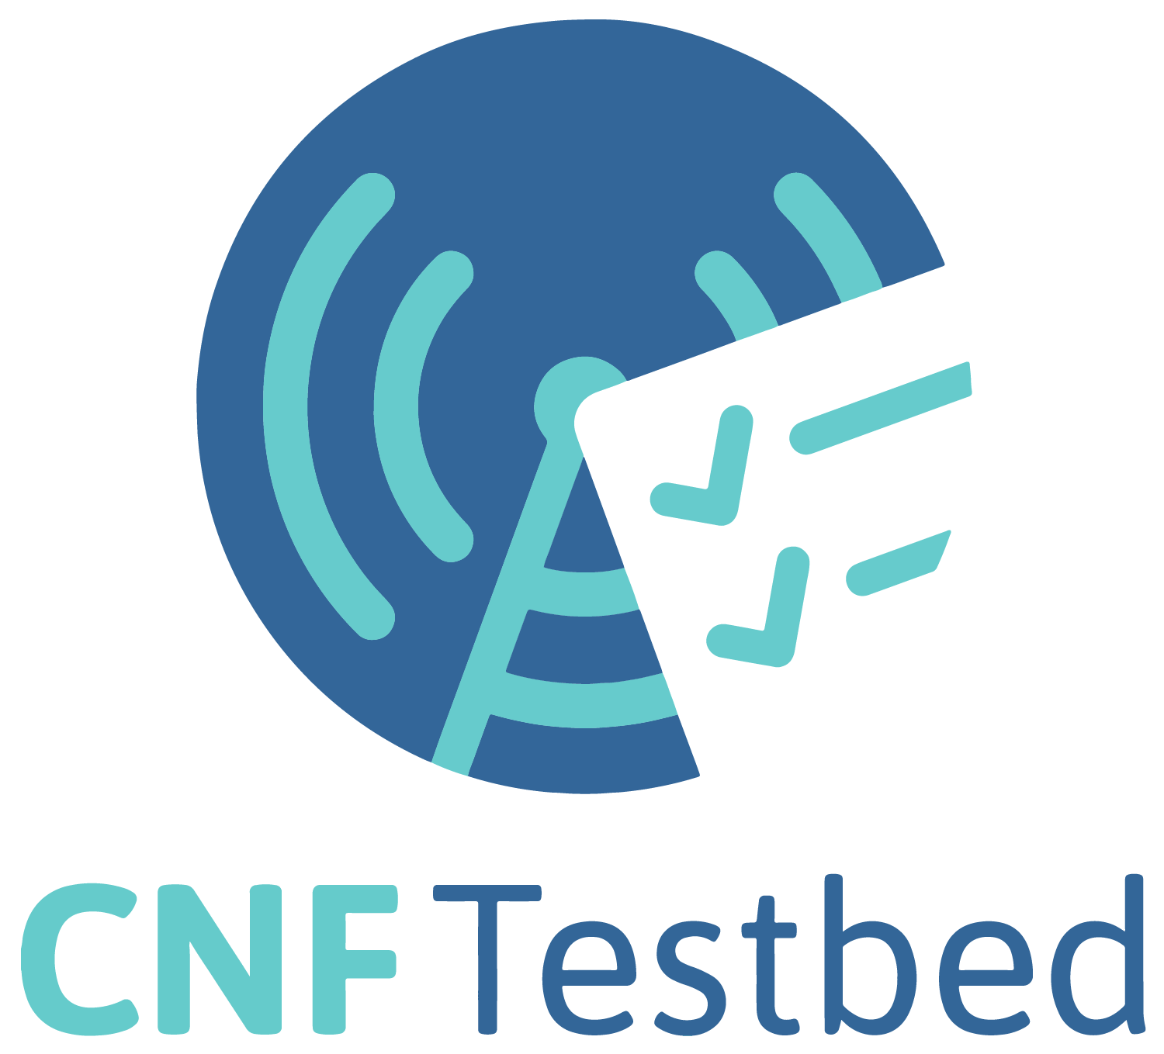



Cross-community CNF landscape
Requirements
Implementations
Testing
Certification
CNTT RI-2 (Testing)
CNTT RC-2 (Testing)
XGVela
Cloud native Principles:
Definition, Papers¹
CNF
Conformance
CNF
Conformance
Core+Addons
Best Practices
SIGS
End-to-end
testing
CNTT Reference Model
+ Architecture
K8s Addon Specs: CSI, CRI, CNI, etc
… any other telcom creator’s solutions
Requirements to create a reference platform w/workloads meeting the model (high-level requirements and features)
Communities can use the requirements as-is or with adjustments when implementing solutions for their end-users
Test cases can cover the requirements and be used for verification of the various implementations
LFN’s certification and badging program. Will use the results of several upstream testing sources. Will use multiple sources for requirements.
Source: https://docs.google.com/presentation/d/1rTUDacKW96IUJYt-QckITmxwRUD1l8pFZe1xCqyK6yo/edit?ts=5f1f18cd#slide=id.g8ecce7b011_2_0
Notes:
Requirements
Updated ONAP xNF requirements to cover mixed workloads of PNF/VNF/CNF
ONAP Requirements complement those provided by CNTT, CNCF-TUG and ensure smooth orchestration experience
Implementation
CNF Orchestration for Cloud-Native Network Functions
Testing and certification
Evolution of VTP to CNTP to support Cloud-Native network functions
CNTP may be used as part of the badging program and is closely aligned with the LFN Compliance, Validation and Certification (CVC) program

