Slide 1
Cloud Native Definitions
Cloud Native
Cloud Native is an approach to building and running applications in a cloud computing delivery model.
Cloud Native is about how applications are built, deployed and managed (not where).
An application is considered Cloud Native by following the Cloud Native Principles.
Technologies and tool choices are considered independently from Cloud Native Principles.
Aligned with CNCF definition of Cloud Native.
Cloud Native Infrastructure
Cloud Native Infrastructure is all the software and hardware that support cloud native applications.
Includes the underlying hardware, operating systems and platform software.
Includes deployment pipelines, configuration management.
Enables all the Principles that a Cloud Native application must follow.
Provides abstractions behind APIs for cloud native workloads to interact with.
Infrastructure is managed by software in order to run applications in a scalable way.
Also follows all the Principles that a Cloud Native application must follow.
Cloud Native Network Function
Cloud Native network function (CNF) is a cloud native application that implements network functionality.
CNFs are built, deployed and managed just like any other Cloud Native apps.
CNFs are considered Cloud Native by following the Cloud Native Principles.
CNFs may have high performance and security requirements, but that is considered independently from Cloud Native Principles.
CNFs may need specific resources from the infrastructure, but requested from a pool of resources.
CNFs should generally run in containers and request the minimum set of resources to operate.
Aligned with CNCF / TUG definition of Cloud Native Network Function.
Notes:
https://github.com/cncf/toc/blob/master/DEFINITION.md
https://github.com/cncf/telecom-user-group/blob/master/whitepaper/cloud_native_thinking_for_telecommunications.md#1.4
https://www.oreilly.com/library/view/cloud-native-infrastructure/9781491984291/ch01.html

Slide 2
Cloud Native Principles
Principle | Description
Platform Capabilities Driven | Workload is portable within a cloud platform – while it may need particular type of device from a resource pool, it doesn't require a specific instance of that device or host. Workload cannot design to a specific hardware or software platform release level, version or patch. The workload is built independent of the infrastructure and orchestration platform. Workload cannot design to a specific kernel (i.e., one kernel for all containers running on a server). Workload uses open interfaces, approaches and ecosystem tools aligned with these Principles. Workload stores its state within the orchestration engine, not an external database.
Immutable | If the workload needs to change, then redeploy a new workload. Workload is designed so that the operators just signal a restart when needed (no login required). Deployed workload (application and configuration) is protected from change. Infrastructure includes software platform and physical hardware. if the infrastructure needs to update for whatever reason, it changes. Workload doesn’t notice.
Declarative | Express intentions for the desired state. Declaration is the source of truth. Designates what to do, not how to do it.
Predictable | Declarative input drives consistent platform behaviors (desired state is expressed up front). Immutable infrastructure drives consistent platform behaviors (redeploy a workload when change is needed). Deployments are planned, repeatable, consistent.
Modular | Functions are broken down into smaller units to enable individual startup, scaling, updates or shutdown. Packaging as one-process containers reinforces right-sized smaller units. Ability to scale dynamically by independently increasing/decreasing resources around a spike. Aligns with loosely coupled microservices based architecture.
Notes:
https://github.com/cncf/toc/blob/master/DEFINITION.md
https://github.com/cncf/telecom-user-group/blob/master/whitepaper/cloud_native_thinking_for_telecommunications.md#1.4
https://www.oreilly.com/library/view/cloud-native-infrastructure/9781491984291/ch01.html

Slide 3
Cloud Native Principles (cont)
Principle | Description
Automation | Ability to idempotently repeat an activity. Ability to be scheduled. Engineered for a CI/CD model: continuous deployment for frequent, faster updates as needed.
Orchestration | Each modular unit can be independently scheduled and managed for resource optimization. Platform manages availability, provisioning, and deployment of containers. Platform manages scaling across infrastructure. Workload is portable within the same cloud platform.
Statelessness | Stores state independent of specific infrastructure, enables highly distributed approach. Workload uses a protocol that allows for a session to continue seamlessly, even when there are drops. HTTP operates this way.
Resiliency | Ability to self-heal, self-scale and operate when the platform has a partial failure. Workload gracefully hands off service request during outage - either planned or unplanned.
Monitoring | Ability to be programmatically monitored via standard approach (health check: liveliness and readiness probes) Aligns to standard ecosystem tooling for metrics / export. Similar to CNCF "Observability & Analysis" - check progress or quality over a period of time, and determine health.
Tenancy | Workload should assume that other workloads are running on the platform. Workload should assume that there is no specific, dedicated hardware. Workload should request the bare minimum level of privileged access (eg, don’t assume admin rights).
Notes:
https://github.com/cncf/toc/blob/master/DEFINITION.md
https://github.com/cncf/telecom-user-group/blob/master/whitepaper/cloud_native_thinking_for_telecommunications.md#1.4
https://www.oreilly.com/library/view/cloud-native-infrastructure/9781491984291/ch01.html

Slide 4
Appendix
Notes:
https://github.com/cncf/toc/blob/master/DEFINITION.md
https://github.com/cncf/telecom-user-group/blob/master/whitepaper/cloud_native_thinking_for_telecommunications.md#1.4
https://www.oreilly.com/library/view/cloud-native-infrastructure/9781491984291/ch01.html

Slide 5
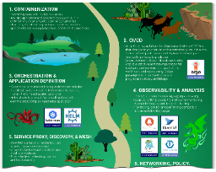
What is Cloud Native
The CNCF published the following definition of cloud native:
  “Cloud native technologies empower organizations to build and run scalable applications in modern, dynamic environments such as public, private, and hybrid clouds.
  Containers, service meshes, microservices, immutable infrastructure, and declarative APIs exemplify this approach.
  These techniques enable loosely coupled systems that are resilient, manageable, and observable.
  Combined with robust automation, they allow engineers to make high-impact changes frequently and predictably with minimal toil.”
CNCF Trail Map
Recommended process for leveraging open source, cloud native technologies.
Cloud Native applications by IBM (link)
  Cloud native refers less to where an application resides and more to how it is built and deployed. Microservices are…
  Building blocks working together, often packaged in containers
  Scaled independently
  Continuously improved, quickly iterated via automation / orchestration
  Cloud native. Built to operate only in the cloud environment.
  Cloud enabled. Traditional app, later adapted to run in a cloud environment.
  Cloud ready. Traditional or Cloud app has been reconfigured for a cloud environment.
  Cloud based. Delivered over the Internet.
  Cloud first. Business strategy in which an organization commits to a cloud approach.
Containerization
CI/CD
Orchestration & Application Definition
Observability & Analysis
Service proxy, discovery & mesh
Networking, policy & security
Distributed database & storage
Streaming & messaging
Container registry & runtime
Software distribution
CNCF considers these to be essential for cloud native
Notes:
https://github.com/cncf/toc/blob/master/DEFINITION.md
https://github.com/cncf/trailmap
https://www.ibm.com/cloud/learn/cloud-native

Slide 6
What is Cloud Native Network Function (CNF)
The CNCF TUG published the following definition of cloud native network function:
  “A cloud native network function (CNF) is a cloud native application that implements network functionality.
  A CNF consists of one or more microservices and has been developed using Cloud Native Principles including immutable infrastructure, declarative APIs, and a “repeatable deployment process”.
Containers in Telcos – Are We There Yet? (SDX Central, Feb 2019)
“Now, as we move into the world of containers, we’re moving forward with much less structure on how to achieve this new concept labelled cloud-native network functions (CNF) – again, a fancy term for, primarily, container technology coupled with microservices architecture.
Squeezing a big fat VM into a container isn’t CNF. To get to cloud-native network functions we need to take a VNF and break it into component microservices. And then we need to figure out how to orchestrate those pieces and turn over control to Kubernetes.”
CNF and VNF verification with Red Hat and Intel (Red Hat, Mar 2020)
“CNFs are more than just the containerization of network functions. To get the full benefit of Cloud Native principles beyond container packaging requires further rearchitecting of CNFs, like decomposition, allowing multiple versions during updates, and supporting provided platform services like generic load-balancers or datastores.”
Notes:
https://github.com/cncf/telecom-user-group/blob/master/whitepaper/cloud_native_thinking_for_telecommunications.md#1.4
https://www.sdxcentral.com/articles/analysis/containers-in-telcos-are-we-there-yet/2019/02/
https://www.redhat.com/en/blog/cnf-and-vnf-certification-red-hat-and-intel

Slide 7
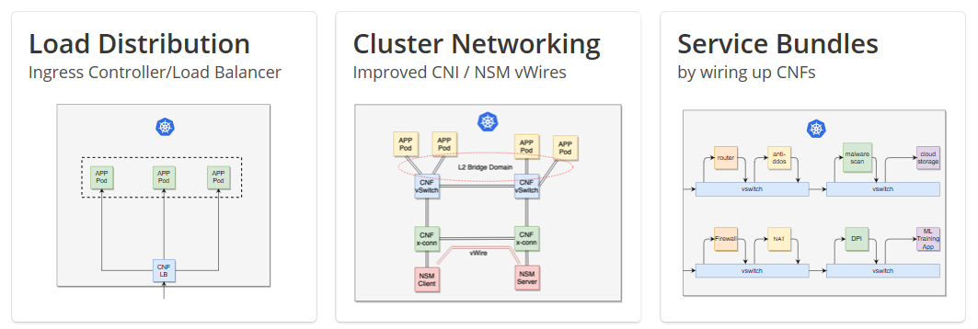
CNF Solution Scenarios

