Slide 1
ONAP ETSI-Alignment Honolulu+ Priorities
October 1st, 2020
Presented by : Byung-Woo Jun (Ericsson)
Fred Oliveira (Verizon)
Seshu Kumar (Huawei)
Participating Companies
Ericsson
Verizon
AT&T
CMCC/ZTE
Huawei
Nokia
Others
Special thanks to : Magnus Buhrgard
Steve Terrill
Orchestration Scenarios (a.k.a. ETSI-Alignment) Task Force weekly meeting,
  Weekly meeting: Mondays at 12PM UTC, 5AM PT, 8AM ET, 2PM CET, 5:30PM India, 8PM China.
  https://zoom.us/j/722438866
  One tap mobile: +16699006833,,722438866# US (San Jose) +16465588656,,722438866# US (New York)

Slide 2
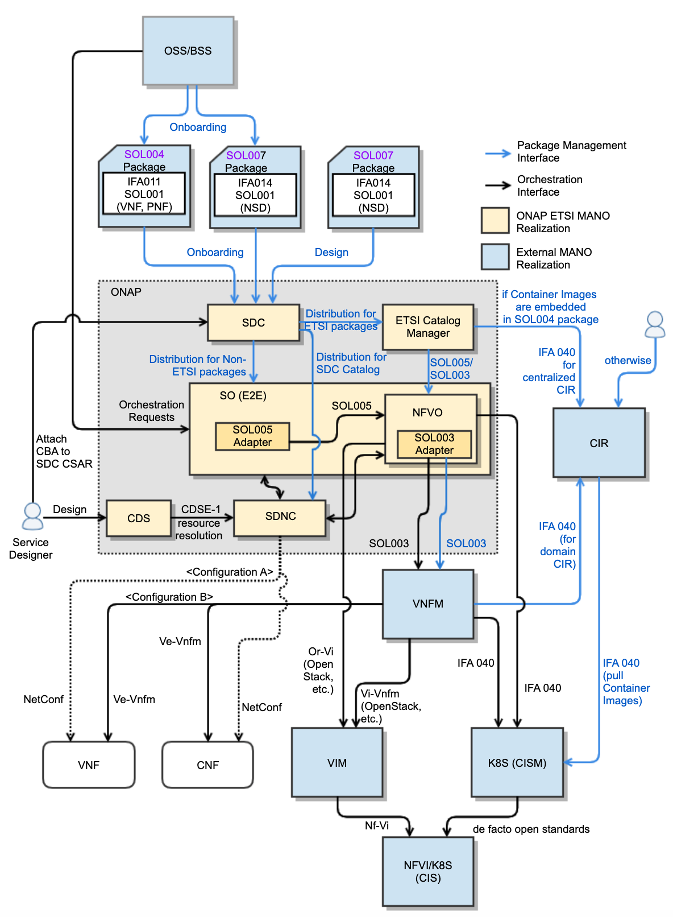
ONAP ETSI-Alignment Honolulu+ Priorities
CNF Support
CNF Support is one of Ericsson’s highest priority work items for ONAP
  Define a fast path to CNF support, and accomplish it across multiple releases (Honolulu+)
  For now, leverage currently available ETSI Stage 2 specifications, without just waiting for ETSI Stage 3 (SOL)
Many (Ericsson, Verizon, Bell Canada, Huawei, others) believe the target is CNF, 5G Edge, etc. VNF support is a steppingstone towards that goal
CNF support and Cloud Native Support are closely related.
  CNF enables Cloud Native (Microservices, Containers, Elastic scalability, On-demand deployment)
  What other Cloud Native support? APs: Define its scope and study architecture
  In Honolulu, CNF scope is:
    CNF modeling and distribution support for microservice-based CNF and images,
    CNF LCM through SO, SO NFVO (or VFC) and VNFM via standard APIs (covering instantiation and Day 0 configuration based on Helm Charts)
      Note: VNFM support for CNF is vendor-specific
    OOM-based Granting only for both VNF/CNF Instantiation and Termination, not for VNF/CNF Healing or Scaling
    Software Images and Container Image Handlings via NFVO, ETSI Catalog Manager and CIR
    Collaborate with non-ETSI-based CNF support in SO; SO launches the CNF LCM path based on models (i.e., model-driven)
Configuration Support
Leverage CBA design and SDC distribution (CBA + CSAR) for model-driven configuration
Leverage existing CDS, SDNC / MultiCloud path, or new ETSI-based configuration support thru Ve-Vnfm (SOL002)

Slide 3
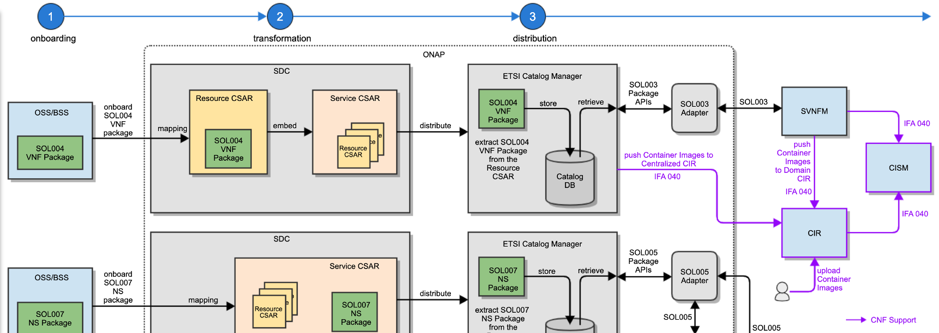
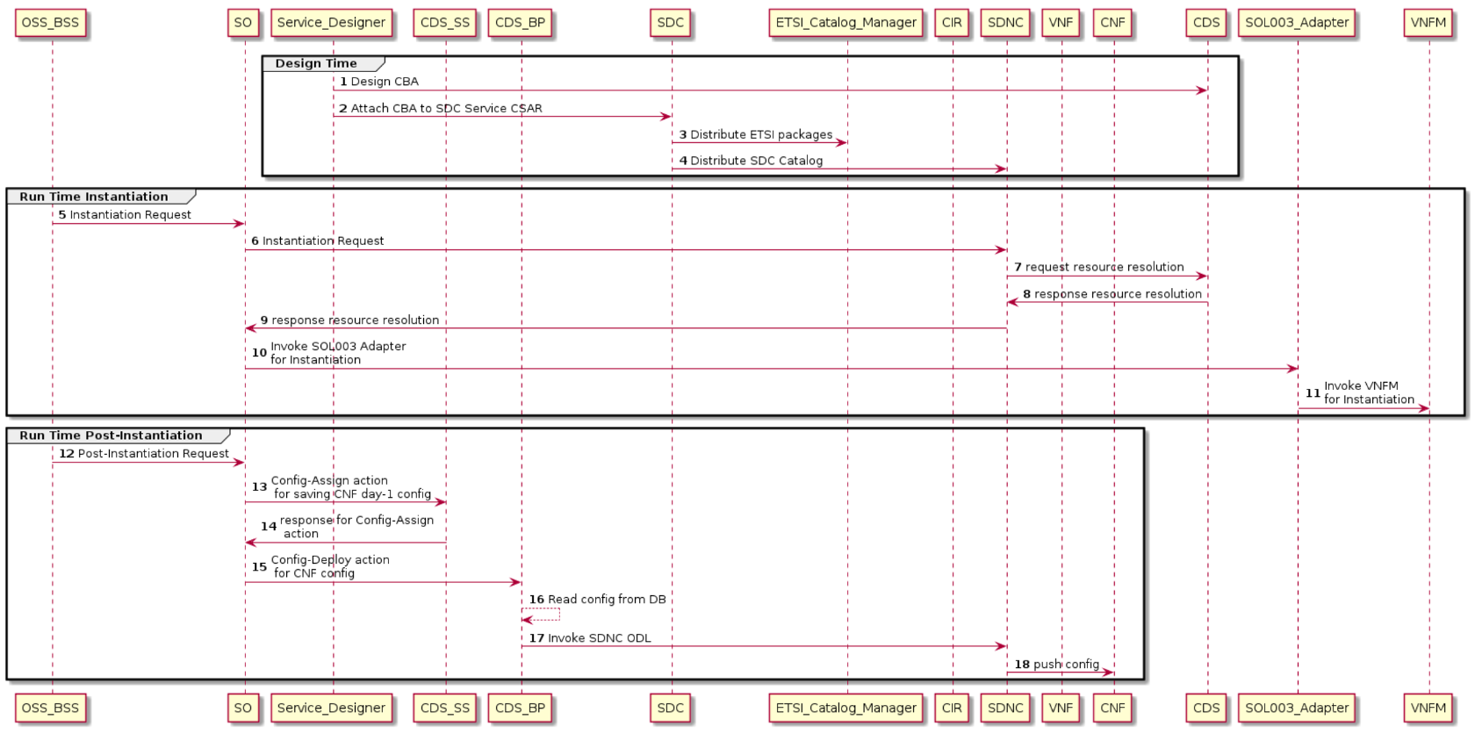
ONAP ETSI-Alignment Honolulu+
Implementation Plan
VNF/CNF Onboarding/Design and Distribution (SDC, ETSI Catalog Manager, AAI)
Finish SOL004 VNF onboarding to SDC including SOL001 VNFD mapping (VN-Module, VNF, others) to SDC DM, Helm Charts, Container Images/reference
Support SOL007 NS onboarding/design to SDC including SOL001 NSD mapping to SDC DM
Update ETSI 2.5.1 to 3.3.1 with TOSCA 1.3
Onboarding VNFD with configuration properties
NS/VNF/CNF LCM (SO, SO NFVO, AAI, OOF, Policy, MultiCloud)
Support ETSI 3.3.1 SOL005 and SOL003 LCM APIs for VNF/CNF LCM
Support Modify VNF Configuration APIs
OOF-based Resource Granting for VNF/CNF Instantiation and Termination
Finish subscription and notification of SOL005 Package Management and LCM APIs
Support SOL005 and SOL003 Security based on SEC022 (OAuth2)
Model-Driven Application Configuration (CDS, SDC, SDNC / MultiCloud)
Define CBA and attach CBA to SDC CSAR
Distribute SDC CSAR (CBA + CSAR) to ETSI Catalog Manager, SDNC / MultiCloud
SO / SO NFVO interfaces with CDS and lets CDS invoke SDNC for VNF/CNF Configuration

Slide 4
Thank you!

