Slide 1
ONAP ETSI-Alignment Update
September 15th, 2020
Presented by: Byung-Woo Jun (Ericsson)
Fred Oliveira (Verizon)
Thinh Nguyenphu (Nokia)
Participating Companies
Ericsson
Verizon
AT&T
CMCC/ZTE
Huawei
Nokia
Others
Special thanks to: Cristina Badulescu &
Joerg Aelken
Orchestration Scenarios (a.k.a. ETSI-Alignment) Task Force weekly meeting,
  Weekly meeting: Mondays at 12PM UTC, 5AM PT, 8AM ET, 2PM CET, 5:30PM India, 8PM China.
  https://zoom.us/j/722438866
  One tap mobile: +16699006833,,722438866# US (San Jose) +16465588656,,722438866# US (New York)

Slide 2
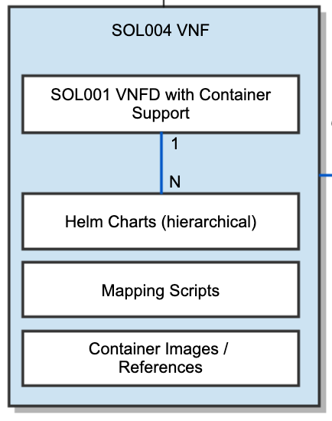
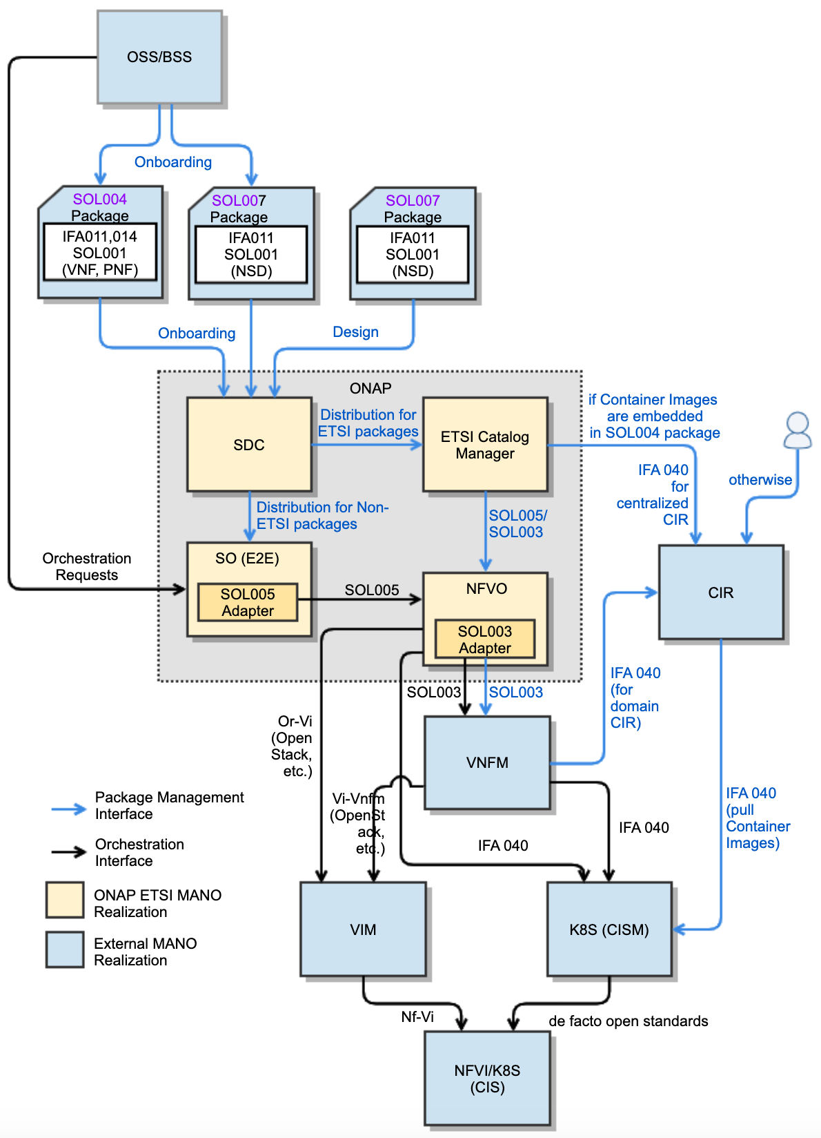
ONAP Conformance to ETSI Specifications
- Future-Proof ETSI-Aligned Orchestration Architecture
NS/VNF/PNF Modeling, Onboarding/Design & Packaging Conformance
SOL004 for VNF and PNF packages (SDC)
SOL007 for NS package (SDC)
SOL001 for describing VNF, PNF and NS models
SOL003 (IFA007) for VNF Package Mgmt (SOL003 Adapter)
SOL005 (IFA 013) for NS/PNF/VNF Package Mgmt (SOL005 Adapter)
SEC022 for ETSI Package and API security
Ongoing CNF Modeling, Packaging and Orchestration Conformance
IFA 011 (VNF Descriptor and Packaging Specification)
  ONAP VNF/CNF package and models including Helm Charts & Container Images conform to IFA 011
IFA 040 (Service interfaces for OS Container Mgmt & Orch)
  ONAP conforms to the OS container NFV object model, CISM and CIR management, based on IFA 040
IFA 010 (NFV Mgmt & Orchestration Functional Reqs)
  ONAP NFVO and VNFM orchestration functions conform to IFA 010 requirements
ONAP also conforms to the following specifications:
  IFA 007 (Or-Vnfm Interfaces & IM Specifications)
  IFA 008 (Ve-Vnfm Interfaces & IM Specifications)
  IFA 013 (Os-Ma-Nfvo Interfaces & IM Specifications)
  IFA 014 (NS Templates Specifications)
Note: ETSI SOL specifications profiling CISM solutions
Note: ONAP is waiting for ETSI SOL specifications for CNF
Note: ETSI-based Configuration (Day 0, 1, 2…) would be beneficial in ONAP (See ONAP SO Hierarchical Orch)
Separate Helm Charts Repository?
Lifecycle Management Conformance for
SDC for SOL004 and SOL007 package onboarding, design and distribution
ONAP NFVO (VFC and SO NFVO) and External NFVO for ETSI MANO NFVO functionalities.
SOL003 Adapter for SOL003-compliant VNF LCM interfaces
SOL005 Adapter for SOL005-compliant NS LCM interfaces
SOL002 Adapter for SOL002-compliant VNF/VNFC LCM interfaces (currently on hold)
ETSI Catalog Manager for ETSI SOL004/SOL007/SOL001 Runtime Package Management and Parsing for NS/VNF/PNF
On top of the ONAP ETSI package onboarding and distribution mechanism, ONAP will support enhanced VNF/CNF models, Helm Charts, CIR and interactions with CISM and VIM for LCM
Leverage
MultiCloud?

Slide 3
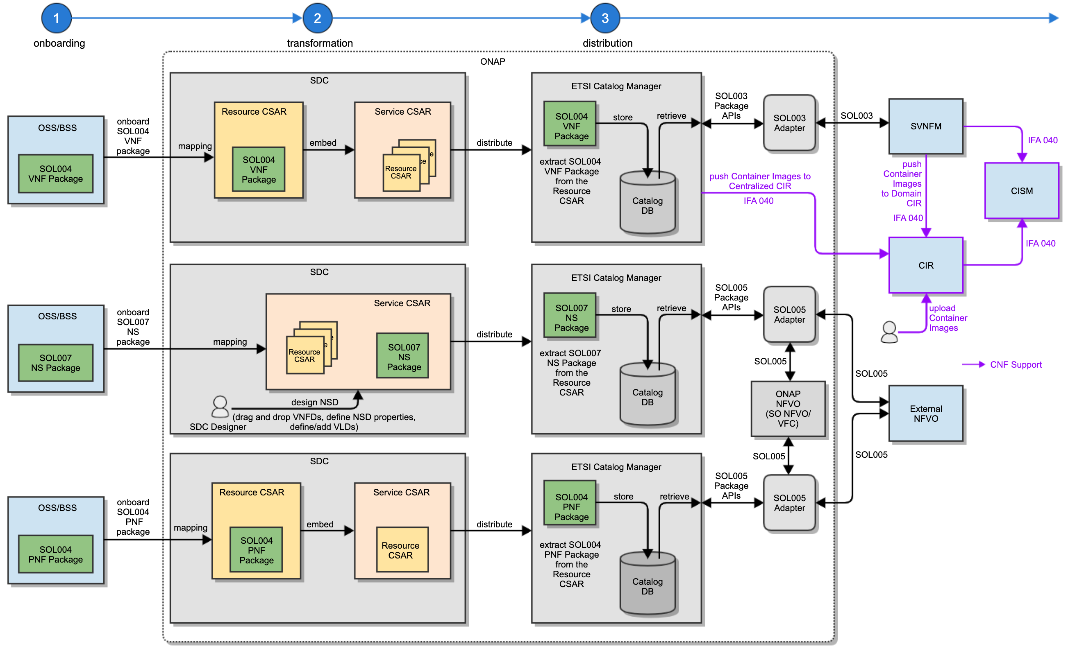
ONAP ETSI Model & Package Onboarding, Design and Distribution
- Conformance to SOL001, SOL004 and SOL007 Standards & IFA 040
Onboard ETSI SOL004 compliant VNF packages
  Support for Cataloging and Preserving the original SOL004 packages
  Support for onboarding ETSI SOL004 CSAR Packages into SDC
  Support for ETSI SOL001 VNFDs/PNFDs in SOL004 Packages
  Support for mapping of ETSI SOL001 VNFD/PNFD into SDC AID Data Model (ONAP Internal Model)
Onboard ETSI SOL007 compliant Network Service Descriptor packages (Planned for Honolulu)
  Support for Cataloging and Preserving the original SOL007 packages
  Support for onboarding ETSI SOL007 CSAR Packages into SDC
  Support for ETSI SOL001 NSDs in SOL007 Packages
  Support for mapping of ETSI SOL001 NSD into SDC AID Data Model (ONAP Internal Model)
Design ETSI SOL007 compliant Network Service Descriptor packages in SDC
  Support for Create/Design NSD 1) includes NS Properties, VLDs and VNF-FG and 2) references VNFD, PNFD and Nested NSD
  Note: VNF-FG Design is for Honolulu
Support for Deploying SOL004 and SOL007 Packages to ONAP runtime components via ETSI Catalog Manager
In the future, Container Images are distributed to CIR for CNF
Separate Helm Charts Mgmt?
PNF distribution use case is under discussion

Slide 4
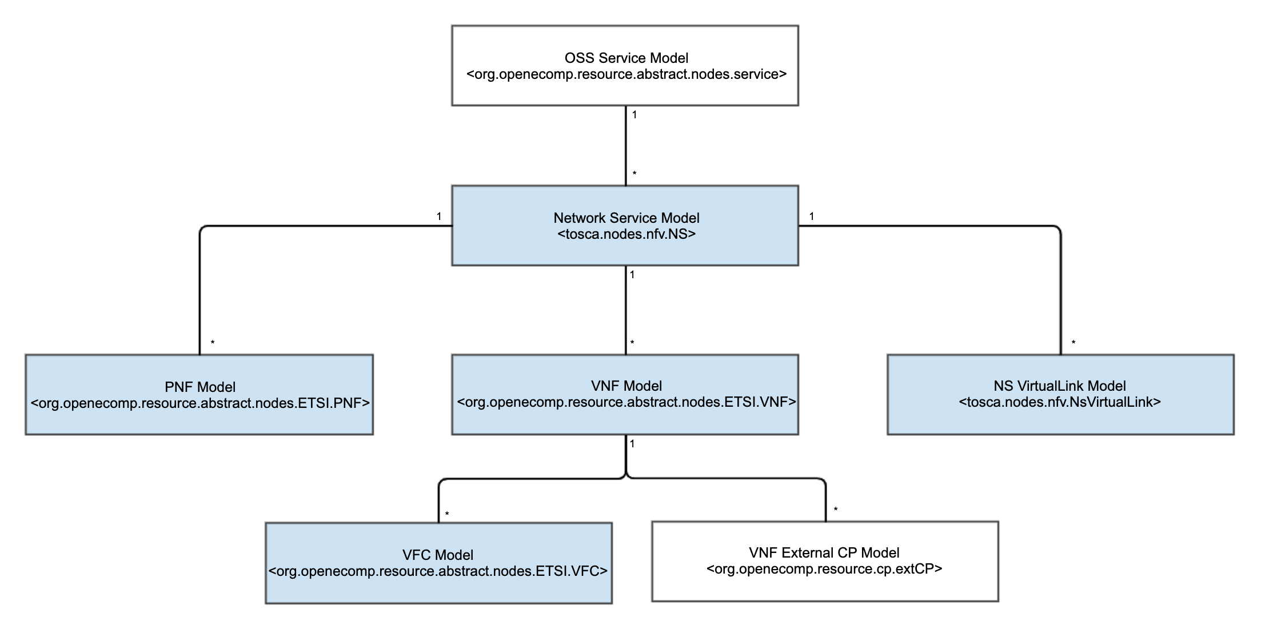
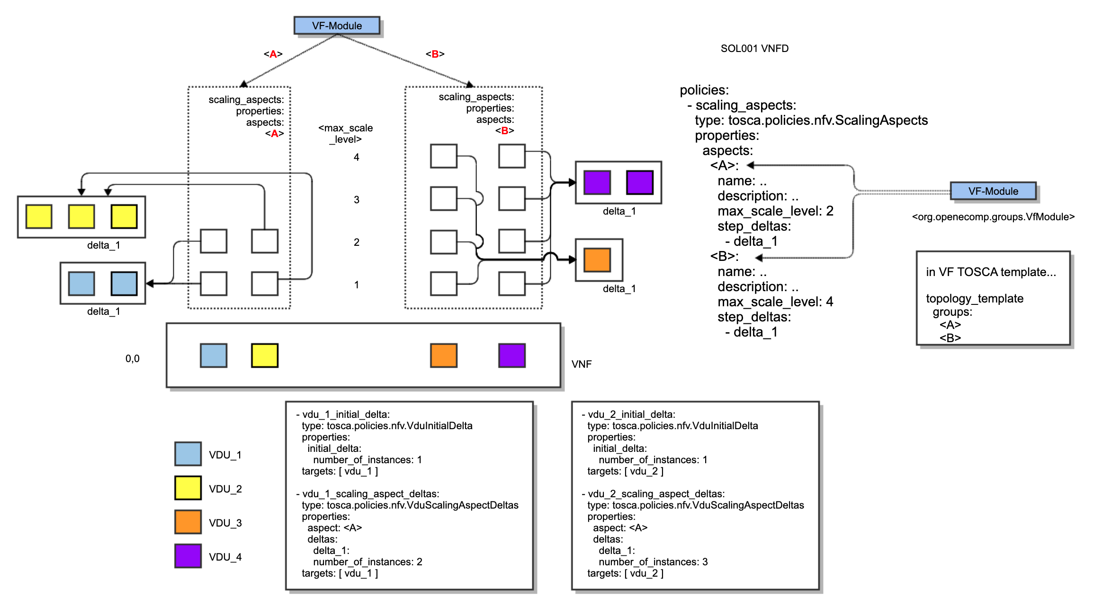
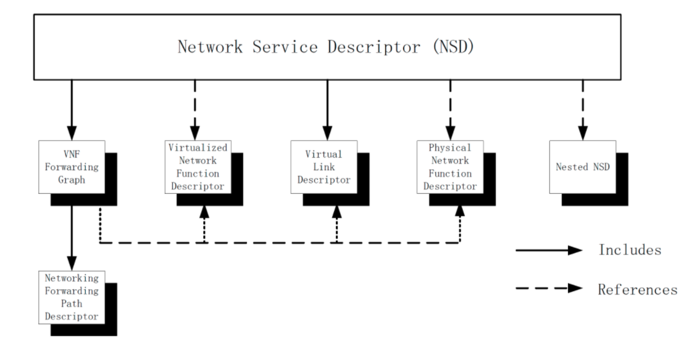
ETSI SOL001 Model Mapping to ONAP Internal Data Model
Onboarded/Designed ETSI SOL001 Models are used in the ETSI-realized components such as NFVOs and SVNFMs as is
However, interacting with existing ONAP runtime components (for Scale, Heal, Granting, etc.) needs data model mapping between ETSI SOL001 Models and ONAP Internal Data Models
  NS, NsVirtualLink, VNF, VDU and Policy Scaling Aspect Mapping to ONAP Internal Data Models
OSS Service-level (a.k.a. E2E Service) modeling continues to be ONAP-specific (i.e., it is outside of ETSI-scope), and it references/includes associated NSs (1:M)
SOL001 Network Service (NS), VNF, PNF and CNF will be mapped to the corresponding ONAP internal models for both design time and runtime
  ONAP uses the SOL001 tosca.nodes.nfv.NS and tosca.nodes.nfv.NsVirtualLink node types as the ONAP NS and NsVirtualLink node types
  The tosca.nodes.nfv.NS plans to reference a new ONAP VNF node type, org.openecomp.resource.abstract.nodes.ETSI.VNF (1:M) and a new ONAP PNF node type, org.openecomp.resource.abstract.nodes.ETSI.PNF (1:M)
<VF-Module Deduction - see backup slide>
ONAP Data Model
OSS Service Model
<org.openecomp.resource.abstract.nodes.service>
ETSI SOL001

Slide 5
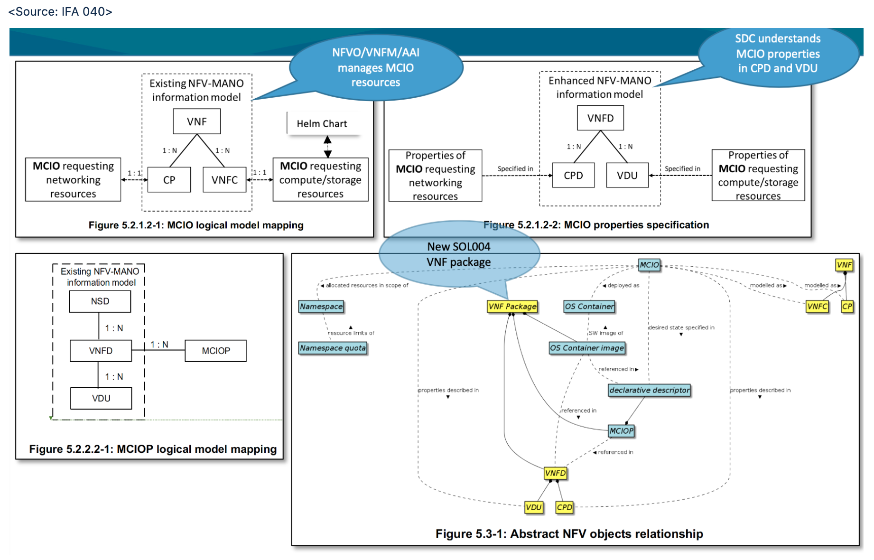
CNF Model Conformance
ONAP CNF conforms to ETSI IFA 011, 029 and 040.
Those specifications would be available by middle of 2020, but their SOL specifications plan to be available by end of 2020 or Q1, 2021.
Until then, ONAP designs CNF models and packages, based on the current IFA 029 and 040.
A Managed Container Infrastructure Object (MCIO) is an abstract NFV object for OS Container management and orchestration.
The declarative MCIO descriptor is used as descriptor object interpreted by the CISM.
A MCIO is created by the CISM by allocating its requested infrastructure resources on Container Infrastructure Service (CIS) instances
Depending on its type, the creation of a MCIO may include the deployment of an OS Container Image.
MCIO’s are lifecycle managed via change requests on their desired state, utilizing a modified declarative descriptor sent to the CISM, which adapts the
infrastructure resource allocations according to the changed infrastructure resource requests.
MCIO’s requesting compute and/or storage infrastructure resources are modeled as a VNF Component (VNFC).
Properties of an MCIO described in declarative descriptors and relevant being exposed to NFV-MANO are mirrored in attributes of the descriptors of the corresponding objects of the existing NFV-MANO information model.
SDC will support CNF Models and Helm Charts Onboarding, Design and Distribution
ONAP SO/NFVO/VNFM will support CNF Models distribution/storage and CNF orchestration, conforming to ETSI specifications

Slide 6
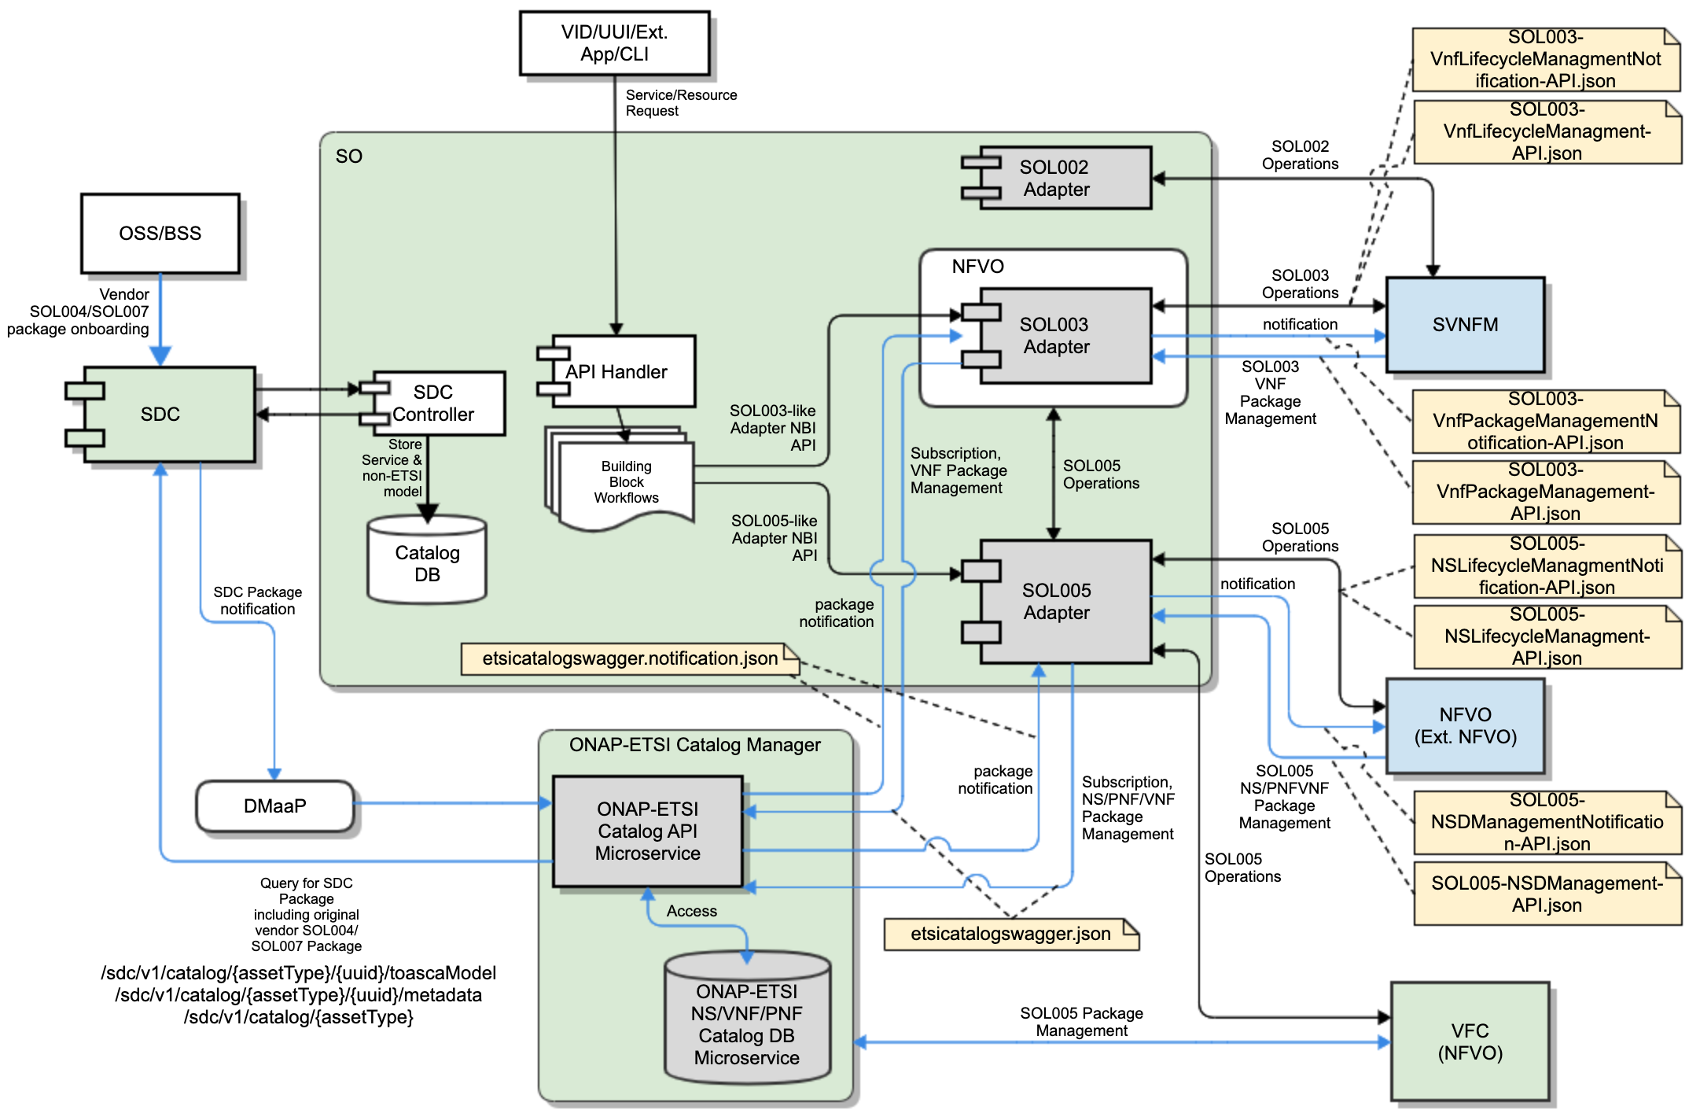
ONAP ETSI-Aligned Package and LCM Runtime APIs
- Conformance to SOL003/SOL005/SOL002 Standards
Support for ETSI SOL003 and SOL002 interfaces from ONAP to external VNF Manager(s) – SOL002 is on hold
Support for ETSI SOL005 interfaces among ETSI Catalog Manager, SOL005 Adapters and NFVO (ONAP internal and external NFVOs) for package management and LCM
ETSI Catalog Manager provides package management APIs and package management notification APIs based on the SOL003 & SOL005 specifications
  etsicatalog.swagger.json
  etsicatalog.swagger.notification.json
  SOL003 & SOL005 Adapters implement notification APIs from ETSI Catalog Manager and invoke the SOL003 & SOL005 package management APIs from ETSI Catalog Manager
SOL003 Adapter and SVNFM use SOL003 package management APIs and LCM APIs
  SOL003-VnfPackageManagement-API.json
  SOL003-VnfPackageManagementNotification-API.json
  SOL003-VnfLifecycleManagment-API.json
  SOL003-VnfLifecycleManagmentNotification-API.json
SOL005 Adapter and External NFVO/VFC/ONAP SO NFVO use SOL005 package management APIs and LCM APIs
  SOL005-NSDManagement-API.json
  SOL005-NSDManagementNotification-API.json
  SOL005-NSLifecycleManagement-API.json
  SOL005-NSLifecycleManagementNotification-API.json
SOL002
SOL003
SOL003
SOL005
SOL005
SOL005

Slide 7
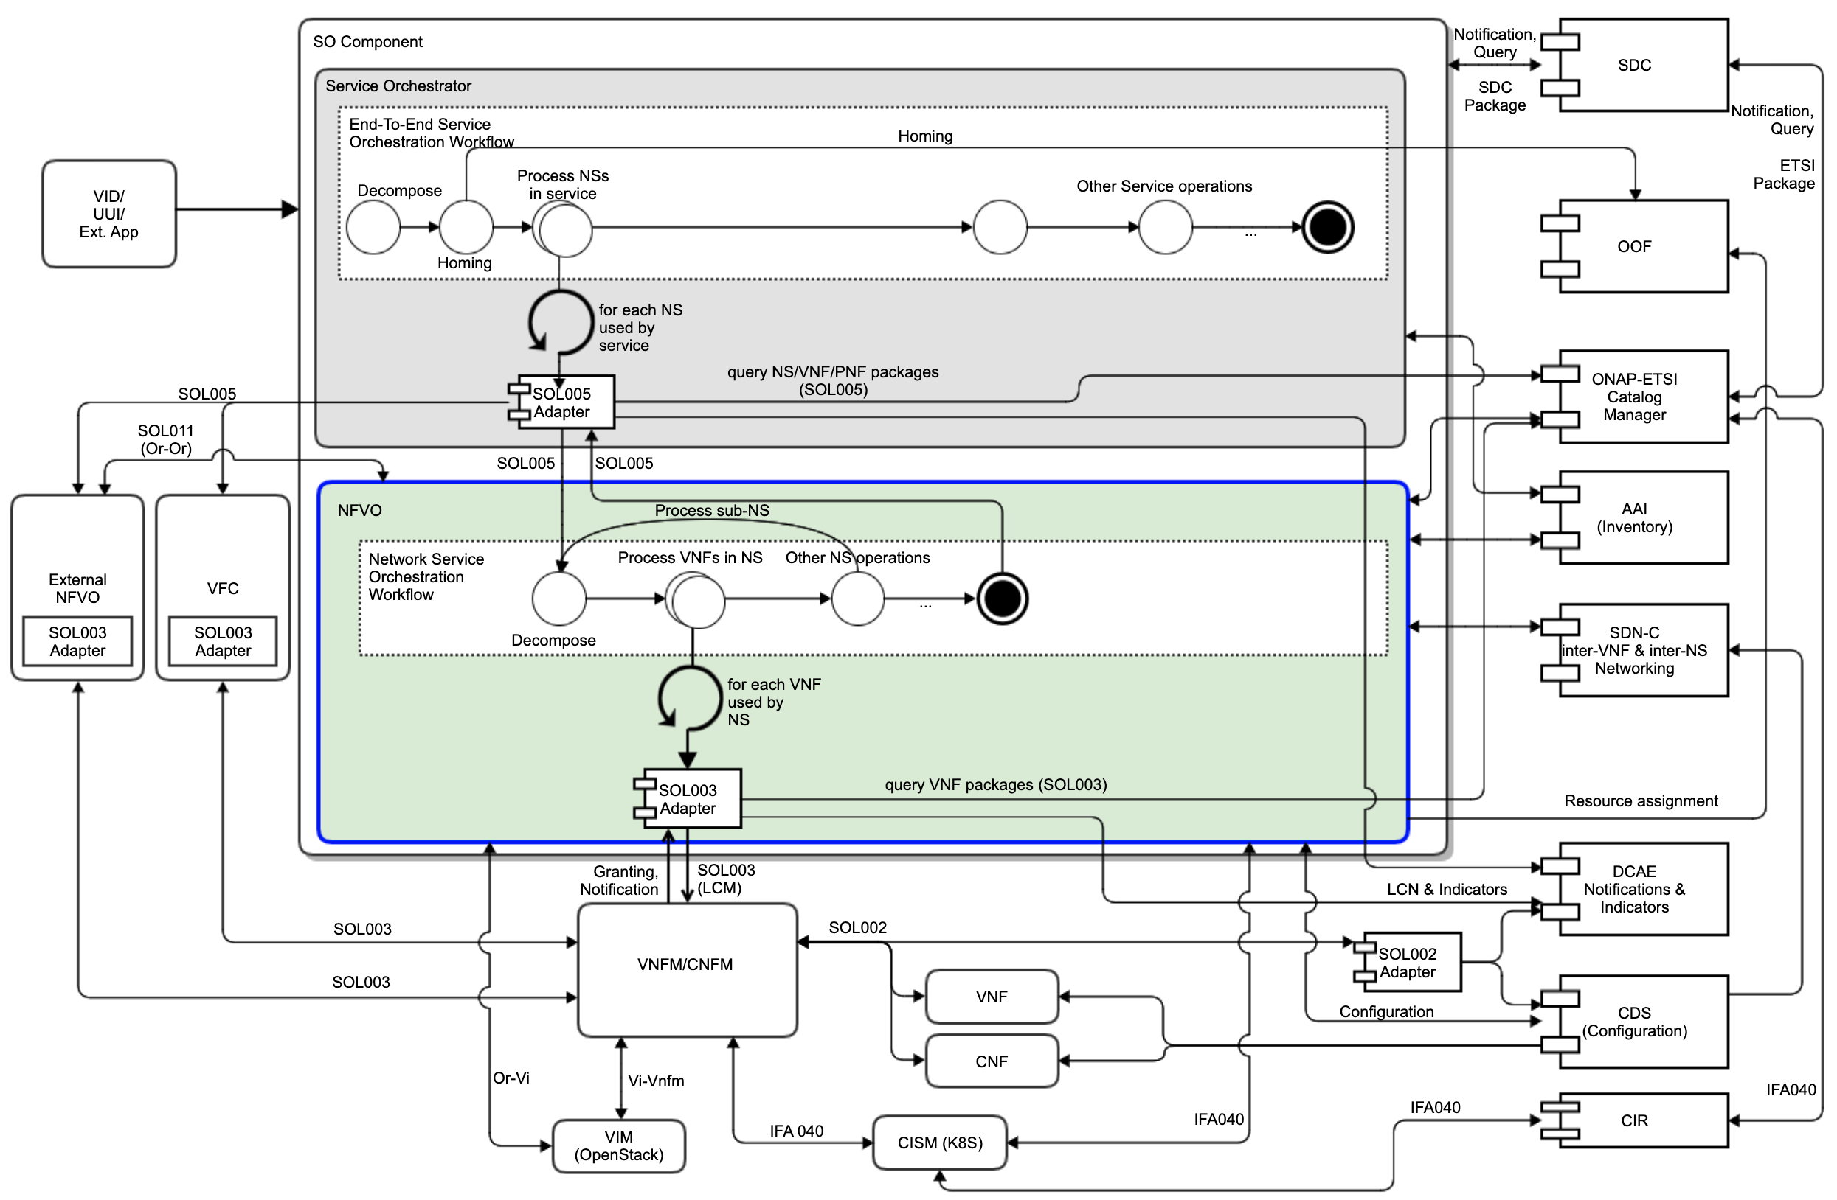
ONAP SO Hierarchical ETSI-based Orchestration
- E2E Service, NS and VNF/CNF Management Demarcation
SOL007, SOL004,
SOL001
ONAP ETSI-based hierarchical resource orchestration, to facilitate ONAP orchestration adoption by operators who have their own NFVOs and/or VNFMs
  NS, VNF, CNF orchestration by leveraging ETSI standards
  Working with the ONAP VFC & SO NFVO, and external NFVOs
  Leveraging ETSI Catalog Manager for ETSI Catalog
  Leveraging OOF for homing
  Foundation for CNF support
ONAP SO supports E2E orchestration and delegates NS and VNF/CNF operations to the NFVO and VNFM
NFVO handles:
  SOL005 Northbound Interface
  NS LCM Orchestration and SOL003 SBI
  SOL003 Granting Resources
  Package Management for NS/VNF/PNF
  Possibly, support of Or-Vi Indirect Resource control for Virtualized Resource Managements
  Possibly, support of interface with other peer NFVOs (Or-Or)
VNFM Supports VNF and CNF management
ETSI-based Configuration (Day 0, 1, 2) would be beneficial in ONAP
SOL005
SOL007, SOL004,
SOL001
SOL005
SOL007, SOL004,
SOL001
SOL005
SOL005
SOL005
SOL003
SOL003
SOL003
SOL003
SOL002
Leverage
MultiCloud?

Slide 8
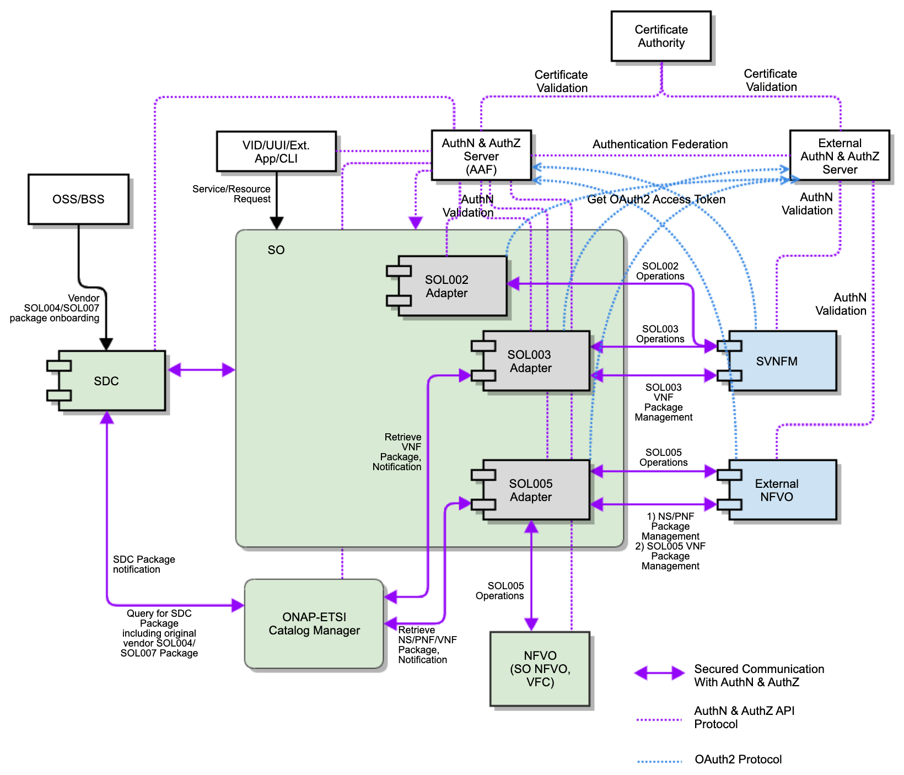
Security Conformance between ONAP and SVNFM/NFVO
ONAP ETSI-Alignment API Security conforms to ETSI NFV SEC022 Specification (SEC022 GS).
SOL003/SOL005/SOL002 Adapters will communicate with the SVNFM/NFVO via secured HTTPS protocol with authentication and authorization
  SOL003/005/002 Adapters support OAuth2 and/or HTTP Basic Authentication
  SOL003/005/002 Adapters will leverage the ONAP Security Management Server (as authorization server)
SVNFM/NFVO will be allowed to have their own security mechanisms based on their security requirements but are required to support OAuth2 and HTTP Basic Authentication.
  Authentication Federation between the Adapters and the SVNFM/NFVO is under discussion.
  Some vendors prefer SAML-based federation
  ONAP Security Authentication and External Authentication Server will exchange authentication tokens, based on federation configuration.
    Typically, operators have their own security mechanisms
    More to discuss

Slide 9
ONAP ETSI-Alignment Roadmaps
Dublin | El Alto | Frankfurt | Guilin | Future Discussion Topics
ETSI SOL 2.5.1 support SOL003 Adapter Create VNF Instantiate VNF Terminate VNF Delete VNF Subscription Notification Granting SO ETSI VNF BB Workflows VNFM Simulator in the SO project SDC SOL004 PNF onboarding | ETSI SOL 2.5.1 support CSIT (test automation) for SOL003 Adapter SOL003 Adapter Bug fixes Communication security between SOL003 Adapter and SVNFM HTTPS support SpringBoot-based authentication VNFM Simulator migration to the Integration Test project SDC SOL004 VNF and PNF onboarding | ETSI SOL 2.5.1 support SO & SOL003 Adapter enhancements (Ericsson) SO SOL004 and SOL001 package storage/retrieval support leveraging ETSI Catalog Manager SOL003-based package management API support SOL003 VNF LCM Operations ETSI Catalog Manager (CMCC/ZTE) Storing vendor ETSI packages Providing ETSI package APIs to the SOL003/SOL005 Adapters Software Image delivery SOL005 Adapter (Verizon) Create NS Instantiate NS Terminate NS Delete NS SOL002 Adapter (Samsung) VNF LCM notification AAF-based HTTPS and Authentication – partial OAuth2 support | SDC enhancements (Ericsson, Verizon, Modeling) SOL007 NS design and packaging SOL004 VNF/PNF package onboarding SOL003 Adapter enhancements for SO NFVO (Ericsson) NFVO SOL005 Northbound Interface support (Ericsson, Verizon) ETSI Catalog Manager enhancements (CMCC/ZTE) ONAP SO embedded NFVO for hierarchical orchestration, as one of the NFVO options – see the hierarchical orchestration section (Ericsson) NS LCM orchestration support | ETSI SOL 3.3.1 support SDC enhancements SOL007 NS package onboarding SOL004 VNF/PNF package onboarding SOL001 NSD and VNFD mapping to SDC AID DM SOL005/SOL003 Adapter, NFVO enhancements ETSI Package Management ETSI runtime model mapping between ETSI and ONAP FM/PM Additional NS LCM Configuration VNF Modify, Heal Policy-based Scaling OOF-based Granting ETSI-based VNF software upgrade CNF support OAuth2-based authentication support between SOL002/SOL003/SOL005 Adapters and SVNFM/NFVO
✔
✔
✔
✔

Slide 10
References
ETSI Alignment Support, https://wiki.onap.org/display/DW/ETSI-Alignment+Support+for+Guilin
SDC Enhancement for ETSI Package Management, https://wiki.onap.org/display/DW/ETSI+Package+Management+%28SDC+Enhancements%29-+Guilin
ETSI Catalog Management, https://wiki.onap.org/display/DW/ETSI+Catalog+Management+%28ETSI+Catalog+Manger%29-+Guilin
Communication Security, https://wiki.onap.org/display/DW/ETSI+Catalog+Management+%28ETSI+Catalog+Manger%29-+Guilin
SOL003 Adapter, https://wiki.onap.org/display/DW/SOL003+Adapter+-+Guilin
SOL005 Adapter, https://wiki.onap.org/display/DW/SOL005+Adapter+-+Guilin
SOL002 Adapter, https://wiki.onap.org/display/DW/SOL002+Adapter+-+Guilin
ETSI Catalog Manager, https://wiki.onap.org/display/DW/Etsicatalog+Documentation
ONAP SO NFVO, https://wiki.onap.org/display/DW/ONAP+SO+ETSI-Aligned+Hierarchical+Orchestration
ETSI-based CNF support, https://wiki.onap.org/display/DW/ETSI+CNF+Support
Orchestration Scenarios (a.k.a. ETSI-Alignment) Task Force weekly meeting,
  Weekly meeting: Mondays at 12PM UTC, 5AM PT, 8AM ET, 2PM CET, 5:30PM India, 8PM China.
  https://zoom.us/j/722438866
  One tap mobile: +16699006833,,722438866# US (San Jose) +16465588656,,722438866# US (New York)

Slide 11
Thank you!

Slide 12
Backup Slides

Slide 13
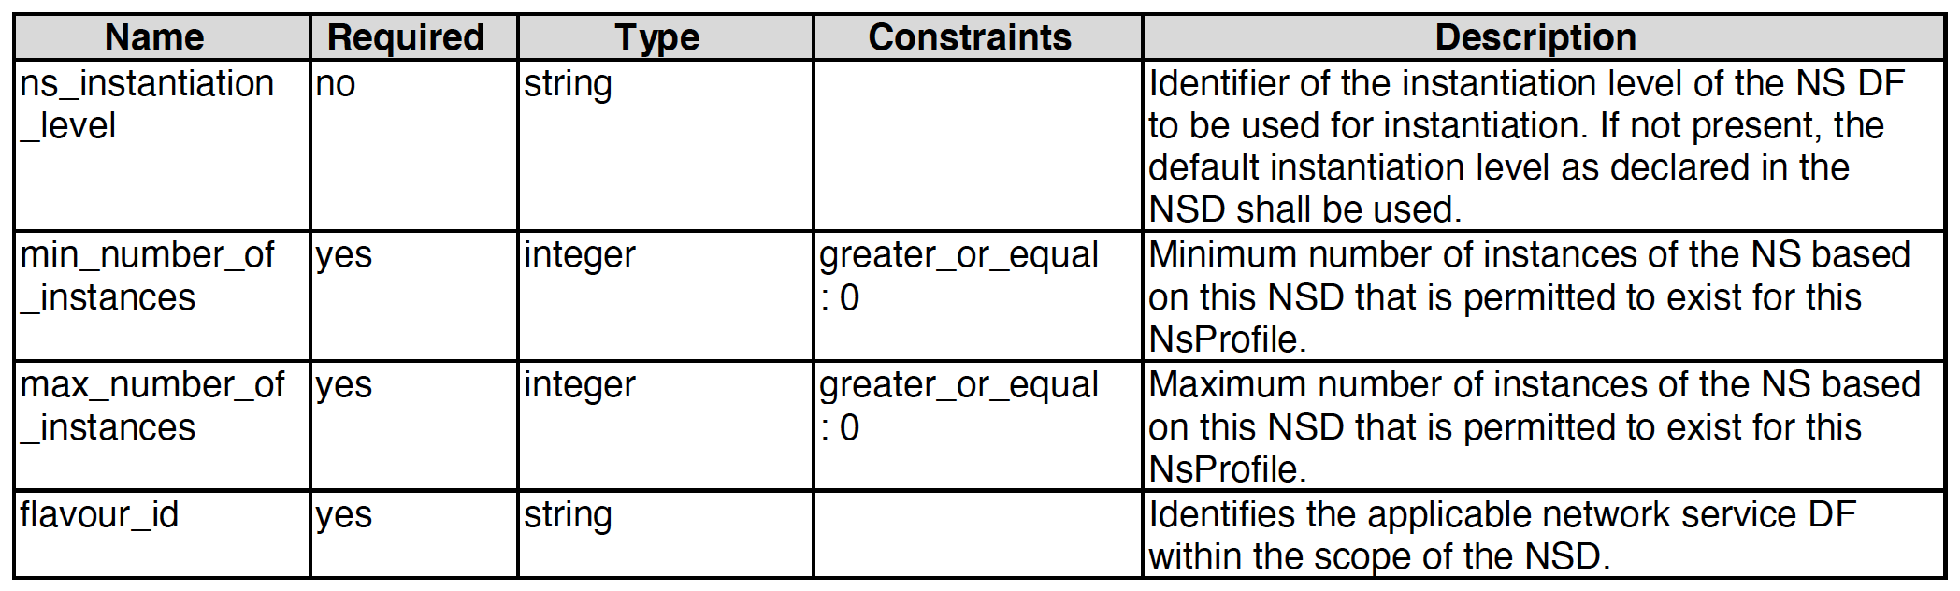
NS Mapping
SDC adopts SOL001 tosca.nodes.nfv.NS node type as the SDC NS node type; i.e., no mapping is necessary
  A new SDC SOL007 Design process generates SOL001 tosca.nodes.nfv.NS for the NS node type
  A new SDC SOL007 Onboarding process (stretch goal) copies the onboarded SOL001 tosca.nodes.nfv.NS contents to SDC AID DM tosca.nodes.nfv.NS contents
SOL001 NS (tosca.nodes.nfv.NS) - Chosen |  |  |  | SDC NSD org.openecomp.resource.vfc.NSD (not used for SOL007 design or onboarding)
name | required | type |  | name | required | type
descriptor_id | yes | string |  | nsd_id | true | string
designer | yes | string |  | nsd_designer | true | string
version | yes | string |  | nsd_version | true | string
name | yes | string |  | nsd_name | true | string
invariant_id | yes | string |  | providing_service_uuid | true | string
flavor_id | yes | string |  | providing_service_invariant_uuid | true | string
ns_profile | no | tosca.datatypes.nfv.NsProfile |  | providing_service_name | true | string
A decision to deprecate the current SDC NS node type, org.openecomp.resource.vfc.NSD for SOL007 design and onboarding
VFC impacts are being analyzed; expect to be minimal
SDC nfv-types directory is enhanced for hosting SOL001 NS node type.
SDC tosca data-types directory is enhanced for SDC AID DM changes
<tosca.datatypes.nfv.NsProfile>

Slide 14
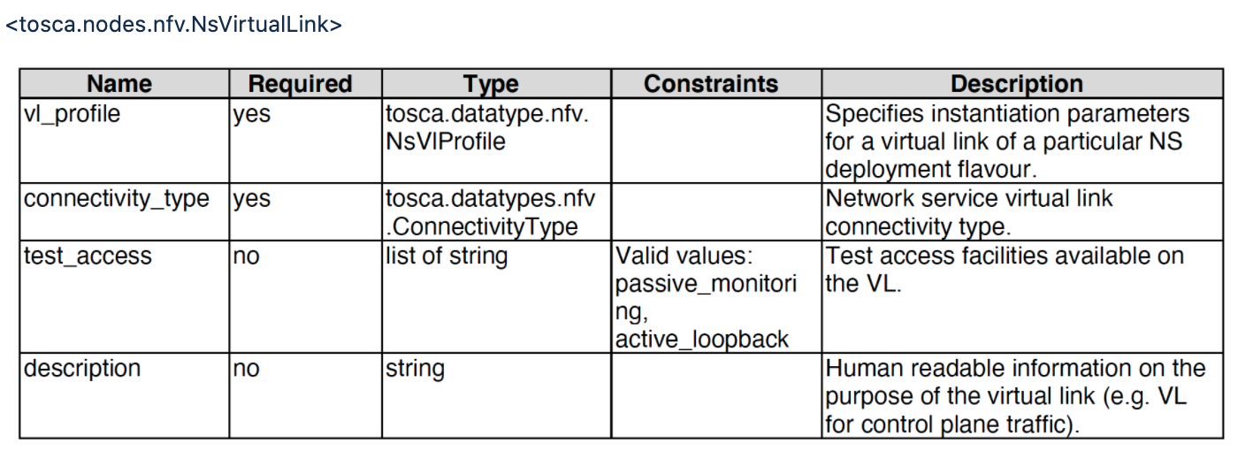
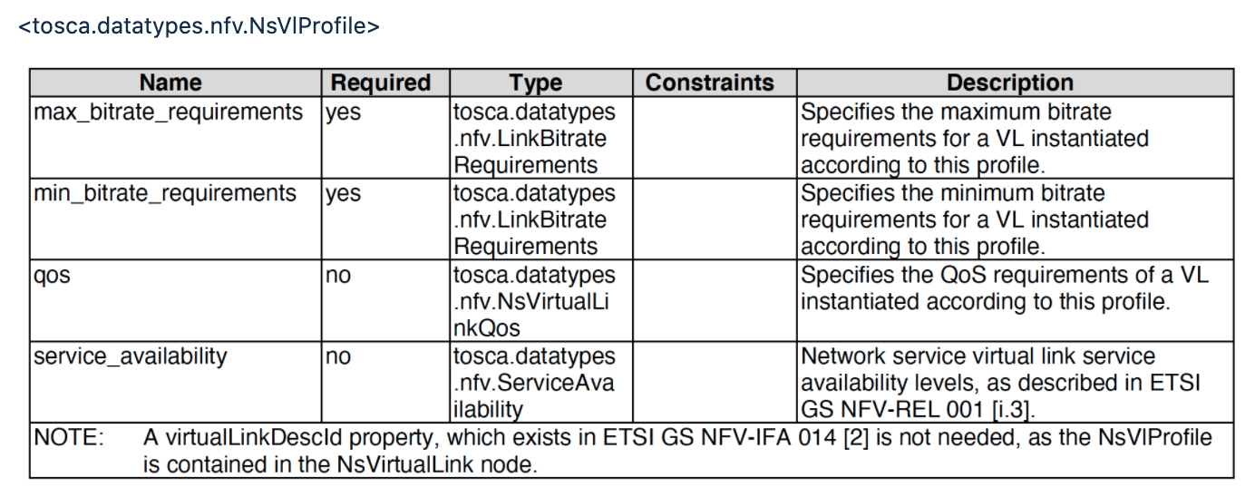
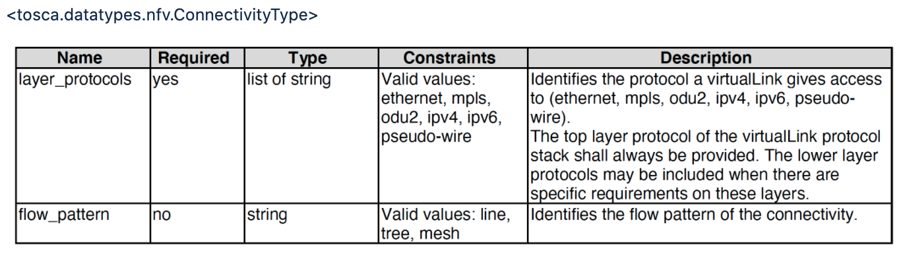
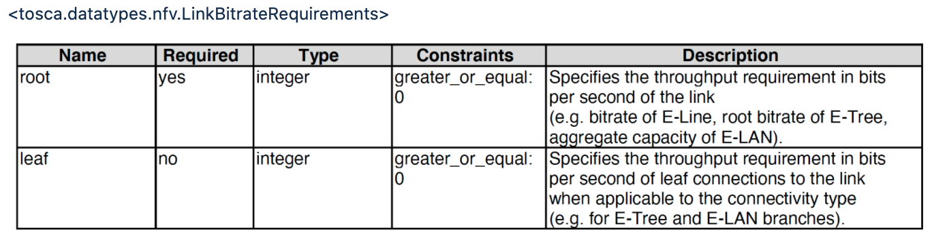
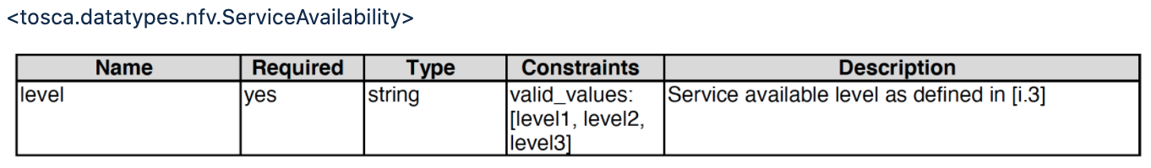
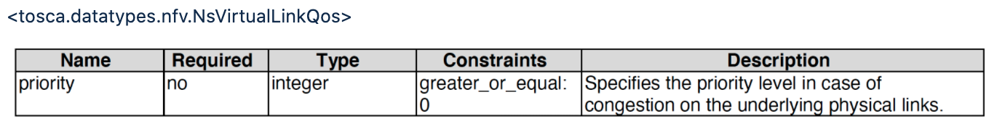
NS-Level VirtualLink (between VNFs) Mapping
SDC adopts SOL001 tosca.nodes.nfv.NsVirtualLink node type for the SDC NS-level VirtualLink node type; i.e., no mapping is necessary
  A new SDC SOL007 Design process generates SOL001 tosca.nodes.nfv.NsVirtualLink for the VirtualLink node type, and includes it in the NSD
  A new SDC SOL007 Onboarding process copies the onboarded SOL001 tosca.nodes.nfv.NsVirtualLink to SDC AID DM tosca.nodes.nfv.NsVirtualLink
  SDC deprecates vendor/operator-specific VLs from SOL007 design and onboarding

Slide 15
VNF Mapping (not for Guilin)
SOL001 VNF (tosca.nodes.nfv.VNF) |  |  | Mapping | New SDC AID DM VNF (org.openecomp.resource.abstract.nodes.ETSI.VNF) derived from org.openecomp.resource.abstract.nodes.VF
name | required | type |  | name | required | type
<SOL001 tosca.nodes.nfv.VNF attributes > |  |  |  | <SOL001 tosca.nodes.nfv.VNF attributes >
descriptor_id | yes | string | <--> | descriptor_id | yes | string
descriptor_version | yes | string | <--> | descriptor_version | yes | string
provider | yes | string | <--> | provider | yes | string
product_name | yes | string | <--> | product_name | yes | string
software_version | yes | string | <--> | software_version | yes | string
product_info_name | no | string | <--> | product_info_name | no | string
vnfm_info | yes | list of string | <--> | vnfm_info | yes | list of string
localization_languages | no | list of string | <--> | localization_languages | no | list of string
default_localization_language | no | string | <--> | default_localization_language | no | string
configurable_properties | no | tosca.datatypes.nfv.VnfconfigurableProperties | <--> | configurable_properties | no | tosca.datatypes.nfv.VnfconfigurableProperties
modifiable_attributes | no | tosca.datatypes.nfv.VnfInfoModifiableAttributes | <--> | modifiable_attributes | no | tosca.datatypes.nfv.VnfInfoModifiableAttributes
lcm_operations_configuration | no | tosca.datatypes.nfv.VnfLcmOperationsConfiguration | <--> | lcm_operations_configuration | no | tosca.datatypes.nfv.VnfLcmOperationsConfiguration
monitoring_parameters | no | list of tosca.datatypes.nfv.VnfMonitoringParameter | <--> | monitoring_parameters | no | list of tosca.datatypes.nfv.VnfMonitoringParameter
flavour_id | yes | string | <--> | flavour_id | yes | string
flavour_description | yes | string | <--> | flavour_description | yes | string
vnf_profile | no | tosca.datatypes.nfv.VnfProfile | <--> | vnf_profile | no | tosca.datatypes.nfv.VnfProfile
 |  |  |  | <SDC AID DM VF attributes that are inherited from org.openecomp.resource.abstract.nodes.VF>
<the following are being considered> |  |  |  | nf_function | no | string
requirements | Yes |  |  | nf_role | no | string
interfaces | Yes | tosca.interfaces.nfv.VnfLcm |  | nf_type | no | string
 |  |  |  | nf_naming_code | no | string
 |  |  |  | nf_naming | no | org.openecomp.datatypes.Naming
 |  |  |  | availability_zone_max_count | no | integer
 |  |  |  | min_instances | no | integer
 |  |  |  | max_instances | no | integer
 |  |  |  | multi_stage_design | no | boolean
 |  |  |  | sdnc_model_name | no | string
 |  |  |  | sdnc_artifact_name | no | string
 |  |  |  | skip_post_instantiation_configuration | no | boolean (default true) constraints: true, false
 |  |  |  | controller_actor | no | string (default: SO-REF-DATA) constraints: SO-REF-DATA, CDS, SDNC, APPC
SDC adopts a new VNF node type, org.openecomp.resource.abstract.nodes.ETSI.VNF, which is derived from org.openecomp.resource.abstract.nodes.VF.
  Merge of SOL001 VNF SDC VF node type attributes
  Non-ETSI modeling continues to use the existing org.openecomp.resource.abstract.nodes.VF
  ETSI VNF Design/Onboarding process uses the new VNF node type, org.openecomp.resource.abstract.nodes.ETSI.VNF as SDC AID DM VF
  For SOL001 VNF to SDC AID DM VNF mapping, SDC copies SOL001 VNF attributes to the corresponding attributes in the org.openecomp.resource.abstract.nodes.ETSI.VNF.
  SOL001 VNF attributes in SDC AID DM will be visible from SDC UI, so those attributes can be changed by SDC UI.
    But the onboarded vendor ETSI package will not be changed by the SDC UI users in Guilin.
    In Honolulu, the sync-up behavior will be be considered.
  For the reverse mapping, only the corresponding SOL001 VNF attributes will be copied
  In Guilin, SO NFVO, VFC and SVNFM get the SOL 001 attributes from descriptors, not from AAI
    AAI schema changes are not expected in Guilin

Slide 16
VDU and VFC Mapping (not for Guilin)
SOL001 VDU |  |  | Mapping | org.openecomp.resource.abstract.nodes.ETSI.VFC (derived from org.openecomp.resource.abstract.nodes.VFC)
Name | Required | Type | <--> | Name | Required | Type
name | yes | string | <--> | name | yes | string
description | yes | string | <--> | description | yes | string
boot_order | no | boolean | <--> | boot_order | no | boolean
nfvi_constraints | no | map of string | <--> | nfvi_constraints | no | map of string
monitoring_parameters | no | list of tosca.datatypes.nfv.VnfcMonitoringParameter | <--> | monitoring_parameters | no | list of tosca.datatypes.nfv.VnfcMonitoringParameter
configurable_properties | no | map of tosca.datatypes.nfv.VnfcConfigurableProperties | <--> | configurable_properties | no | map of tosca.datatypes.nfv.VnfcConfigurableProperties
boot_data | no | tosca.datatypes.nfv.BootData | <--> | boot_data | no | tosca.datatypes.nfv.BootData
vdu_profile | yes | tosca.datatypes.nfv.VduProfile | <--> | vdu_profile | yes | tosca.datatypes.nfv.VduProfile
sw_image_data | no | tosca.datatypes.nfv.SwImageData | <--> | sw_image_data | no | tosca.datatypes.nfv.SwImageData
 |  |  |  | <SDC AID DM VFC attributes that are inherited from the org.openecomp.resource.abstract.nodes.VFC>
 |  |  |  | nfc_function | no | string
 |  |  |  | high_availability | no | string
 |  |  |  | vm_image_name | no | string
 |  |  |  | vm_flavor_name | no | string
 |  |  |  | nfc_naming_code | no | string
 |  |  |  | vm_type_tag | no | string
 |  |  |  | nfc_naming | no | org.openecomp.datatypes.Naming ONAP_generated_naming: yes: boolean naming_policy: no: string instance_name: no: string
 |  |  |  | min_instances | no | integer
SDC adopts a new VFC node type, org.openecomp.resource.abstract.nodes.ETSI.VFC, which is derived from org.openecomp.resource.abstract.nodes.VFC
  Non-ETSI modeling continues to use the existing org.openecomp.resource.abstract.nodes.VFC
  ETSI VNF Onboarding process uses the new VDU node type, org.openecomp.resource.abstract.nodes.ETSI.VFC for SDC AID DM VFC
    SDC copies SOL001 VDU attributes to the corresponding attributes in the org.openecomp.resource.abstract.nodes.ETSI.VFC.
SOL001 VDU attributes in SDC AID DM will be visible from SDC UI, so those attributes can be changed by SDC UI.
    But the onboarded vendor ETSI package will not be changed by the SDC UI users in Guilin.
    In Honolulu, the sync-up behavior will be considered.
  In Guilin, SO NFVO, VFC and SVNFM get the SOL 001 attributes from descriptors, not from AAI
    AAI schema changes are not expected in Guilin
Note: org.openecomp.resource.abstract.nodes.VFC represents design-time VFC, not VFC instances

Slide 17
SOL001 VNFD and SDC AID DM VF Template Mapping
(not for Guilin)
SOL001 VNFD |  |  | SDC AID DM VFD
Name | Grammar |  | Name | Grammar
tosca_definitions_version | String (tosca_simple_yaml_1_2) |  | tosca_definitions_version | String (tosca_simple_yaml_1_2)
description | string |  | description | string
metadata | map of <string> |  | metadata | map of <string>
imports | Single-line grammar |  | imports | Identifies the lower level models (VFC, CP, VL, heat)
data_types | <data_type_name>: |  | data_types | <data_type_name>:
node_types | <node_type_name>: |  | node_types | <node_type_name>:
topology_template | topology_template |  | topology_template | similar, but the following are different node_templates contents groups and workflows
description | string |  | description | string
inputs |  |  | inputs | <parameter name>:
node_templates | vnf: tosca.nodes.nfv.Vnf vdu: tosca.nodes.nfv.Vdu vl: tosca.nodes.nfv.VnfVirtualLink vduCp: tosca.nodes.nfv.VduCp vduCompute: tosca.nodes.nfv.Vdu.Compute |  | node_templates | vfc: type: org.openecomp.resources.vfc.<> vl: type: org.openecomp.resources.vl.<> cp: type: org.openecomp.resources.cp.<> allotted_resource: type: org.openecomp.resource.allottedResource.<>
 |  |  | workflows | <workflow name>
policies scaling aspect | tosca.datatypes.nfv.ScalingAspect |  | groups | list of VF Modules VFModule_Base: type: org.openecomp.groups.VfModule VFModule_Expansion: type: org.openecomp.groups.VfModule
 |  |  | policies | Optional list of policies
substitution_mappings |  |  | substitution_mappings
node_type |  |  | node_type
capabilities | <capability_type_name>: |  | capabilities | <capability_type_name>:
requirements |  |  | requirements
group | not defined |  | group | <group_type_name>:
policy | only the Abstract.SecurityGroupRule policy type is defined not sure if we can map this into SDC AID DM |  | policy | <policy_type_name>:
relationship | tosca.relationships.nfv.VirtualBindsTo tosca.relationships.nfv.AttachesTo |  | relationship | <relationship_type_name>:
 |  |  | annotation_type | <annotation_type_name>:
 |  |  | annotation | <annotation_name>:
Templates between SOL001 VNFD and SDC AID DM are similar, but the contents of node_templates and groups are different

Slide 18
VF-Module Deduction from SOL001 VNFD (not for Guilin)
SDC deduces the VF-Module from the SOL001 VNFD Policies>scaling_aspects>properties>aspects
Additional VF-Module attributes are deduced as the following table
SOL003 Adapter may need to transform the VF-Module back to the SOL001 VNFD policies for the scaling and healing requests from VNFM(s) – not part of Guilin
Name | Required | Type | SOL001 VNFD Policies
vf_module_type | yes | string valid values: Base, Expansion | Base default: Base
vf_module_label | yes | string | aspects: <A>
min_vf_module_instances | yes | integer | initial_delta: 0
max_vf_module_instances | no | integer | max_scale_level
initial_count | yes | integer | initial_data: number_of_instances
vf_module_description | no | string | aspects: description
volume_group | yes | Boolean | Default to false
group_naming | no | org.openecomp.datatypes.Naming | Optional field, leave it empty

