Slide 1
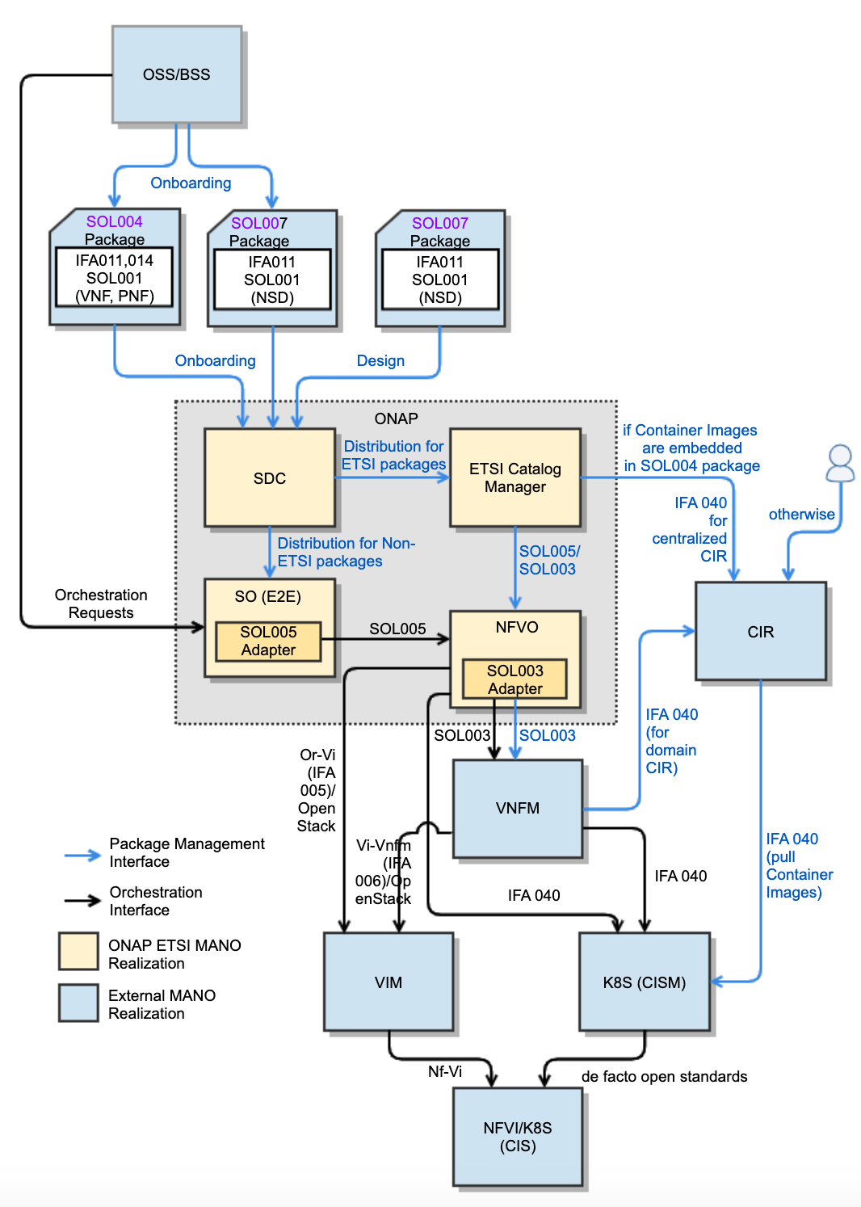
ONAP for ETSI SDO (Conformation to ETSI Specifications)
NS/VNF/PNF Modeling and Packaging Conformation
SOL004 for VNF and PNF packages
SOL007 for NS package
SOL001 for describing VNF, PNF and NS models
SOL003 (IFA007) for VNF Package Management
SOL005 (IFA 013) for NS/PNF/VNF Package Management
SEC022 for ETSI Package and API security
Lifecycle Management Conformation for
SDC for SOL004 and SOL007 package onboarding, design and distribution
ONAP NFVO (VFC and SO NFVO) and External NFVO for ETSI MANO SOL005-compliant NFVO functionalities.
SOL003 Adapter for SOL003-compliant VNF LCM interfaces
SOL005 Adapter for SOL005-compliant NS LCM interfaces
SOL002 Adapter for SOL002-compliant VNF/VNFC LCM interfaces (currently on hold)
ETSI Catalog Manager for ETSI SOL004/SOL007/SOL001 Runtime Package Management and Parsing for NS/VNF/PNF
Ongoing CNF Modeling, Packaging and Orchestration Conformation
IFA 011
  ONAP VNF/CNF package and models including Helm Charts & Container Images conform to IFA 011
IFA 029
  ONAP CNF architecture and interfaces for MANO, NFVI, CISM and CIS conform to IFA 029
IFA 040
  ONAP conforms to the OS container NFV object model, CISM and CIR management, based on IFA 040
IFA 010
  ONAP NFVO and VNFM orchestration functions conform to IFA 010 requirements
IFA 005
  ONAP NFVO and VIM interfaces conform to IFA 005 (Or-Vi)/OpenStack
IFA 006
  ONAP architecture conforms to IFA 006/OpenStack for the interfaces between VNFM and VIM
Prepared by: Byung-Woo Jun (Ericsson), Fred Oliveira (Verizon), Seshu Kumar (Huawei)

