Slide 1
ONAP and Cloud Native
Best of Both Worlds
@twitter

Slide 2
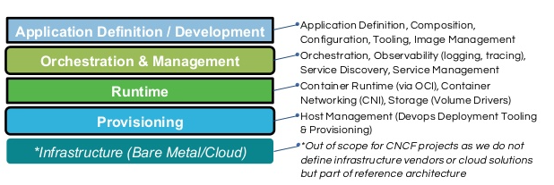

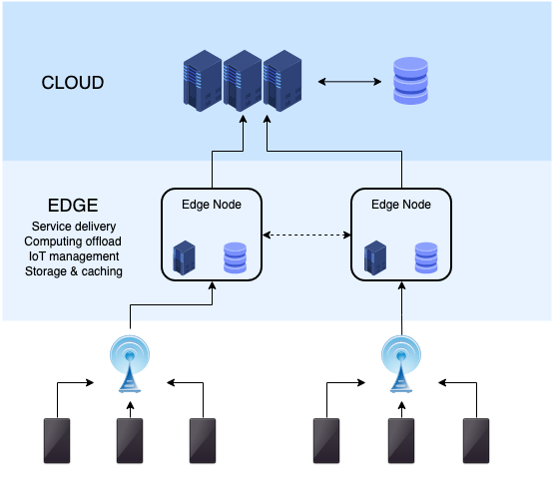

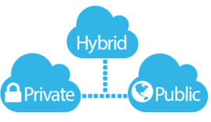
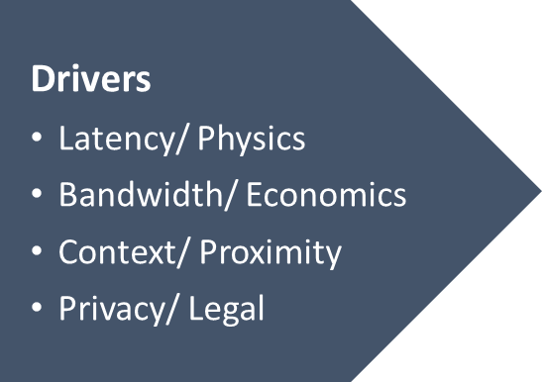



Our ONAP Cloud Native Journey
Cloud Native Reference Architecture
Reference: https://www.slideshare.net/caniszczyk/cloud-native-landscape-cncf-and-oci

Slide 3


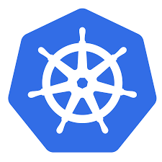
Big Picture - Service Orchestration
OSS/BSS
Service Orchestrator
Deployed CNFs/VNFs
Edge Platform
(K8S based)
Edge Platform
(Openstack based)
Machines
Machines
Site1 Cluster1
Site1 Cluster M
K8s Site1
Site
K8s Site N
Site

Slide 4
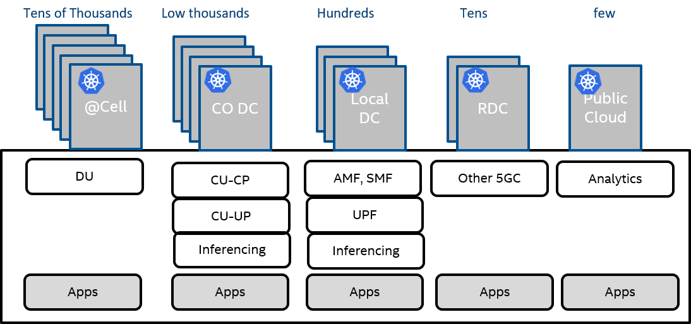
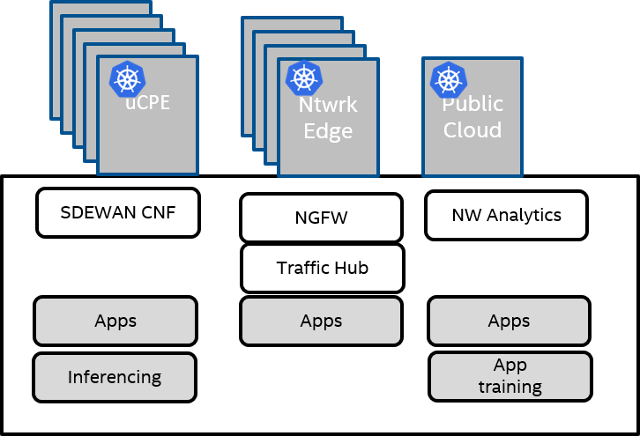
Why Do You Need Service Orchestrator?
5G Use case
Universal CPE Use case
Large Number of sites
Computing (Apps across sites) – MEC
Multiple tenant applications along with operator CNFs.
Workload types - VMs, VNFs, CNFs, CNAs and Functions (FaaS)
Note: K8s is becoming choice of workload orchestrator in each cluster
Multi Edge/Cloud computing scale is similar (or even higher) to Hyper-scalers’ scale
Now Telcos, Enterprises, MSPs need @scale Orchestration and Automation solutions

Slide 5
What is the value proposition of ONAP?
ONAP itself uses Micro-service architecture & uses Cloud Native principles
ONAP supports standard models & APIs as per ETSI, TMF, MEF, 3GPP
OSS/BSS
ONAP Manages Network-service & application LCM across Multiple VIMs (Openstack, K8s)
ONAP enables Day2 configuration of Network functions via RESTful API, NetConf, K8s CRDs
ONAP (Service Orchestrator)
ONAP Design tools support multiple descriptions (Helm, TOSCA, HEAT etc..)
Design time
(SDC)
Orchestrator
(SO, OOF, A&AI)
Day2/Operations
(DCAE, POLICY, CLAMP, CDS)
ONAP AAI (Inventory) secures mechanism to store/inject CNF images
Openstack VNFM
K8s VNFM
ONAP OOF chooses the right locations to place workloads
Openstack site
K8s Edge Clusters
K8s Cloud Clusters
Openstack site
K8s Edge Clusters
K8s Cloud Clusters
ONAP DCAE collects telemetry from remote sites, analyzes them and generate any control loop actions (Scale, Heal)
ONAP is comprehensive service orchestrator

Slide 6


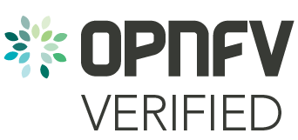
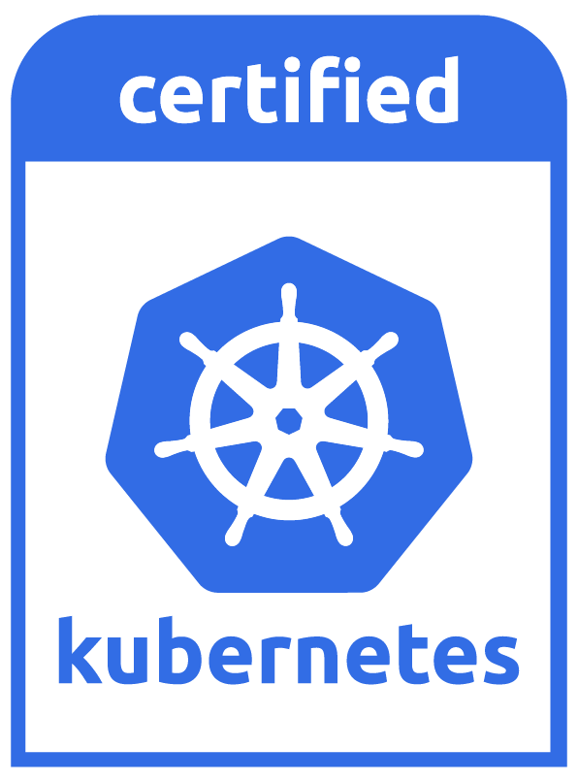



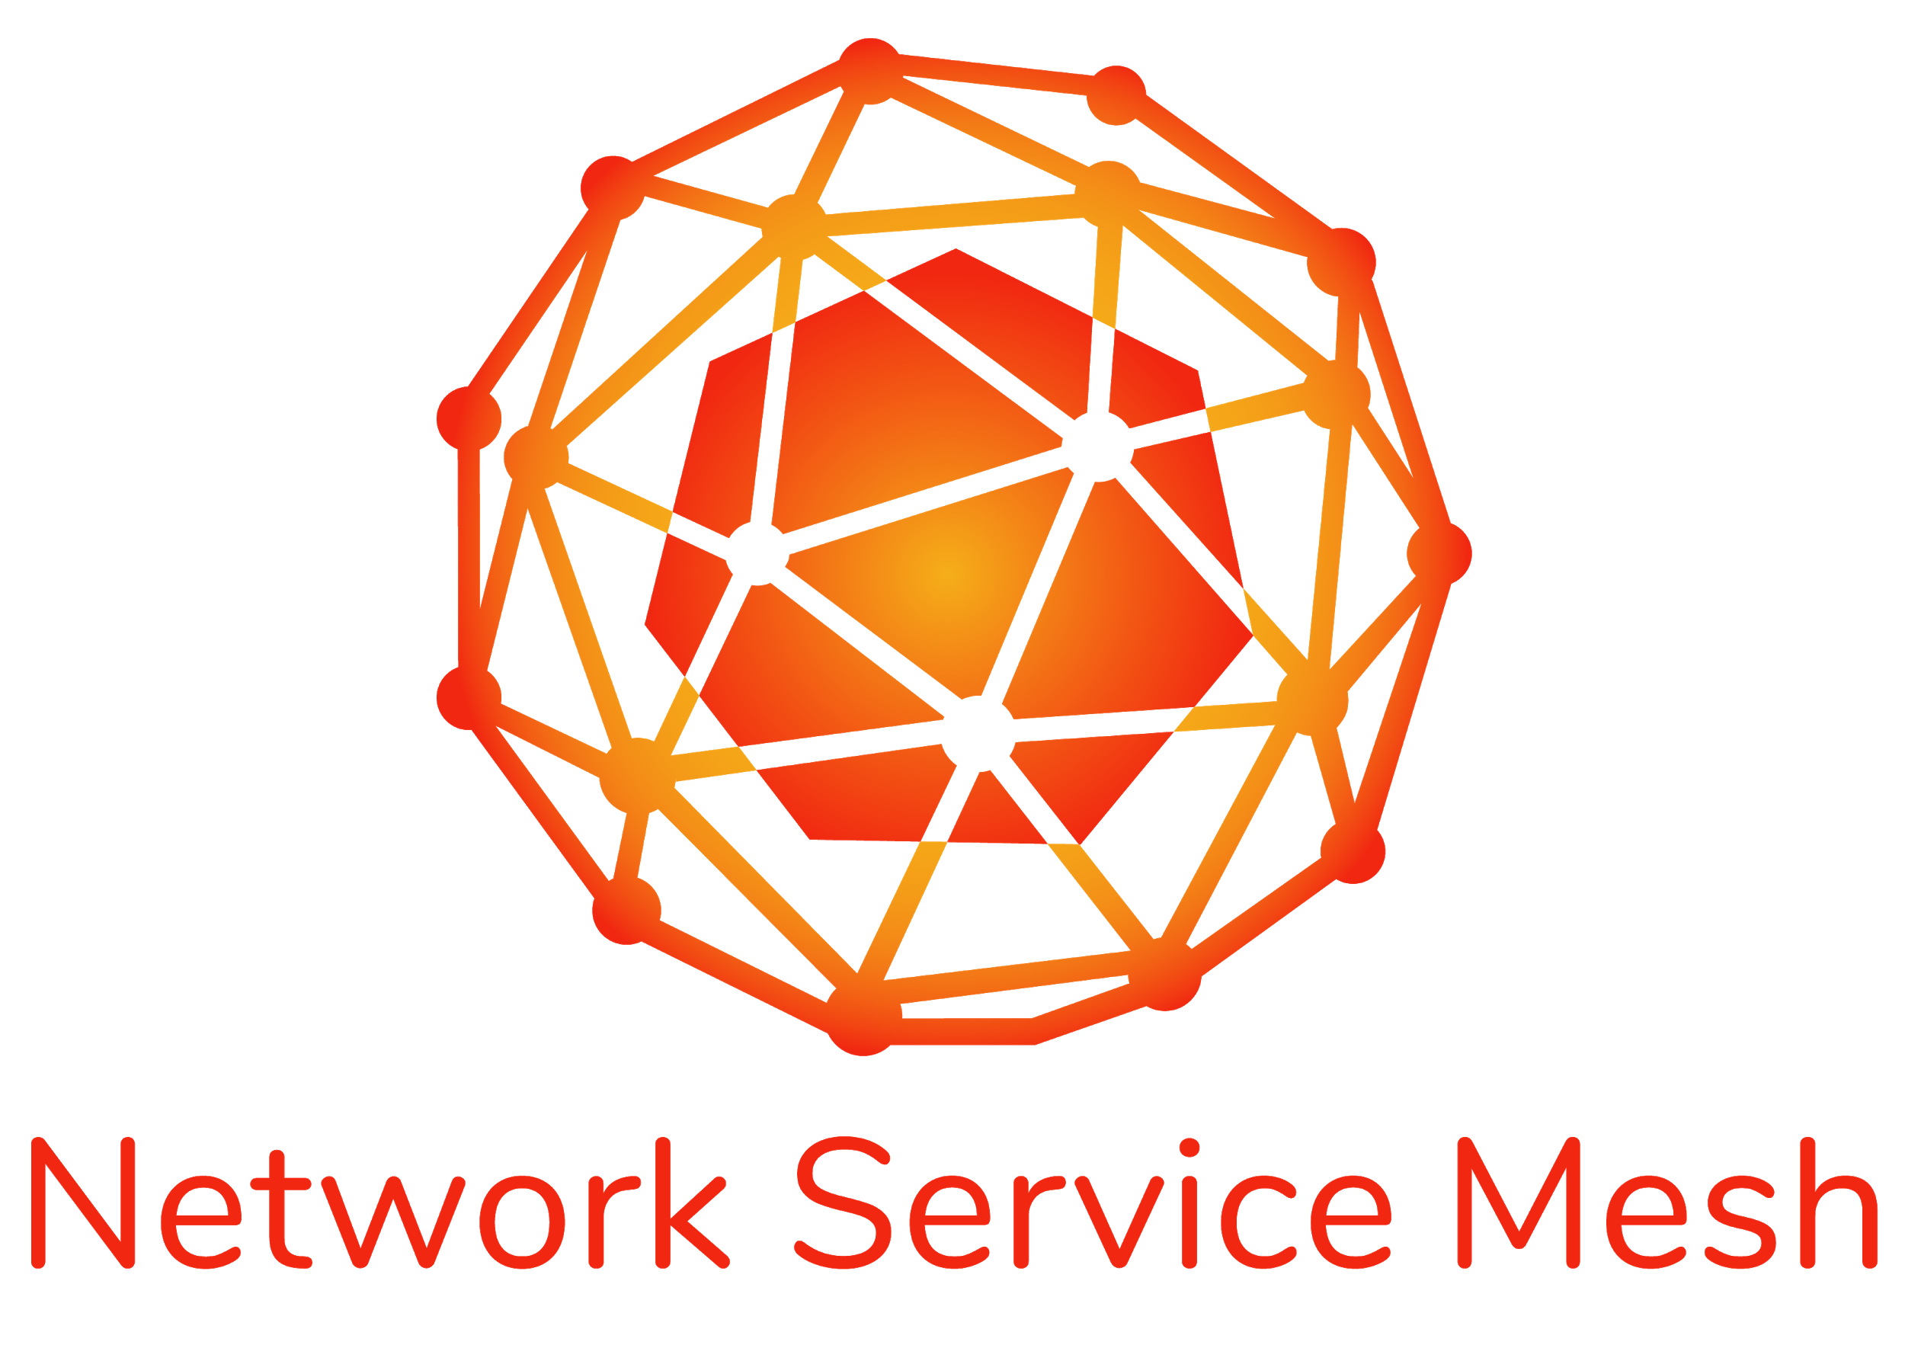
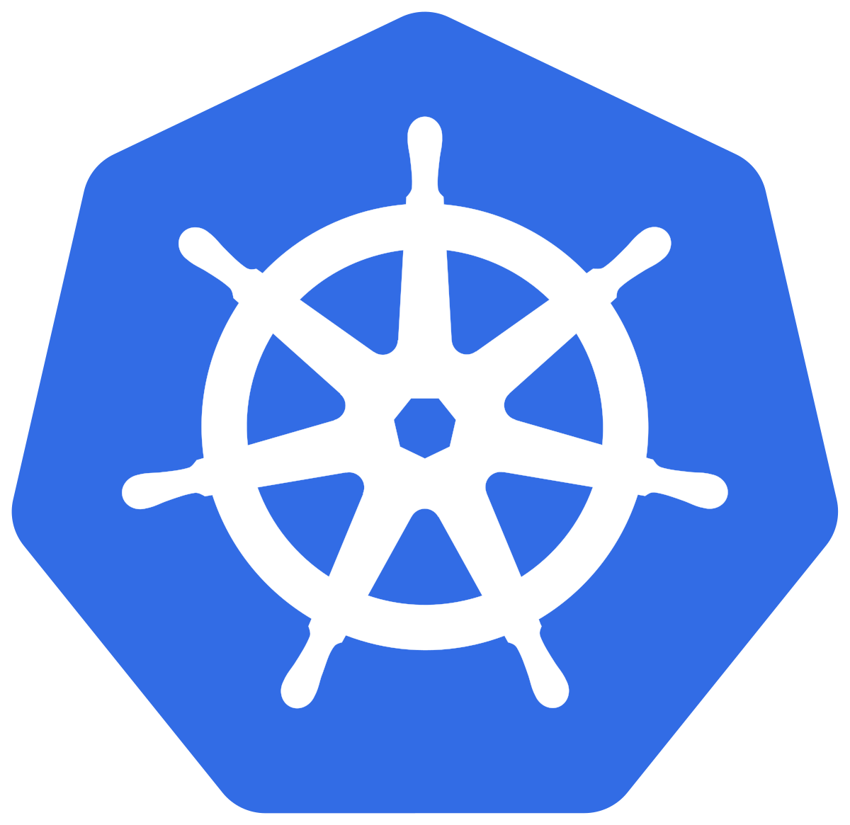

Cross-community CNF landscape
Requirements
Implementations
Testing
Certification
CNTT RI-2 (Testing)
CNTT RC-2 (Testing)
XGVela
Cloud native Principles:
Definition, Papers¹
CNF
Conformance
CNF
Conformance
Core+Addons
Best Practices
SIGS
End-to-end
testing
CNTT Reference Model
+ Architecture
K8s Addon Specs: CSI, CRI, CNI, etc
… any other telcom creator’s solutions
Requirements to create a reference platform w/workloads meeting the model (high-level requirements and features)
Communities can use the requirements as-is or with adjustments when implementing solutions for their end-users
Test cases can cover the requirements and be used for verification of the various implementations
LFN’s certification and badging program. Will use the results of several upstream testing sources. Will use multiple sources for requirements.
Source: https://docs.google.com/presentation/d/1rTUDacKW96IUJYt-QckITmxwRUD1l8pFZe1xCqyK6yo/edit?ts=5f1f18cd#slide=id.g8ecce7b011_2_0
Notes:
Requirements
Updated ONAP xNF requirements to cover mixed workloads of PNF/VNF/CNF
ONAP Requirements complement those provided by CNTT, CNCF-TUG and ensure smooth orchestration experience
Implementation
CNF Orchestration for Cloud-Native Network Functions
Testing and certification
Evolution of VTP to CNTP to support Cloud-Native network functions
CNTP may be used as part of the badging program and is closely aligned with the LFN Compliance, Validation and Certification (CVC) program

Slide 7
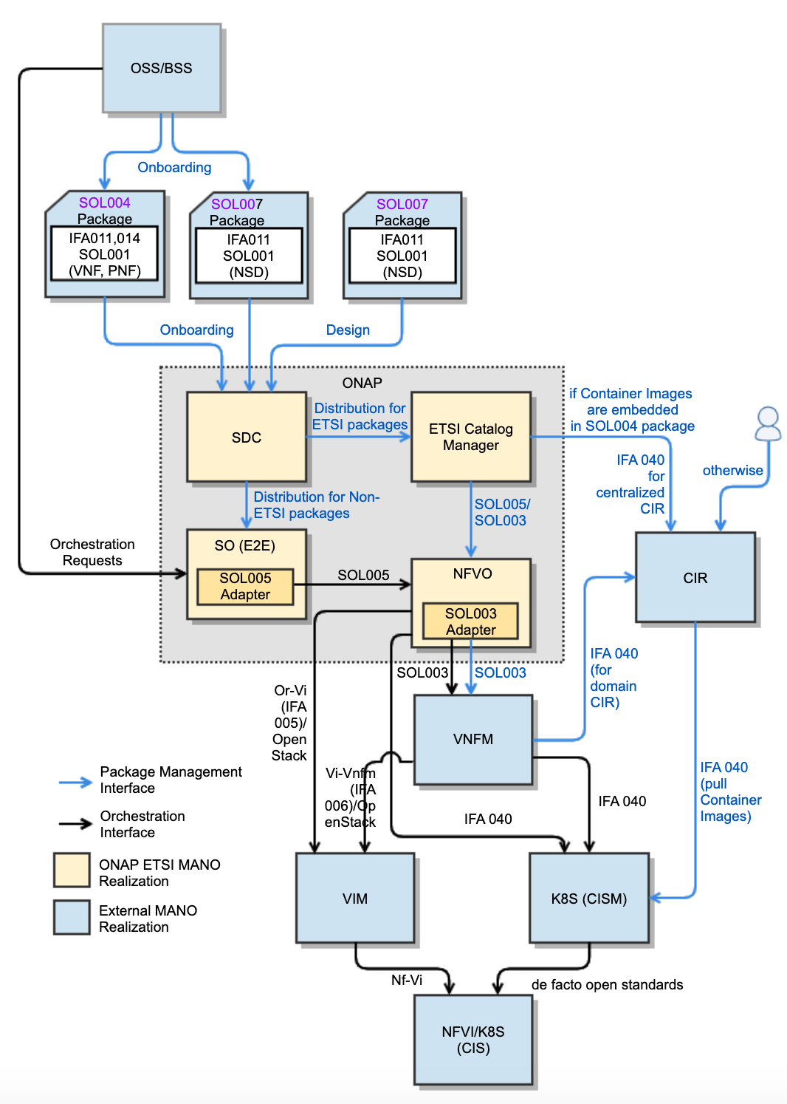
ONAP for ETSI SDO (Conformation to ETSI Specifications)
NS/VNF/PNF Modeling and Packaging Conformation
SOL004 for VNF and PNF packages
SOL007 for NS package
SOL001 for describing VNF, PNF and NS models
SOL003 (IFA007) for VNF Package Management
SOL005 (IFA 013) for NS/PNF/VNF Package Management
SEC022 for ETSI Package and API security
Lifecycle Management Conformation for
SDC for SOL004 and SOL007 package onboarding, design and distribution
ONAP NFVO (VFC and SO NFVO) and External NFVO for ETSI MANO SOL005-compliant NFVO functionalities.
SOL003 Adapter for SOL003-compliant VNF LCM interfaces
SOL005 Adapter for SOL005-compliant NS LCM interfaces
SOL002 Adapter for SOL002-compliant VNF/VNFC LCM interfaces (currently on hold)
ETSI Catalog Manager for ETSI SOL004/SOL007/SOL001 Runtime Package Management and Parsing for NS/VNF/PNF
Ongoing CNF Modeling, Packaging and Orchestration Conformation
IFA 011
  ONAP VNF/CNF package and models including Helm Charts & Container Images conform to IFA 011
IFA 029
  ONAP CNF architecture and interfaces for MANO, NFVI, CISM and CIS conform to IFA 029
IFA 040
  ONAP conforms to the OS container NFV object model, CISM and CIR management, based on IFA 040
IFA 010
  ONAP NFVO and VNFM orchestration functions conform to IFA 010 requirements
IFA 005
  ONAP NFVO and VIM interfaces conform to IFA 005 (Or-Vi)/OpenStack
IFA 006
  ONAP architecture conforms to IFA 006/OpenStack for the interfaces between VNFM and VIM
Prepared by: Byung-Woo Jun (Ericsson), Fred Oliveira (Verizon), Seshu Kumar (Huawei)

Slide 8
K8s VNFM – Past, Present and Future

Slide 10

Geo Distributed Computing Trend
Public/ Private Cloud
μS4
μS4
External System
μS3
Cloud
Platform
Public/ Private Cloud
Drivers
Latency/ Physics
Bandwidth/ Economics
Context/ Proximity
Privacy/ Legal
WAN
μS4
μS4
Edge 1
Edge n
μS3
WAN
μS2
μS2
μS2
μS1
μS1
μS1
μS1
μS1
μS1
Cloud Platform
Edge
Platform
Edge
Platform
WAN
Network (LAN/ WAN)

