Slide 1
ONAP and Cloud Native
Best of Both Worlds

Slide 2
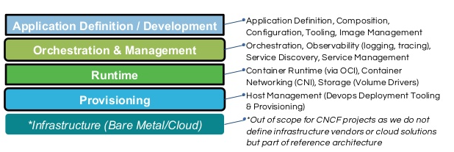

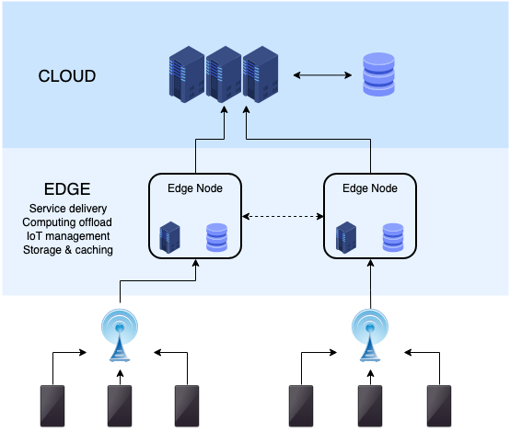

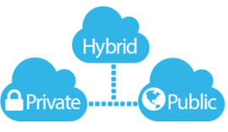
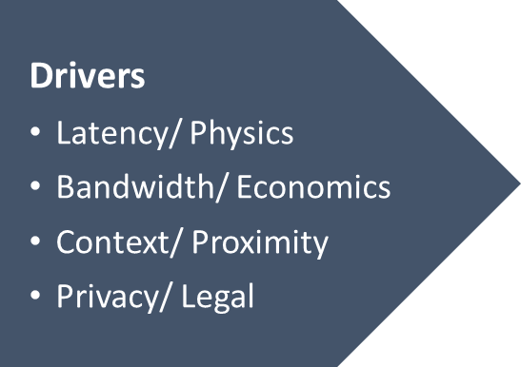



The ONAP Cloud Native Journey
Prepared by Catherine Lefèvre (AT&T) & ONAP CNF Task Force
Cloud Native Reference Architecture
Reference: https://www.slideshare.net/caniszczyk/cloud-native-landscape-cncf-and-oci

Slide 3
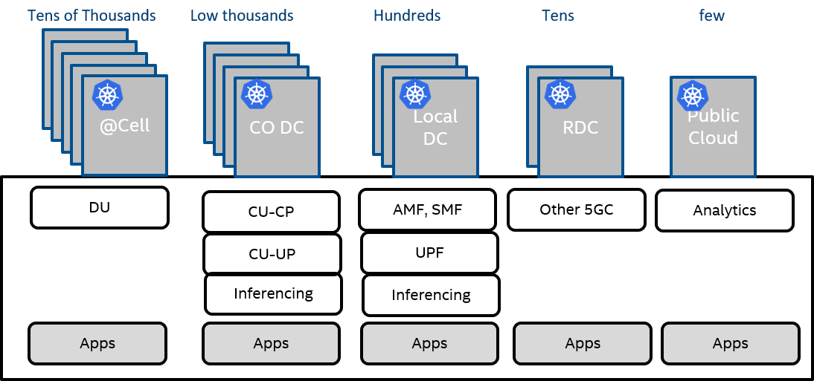
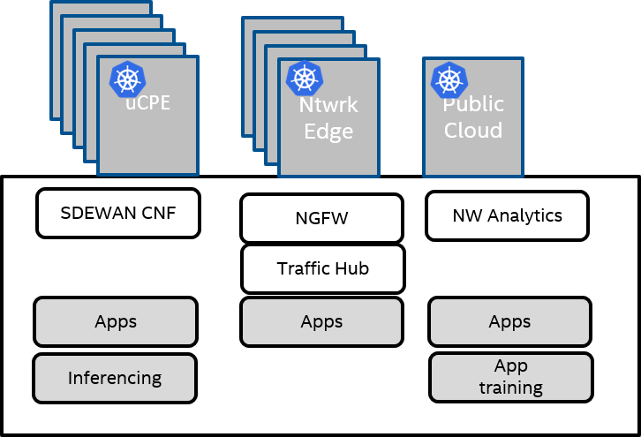
One Cloud Native Cornerstone – Service Orchestration
Prepared by Srinivasa Addepalli (Intel)
5G Use case
Universal CPE Use case
Large Number of sites
Computing (Apps across sites) – MEC
Multiple tenant applications along with operator CNFs.
Workload types - VMs, VNFs, CNFs, CNAs and Functions (FaaS)
Note: K8s is becoming choice of workload orchestrator in each cluster
Multi Edge/Cloud computing scale is similar (or even higher) to Hyper-scalers’ scale
Now Telcos, Enterprises, MSPs need @scale Orchestration and Automation solutions

Slide 4


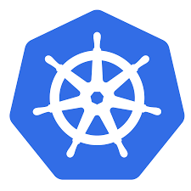



The Role of ONAP?
TIMO
Prepared by Timo Perala (Nokia), Srinivasa Addepalli (Intel)
OSS/BSS
Service Orchestrator
Deployed CNFs/VNFs/PNFs
K8s based
Platform
Openstack based Platform
Other Platforms
Machines
Machines
Site1 Cluster1
Site1 Cluster M
K8s Site 1
Site 1
Site 1
K8s Site N
Site N
Site N

Slide 5
What Are The Other Added Values for Cloud Native?
Prepared by Alla Goldner (Amdocs), Srinivasa Addepalli (Intel)
ONAP itself uses Micro-service architecture & uses Cloud Native principles
ONAP supports standard models & APIs as per ETSI, TMF, MEF, 3GPP
OSS/BSS
ONAP Manages Network-service & application LCM across Multiple VIMs (Openstack, K8s)
ONAP enables Day2 configuration of Network functions via RESTful API, NetConf, K8s CRDs
ONAP Design tools support multiple descriptions
(Helm, TOSCA, HEAT etc.)
Design Time
(SDC)
Orchestrator
(SO, OOF, A&AI)
Day2/Operations
(DCAE, POLICY, CLAMP, CDS)
ONAP AAI is the central repository that keeps site/network element inventory and network service status.
Openstack VNFM
K8s VNFM
ONAP OOF (Optimization) chooses the right locations to place workloads
Openstack site
K8s Edge Clusters
K8s Cloud Clusters
Openstack Site
K8s Edge Clusters
K8s Cloud Clusters
ONAP DCAE collects telemetry from remote sites, analyzes them and generate any control loop actions (Scale, Heal)
ONAP is a comprehensive E2E Network Management Platform Solution

Slide 6
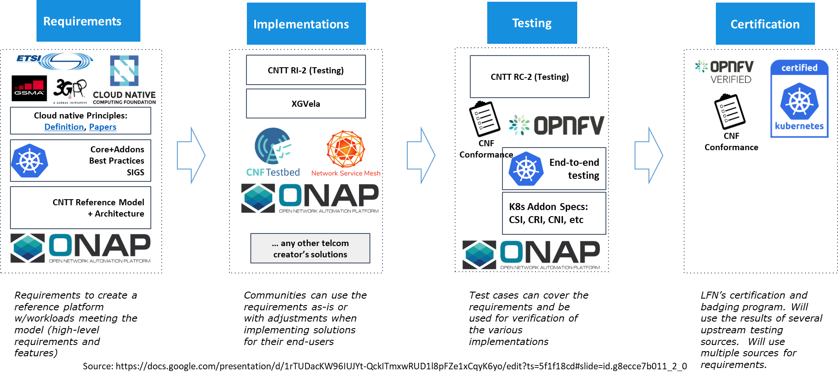
Cross-Community CNF Landscape
Prepared by Ranny Haiby (Samsung), Olivier Smith (Matrixx)
Notes:
The shift towards a cloud-native architecture in Telecom is a coordinated effort between several communities. There are several ”pillars” to this transition, and ONAP has an important role to play here. While this landscape may seem confusing at first glance, it is actually a well orchestrated endeavor. Each community provides its deliverables, and there is little to no overlap.
(Requirements)
The first step in building a modern network functions is defining the architecture for both the cloud infrastructure and the network function itself. Several groups within the LF Networking and the CNCF are working on defining the requirements for such architecture, as well as SDOs like ETSI and the GSMA.
ONAP has an updated set of NF requirements to cover mixed workloads of PNF/VNF/CNF. The requirements ensure that the NF can be a part of an. E2E service managed by ONAP.
ONAP Requirements complement those provided by CNTT, CNCF-TUG and ensure smooth orchestration experience
(Implementation)
Moving into the implementation phase, ONAP provides CNF Orchestration for Cloud-Native Network Functions. It enables building network services that are cloud-native, and may also include virtual or even physical components.
(Testing and certification)
To make sure everything plays nicely together, tools for testing and validating the cloud native services are being developed.
The ONAP community is working on the evolution of VTP to CNTP to support Cloud-Native network functions
CNTP may be used as part of the badging program and is closely aligned with the LFN Compliance, Validation and Certification (CVC) program.
The result is going to be a coherent set of requirements and tools for implementation, making it easier for both operators and vendors to smoothly transition to a cloud-native architecture.

Slide 7
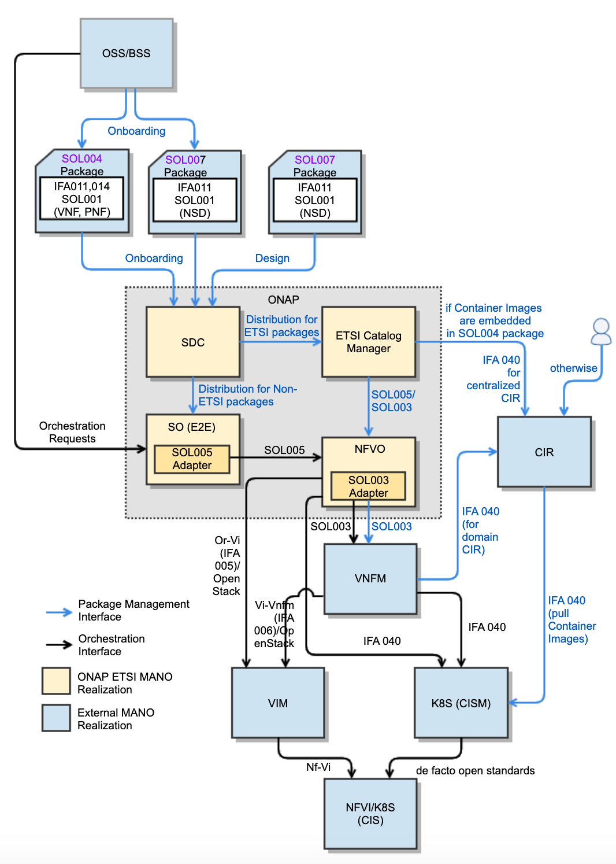
ONAP For ETSI SDO (Conformance to ETSI Specifications)
Prepared by Fred Oliveira (Verizon), Byung-Woo Jun (Ericsson), Seshu Kumar (Huawei)
NS/VNF/PNF Modeling and Packaging Conformance
SOL004 for VNF and PNF packages
SOL007 for NS package
SOL001 for describing VNF, PNF and NS models
SOL003 (IFA007) for VNF Package Management
SOL005 (IFA 013) for NS/PNF/VNF Package Management
SEC022 for ETSI Package and API security
Lifecycle Management Conformance for
SDC for SOL004 and SOL007 package onboarding, design and distribution
ONAP NFVO (VFC and SO NFVO) and External NFVO for ETSI MANO SOL005-compliant NFVO functionalities.
SOL003 Adapter for SOL003-compliant VNF LCM interfaces
SOL005 Adapter for SOL005-compliant NS LCM interfaces
SOL002 Adapter for SOL002-compliant VNF/VNFC LCM interfaces (currently on hold)
ETSI Catalog Manager for ETSI SOL004/SOL007/SOL001 Runtime Package Management and Parsing for NS/VNF/PNF
Ongoing CNF Modeling, Packaging and Orchestration Conformance
IFA 011 (VNF Descriptor and Packaging Specification)
  ONAP VNF/CNF package and models including Helm Charts & Container Images conform to IFA 011
IFA 040 (Service interfaces for OS Container Mgmt & Orch)
  ONAP conforms to the OS container NFV object model, CISM and CIR management, based on IFA 040
IFA 010 (NFV Mgmt & Orchestration Functional Reqs)
  ONAP NFVO and VNFM orchestration functions conform to IFA 010 requirements
IFA 005 (Or-Vi Interface and IM)
  ONAP NFVO and VIM interfaces conform to IFA 005 (Or-Vi)/OpenStack
IFA 006 (Vi-Vnfm Interface and IM)
  ONAP architecture conforms to IFA 006/OpenStack for the interfaces between VNFM and VIM
On top of the ONAP ETSI package onboarding and distribution mechanism, ONAP will support enhanced VNF/CNF models, Helm Charts, CIR and interactions with CISM and VIM for LCM

Slide 8

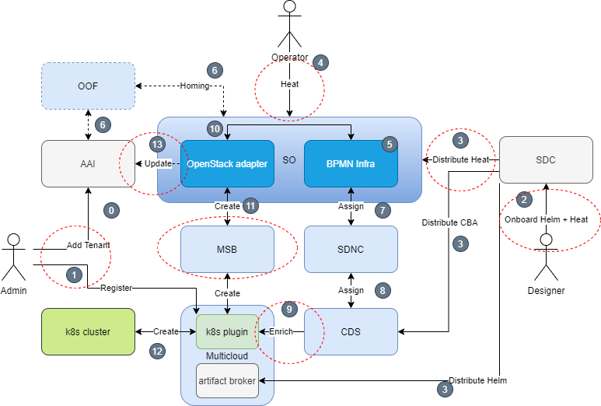
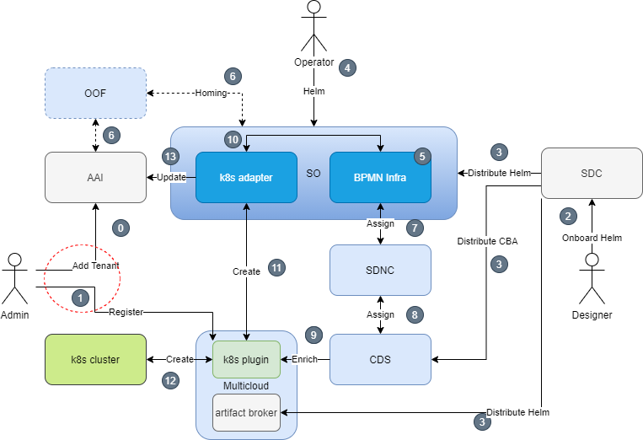
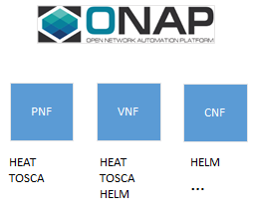
ONAP CNF Evolution
Prepared by Seshu Kumar (Huawei), Lukasz Rajewski (Orange)
Completed
On-Going
Expected
Till Frankfurt
Embedding the Helm into the Heat package distro
CLOUD_TECHNOLOGY_SPECIFIC artifact distributes Helm
Installation of Helm package(s) into K8s cluster
Basic Helm enrichment through CDS - Introduced
Guilin Brings
HELM artifact is Introduced to make Helm charts a first class citizen
HELM artifacts supported in Day 0 and Day 1
Native Helm support in E2E Orchestration
Enhanced native Helm enrichment through CDS, K8s Plugin interactions.
Beyond
Cross community Integration and SDO conformance
Extension to CNF model with Health Check and Monitoring of CNF resources
Auto discovery of K8S cluster in ONAP
Intent Driven orchestration and Service Control Loop Inc. CNFs
8

Slide 9
Speakers
Srinivasa Addepalli - Senior Principal Engineer, Intel
Alla Goldner - Director, Technology, Strategy & Standardization, Amdocs
Ranny Haiby - Director, Open Source Group, Samsung
Seshu Kumar Mudiganti – Lead Architect, Huawei
Catherine Lefèvre – AVP & ONAP TSC Chair, AT&T
Fernando Oliveira – Fellow, Network Technology, Verizon
Timo Perala - Head of Open Source Network and Service Automation, Nokia

