Slide 1
REQ-341 – CNFO – Next Steppingstones Towards CNF In Production Deployments
Lukasz Rajewski (Orange)
Seshu Kumar M (Huawei)
Last Updated: 08.10.2020

Slide 2


ONAP - ETSI model Alignment
E2E Service
Network Service
TOSCA
VNFD
VNF
PNF
CNF?
Helm
Helm
Integration of Native (K8s Adapter) with
ETSi (SOL003 Adapter) paths in SO
Design/AAI CNF Model
How the ETSI CNF AAI model will look?

Slide 3
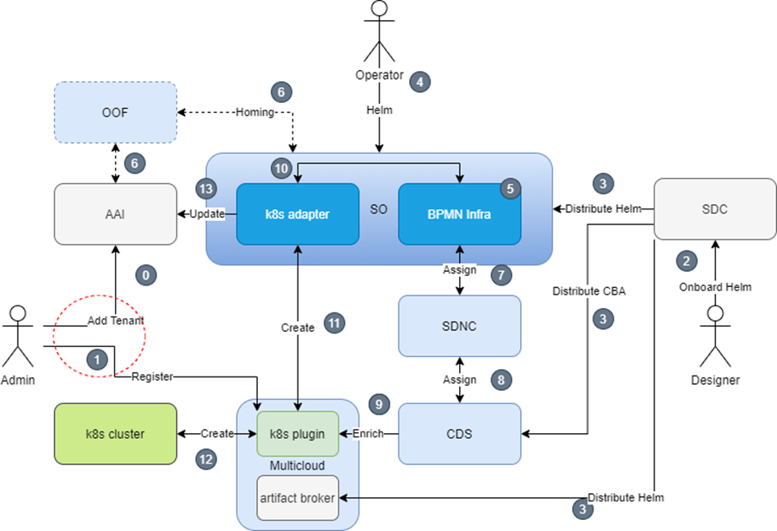
Guilin - K8s Adapter (Helm) Flow Day 0/1
Focus on Native Day2 Operations
  AAI model changes
  SO AAI Data Update
  SO CNF Status
  SDC Distribution
  Helm Validation
  K8s Plugin – v2 APIs
  Native Day2 for CNF in CDS
HELM

Slide 4
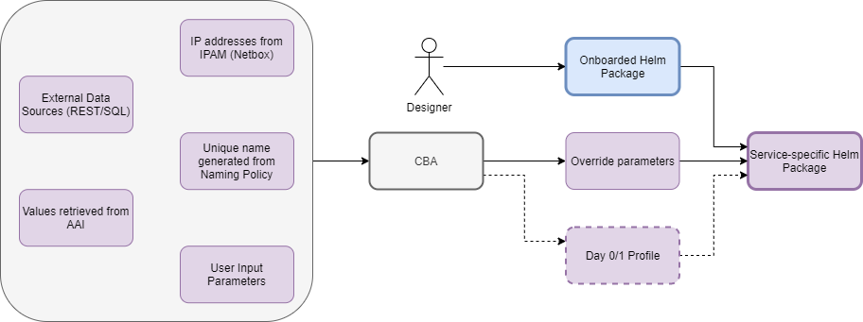
Helm Package Day 0/1 + Day2
1
HELM
2
6
3
4
5
K8s Cluster Resources
7
Day 2 Configuration Template
Day 2 Configuration
Instance
8
Day 2 Configuration Parameters
9

Slide 5
Day2 CNF Health Flow - ONAP
1
On-demand Health Check
SO
3
K8s Plugin
4
4`
K8s Cluster
K8s
Res
2
3`
AAI
2`
DCAE
Prometheus
0
1`
Background Health Check
Day 0/1 Synch by SO CNF Adapter

Slide 6
On-Demand CNF CNF Health Check – Challenge
K8s Cluster APP NS
CNF Healtcheck Workflow in SO
K8S Resources
CNF Status Check
CNF Health Check
?
K8S Application
(RB Instance)
K8s Cluster ONAP NS
K8s Plugin
Status Handler
K8s API

Slide 7
Generic On-Demand CNF Health Check – Proposal
K8s Cluster APP NS
CNF Healtcheck Workflow in SO
K8S Resources
CNF Status Check
CNF Health Check
K8S Application
(RB Instance)
Health Check Job
K8s Cluster ONAP NS
K8s Plugin
Status Handler
Configuration Handler
K8s API

Slide 8
Honolulu+ – Proposed scope for REQ-341 (1)
  SDC Enhancements
    Continuation of native Helm support changes
    Helm validation [stretch]?
  AAI model changes
    K8s resource type created from helm package -> similar role to vserver object
    Snapshot of Status API result in AAI
  AAI API - Exposure of Status API result with conversion to JSON
  SO Changes
    SO E2E API Improvements
    SO CNF Adapter
      Status API in CNF Adapter
      AAI synchronization after each change -> Notification based
    SO Integration ETSI Flow <- We need to make sure the flow will coexist with REQ-334

Slide 9
Honolulu+ – Proposed scope for REQ-341 (2)
  Integration of K8s API v2 -> Investment for the future development
    Configuration API for v2
    v2 in OOM + adaptation of existing helm charts for
    SO CNF adapter must be changed in SO
    ArtifactBroker must be modified for v2 or replaced by CNF adapter
    Native Profile Handler in CDS must be switched into v2
    v2 in ONAP python-sdk?
CCSDK/CDS
    Native Configuration API Handler for v1 or v2
    Native Status API Handler for v1 or v2
  Dedicated CNF Health Check Workflow in SO
    Status Check -> Status API result verification
    CNF Health Check with Dedicated Health Check Job Execution
  We may want to switch to another pure CNF use case
    CNF use case CBA + Integration scripts
    Reference Health Check Job Implementation for selected CNF use case
    Prometheus for collection of metrics

Slide 10
ONAP CNF Orchestration – Impacted Components - Honolulu
SDC:
On-board the helm and process it as an artifacts of the CSAR to be distributed
On-board Helm Charts (Continuation)
Helm Validation in SDC (Stretch)
SO:
Won’t consume the Helm by itself but parse it and push it forward to other ONAP components
Parse the CSAR, extract helm
SOL003 adapter enhancements
K8s Adapter – v2 + Status API
Distribution of Helm from CNF adapter (Optional)
K8s Plugin:
Configuration API in v2
Artifact Broker supports v2
v2 in OOM
AAI:
Persist k8s instance identifier
Persist k8s resources ID created from Helm
Expose Status API result
CCSDK:
Native suport of Configuration API
Native Support of Status API
Adaptation for v2
ETSI Catalog DB:
Persist the ETSi VNFM data (IFA-29 and IFA-40 )
Persist Images
So
SDC
AAI
ETSI
Catalog DB
SDC
Controller
SO
BPMN Infra
Catalog DB
K8S Plugin
SOL003
Adapters
K8s Adapter
CCSDK
Model to drive the flows:
External (S)VNFM
SDC to denote the flow of which VNFM should be used - similar to Orchestration Type
Information model – optional
Need to investigate the best place to have the meta data, we can perhaps use the existing fields

Slide 11
Thank You!

