Slide 1


Use Case Realization Call
Use Case Realization Overviews & Tasks
Benjamin Cheung
January 26, 2021 version 1

Slide 2
Managing / Developing / Coordinating
Release Portal Page
Information sharing across Use Cases
Interdependencies
Coordinating and Developing
Use Case Overview Table
Process / Way of Working for U/C teams
Coordinate Use Case Overviews
with release updates
Coordinating Specific Discussions
per topic / release basis / on demand
vDDF, Requirements Call (Alla)
Platform Component discussions
With Use Case teams
5G Specific discussions & topics

Slide 3
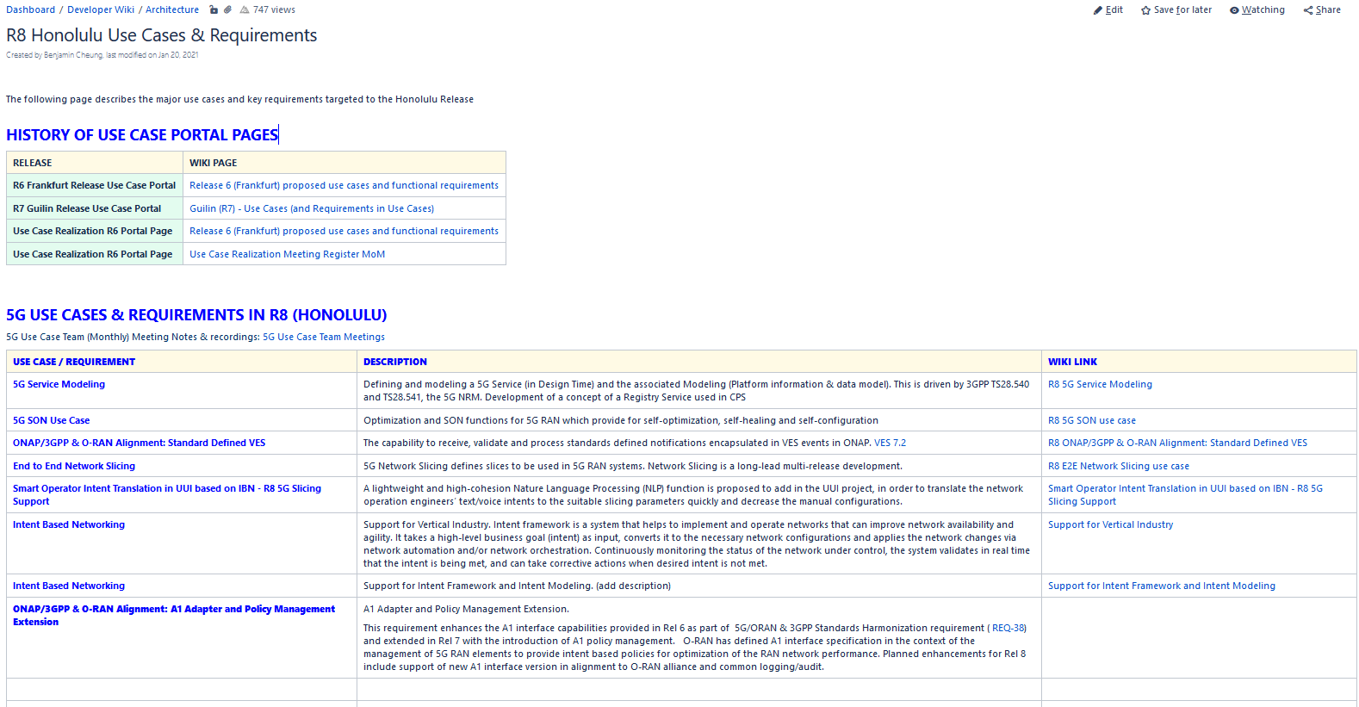
Managing / Developing / Coordinating
Release Portal Page
DESCRIPTION: Each release there is a portal page that describes the use cases in detail. This task entails:
- Reaching out to the Use Case teams to make them aware of the portal page
- Help them in creating the pages with same look & feel.
- Create the release “Base” Page. That others can clone
- Updating the PTLs after nominations.
- Updating the portal page framework.
LINK: https://wiki.onap.org/pages/viewpage.action?pageId=92996235

Slide 4
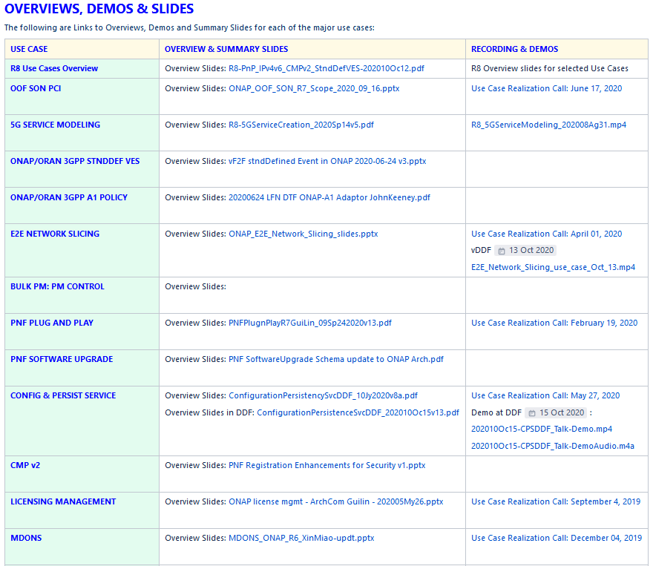
Coordinating and Developing
Use Case Overview Table
DESCRIPTION: On the portal page there is a table dedicated to an overview of all of the use cases
- Reaching out to the Use Case teams get their latest overview slides
- Finding the latest Video/Demo presentation recording
- Keeping this table up to date per release
LINK: https://wiki.onap.org/pages/viewpage.action?pageId=92996235

Slide 5
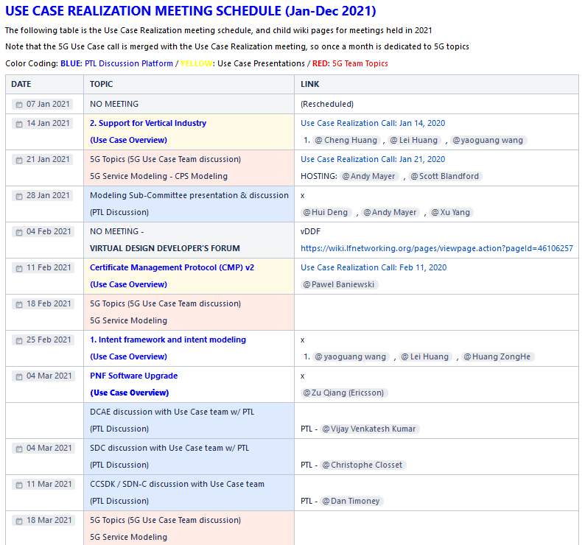
Coordinate Use Case Overviews
with release updates
DESCRIPTION: At the Use Case Realization Calls with U/C Overviews
- Reaching out to the Use Case teams to coordinate talks
- Schedule & coordinate with presenters
- Update the schedule of presenters
- Make sure there is good coverage of Use Cases with presentations
- Work with the Overview Table manager
LINK: https://wiki.onap.org/display/DW/Use+Case+Realization+Meeting+Register+MoM

Slide 6
Platform Component discussions
With Use Case teams
DESCRIPTION: At the Use Case Realization Calls with U/C Overviews
- Reaching out to the Use Case teams that have impact on platform components
- Schedule & coordinate with PTLs & Use Case Teams
- Update the schedule of PTL meetings
- Make sure there is good coverage of Use Cases across component impacts
- Ideally meet before M1
LINK: https://wiki.onap.org/display/DW/Use+Case+Realization+Meeting+Register+MoM

Slide 7
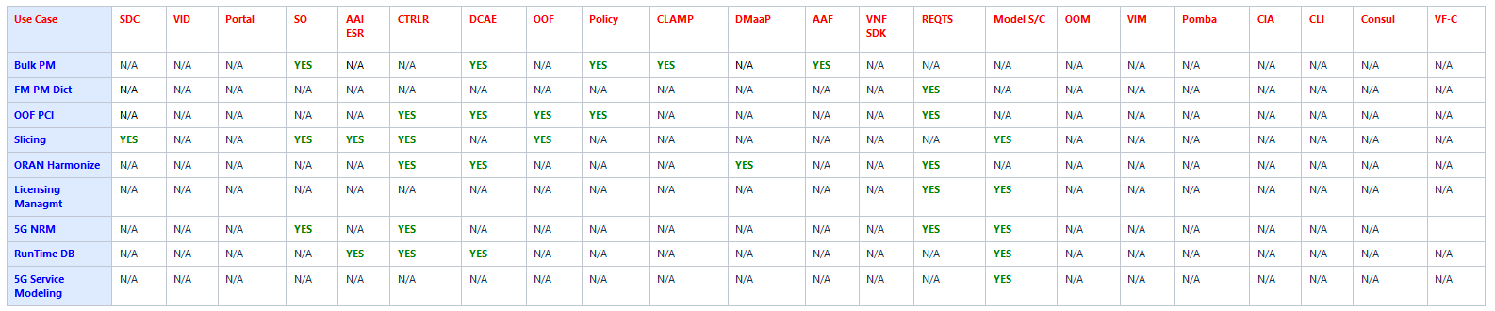
Information sharing across Use Cases
Interdependencies
DESCRIPTION: At the Use Case Realization Calls with U/C Overviews
- Interdependency Chart
- Schedule & coordinate Use Case Teams
- Identify key interdependencies between Use Case Teams
- Socialize interdependencies, host meetings to resolve and raise awareness
- e.g. CPS, Vertical Industry, E2E Network Slicing
LINK: https://wiki.onap.org/display/DW/Use+Case+Realization+Meeting+Register+MoM

Slide 8
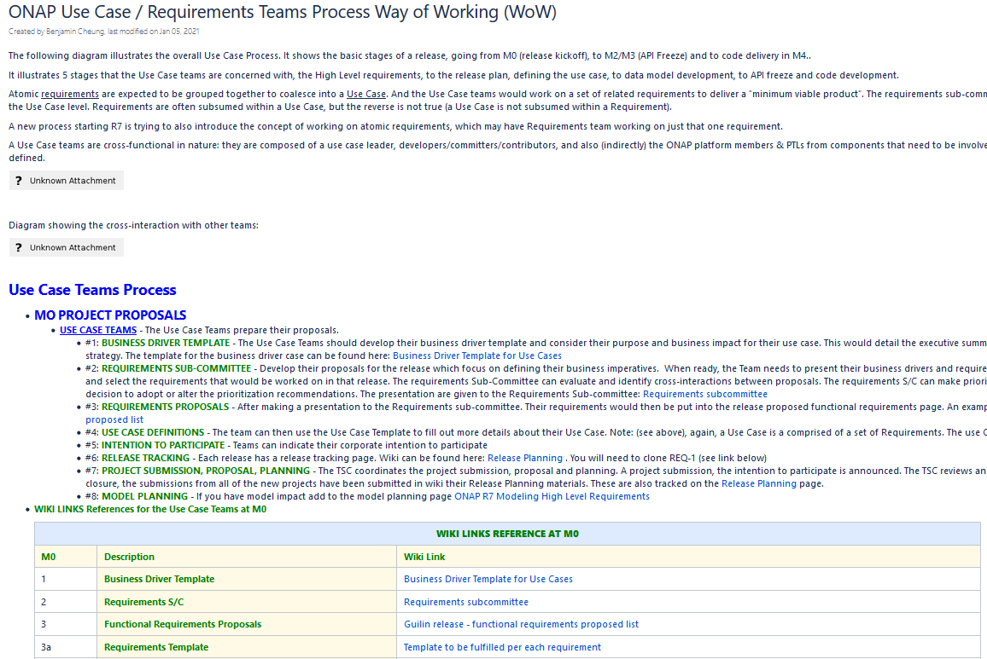
Process / Way of Working for U/C teams
DESCRIPTION: At the Use Case Way of Working
- Develop and maintain the Way of Working Process Page
- Update as process changes
- Communicate to TSC and other groups
- Discuss with Use Case Teams for common process
- Coordinate w/ ONAP PJM
LINK: https://wiki.onap.org/pages/viewpage.action?pageId=79204390

Slide 9
Coordinating Specific Discussions
per topic / release basis / on demand
vDDF, Requirements Call (Alla)
DESCRIPTION: One Demand Topics
- Coordinate on demand topics coming from Arch, TSC, Req calls
- Present on vDDFs
- Coordinate w/ Arch, TSC, Req calls sharing of information and U/C developments.
- Discuss and help to resolve key major issues impacting all use cases
- Share information on new developments, new developments (e.g. CPS)
LINK: https://wiki.onap.org/display/DW/Use+Case+Realization+Meeting+Register+MoM

Slide 10
5G Specific discussions & topics
DESCRIPTION: Helping to facilitate 5G specific topics
- Lay a roadmap for key 5G topics
- Lead the preparation of ONAP for 5G RAN Integration with live network
- Lead discussions with Use Case teams working on 5G Use Cases to insure consistency
- Work with 5G teams to share information and coordinate interdependencies
- Identify holes on 5G roadmap and fill gaps
LINK: https://wiki.onap.org/display/DW/Use+Case+Realization+Meeting+Register+MoM

