Slide 1
Transport Slicing for Guilin Release Discussion
March 12, 2020

Slide 2
Content
Overview of Transport Slicing solution
Align Transport slicing solution with E2E Network Slicing Use case
Scope of Guilin release

Slide 3
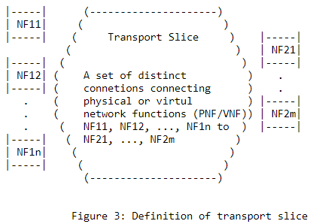
What is Transport Slicing?
3GPP provides requirements, but not standards, for Transport Slicing, so IETF picks up the ball…
IETF is working on Transport Slicing standards
Not defined by 3GPP
Source: draft-rokui-5G-transport-slice
https://tools.ietf.org/html/draft-rokui-5g-transport-slice-00

Slide 4
IETF Transport Slice solution (2 levels of abstraction models)
E2E NS controller, RAN Slice controller, CORE Slice controller
TSCi (draft-rokui-5G-transport-slice)
Intent-like, technology agnostic, model-driven interface
ONAP SDC/SO/SDNC/AAI/OOF
Transport Slice Definition Model
Definition of a transport slice and its corresponding implementation are decoupled. They are two different sets of models.
Transport Slice Implementation Models
Transport slice implementation models
Ietf-detnet-topology
Ietf-detnet-config
TE-MPLS-tunnel
TE-topology, etc.
ACTN TE / L0/L1/L2 models
Os-Ma-Nfvo (NFV IFA 013)
NOTE: The implementation models is a set and will keep evolving. So for forward compatibility, our architecture needs be flexible/generic to allow the addition of non-IETF models to the implementation models.
IP/MPLS Domain Controller
Optical Domain Controller
NFVO
IP/MPLS Network
Optical Network
NFVI-PoP

Slide 5
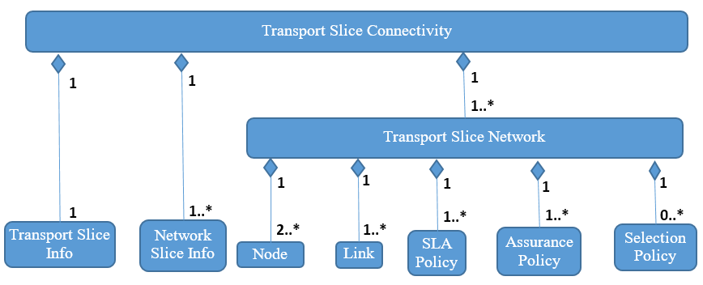
Definition Model
Implementation Model
TSCi Information Model

Slide 6
Definition Model
Implementation Model
TSCi Information Model
The TSCi model includes the following building blocks:
Transport Slice Info: Information related to transport slice, such as transport slice ID and transport slice name;
Network Slice Info: A list of all E2E network slices mapped to the transport slice;
Transport Slice Networks: Each transport slice is a set of networks. Each network contains the following:
  List of Nodes: list of RAN and Core network functions;
  List of Links: list of connections between nodes;
  List of SLA Policies: Mandatory policy. It represents in a generic and technology-agnostic way the SLA requirements needed to realize a group of connections which are part of a transport slice. It is defined per Transport-Slice-Network;
  List of Assurance Policies: Mandatory policy. The E2E Network Slice MD shall influence the TN MD for transport slice assurance on how to perform monitoring, analytics and optimization. To this end, the transport-slice-assurance-policy will be used. It contains the type of assurance needed, applicable time interval, how often to update the E2E Network Slice MD etc.;
  List of Selection Policies: Optional policy. In some deployments, the E2E Network Slice MD might want to assist the TN MD regarding how to realize a transport slice by providing some information regarding the type of technologies and tunnels. This information will be provided in transport-slice-selection-policy

Slide 7
Definition Model
Implementation Model
TSCi Data Model
OSS/BSS/Apps
TSCi Data Model is a YANG module
Augmentation of the ACTN VN model; still under development in IETF. Draft will be released this year.
RESTCONF/NETCONF interface
TMF APIs
CSMF (ONAP)
ONAP
NSMF (ONAP)
TSCi Data Model (RESTCONF/YANG)
TN NSSMF
xNFs

Slide 8
Definition Model
Implementation Model
Implementation Models
Implementation models shall consist of two kinds: resource models and service models.
Resource models is an abstraction to represent the capabilities of the network. For example, the models shall provide traffic engineering attributes which can be used for service assurance. The following picture shows some examples of IETF resource models. Note that IETF models represent resources in the form of topology, and also notice that model reusability is achieved via augmentation (like class inheritance).
Service models represent various services which realize a Transport Slice. Service models may need to refer to (work with) resource models. IETF provides a set of L0-L3 service models. The following figure shows some example. Note the Non-IETF models may also be used, as long as they can work with the resource models.
L0-L3 Resource Models
Service Models
IETF I2RS Topology
L3 models: L3VPN/DetNet-Config/etc.
L2 models: L2VPN/ETH-trans-service/etc.
TE-Topology
L1 models: OTN-tunnel
L0 models: Och-tunnel
DetNet-Topology
OCH-Topology
OTN-Topology
ETH-Topology
TSN-Topology??
Non-IETF service models: TAPI, MEF, etc.

Slide 9
Content
Overview of Transport Slicing solution
Align Transport slicing solution with E2E Network Slicing Use case
Scope of Guilin release

Slide 10
ONAP-based Slice Management Overall Architecture Choices
1
OSS/BSS/Apps
2
OSS/BSS/Apps
3
OSS/BSS/Apps
4
OSS/BSS/Apps
5
OSS/BSS/Apps
✓
To Be Done in G release
Standard APIs
TMF APIs
CSMF (ONAP)
CSMF
CSMF
CSMF (ONAP)
CSMF
Internal call
3GPP APIs
3GPP APIs
Internal call
NSMF (ONAP)
NSMF (ONAP)
NSMF (ONAP)
NSMF (ONAP)
NSMF
Standard APIs
Standard APIs
Standard APIs
Internal call
Internal call
NSSMF(s)
(ONAP)
NSSMF(s)
(ONAP)
NSSMF(s)
NSSMF(s)
NSSMF(s)
(ONAP)
xNFs
xNFs
xNFs
xNFs
xNFs
In F release, only Scenario 4 is implemented. Scenario 1 will be supported in G release and following releases. Subsequently, remaining scenarios 2,3,5 can be easily realized.
3rd party component

Slide 11
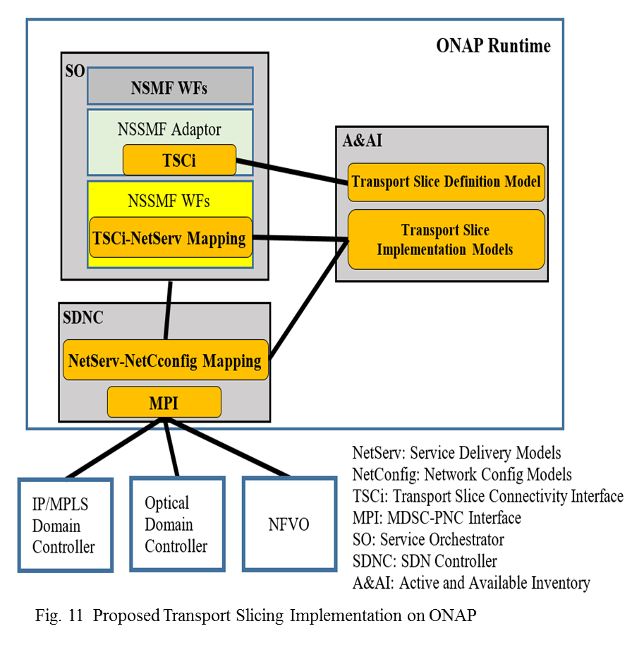
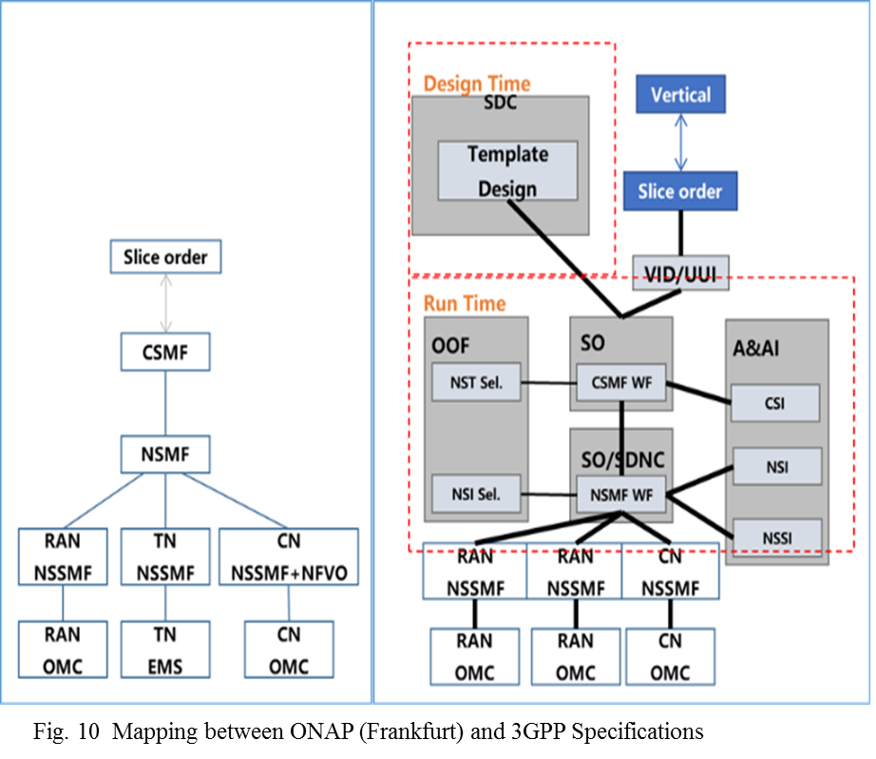
TS Implementation (right figure) to realize TN MSSMF (left figure)

Slide 12
How Transport Slicing Fit into E2E Network Slicing
To support E2E Network Slicing on ONAP, we need to implement 4 controllers: E2E NS, RAN, TS, and Core. TS controller provides TS service. The following figure shows how TS fit into the E2E NS.
IETF
3GPP
ONAP
Customer (aka Tenant) portal
CSMF
EXT-API
Generate NS Profile (aka NSI) using NS Blueprints
Decompose NS Profile and trigger various actions
NSMF
SO
TSCi
RAN NSSMF
Generate NSS Profile (aka NSSI) using NSS Blueprints
Transport
Generate NSS Profile (aka NSSI) using NSS Blueprints
Core
Generate NSS Profile (aka NSSI) using NSS Blueprints
NSSMF
RAN
Domain Controller
Transport
Mgmt Functions
Core
Domain Controller
NSSMF??
SDNC
Derived from draft-rokui-5G-transport-slice
ETSI ZSM 003 provides a similar architecture as above

Slide 13
Content
Overview of Transport Slicing solution
Align Transport slicing solution with E2E Network Slicing Use case
Scope of Guilin release

Slide 14
Scope For Guilin Release
E2E NS controller, RAN Slice controller, CORE Slice controller
TSCi (draft-rokui-5G-transport-slice)
1. Implement TSCi (i.e., create TS definition model)
ONAP Impacted modules:
SDC/SO/OOF
/SDNC
/AAI
Transport Slice Definition Model
Transport Slice Implementation Models
2. L1 (OTN) and L2 (E-line) service slicing
NOTE: many existing CCVPN features can be reused.
NOTE: could also leverage MDONS L1 (OTN) using TAPI as implementation models.
ACTN TE / L0/L1/L2 models
Optical Domain Controller
NOTE: Nokia might be interested in implementing IP slicing. i.e., adding their IP domain controller
Optical Network

Slide 15
Standards-based solution to support Multi-domain, multi-vendor networks
E2E NS controller, RAN Slice controller, CORE Slice controller
TSCi
ONAP Impacted modules:
SDC/SO/OOF
/SDNC
/AAI
Transport Slice Definition Model
Transport Slice Implementation Models
ACTN TE / L0/L1/L2 models
ACTN TE / L0/L1/L2 models
Optical Domain Controller from vendor A
Optical Domain Controller from vendor B
Optical Network from vendor A
Optical Network from vendor B

Slide 16
Transport Sub-net Slicing: Proposal
Scope for Guilin release
1. Implement TSCi (e.g., create TS definition model)
2. L1 (OTN) and L2 (E-line) service slicing (reuse many existing CCVPN features)
Assumption
Transport slicing solution includes 2 level of abstraction models: Transport Slice Definition Model and Transport Slice Implementation Model.
Impacted Modules
SO: NSSMF (IETF TSCi, TSCi-netServ mapping + existing CCVPN functionality enhancements)
SDN-C: NetServ-NetConfig mapping + MPI
A&AI: TS Definition Model (TSCi) : Intent-like, technology agnostic
    TS Implementation Models: L0-L3 resource and service models (technology specific)
OOF: Transport NSSI selection and Slice profile determination enhancements
SDC: TSCi models
ONAP
Policy
Transport sub-net config policies
SO
OOF
SO CSMF
Transport Slice profile determination
SO NSMF
Transport NSSI selection
SDC
NSSTs
TSCi
SO NSSMF
A&AI
Slice profiles
NSST, NSSI
TS Definition Model
TS Implementation Models
SDN-C
Domain Controller
Blue - Impacts
NSSMF functionality
Notes:
TSCi
Add external interfaces

Slide 17
Backup Slides

Slide 18
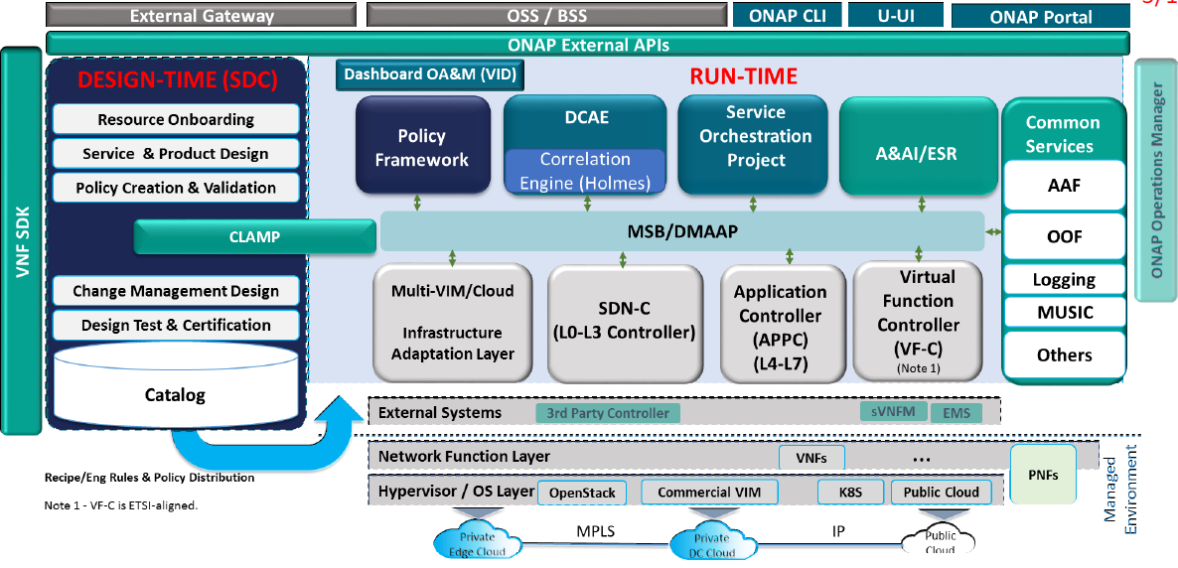
Proposed Transport Slicing changes
NSMF WFs
TSCi model
TS impl. models
NSSMF Adaptor
(IETF TSCi)
NSSMF WFs
TSCi-netServ mapping
YANG Framework Micro Service (optional)
CCVPN WF (existing)
NetServ-NetCconfig mapping
MPI
Transport Slicing changes
NetServ: IETF Service Delivery Models
NetConfig: IETF Network Config Models
TSCi: Transport Slice Connectivity Interface (draft-rokui-5g-transport-slice)
MPI: MDSC-PNC Interface (RFC8453)

Slide 19
Transport Slicing Design Requirements
Functional Requirements:
Provide a model-driven, standards-based interface for RAN controller, CN controller, and E2E NS Controller to consume Transport Slicing service
Support multi-layer (L0-L3) connections between NFs
Support connectivity of VNFs, PNFs, and mixed
Support cross-domain/cross-carrier connections
Support service isolation
Support closed-loop automation
Design Requirements:
Unified resource abstraction and management model for L0-L3 resources. This is needed for supporting multi-layer services
Interacting with NFV-MANO for managing VNF connectivity. This is needed for supporting connectivity of VNFs

Slide 20
Transport Slicing Architecture (TN-NSSMF Design)
E2E NS controller
The interfaces and the architecture that we propose mainly follow the IETF/ACTN solution, because, among the SDOs, IETF by far provides the most complete solution for Transport Slicing.
Even that said, however, we still find gaps in IETF models that we are working with them to close.
TSCi (draft-rokui-5G-transport-slice)
TN-NSSMF
(MDSC)
NSSI-to-Net-Service Mapping Function
Closed-loop Mgmt Function
Notification Mgmt Function
Service Delivery models (L1-L3)
Net-Service-to-Net-Config Mapping Function
Unified L0-L3 Resource Abstraction and Mgmt
YANG data
Unified Resource Model
TE-MPLS-tunnel
TE-topology
ACTN TE / L0/L1/L2 models
Os-Ma-Nfvo (NFV IFA 013)
IP/MPLS Domain Controller
Optical Domain Controller
NFVO
MDSC: Multi-domain Service Coordinator
NFVI: NFV Infrastructure
NFVI-PoP: NFVI Point of Presence
NFV-MANO: NFV Management & Orchestration
NFVO: NFV Orchestrator
TSCi: Transport Slice Connectivity Interface
VN: Virtual Network as defined by RFC8454
IP/MPLS Network
Optical Network
NFVI-PoP

