Slide 1


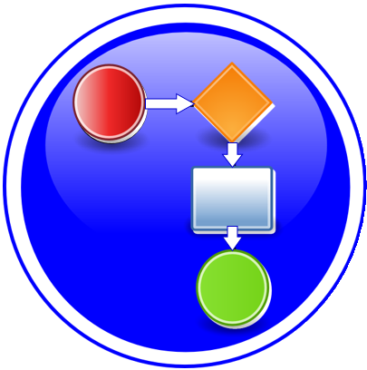


5G Service Modeling & 5G Service Creation
R6 Frankfurt Use Cases
Benjamin Cheung, PhD
July 20, 2020 version 2

Slide 2
5G Basics & 5G RAN
Benjamin Cheung, PhD

Slide 3

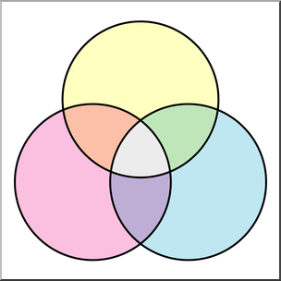












3GPP Release 15, IMT-2020 = 5G
eMBB (enhanced Mobile Broadband)
Media Anywhere
Broadband Experience Everywhere Anytime
Smart
Virtual and Augmented Reality
Connected
Remote Surgery and Examination
Smart Infrastructure
Smart City
Collaborate
Access
Interactive
Factory Automation
Smart Automated Vehicle Control
Internet of Things (IoT)
Remote Device Control
Geographically spread devices
Aware
URLLC (Ultra Reliable Low Latency Communications)
mMTC (massive Machine Type Communications)

Slide 4





5G RAN Wireless Network
SO – Service Orchestrator
SDN-C – Service Design Network Controller
DCA&E – Data Collection Analytics & Events
A&AI – Available & Active Inventory
APP-C – Application Control
ONAP Run Time Management
OSS
BSS
SO
SDN-C
DCAE
A&AI
APP-C
5G
Application
Ecosystem
RAN Network Elements
Core Network Elements
Disaggregated Core
Antenna
CU
UPF
SMF
UDM
AUSF
AMF
DU
RAU
Back Haul
RF
N
1
N
1
RU
DU
CU
Edge
Cloud
Centralized
Cloud
Internet
CPRI
Mid Haul
External Content
RAP
UE
UPF – User Plane Function
SMF – Session Management Function
UDM – Unified Data Management Function
AUSF – Authentication Service Function
AMF – Access Management Function
RU – Remote Radio Unit
DU – Distributed Unit (5G Base Unit)
CU – Centralized Unit
CPRI – Common Public Radio Interface

Slide 5
Cell
Carrier-Sector
Carrier-Sector
3GPP TS28.541
5G NRM
Carrier-Sector
Antenna
DU
RAU
CU
Carrier-Sector
RF
N
1
N
1
Carrier-Sector
RU
DU
CU
CPRI
Mid Haul
RAP
Carrier-Sector
Carrier-Sector
GROUPINGS
Kevin
What parameters are common to many functions
Super-class w/ common things and sub-class to particular functions
Configurations & groupings.
Different Domains
Are there common constructs we can use across domains.
Optical Fixed Wireless = same Information
Data Models domain focused?
Fred
RAN management – see it/ performing/ control
Performance, 28.541 as anchor
Model for gNB.
Look at other 3GPP documents to capture common for functions
Categorized to lifecycle management; instant. Rtconfig, …
Orchestration / Performance FCAPS. LCM

Slide 6
Fred F.
Bob Pape
Chris Skowronek
Chuyi Guo
Jacqueline Beaulac
Marek Kukulski
S. Ricci
Yaoguang Wang
Andy Mayer
Kevin Skaggs
f1
f1
orthogonal
f1

Slide 7
5G Service Modeling & 5G Service Creation
Benjamin Cheung, PhD

Slide 8



R7: Modeling a 5G Service
5G SERVICE
Informational
Artifacts
Deployment
Artifacts
P
Network
Function (VNF)
Policies
Configuration
Files
HEAT
Templates
Network
Function PNF
Templates
Connection
Point
Allotted NF
ANF
Blueprints
Virtual
Link
Vendor Provided
Foundational
User Designed
Resources

Slide 9
R4: 5G Base Station (gNodeB)
RAN Network Elements
DU
RAU
CU
5G SERVICE
DU
CU
(VNF)
N
1
N
N
1
1
UPF
(VNF)
AMF
(VNF)
Core Network Elements
PNF/DU #1
VNF/CU #1
Virtual Link
Conn Pt #3
Conn Pt #1
…
PNF/DU #n
Conn Pt #n
Resources

Slide 10
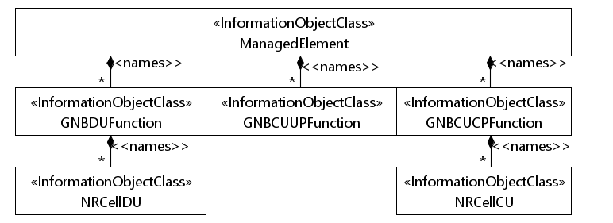
3GPP TS28.541/TS28.622 Model

Slide 11
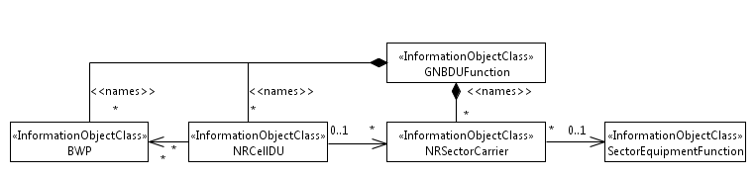
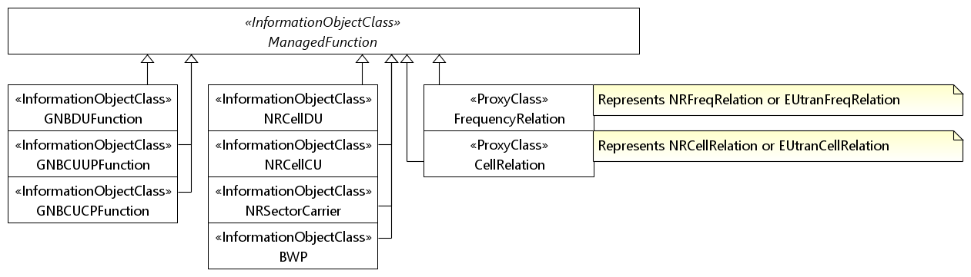
3GPP TS28.541/TS28.622 Model
ETSI Alignment R7+ U/C will introduce a CNF version of the gNB DU

Slide 12
3GPP TS28.541 Model

Slide 13
3GPP TS28.541 Model

Slide 14
PNF Descriptor Model
NetworkServiceDescriptor
*
NsdReferencesPnfd
*
Pnfd
pnfdId – Identifier [1]
provider – String [1]
version – Version [1]
security – SecurityParameters [0..1]
functionDescription – String [1]
pnfdInvariantId – Identifier
name – String [1]
NetworkFunctionDesc
ResourceDesc
1
PnfdHasPnfExtCpd
1..*
PnfExtCpd
cpdId – Identifier [1]
cpRole – String [0..1]
description – String [0..1]
cpProtocol – CpProtocolData [1..*]
trunkMode – Boolean [1]
allowedAddressData – AddressData [*]
ExtCpd
Cpd
https://wiki.onap.org/display/DW/Agreed+PNFD+Model

Slide 15
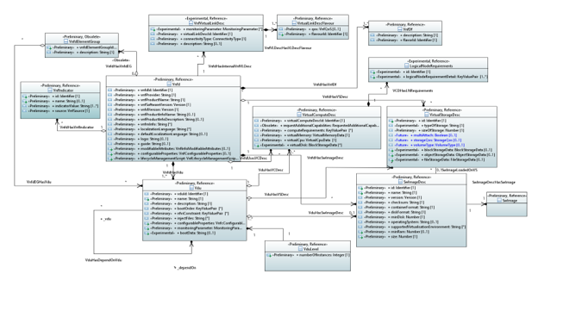
VNFD Model
https://wiki.onap.org/display/DW/Updated+V2.5.1+VNFD+Model

Slide 16
PNF A&AI Model
PnfsType
1
5000
Pnfd
pnfName – String [0..1]
pnfName2 – String [0..1]
selflink – String [0..1]
pnfName2Source – String [0..1]
pnfId – String [0..1]
equipType – String [0..1]
equipVendor – String [0..1]
equipModel – String [0..1]
managementOption – String [0..1]
orchestrationStatus – String [0..1]
ipaddressV4Oam – String [0..1]
swVersion – String [0..1]
inMaint – Boolean [0..1]
frameId – String [0..1]
serialNumber – String [0..1]
ipaddressV4Loopback0 – String [0..1]
ipaddressV6Loopback0 – String [0..1]
ipaddressV4Aim – String [0..1]
ipaddressV6Aim – String [0..1]
ipaddressV6Oam – String [0..1]
invStatus – String [0..1]
resourceVersion – String [0..1]
provStatus – String [0..1]
nfRole – String [0..1]
adminstatus – String [0..1]
opertionalStatus – String [0..1]
modelCustomizationId – String [0..1]
modelInvariantId – String [0..1]
modelVersionId – String [0..1]
pnfIpv4Address – String [0..1]
pnfIpv6Address – String [0..1]
https://wiki.onap.org/display/DW/Example%3A+PNF+in+AAI

Slide 17
SOL 001 Civic Address RFC 6225 Geolocation

Slide 18
3GPP TS32.
Some IOC of TS 28.622 are derived from IOCs in TS 28.620 (Federation Umbrella Information Module)
BR,
Jing
From: Andrianov, Anatoly (Nokia - US/Naperville)
Sent: Friday, November 22, 2019 8:29 AM
To: Cheung, Ben (Nokia - US/Murray Hill) <ben.cheung@nokia.com>
Cc: Ping, Jing (NSB - CN/Chengdu) <jing.ping@nokia-sbell.com>; Andrianov, Anatoly (Nokia - US/Naperville) <anatoly.andrianov@nokia.com>
Subject: RE: 5G Configuration / Resource Model
Hi Ben,
Yes, 5G NRM is in TS 28.541. For complete 5G picture you also need to look at TS 28.622 (generic NRM) and TS 28.632 (inventory NRM). There are several NRMs for LTE… for 5G we tried to consolidate all necessary information in one place, but as you may see (28.622 and 28.632) it’s not the case now.
-Anatoly
P.S.: I’m CC-ing Jing – she is the rapporteur of 5G NRM

Slide 19
Sources
3GPP TS28.501
3GPP
Inventory
A&AI Schema
ORAN WGx
3GPP TS32.106
ITUT X.731
Op/Admin
SDC AID
3GPP
Operational
ONAP Platform
Information Model
Complex Object
Place object
TMF GB922
Location (Place)
RFC 6225
Geo Location
3GPP TS28.620
FNIM UIM
3GPP TS28.540
5G NRM
ETSI SOL 001
Civic Address
3GPP TS28.622
Generic NRM
3GPP TS28.541
5G NRM

Slide 20
3GPP TS28.622
Generic NRM
3GPP TS28.620
FNIM, UIM
* Federated Network Information Model (FNIM) , Umbrella Information Model (UIM)

Slide 21
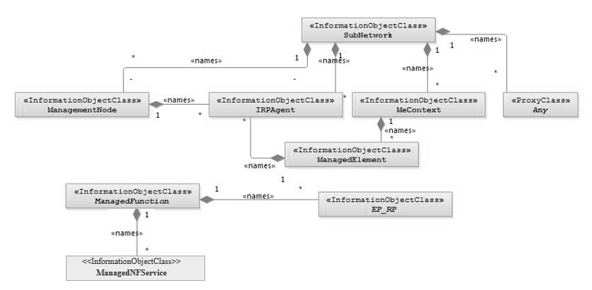
3GPP TS28.622
Generic NRM
3GPP TS28.620
FNIM, UIM

Slide 22
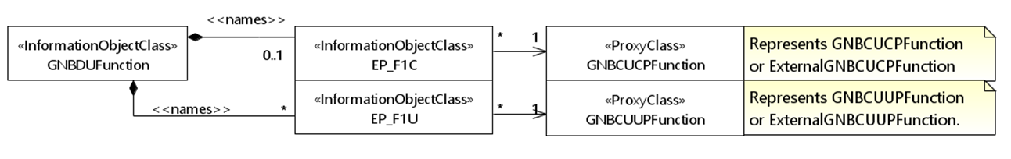
3GPP DU Models from TS28.541, 620, 622

Slide 23




Enhance Platform Information Model
3GPP TS28.540 5G NRM
3GPP TS28.541 5G NRM
3GPP TS28.620 FNIM UIM
Platform
Information
Model ++
TS28.622 Generic NRM
RUN TIME
SDN-C (etc)
DESIGN TIME
5G NRM
Generic NRM
Service CSAR
Domain & Vendor specific
C&PS Database
xNF Resource

Slide 24
Generic Application Model
3GPP TS28.540 5G NRM
3GPP TS28.541 5G NRM
3GPP TS28.620 FNIM UIM
TS28.622 Generic NRM
DESIGN TIME
RUN TIME
Service CSAR
SDN-C (etc)
Generic
Application
Model
5G NRM
Generic NRM
+ Domain & Vendor specific
C&PS Database
xNF Resource
Platform
Information
Model

Slide 25
(Zu) Use case driven, in current use cases, use SDN-C
For node configuration, C&PS stores the config data
Need to understand the application model, no other run-time component
Needs this model, so it would be nice to NOT significantly change the PlfrmInfoModel
The 3GPP model is well-defined, doesn’t make sense for ONAP to redefine it.
CNF/VNF (Fred) the generic APP-C using CDS as the modeling approach would fit this model well. Intended to
Encompass application model, and deal w/ configuration manipuatlion of application model > turn into
Specific implementations. CDS & APP-C . xNF consideration. General abstraction problem
Unification strategy to join SDN-C and APP-C into one entity. Yuriy for CDS.
CDS – GUI – define the (3GPP model) model that you can import; enable you to input the model and instance specific configuration to talk to each instance. Define models for manip application data. Define a model (importing the 3GPP model) and have the manipulation svc to implement the configuration associated w/ the xNF.
ACTION ITEM: PNF resource instantiated by ONAP. The issue of non-unification. Could interact w/ PNF. Yuriy.
(Andy) Maybe we introduce “core” sub-model to the Platform information that might accompany the G-A-M solution. Creating a “hybrid” solution, where the G-A-M serves the MAIN data model for xNFs, and this adjunct model maybe a way to SUPPLEMENT the P.I.M. w/ information that G-A-M solution falls short on, (1) isolates the changes thus there is not a big change to the P.I.M. (2) covers all the bases, “management level” that G-A-M 100% sufficient.

Slide 26
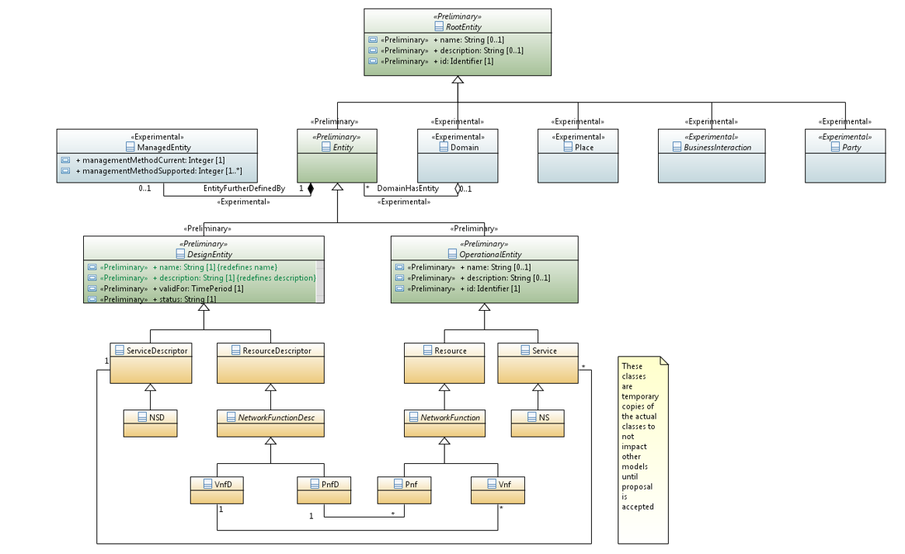

Slide 27
PNFD Model
PNFD
Logical view
5G RAN
DU:
1-N
CU
1
VNFD
CP1
CP1 to CP6: Ext connection points (e.g. Control plane, data plane, management, etc
CP7
NsVL1
CP1
CP3
CP5
CP6
CP4
CP2
NsVirtual link for each type of connection types
Note: These VL may also can represent transport network technologies used.
NsVL3
ECP7
CP7: Ext connection point(s) for network core elements.
NsVL2
NsVL1
NSD

Slide 28
Example: TOSCA Service Template
tosca_definitions_version: tosca_simple_yaml_1_2
description: 5G RAN simple example
imports:
- etsi_nfv_sol001_nsd_2_6_1_types.yaml
node_types:
tosca.5gexample_NS:
derived_from: tosca.nodes.nfv.NS
properties:
descriptor_id:
flavour_id:
topology_template:
substitution_mappings:
node_type: tosca.5gexample_NS
requirements:
virtual_link: [ CU, virtual_link_XYZ ] # the External connection point of CU
node_templates:
my_5gservice:
type: tosca.5gexample_NS
properties:
interfaces:
Nslcm:
CU:
type: tosca.nodes.nfv.5Gexample_VNF1 # this type is described in another service template
properties:
flavour_id: simple
vnf_profile:
requirements:
- virtual_link_1: NsVirtualLink_1
- virtual_link_2: NsVirtualLink_2
- virtual_link_3: NsVirtualLink_3
DU_1_to_N:
type: tosca.nodes.pnf.5gexample_DU # the description of this type is described in another service template
properties:
requirements:
- virtual_link_1: NsVirtualLink_1
- virtual_link_2: NsVirtualLink_2
- virtual_link_3: NsVirtualLink_3
- dependency: CU
NsVirtualLink_1: #
type: tosca.nodes.nfv.NsVirtualLink
properties:
connectivity_type:
vl_profile:
NsVirtualLink_2: #
type: tosca.nodes.nfv.NsVirtualLink
NsVirtualLink_3: #
type: tosca.nodes.nfv.NsVirtualLink
# omitted here for brevity

Slide 29
Creating a 5G Service
Need to create a 5G service in R6
Currently individual services can be created using VNFs and PNFs
Modeling of 5G NFs is work ongoing in Platform (Internal) Info Modeling Committee
Architecture sub-committee needs to approve modeling committee proposal before requirements can go to SDC
SDC needs to receive requirements so service models can be created
Schedule in R6 M0 (Sept 5 2019).
5G Use Case Proposed for R6.
“Target” 5G Service. Multiple options. 3GPP options 2/7/8. Based on U/C.

Slide 30
Creating a 5G Service
  Config DB (MariaDB) used by PCI-H-MS (step 4b) and OOF (step 7)
  Query API (swagger JSON spec) exposed to other ONAP modules
  cellId needs to be globally unique (assumed eCGI) and align with ONAP YANG model, ORAN, 3GPP
  pnf-name/pnf-id indicates netconf server to be used for interactions regarding cells
  ‘ho’ property added to support ANR use case
Cell (Object)
Cell_Nbr_Info (Object)
Attribute | Format
networkId | string
cellId | string
pciValue | uint64
nbrList | list of cellId
lastModifiedTS | timestamp
pnf-id | string
Attribute | Format
cellId | String
target_cell_id | String
ho | BIT(1)

Slide 31
Cell Management, Cell object, Cell Configuration
Benjamin Cheung, PhD

Slide 32
Cell Definition
DEFINITION: Cell in wireless communication technologies, the geographical region that is covered by a transmission facility. The term «cell» is most often used in reference to cellular phone technology, but it can also be used in reference to the coverage areas for transmission of cordless telephones, satellite transmissions, wireless local area networks (LANs), packet radio, and paging technologies.
https://networkencyclopedia.com/cell-in-wireless-communication/
CELL
Carrier-Sector
1
Carrier-Sector
5G Base Station
Logical Entity
that the RU services
…
Antenna
DU
RAU
CU
RF
N
1
N
1
ONAP doesn’t
Manage the RU
Per se except for
Front-haul
Carrier-Sector
RU
DU
CU
CPRI
Carrier-Sector
N

Slide 33
Cell Management
VISIBILITY / EXISTENCE OF CELL
1 USE CASES –
1a E2E Network Slicing - Slicing – xNFs involved in a slice (TA/RA), where is the “slice” stored? NSI in A&AI. Alloted NF (ANF). Slice Service.
1b OOF/SON/PCI What use cases are Using it – OOF/SON/PCI which needs to store some cell info, KPI HO success rate. CellID. What Attributes to update. Key Identifiers. Neighbor Lists.
2 EXISTENCE - does ONAP need to know of existence of Cell? What does it need to know about a Cell?
MANAGEMENT OF CELL
1 LIFE CYCLE - Life Cycle of a Cell (FCAPS); OA&M interface at ONAP (no interface) all the information related to a cell is reported/retrieved from the DU. -> ONAP command “xyz Cell” (add/del/ onboard). ONAP would not “manage” a cell at all; it would manage a DU -> rather information for a cell (adds/deletes) are covered by the C&PS database solution.
2 FUNCTION - What would it do with a Cell
3 ADD/DELETE - For add/delete Cell case -> the corresponding activity in ONAP is to add/delete C&PS database entry. The DU informs ONAP that a Cell is added/deleted, then C&PS updates database accordingly. ONAP management level to add/delete would be a configuration update.
4 MODELING - How would it Model it? (Info Model). A DU is a MOC. A Cell is a Logical object. -> No modeling is needed.
INFORMATION ABOUT CELL
1 PERFORMANCE MANAGMENT - Cell specific KPIs, PM generated & reported from DU. COUNTERS collected & reported by the DU. KPI derived from counters. ONAP doesn’t need to interact with a RU/Cell w.r.t. PM (Counters & KPI).
2 CONFIGURATION MGMT - Cell configuration info - Cell related information stored in C&PS.; Cell – A cell is a logical object. CDS. Cell related information is use case specific (PCI and E2ENS). (1) define, (2) store, (3) loop back to the xNF.

Slide 34
C&PS Database (Run-Time View)
Cell #1 – Logical Object
PNF #106
Cell #2
Cell #3
C&PS
Database
RECORD ELEMENT
INDEX = PNF #106
Parameter #1
Parameter #2
Parameter #3
Logical object, Cell #1
Cell Parameter #1
Cell Parameter #2
Cell Parameter #3
RECORD ELEMENT
INDEX = PNF #106
Parameter #1
Parameter #2
Parameter #3
State Info X.733
Associations
{ Logical Object #111 Cell #2 }
Cardinality Rules
Linking Restrictions
RECORD ELEMENT
INDEX = Logical Object #111
Parameter #1
Parameter #2
Parameter #3
State Info
Associations
{ PNF #106 } List
Cardinality Rules
Linking Restrictions

Slide 35
Appendix
Benjamin Cheung, PhD

Slide 36
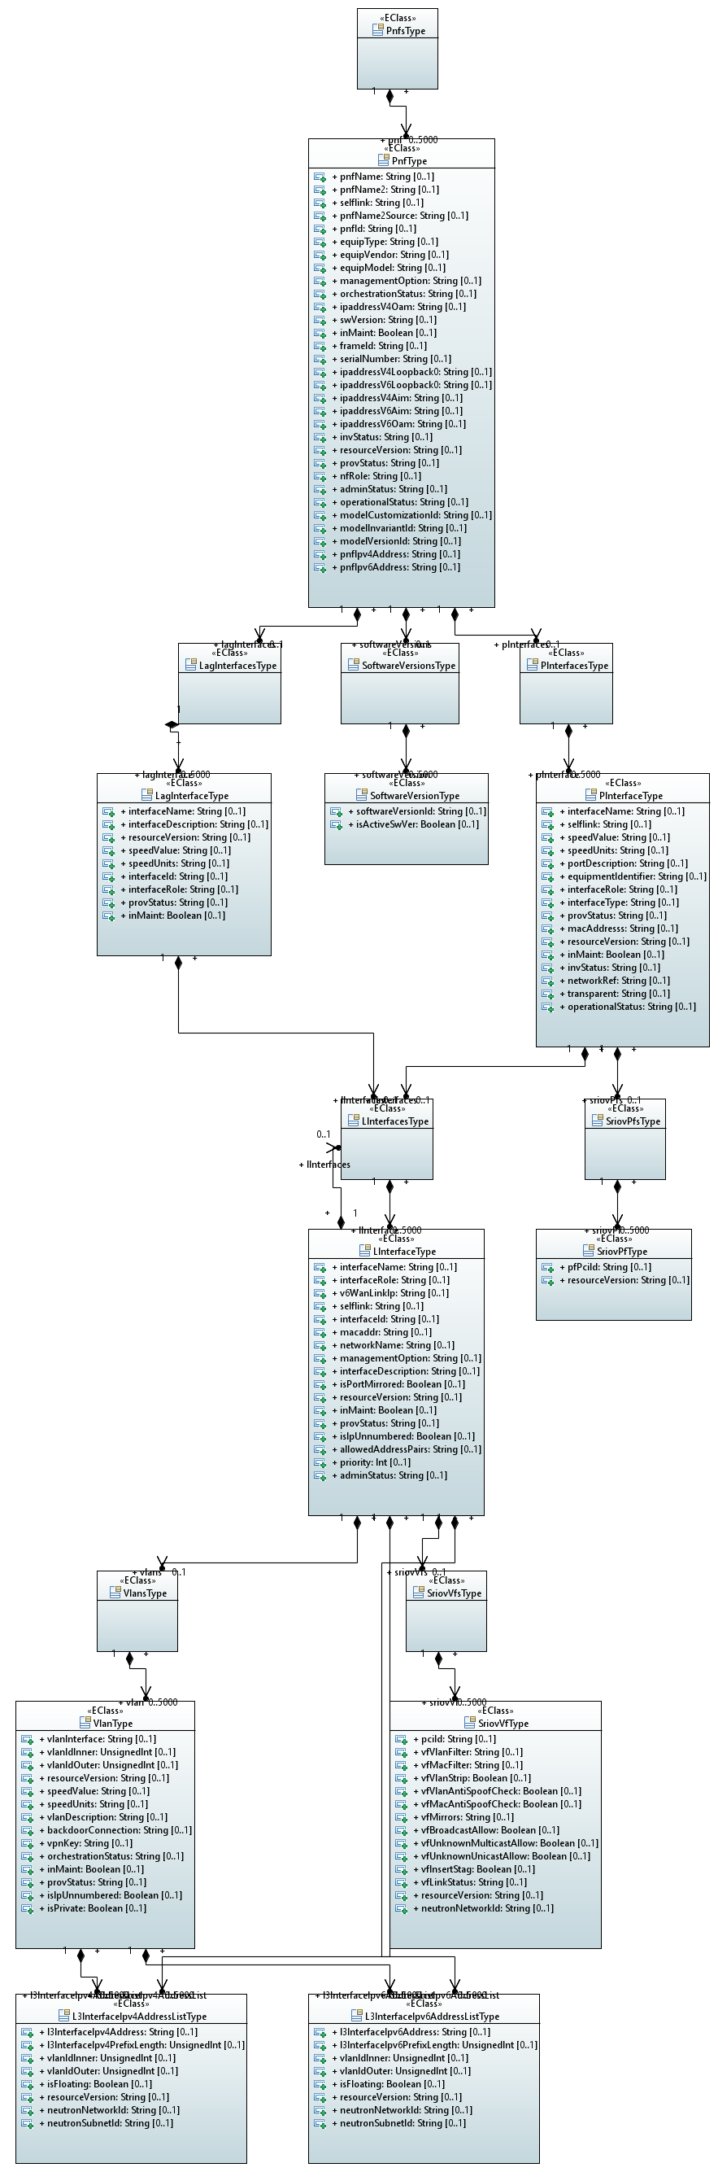
PNF (Full) A&AI Model
https://wiki.onap.org/display/DW/Example%3A+PNF+in+AAI

Slide 37
