Slide 1
ONAP VNF Requirements project Workflow
Git repos
Output Rqts List
(Spreadsheet)
Committed Code changes
Jenkins
Sphinx
Readthedocs
etc
Output Webpage
PDF
Output
docs/apis
PDF
Seed
One time artifact
Align process with docs project
Output documents generated dynamically
Rqts txt changes
vnfrqts/requirements
Commits on:
Individual requirements
Introductory text chunks
Chapters
Tables
figures

Slide 2
Structuring ONAP VNF Requirements Project Deliverables
VNF Guidelines for Network Cloud and ONAP,
VNF Management Requirements for ONAP
VNF Cloud Readiness Requirements for ONAP,
VNF Heat Template Requirements for ONAP
VNF TOSCA Template Requirements for ONAP
or
VNF Requirements for ONAP – html, pdf, spreadsheet
VNF EPICs for ONAP
VNF Use cases for ONAP
VNF Test Case Descriptions for ONAP
Or
Something else?
Release & Versioning relationships
VNF reqts docs versioned by ONAP release
Tracking support of VNF Requirements by ONAP release
  Forward looking guidelines and requirements
VNF versioning?
“features” ie groups of requirements?
Release 1 Use case alignment?
Commit points
Individual Reqts, etc.
Output documents
Branching / merging

Slide 3
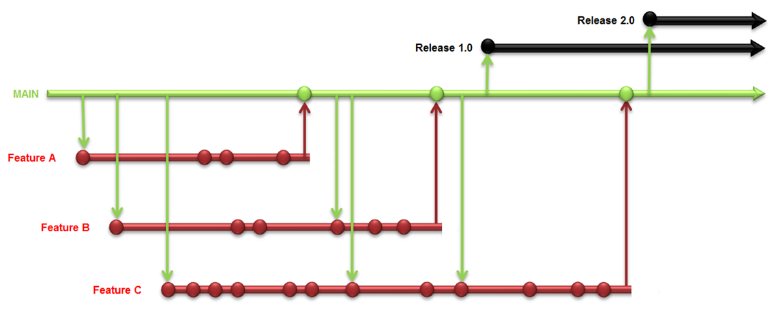
Software Configuration Management Strategy
Branch and Merge Workflow (AKA Feature Branching)
  Approach
    use a git type (github.io, gitlab.com, Atlassian Bitbucket [CodeCloud], etc.) repository
    always maintain a releasable mainline code line
    branch for every issue, feature, user story and bug fix
    if the branch becomes long lived, rebase (merges mainline changes back into the branch) the branch often
    once the branch work is complete and fully tested, merge back into the mainline and retest
Notes:
See also git’s view on branching - https://guides.github.com/introduction/flow/
the 2016 State of DevOps Report page 31 suggests the best and most effective CI/CD way is a modified Branch and Merge Workflow where the branch has a very short (1 day) lifetime before being merged back into the mainline. https://puppet.com/resources/white-paper/2016-state-of-devops-report
Atlassian uses Branch Per Issue model
https://www.atlassian.com/continuous-delivery/why-git-and-continuous-delivery-are-super-powered
https://www.atlassian.com/continuous-delivery/continuous-delivery-workflows-with-feature-branching-and-gitflow
Martin Fowler claims that feature branching makes development teams much less likely to refactor and that is the primary reason to avoid this technique.
Fowler’s solution is to force all commits to the mainline daily so that developers notice other developers making changes and then the developers are forced to communicate.
Sounds developer communication and coordination are critical regardless of the method used.
http://martinfowler.com/bliki/FeatureBranch.html
http://eugenedvorkin.com/continuous-integration-strategies-for-branching-and-merging/
https://continuousdelivery.com/2011/07/on-dvcs-continuous-integration-and-feature-branches/
http://martinfowler.com/bliki/FeatureToggle.html
http://martinfowler.com/bliki/BranchByAbstraction.html

