Slide 1
ETSI NSD Overview & TOSCA model
Thinh Nguyenphu, Nokia thinh.nguyenphu@nokia.com
August 3, 2017

Slide 2
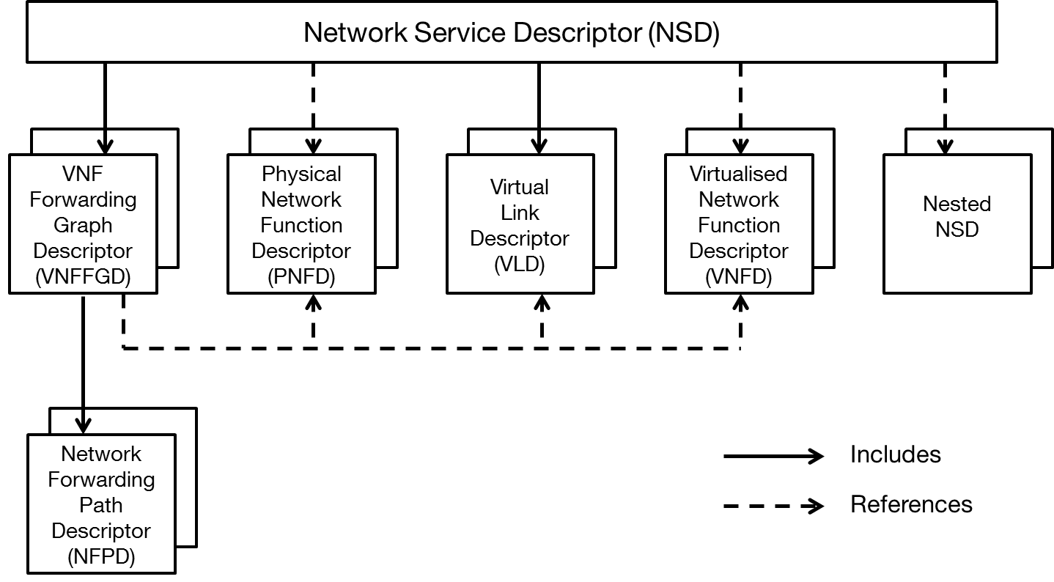
ETSI NFV: Network Service Descriptior (NSD)
Network Service Descriptor (NSD) is a deployment template which consists of information used by the NFV Orchestrator (NFVO) for life cycle management of an network service (NS).
NSD is stored by the NFVO, as part of on-boarded NSD operation.
NSD contains:
  Reference to VNFD as part of this NS
  Reference to PNFD to determin how to connect PNFs to VLs
  Reference to nested NSD
  Virtual Links Descriptors (VLD)
  VNF Forwarding Graph Descriptors and Network Forwarding Path Descriptor.

Slide 3
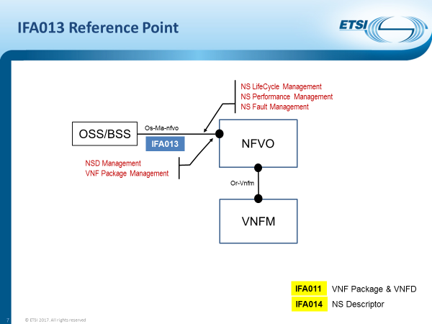
IFA013 Ref point
Ref: IFA013 tutorial, IFA013 Rapporteur, Marc Flauw

Slide 4
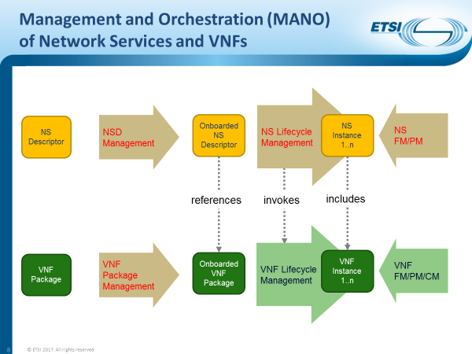
NSD and VNF managements overview
Ref: IFA013 tutorial, IFA013 Rapporteur, Marc Flauw

Slide 5
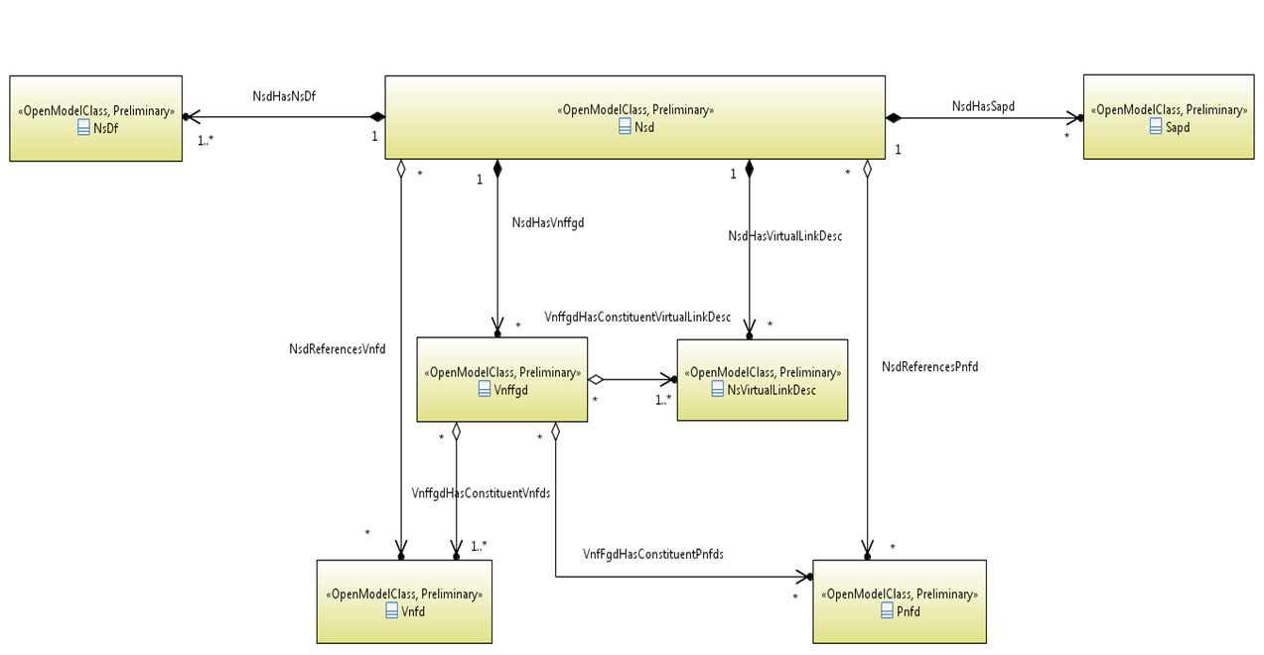
UML information diagram of NSD

Slide 6
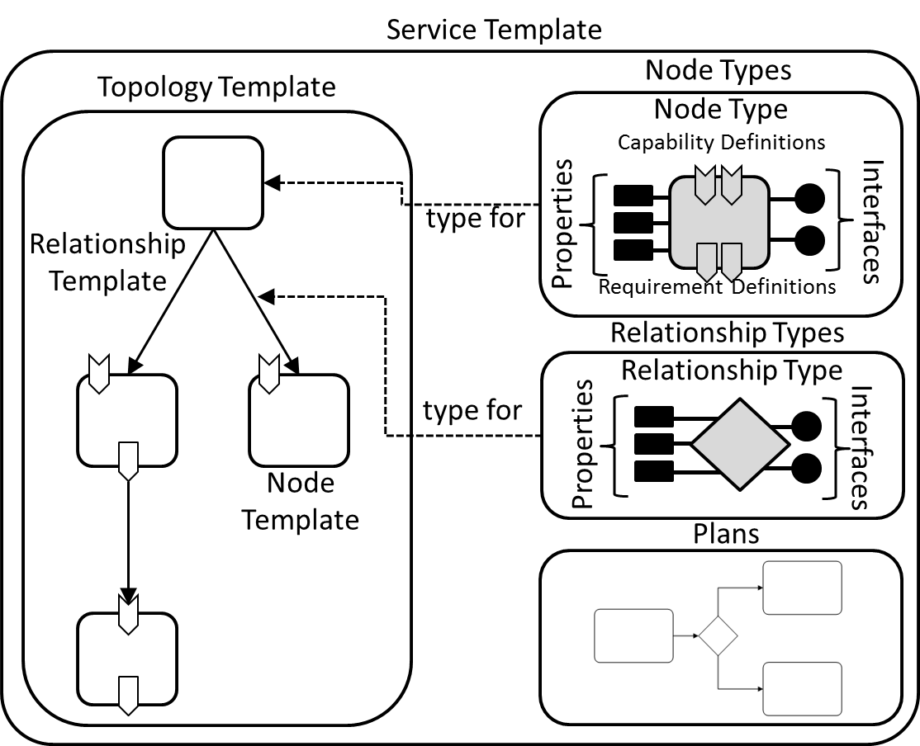

NSD: overview building blocks of TOSCA
NSD modeled in TOSCA is composed basic building blocks:
  Service Template
  Node Types
  Relationship Types
  Node Templates
  Interfaces
  Requirements
  Inputs/outputs
  Groups

Slide 7
Network connection topology of a Network
Service using VNFs, VLs, and Connection Points
CP = connection point, VL = Virtual Link
NS
VNF1
VNF2
VNF3
Service Access Point: connection point where a NS can be accessed
NOTE: A SAP can either provide access to an NS, e.g. to an end-user, or interconnect different NS.
CP4
CP5
CP6
CP8
CP10
CP7
CP11
VL1
VL2
VL4
CP1
CP14
VL3
VL1 = {CP1,CP4}
VL2 = {CP5,CP8,CP10}
VL3 = {CP6,CP7}
VL4 = {CP11,CP14}

Slide 8
VNF Forwarding Graph and Network
Forwarding Path on top of a Network Service
CP = connection point, VL = Virtual Link, VNFFG = VNF Forwarding Graph, NFP = Network Forwarding Path
NS
VNF1
VNF2
VNF3
CP4
CP6
CP5
CP8
CP10
CP7
CP11
Traffic
flow
VL1
VL2
VL4
CP1
VNFFG1:NFP1
CP14
VNFFG1:NFP2
VL3
Graph
endpoint
VNFFG2:NFP1

