Slide 1
VNFD Overview & TOSCA model
Thinh Nguyenphu, Nokia thinh.nguyenphu@nokia.com
July 27, 2017

Slide 2
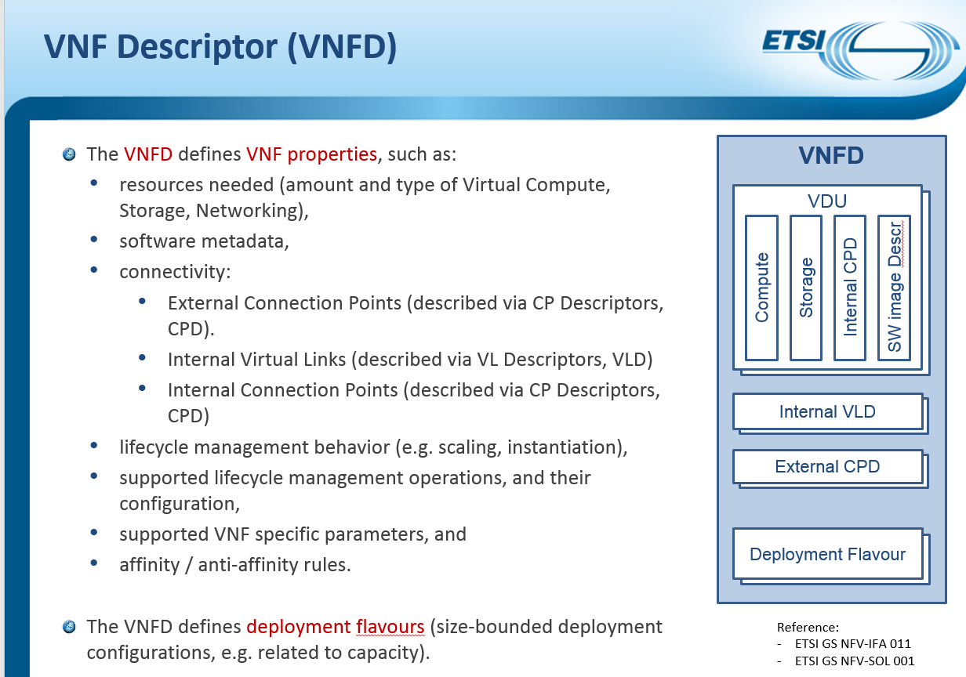
ETSI NFV: VNFD Overview

Slide 3
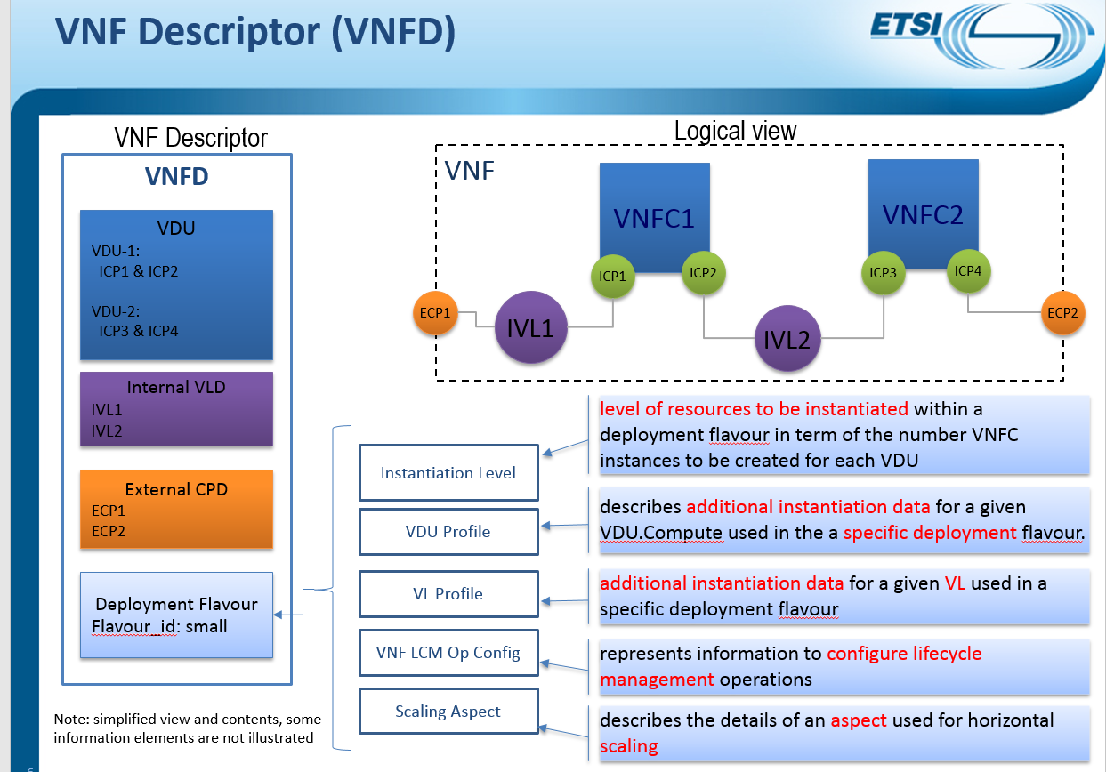
VNFD: logical and DF

Slide 4
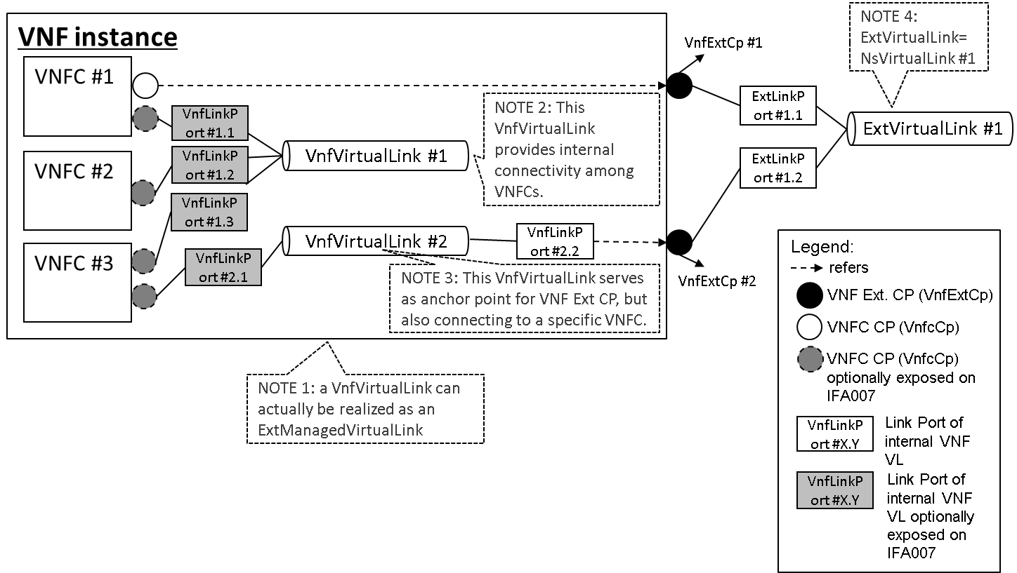
Connection point concept:
Ref: SOL003 Annex

Slide 5
VNFD with TOSCA structure overview:
topology_template
substitution_mappings (VNF)
node_templates
groups
policies
properties
requirements
capabilities
interfaces
VDU, VL,
ICP, ECP, …
Scaling
Group
1..*
*
Links for ext. connection points
Modifiable Attributes
Deployment Flavour
Lifecycle
Operation
Anti/Affinity
*
*
TOSCA template
structure
Extension
Scaling Aspect
VNFD types (IFA011)

Slide 6
tosca.node.nfv.VNF
VNF
VL
VirtualLinkTo
internalCpd
VDU.Compute
VnfVirtualLinkDesc
VduCpd
VirtualComputeDescriptor
virtualStorage
derived:
tosca.nodes.Root
cap
derived: Cpd
VDU.AttachTo
VirtualStorageDescriptor
cap
VirtualLinksTo
VirtualLinkable
req
cap
cap
VirtualBindsTo
virtual_compute
VirtualLinkable
req
virtual_compute
VirtualLinkable
artifact
interfaces
req
Virtual_storage
swImage
VirtualBindable
cap
Basic
Healable
Scalable
Custom
cap
VirtualBindable
ExtCpd
VirtualLinksTo
VduCpd
artifact
vnfExtCpd
swImage
req
cap
VduCpd
vnf
deployment_flavour
monitoring_parameter
req
VirtualLinkable
XOR
req
VitualLinkable
Under discussion
VirtualLinksTo
VL
VirtualBindable

