Slide 1
PNF Package Discussion
Ericsson

Slide 2
PNF Package
ETSI
  Introduce PNF package into ETSI NFV
  PNF / VNF package format should be aligned
ONAP
  Defining the PNF Descriptor / Package in ONAP Dublin release based on the proposed ETSI NFV PNF package format.
  Improve the ONAP VNFSDK to support PNF package
  Update the ONAP VNF requirements for PNF package
  Improve ONAP SDC to support PNF package onboarding

Slide 3
ONAP onboarding procedure
Package Delivery
Vendor provided PNFD and artifacts
Reference: SOL001, ONAP VNF requirements
Onboarding
CSAR file provided by vendor
Design time
Create VF CSAR file,
Design time catalog
Reference: SOL007
Run time
Instantiation
Run time catalog
Create Service CSAR file
Reference: SOL004, ONAP VNF requirements
Pre-Onboarding
Package Validation
Create CSAR file

Slide 4
Applicable PNF on-boarding requirements
R number | Description | Comments
R-77707 | The xNF provider MUST include a Manifest File that contains a list of all the components in the xNF package | OK. Overlapped with R-10087 in section 5.1.6.3
R-66070 | The xNF Package MUST include xNF Identification Data to uniquely identify the resource for a given xNF provider. The identification data must include: an identifier for the xNF, the name of the xNF as was given by the xNF provider, xNF description, xNF provider, and version. | Part of the descriptor
R-98617 | The xNF provider MUST provide information regarding any dependency (e.g., affinity, anti-affinity) with other xNFs and resources. | Part of the descriptor
R-22346 | The VNF package MUST provide VES Event Registration for all VES events provided by that xNF. | VES event Registration Should be applicable to PNF
R-89571 | The xNF MUST support and provide artifacts for configuration management using at least one of the following technologies; a) Netconf/YANG, b) Chef, or c) Ansible.
R-30278 | The xNF provider MUST provide a Resource/Device YANG model as a foundation for creating the YANG model for configuration. This will include xNF attributes/parameters and valid values/attributes configurable by policy.
R-27711 | The xNF provider MUST provide an XML file that contains a list of xNF error codes, descriptions of the error, and possible causes/corrective action | Not the proposed FM dictionary
R-74763 | The xNF provider MUST provide an artifact per xNF that contains all of the xNF Event Records supported. The artifact should include reference to the specific release of the xNF Event Stream Common Event Data Model document it is based on. (e.g., VES Event Listener) | VES event Listener
R-35851 | The xNF Package MUST include xNF topology that describes basic network and application connectivity internal and external to the xNF including Link type, KPIs, Bandwidth, latency, jitter, QoS (if applicable) for each interface. | Part of the descriptor?
R-26881 | The xNF provider MUST provide the binaries and images needed to instantiate the xNF (xNF and VNFC images). | Not supported by Casablanca
R-96634 | The xNF provider MUST describe scaling capabilities to manage scaling characteristics of the xNF. | Not supported by PNF
R-04298 | The xNF provider MUST provide their testing scripts to support testing. | Testing Requirements.
R-58775 | The xNF provider MUST provide software components that can be packaged with/near the xNF, if needed, to simulate any functions or systems that connect to the xNF system under test. This component is necessary only if the existing testing environment does not have the necessary simulators.
R-85653 | The xNF MUST provide metrics (e.g., number of sessions, number of subscribers, number of seats, etc.) to ONAP for tracking every license. | Only if Licensing is needed
R-40827 | The xNF provider MUST enumerate all of the open source licenses their xNF(s) incorporate.
R-85991 | The xNF provider MUST provide a universal license key per xNF to be used as needed by services (i.e., not tied to a VM instance) as the recommended solution. The xNF provider may provide pools of Unique xNF License Keys, where there is a unique key for each xNF instance as an alternate solution. Licensing issues should be resolved without interrupting in-service xNFs.
R-47849 | The xNF provider MUST support the metadata about licenses (and their applicable entitlements) as defined in this document for xNF software, and any license keys required to authorize use of the xNF software. This metadata will be used to facilitate onboarding the xNF into the ONAP environment and automating processes for putting the licenses into use and managing the full lifecycle of the licenses.

Slide 5



ONAP vender provided VNF packaging
Provided by vendor
for HEAT base template
HEAT
HEAT_VOL
Note:
This is an example of the current vendor provided VNF package to SDC for onboarding.
The files listed in the folder is example only. And not all files are listed here.
Folder / file name in blue is requested by SOL004.
Folder / file name in green is expected by ONAP.
Folder / file name in black is example only.
HEAT_NET
CSAR file
HEAT_ENV
HEAT_ARTIFACT
HEAT_NESTED
YANG_XML
MODEL_INVENTORY_PROFILE
TOSCA.meta
VNF_CATALOG
ROOT
NF descriptor
VNF_LICENSE
MainServiceTemplate.yaml
VENDOR_LICENSE
TOSCA-Metadata
Not supported by ONAP Casablanca
APPC_CONFIG
Definitions
Images
VF_MODULES_METADATA
Artifacts
Deployment
DCAE_TOSCA
MainServiceTemplate.yaml
Informational
Other
DCAE_JSON
MainServiceTemplate.mf
Copy of NF descriptor
PLAN
VFCname
metadata:
vnf_product_name: gNB
vnf_provider_id: Ericsson
vnf_package_version:1.0
vnf_release_date_time:2018-11-07T08:44-05:00
Tests
GUIDE
Any unrecognized artifacts
VFC/Deployment
VFC/Information
ChangeLog.txt
Install.csh
MainServiceTemplate.cert
…

Slide 6
Example for PNF packaging with TOSCA-Metadata
TOSCA-Meta-Version: 1.0
CSAR-Version: 1.1
Created-By: Ericsson (Zu Qiang 2018-11-15)
Entry-Definitions: Definitions/MainServiceTemplate.yaml
Entry-Manifest: MainServiceTemplate.mf
Entry-Change-Log: Artifacts/ChangLog.txt
Entry-Tests: Artifacts/Tests
Entry-Certificate: Artifacts/License_term.txt
Note:
This is an example of the package.
The files listed in the folder is example only. And not all files are listed here.
Folder / file name in blue is requested by SOL004.
Folder / file name in green is expected by ONAP.
Folder / file name in black is example only.
CSAR file
TOSCA.meta
NF descriptor
ROOT
MainServiceTemplate.yaml
Not supported by ONAP Casablanca
If HEAT is not used…
TOSCA-Metadata
Definitions
Images
Artifacts
Configuration
yang-module.yang
Deployment
Yang_module
MainServiceTemplate.yaml
Scripts
Measurements
MainServiceTemplate.mf
Tests
Events
pm-dictionary.yaml
metadata:
pnf_product_name: gNB
pnf_provider_id: Ericsson
pnf_package_version:1.0
pnf_release_date_time:2018-11-07T08:44-05:00
Copy of NF descriptor?
ChangeLog.txt
…
No ONAP requirement
MainServiceTemplate.cert
ves-dictionary.yaml
Maybe empty if no open source licenses
Install.csh
License_term.txt
…
Notes:
https://wiki.onap.org/display/DW/Csar+Structure

Slide 7
Impacts
Proposed changes to ONAP
  Update VNFSDK tool to include PNF
    VNFSDK-xxx: PNF packaging support
  Update VNF requirement documentation to include PNF package
    VNFRQTS-497: Adding xNF Package security
    VNFRQTS-498: Adding VES Event Registration requirement to PNF package
    VNFRQTS-499: PNF CSAR Package
    ?
  Update SDC to adopt PNF package requirements
    SDC-xxxx: PNF packaging support
Proposed changes to ETSI NFV
  Adding PNF package requirements to SOL004
    Extend SOL004 WI proposed: Specification of PNF Package file structure (Arturo )
    Adding PNF Package Support in SOL004 CR (Zu, …)
  Update PNFD in SOL001
opened
merged
opened

Slide 8
VNFD/PNFD/NSD properties alignment
PNFD | VNFD | NSD | Comments
descriptor_id | descriptor_id | descriptor_id
version | descriptor_version | descriptor_version | Proposed new name in PNFD: descriptor_version
provider | provider | provider
name | product_info_name | name | Better to be aligned. Proposed new name in VNFD: name
- | software_version | software_version | New in PNFD 1. Better to align with VNFD. VNFD uses software_version for only software change. descriptor_id might be changed only due to descriptor evolution itself like security adding. 2. Long-term view, it would be useful to upgrade PNF software. 3. It is also useful for service provider to get such information for OAM view like trouble-shooting, service checking, PNF packability checking and so on 4. Align with ONAP model
function_description | product_info_description | - | Proposed new name in VNFD: function_description. Add function_description into NSD
descriptor_invariant_id | product_name | invariant_id | Proposed new name in VNFD / PNFD: invariant_id
geographical_location_info | - | -

Slide 9
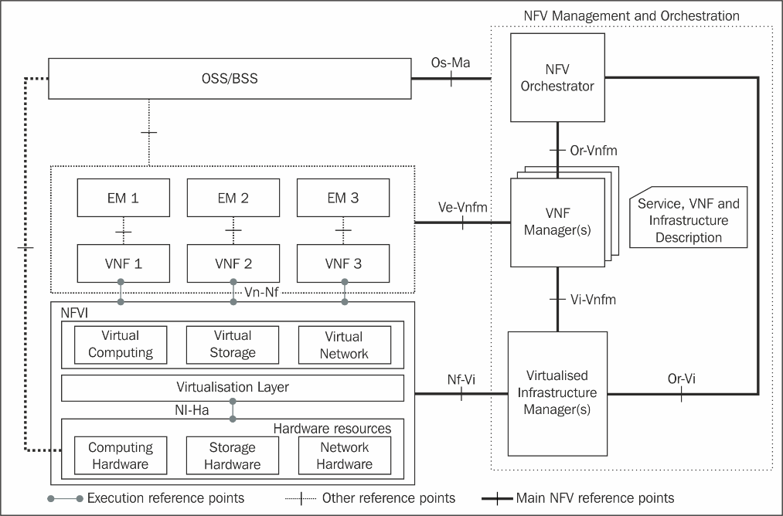
NFV Release 2: stage 2 and stage 3 specification summary
(*) Release 2 Stage 3 work items in “green”
Status as of Apr. 2018
NFV-SOL007 (NSD file structure)
PNF Descriptor impacts
NFV-IFA 015
(NFV Information Model Report)
+
NFV-IFA 016 (Papyrus Guidelines),
NFV-IFA 017 (UML Modeling Guidelines),
NFV-IFA 024 (NFV Information Model External Touchpoints)
NFV-IFA 013
NFV-IFA 010
(NFV-MANO Functional Reqs)
NFV-SOL005
SOL004
(VNF Packaging)
NFV-SOL 001
NFV-SOL 006
(VNF and NS
Descriptors)
NFV-IFA 011
(VNF Pkg)
NFV-IFA 014
(NS templates)
PNF package impacts
NFV-IFA 007
NFV-SOL 003
NFV-IFA 008
NFV-SOL 002
NFV-IFA 006
NFV-IFA 005
NFV-TST 008
(NFVI metrics)
NFV-IFA 004
(Acceleration)
Published!
NFV-IFA 002
(Acceleration)
NFV-IFA 003
(Acceleration)

Slide 10
SOL004 expanded scope option
Tentative updated SOL004 title :
“Network Functions Virtualisation (NFV) Release 2; Protocols and Data Models; VNF Package specification ”
Tentative updated scope:
The present document specifies the structure and format of a VNF package file and its constituents, fulfilling the requirements specified in ETSI GS NFV-IFA 011 [1] for a VNF package and in ETSI GS NFV-IFA 014 [x] for a PNFD.
Working schedule:
Milestone name | Target date
CR approval with expanded scope of 2.6.1 | 2018/12/07
Functional CRs approved | 2018/12/13
WG approval | 2018/12/31
TB approval | 2019/01/31

Slide 12
ETSI PNFD latest proposal (not yet approved)
Substituted by
PNFD Example service template
PNFD Example
Abstract
PNF
cap
Node
req
virtualLinkable
DependsOn
PnfExtCp_B2
cap
NsVirtualLink
Maps to
req
Node
virtualLinkable
req
virtualLinkable

Slide 13
PNFD with LCM, min add classes with separation – Modeling and files
PNFD Service template [tosca.nodes.PNF.yaml]
Vendor.PNF.types.yaml
PNFD Service template (NFV substitute) [Vendor.concrete.pnfd.yaml]
PNFD
[Vendor.PNF.1_0]
Vendor.PNF.1_0
(node type definition)
GnbPNF
[Ericsson.LcmExt.GnbPNF.1_0]
i/f
SWImage
ExtVl
(traffic)
ExtVl
(OAM)
Property x
Property y
feature
ExtVl
(traffic)
feature
ExtVl
(OAM)
DependsOn
dependency
dependency
appTrafficCp
[tosca.nodes.nfv.PnfExtCp]
appOamCp
[tosca.nodes.nfv.PnfExtCp]
Legend
tosca.datatypes.nfv.Pnf.yaml
Vendor.LcmExt.GnbPNF.1_0 (node type definition)
i/f
SW image
ExtVl
(traffic)
ExtVl
(OAM)
Class defintion
Property x
Property y
Substitution
ExtVl
(traffic)
feature
ExtVl
(OAM)
tosca.interfaces.nfv.Pnflcm.yaml
tosca.interfaces.nfv.Pnflcm
(interface type definition)
Introduced for PNF LCM in ONAP
i/f
ONAP LCM operation ( or put into ESTI scope??)
New ETSI PNF DM

