Slide 1
CSMF/NSMF Portal <-> External API Impact Assessment
Adrian O’Sullivan – Adrian.Osullivan@huawei.com

Slide 2
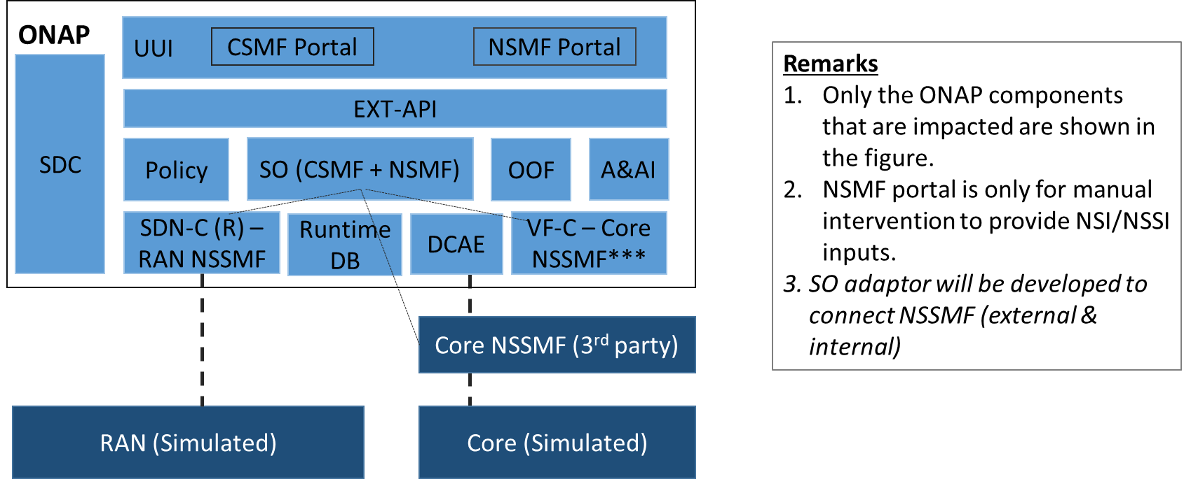
5G E2E Network Slicing Use Case ExtAPI potential Scope – Pending resource availability / specification readiness for Guilin
Focus for this ExtAPI LLD is to identify enhancement for the Communication
between CSMF & NSMF Portals and ONAP via External API for future consideration pending development resources availability
https://wiki.onap.org/display/DW/E2E+Network+Slicing+Use+Case+in+R6+Frankfurt

Slide 3
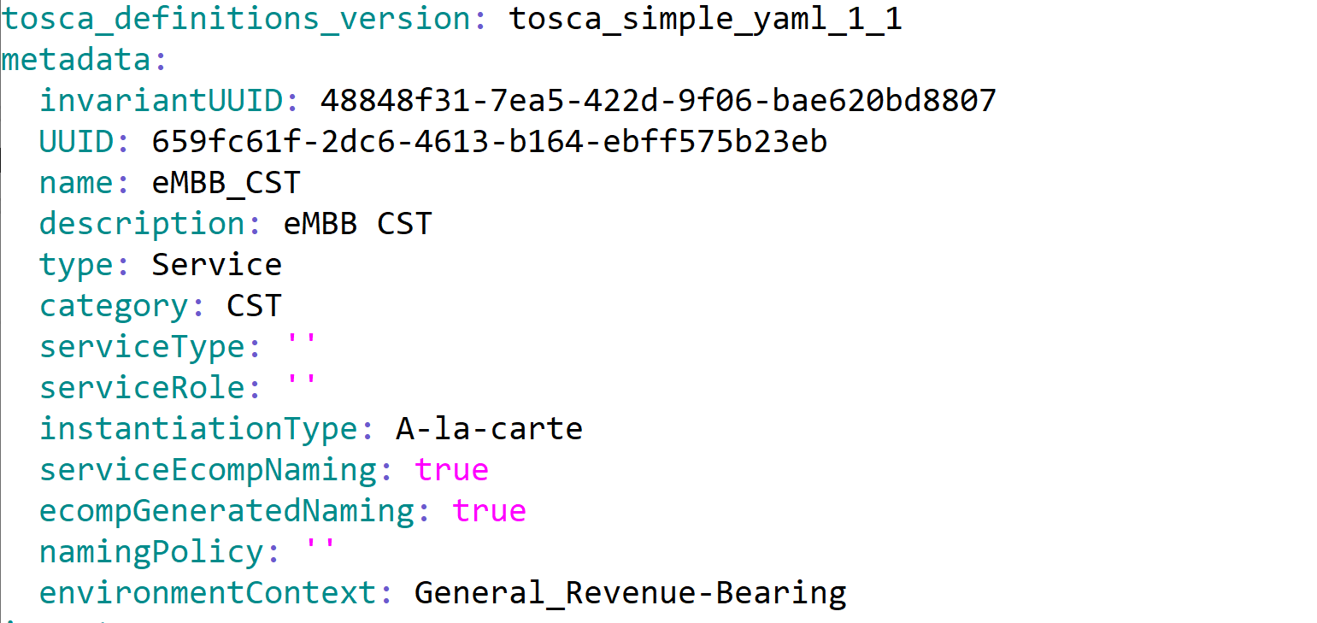
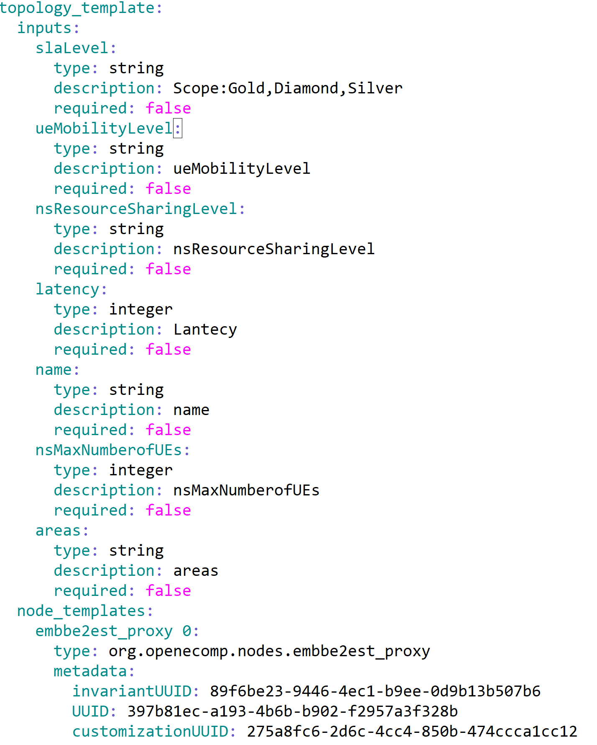
ExtAPI Interactions with 5G CST – Communication Service Template
Service Catalog & Order APIs
Reference the CST UUID
Inputs Required to Instantiate the CST will be exposed as Service Characteristics in TMF 633 and TMF 641 interfaces.
Assumption : External API Framework will interact with the top level Communication Service Template and Communication Service Template only.

Slide 4
CS Service Order from CSMF Portal -> ExtAPI
Service Order:
The CSMF Portal can optionally supply their own external tracking ID Id. ExtAPI will generate a Service Order ID that can be used to track the order in the response.
The relatedParty is set according to the CF Customer, where relatedParty.id will map to the AAI "global-customer-id“ in the “customer” object.
The serviceSpecification.id is to be set to the uuid of the CST from SDC ( i.e. this is the template for the Service we are ordering from CSMF)
The CSMF Portal needs to capture the values for the requested ServiceCharacteristics that are required as Inputs to CST Service model from SDC ( full list from modelling team )
When ready CSMF POST this JSON body to /{api_url}/nbi/api/v4/serviceOrder/
Response Includes the ServiceOrder id for tracking
NB – Currently Service Order does not support a an action ‘modify’ to activate a Service instance, i.e. no support for NSMF activate as SO API did not exist.
{
"externalId": “CSMF_Portal_TrackindId3584",
"category": “Communication Service",
"description": "Service Order for a new CS",
"priority": "1",
"relatedParty": [
{
"id": “CustomerId1", This is the customer id used in AAI Service Instance hierarchy
"role": "ONAPcustomer",
"name": “CustomerId1",
"@referredType": "Consumer"
}],
"orderItem": [
{
"id": "1",
"action": "add", Note : add here means create the CS Service Instance
"service": {
"name": “Service_1234",
“serviceType” : “CST”, Note does not exist yet, needed for AAI else defaults to template name
"serviceSpecification": {
"id": "1e3fddb0-9e36-46c6-862c-236d9c626400“ The uuid from SDC of the CST
},
"serviceCharacteristic": [ These are the Inputs for CST SDC Topology
{
"name": “slaLevel",
"value": {
"serviceCharacteristicValue": “Gold"
}
},
{
"name": “ueMobilityLevel",
"value": {
"serviceCharacteristicValue": “A"
}
}
Add whatever other Inputs we model in SDC for the CST here….
]
}
}
]
}

Slide 5
Service Order Tracking – Using REST API
CSMF Portal -> ExtAPI
{
"id": "5af2e0914bf3d66721c09c3f",
"href": "serviceOrder/5af2e0914bf3d66721c09c3f",
"state": “INPROGRESS", This is the Order State - if an order had many items then summarizes them
"externalId": “CSMF_Portal_TrackindId3584",
"category": “Communication Service",
"description": "Service Order for a new CS",
"priority": "1",
"relatedParty": [
{
"id": "CustomerId1", This is the customer id used in AAI Service Instance hierarchy
"role": "ONAPcustomer",
"name": “CustomerId1",
"@referredType": "Consumer"
}],
"orderItem": [
{
"id": "1",
"state": “INPROGRESS", This is the OrderItem State ACKNOWLEDGED/INPROGRESS/….
"action": "add",
"service": {
“id” : “c96fb8ec-8552-4956-8a8d-65680aaa57cc”, CS service instance id in A&AI
"name": “Service_1234",
"serviceState": "active",
"serviceSpecification": {
“id” ": "1e3fddb0-9e36-46c6-862c-236d9c626400“ The uuid from SDC of the CST
},
"serviceCharacteristic": [ These are the Inputs for CST SDC Topology
{
"name": “slaLevel",
"value": {
"serviceCharacteristicValue": “Gold"
}
},
{
"name": “ueMobilityLevel",
"value": {
"serviceCharacteristicValue": “A"
}
} ….. Other inputs…
}
}
]
}
Service Order Tracking:
The CSMF Portal should receive the Service Order Id which can be used for tracking the order in the service Order POST response e.g. "id": "5af2e0914bf3d66721c09c3f"
The CSMF Portal can then poll the REST API
GET /{api_url}/nbi/api/v4/serviceOrder/{orderId} To retrieve order state which indicates the Order Item Progress.
The state of the Servive Order/OrderItem for the CS will have one should be one of
ACKNOWLEDGED, REJECTED, INPROGRESS, COMPLETED or FAILED
State of OrderItem for CSMF should be the same as Service Order if only one orderItem. The orderItem is linked on a 1-2-1 basis with the service Instance for CS service. Service.id is only available once orderItem has gone from ACKNOWLEDGED to INPROGRESS, i.e. only once SO has created service instance in A&AI and started to orchestrate it
Alternatively / in Parallel the CSMF Portal can also register a listener to retrieve notifications on Service Order State Changes ( see next slide )

Slide 6
CSMF Portal: How to register External Listeners
CSMF Portal -> ExtAPI
POST
http://xx.yy.tt.rr:30274/nbi/api/v4/hub
{
"callback": "http://csmfportalhost:port/serviceOrderStateListener/listener/v1/",
"query":"eventType = ServiceOrderStateChangeNotification"
}
POST
http://xx.yy.tt.rr:30274/nbi/api/v3/hub
{
"callback": "http://csmfportalhost:port/ServiceAttributeValueChangeListener/listener/v1/",
"query":"eventType = ServiceCreationNotification,ServiceAttributeValueChangeNotification, ServiceRemoveNotification"
}
GET
http://xx.yy.tt.rr:30274/nbi/api/v4/hub
[
{
"id": "5c654c228ffdcd0001d11ba2",
"callback": "http://csmfportalhost:port/serviceOrderStateListener/listener/v1/",
"query": "eventType=ServiceOrderStateChangeNotification"
},
{
"id": "5c654d5e8ffdcd0001d11ba3",
"callback": "http://csmfportalhost:port/ServiceAttributeValueChangeListener/listener/v1/",
"query": "eventType= ServiceCreationNotification,ServiceAttributeValueChangeNotification, ServiceRemoveNotification"
}
]
Then NBI POST http://csmfportalhost:port/serviceOrderStateListener/listener/v1
{
"eventType": “ServiceOrderStateChangeNotification",
"eventDate": "2019-02-21T14:21:31.740Z",
"eventId": "34556",
“event": {"id": "5af2e0914bf3d66721c09c3f",
"href": "serviceOrder/5af2e0914bf3d66721c09c3f",
"externalId": " CSMF_Portal_TrackindId3584 ",
"state": “COMPLETED",
"orderDate": "2019-02-21T13:39:20.540Z",
"completionDateTime": "2019-02-21T13:45:39.919Z
  }
}
External API hub resource:
The CSMF Portal can register its listeners addressed for external notifications using the hub API
POST /{api_url}/nbi/api/v4/hub
To retrieve order state tracking notifications for the CSMF Portal Order tracking UI, it can provide a serviceOrderStateListener URI that ExtAPI will POST order state change events to.
To retrieve attribute change tracking notifications for the CSMF Portal Service Instance tracking UI functions, it can provide a ServiceAttributeValueChangeListener URI that ExtAPI will POST service instance attribute change events made to the CS service instance in A&AI.
The events will include a href to the object the event is associated with, which for Service Orders is a href to the ServiceOrder and for Service Inventory is a href to the Service Instance.

Slide 7


Service Inventory API REST API Sequence Diagram
ONAP
BSS
External API
SO
SDC
A&AI
GET nbi/api/v4/service/{serviceInstanceId}
GET /business/customers/customer/{global-customer-id}/service-subscriptions/service-subscription/{service-type}/service-instances/service-instance/{service-instance-id}
The BSS can access ONAP to view service instance data in relation to Service created as a result of Service Orders. This can allow a BSS to provide details on a Customer Service Instance direct to the Customer via a Self-Service. Information can include current Service Instance State, history on which Service Specification version was used to instantiate the service.
Return Service Instance Details
{ "id": "c0c28751-97d3-42d5-ae01-77566dc533dc",
"name": "SOTNVPNInfra-onap-11",
“state” : “active”
"serviceSpecification": {
"id": "462f84e5-f0e5-44c5-ab95-38fb4bf77064",
"@type": "ONAPservice"
},
"relatedParty": {
"role": "ONAPcustomer",
"id": "Orange"
},
"hasStarted": "yes“,
…….
}
{
"service-instance-id": " c0c28751-97d3-42d5-ae01-77566dc533dc ",
"service-instance-name": " SOTNVPNInfra-onap-11 ",
"environment-context": "General_Revenue-Bearing",
"workload-context": "Production",
"model-invariant-id": "f3ec9092-5c98-41f1-9fea-96be80abd064",
"model-version-id": " 462f84e5-f0e5-44c5-ab95-38fb4bf77064 ",
"orchestration-status": "Active",
………..
}
ONAP validates the Service Instance Id exists in A&AI and retrieves the corresponding service Instance details.

Slide 8

Service Inventory State Event Tracking Sequence Diagram
ONAP
BSS/OSS
External API
SO
DMaaP
A&AI
POST nbi/api/v4/hub
GET events/AAI-EVENT/{extapiconsumegroup}/{extapiconsumerid}?timeout=2000
{"callback": “http://csmfportalhost:port/serviceStateListener/listener/v1/",
“query”:”eventType=ServiceAttributeValueChangeNotification”}
POST events/AAI-EVENT
{“id”: “58673”, "callback": "http://csmfportalhost:port/ServiceAttributeValueChangeListener/listener/v1/",
“query”:”eventType=ServiceAttributeValueChangeNotification”}
ONAP A&AI once a Service Instance has been modified will publish an event to the DMaaP kafka bus on topic AAI-EVENT, i.e. act as a publisher. External API shall add a new consumer to the AAI-EVENT Topic and once events arrives will filter/transform and notify valid OSS/BSS external listeners.
BSS/OSS Registers Listener
to be notified automatically of ONAP
Service Inventory Changes.
This allows for example the BSS to update the customer automatically when the Customers Service Instance(s) is modified
POST http://bbsportalhost:port/serviceStateListener/listener/v1/"
{"event": {"eventType": “ServiceAttributeValueChangeNotification",
…. "event": {"id": " as34-rf11",
"href": “service/{serviceinstanceId}”,
"name": "SOTNVPNInfra-onap-11",
“state” : “active”,
…..
}
GET nbi/api/v4/service/{serviceinstanceId}
{ "id": "c0c28751-97d3-42d5-ae01-77566dc533dc",
"name": "SOTNVPNInfra-onap-11",
“state” : “active”
"serviceSpecification": {
"id": "462f84e5-f0e5-44c5-ab95-38fb4bf77064",
"@type": "ONAPservice"
},
…….
}
GET /business/customers/customer/{global-customer-id}/service-subscriptions/service-subscription/{service-type}/service-instances/service-instance/{service-instance-id}
BSS/OSS can also poll ONAP Service Inventory at any time allowing for example a Self Service UI Portal to display Service Instance State.
{
"service-instance-id": " c0c28751-97d3-42d5-ae01-77566dc533dc ",
"service-instance-name": " SOTNVPNInfra-onap-11 ",
"orchestration-status": "Active",
………..
}

Slide 9
CSMF Portal - Service Inventory View
CSMF Portal -> ExtAPI
Retrieve a specific service instance
GET http://extapihost:port/nbi/api/v4/service/c96fb8ec-8552-4956-8a8d-65680aaa57cc
{
"id": " c96fb8ec-8552-4956-8a8d-65680aaa57cc", the CS CFS Service Instance Id
"name": “Service_1234",
"@type": "serviceONAP",
"supportingResource": [], currently service resources are not retrieved by ExtAPI in Casablanca
"serviceSpecification": {
"id": "462f84e5-f0e5-44c5-ab95-38fb4bf77064", This template was used to instantiate the instance
“name”: “CS Template Name”,
"invariantUUID": "88dcb2f0-085b-4548-8b93-0882e37d25d8",
"@type": "ONAPservice"
},
“state”: “active”, This is the current Service State of the CS service instance, orchestration-status in AAI
"relatedParty": {
"role": "ONAPcustomer“
“id”: “CustomerId1", This is the customer Id used in the Order & AAI Service Instance hierarchy
},
"type": "service-instance"
}
Or get a list of all Service Instances for a customer using
GET http://extapihost:port/nbi/api/v4/service/?relatedParty.id=CustomerId1
External API Service Inventory API:
The CSMF Portal can retrieve the state of a service instance via a GET request to
http://extapihost:port/nbi/api/v4/service/{id}
The CSMF Portal , for each Consumer ( Customer.id ) can retrieve a list of services and their corresponding states using GET request to
http://extapihost:port/nbi/api/v4/service/?relatedParty.id={customerId}
NB As of El Alto, very limited data can be retrieved via service Inventory. Perhaps for Frankfurt CSMF Portal may want to access AAI directly

Slide 10
Service Inventory ServiceAttributeValueChangeNotifications ( EXTAPI-98 ) ExtAPI -> BBS Portal
The CSMF Portal will be able to register a listener for ServiceAttributeValueChangeNotifications using the ExtAPI hub resource.
POST http://xx.yy.tt.rr:30274/nbi/api/v3/hub
The CSMF Portal needs to provide an API that ExtAPI can POST service attribute change events to.
External API Framework will register as a Consumer of DMaaP AAI-EVENT topic
When AAI “service-instance” entity is updated, the entity action from A&AI will be “UPDATE”. For example when the state of the CS Service instance changes, the change will be caught by ExtAPI and forwarded to the external listener, which in the 5G Use case could be the CSMF Portal. The CSMF Portal may keep some level of Service Instance State
Example format of what the event may look like is shown on the right.
POST
http://xx.yy.tt.rr:30274/nbi/api/v4/hub
{
"callback": "https://csmfportalhost:port/ServiceListener/listener/v1/",
"query":"eventType = ServiceCreationNotification,ServiceAttributeValueChangeNotification, ServiceRemoveNotification"
}
GET
http://xx.yy.tt.rr:30274/nbi/api/v4/hub
[
{
"id": "5c654d5e8ffdcd0001d11ba3",
"callback": "https://csmfportalhost:port/ServiceListener/listener/v1/",
"query": "eventType=ServiceCreationNotification,ServiceAttributeValueChangeNotification, ServiceRemoveNotification"
}
]
Then NBI POST http://csmfportalhost:port/ServiceListener/listener/v1
{
"eventType": “ServiceAttributeValueChangeNotification",
"eventDate": "2019-02-21T14:21:31.740Z",
"eventId": "34557",
“event": {“id": " c96fb8ec-8552-4956-8a8d-65680aaa57cc",
“href” : “service/ c96fb8ec-8552-4956-8a8d-65680aaa57cc”
“name”: “Serice_1234”,
“state”: “active”,
“type”: “service-instance”
"relatedParty": {
“id”: “CustomerId1",
“name”: “CustomerId1”
}
  }
}

Slide 11
CS Service Order from NSMF Portal -> ExtAPI
Service Order:
The NSMF Portal can optionally supply their own external tracking ID Id. ExtAPI will generate a Service Order ID that can be used to track the order in the response.
The relatedParty is set according to the CF Customer, where relatedParty.id will map to the AAI "global-customer-id“ in the “customer” object.
The serviceSpecification.id is to be set to the uuid of the CST from SDC ( i.e. this is the template for the Service we are ordering from CSMF)
The CSMF Portal needs to capture the values for the requested ServiceCharacteristics that are required as Inputs to CST Service model from SDC ( full list from modelling team )
When ready CSMF POST this JSON body to /{api_url}/nbi/api/v4/serviceOrder/
Response Includes the ServiceOrder id for tracking
NB – Currently Service Order does not support a an action ‘modify’ to activate a Service instance, i.e. no support for NSMF activate as Activate/Deactivate E2EService Instance SO API does not exist yet.
{
"externalId": “CSMF_Portal_TrackindId3584",
"category": “Communication Service",
"description": "Service Order for a new CS",
"priority": "1",
"relatedParty": [
{
"id": “CustomerId1", This is the customer id used in AAI Service Instance hierarchy
"role": "ONAPcustomer",
"name": “CustomerId1",
"@referredType": "Consumer"
}],
"orderItem": [
{
"id": "1",
"action": “modify", Note : here we can to activate the Service Instance, i.e. modify state
“updateType” : “activate”, note this does not exist in 641 Spec but is in ETSI SOL 005
"service": {
“id”: “5c3feee0-6e36-46c6-862c-236d9c626422” service instance id in aai we want to activate
"serviceSpecification": {
"id": "1e3fddb0-9e36-46c6-862c-236d9c626400“ The uuid from SDC of the CST
},
"serviceCharacteristic": [] assumed no characteristics needed for activate call to SO ???
}
}
]
}
Note for action modify with an updateType, External API Framework would also need be build the JSON transformations into whatever the new SO Activate/Deactivate APIS for the Network Slice are ( these are yet to be designed built, hence, this translation layer shall have to come after SO API Design completed.

Slide 12
Other Possible future Externally exposed ONAP APIs.
ONAP R7 + ( Specification focus only )

Slide 13


Performance Mgmt API Sequence Diagram – New API
ETSI SOL 005 PM APIs / TM Forum 628
ONAP
BSS/OSS/CSMF/NSMF Portal
External API
SO
A&AI
DCAE/Controllers
POST nbi/api/v3/pm/pm_jobs/
{
"objectInstanceIds": [“serviceInstanceId"],
"criteria": {
"performanceMetric": [“Jitter”, “Latency”],
"performanceMetricGroup": [""],
"collectionPeriod": 0,
"reportingPeriod": 0,
"reportingBoundary": "2018-12-03T16:58:48.091Z“
…..
}
}
POST so/infra/e2eServiceInstances/v3/pm/pm_jobs
{
"objectInstanceIds": [“serviceInstanceId"],
"criteria": {
"performanceMetric": [“Jitter”, “Latency”],
"performanceMetricGroup": [""],
"collectionPeriod": 0,
"reportingPeriod": 0,
"reportingBoundary": "2018-12-03T16:58:48.091Z“
…..
}
}
Check Service Instances Filter
ONAP allows external systems to create Performance Mgmt Jobs. The creation of PMJob will involve any necessary configuration in the controllers (APP-C/VF-C/SDN-C) depending on the node types the Performance Metrics are attached to, and creation in DCAE of the necessary data collection and data router configurations for PM Reports storage.
Allowing BSS/OSS/CSMF/NSMF Portal the ability for performance measurement job creation, notification and collection. This capability enables the BSS to collect and show Service Instance specific performance data reports. For example the BSS can offer a customer self service portal where the customer can view performance data related to their service instances.
Create PM collection job in DCAE
Link PMJob to service Instance(s)
“id”:”pmJobId”,
"objectInstanceIds": [“serviceInstanceId"],
"criteria": {
"performanceMetric": [“Jitter”, “Latency”],
…..
"reports": {
"href": "string",
"readyTime": "2018-12-03T16:58:48.176Z",
This feature may impact
SDC, SO, ExtAPI, A&AI, DCAE
VF-C, APP-C – Extensive Impact
GET nbi/api/v3/pm/pm_jobs/{pmJobId}/reports/{reportId}
GET report based on ReportId from DCAE
{"entries": [ {
"objectType": "string",
"objectInstanceId": "string",
"performanceMetric": “Jitter",
"performanceValues": [{
"timeStamp": "2018-12-03T17:04:57.582Z",
"value": 34 ,…….
……
{"entries": [
{ "objectType": "string",
"objectInstanceId": "string",
"performanceMetric": “Jitter",
"performanceValues": [
{
"timeStamp": "2018-12-03T17:04:57.582Z",
"value": …..
} …….
ONAP allows retrieval of specific Performance Reports from External Systems.
Availability of the Report made via Notifications

Slide 14
Performance Mgmt API Operations
The operations that may be provided through this interface if compliant with TMF 628 / ETSI SOL 005 Perfomance Management Specification include:
• Create PM Job
• Query PM Job
• Delete PM Job
• Create Threshold
• Query Threshold
• Delete Threshold
• Subscribe
• Query Subscription Information
• Terminate Subscription
• Notify
Each operations require significant effort, in ONAP Core components ( such as DCAE to support PM Job creation, deletion etc.
After Operation support comes Notification support which may include:
filesReady, filesPreparationError, adhocCollectionJobAVCN, measurementCollectionJobAVCN
measurementCollectionJobOCN, measurementProductionJobOCN,
measurementCollectionJobODelN, measurementProductionsJobODelN
Notification creations and handling software

Slide 15
Thanks

