Slide 1
ExtAPI impacts for E2E Network Slicing use case
Swaminathan S
Jan 20, 2020

Slide 2
Use case: Architectural Scope For Frankfurt
Slice Service/Network Slice instantiation and (de)activation, with core slice sub-net (RAN – stretch goal as PoC, under discussion)
Notes
CSMF and NSMF are within ONAP.
Core NSSMF is external to ONAP.
RAN NSSMF (stretch goal) as PoC within ONAP, RAN NSSMF functionality is simplified greatly as we adopt a bottom-up approach (i.e., all virtual resources are already instantiated and initial configuration done).
UUI
ExtAPI
SDC
SO
OOF
CSMF WFs
NSMF WFs
AAI
NSSMF Adaptor
NSSMF WFs
Policy
SDN-C (R)
ONAP
Part of Scenario 1 (NSSMF in ONAP)
Core NSSMF
CSMF
NSMF
External NSSMF
Internal NSSMF - under discussion
Part of Scenario 4 (NSSMF outside ONAP)

Slide 3
Frankfurt Scope
Service Instantiation Request (Service Order API)
  Will be integrated with UUI and SO
  Minor enhancement to Service Order API (serviceType)
Stretch Goal: Service Activation Request - ExtAPI implementation alone (postman based trigger), no integration with UUI
  Service Order API enhancements to be discussed further, and will be part of future release (not in Frankfurt)

Slide 4
CS Service Order from UUI (CSMF Portal) -> ExtAPI
{
"externalId": “CSMF_Portal_TrackindId3584",
"category": “Communication Service",
"description": "Service Order for a new CS",
"priority": "1",
"relatedParty": [
{
"id": “CustomerId1", This is the customer id used in AAI Service Instance hierarchy
"role": "ONAPcustomer",
"name": “CustomerId1",
"@referredType": "Consumer"
}],
"orderItem": [
{
"id": "1",
"action": "add", Note : add here means create the CS Service Instance
"service": {
"name": “Service_1234",
“serviceType” : “CST”, Note does not exist yet, enhancement as optional parameter
"serviceSpecification": {
"id": "1e3fddb0-9e36-46c6-862c-236d9c626400“ The uuid from SDC of the CST
},
"serviceCharacteristic": [ These are the Inputs for CST SDC Topology
{
"name": “slaLevel",
"value": {
"serviceCharacteristicValue": “Gold"
}
},
{
"name": “ueMobilityLevel",
"value": {
"serviceCharacteristicValue": “A"
}
}
]
}
}
]
}
serviceType introduced as optional parameter
Notes
serviceType attribute is defined in TMF 641 v18.5.1.
serviceType is introduced as an optional field to avoid impacts to other existing use cases.

Slide 5
CS Service Order from CSMF Portal -> ExtAPI
ExtAPI will generate a Service Order ID that can be used to track the order in the response.
The relatedParty is set according to the CF Customer, where relatedParty.id will map to the AAI "global-customer-id“ in the “customer” object.
The serviceSpecification.id is to be set to the uuid of the CST from SDC ( i.e. this is the template for the Service we are ordering from CSMF)
The CSMF Portal needs to capture the values for the requested ServiceCharacteristics
When ready CSMF POST this JSON body to /{api_url}/nbi/api/v4/serviceOrder/
Response Includes the ServiceOrder id for tracking

Slide 6
Service Order Tracking – UUI (CSMF Portal) -> ExtAPI
{
"id": "5af2e0914bf3d66721c09c3f",
"href": "serviceOrder/5af2e0914bf3d66721c09c3f",
"state": “INPROGRESS", This is the Order State - if an order had many items then summarizes them
"externalId": “CSMF_Portal_TrackindId3584",
"category": “Communication Service",
"description": "Service Order for a new CS",
"priority": "1",
"relatedParty": [
{
"id": "CustomerId1", This is the customer id used in AAI Service Instance hierarchy
"role": "ONAPcustomer",
"name": “CustomerId1",
"@referredType": "Consumer"
}],
"orderItem": [
{
"id": "1",
"state": “INPROGRESS", This is the OrderItem State ACKNOWLEDGED/INPROGRESS/….
"action": "add",
"service": {
“id” : “c96fb8ec-8552-4956-8a8d-65680aaa57cc”, CS service instance id in A&AI
"name": “Service_1234",
"serviceState": "active",
"serviceSpecification": {
“id” ": "1e3fddb0-9e36-46c6-862c-236d9c626400“ The uuid from SDC of the CST
},
"serviceCharacteristic": [ These are the Inputs for CST SDC Topology
{
"name": “slaLevel",
"value": {
"serviceCharacteristicValue": “Gold"
}
},
{
"name": “ueMobilityLevel",
"value": {
"serviceCharacteristicValue": “A"
}
} ….. Other inputs…
}
}
]
}
The CSMF Portal should receive the Service Order Id which can be used for tracking the order in the service Order POST response e.g. "id": "5af2e0914bf3d66721c09c3f"
The CSMF Portal can then poll the REST API
GET /{api_url}/nbi/api/v4/serviceOrder/{orderId} To retrieve order state which indicates the Order Item Progress.
The state of the Servive Order/OrderItem for the CS will have one should be one of
  ACKNOWLEDGED, REJECTED, INPROGRESS, COMPLETED or FAILED
  ACKNOWLEDGED - NBI has received the request but SO BPMN has not yet started
  REJECTED - NBI has rejected the Order, reasons given in order message, for example the order specifies a ServiceSpecification id that does not exist in SDC.
  INPROGRESS - NBI has sent the request to SO and SO is processing it
  COMPLETED - SO has finished and indicated it has “finished” Success
  FAILED - SO has finished and indicated “error” failure

Slide 7



Service Inventory State Event Tracking Sequence Diagram
ONAP
BSS/OSS
External API
SO
DMaaP
A&AI
POST nbi/api/v4/hub
GET events/AAI-EVENT/{extapiconsumegroup}/{extapiconsumerid}?timeout=2000
{"callback": “http://csmfportalhost:port/serviceStateListener/listener/v1/",
“query”:”eventType=ServiceAttributeValueChangeNotification”}
POST events/AAI-EVENT
{“id”: “58673”, "callback": "http://csmfportalhost:port/ServiceAttributeValueChangeListener/listener/v1/",
“query”:”eventType=ServiceAttributeValueChangeNotification”}
ONAP A&AI once a Service Instance has been modified will publish an event to the DMaaP kafka bus on topic AAI-EVENT, i.e. act as a publisher. External API shall add a new consumer to the AAI-EVENT Topic and once events arrives will filter/transform and notify valid OSS/BSS external listeners.
BSS/OSS Registers Listener
to be notified automatically of ONAP
Service Inventory Changes.
This allows for example the BSS to update the customer automatically when the Customers Service Instance(s) is modified
POST http://bbsportalhost:port/serviceStateListener/listener/v1/"
{"event": {"eventType": “ServiceAttributeValueChangeNotification",
…. "event": {"id": " as34-rf11",
"href": “service/{serviceinstanceId}”,
"name": "SOTNVPNInfra-onap-11",
“state” : “active”,
…..
}
GET nbi/api/v4/service/{serviceinstanceId}
{ "id": "c0c28751-97d3-42d5-ae01-77566dc533dc",
"name": "SOTNVPNInfra-onap-11",
“state” : “active”
"serviceSpecification": {
"id": "462f84e5-f0e5-44c5-ab95-38fb4bf77064",
"@type": "ONAPservice"
},
…….
}
GET /business/customers/customer/{global-customer-id}/service-subscriptions/service-subscription/{service-type}/service-instances/service-instance/{service-instance-id}
BSS/OSS can also poll ONAP Service Inventory at any time allowing for example a Self Service UI Portal to display Service Instance State.
{
"service-instance-id": " c0c28751-97d3-42d5-ae01-77566dc533dc ",
"service-instance-name": " SOTNVPNInfra-onap-11 ",
"orchestration-status": "Active",
………..
}

Slide 8
Thank You!

Slide 9
CS Service Order Activation from UUI -> ExtAPI
Stretch Goal (PoC)
No integration with UUI
Service Order:
The NSMF Portal can optionally supply their own external tracking ID Id. ExtAPI will generate a Service Order ID that can be used to track the order in the response.
The relatedParty is set according to the CF Customer, where relatedParty.id will map to the AAI "global-customer-id“ in the “customer” object.
The serviceSpecification.id is to be set to the uuid of the CST from SDC ( i.e. this is the template for the Service we are ordering from CSMF)
The CSMF Portal needs to capture the values for the requested ServiceCharacteristics that are required as Inputs to CST Service model from SDC ( full list from modelling team )
When ready CSMF POST this JSON body to /{api_url}/nbi/api/v4/serviceOrder/
Response Includes the ServiceOrder id for tracking
NB – Currently Service Order does not support a an action ‘modify’ to activate a Service instance, i.e. no support for NSMF activate as Activate/Deactivate E2EService Instance SO API does not exist yet.
{
"externalId": “CSMF_Portal_TrackindId3584",
"category": “Communication Service",
"description": "Service Order for a new CS",
"priority": "1",
"relatedParty": [
{
"id": “CustomerId1", This is the customer id used in AAI Service Instance hierarchy
"role": "ONAPcustomer",
"name": “CustomerId1",
"@referredType": "Consumer"
}],
"orderItem": [
{
"id": "1",
"action": “modify", Note : here we can to activate the Service Instance, i.e. modify state
“updateType” : “activate”, note this does not exist in 641 Spec but is in ETSI SOL 005
"service": {
“id”: “5c3feee0-6e36-46c6-862c-236d9c626422” service instance id in aai we want to activate
"serviceSpecification": {
"id": "1e3fddb0-9e36-46c6-862c-236d9c626400“ The uuid from SDC of the CST
},
"serviceCharacteristic": [] assumed no characteristics needed for activate call to SO ???
}
}
]
}
Note for action modify with an updateType, External API Framework would also need be build the JSON transformations into whatever the new SO Activate/Deactivate APIS for the Network Slice are ( these are yet to be designed built, hence, this translation layer shall have to come after SO API Design completed.

Slide 10
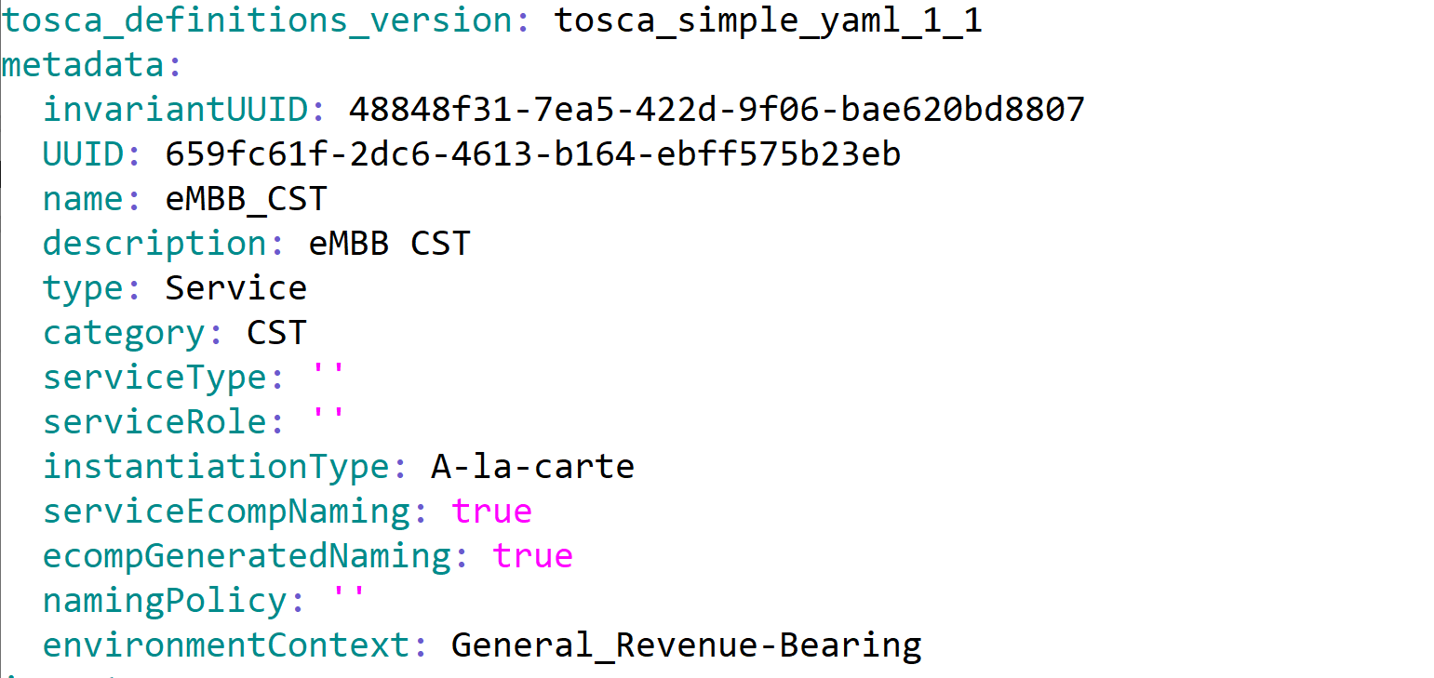
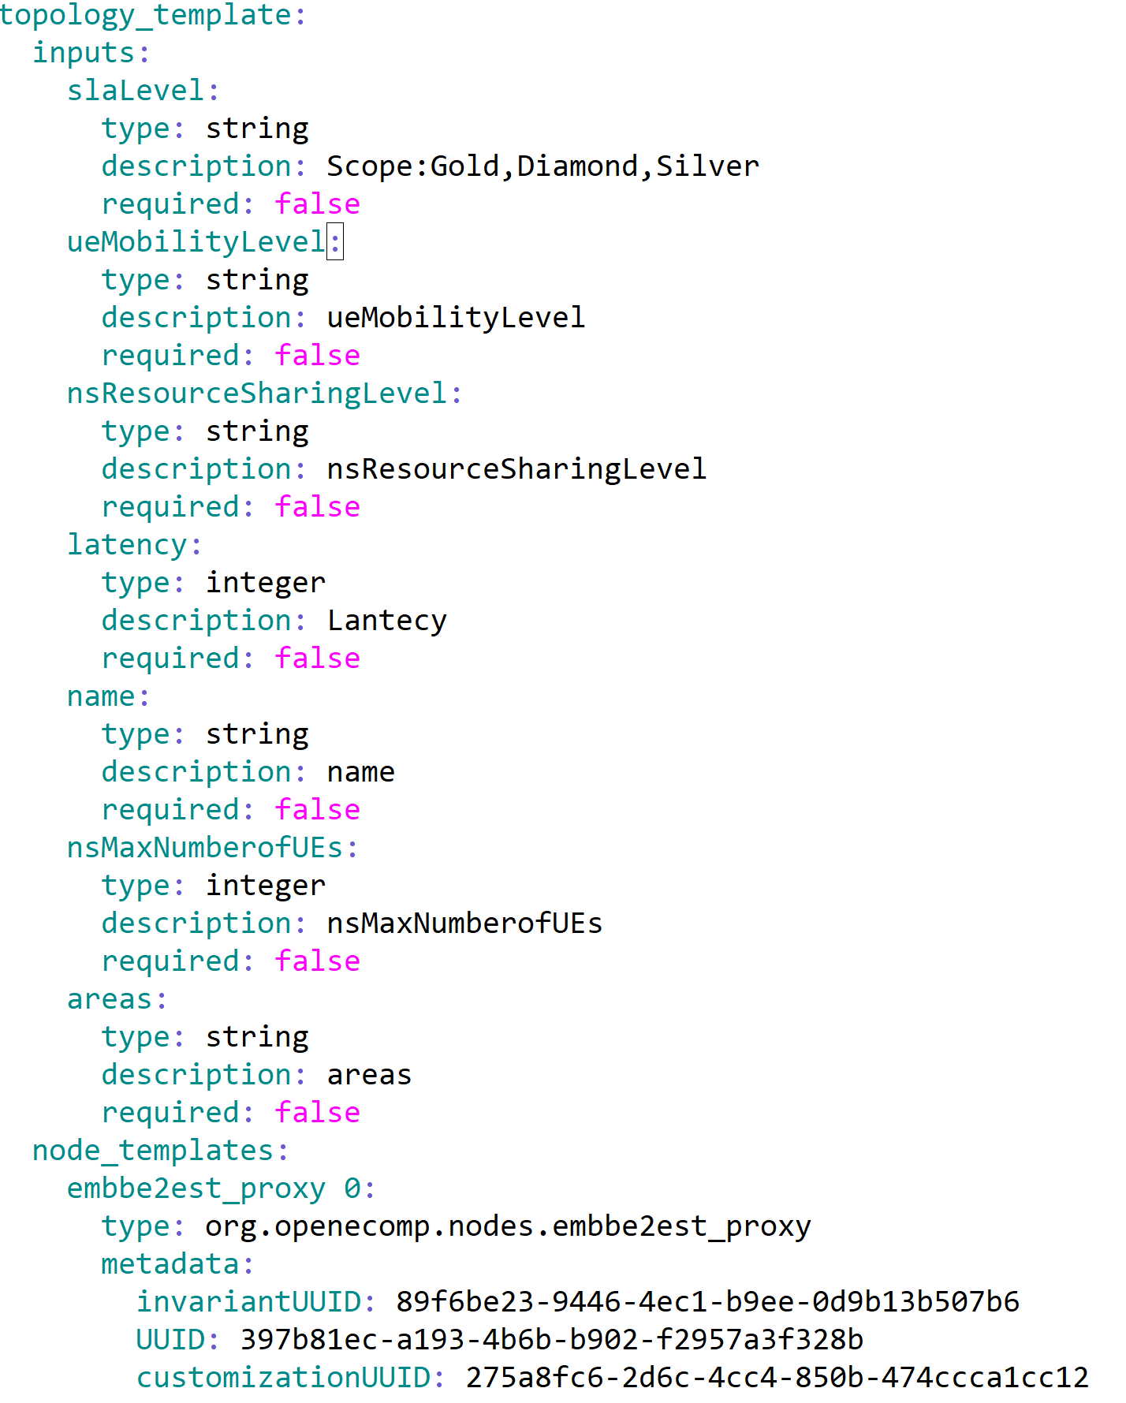
ExtAPI Interactions with 5G CST – Communication Service Template
Service Catalog & Order APIs
Reference the CST UUID
Inputs Required to Instantiate the CST will be exposed as Service Characteristics in TMF 633 and TMF 641 interfaces.
Assumption : External API Framework will interact with the top level Communication Service Template and Communication Service Template only.

