Slide 1
EXTAPI Model Driven ONAP
30 August 2017
Andy Mayer, Ph.D.

Slide 2
Topics
General Model Driven Approach
Role of External APIs in Model Driven ONAP

Slide 3
Model Driven Approach in ONAP
Traditionally, introducing new network elements, new products, and new services require long software development cycles
A key objective is to eliminate these long cycles by:
    Standards to establish common ways provide lifecycle management of VFs in support of operational integration
    Abstractions to support new types of Services and VFs with minimal changes
    Machine learning and generic ways to monitor the infrastructure
    Standard functions with fixed inputs and outputs that are tunable via metadata
    Models and processes that are designed, distributed, and interpreted by the execution environment

Slide 4
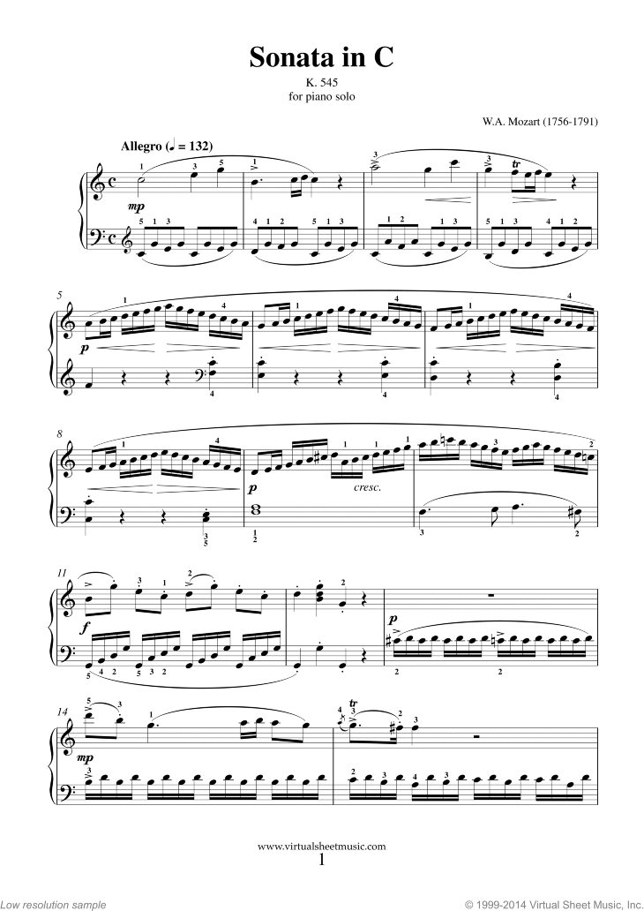

Model Driven Analogy
  The Score
  The Performer
  The Music
New pieces of music can be performed by the musician, and changes can be made to existing piece of music.
Symbols used to write the music are well-defined.

Slide 5





The Model Driven Paradigm
Models
Execution Engines
Behaviors
Resource definition
Service composition
Product models
Lifecycle models (Operational Integration)
Processes and policies
Optimization rules
Software images
Orchestration
Policy execution
Data movement
Data storage
Coded algorithms
Control
Standard data models
Real-time service delivery
Elastic scalability
Self-optimizing
Self-healing

Slide 6
Inter-relationship between
Services and Network Functions
Service
Design
Designed
Service
Descriptor
Service
Instantiation
Instantiated
Service
Service
Lifecycle
Management
VNF On-Boarding
VNF
Instantiation
VNF
Package
VNF
Descriptor
Instantiated
VNF
Resource
Lifecycle
Management

Slide 7

Role of External APIs in Model Driven ONAP
The Story
6. BSS/OSS builds Products based on Service Descriptors
7. Based on a Product Order, BSS/OSS requests Service instantiation based on Service Descriptor
8 . SO uses Service Parameters from request and corresponding Service Recipe to instantiate the Service
5. BSS/OSS retrieves Service Descriptors from the Catalog
1. VNF Package with VNFD is On-Boarded into SDC
ONAP Portal – Design Studio & Dashboard
BSS/OSS
Design-time (SDC)
Run-time
Lab Integration & Certification
ONAP Operations Management (OOM)
External Data Movement & APIs
Modeling (specs & Utilities)
Resource Onboarding
A&AI
DCAE
Policy
2. SDC designs a service using the VNFD.
Design includes Service Descriptor and Service Recipes
VNF SDK
Service & Product Design
Orchestration Framework
Active / Available
Analytic µServices
Runtime Policy Execution Engine
Service Orchestration
Entitlements
CDAP
Holmes
…
Policy Creation & Validation
Resource Orchestration
Resource / Service Topology
Data Distribution
Analytic Application Design
ESR
Data Collection Layer
Common
Service
Catalog
DMaaP
AAF
Logging
Micro Services Bus
Testing & Certification
Products
Services
SDN-C
gVNF-Controller (prev. App-C)
Resources
Policies
Multi-VIM
L0-3 Network Controller
L4-7 Generic VNF Controller
4. Service Descriptors are made available via the Catalog
Eng. Rules
Analytics
Model Driven
Infrastructure
Adaption Layer
Config
Database
Service Logic
Interpreter
Life Cycle Mgmt DGs
Config Database
Service Logic Interpreter
Life Cycle Mgmt func.
Recipe / Engineering Rules & Policy Distribution
Adaption Layer
Open
Stack
AWS
Azure
3rd Party Network
controller
Standard & sVNFM Adaption Layer
Netconf
Yang
CLI
Chef
Netconf
Ansible
Vendor A
Vendor B
sVNFM
EMS
3. Service Recipes are distributed to ONAP components (i.e. SO)
VNF 1
VNF 2
VNF n
PNF
VNF x
Infrastructure
OpenStack
VMware
RackSpace
Azure
......

