Slide 1
EXTAPI-102: ExtAPI E2E Enhancement Low level design
Adrian O’Sullivan / Adrian.osullivan@huawei.com
Marios Iakovidis / marios.Iakovidis@huawei.com

Slide 2


Service Order API E2E Use Case Support in Casablanca
BSS
TMF/MEF LEGATO External Open APIs
BSS or other ONAP Instance
ONAP Platform
Internal APIs
Create Service Order (TMF641)
HTTP POST https://{api_url}/nbi/api/v1/serviceOrder/
Create Service Order (TMF641)
HTTP POST https://{api_url}/nbi/api/v1/serviceOrder/
Currently : ONAP External API Framework
In Beijing uses the VID orientated API to instantiate a Service Instance{{so_url}/serviceInstances/v4}. However there was no E2E Use Case provisioning using External APIs, i.e. to create a Service and the underlying resources and connectivity. To instantiate and E2E service such as VoLTE/CC VPN, SO uses {{so_url}}/e2eServiceInstances/v3 API.
Proposal : To allow a Service Order instantiate both an E2E Services for CCVPN/VoLTE or a Service Instance like vFW/vCPE the External API Framework the ExtAPI needs to be updated to support also calling the {{so_url}}/e2eServiceInstances/v3 APIs, as SO does not one consolidated SO APIs yet
External API Framework
External API Framework
POST {{url}}/e2eServiceInstances/v3
&&
POST {{url}}/ecomp/mso/infra/serviceInstances/v4
POST {{url}}/ecomp/mso/infra/serviceInstances/v4
SO
SO
ONAP Beijing Flow
Proposed ONAP Casablanca Flow

Slide 3
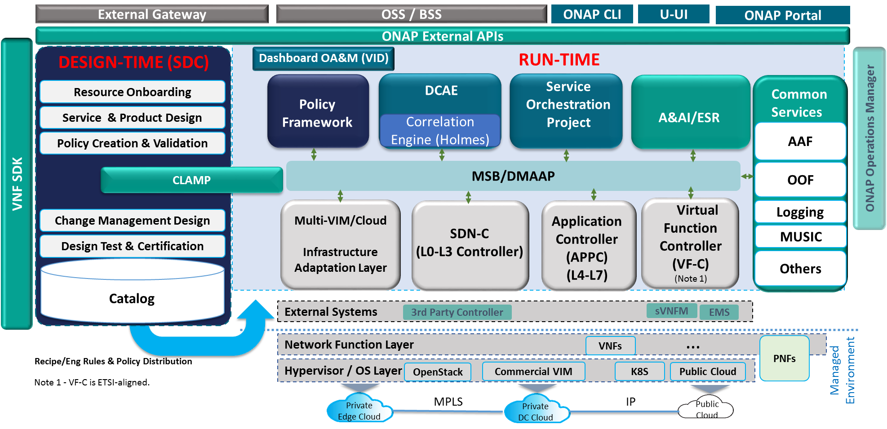

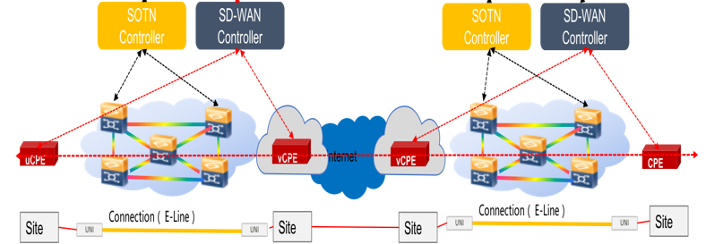
CC VPN – Impacts on ONAP to Support INTERLUDE
INTERLUDE (SOF:SOF)
Simplest approach is for the Service Orchestrator to request the new Access Service from a Partner using the Partners ONAP External API Framework. The Service Order TMF 641 API can be used to create the Access Service request to the Partner . The Originating ONAP SO can create (add) , modify or delete the Partners Access Service through the External API Framework Service Order APIs

Slide 4



ExtAPI Design: CC VPN Service Order E2E Framework & Flow
1
Customer configures the E2E Service to be delivered using the UUI Portal
ADD ExtAPI Support for SO
POST {{so_url}}/e2eServiceInstances/v3
GET {{so_url}}/e2eServiceInstances/v3/{serviceId}/operations/{operationId} APIs
Service Order API (TMF641)
Interlude reference points
3
External API
External API
UUI
2
SO
A&AI
SO
Create Partner Access service instance using e2eServiceInstances SO API
4
Create E2E service instance
SDN-C
SDN-C
1
2
New Requirements on ONAP External API Framework:
To Allow a Service Order to instantiate both an E2E Service like CC VPN or VoLTE or a Service Instance like vFW/vCPE. i.e. to support point 4 on the above diagram, the southbound request to SO needs to be able to be transformed into {{so_url}}/e2eServiceInstances/v3 API format for the creation of the CC VPN E2E Service Instances.
SO on ONAP Instance 1 will require the ability to request the completion status of the Service Order on ONAP Instance 2 to. External API Framework SO polling mechanism need to be update to support the GET {{so_url}}/e2eServiceInstances/v3/{serviceId}/operations/{operationId} APIs from SO

Slide 5
Development Plan: Tasks and Dependencies
Tasks
Group | Feature list | Component | Development Tasks | Priority | Workload (Kloc) | Development Mode Analysis | Remarks
ExtAPI | Base Framework Requirement | Support E2E API structure | Create new JSON model to support E2E JSON structure required by SO Create new class to send E2E JSON payload Need to implement Service and Resource level attribute handling miss-match for E2E API, i.e. how to pass resource level requestInputs parameters, when the incoming JSON only have service level parameters ( via Service Characteristcics ) | HIGH | 1 | Contribute | Planned for September demo
ExtAPI | Base Framework Requirement | Support E2E Service Instance Creation Progress | Add support to monitor the E2E Service Instance creation progress through Service Order API ( TMF 641). This shall allow SO in ONAP instance 1 to know the service state on ONAP instance 2 for the service created in the partner domains ONAP instance. SO has a separate API for E2E Service Instance progress so_url/e2eServiceInstances/v3/{serviceId}/operations/{operationId} | MEDIUM | 1 | Contribute | Planned for September demo
Dependencies
Si No | Requirement | Dependencies | Owner | Status | Remark
1 | Handling of inbound->outbound JSON mapping between SO and ExtAPI | Existing ExtAPI implementation for Service expects SO to have the ability to map CFS to RFS, which is currently not the case in SO. Need to use SDC Catalog to find resources belonging to the Service. | ExtAPI & SO | In-Progress | Mapping Spreadsheet have been created and shared with SO team members.
2 | As SO supports 2 types of Service Instances, we need the Service Catalog to mark which instantiation method applied to which service | Dependency that SDC allows External API to distinguish between E2E Services and all other services. External API framework is required to know which SO APIs to call based on the Service Specification in SDC. Assumption that SDC uses Category beginning with E2E for E2E services. | ExtAPI & SO & SDC | In-Progress | All CC VPN Services are created in SDC in the category of “E2E Services”

Slide 6
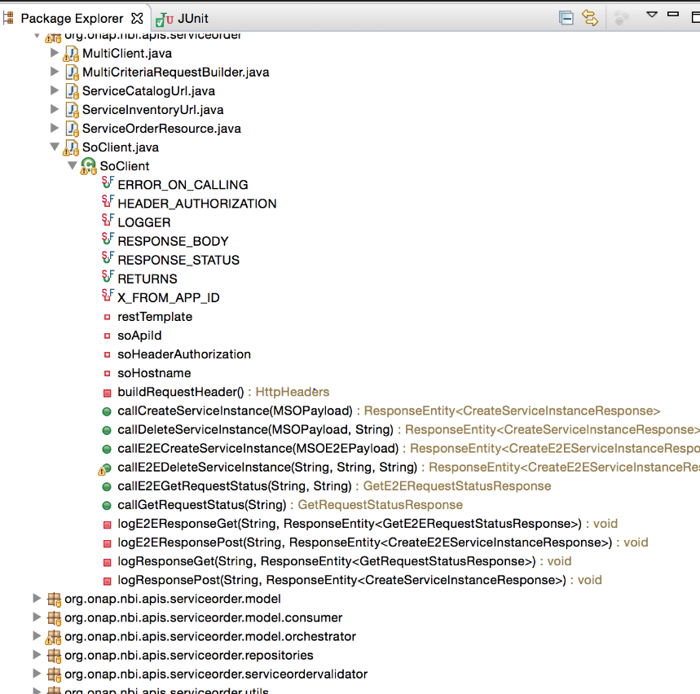
ExtAPI – E2E Development: Additional support for E2E Services within SOClient
New Development:
In OnapComponentsUrlPaths add MSO_CREATE_E2ESERVICE_INSTANCE_PATH = "ecomp/mso/infra/e2eServiceInstances/v3"
In ModelInfo add private String modelCategory and toString modelCategory
Add new class (file) ServiceModel to support the e2eJSON
Add new class (file) MSOPayloadE2E to send the e2eJSON payload
SOTaskProcessor in processOrderItem we check if category.startsWith("e2e")
In SoClient add new method callE2ECreateServiceInstance adding URL MSO_CREATE_E2ESERVICE_INSTANCE_PATH
Created files marked in red boxes to provide the E2E JSON model within Ext API Framework

Slide 7


Conversion required within the ONAP External API Framework.
External TMF 641 JSON sent to External API
Service Order API
{
"externalId": "ONAP1_SO_3584",
"category": "Network Service",
"description": "Service Order for SOTN Infrastructure from SPpartner",
"requestedStartDate": "2018-04-05T17:20:11.978Z",
"requestedCompletionDate": "2018-04-05T17:20:11.978Z",
"priority": "1",
"@type": null,
"@baseType": null,
"@schemaLocation": null,
"relatedParty": [{
"id": "Customer1",
"href": null,
"role": "ONAPcustomer",
"name": "Customer1",
"@referredType": "Consumer"
}],
"orderItem": [{
"id": "1",
"action": "add",
"service": {
"name": "SOTNServiceName",
"serviceState": "active",
"serviceSpecification": { "id": "1e3fddb0-9e36-46c6-862c-236d9c626400" },
"serviceCharacteristic": [{ "name": "access-provider-id",
"value": { "serviceCharacteristicValue": "ey64eg-8374hfhf" }
},
{ "name": "access-client-id",
"value": { "serviceCharacteristicValue": "sjydfherrv-3774hf" }
}]
}
}]
}
{ "service":{
"name": “SOTNServiceName",
"description": "Service for SOTN Infrastructure from SPpartner",
"serviceInvariantUuid": " 1e3fddb0-9e36-46c6-862c-236d9c626399",
"serviceUuid": " 1e3fddb0-9e36-46c6-862c-236d9c626400",
"globalSubscriberId":“Customer1",
"serviceType": “SOTN",
"parameters": {
"resources" :[
{
"resourceName":"vFW-SINK",
"resourceInvariantUuid": "6e3feeb0-8e36-46c6-862c-236d9c626438",
"resourceUuid":"2e3feeb0-8e36-46c6-862c-236d9c626438",
"parameters":{
"locationConstraints": []
}
}
],
"requestInputs":
{
"access-provider-id": "1234765",
“access-client-id": "654321"
}
}
}
}
External API Framework
Service Order API
Internal ONAP JSON Format Sent from
External API Framework to ONAP SO

Slide 8
ServiceOrder Mapping LLD
Please view attached Excel for mappings required by SO firstly to Compose a ServiceOrder to send to External API Framework which is the Worksheet called “SO->ExtAPI” i.e. how SO is required to build the TMF 641 based ServiceOrder JSON to send to the External API Framework on ONAP Instance 2.
The second Worksheet called “ExtAPI->SO” if the required translation mapping that External API Framework needs to perform to send the create e2eServiceInstances request to SO in SO ONAP internal format.

Slide 9
Mapping Assumptions
1) "resourceName", "resourceInvariantUuid", "resourceUuid",
Can be obtained via the existing ExtAPI calling sdcClient to retrieve from resourceSpecification details from the SDC catalog
2) “requestInputs” will be taken from incoming Service Order Service Characteristics. Service Characteristics are at service level, proposed workaround would be to map serviceCharacteristics to SO e2eServiceInstances API service.parameters.requestInputs and let SO take what params it needs for each resource from here as per the VoLTE example.
3)LocationConstraints can be populated by the Ext API application.properties ( as was done for Beijing ). Clarification received from SO team is that LocationContstraints can be empty for CC VPN Service Orders
4) “Service” level parameters can be taken directly from the incoming Service Order JSON and from SDC Catalog
5) operationId returned from the SO POST will be stored in the External framework along with the serviceId in the ServiceOrderItem JSON in the MongoDB. This is needed to allow External API framework to query SO for progress of order using SO API {so_url}/e2eServiceInstances/v3/{serviceId}/operations/{operationId}
It is assumed we can re-use the existing Beijing ServiceOrderItem.requestId attribute to store the operationId for E2E Services.
6) External API Framework can use the category of the ServiceSpecification from SDC to distinguish an E2E service from all other Services. i.e. in SDC an E2E service has to be created within a Category “E2E Service” i.e. the “category” returned from https://{sdc_url}/sdc/v1/catalog/services/{uuid}/metadata URI. This is required from SDC so that the External API framework knows which flavour of the SO APIs it needs to use in communication with SO, i.e.
{{so_url}}/e2eServiceInstances/v3 for E2E Services||
{{so_url}}/ecomp/mso/infra/serviceInstances/v4 for all other Services.

Slide 10
Query Service Order Progress
ONAP External API Framework will need to maintain the relationship between the ServiceOrderItem operations/action ( create / delete / modify ) and SO’s internal operationId that SO uses to track progress of operations.
For SO to query the progress of a ServiceOrder on partners the ONAP Instance, SO will HTTP GET to
  https://{ExtApi_url}/nbi/api/v1/serviceOrder/{id} where ExtAPI_url is the External API Framework on ONAP Instance 2
  Where the id is the ServiceOrder.id the External API framework returned to the POST request to create the Service Order.
Internally in the External API Framework, External API will maintain a map between ServiceOrder.ServiceOrderItem.requestId & ServiceOrder.ServiceOrderItem.service.id. ServiceOrder.ServiceOrderItem.requestId is the Id that the Beijing External API maintains for communicating with the second set of SO APIs “/ecomp/mso/infra/orchestrationRequests/v4/{requestId”
i.e. we shall set requestId = operationId for E2E Services within the ServiceOrderItem.java
The External API framework will retrieve the ServiceOrder.ServiceOrderItem.requestId & ServiceOrder.ServiceOrderItem.service.id associated with this ServiceOrder.id and then internally query the SO of ONAP Instance 2 for E2E Services using
  GET {serverRoot}/e2eServiceInstances/v3/{serviceId}/operations/{operationId} via the SOTaskProcessor pollSoRequestStatus enhanced method
SO on ONAP instance 1 can call GET https://{api_url}/nbi/api/v1/serviceOrder/{id} to retrieve the status of the ServiceOrder
The response to SO in ONAP instance 1 will contain the ServiceOrder.OrderItem.state, which will be one of “ACKNOWLEDGED”, “REJECTED”, “INPROGRESS”, “COMPLETED”, “PARTIAL”, “FAILED”
  SO can use this ServiceOrder.OrderItem.state to know when the SerivceOrderItem is completed.
ServiceOrder.state exists to reflect cases where a ServiceOrder has multiple ServiceOrderItems ( i.e. requesting multiple services in one ServiceOrder via multiple ServiceOrderItems). For CC VPN we believe there will be only one ServiceOrderItem per ServiceOrder, which if this is the case ServiceOrder.state will always be equal to ServiceOrder.OrderItem.State.

Slide 11
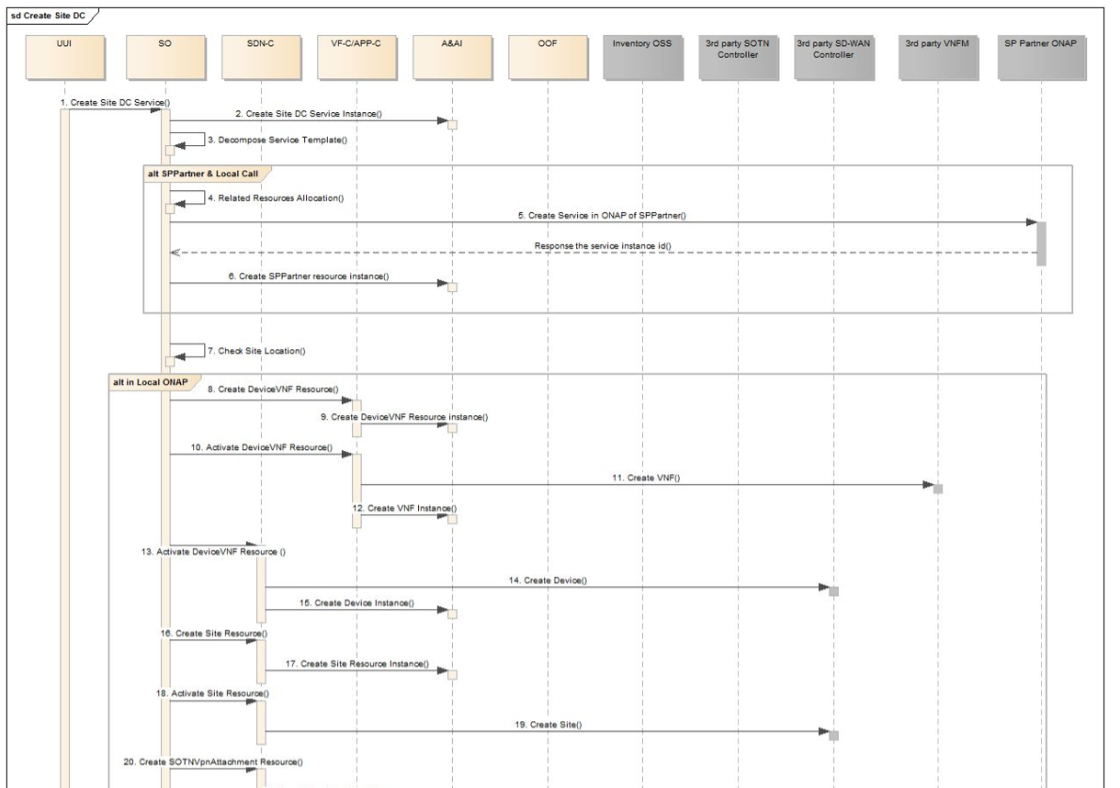
Service Order API within Broader CC VPN Flow

Slide 12
Thanks

