Slide 1

MEF LSO Legato SDK
24 October 2017
Andy Mayer, Ph.D.
Tara Cummings

Slide 2



E
REFERENCE ARCHITECTURE
Customer Domain
SP Domain
Partner Domain
Cantata
(CUS:BUS)
Business Applications
Sonata
(BUS:BUS)
Business Applications
Customer
Application Coordinator
LEGATO
(BUS:SOF)
LEGATO
(BUS:SOF)
Allegro
(CUS:SOF)
Service Orchestration Functionality
Interlude
(SOF:SOF)
Service Orchestration Functionality
Presto
(SOF:ICM)
Presto
(SOF:ICM)
Infrastructure Control
and Management
Infrastructure Control
and Management
ADAGIO (ICM:ECM)
ADAGIO (ICM:ECM)
Element Control
and Management
Element Control
and Management
Network Infrastructure

Slide 3
SOF Interface Reference Points
Service feasibility;
Service configuration & activation;
Usage events & metrics;
Service performance & quality;
Service policy
LEGATO
Dynamic service control;
Service state info;
Service performance & quality;
Service related alerts;
Service Orchestration Functionality
Dynamic service control;
Service parameter config;
Service state info;
Service performance info;
Service problem alerts
ALLEGRO
INTERLUDE
PRESTO
Connectivity and network function feasibility;
Configuration, activation, and management of connectivity and logical network functions;
Topology and routing;
Performance and Fault;
Connectivity policy

Slide 4
LSO Management View Abstractions
Management
Abstractions
Information Class Examples per Management Abstraction View
LSO RA
Context
Product View
Product
Catalog
Product
Offering
Product
Instance
Product
Spec
Business Apps
Customer
Service Orchestration
(Provider domains & multi-domain)
LEGATO
Service Access Point
Service View
Service
Service Component
Service Spec
Service
Interface
Service Orchestration & Infrastructure Management
(Subnetwork)
Resource View
Link
Logical Termination Point
Forwarding Domain
Forwarding Construct
Route
Network & Topology
Element & Equipment
Fabric
Facility
VNE
Element Control & Management
Cross Connect
Network Element
Port
Card
Server
VNF

Slide 5
Apply LSO RA Phase 2 Operational Threads
Legato is characterized by interactions between Business Applications and the SOF.
These specific interactions are described in the MEF LSO Operational Threads / User Stories for:
    Product Ordering and Service Activation Orchestration
    Controlling a Service
    Customer Viewing Service Performance and Fault Reports and Metrics
    Placing and Tracking Trouble Reports
    Assessing Service Quality Based on SLS
    Collection and Reporting of Billing and Usage

Slide 6
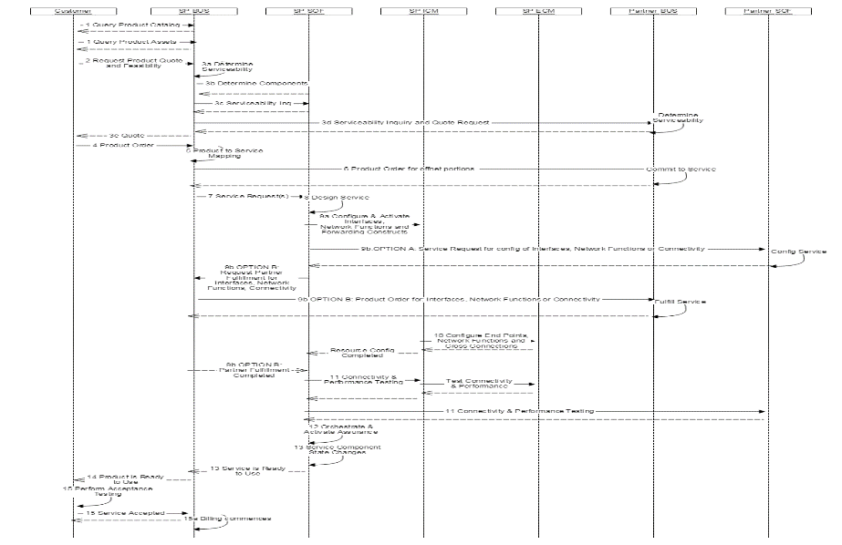
Apply LSO RA Phase 2 Operational Threads
LEGATO

Slide 7
Model Driven Orchestration with Legato
Traditionally, introducing new network elements, new products, and new services require long software development cycles
A key objective is to eliminate these long cycles by:
    Standards to establish common ways provide lifecycle management of Services and Network Functions in support of operational integration
    Common abstractions to support new types of Services and Network Functions with minimal changes
    Common ways to monitor the services, functions, and infrastructure
    Standard APIs and Microservices with fixed inputs and outputs that are tunable via models and metadata
    Models and processes that are designed, distributed, and interpreted by the execution engine

Slide 8




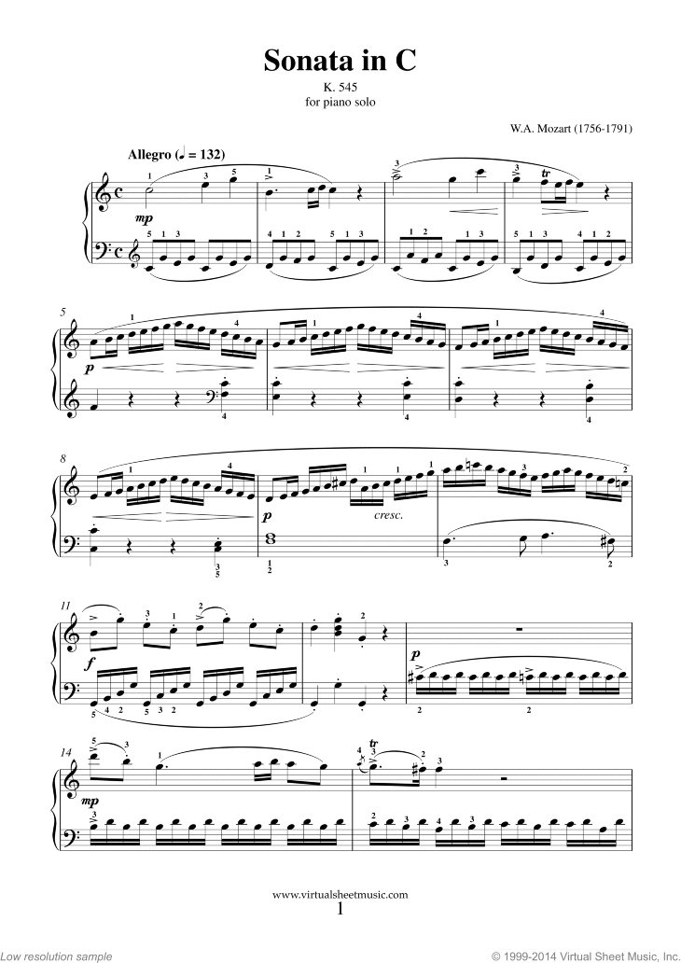

The Model Driven Paradigm
Models
Execution Engines
Behaviors
Resource definition
Service composition
Product models
Lifecycle models (Operational Integration)
Processes and policies
Optimization rules
Software images
Orchestration
Policy execution
Data movement
Data storage
Coded algorithms
Control
Standard data models
Real-time service delivery
Elastic scalability
Self-optimizing
Self-healing

Slide 9

Role of External APIs in Model Driven ONAP
The Story
6. BSS/OSS builds Products based on Service Descriptors
7. Based on a Product Order, BSS/OSS requests Service instantiation based on Service Descriptor
8 . SO uses Service Parameters from request and corresponding Service Recipe to instantiate the Service
5. BSS/OSS retrieves Service Descriptors from the Catalog
1. VNF Package with VNFD is On-Boarded into SDC
ONAP Portal – Design Studio & Dashboard
BSS/OSS
LEGATO
Design-time (SDC)
Run-time
Lab Integration & Certification
ONAP Operations Management (OOM)
External Data Movement & APIs
Modeling (specs & Utilities)
Resource Onboarding
A&AI
DCAE
Policy
2. SDC designs a service using the VNFD.
Design includes Service Descriptor and Service Recipes
VNF SDK
Service & Product Design
Orchestration Framework
Active / Available
Analytic µServices
Runtime Policy Execution Engine
Service Orchestration
Entitlements
CDAP
Holmes
…
Policy Creation & Validation
Resource Orchestration
Resource / Service Topology
Data Distribution
Analytic Application Design
ESR
Data Collection Layer
Common
Service
Catalog
DMaaP
AAF
Logging
Micro Services Bus
Testing & Certification
Products
Services
SDN-C
gVNF-Controller (prev. App-C)
Resources
Policies
Multi-VIM
L0-3 Network Controller
L4-7 Generic VNF Controller
4. Service Descriptors are made available via the Catalog
Eng. Rules
Analytics
Model Driven
Infrastructure
Adaption Layer
Config
Database
Service Logic
Interpreter
Life Cycle Mgmt DGs
Config Database
Service Logic Interpreter
Life Cycle Mgmt func.
Recipe / Engineering Rules & Policy Distribution
Adaption Layer
Open
Stack
AWS
Azure
3rd Party Network
controller
Standard & sVNFM Adaption Layer
Netconf
Yang
CLI
Chef
Netconf
Ansible
Vendor A
Vendor B
sVNFM
EMS
3. Service Recipes are distributed to ONAP components (e.g. SO)
VNF 1
VNF 2
VNF n
PNF
VNF x
Infrastructure
OpenStack
VMware
RackSpace
Azure
......

Slide 10
Next Steps
Work jointly with ONAP External API Project in defining Use Cases and Information Model for Legato
Leverage MEF Operational Threads and revise MEF 56, Interface Profile Specification: Service Configuration and Activation, to reflect consistent Use Cases
The Service Descriptor Model is key to Model Driven Orchestration
Work with ONAP and TM Forum define the Service Catalog and Service Instantiation API is a model driven and extensible fashion

