Slide 1
ONAP Contribution:
LSO Presto Interface Activities
9 May 2018
Jack Pugaczewski – CenturyLink
Nigel Davis – Ciena
https://wiki.mef.net/display/CESG/LSO+Presto

Slide 2
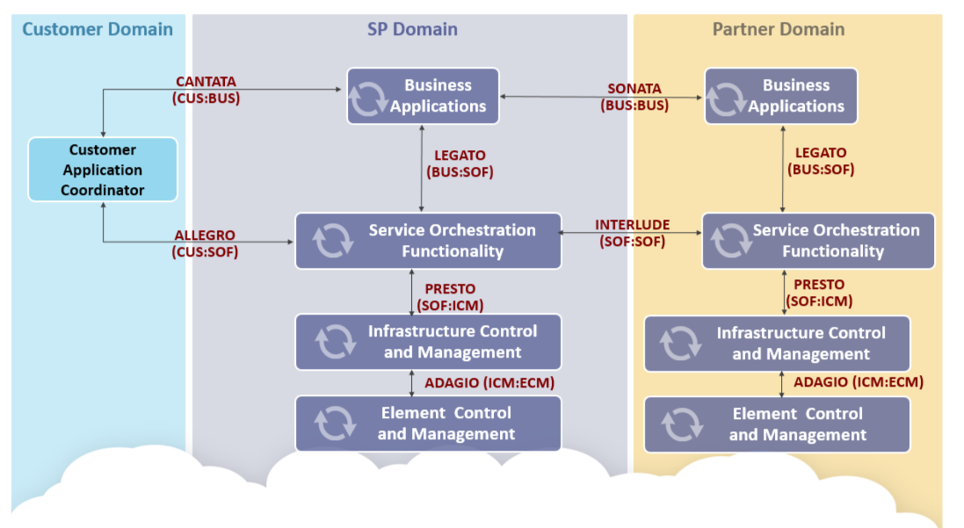
Presto positioning in LSO
Presto reference point covers all interactions between an Orchestrator and an infrastructure controller
  Determining resource capability
  Retrieval of current resource state
  Provisioning of new resource state
  Provides a resource – service bridge
Infrastructure includes networking technologies

Slide 3
Presto NRP/NRM
MEF 60 NRP Interface Profile Specification is result of MEF and ONF (TAPI) collaboration.
Currently support for Ethernet.
Next release support for OTN.
  Allows for activation of overlay/underlay of network resources.
TAPI model is proven for packet, circuit and photonic media cases
  TAPI is also advancing Photonic support.
  The Presto/TAPI network model embodies many years of experience.
MEF-LSO-Presto-SDK:
https://github.com/MEF-GIT/MEF-LSO-Presto-SDK

Slide 4
Presto SOAM/SAT
Presto SOAM currently under development and incorporates ONF TAPI OAM Service.
Closely monitoring and aligning with ITU-T SG15 IEEE and ITU-T effort.
Will include Interface Profile Specification(s) and SDK with YANG model, Swagger RESTCONF/YANG API and reference implementation.

Slide 5
Toolchain
Tool chain is imperative for agile development.
Need toolchain development for TOSCA.

Slide 6
Presto/TAPI POCs
MEF 17 POC – Topology Engine leveraging NRP w/OTN.
Numerous Hackathons – e.g., UNI Manager.
Sequence of OIF Demos ongoing.
Various operators calling for TAPI

Slide 7
Evolution and vision
Broadening of the resource model beyond transport
  Physical
  General functional
  Control Constructs
Strengthening the Spec/Template model
  Providing machine interpretable Specs/Templates for system structures
    This relates to TOSCA templates
Moving to an Outcome Oriented Constraint Based (Intent) form
  Using constraint grammar to within messaging
  Providing arbitrary subgraph reporting
Developing guidelines and tooling for additional encodings
  Such as pure OpenApi, Protobuf and TOSCA
Industry wide convergence of models, grammars, interaction paradigms etc

Slide 8
Recommendation
It is recommended that MEF Presto / ONF TAPI be used for interfacing between ONAP and underlying controllers

