Slide 1
ONAP/external API
Contribution for ONAP Beijing release
13/03/2018

Slide 2


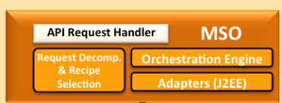
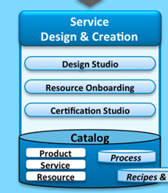
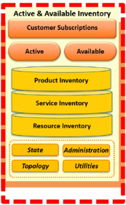

Global Picture
Note: The TMF APIs mentioned in this slide are updated accordingly to TMF guidelines 3.0 (polymorphism; schemaLocation to refer descriptor file)
+
Swagger under Apache 2.0
BSS
LEGATO
Service Catalog TMF 633
Service Order
TMF 641
Service Inventory
TMF 638
External API Management
(Order, Catalog, Inventory)
INTERLUDE
ONAP internal API
Service Order
API build on
Open APIs
Service catalog
Service inventory

Slide 3
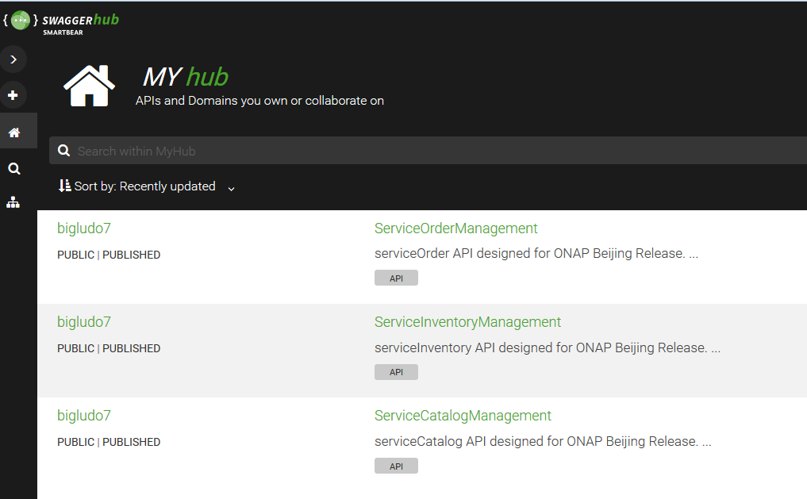
Available APIs & operations
ONAP external API component features 3 APIs & operations:
  serviceCatalog – only serviceSpecification resource – operations GET byList and GET byId
  serviceInventory – service resource – operations GET byList and GET byId
  serviceOrder - serviceOrder & hub resources - operations POST, GET byList & GET byId for serviceOrder and POST, DELETE, GET byList and GET byId for hub
Where to find swaggers ?
  serviceCatalog – https://app.swaggerhub.com/apis/bigludo7/ServiceCatalogManagement/0.1.8
  serviceInventory – https://app.swaggerhub.com/apis/bigludo7/ServiceInventoryManagement/0.1.6
  serviceOrder - https://app.swaggerhub.com/apis/bigludo7/ServiceOrderManagement/0.1.10
  event (to receive SO notification): https://app.swaggerhub.com/apis/bigludo7/EventManagement/1.0.0

Slide 4
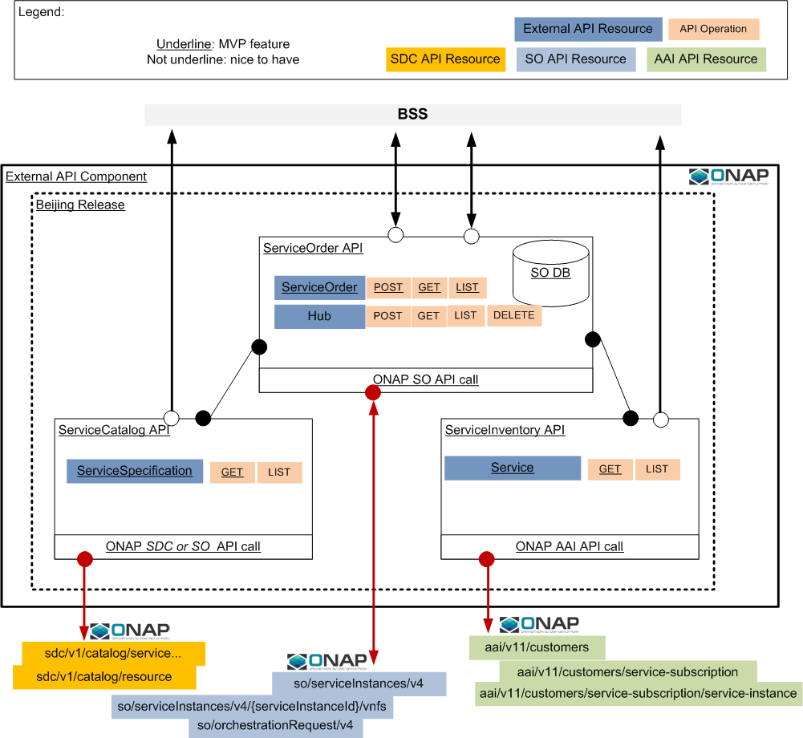
Inside the component

Slide 5
Assumption
We took as assumption in this API delivering that either service-level instantiation workflow or vnf-level instantiation workflow are existing and ready to work. A property is set in the externalAPI component to indicate if the component should interact with SO at service level or (service + vnf) level.
If this parameter is set to service level: External Api will only perform a POST SO service instance request call. This means that from this request SO is able to retrieve:
in SDC the recipe to fulfill this service
identify the BPMN to be executed
execute this BPMN with SO& SDNC interactions
If this parameter is set to vnf level: External Api will perform a POST SO service instance request call, retrieve vnf list in SDC, perform POST SO vnf request call for each required vnf. This means that from this/these vnf request(s) SO is able to retrieve workflow at vnf level and execute it.

Slide 6


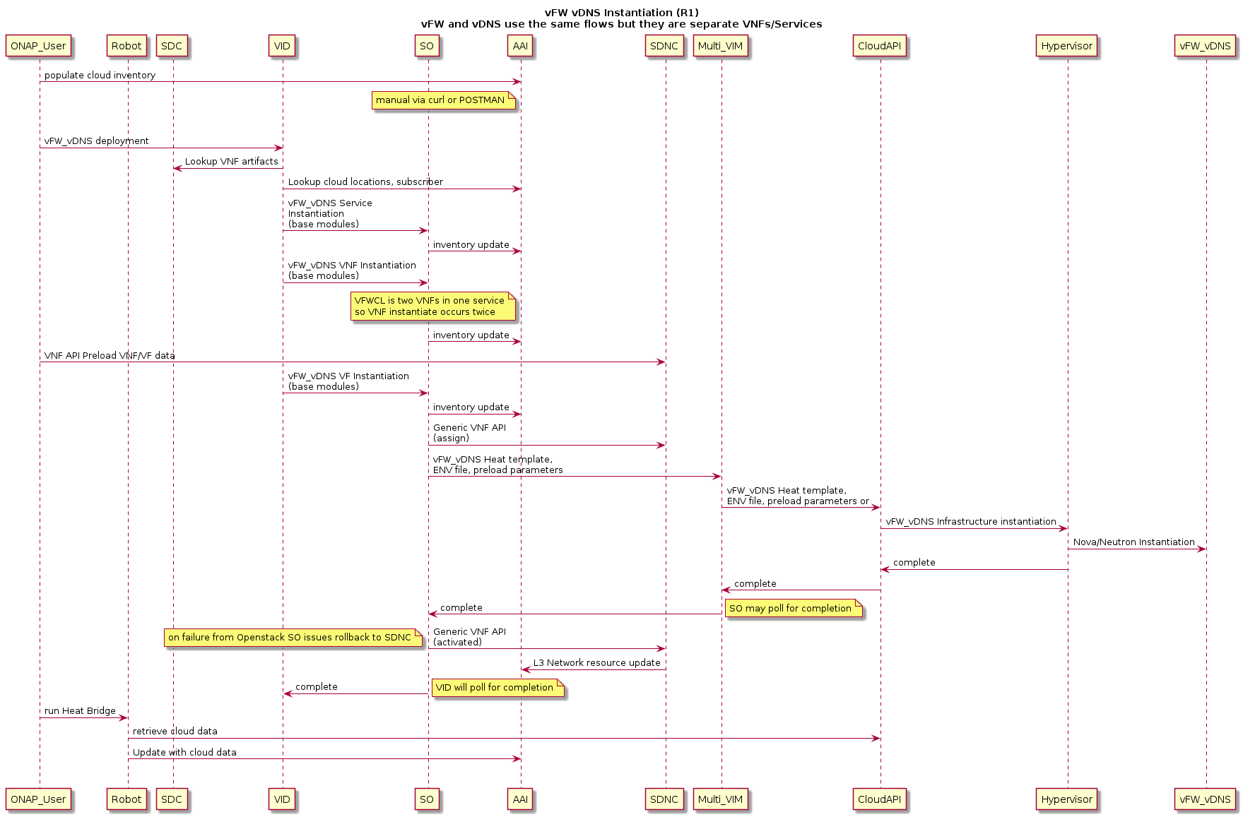
How External API works ?
REMINDER: service onboarding is out of the scope of ExternalAPI
Diagram source: http://onap.readthedocs.io/en/latest/use-cases/vfw.html
Assumption: cloud/tenant existing
Done with external API: we lookup location, subscriber, service-type and create in AAI the last 2 if required
If property CallForVNF is set to ‘yes’ we make the call to SO for all required vnf
External API did not make call to SDNC
External API did not make call to SO at VF level
ExternalAPI poll SO for completion

Slide 7
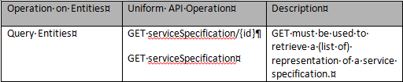


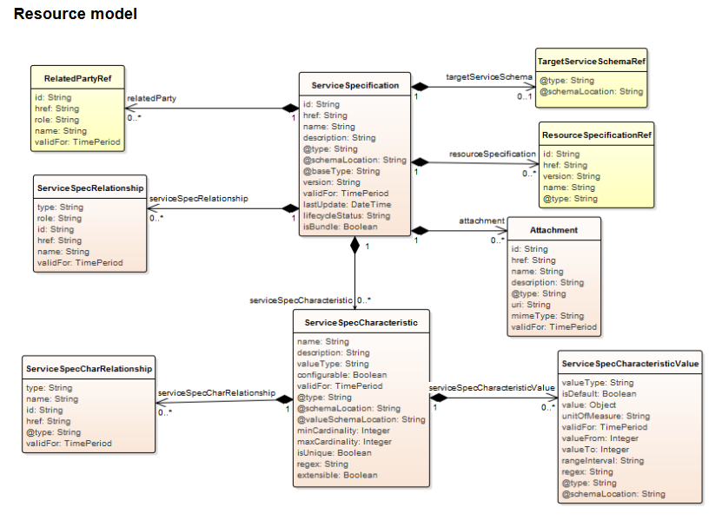
ServiceCatalog API
Assumption: we retrieve information in SDC
TMF API polymorphism helps to retrieve ONAP specific attributes
ServiceSpecCharacteristic description + VNF resource attributes have to be retrieved in the Tosca file
Only string, boolean & integer characteristic type are retrieved (not map or list)
SDC has limited research capability (category & distributionStatus)
We do not retrieve all vnf catalog information (→ should be in the TMF API resourceCatalog)
P
P
SDC
P
P
P
P
TOSCA
Only ‘basic’ type
TOSCA

Slide 8

ServiceCatalog API
BSS
External API
SDC
GET {{url}}/serviceSpecification/?category=NetworkService&distributionStatus =DISTRIBUTED
GET {{url}}/sdc/v1/catalog/services/?distributionStatus=DISTRIBUTED&category=Network Service
List of services (could be empty list or 404)
List of services (with uuid) could be empty list
GET {{url}}/serviceSpecification/{uuid}
GET {{url}}/sdc/v1/catalog/services/{uuid}/metadata
404 if no service retrieve
Detailed service data (or 404)
GET {{url}}/sdc/v1/catalog/services/{uuid}/toscaModel
Tosca .czar file
Unzip .czar file – consider ‘*-template.yml’ file - retrieve characteristic & customization id/name
200 Complete service data /
206 Partial service date retrieved (Tosca no retrieved)

Slide 9
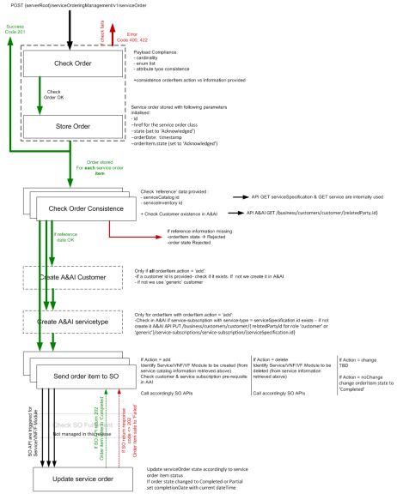
ServiceOrder API
Complex because a multi-steps order process is required
We took following assumptions in our development:
We manage ONAP customer creation but it’s optional (API manage if no ONAP customer information are present → use dummy ‘generic’ customer.
We manage the service-type constraint in AAI (prerequisite in AAI to have the service-type created before to instantiate the service instance) – we value service-type with ONAP serviceSpecification name.
Only ADD and DELETE operations are managed (no change)
(!) We offer 2 levels of integration with SO (property set at external API component level) :
  Service level integration: External API will trigger only SO request at serviceInstance level → ONAP prerequisite: SO must be able to find a BPMN to process service fulfillment (integrate vnf, vnf activation in SDNC, VF module)
  Service + VNF level integration: External API trigger first SO request at serviceInstance then triggers VNF level SO request (relating to the service instance) → ONAP prerequisite: SO must be able to find a BPMN to process VNF fulfillment (integrate vnf activation in SDNC, VF module)
When External API calls SO for service and then for VNF, we use all serviceOrder characteristics described in the serviceOrderItem for both calls.

Slide 10
ServiceOrder API
BSS
External API
AAI
POST{{url}}/serviceOrder
Check Order (surface control)
422 if consistency check fails
Store Order
201 – Order saved {id}
‘add’ order item action is described from this point(*)
Get serviceSpecification (internal use service catalog API)
Only if customer information are sent in the service order
GET {{url}}/aai/v11/business/customers/customer/relatedParty.id
* For ‘delete’ action item we use DELETE operation in SO.
When CallForVNF is set to ‘yes’ we first delete the vnf(s) and then the service.
A rollback is also coded if vnf deletion was performed but not service one
Customer information or 404
PUT {{url}}/aai/v11/business/customers/customer/relatedParty.id
If 404
201

Slide 11
ServiceOrder API
BSS
External API
AAI
GET {{url}}/aai/v11/business/customers/customer/{relatedParty.id or generic}/service-subscriptions
Service-type information or 404
If 404
PUT {{url}}/aai/v11/business/customers/customer/{relatedParty.id or generic}/service-subscriptions/service-subscription/{service.name}
201
Notification send if BSS subscribed to order item status change (acknowledged→ inProgress
SO
If CallForVNF is set to ‘no’
POST {{url}}/ecomp/mso/infra/serviceInstances/v4 + {body}
201 – instanceId and requestId retrieved
Complete order
Loop if percentProgress <100
GET {{url}}/ecomp/mso/infra/orchestrationRequests/v4 /{requestId}
201 – requestState and percentProgress retrieved
Notification send if BSS subscribed to order item status change (inProgress → completed
Complete order

Slide 12
ServiceOrder API
BSS
External API
SO
If CallForVNF is set to ‘yes’
POST {{url}}/ecomp/mso/infra/serviceInstances/v4 + {body}
201 – instanceId and requestId retrieved
Complete order
GET {{url}}/ecomp/mso/infra/orchestrationRequests/v4/{requestId}
Loop if percentProgress <100
201 – requestState and percentProgress retrieved
For each vnf
POST {{url}}/ecomp/mso/infra/serviceInstances/v4 /{serviceInstance.id}/vnfs + {body}
If vnf fulfillment fails we trigger DELETE for previous vnf & service instantiation (rollback)
201 – instanceId and requestId retrieved
Complete order
GET {{url}}/ecomp/mso/infra/orchestrationRequests/v4/{requestId}
Loop if percentProgress <100
201 – requestState and percentProgress retrieved
Notification send if BSS subscribed to order item status change (inProgress → completed
Complete order

Slide 13
ServiceOrder API
BSS
External API
GET {{url}}/serviceOrder/?state=completed&…&fields=….
Retrieve Store Order list in the external API DB
List of serviceOrder (with fields specified in the request)
Empty list if no serviceOrder match requested criteria(s)
GET {{url}}/serviceOrder/{id}
Retrieve Store Order information in the external API DB
404 if no service retrieve
200 Complete serviceOrder information

Slide 14
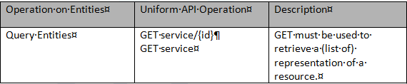


ServiceInventory API
AAI enforces a customer/service-type/service structure → to get service information customer id and service-type id are required
Very few information are retrieved in AAI at service level: no status, date, characteristics valued
We pre-defined for the get by list the criteria useable + the service summary view
We do not retrieve vnf information (→ should be in the TMF API resourceInventory)
P
P
P
P
P
A&AI

Slide 15
ServiceInventory API
BSS
External API
AAI
GET {{url}}/service/?relatedParty.id=Pontus
GET {{url}}/aai/v11/business/customers/customer/{Pontus}/ service-subscriptions/
List of services type (could be empty list or 404)
For each service-type
{{url}}/aai/v11/business/customers/customer/{Pontus}/service-subscriptions/service-subscription/{service-type}/service-instances/
List of service instances (in particular uuid) – could be empty list
List of services instance (could be empty list or 404)
GET {{url}}/service/{uuid} + customerId & serviceSpecification.id
If servicepecification.name not in the request
Get serviceSpecification (internal use service catalog API)
GET {{url}}/aai/v11/business/customers/customer/{customerId}/service-subscriptions/service-subscription/{servicespecification.name }/service-instances/service-instance/{service.id}
404 if no service retrieve
Detailed service data (or 404)
GET {{url}}/aai/v11/network/generic-vnfs/generic-vnf/{vnf id}
Detailed vnf data (or 404)
200 Complete service data

