Slide 1

TMF 640/641
API Analysis
December 2017

Slide 2
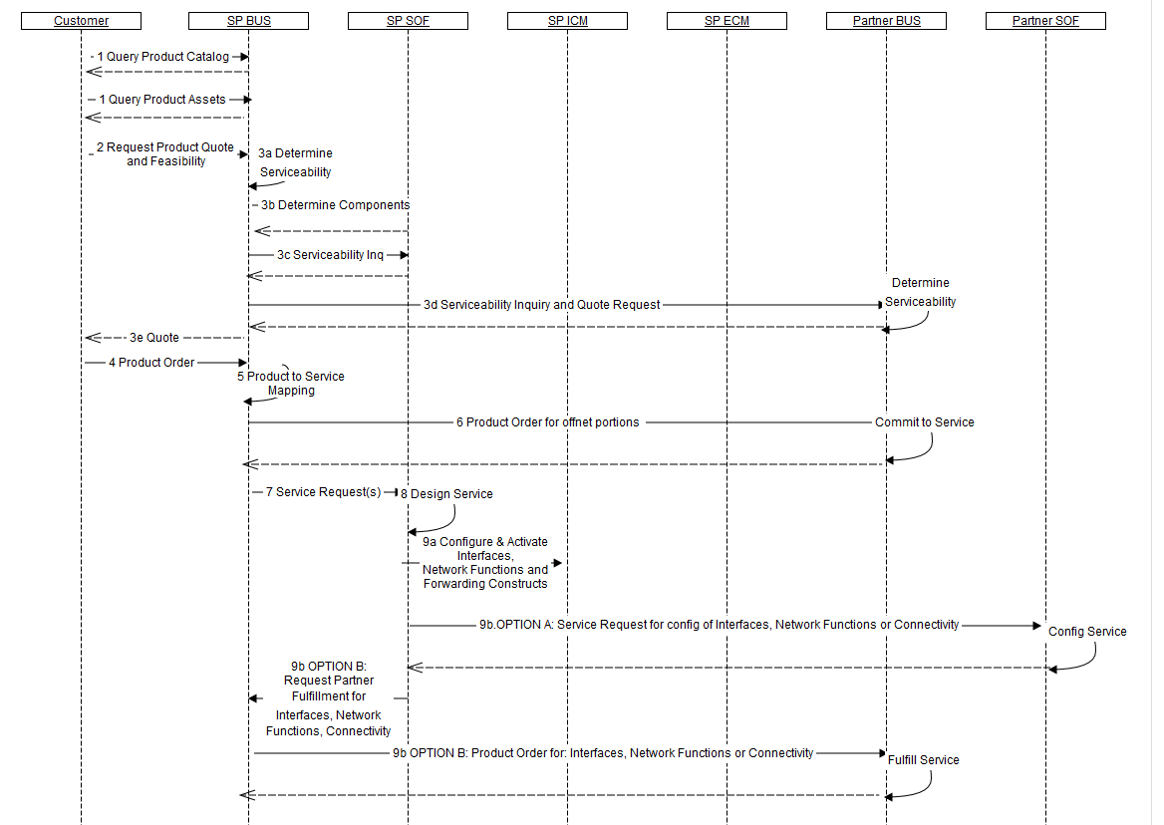
How to motorize service request between BUS:SOF
Flow source:
https://wiki.onap.org/download/attachments/8227019/D00135_001_Amend%20MEF55-OperationalThreads%20AD%201_Mayer.pdf?api=v2
Which API to use for this interaction between SP BUS and SP SOF ?

Slide 3
TMF 640 Activation & Configuration
Service inventory instance
POST service
id: 12sd-ty45-oi12
state: reserved
serviceSpec: s4569
Characteristic…
Relationship…
Supporting Service..
Create a new service
(name, description, type, version, state, serviceSpec, serviceCharacteristic(*), relationship, relatedParty, supportingService)
Creation notification
FIND/GET service
id: 12sd-ty45-oi12
state: reserved
serviceSpec: s4569
Characteristic…
Relationship…
Supporting Service..
id: 12sd-ty45-oi12
state: active
serviceSpec: s4569
Characteristic…New value
Relationship…
Supporting Service..
PATCH service
Modify existing service (change state, change characteristic, change relationship and/or supporting service)
Update notification
DELETE operation should be kept for AMDIN user

Slide 4
TMF 641 Service Order
Service Order
Service inventory instance
POST serviceOrder
id: 12sd-ty45-oi12
state: active
serviceSpec: s4569
Characteristic…
Relationship…
Supporting Service..
externalId
requestedStardDate
orderRelationship
relatedParty
…
Item #, action, serviceId, serviceSpec, service relationship, item relationship, characteristic, service state
Create a new service order
Order progress notification
id: 1zod-ludo-sdr2
state: active
serviceSpec: 56df
Characteristic…
Relationship…
Supporting Service..
FIND/GET
id: 12sd-ty45-oi13
state: reserved
serviceSpec: s4569
Characteristic…
Relationship…
Supporting Service..
id: 12sd-ty45-oi13
state: active
serviceSpec: s4569
Characteristic…New value
Relationship…
Supporting Service..
PATCH
Order item progress notification
Modify service order in progress (could be denied if PONR reached)
DELETE operation should be kept for ADMIN user

Slide 5
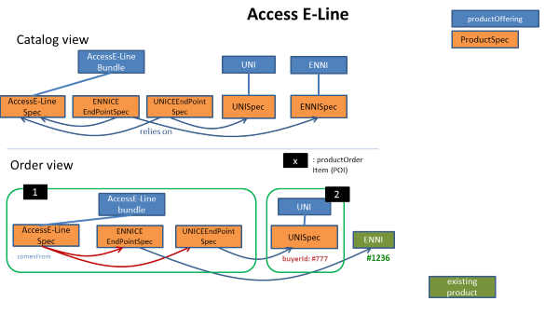
Suppose we have to deliver a e-line service with2 endPoints for this e-Line: one related on an existing UNI and the other on an existing ENNI.
Service Modelling describe relationship from endPoint service to e-Line service
TMF640 vs TMF641
USE TMF640
Client side should trigger a POST service to create e-line service
If success, Client side should trigger a POST service to create UNI endPoint service with 2 relationships to existing UNI and to e-line created in 1.
If success, Client side should trigger a POST service to create ENNI endPoint service with 2 relationships to existing ENNI and to e-line created in 1.
Client side must do the orchestration. If step 2 fails, client mist manage step 1 rollback
USE TMF641
Client side triggers one POST service order with 3 items
  One for the e-line (item #1)
  One for UNI endPoint service with a service relationship to UNI and one item relationship targeting item #1
  One for ENNIendPoint service with a service relationship to existing ENNI and one item relationship to item #1
Server side do the orchestration. ServiceOrder delivery could take time – serviceOrder/item provide status lifecycle.

Slide 6
TMF640 vs TMF641
TMF 640 allows to find, retrieve, create, modify, delete directly one service
TMF 640 can be also used at resource level.
The operation is unitary – only one service could be managed
No status on the operation itself. Only service state is managed.
No date or mechanism to have a follow-up on action progress but notification could be trigger on service change
Relationship could be describe but relationship target must exist in inventory [AAI] (at least have an id)
TMF 641 allows to find, retrieve, create modify, delete a service order
Service order is a distinct resource than service. A service order describes a group of operations on service – one service order item per service.
An action at the level of the service order item describe the operation to be done on a service
Separate status on order/order item that on the service itself. Delivery progress could be tracked at service order/SO item levels
Capability to describe relationship between not yet existing services (based on items relationship)

Slide 7
Mapping the TMF ServiceOrdering to SO
Step 1: Use serviceOrderItem to ‘break’ the service order in ONAP-manageable chunks
Step 2: Use serviceOrderItem + orderItemRelationship + serviceRelationship to orchestrate chunks
ServiceOrder #12
OrderItem #1 – Add – ServiceSpec1
Adaptation layer has to:
Check mandatory “customer” existence in AAI
Trigger simultaneous
  SO POST request for #1
  SO POST request for #3
  Check 456987 existence in AAI
When 2.1 done trigger SO POST request for #2
When 2.3 checked trigger SO POST request for #4
OrderItem #2 – Add – ServiceSpec2
OrderItemRelationship: reliesOn #1
OrderItem #3 – Add – ServiceSpec3
OrderItem #4 – Add – ServiceSpec3
serviceRelationship: reliesOn 456987

