Slide 1
ONAP External API Framework
Dublin Proposed Service Catalog Enhancement
Adrian O’Sullivan Huawei Adrian.Osullivan@Huawei.com

Slide 2





Service Catalog API Enhancement
Business Support Systems
Open APIs
Business Support Systems
ONAP Platform
Internal APIs
Query L2 Service Catalog (TMF633)
HTTP GET https://{api_url}/nbi/api/v3/serviceSpecification/{uuid}
Query L2 Service Catalog (TMF633) & Open API schema
HTTP GET https://{api_url}/nbi/api/v4/serviceSpecification/{uuid}
HTTP GET https://{api_url}/nbi/api/v4/serviceSpecification/{uuid}/ specificationInputSchema
Currently : ONAP External API Framework
Uploads the full TOSCA CSAR file from SDC to extract ServiceCharacteristics from the TOSCA Inputs . It is repeated every time the Service Catalog API is called for this uuid which is a waste of resources as the distributed ServiceSpecification for a specific uuid should not change.
Proposal : ServiceSpecification ServiceCharacteristics are extracted from the TOSCA Service Topology from SDC using the SDC TOSCA Parser and stored for use future use by EXTAPI. The BSS can simply retrieve the required ServiceCharacteristics in OpenAPI format that are required to instantiate a Service Instance directly from EXTAPI with a new specificationInput Schema URL.
External API Framework
External API Framework
Specification
InputSchema
Specification
Distribution Event
Everytime
Only Once
CSAR
CSAR
GET {{url}}/sdc/v1/catalog/services/{id}/MetaData
GET {{url}}/sdc/v1/catalog/services/{id}/toscaModel
GET {{url}}/sdc/v1/catalog/services/{id}/MetaData
GET {{url}}/sdc/v1/catalog/services/{id}/toscaModel
SDC
SDC
ONAP Casablanca Flow
Proposed ONAP Dublin Flow

Slide 3
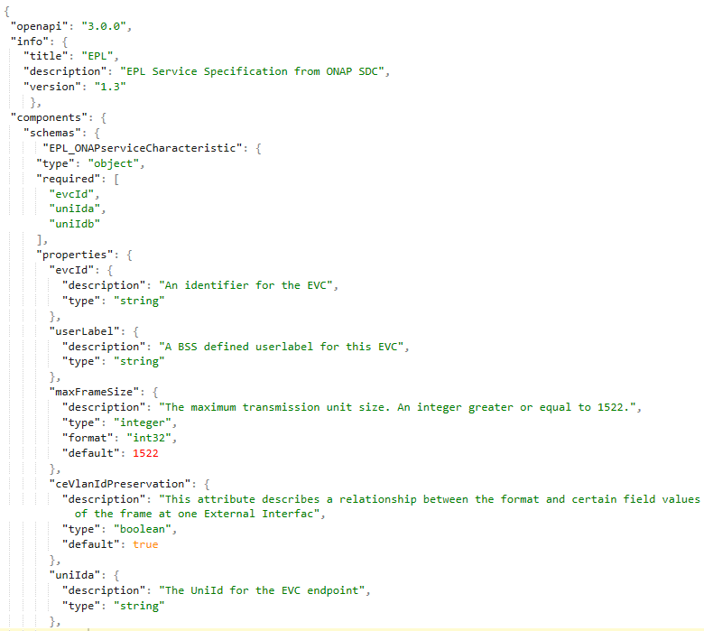
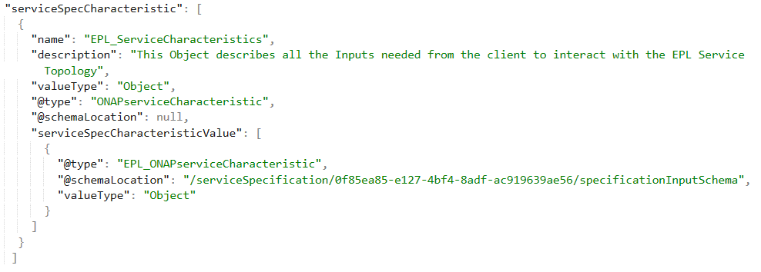
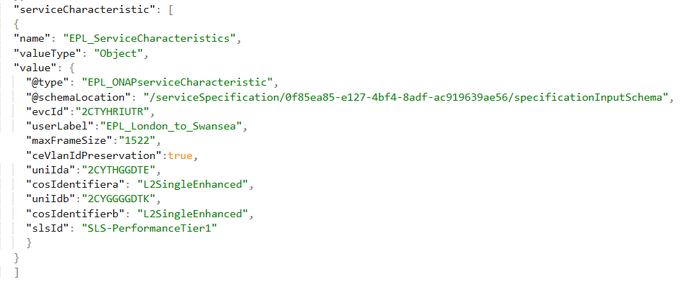
Simplification of Service Catalog API Payload
specificationInputSchema
ServiceCatalog
ServiceOrder
Referenced In
Populated In

Slide 4
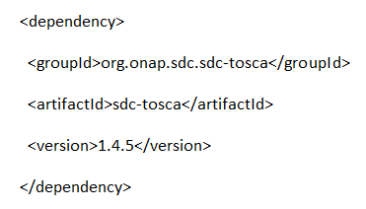
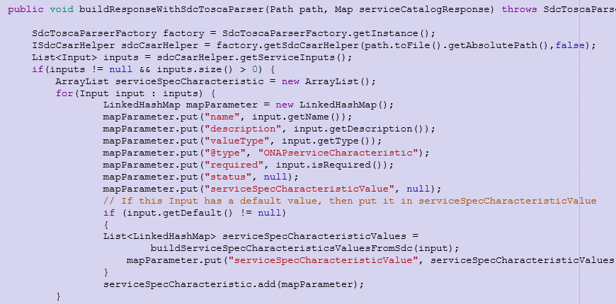
CSAR parsing to extract Service Inputs
Use of the ONAP SDC-Tosca parser API package to retrieve and parse service CSARs
Service Topology Template Inputs:
Maintained by SDC Project team, aligned in each version according to added SDC features
Can be added to extAPI as a jar lib as a POM dependency
By adopting sdc-tosca parser it allows the External API Framework to factor out having to maintain the hand parsing of Tosca Service Topology Template yaml and use the ISdcCsarHelper instead.
Advantage: As TOSCA model support changes in SDC, parser is adjusted also.
EXTAPI-171
See https://gerrit.onap.org/r/73414

Slide 5



Service Catalog API Sequence Diagram: Adopt SDC Distribution Client in ExtAPI to Subscribe to SDC Distribution Events to trigger Specification Inputs Schema generation on distribution
ONAP
BSS
External API
SDC
POST sdc/v1/registerForDistribution
POST nbi/api/v3/hub
{"ApiPublicKey": "ur874bv84-3654cv6-gwhj”,
"distrEnvName": "PROD",
"distrConsumeProduceStatusTopic": false
{"callback": "https://serverRoot/BSSAppListener/listener/v1",
“query”:”eventType = ServiceSpecificationCreationNotification”}
{“id”: “58673”, "callback": "https://serverRoot/BSSAppListener/listener/v1",
“query”:”eventType = ServiceSpecificationCreationNotification”}
{"distrNotificationTopicName": "SDC-DISTR-NOTIF-TOPIC-PROD",
"distrStatusTopicName": "SDC-DISTR-STATUS-TOPIC-PROD“}
BSS registers listener
to be notified of ONAP
new Service Specification
Creation
GET /events/SDC-DISTR-NOTIFICATION-TOPIC-PROD/nbi.12345/nbi.12345
ONAP SDC
distributes a new service
to the ONAP Runtime.
External API uses the sdc distribution client to register for notifications of SDC distribution events for new Service Specifications the become available for use in the run-time.
sdc-distribution-client :
Consume Specification Distribution Event
POST https://serverRoot/BSSAppListener/listener/v1
{"distributionID": "34cb001c-c9f0-4db9-b59c-9421c0b3cb5e",
"serviceName": “BroadBandService",
"serviceVersion": "1.0",
"serviceUUID": ……
("event": {
"eventType": “ServiceSpecifcationCreationNotification",
"eventDate": "2018-06-21T14:21:31.740Z",
"eventId": "34556",
"event": {
"id": "81b9430b-8abe",
"href": "nbi/api/v3/serviceSpecification/81b9430b-8abe",
“name": “BroadBandService"}}}
GET {{url}}/sdc/v1/catalog/services/{uuid}/toscaModel called only once when SDC Distributes Service
BSS is notified that a new ONAP Service has been created. BSS can view the ONAP service Catalog.
BSS can then incorporate the new
ONAP Service into
Product offerings ( add pricing etc )
GET /sdc/v1/catalog/service/{serviceInstanceId}/metadata
GET nbi/api/v3/serviceSpecification/{uuid}/specifcationInputsSchema
Generate and Persist
specificationInputsSchema
GET nbi/api/v3/serviceSpecification/81b9430b-8abe
Use of SDC Distribution Client
to Enable Catalog notifications is
planned for Dublin release: EXTAPI-158
{ "id": " 81b9430b-8abe ",
"name": “BroadBandService",
"category": “E2E Service",
"distributionStatus": "DISTRIBUTED“,
serviceCharacteritics
……..

Slide 6

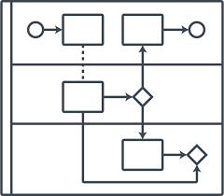
Service Order for action “add” Sequence Diagram
ONAP
BSS
External API
SO
SDC
A&AI
POST nbi/api/v3/serviceOrder
{ "externalId": “BSSProvidedTrackingID", "priority": "1",
"orderItem": [
{ "id": "1",
"action": "add",
"service": {
"serviceSpecification": {
"id": "81b9430b-8abe",
"name“: ….
"serviceCharacteristic": [
{
"name": "EPL_ServiceCharacteristics",
"valueType": "Object",
"value": {
"@type": "EPL_ONAPserviceCharacteristic",
"@schemaLocation": "/serviceSpecification/{uuid}/apiSchema",
"evcId":"2CTYHRIUTR",
………..
GET sdc/v1/catalog/services/{id}/metadata
POST so/infra/e2eServiceInstances/v3
BSS can offer automated fulfilment via a Customer Self Service Portal. The Customer can choose their required Service Characteristics they need according to the Inputs that have been modelled in the SDC Tosca Topology template.
PUT /business/customers/customer/{global-customer-id}/service-subscriptions/service-subscription/{service-type}/service-instances/service-instance/{service-instance-id}
ONAP validates the Service Order Details against the Service Specification details in SDC. ONAP then orchestrates the fulfilment
Of the Service by calling the relevant Controllers to deliver the service according to its specification.
Return ServiceInstanceId and OperationId for Internal ONAP tracking
GET so/infra/e2eServiceInstances/v3/
{serviceId}/operations/{operationId}/
"operation": {"operationId": "XXXXXX",
"operation": "create",
"result": “processing",
"progress": 2, ….}
Return ServiceOrder id and orderItem(s) serviceinstance Ids
{“id”: “sjf8bd-onap-generated-order-id”, externalId": “BSSProvidedTrackingID", "priority": "1",
"orderItem": [
{ "id": "1",
"action": "add",
“state”: “ACKNOWLEDGED”
….

Slide 7
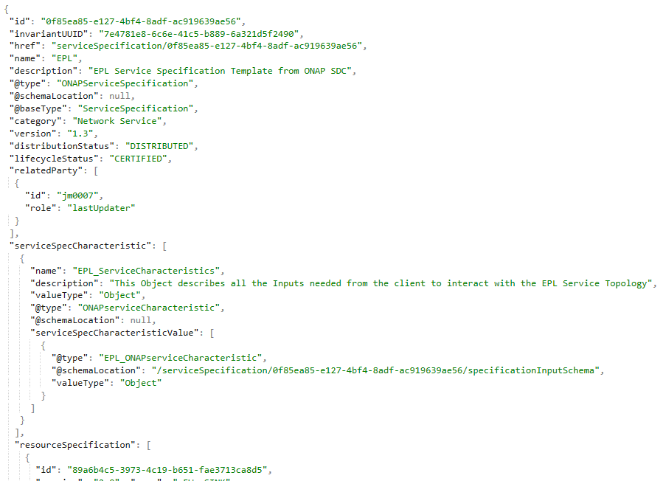
ServiceSpecification API Replies
GET /nbi/api/v1/serviceSpecification/{uuid}
GET /nbi/api/v1/serviceSpecification/{uuid}/specificationInputSchema
REPLY
REPLY

Slide 8
Back Up Slides
Service Inventory API Enhancement in Support of BSS Use Case

Slide 9

Service Inventory API Sequence Diagram
ONAP
BSS
External API
SO
SDC
A&AI
GET nbi/api/v3/service/{serviceInstanceId}
GET /business/customers/customer/{global-customer-id}/service-subscriptions/service-subscription/{service-type}/service-instances/service-instance/{service-instance-id}
The BSS can access ONAP to view service instance data in relation to Service created as a result of Service Orders. This can allow a BSS to provide details on a Customer Service Instance direct to the Customer via a Self-Service. Information can include current Service Instance State, history on which Service Specification version was used to instantiate the service.
Return Service Instance Details
{ "id": "c0c28751-97d3-42d5-ae01-77566dc533dc",
"name": "SOTNVPNInfra-onap-11",
“state” : “active”
"serviceSpecification": {
"id": "462f84e5-f0e5-44c5-ab95-38fb4bf77064",
"@type": "ONAPservice"
},
"relatedParty": {
"role": "ONAPcustomer",
"id": "Orange"
},
"hasStarted": "yes“,
…….
}
{
"service-instance-id": " c0c28751-97d3-42d5-ae01-77566dc533dc ",
"service-instance-name": " SOTNVPNInfra-onap-11 ",
"environment-context": "General_Revenue-Bearing",
"workload-context": "Production",
"model-invariant-id": "f3ec9092-5c98-41f1-9fea-96be80abd064",
"model-version-id": " 462f84e5-f0e5-44c5-ab95-38fb4bf77064 ",
"orchestration-status": "Active",
………..
}
ONAP validates the Service Instance Id exists in A&AI and retrieves the corresponding service Instance details.
Supported in Casablanca

Slide 10
Service Inventory State Tracking Sequence Diagram
ONAP
BSS/OSS
External API
SO
DMaaP
A&AI
POST nbi/api/v3/hub
GET events/ServiceStateChange/{extapiconsumegroup}/{extapiconsumerid}/
{"callback": "https://serverRoot/BSSInvAppListener/listener/v1",
“query”:”eventType=ServiceStateChangeNotification”}
POST events/ServiceStateChange
{“id”: “58673”, "callback": "https://serverRoot/BSSInvAppListener/listener/v1",
“query”:”eventType=ServiceStateChangeNotification”}
ONAP A&AI once a Service Instance State has been modified will publish a ServiceStateChange event to the DMaaP kafka bus, i.e. act as a publisher. External API shall subscribe to the Service StateChange Topic and once events arrives can notify valid OSS/BSS external listeners.
BSS/OSS Registers Listener
to be notified automatically of ONAP
Service Inventory State Changes.
This allows for example the BSS to update the customer automatically when the Customers Service Instance(s) change state.
Potential Enhancement to allow ExtAPI to instead subscribe to DMaaP to get ServiceStateChanges events but requires new feature support from both A&AI and ExtAPI teams
POST https://serverRoot/BSSInvAppListener/listener/v1
{"event": {"eventType": “ServiceStateChangeNotification",
"event": {"id": " as34-rf11",
"href": “nbi/api/v3/service/{serviceinstanceId}”,
"name": "SOTNVPNInfra-onap-11",
“state” : “active”,
…..
}
GET nbi/api/v3/service/{serviceinstanceId}
{ "id": "c0c28751-97d3-42d5-ae01-77566dc533dc",
"name": "SOTNVPNInfra-onap-11",
“state” : “active”
"serviceSpecification": {
"id": "462f84e5-f0e5-44c5-ab95-38fb4bf77064",
"@type": "ONAPservice"
}, "hasStarted": "yes“,
…….
}
GET /business/customers/customer/{global-customer-id}/service-subscriptions/service-subscription/{service-type}/service-instances/service-instance/{service-instance-id}
BSS/OSS can also poll ONAP Service Inventory at any time allowing for example a Self Service UI Portal to display Service Instance State.
{
"service-instance-id": " c0c28751-97d3-42d5-ae01-77566dc533dc ",
"service-instance-name": " SOTNVPNInfra-onap-11 ",
"orchestration-status": "Active",
………..
}

