Slide 1
ONAP External API ServiceSpecification Input Schema and CSAR parsing enhancement proposal
Related JIRA - EXTAPI-105
Date : 08/10/2018
Adrian O’Sullivan and Marios Iakovidis
Adrian.Osullivan@Huawei.com
marios.iakovidis@Huawei.com

Slide 2





Service Catalog API Enhancement Proposal
Business Support Systems
TMF/MEF LEGATO External Open APIs
Business Support Systems
ONAP Platform
Internal APIs
Query L2 Service Catalog (TMF633)
HTTP GET https://{api_url}/nbi/api/v3/serviceSpecification/{uuid}
Query L2 Service Catalog (TMF633)
HTTP GET https://{api_url}/nbi/api/v4/serviceSpecification/{uuid}
Retrieve the Inputs for ServiceSpecification in Swagger format
HTTP GET https://{api_url}/nbi/api/v4/serviceSpecification/{uuid}/ specificationInputSchema
Currently : ONAP External API Framework
Uploads the full TOSCA CSAR file from SDC to extract ServiceCharacteristics from the TOSCA.
This uploading of the full CSAR to extract the Service Characteristics is repeated every time the Service Catalog API is called for this uuid which is a waste of resources the distributed ServiceSpecification for a specific uuid does not change.
Proposal : ServiceSpecification ServiceCharacteristics are extracted from the TOSCA Service Topology from SDC and stored for use future use by EXTAPI. The BSS can simply retrieve the required ServiceCharacteristics in Swagger format that are required to instantiate a Service Instance directly from EXTAPI new specificationInput Schema URL.
External API Framework
External API Framework
Specification
InputSchema
Specification
CSAR
CSAR
GET {{url}}/sdc/v1/catalog/services/{id}/toscaModel called every time
GET {{url}}/sdc/v1/catalog/services/{id}/toscaModel called only first time
SDC
SDC
ONAP Casablanca Flow
Proposed ONAP Dublin Flow

Slide 3
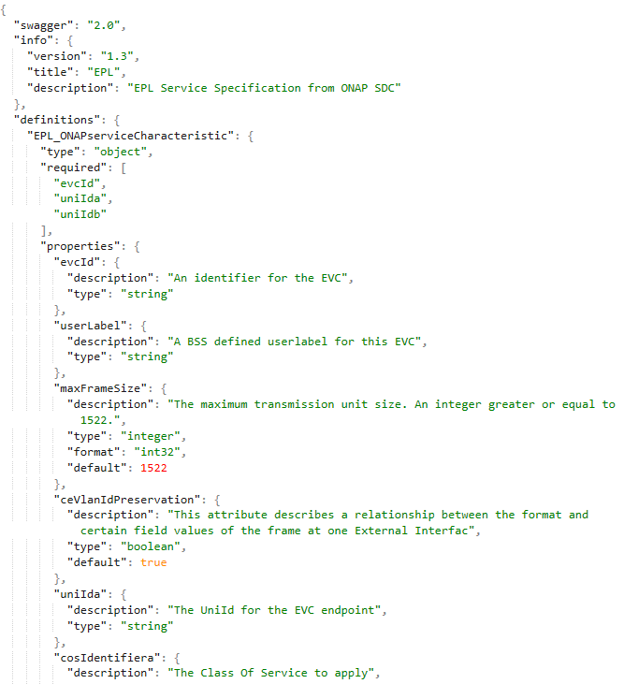
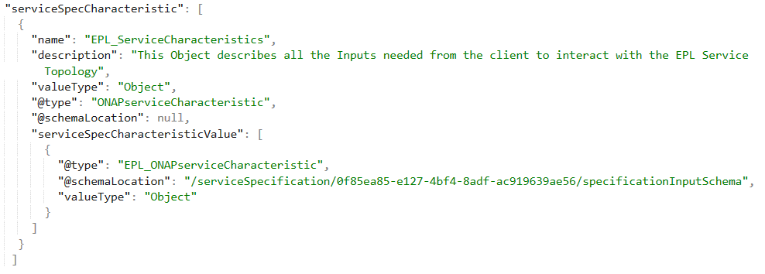
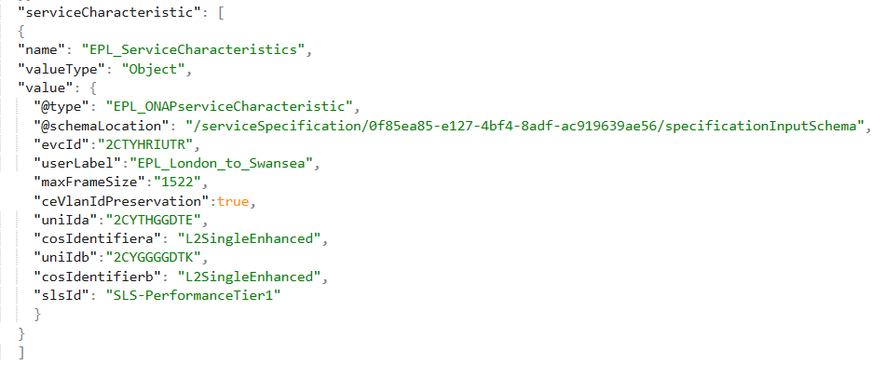
Simplification of Service Catalog API Payload
specificationInputSchema
ServiceCatalog
ServiceOrder
Referenced In
Populated In

Slide 4
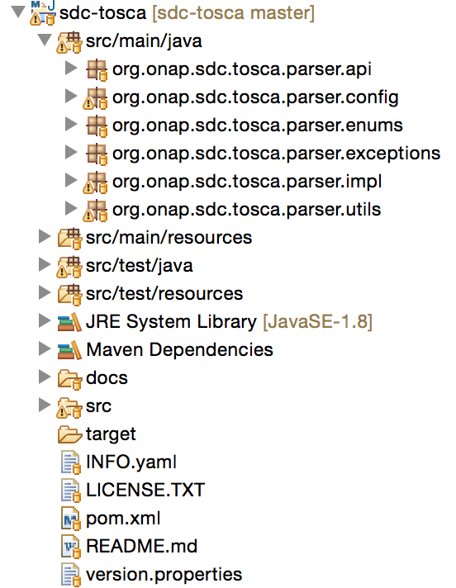
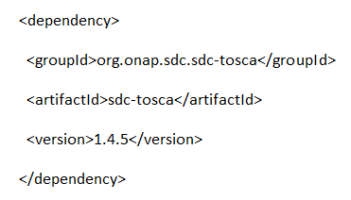
Adopt ONAP SDC-Tosca CSAR parsing within ExtAPI
Use ONAP SDC-Tosca parser API package to retrieve and parse service CSARs
Community maintained, aligned in each version according to added features
Intended as default parsing method across ONAP to access and parse CSARs
Can be added to extAPI as a jar lib as a POM dependency
Parser github location & documentation:
https://github.com/onap/sdc-sdc-tosca
ONAP SDC-Tosca is delivered as helper JAR that can be used by clients that work with SDC TOSCA CSAR files.
It parses the CSAR and returns the model object which represents the CSAR contents, through designated function calls with SDC flavour.
It uses the underlying generic JTOSCA parser.

Slide 5
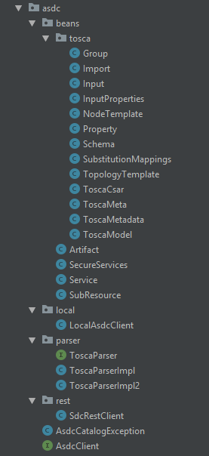
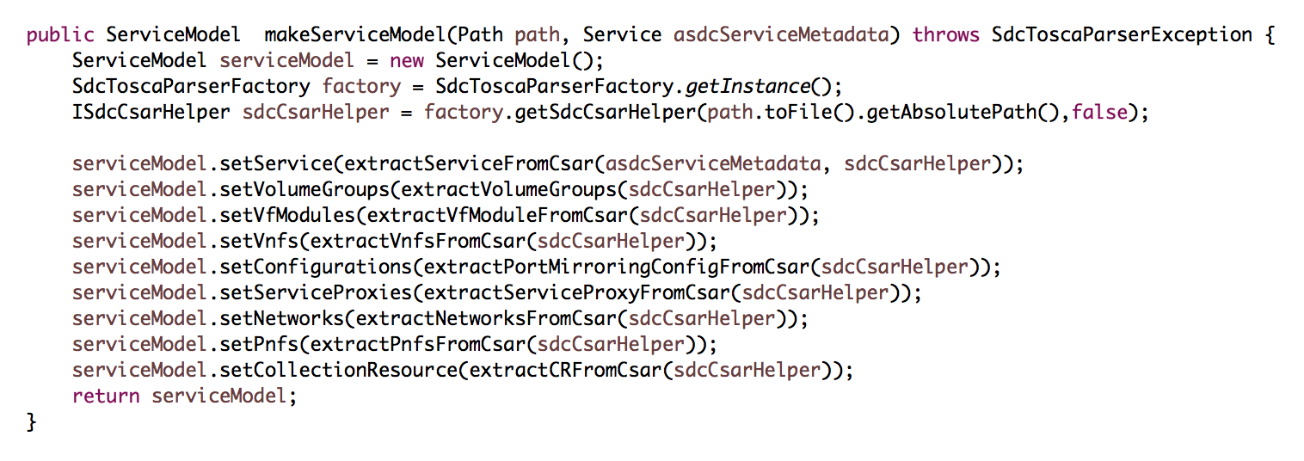
Utilize ONAP SDC-Tosca Parser like VID did in Casablanca
VID SDC Parser Client
To be able to show on the VID what parameters need to be populated for Service Instantiation
The VID has a VidController which used the VidServiceImpl to call out to SDC via the AsdcClient.
The SdcRestClient implements the AsdcClient Interface to retrieve the CSAR from SDC and then
Uses the sdc-tosca parser jar to parse the CSAR.
For example below shows how the Service Topology is parsed into a ServiceModel Object. In External we can use a similar method to Parse the CSAR to Java Objects and these Java Objects generate the Input Schema Specification. In future releases we may expand the Schema generation to incorporate more TOSCA definition, for example Interfaces for support of modification for example.

Slide 6
Low Level Design – API Calls
GET /nbi/api/v1/serviceSpecification/{uuid}
GET /nbi/api/v1/serviceSpecification/{uuid}/specificationInputSchema
getServiceSpecification
if(!existsInDB)
getSpecificationInputsSchema
ServiceSpecificationService
Get schema from DB
ServiceSpecificationDatabaseService.findSpecificationInputSchemaById
if(existsInDB)
Retrieve serviceCatalogResponse from mongoDB
Save serviceCatalogResponse to mongoDB
ToscaInfosProcessor
asdcParserAPI
ServiceSpecificationDatabaseService
Return SpecificationInputSchema
Save Input schema
to mongoDB
Return serviceCatalogResponse

Slide 7
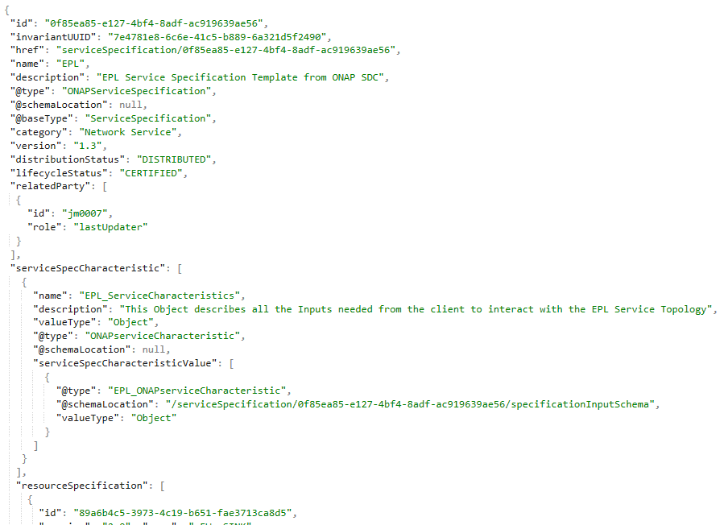
ServiceSpecifcation API Replies
GET /nbi/api/v1/serviceSpecification/{uuid}
GET /nbi/api/v1/serviceSpecification/{uuid}/specificationInputSchema
REPLY
REPLY

