Slide 1
ONAP Deployment Configuration Contract
Proposal
July, 2017

Slide 2
Goals
Define configuration contract between OOM deployment manager to application containers
  Configuration parameters inclusion policy
  Ownership of configuration parameters
Solution should be deployment manager technology neutral

Slide 3
How
Minimize the contract to the environment specific parameters only (e.g. DMaaP server address)
Inject configuration parameters into container via environment variables
Declaration and mapping of parameters to application configuration is under the application ownership

Slide 4
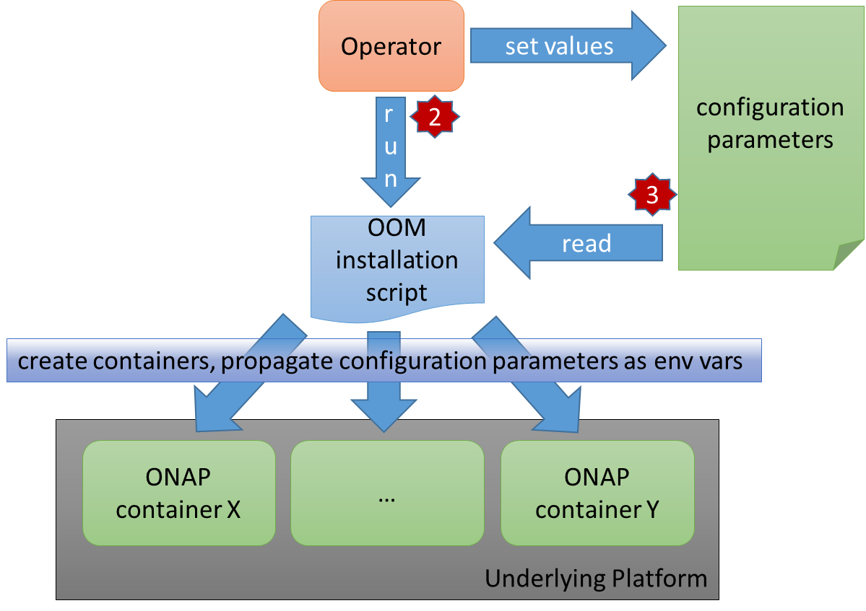
HL Deployment Process

Slide 5
deployment configuration file
Each ONAP component shall create a yaml file describing its deployment specific configuration parameters
The yaml shall be located within a common path within each component repo
          //deployment/config/params.yaml
The Yaml will contain a list of parameters each with following attributes
  Name – the name of the environment variable which will contain the configured runtime value
  Required – whether this parameter is mandatory for the succesfull execution of the container
  Default value – used if there is no user specified value. The OOM orchestrator is responsible for setting the default value.
  Description – will be used to display the user which populates the configuration runtime values.

Slide 6
deployment configuration file- Example
name: appc
environment:
- name: MYSQL_ROOT_PASSWORD
required: true
secret: true
description: SQL server password
- name: DMAAP_TOPIC_ENV
required: true
default: TEST
description: Name of the ASDC environment

Slide 7
Next Steps
Contact each component PTL and share this design and ask for commitment for adding parameters declaration file and mapping script
Amdocs OOM team will provide each of the project an initial list of proposed parameters which is based on internal knowledge and analysis process.

