Slide 1
ONAP – Centralization & Externalization of Parser Distribution
Atul Purohit – Vodafone Group
Date , 8th January 2017

Slide 2
Table of content
Problem Statement / Benefits
Present ONAP Understanding : Steps Towards Model Driven
Parser Centralization (& Subsequent) Externalization Proposal
Some Additional Details from Proposal (User Stories, Dependencies, Investigations etc…)

Slide 3
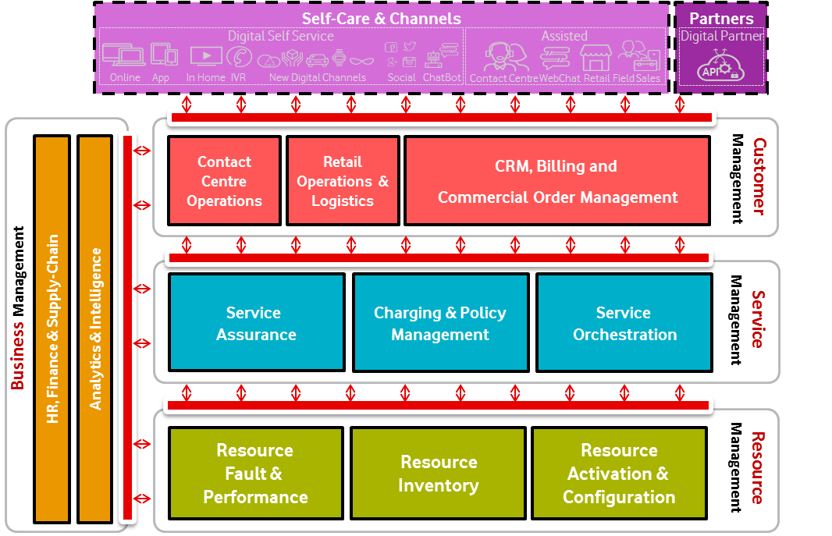
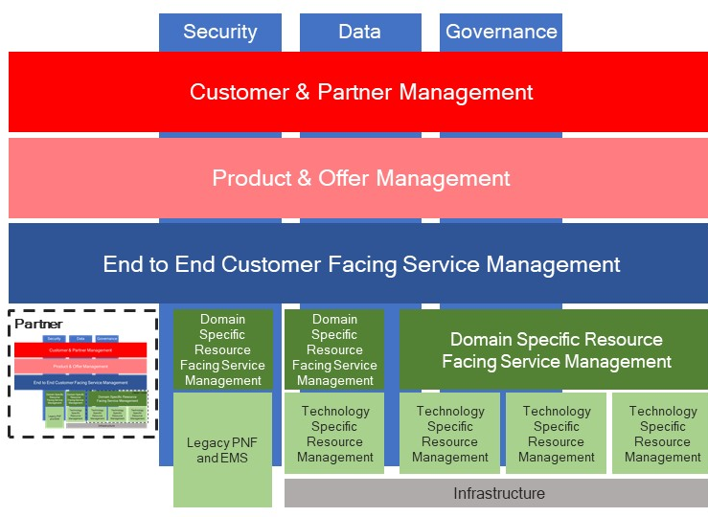
Problem Statement / Benefits : Present Operator Scenario(s)
Vodafone Platforms
ONAP Addressable Stack
Primarily BPMN2.0 Service Models
TMF Open Digital Architecture
Opportunity for Intent Based Models
uCPE
SDN
NFV

Slide 4
Problem Statement / Benefits (Model Driven Approach)
Problem Statement (Current Operator Stack)
Native / In-Built Service Models in Orchestration
Whole Stack Not Working to Same Model Definition(s)
Primarily Static or Imperative Workflow Based Stack Orchestration
Stack is Not Model Driven or Models Locally / Separately Built
Lack of API Based Standardization @ Information Model
Lack of Intent Based / Declarative Service Models
Variation in Data Models of Stack Applications
Separation of Models (Global v/s Local) : Glo-cal RTC
Benefits
Service Models : Centralize Where We Can / Local Where We Must
Whole Stack Starts Working towards Same (abstracted) Service Model(s) & Definition(s)
Complete Service Models (to be Manifested) in TOSCA Based Declarative Intents
Centralized Parser Gives Common Placeholder for A Central Governance & Becomes Truly Models Driven
Service Models at SDC Level Are Global Intents with Higher Business / Offering Affinity
Global RTC For De-Coding Common Service Models (Applicable to Entire Stack)
Local RTC for Catering to Variation in Data Models of Stack Applications (Local / Internal Recipe)
Move from Imperative (Only) to
Declarative / Imperative
Multiple to Unified / Single Parser Function (Use of Common Grammar)
Centralization & (Subsequently) Global Standardization of Parser

Slide 5
Present Operator Scenario(s)
Different Geographies / Operating Companies
Fixed Workflows for Provisioning / Often Denoted in BPMN2.0 / Imperative, more often than not
Each System Build Their Own Service Definitions, Hardly Model Driven
Local Service Definition
Local Service Definition
Different Stacks / Multiple Legacy Stacks

Slide 6
Present ONAP Understanding – Steps Towards Model Driven
Design Time / Definition of Service
Run Time / Execution of Service Instance(s) or Operational Environment
Link to OASIS/TOSCA parsers: https://wiki.oasis-open.org/tosca/TOSCA-implementations
Deployment
Model
Design
BPEL
TOSCA
DG
Runtime
SO
A&AI
SDC
HEAT
YANG
Policy
EMF
TOSCA
HEAT
DG
Network-C
L1-L3
Infra-C
APP-C
L4-L7
VNF-C
DCAE
DG
YANG
TOSCA
YANG
TOSCA
BPEL
NFVO
GVNFM
EMF
Policy
YANG
HEAT
YANG
EMF
RESTCONF
YANG
SVNFM
EMS
YANG
Focus For Release 1
Policy
BPEL
FCAPS
Service Conf.
SDN
Controller
OPENSTACK
HEAT
ODL
DG
NEUTRON
HEAT
YANG
NETCONF
YANG
SWIFT
GLANCE
CINDER
TOSCA
YANG
Management
Model
VNF in DC
(lb, fw…)
VNF in Core
(EPC, IMS…)
EMF is Eclipse Modeling Framework for Data Modeling - Supported in Eclipse IDE Neon (plugin might be required)
I’m not familiar with SUPA – found in google that it’s one of IETF like YANG (might be a policy abstraction)
DG is Data Graph based on Node JS / Node Red
Network Device

Slide 7
Present ONAP Understanding – Steps Towards Model Driven
Design & En-Code
Service Model Definition
SDC Module For Service Template Definition (Design Time Activity)
Provisional Placeholder for Modelling : TOSCA, HEAT, DG, YANG, BPMN (BPEL) etc…
Model Distribution
Model(s) Will Be En-Coded Centrally & Distributed Locally
Distribution is via Catalogue to Catalogue Communication
Distributed Model Consumption
Consumers of Recipient of Models
Each Recipient Has Run-Time Catalogue Which Receives Service Models
Provisional Placeholder for Policy Models : EMF, SUPA etc…
Local Parser within SDC for En-Coding of Service Models (Local Static Copy of ARIA / Apache TOSCA Parser)
Initial Amsterdam / 1st Release Uses (for now) TOSCA models with ARIA Parser encoder
Service Orchestration is the Only Consumer of Models in Amsterdam Release
Designer UI and Usability Requirements Slotted
Inter-Module Communication is via Micro-Services Bus (For Now it is Pass-Through, 1:1 Map)
Run Time Catalogue Converts Models into Objects Using Parser Binaries
ARIA TOSCA Parser Locally Built in Run-Time Catalogue in Service Orchestration
Run / Execute / Operationalize
Actual Instances / Threads On a Per Order Basis
Every Module Will Receive Respective Models
Distribute
Stage & De-Code
Consumer Objects & Instantiate

Slide 8
Present ONAP Understanding – Steps Towards Model Driven
ONAP TOSCA-based Orchestration Proposal: Option 1
Design Time
Execution Time
Upon receipt of a SO request, initiate appropriate top-level BPMN workflow.
Request
SDC
Domain Service Orchestrator
Tools for Imperative
Model Design
Micro-Service Bus
Determine top-level workflow
BPMN
Design
Catalog
Runtime
Catalog
Service
Model
Model Distribution
Service
Model
Metadata Model Driven Orchestration
Service Agnostic WFs
Service
Model
Service
Model
Service
Model
Service
Model
Success/Fail
Resource
Model
Invoke
Resource
Model
Resource
Model
Resource
Model
Resource
Model
Resource
Model
Service Specific WFs
For each service agnostic work step that delegates to the next level of workflow:
Determine the associated service workflow and associated Inputs
perform the relevant action
TOSCA Parser for En-Coding / De-Coding
The same BPMN workflow engine executes the two layer service workflows.

Slide 9
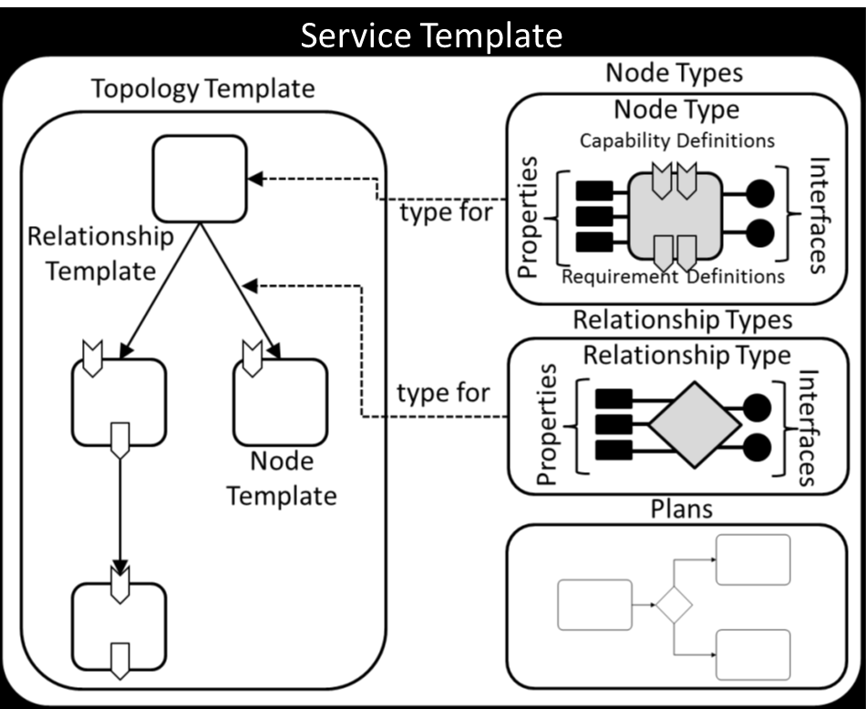
Present ONAP Understanding – Steps Towards Model Driven
TOSCA-based Orchestration: Option 2
Design Time
Execution Time
Upon receipt of a SO request, initiate appropriate top-level BPMN workflow.
Preference to keep as simple as possible, to promote Declarative processing approach
Request
SDC
Service Orchestrator
Tools for Declarative & Imperative
Model Design
Micro-Service Bus
Determine top-level workflow
BPMN
Design
Catalog
Runtime
Catalog
Service
Model
Model Distribution
Service
Model
Metadata Model Driven Orchestration
Service
Model
Service
Model
Service
Model
Service
Model
Success/Fail
Rainy Day Option:
Invoke Inverse
Resource
Model
Load
Invoke
Resource
Model
Resource
Model
Resource
Model
Resource
Model
Resource
Model
Invoke Operation Implementation
Preferred : Since it Achieves Some Benefits As Mentioned
TOSCA
Orchestrator
For each BPMN work step that delegates to the TOSCA Orchestrator:
Determine the associated TOSCA Service Template and associated Inputs
load into the TOSCA Orchestrator
Call TOSCA Orchestrator to perform the relevant action
The TOSCA Orchestrator uses the Service Template to determine the proper Operations and sequencing thereof on the various Node Types
TOSCA Parser for En-Coding / De-Coding

Slide 10
Parser Centralization (& Subsequent) Standardization Proposal
Under Lens : As – Is Proposal From Linux Foundation
  Use both Declarative and Imperative workflow patterns for Service and Domain Orchestration Engines
  Parser to be used inside execution engines, specific to component consuming models
ARIA Parser
Runtime
Catalog
& / or
Design
Catalog
Apache Foundation ARIA / ONAP Custom Version
Service Orchestration Engine
Service
Model
Service
Model
Service
Model
Service
Model
Imperative Orchestration
Declarative
Model
Service
Model
Service
Model
Declarative
Model
Resource
Model
Resource
Model
Domain Orchestration Engine
Resource
Model
Resource
Model
Resource
Model
Resource
Model
Declarative Orchestration
Model Designer
Model En-Coding
Model De-Coder
Object Formation
Design Service Templates
Decode / Parse Service Templates & Distribute to Execution / Operational Platforms

Slide 11
Parser Centralization (& Subsequent) Externalization Proposal
Architectural Separation For True “Model Driven” Alignment
  Present Mechanism will be Repeated For Each Execution Platform
  We Want to Propose De-Duplication / Centralization Within ONAP of Highlighted Logic Block (we will explain later in the deck, how it helps)
A “Central” Parser Staging Block,
For En-Coding & De-Coding
ARIA Parser
Runtime
Catalog
& / or
Design
Catalog
Apache Foundation ARIA / ONAP Customer Version
Service Orchestration Engine
Service
Model
Service
Model
Service
Model
Service
Model
Service
Model
Service
Model
Resource
Model
Resource
Model
Domain Orchestration Engine
Resource
Model
Resource
Model
Resource
Model
Resource
Model
Model Designer
Model En-Coding
Model De-Coder
Object Formation
Design Service Templates
Decode / Parse Service Templates & Distribute to Execution / Operational Platforms

Slide 12
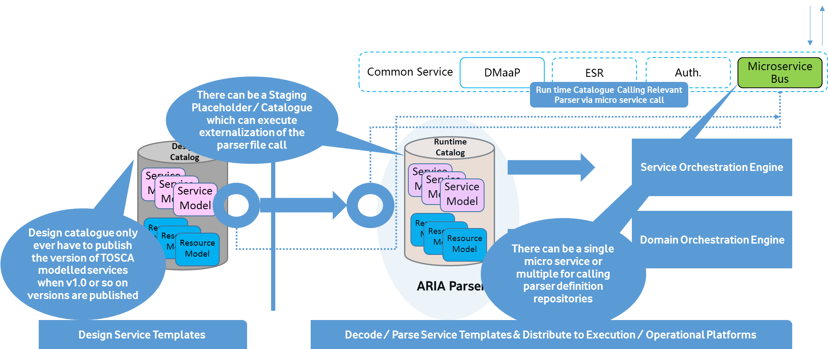
Parser Centralization (& Subsequent) Externalization Proposal
Micro Service(s) / API For Acquiring Parser (not a run time activity, but a definition push time activity)
https://wiki.oasis-open.org/tosca/TOSCA-implementations
Enhance “Design Time” TOSCA Templates to include “Decoding” Parser Needed By Consumer(s)
Enhance “Design Time” TOSCA Templates to include models needed by A&AI, FCAPS Analytics, and all other modules in ONAP
Build a micro service in “Common Services Layer” to call OASIS / External Parser Validation Tool
As Long as Consumer has access to this common service call and a centralized mechanism to call requires parser,
it can understand and execute the required workflow / intent
Provides inter-op with external non ONAP components
Centralization / Externalization of Parser

Slide 13
Parser Centralization (& Subsequent) Externalization Proposal – Derived Requirements
Req. 1: Service / Resource Model (Designer &) Consumers (SO, AAI, SDN-C etc…) Shall Not Maintain Multiple Parsers for Consumption of Models – All to work towards same / shared intent
Req. 2: SDC will provide a centralized distribution of models and parsers URI’s for ‘all’ types of consumers (To begin with, all of ONAP’s execution modules) – Refer Slide 10 for highlighted block to be centralized within ONAP for Release 2
Req.3: Subsequently Micro-Service/Centralized API should be called for acquiring a Parser Definition
  Proposed ONAP MS will be used for both internal (to begin with - centralization) and (subsequently) external Parser Definitions
  By Externalizing ONAP Parser, the same can be consumed by both ONAP and non-ONAP components
Agreement on Req. 1 in Release 2
Prioritization on Req. 2 in Release 2
Prioritization on Req. 3 in Release 2 or 3
Internal / Member Dependency
Internal / Member Dependency
External / SDO Liaison Dependency
Proposal is to include Req. 1, 2 and 3 as part of the Carrier Grade Requirements list

Slide 14
Supporting companies and proposed VNFs
Vodafone
AMDOCS
Cloudify
Huawei
Infosys
Any other?
Any NS and/or VNF in any R2 Use Case will benefit from Centralisation of parser(s)
Proposal to merge Centralisation use case with any of the following (R2) use cases, subject to agreement:
  vCPE (or)
  Slicing (or)
  Scale out

Slide 15
Backup
User Stories, Dependencies…

Slide 16
Some Additional Details from Proposal (User Stories, Dependencies, Investigations etc…)
The Details
TOSCA Definition : Enhance to Mention Parser Version / Location / Name Space
Introduce Centralized Micro Service to Stage TOSCA Parser Definition – Rls 2
Re-Condition Centralized Micro Service to Fetch TOSCA Parser Definition – Rls 2/3
Potential Challenges
Flexibility of TOSCA Constructs to Define Additional Details
Response Times, Design Time or Publish Time Activity (Not a run time activity)
Dependency on Hosting Parser Definition Externally to ONAP, within Linux Foundation or Apache or OASIS etc…
Micro Service Invocation Conditions To Be Determined
Service Version Change
& / or
Parser Version Chance (Both Ways Invocation)
Target Release / Liaison for Parser Hosting & Governance
Release 2 or 3
(Work Out Design / Delivery Roadmap) &
SDO Liaison, Updated Parser Governance Work Stream As Part of Modelling Sub-Committe
Detailed Proposal & Impact Assessment
To Be Elaborated, Collect Feedback from Partners / Members
Benefit 1 : Shared Intent With Existing Modules within ONAP Stack (to begin with)
This Seemingly Small Technical Change has Profound Impact on Increasing ONAP Adoption
Benefit 2 : Existing Service Providers Stacks Conforms / Migrates To TOSCA Intents [Triggers Business Case For Upgrades]
Benefit 3 : Global Parser Hosting / Management / Governance (OASIS, OPNFV, Apache, Linux Foundation etc…) – Move to truly Model Driven Approach
Benefit 4 : Global Service Model Definitions, Inter – Op Between Existing B/OSS and ONAP Facilitation

Slide 17
Some Additional Details from Proposal (User Stories, Dependencies, Investigations etc…)
Summary | Release 2 : Centralization of Parser
User Stories | Decouple Parser Bundling at Design and Run time Catalogue into A Central Staging Micro-Service
Actor(s) | Design Catalogue, Run Time Catalogue, Micro-Service Layer, Model Distribution, TOSCA Definition URL / Semantics Enhancement
Pre-Conditions | Some of the perceived pre-conditions to execute this requirement are - (a) Enhancement ability of TOSCA definitions to mention URL of Parser (b) Ability of Micro Service Layer to Expose Parser Staging Capability (c) Design and Run Time Catalogue to Interact with Staging Micro-Service to Acquire Parser Binary [Single Hosting of Parser Definition / Whoever Wants it, will call this Micro-Service]
Description | Create a micro-service placeholder in services layer for parser hosting Create methods for query / access / acquire TOSCA binaries from this central micro-service Update ONAP modelling architecture to depict change for centralization of parser function
Post-Conditions | There should be a central MS which all design and run time blocks in ONAP can refer to for parser definition Not to be confused with this being a run-time activity itself, this is a design time function and not a recurring function unless parser definition changes or service models change
Implications on the Interfaces | Micro-Services Layer Update Interaction from all publishers and consumers within ONAP and this service exposure layer / micro-service
Release 2
User Story
TOSCA Definition Tweak (Declare Parser Location)
Micro-Service Placeholder / Block for Centralization of Parser
Interactions from SDC and Consumers (SO, AAI etc…)

Slide 18
Some Additional Details from Proposal (User Stories, Dependencies, Investigations etc…)
Summary | Release 2 / 3 : Externalization of Parser
User Stories | Central Micro-Service Makes Calls to External Hosting Repository for Acquiring Parser Definition
Actor(s) | Micro-Service Layer, External SDO
Pre-Conditions | Some of the perceived pre-conditions to execute this requirement are - (a) Engagement and Governance of Parser Function with Chosen SDO – OASIS or Apache or Others…(b) Ability of Micro Service Layer to Acquire Parser Binaries from Hosting SDO – Trigger Conditions To Be Discussed (c) Open Integration With SDO and Staging / Storing Binaries in Services Layer – Would be covered in Release 2
Description | Methods for query / access / acquire TOSCA binaries from this externally hosted SDO repository Discussion threads with SDO for Parser Governance, Feed-Back and Maintenance of Definitions
Post-Conditions | Governance and SDO Repository Worked Out Member Companies Agree on Parser Definition and Invocation of Case for ONAP and non-ONAP interop for referencing same Parsing Function to SDO repository
Implications on the Interfaces | Micro-Services Layer Update Interaction from all publishers and consumers within ONAP and (potentially outside ONAP)
Release 2 &/or 3
User Story
SDO Engagement / Governance
Micro-Service Placeholder / Block for Externalization of Parser
Interactions with ONAP and non-ONAP Stacks

Slide 19
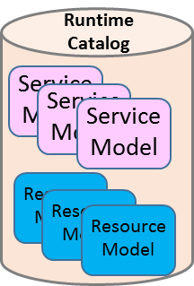
Architecture Improvisation - 1
SO
Common Parser Binary
[Parsing Function]
Apache Foundation ARIA / ONAP Custom Version
Model Distribution
VFC
Model De-Coder
Object Formation
Design
Catalog
SDNC
Service
Model
APPC
Service
Model
Service
Model
Resource
Model
Policy
Resource
Model
Resource
Model
Model Distribution
……..
Model De-Coder
Object Formation
3rd Party External System
Model Designer
Model En-Coding
Design Service Templates
Decode / Parse Service Templates & Distribute to Execution / Operational Platforms

Slide 20


Architecture Improvisation - 2
External SDO Managed Model(s) / Parser(s)
OSS / BSS
CLI
U-UI
ONAP Portal
ONAP External APIs
DESIGN-TIME
Dashboard OA&M
RUN-TIME
Resource Onboarding
Policy Framework
Data Collection, Analytics, and Events
Event Correlation
Active & Available Inventory
External Registry
Common Services
Orchestration
Service Design
Run Time Object
Run Time Object
Run Time Object
Parser Binaries / Definition Placeholder
Parser Binaries / Definition Placeholder
Policy Creation & Validation
ONAP Operations Manager
Analytic Application Design
Micro Services Bus / Data Movement (see Note 1)
VNF / PNF Onboarding
Application
Authorization
Framework
Closed Loop Design
Change Management Design
Generic NF Controllers (L4-L7)
ONAP Optimization Framework
Multi-Cloud
Adaptation
SDN Controller
(L0-L3)
Design Test & Certification
Life Cycle Management & Config
Logging
CCSDK
(see Note 1)
(see Note 1)
[Design Time] Catalog
Optional External Systems
3rd Party Controller
Specific VNF Manager
Element Management System
…
Managed Environment
Network Function Layer
Recipe/Eng Rules & Policy Distribution
ONAP Optimization Framework
VNFs
PNFs
Hypervisor / OS Layer
OpenStack
VMware
Azure
AMZ
RackSpace
Note 1 – Consistent APIs between Orchestration layer and Controllers
MPLS
IP
Private
Edge Cloud
Private
DC Cloud
Public
Cloud

Slide 21
Architecture Improvisation - 3
Design Time / SDC
(DT-Catalog)
TOSCA Parser Binar(ies)
[As a Service]
Run Time / Execution Platforms
[RT-Catalog / Object Creation]
Resource Library Creation
[Discover Resources]
Parser Binary Reference /
Get Latest Parser Grammar
Get / Receive Service Model Packages
Service Model Creation
[Model Repository]
Check package structure
Distribute
Service
Models
Parser Binary Reference /
Get Latest Parser Grammar
Update the service model package as per
models “state machine”
Parser all the packages
Create Application Specific Objects
Save Objects in Application Data Model

Slide 22
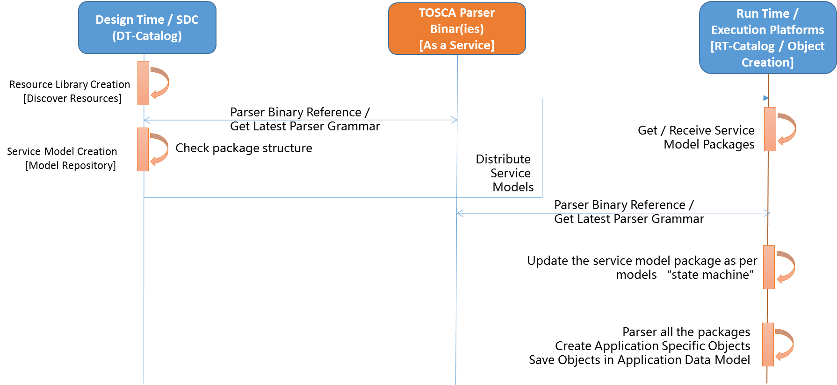
Architecture Improvisation - 4
External SDO / Managed Parser Binary Repository
Externalization of Parser Binary (API Layer)
ONAP Boundary

Slide 23
Some Additional Details from Proposal (User Stories, Dependencies, Investigations etc…)
NS Package is created and includes Model and Parser URI per consumer
  Models and Parser URI’s are distributed to all consumers by SDC
  A consumer calls MS for retrieving an applicable parser from parsers repository
  Note: SDC R&D currently develops a parser based on the Open Stack parser and it may also be arranged as a MS
➢For Outside-ONAP components
  Operator on-boards models and parser URI’s for consumers outside ONAP
  SDC while parsing NS package recognizes the artifacts to be forwarded to consumers outside ONAP

Slide 24
