Slide 1
OOF-SON: 5G Self-Organizing Network (SON) using ONAP Optimization Framework (OOF):
Requirements Proposal for Guilin
March 16, 2020
Collaborators : AT&T, Wipro, IBM, highstreet technologies,
TechMahindra, Lumina Networks, Nokia,
Reliance Jio, Rutgers Winlab
Acknowledgments : Feedback and support from participants
in ONAP OOF-SON team calls
Presenters : Shankaranayaranan N K, Swaminathan S

Slide 2
Summary of Requirements (Under Discussion)
Category | Requirement | Content | Priority
Interoperability | O-RAN alignment (VES, O1 interface) | Receive Configuration Management (CM) notifications over VES (instead of netconf) | HIGH
Functional | RAN Database (Runtime Config DB), including any new RAN models | Data models/DB schema and APIs to be generated from yang models Details of cells to be stored with PNF reference in AAI Modeling of RAN functions and objects | HIGH
Platform | Control Loop Coordination (CLC) extensions | Collaborate on CLC extensions (queueing, priority, …) | HIGH
Functional | Integration of SON and PNF onboarding functions | New cell(s) addition – extension to PNF onboarding & registration scenario, addition of new cell later to a PNF Initial assignment of PCI to a cell | MEDIUM
Functional | New SON function to evolve ONAP platform | SON based on data/KPI analysis CLC interaction Machine Learning (ML) aspects in DCAE | MEDIUM
Functional | SON Lifecycle | Role of SO, SDC, CLAMP (for SON service/feature deployment) | LOW
Interoperability | Real gNB interaction | Interaction with real gNB in lab | LOW

Slide 3
ONAP SON alignment with O-RAN
This has dependency on progress within O-RAN
Simulated RAN
~2000 Cells
Neighbor list, PCI
ONAP
Centralized SON (cSON) functions
Control Loop actions
✓
✓
DB schema &APIs generated from yang models
Config change
O1 - Netconf interface
✓
CM Notify
VES
O1 - VES
outputs
FM/PM KPIs
Cells/GNBs
RIC
Yang model
✓
Guilin scope
Receive Config Management (CM) notification from RAN over (standardized) VES (Priority 1)
ONAP DB schema and APIs to be generated from associated ORAN network yang models (Priority 1)
Send Config change to RAN (to update neighbor list or PCI value) using O-RAN aligned yang models (Priority 2)
Note: Substantial work in RAN Simulator to develop/test/demo ONAP functionality

Slide 4
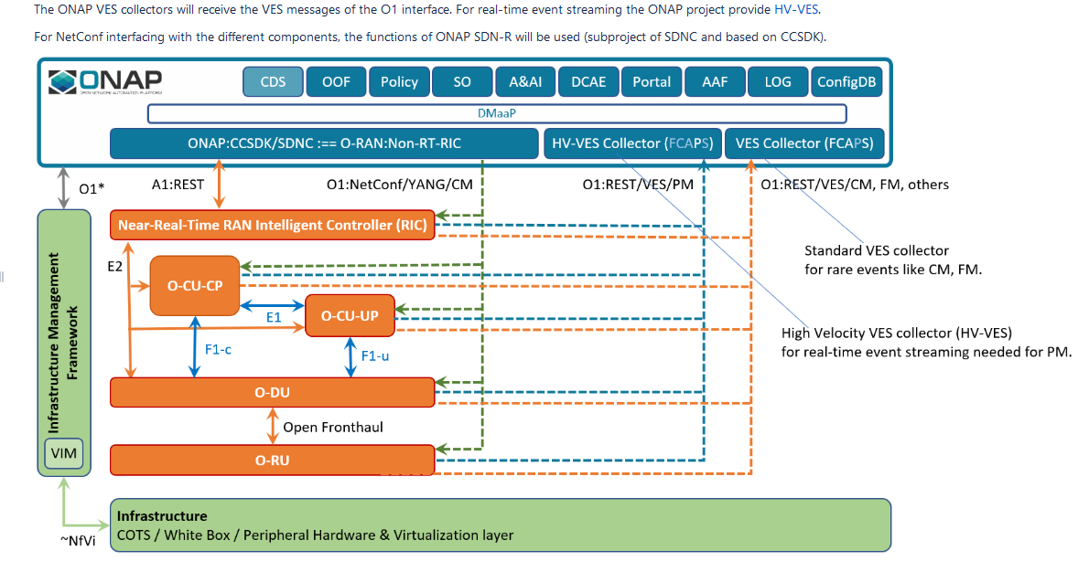
ONAP SON alignment with O-RAN

Slide 5
ONAP RAN Database (Runtime Config DB)
Objectives
  Build upon 5G SON RAN Database started in Dublin & Frankfurt
  Collaborate with (new) Rel 7 Runtime Config DB project to make this a shared ONAP functionality
Dependencies
  Availability of O-RAN yang models and VES specification
  Runtime Config DB, DCAE
 | Frankfurt (Release 6) | Guilin (Release 7)
RAN database | ConfigDB (part of SDN-C CCSDK) | Runtime Config DB (RCDB) (New Rel 7 function)
Config (CM) notification | Pre-standard VES message | ORAN standard VES CM Notify message
CM Notify processing | RANSim –> DMaaP -> SDNR | RANSim -> DCAE -> DMaaP -> SDNR
CM update | SDNR -> ConfigDB | SDNR -> RCDB

Slide 6







Control Loop Coordination
Illustration of CLC with queuing
CL2
Collaborate with Policy/Control Loop Team for extensions to Control Loop Coordination (CLC)
Build further on Frankfurt work to enhance Platform capabilities, for example:
  Queueing/de-queueing (illustrated in the figure)
  Discard outdated loop actions
  Prioritization/pre-emption
CLC has much wider implications to ONAP as a platform, and not just restricted in scope to SON use cases
Optimization (OOF)
2c
Co-ordination, Decisions
(Policy)
2a
2b
2d
Data Collection,
& Analysis
(DCAE)
1a
1b
1c
1f
RIC (non-RT)
Action
(SDN-R)
FM, PM, CM
1d
2e
A-1/O-1
(Near RT) RIC
1e
ORAN Radio Network
A-1/O-1
Control Loop 1
Control Loop 2

Slide 7



SON Lifecycle – Cell addition/configuration
1
Resources Definition/Services Definition
SDC: PNF (physical element) Modeling
Distribution of types
Design
PNF Modeling
New cell addition by ONAP – extend PNF Plug-and-play use case
Assign initial PCI value (any other configuration?)
Points for further analysis and discussion
  Modeling of RAN “Cell” in ONAP
  ‘Discovery’ of a new cell (provided by PNF?) and subsequent configuration (by ONAP?) before it is active; removal of a cell (dis-associate from PNF)
  Handling of “shared”/”virtual” cells
  O-RAN alignment
    Cell discovery, initial configuration, new cell addition/removal later, initial PCI assignment
  Initial NR details update in ONAP (topology discovery?)
2
PNF Infrastructure Service Declaration
First part of PNF instantiation
DCAE & AAI Entry with PNF ID (e.g. MAC address)
PNF Instance
Declaration
3
PNF Powers up and Boot-straps
PNF performs a “Plug and Play” procedure
Equipment vendor proprietary steps
PNF
Boot-strapping
4
PNF
Contacts ONAP
PNF connects to ONAP via a Registration Event
PNF Registration Handler (PRH) processes the event
Run-Time (Instances)
5
PNF
Activation
Connection points configured
Second part of PNF service instantiation
PNF configured and ready to provide service
6
New cells configured & manageable from ONAP
Include PCI assignment to cells associated with PNF
and update NR info from cells
Cell Configuration
(for SON)
Notes:
SDN-R impacts
Interactions with Runtime Config DB
SON-Handler MS and OOF interface updates (no existing PCI)? Or will SO trigger OOF directly?
32.501 REQ_SCRCD_CON_1 (Self configuration of eNodeB) (check similar aspect for 5G gNodeB)

Slide 8
Other requirements (under investigation)
New SON use case to extend ONAP platform capabilities
Handle large volume of real-time data (HV-VES), and process it
Application of ML in ONAP (specifically in Control Loops)
CLC
SON Lifecycle
  Role of SDC, SO and AAI for “ONAP SON Service”
  Deployment of Control Loop via CLAMP
  Instantiation of SON-Handler MS when the first cell is activated
Interaction with real gNB and/or O-RAN software components

Slide 9
Business Drivers
Executive Summary
SON (Self-Organizing Networks) functionality is an essential part of 4G networks, and will be even more critical for 5G. SON enables automation to improve network performance and efficiency, improve user experience, and reduce operational expenses and complexity. The objective of the OOF SON use cases is to develop an ONAP-based SON platform using the ONAP Optimization Framework (OOF). We have taken a phased approach since SON is complex, and SON for 5G is still evolving. We started with the Physical Cell Identity (PCI) optimization SON use case in Casablanca, and added centralized Automated Neighbor Relations (ANR) aspects in Dublin. In Frankfurt, we included adaptive SON functionality, took initial steps in O-RAN alignment and collaborated with Policy Control Loop Co-ordination (CLC). For Guilin, we will align with ORAN interfaces, be the early adopter of the new Runtime Config DB (e.g. generate DB schemas and APIs based on yang models), cover SON-related workflow for new cell addition, introduce another SON use case to add new platform capabilities, and collaborate on further extensions to CLC. We will also pursue alignment with industry trends for open interfaces & open models for RAN interactions, in particular with O-RAN.
Business Impact
SON is an essential feature in mobile networks, and relevant to every operator. Any ONAP-based network deployment for 5G will benefit from an ONAP-based SON solution, which provides a disaggregation of SON functions into modules aligned with the ONAP architecture. Operators and vendors will both benefit from the ability of vendors to bring best-in-class solutions to each module, while leveraging the benefits of a community-supported open platform. This will enable faster development of innovative solutions. The approach taken could very well be evolved to address SON use cases whose scope extends beyond just the RAN.

Slide 10
Business Markets
SON for 5G is relevant to all 5G operators and markets.
Funding/Financial Impacts
SON functions reduce OPEX since the automated self-organizing functions are an efficient approach to continuously optimize network configurations to improve performance and respond to network conditions.
Organization Mgmt, Sales Strategies
There are no additional organizational management or sales strategies for this beyond whatever is required for ONAP deployment to support 5G.

Slide 11
Thank You!

