Slide 1
AllottedResource and Network Slicing in Rel 7

Slide 2
R7 Model Flow
CST
Allotted resource here is to show one NS requirement need find a NSI to carry.
2
DT relation
1
RT relation
AllottedResource
ServiceProfile (T)
NST
3
Here NST associate AllottedResource in DT, where AllottedResource contains NSST ID in DT.
OOF use policy/rules to do NST selection first in RT.
Allotted resource here is to show NSI need NSSI to compose, NSSI can be new or a existed one.
NSSI selection needs slice profile as assistance
Slice Profile(T)
Slice Profile(T)
4
AllottedResource
AllottedResource
AllottedResource
AllottedResource
5
Allotted resource here is to tell each slice profile requirement should find an NSSI to carry. Just need create an relationship, don’t need to do any selection.
NSST
NSST

Slide 3
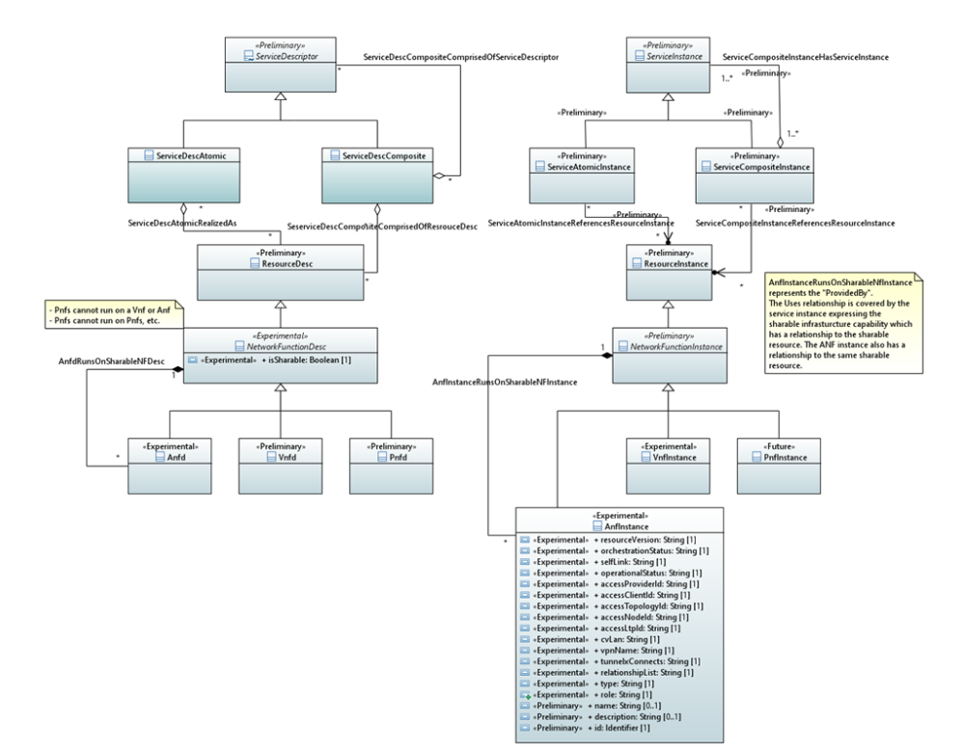
Allotted Resouce Model Proposal
Defined Relations:
ServiceDescCompositeComprisedOfServiceDescriptor
ServiceDescAtomicRealizedAs
ServiceDescCompositeComprisedOfResourceDesc
AnfDRunsOnSharableNFDesc

Slide 4
Identification of the Relations used in Slicing Model
CST
?
AllottedResource
ServiceDescCompositeComprisedOfServiceDescriptor
?
ServiceProfile (T)
NST
3
ServiceDescCompositeComprisedOfServiceDescriptor
ServiceDescCompositeComprisedOfServiceDescriptor
?
?
4
Slice Profile(T)
Slice Profile(T)
AllottedResource
AllottedResource
?
?
?
AllottedResource
AllottedResource
?
5
NSST
NSST
?
ServiceDescriptor

Slide 5
Identification of the Relations used in Slicing Model: OPTION1
CST
ServiceDescCompositeComprisedOfServiceDescriptor
ServiceDescCompositeComprisedOfServiceDescriptor
?
AllottedResource
ServiceDescCompositeComprisedOfServiceDescriptor
ServiceProfile (T)
NST
3
ServiceDescCompositeComprisedOfServiceDescriptor
ServiceDescCompositeComprisedOfServiceDescriptor
?
?
4
Slice Profile(T)
Slice Profile(T)
AllottedResource
AllottedResource
?
?
?
AllottedResource
AllottedResource
?
5
NSST
NSST
?
ServiceDescriptor

Slide 6
Identification of the Relations used in Slicing Model: OPTION2
CST
No relation in current IM proposal can be used here.
Should we consider to change
”AnfDRunsOnSharableNFDesc” in “AnfDRunsOnSharableServiceDesc” ?
?
AllottedResource
ServiceDescCompositeComprisedOfServiceDescriptor
ServiceProfile (T)
ServiceDescCompositeComprisedOfResourceDesc
NST
3
ServiceDescCompositeComprisedOfServiceDescriptor
ServiceDescCompositeComprisedOfServiceDescriptor
?
?
4
Slice Profile(T)
Slice Profile(T)
AllottedResource
AllottedResource
?
?
?
AllottedResource
AllottedResource
?
5
NSST
NSST
?
ResourceDescriptor
ServiceDescriptor

