Slide 1
k8splugin/EMCO v1 & v2 overview for AAI CNF Modeling meeting
Ritu Sood & Eric Multanen

Slide 2
k8splugin v1 overview
k8splugin
https://wiki.onap.org/display/DW/MultiCloud+K8s-Plugin-service+API
Connectivity Info API
Definition API (onboard helm packages)
Profile API (customizations)
Instantiation API
(Configuration API)
monitor in clusters
connectivity info
(cluster/cloudregion register)
Definition API (helm package)
Profile API
External API Endpoint
Instantiation API
Resource Synchronizer
Configuration API
Mongo
DB
Monitor
Monitor
Monitor
2

Slide 3




Orchestrate Geo-Distributed
Edge Applications
Public/ Private Cloud
μS4
μS4
External System
μS3
Cloud
Platform
Public/ Private Cloud
Edge Drivers
Latency/ Physics
Bandwidth/ Economics
Context/ Proximity
Privacy/ Legal
WAN
μS4
μS4
Edge 1
Edge n
μS3
WAN
μS2
μS2
μS2
μS1
μS1
μS1
μS1
μS1
μS1
Cloud Platform
Edge
Platform
Edge
Platform
WAN
Network (LAN/ WAN)
Vision: “One click” cross-cluster deployment
3

Slide 4
ONAP4K8s v2 features
Geo-Distributed composite application support
Ability to replicate workloads in multiple locations
Completely intent based
Extensible architecture to allow external controllers & intents
Cluster provider support
Ability to create multiple virtual networks
Ability to expose provider networks in the cluster
Updating K8s resources based on intents (no changes to vendor provided helm charts)
4

Slide 5
High Level EMCO Architecture
Cluster Registration Controller registers clusters by cluster owners
Network Configuration Management handles creation/management of virtual and provider networks
Distributed Application Scheduler provides simplified, and extensible placement
Hardware Platform Aware Controller enables scheduling with auto-discovery of platform features/ capabilities
Distributed Cloud Manager presents a single logical cloud from multiple edges
Secure Mesh Controller auto-configures both service mesh (ISTIO) and security policy (NAT, firewall)
Secure WAN Controller automates secure overlays across edge groups
Resource Syncronizer manages instantiation of resources to clusters
Monitoring covers distributed application performance, and accesses
CLI/GUI
EMCO
Cluster Registration Controller
Distributed Application scheduler
Hardware Platform
Aware Controller
Distributed Cloud Manager
Network Configuration Management
Secure Mesh Controller
Secure WAN Controller
Resource Synchronizer
Monitoring
Software Platforms
Enterprise Edges
Edge Clouds
Network
Edges
Telco CO
Edges
Pub/Pvt
Clouds
5

Slide 6
Distributed Application Scheduler (orchestrator)
Project Management provides multi-tenancy in the application from a user perspective
Composite App Management manages composite apps that are collections of Helm Charts one per application
Composite Profile Management manages composite profiles that are collections of profile one per application
Deployment Intent Group Management manages Intents for composite Applications
Controller Registration manages placement and action controller registration, priorities etc.
Status Notifier framework allows user to get on-demand status updates or notifications on status updates
Scheduler
  Placement Controllers
    Generic Placement Controller
  Action Controllers
Distributed Application Scheduler Microservice
Generic Placement Controller
Project Management
Placement Controllers
Composite App Management
Scheduler
Placement Stage
Composite Profile Management
OVN4NFV action Controller
External API Endpoint
Deployment Intent Group Management
Action
Controllers
Status Notifier
Action Stage
Controller Registration
Resource Synchronizer and Status Microservice
Mongo
DB
etcd
Monitor
Monitor
Monitor
6

Slide 7
Cluster Registration Management Microservice (clm)
Cluster Registration Management Microservice
Cluster Provider Management manages cluster providers
Cluster Management manages cluster per provider
Cluster Provider Management
External API Endpoint
Cluster Management
Mongo
DB
7

Slide 8
Network Configuration Management Microservice (ncm)
Provider Network Management provides support to create provider networks
Virtual Network Management provides support to create dynamic virtual networks
Controller Registration manages network plugin controllers, priorities etc.
Status Notifier framework allows user to get on-demand status updates or notifications on status updates
Scheduler
  Built in Controller - OVN-for-K8s-NFV Plugin Controller
  Network Plugin Controllers
Cluster Network Configuration Management Microservice
Provider Network Management
OVN-for-K8s-NFV Plugin Controller
Virtual Network Management
Scheduler
External API Endpoint
Controller Registration Management
Network Plugin
Controllers
Status Notifier
Resource Synchronizer and Status Microservice
Mongo
DB
etcd
Monitor
Monitor
Monitor
8

Slide 9
vFW Use Case Recap – k8splugin v1 API resources
virtlet containers
Management Network
KUD k8s cluster
packetgen
firewall
sink
Unprotected Network
Protected Network
Connectivity Info
Definitions
Profiles
vFW Chart
vFW profile
cluster edge01
Templates
Sub-charts
profile content
firewall
packetgen
unprotected-network
sink
protected-network
onap-network

Slide 10
vFW Use Case Recap
virtlet containers
Management Network
KUD k8s cluster
packetgen
firewall
sink
Unprotected Network
Protected Network
Definitions
Profiles
vFW Chart
vFW profile
Templates
Sub-charts
profile content
firewall
packetgen
unprotected-network
sink
protected-network
onap-network

Slide 11
vFW demo - v2 API resources
Controller registrations
Network Control Intents
Generic Placement Intent
ovnaction
vFW Composite Application
vFW Composite Profile
rsync
packetgen workload intent
packetgen placement intent
packetgen chart
packetgen profile
Interface Intents
emco-net i/f intent
firewall placement intent
Cluster Provider
profile content
Templates
unprotected i/f intent
cluster edge01
packetgen deployment
firewall profile
firewall workload intent
sink placement intent
cluster edge02
packetgen service
Interface Intents
Provider Network Intents
firewall chart
profile content
emco-net i/f intent
Templates
sink
profile
unprotected i/f intent
emco-network
firewall deployment
protected i/f intent
Deployment Intent
unprotected-network
profile content
sink workload intent
sink chart
placement:
generic placement
Templates
Interface Intents
Virtual Network Intents
sink deployment
emco-net i/f intent
action:
ovnaction
sink configmap
protected i/f intent
protected-network
sink service

Slide 12
vFW Test Script – set up clusters and controllers
test script
3
(ovnaction, rsync)
2
clm
ncm
orchestrator
ovnaction
cluster APIs
1
network intents
scheduler
composite app APIs
generic placement
deployment intent
scheduler
workload / interface APIs
controller register API
ovn4k8s
controller
generic placement
controller
ovnaction
controller
rsync
mongodb
ectd (appcontext)
edge01
edge02
12

Slide 13
vFW Test Script – set up the composite app and intents
test script
1
2
4
3
clm
ncm
orchestrator
ovnaction
cluster APIs
network intents
scheduler
composite app APIs
generic placement
deployment intent
scheduler
workload / interface APIs
controller register API
ovn4k8s
controller
generic placement
controller
ovnaction
controller
rsync
mongodb
ectd (appcontext)
edge01
edge02
13

Slide 14
vFW Test Script – apply the network intents
test script
1
clm
ncm
orchestrator
ovnaction
cluster APIs
network intents
scheduler
composite app APIs
generic placement
deployment intent
scheduler
workload / interface APIs
2
controller register API
ovn4k8s
controller
generic placement
controller
ovnaction
controller
4
3
rsync
mongodb
ectd (appcontext)
5
Management Network
Management Network
Unprotected Network
Protected Network
Unprotected Network
Protected Network
edge01
edge02
14

Slide 15
vFW Test Script – instantiate a specific deployment intent
test script
1
clm
ncm
orchestrator
ovnaction
cluster APIs
network intents
scheduler
composite app APIs
generic placement
deployment intent
scheduler
workload / interface APIs
controller register API
2
4
ovn4k8s
controller
generic placement
controller
ovnaction
controller
6
3
5
rsync
mongodb
ectd (appcontext)
7
Management Network
Management Network
packetgen
firewall
sink
packetgen
firewall
sink
Unprotected Network
Protected Network
Unprotected Network
Protected Network
edge01
edge02
15

Slide 16
Status Monitoring Overview
https://wiki.onap.org/display/DW/Status+and+Monitoring
6
clm
ncm
orchestrator
ovnaction
cluster APIs
network intents
scheduler
composite app APIs
generic placement
deployment intent
scheduler
workload / interface APIs
controller register API
ovn4k8s
controller
generic placement
controller
ovnaction
controller
7
mongodb
ectd (appcontext)
rsync
5
watcher
watcher
Instantiate app resources to a cluster
  create the Status CR per app/cluster – select match Label
  resources (with Label) are instantiated by rsync
monitor watches for changes to Labelled resources
monitor update Status CR
watcher detects changes in Status CRs
watcher updates Status Resource in appcontext
query status of a deployment
retrieve from appcontext
4
1a
L
1b
Status CRs
Status CRs
Status CRs
Status CRs
Status CRs
Status CRs
3
resources
resources
L
resources
resources
resources
2
resources
monitor
monitor
edge01
edge02
16

Slide 17
ResourceBundleState CR (Status CR) – updated by ‘monitor’
apiVersion: k8splugin.io/v1alpha1
kind: ResourceBundleState
metadata:
labels:
emco/deployment-id: 171887448792644816-sink
name: sink-171887448792644816
namespace: default
spec:
selector:
matchLabels:
emco/deployment-id: 171887448792644816-sink
status:
ready: false
resourceCount: 0
configMapStatuses: []
daemonSetStatuses: []
deploymentStatuses: []
ingressStatuses: []
jobStatuses: []
podStatuses: []
secretStatuses: []
serviceStatuses: []
statefulSetStatuses: []
Instantiate app resources to a cluster
  create the Status CR per app/cluster – select match Label
  resources (with Label) are instantiated by rsync
monitor watches for changes to Labelled resources
monitor update Status CR
watcher detects changes in Status CRs
watcher updates Status Resource in appcontext
query status of a deployment
retrieve from appcontext
Todo:
Extend monitor for other resources
Framework to ‘register’ with the watcher to get events
ectd (appcontext)
rsync
5
watcher
watcher
4
1a
L
1b
Status CRs
Status CRs
Status CRs
Status CRs
Status CRs
Status CRs
3
resources
resources
L
resources
resources
resources
2
resources
monitor
Monitor populates the CR with resource info
monitor
edge01
edge02

Slide 18
Format produced for query output
GET: /v2/projects/{project-name}/composite-apps/{composite-app-name}/{version}/deployment-intent-groups/{deployment-intent-group-name}/status?output=<output-type>&app=<app-name>&cluster=<cluster-name>&resource=<resource-name>
RETURN BODY:
{
"name": "<name>",
"composite-app-name": "test-app",
"composite-app-version": "v1",
"profile-name": "test-app-profile",
"intent-group": "intent-group-1"
"namespace": "testinstallns",
"resources": [
{
"app-name": "collectd",
"clusters": [
{
"name": "cluster1",
"resources": [
{
"GVK": {
"Group": "",
"Version": "v1",
"Kind": "Service"
},
"Name": "mongo",
"status": "Running“ or { … }
},
{
"GVK": {
"Group": "",
"Version": "v1",
"Kind": "Service"
},
"Name": "mongo-read",
"status": "Terminated"
}
]
}
]
}
]
}
6
orchestrator
composite app APIs
generic placement
deployment intent
scheduler
controller register API
generic placement
controller
7
ectd (appcontext)
rsync
5
watcher

Slide 19
Reading
Geo-Distributed Application/Network-Service Requirements: https://www.linkedin.com/pulse/geo-distributed-application-orchestration-across-k8s-addepalli
Guidelines we followed: https://www.linkedin.com/pulse/central-orchestrator-onap4k8s-generic-design-srinivasa-addepalli
Architecture of ONAP4K8s(EMCO): https://www.linkedin.com/pulse/onap4k8s-architecture-srinivasa-addepalli
How does it compare to other Industry solutions: https://www.linkedin.com/pulse/multi-cluster-application-orchestration-industry-value-addepalli

Slide 20
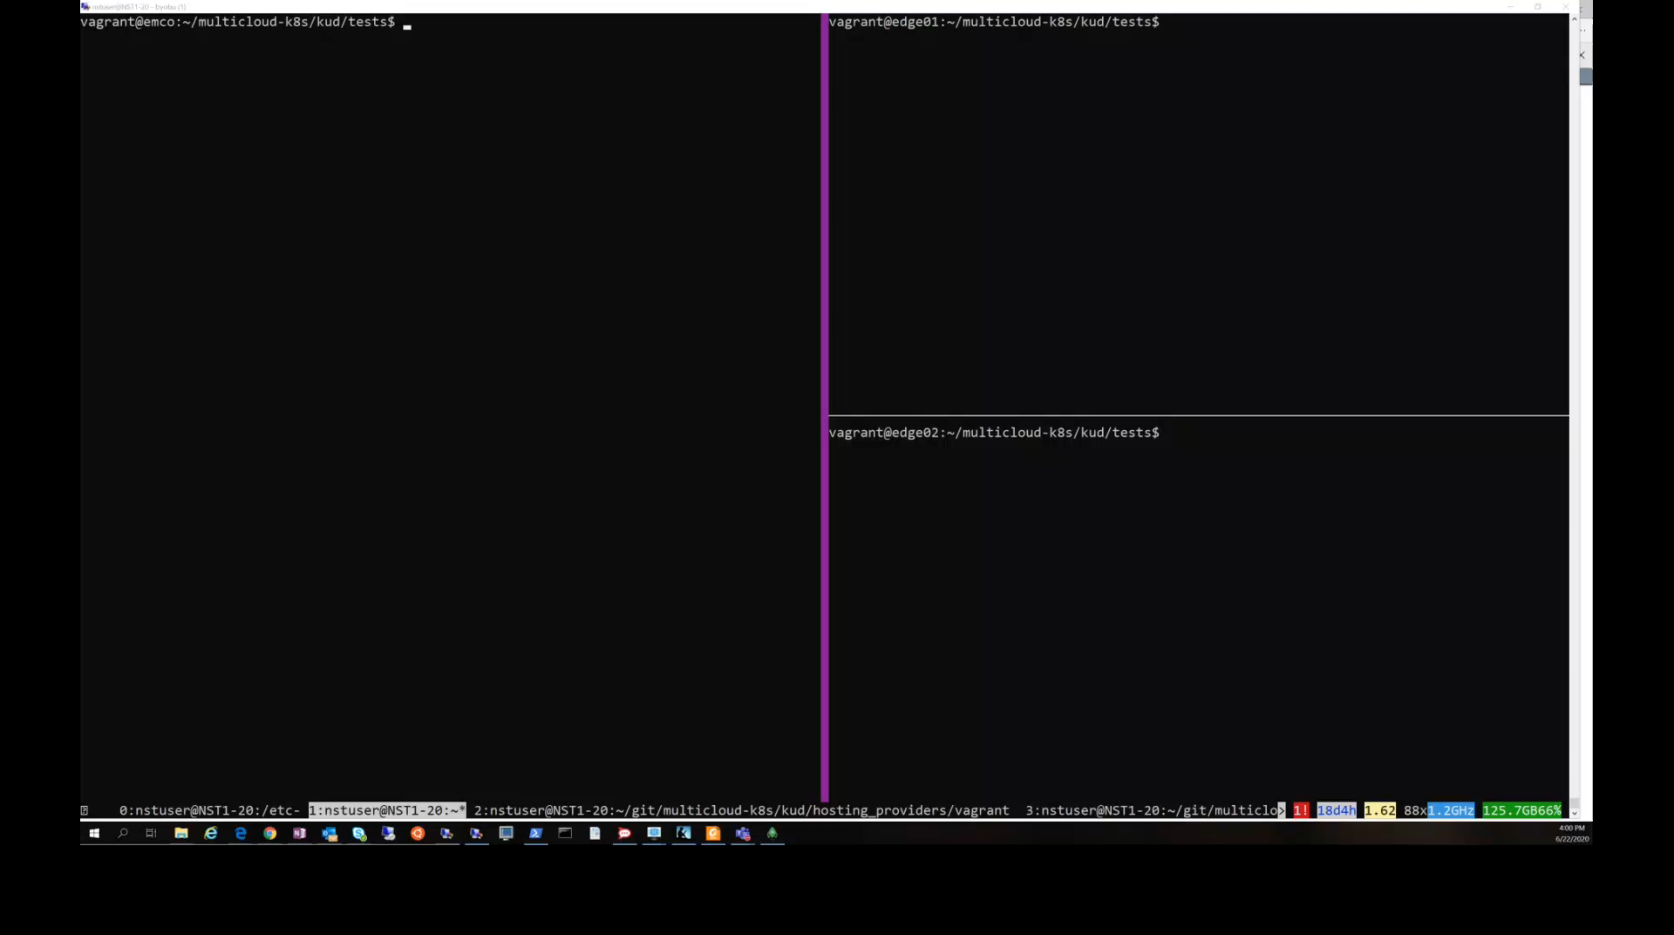
Run the demo

Slide 21
