Slide 1
ONAP CNF Orchestration Update & Summary
June 19th, 2020
Presented by: Byung-Woo Jun (Ericsson)
Fred Oliveira (Verizon)
Participating Companies
Ericsson
Verizon
AT&T
CMCC/ZTE
Huawei
Samsung
Intel
Others

Slide 2
Agenda
1 | ONAP CNF Taskforce Activities Initial Considerations Architecture / Modeling Approach Three CNF support approaches in ONAP
2 | Approach 1: ETSI-Alignment CNF Orchestration (Ericsson, Verizon, ETSI NFV) CNF Orchestration Overview CNF Package Management CNF Models ETSI VNFD and VDU Changes for CNF MCIOP Profile Access Information for VNF Package Content OsContainerDesc SwImageDesc Attributes VirtualStorageDesc Attributes VNF Lifecycle Operation Granting CNF Resource Definition for Granting IFA011 411 Draft Proposal addition to VipCpd AA&I Schema for CNF
3 | References

Slide 3
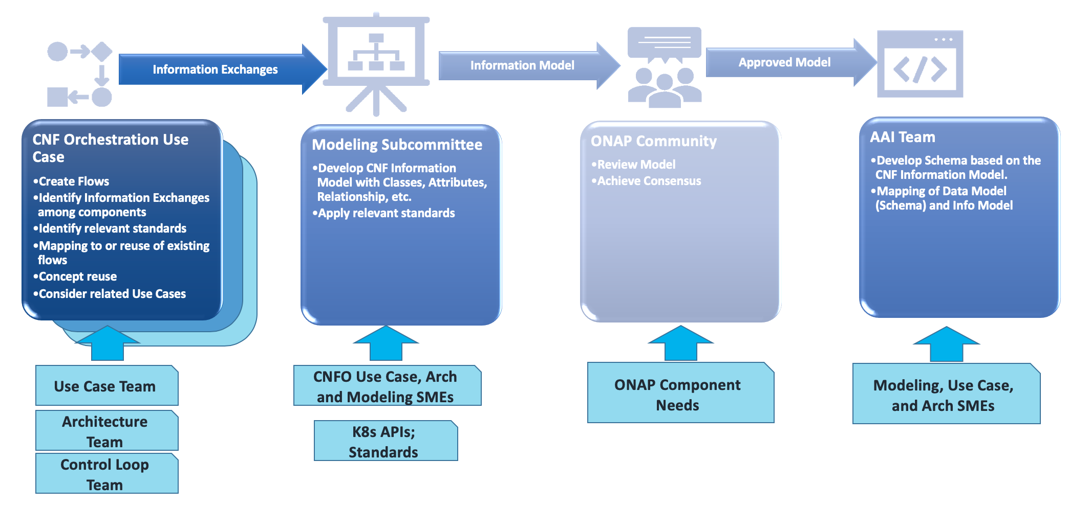
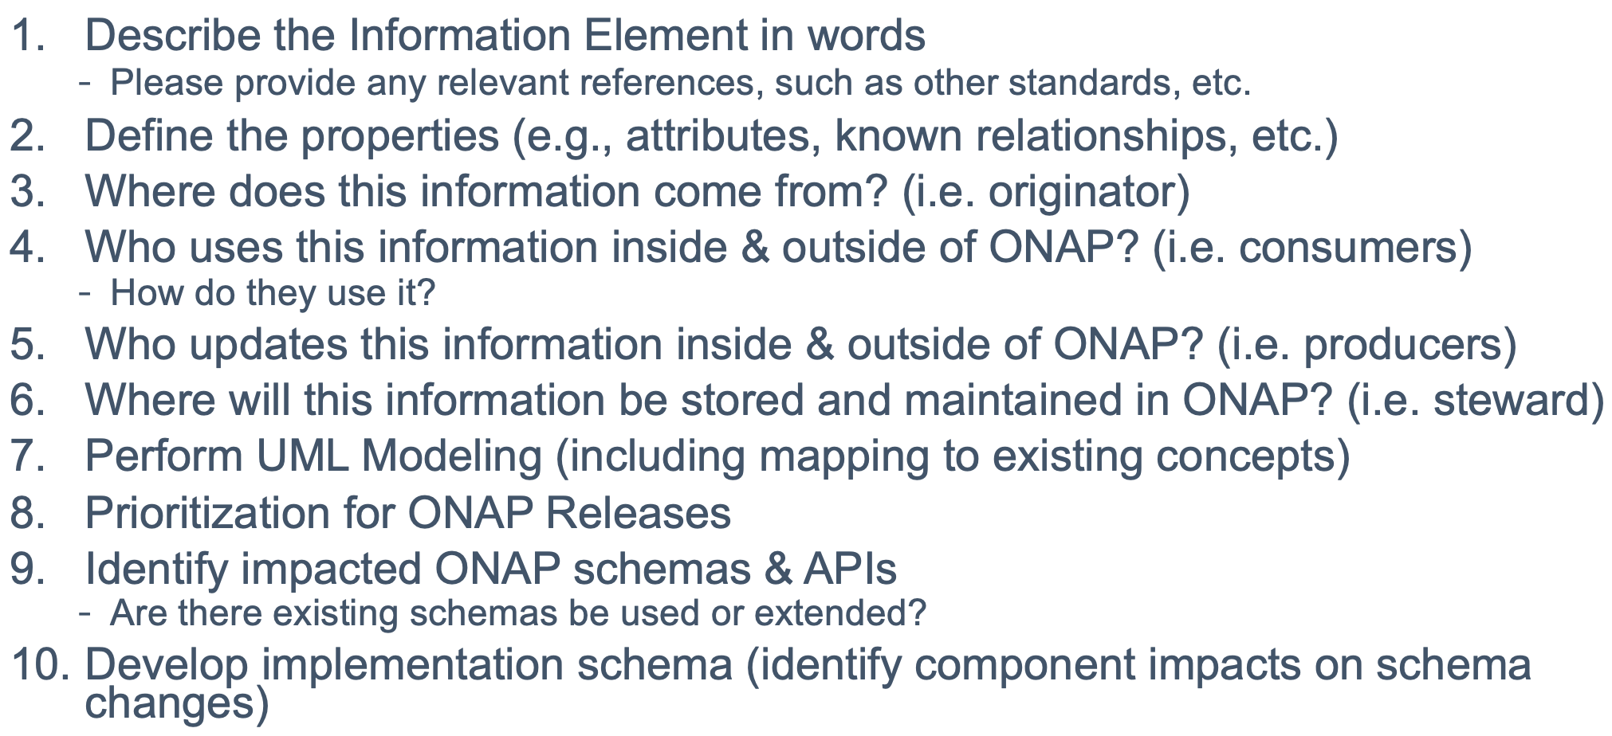
ONAP CNF Taskforce Activities
CNF Task Force team is formed in ONAP
  Initial Considerations / Analysis
    What do we need to do in ONAP to support CNF modelling and storage?
    How and who will support CNF Modelling, Packaging, LCM, Service Assurance, Control Loop, etc.? What standards? ETSI, CNCF?
    How to model the generic CNF to avoid customization per CNF?
    How to identify Pods in AAI?
    How to map VNFD (CNFD) to SDC AID DM?
  Suggested Use Cases: cFW, CNF “free5GC” (https://www.free5gc.org/), Samsung 4G/5G
  Architecture Discussions:
    Where is the best place to handle K8S adapter (MultiCloud, SO, ETSI external component)?
    Considering ETSI CNF Support and how to make workflows for internal and external VNFM as similar as possible
Three CNF support approaches in ONAP
  ETSI-Based CNF Orchestration (Hierarchical Management) – Ericsson and Verizon
    What information we need to store in ONAP (A&AI) for granting ((by NFVO) and others is one of questions – under investigation
  ONAP SO CNF Orchestration (Direct Management) – Huawei, Samsung, Intel
    Author Note: attaching the Helm Chart to the vf-module is a concern
  MultiCloud CNF Orchestration – Intel and some PoCs done by other participants
    Author Note: use the dummy HEAT template to host the Helm chart for distribution is a concern
Modeling Approach
For each Information Element:

Slide 4
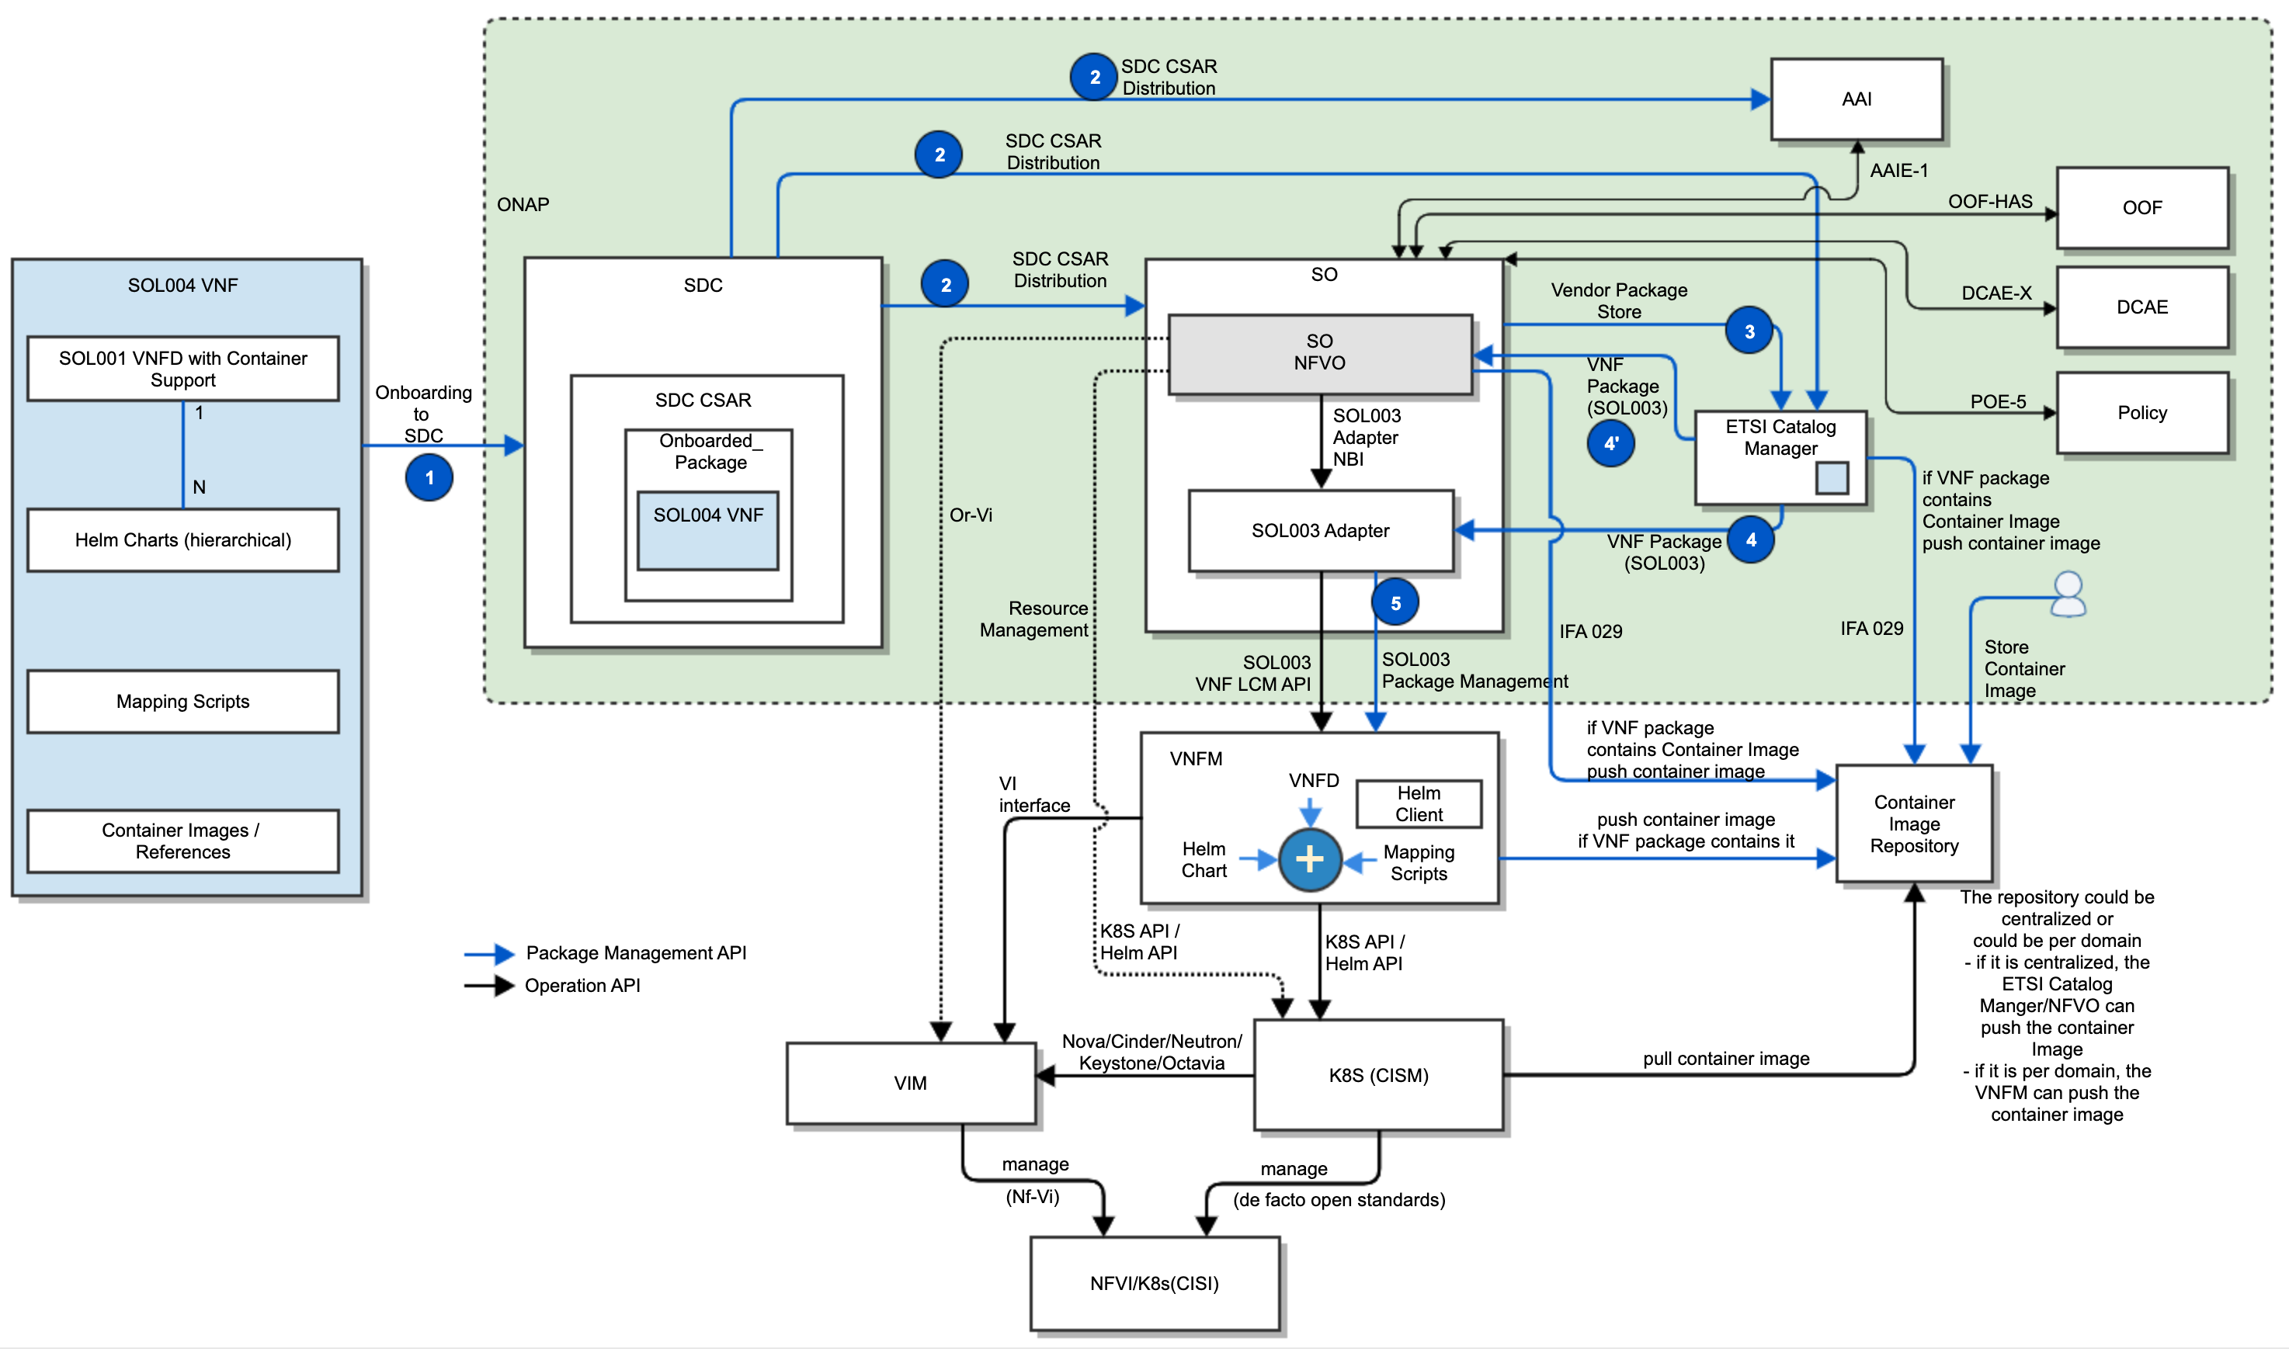
1: ETSI Alignment – CNF Orchestration Overview
Hybrid orchestration templates – TOSCA VNFD and Helm Charts (for MCIO)
  TOSCA VNFD drives the interaction between NFVO and VNFM and NS/VNF LCMs
  Helm Charts are included as a binary archive in the VNF package, and are consumed by VNFM
Container images are either included in the VNF package or referenced in the descriptors (URL to CIR)
  If the VNF package includes Container images, NFVO/ETSI Catalog Manager uploads them to the CIR
  Otherwise, operators store Container images to the CIR
Parameter mapping from Or-Vnfm (SOL003) incoming information to Helm input parameters at VNFM for CISM
Resource Mapping between resources in TOSCA VNFD and K8S resources described in Helm chart (for granting between VNFM and NFVO) – Impact on VNFM, AAI, OOF
Mapping the LCM operations to HELM commands (VNFM behavior triggered on Or-Vnfm), etc.
VNFM-K8S (CSIM) communication prefers Helm APIs to lower- level K8S APIs
K8S-VIM communication uses de facto open source standards (Nova/Cinder/Neutron/Keystone/Octavia)
CISM-CIS communication uses de facto open source standards
Leveraging the ONAP ETSI-Alignment Architecture.
Source: ONAP
The above diagram is a draft, based on a CNF PoC and IFA011, IFA 029 and 040. It will be refined by conforming to the coming ETSI CNF standards.
If the vendor VNFM has CNF capabilities, SO will leverage it through the SOL003 Adapter. Otherwise, SO/NFVO could invoke K8S API/Helm API towards K8S – See the Option 2.

Slide 5
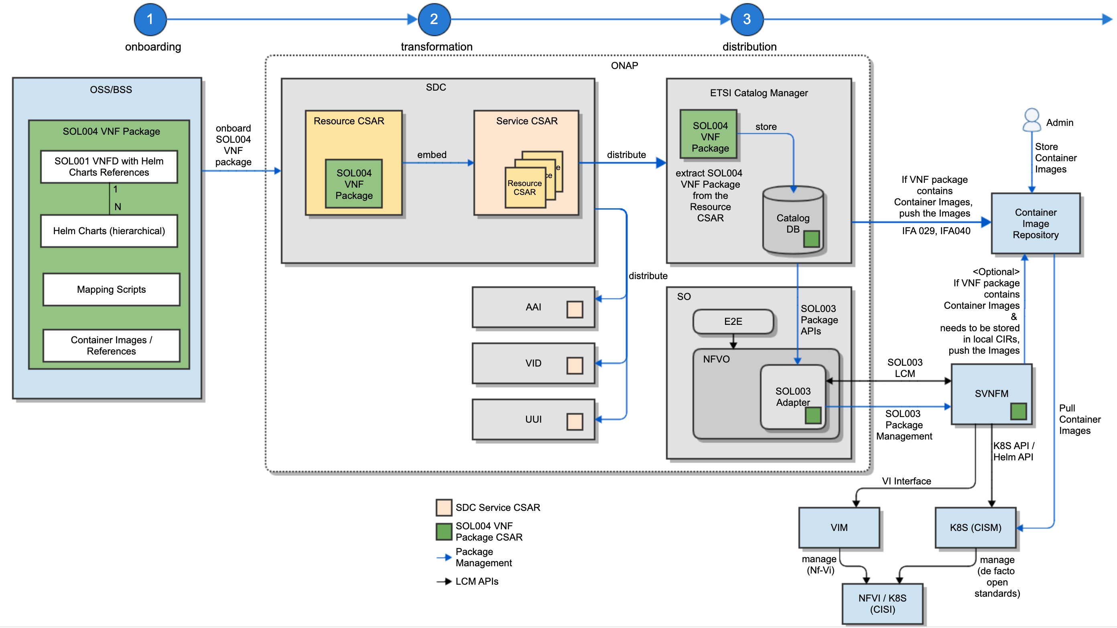
1: ETSI Alignment – CNF Package Management
OSS/BSS onboards SOL004 VNF packages to SDC
SOL004 VNF package consists of:
  SOL001 VNFD with Helm Chart References
  Helm Charts (hierarchical)
  Mapping Scripts
  Container Images / References
SDC preserves the SOL004 VNF Packages in the ONBOARDED_PACKAGE directory of SDC Resource CSAR
SDC Service CSAR including SDC Resource CSAR(s) is distributed to ONAP Runtime components: SO, AAI, VID and others
ETSI Catalog Manager extracts the SOL004 VNF Packages from SDC CSAR and stores in its Database
If a VNF Package contains Container Images, ETSI Catalog Manager pushes the images to Container Image Repository
SOL003 Adapter gets SOL004 VNF packages from ETSI Catalog Manager
SOL003 Adapter sends SOL004 VNF packages to sVNFMs
Optionally, if operators use local CIRs, VNFM can push the Container Images to the local CIRs.
SVNFMs invokes K8S CSIM for CNF operations
K8S CSIM pulls Container Images from the CIR
Note:
It is an extension of the current ONAP VNF Package Management.
mapping between SOL001 VNFD and SDC AID DM are under discussion.
Source: ONAP

Slide 6
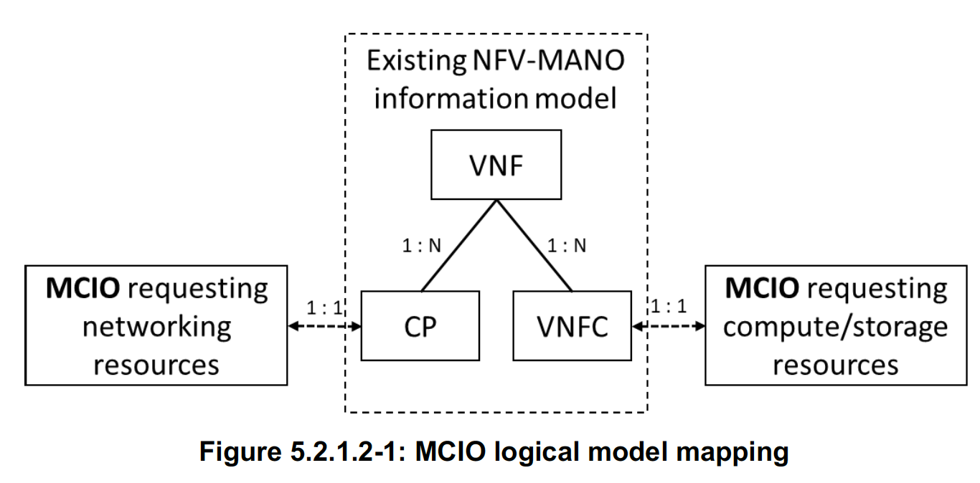
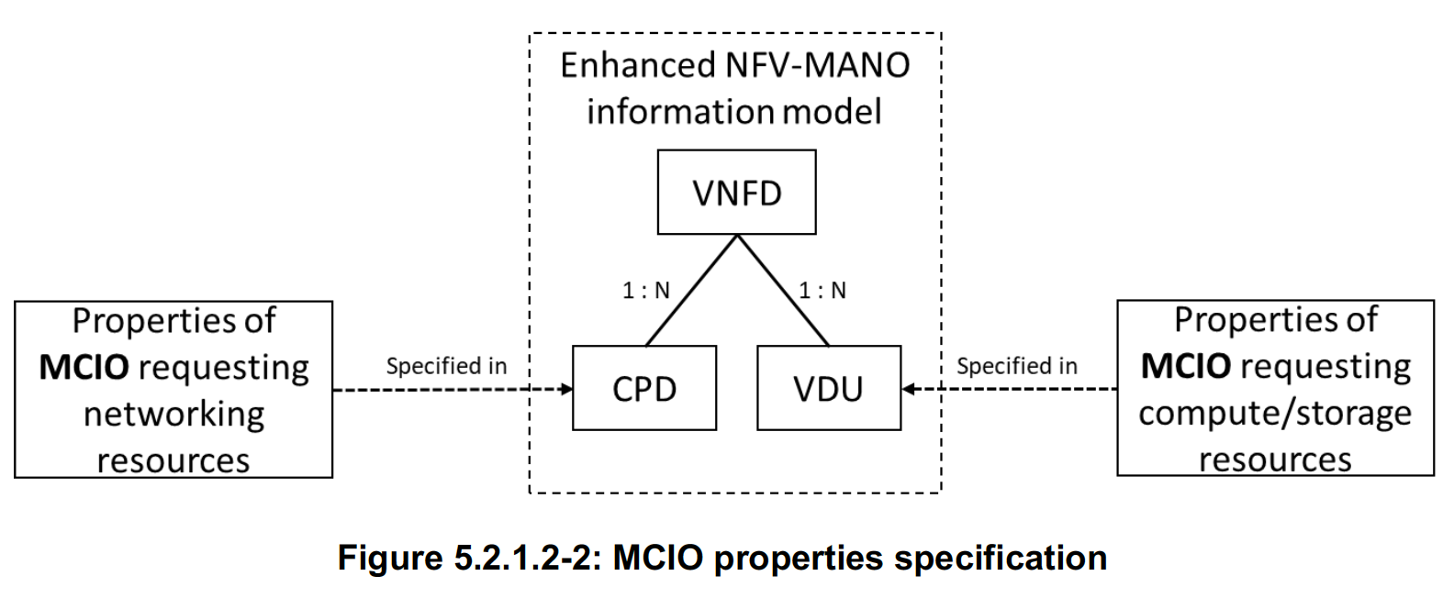
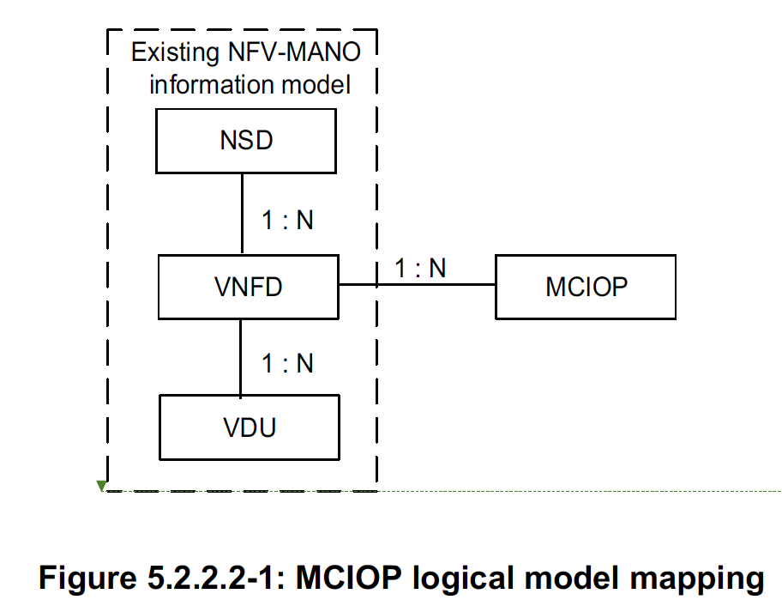
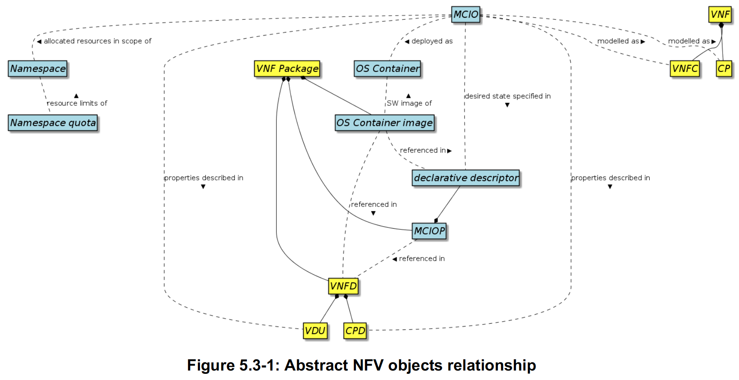
1: ETSI Alignment – CNF Models
Current understanding
SDC understands MCIO properties in CPD and VDU
NFVO/VNFM/AAI manages MCIO resources
Conforms to ETSI IFA 011, IFA 029 and 040.
Those specifications would be available by end of June / July 2020, but their SOL specifications plan to be available by end of 2020 or Q1, 2021
Until then, ONAP designs CNF models and packages, based on the current IFA 011, 029 and 040
A Managed Container Infrastructure Object (MCIO) is an abstract NFV object for OS Container management and orchestration.
The declarative MCIO descriptor is used as descriptor object interpreted by the CISM.
A MCIO is created by the CISM by allocating its requested infrastructure resources on Container Infrastructure Service (CIS) instances
Depending on its type, the creation of a MCIO may include the deployment of an OS Container Image.
MCIO’s are lifecycle managed via change requests on their desired state, utilizing a modified declarative descriptor sent to the CISM, which adapts the infrastructure resource allocations according to the changed infrastructure resource requests.
MCIO’s requesting compute and/or storage infrastructure resources are modeled as a VNF Component (VNFC).
Properties of the MCIO’s relevant to be exposed to NFV-MANO.
Pod
Helm Chart
New SOL004
VNF package
SDC enhancements to understand and parse new IFA 011 VNFD
AAI enhancements to represent VNF instance inventories, based on IFA 011
NFVO/VNFM enhancements to handle new NS/VNF models and packages
ETSI Catalog Manager enhancements to handle new NS/VNF models and packages
Source: ONAP & ETSI NFV

Slide 7
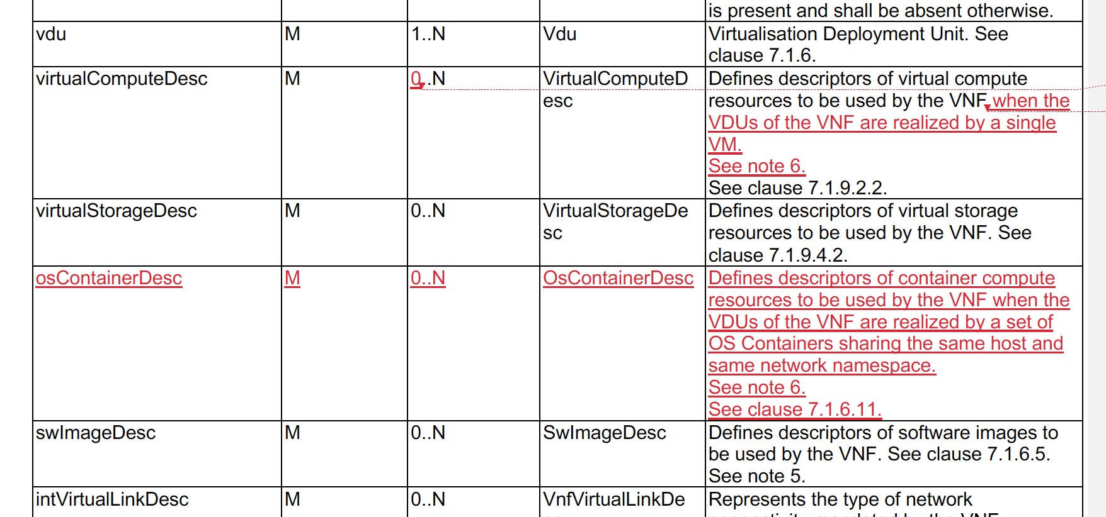
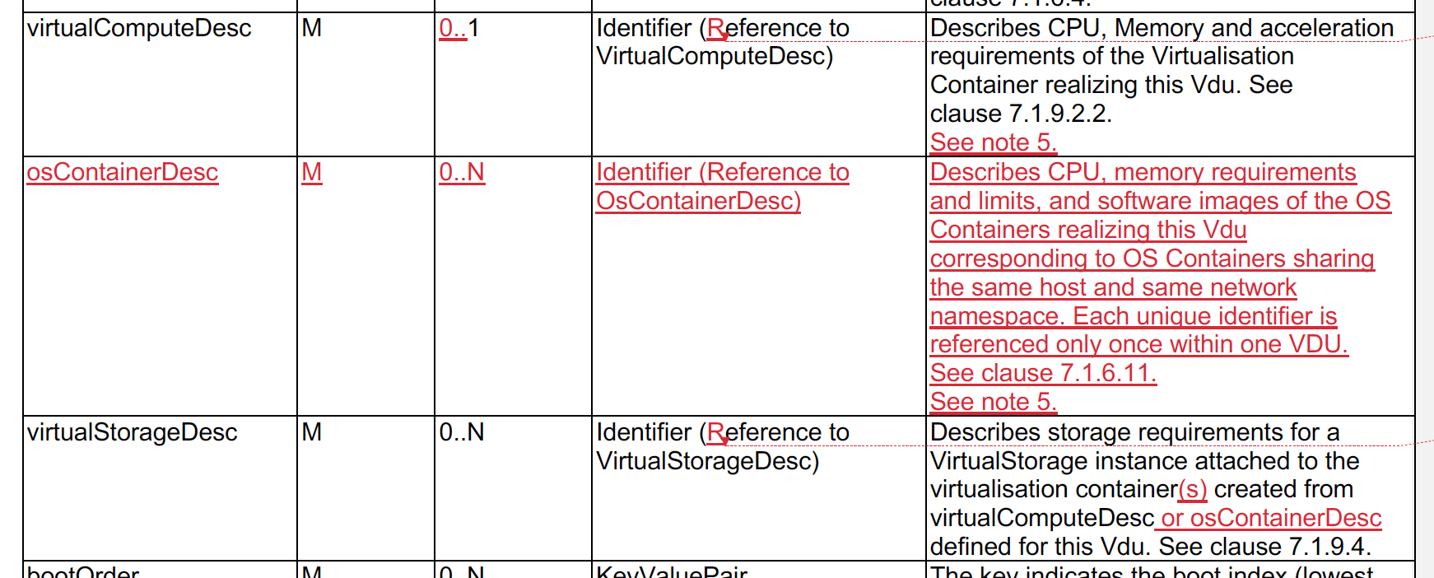
1: ETSI Alignment - ETSI VNFD and VDU Changes for CNF
Conforms to new ETSI IFA 011.
ETSI NFV Team Discussions and Resolutions:
  VNFD enables the modelling of MCIOs (e.g., Kubernetes Pods) as VDU and introduces a new IE OsContainerDesc.
  A VNF could consist of VM-based and/or container-based components (hybrid VNF) – at least one of them
    Either the virtualComputeDesc or the osContainerDesc, but not both
  The relationship between osContainerDesc and MCIO is defined in IFA 029.
  The relationship between the NFV abstract objects and their relationship have been described in IFA 049 (clause 5.3)
  Changes due to differences between networking in VM-s and in pods shall be investigated
  The properties of MCIOs specifying networking resource requests can be modelled
  As CPs or derived classes and their properties are specified in CPDs or derived types in the VNFD
  Each reference of an identifier of an OsContainerDesc is unique; each OsContainerDesc is only referenced once in a VDU. This is in alignment with the Kubernetes PodSpec
  No hybrid VNFCs shall be allowed
VNFD Note 6: Either the virtualComputeDesc or the osContainerDesc shall contain at lease one element
VDU Note 5: Only one of virtualComputeDesc or osContainerDesc shall be part of a Vdu. If the Vdu includes osContainerDesc, then bootOrder, swImageDesc, monitoringParameter and bootData shall not be present in the Vdu.
VNFD Attributes
Now, it is optional
VDU Attributes
Now, it is optional

Slide 8
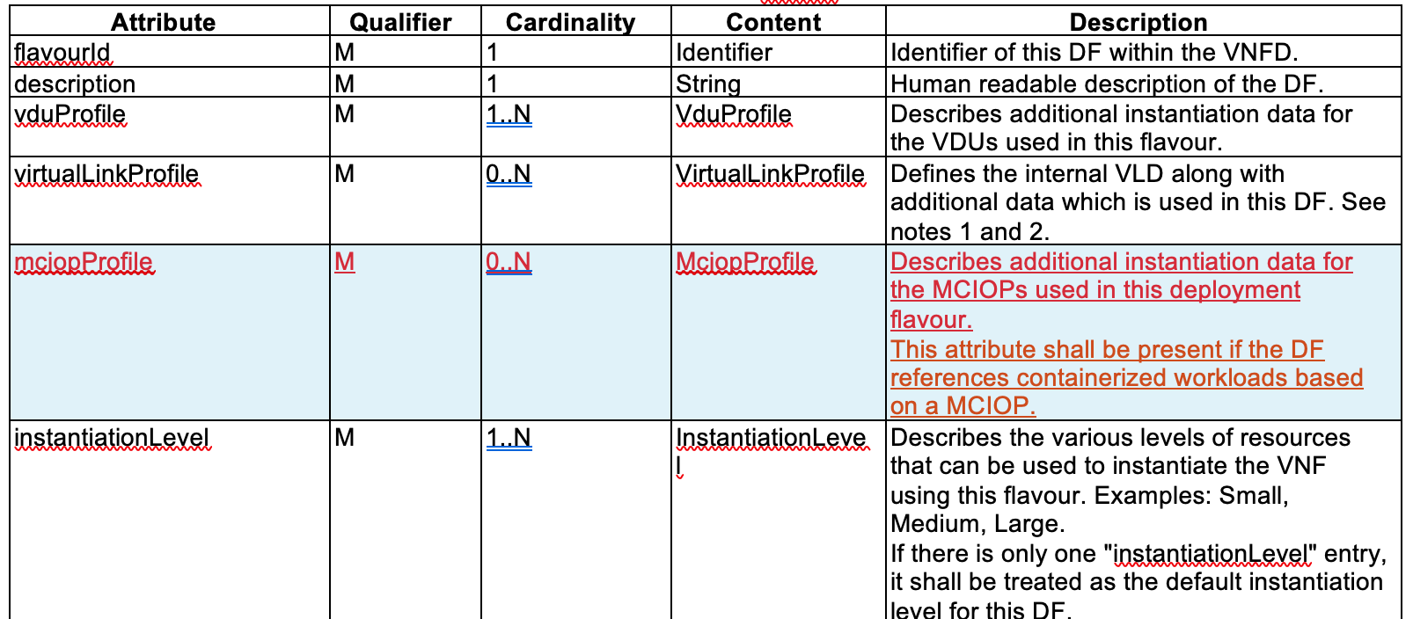
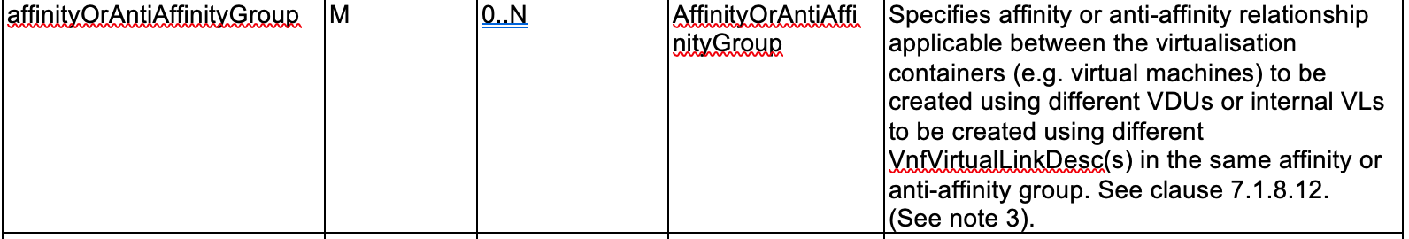
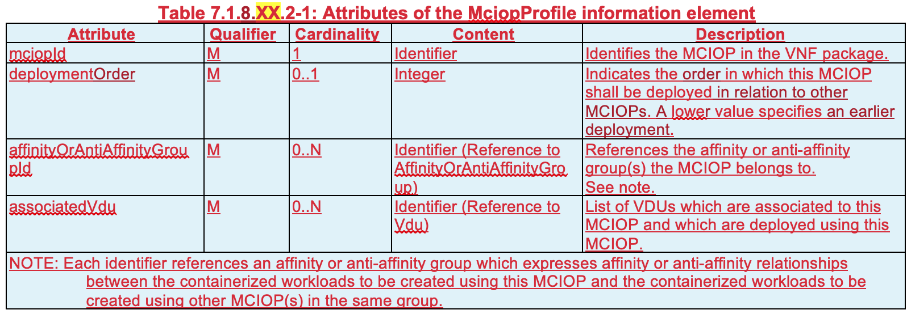
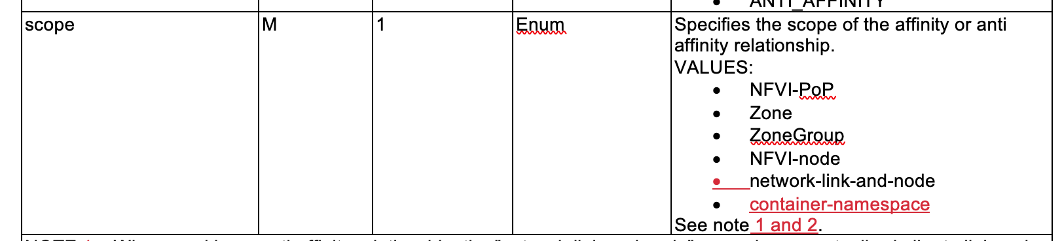
1: ETSI Alignment - MCIOP Profile
Reason for change:
  An important object which is to be included in the VNF package is the MCIOP. The MCIOP needs to be identified in the VNF package, but also additional properties of the MCIOP are required to be specified.
  This information related to the MCIOP needs to be provided via a dedicated profile information element for the MCIOP.
Change:
  Add a descriptor information element for a MCIOP profile to the VnfDf.
  Enhance the scope attribute of the AffinityOrAntiAffinityGroup information element with a new scope type “container-namespace”.
    The “container-namespace” scope is used to express the affinity or anti-affinity relationship between containerized workloads which are deployed based on a MCIOP.
A Managed Container Infrastructure Object Package (MCIOP) is a hierarchical aggregate of information objects for OS container management and orchestration.
Multiple MCIOPs can be included in a VNF Package.
The MciopProfile information element provides properties of the MCIOP which are used during deployment of containerized workloads based on a MCIOP, associated to a VNF deployment flavor.
VnfDf Attributes
MCIOP Profile Attributes
AffinityOrAntiAffinityGroup Attributes

Slide 9
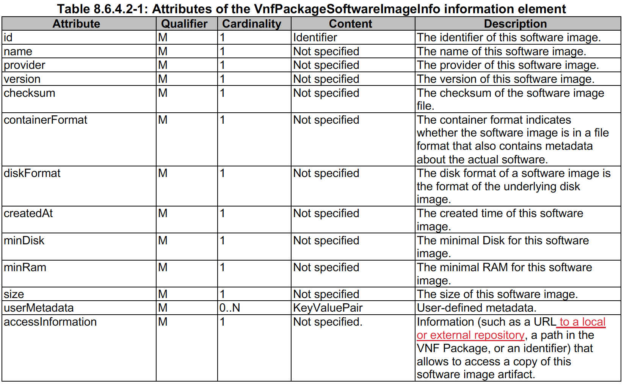
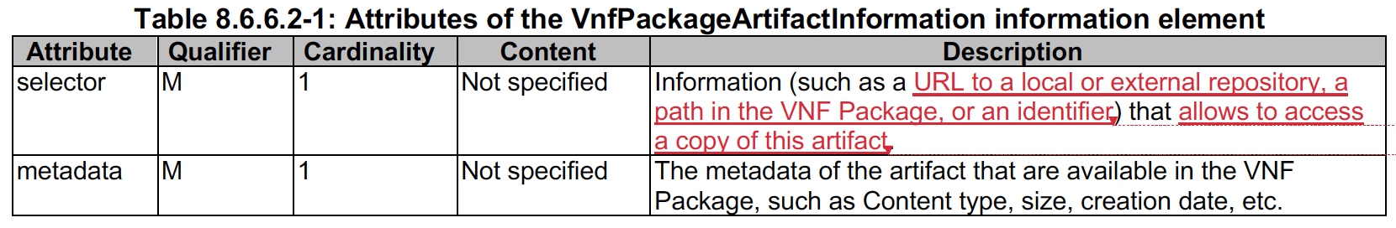
1: ETSI Alignment
- Access Information for VNF Package Content
The VNF Package can contain multiple OS container software images and multiple MCIOPs.
NFVO, upon onboarding of the containerized VNF package, extracts the OS container images and the MCIOPs and stores them in respective repositories
Enhance the descriptions of the accessInformation attribute of the VnfPackageSoftwareImageInfo IE and of the selector attribute of the VnfPackageArtifactInformation IE

Slide 10
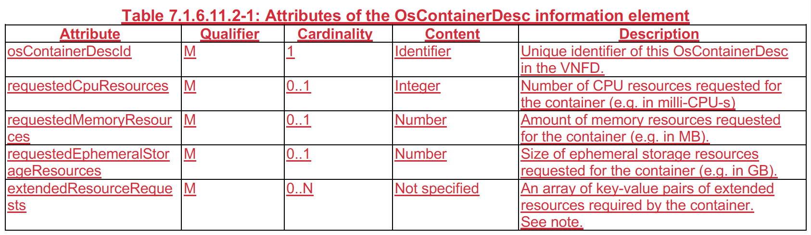
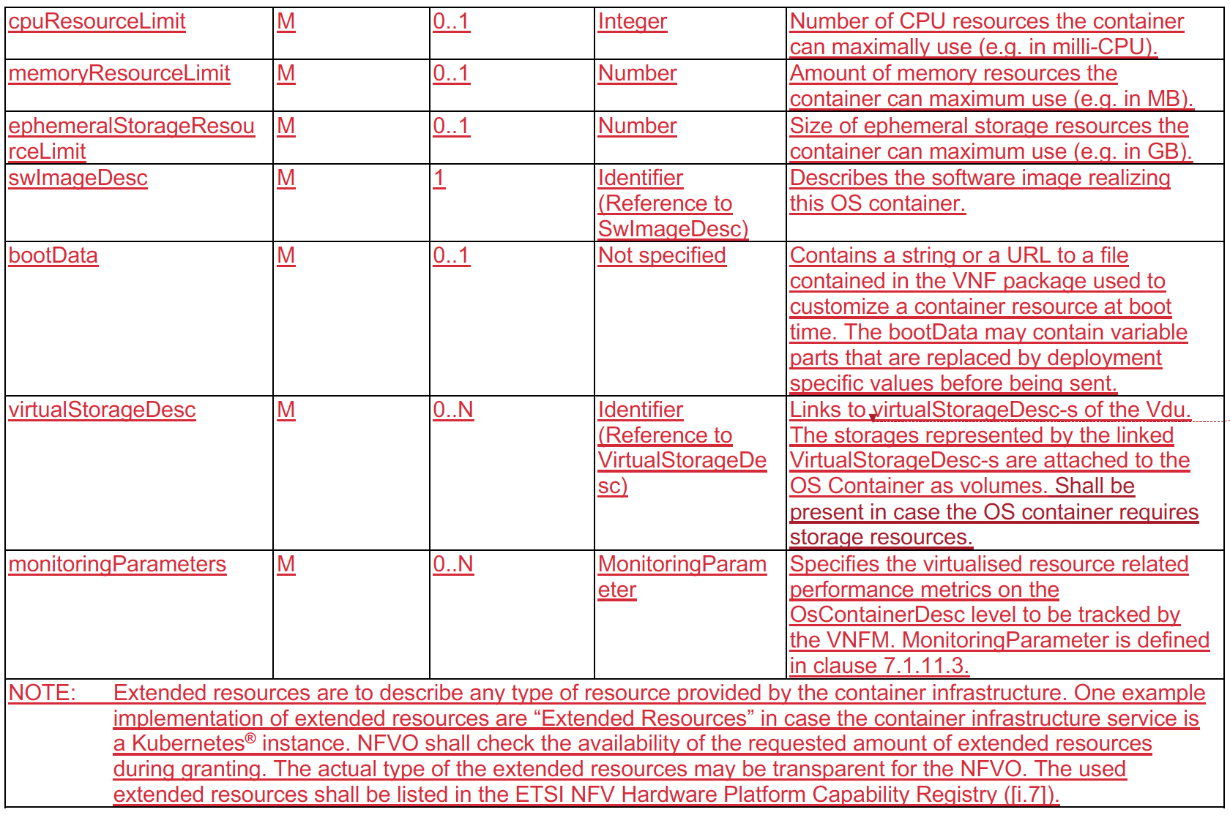
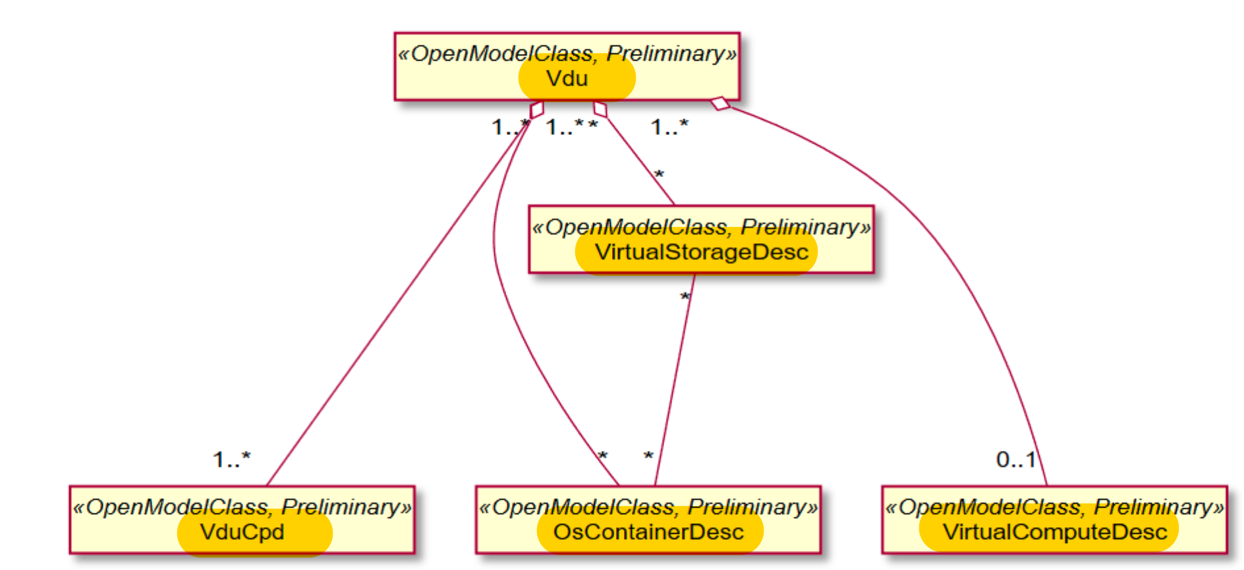
1: ETSI Alignment - OsContainerDesc
The OsContainerDesc information element describes the members properties of a set of co-located container compute resources when these are realizing a VDU.
OsContainerDesc Attributes are defined
The relationship between osContainerDesc and MCIO is defined in IFA 029; i.e., in which scenarios to apply osContainerDesc and what other cases use MCIO. Changes due to differences between networking in VM-s and pods shall be investigated and changes added to the Vnfd IE if needed.
Vdu Deployment View

Slide 11
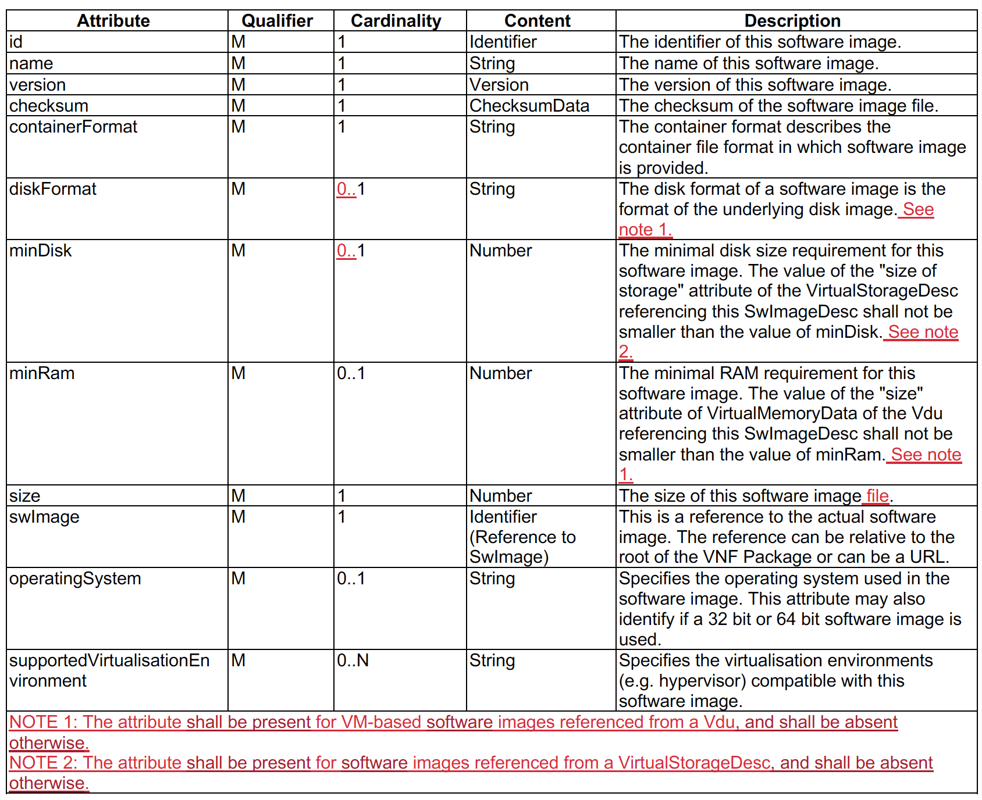
1: ETSI Alignment - SwImageDesc Attributes
It describes the software image for a “particular” VM-based VDU, OS Container or a virtual storage resource
The diskFormat and minDisk are optional for the case that the software images are referenced by non VM-based VDU (i.e., container-based VDU)
Now, it is optional
Now, it is optional

Slide 12
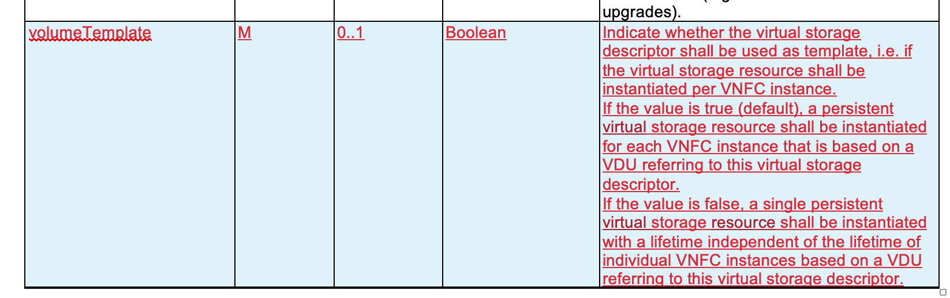
1: ETSI Alignment - VirtualStorageDesc Attributes
Reason for change:
  The current solution for persistent virtual storage resources in the VNFD is that they are:
  Referenced in the VDU
  Instantiated per VNFC instance, i.e. for each VNFC instance created based on the VDU, a dedicated virtual storage instance is created and attached to the VNFC instance. Such storage instance also has a lifetime coupled to the VNFC lifetime.
  The current solution does not allow to have persistent virtual storage instances that are not per VNFC and have their own lifetime.
Change:
  Enhance the VirtualStorageDesc with an attribute to indicate if the block/file/object storage resource templates shall be used as template for all VNFC instances (current semantic), or if they shall be created only once (new semantic).
VirtualStorageDesc Attributes

Slide 13
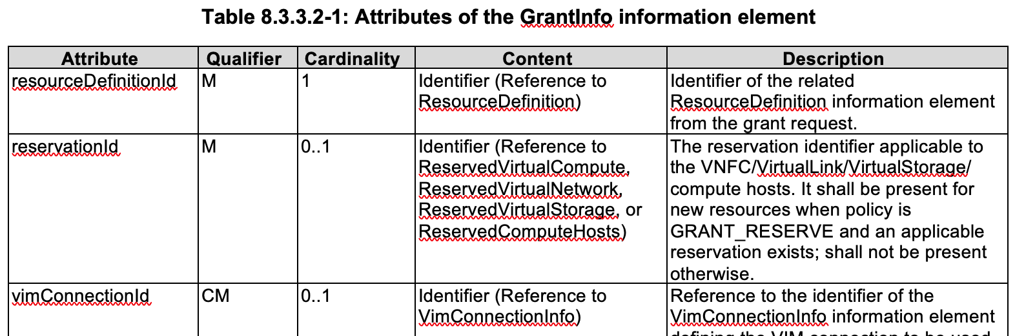
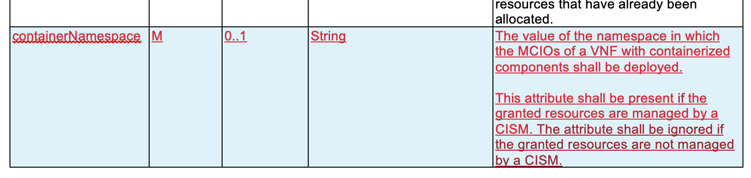
1: ETSI Alignment - VNF Lifecycle Operation Granting
VNF Lifecycle Operation Granting interface produced by the NFVO on the Or-Vnfm reference point shall support granting lifecycle operations
Changes for CNF: the VNF Lifecycle Operation Granting interface produced by the NFVO on the Or-Vnfm reference point shall enable the VNFM
  to indicate the virtualized resources or namespace quota (when the VDUs of the VNF are realized by a set of OS containers) impacted by the VNF lifecycle operation (e.g., allocated or release)
  obtaining information about the identification and configuration information to access the VIM or CISM
The Namespace is via the VNF LCM Granting and to include the value of the namespace in the GrantInfo information element as part of the GrantVnfLifecycleOperationResponse.
  Enhance the GrantInfo information element with an additional attribute for a container namespace
ONAP
Policy
MultiCloud
AAI
SO
OOF
Homing Intf
NFVO
ONAP NFVO leverages OOF for Granting requests from VNFM for Container-based VNF and VM-based VNF
Or-Vnfm
VNFM
VNFM
VI Interface
K8S API /
Helm API
VIM
CISM

Slide 14
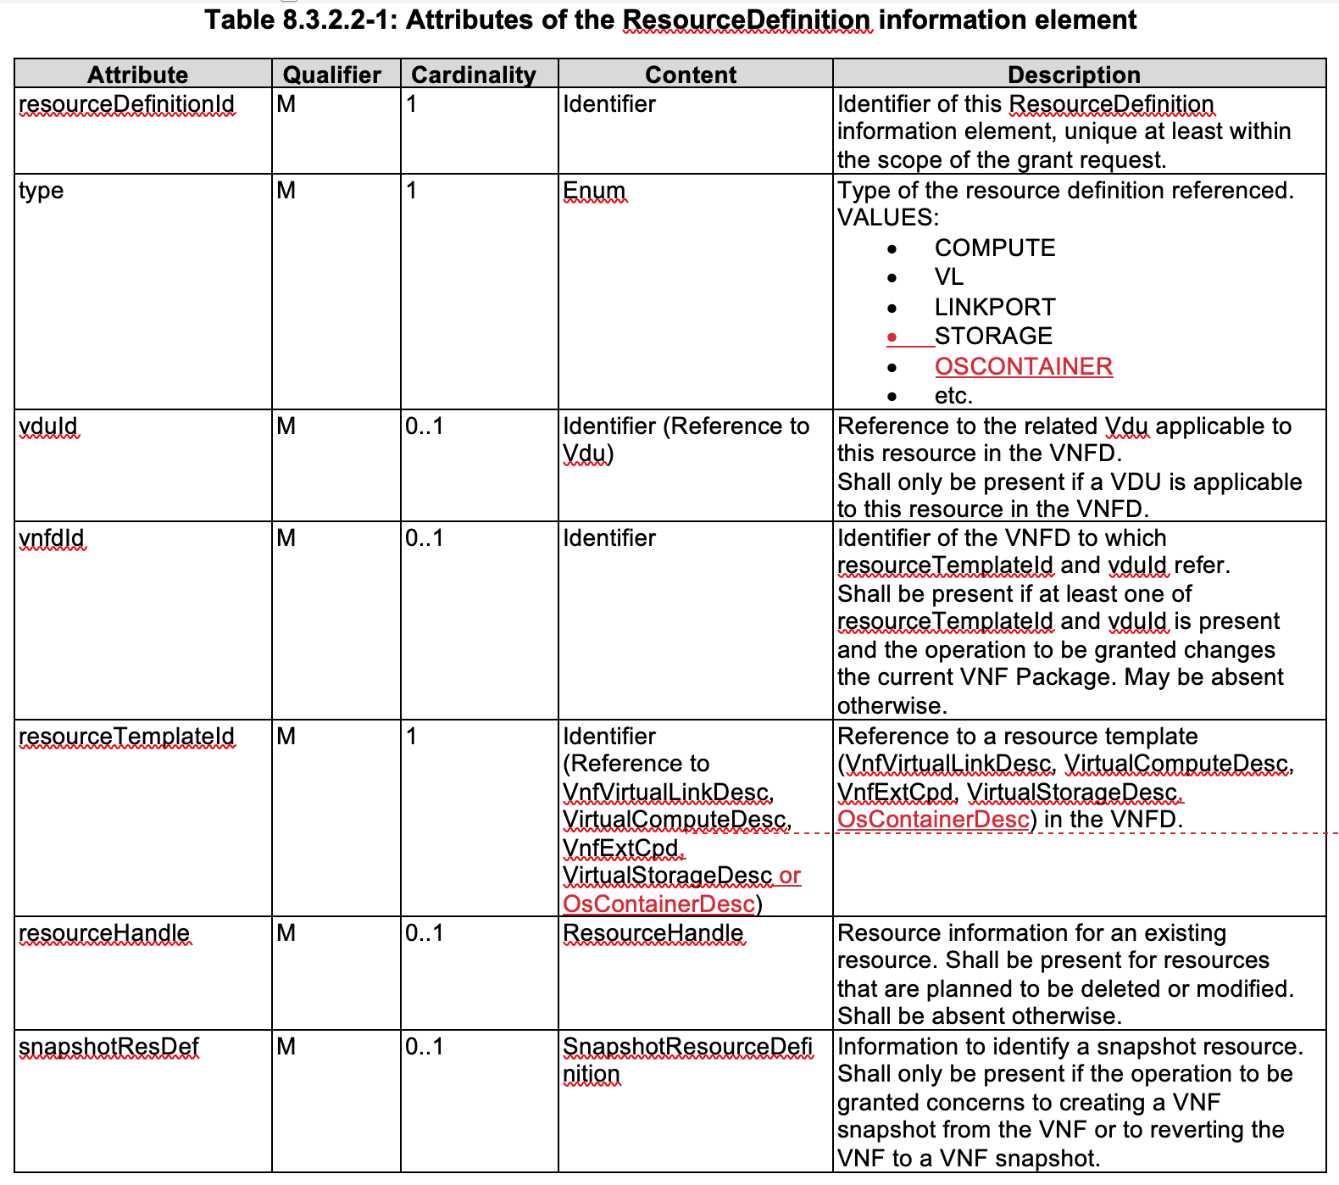
1: ETSI Alignment - CNF Resource Definition for Granting
The VNFD introduces a new resource template OsContainerDesc for OS containers.
The ResourceDefinition information element used in the grant request message needs to be enabled to reference resource templates for OS containers, the same way as the other resource template
Enhance the ResourceDefinition information element attributes with references to OS container resource definition types and resource templates.
  OsContainer Type is added
  Reference to OsContainerDesc is added

Slide 15
IFA011 411 Draft Proposal addition to VipCpd
VipCpd in SOL001 2.7.1 describes the mapping of a “virtual IP” address to connection points in a VNF.
  Either HA (Active/Standby) or Load Balancing.
Proposed for 4.1.1
AdditionalVipData – Expose information about a port and service data
  Name of the VIP (uService)
  L4 Protocol exposed (TCP, UDP, SCTP, )
  Port exposed
Service Data
  L7 info (unspecified in VNF-D)

Slide 16
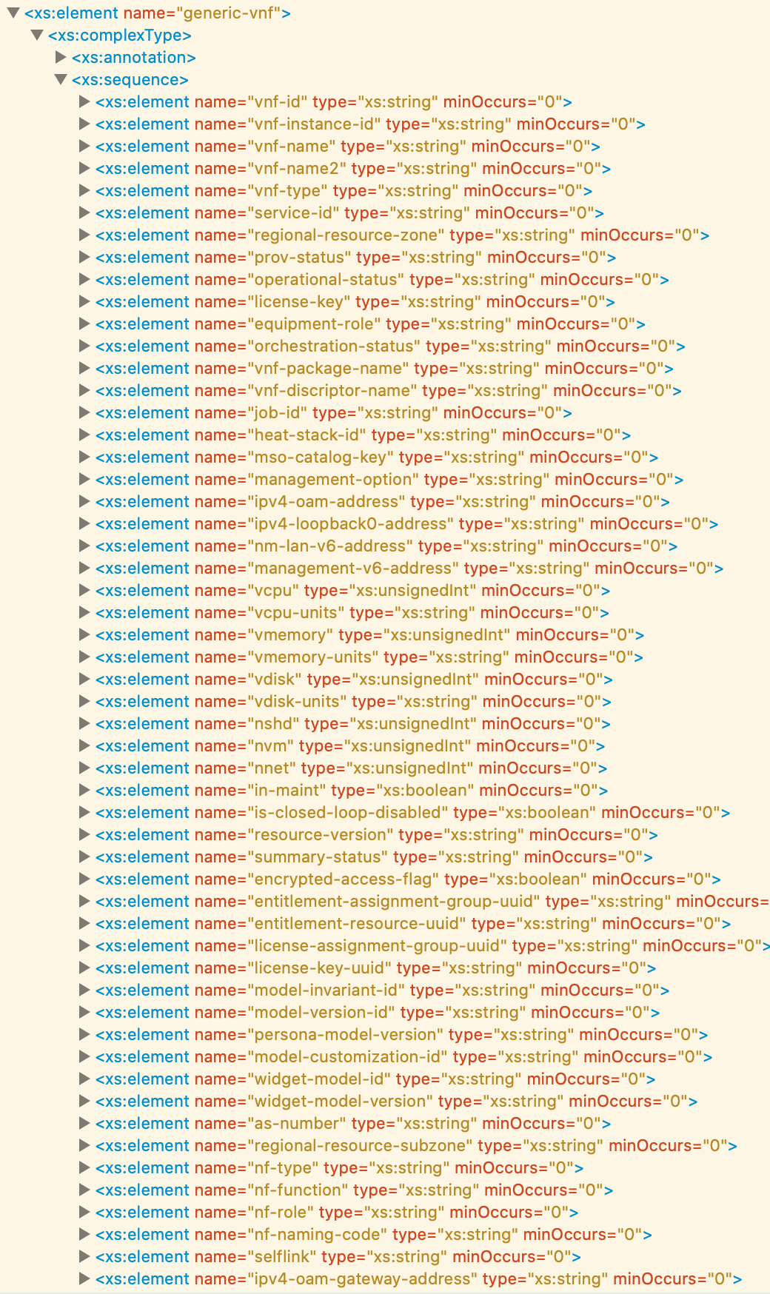
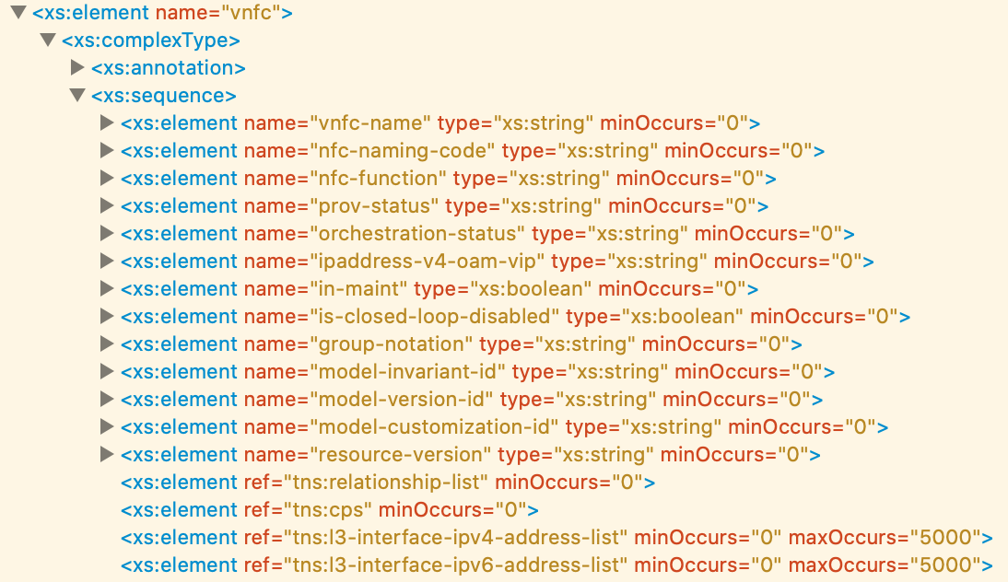
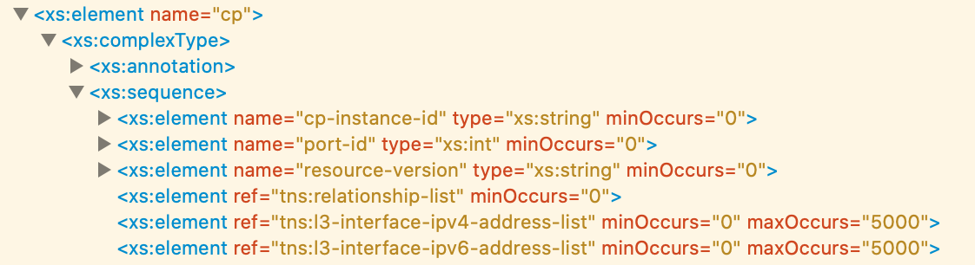
1: ETSI Alignment – AA&I Schema for CNF
We are looking into A&AI schema for CNF:
vnf (generic-vnf)
vnfc
cp
More to analyze along with the Modeling team

Slide 17
References
TSC Task Force – Cloud Native, https://wiki.onap.org/pages/viewpage.action?pageId=79203136#TSCTaskForceCloudNative-June4th,2020at1pmUTC
ETSI-Based CNF Orchestration, https://wiki.onap.org/display/DW/ETSI+CNF+Support, presented by Fred Oliveira (Verizon) and Byung-Woo Jun (Ericsson)
ONAP SO Direct CNF Orchestration, https://wiki.onap.org/pages/viewpage.action?pageId=79203136#TSCTaskForceCloudNative-May21st,2020at1pmUTC, presented by Seshu Kumar (Huawei)
MultiCloud CNF Orchestration, https://wiki.onap.org/pages/viewpage.action?pageId=79203136#TSCTaskForceCloudNative-March19th,2020, presented by Bin Yang (Windriver)

Slide 18
Thank you!

Slide 19
ETSI IFA040 Overview
https://nfvwiki.etsi.org/images/NFVIFA%2820%29000163_NFV_release_4_FEAT17_CNF_management_concepts.pdf

Slide 20
ETSI IFA040 Information Model Changes
https://docbox.etsi.org/ISG/NFV/Open/Drafts/IFA040__OS_Container_MANO_service_interfaces/NFV-IFA040v050.zip

Slide 21
Enhanced IFA011 -> Impacts ONAP Resource IM

