Slide 1
ONAP Guilin CNF Inventory Model (Work In Progress)

Slide 2
Modeling Assumptions
Store minimal information in inventory:
  Rely on k8s for complete attribute set.
  Provide traceability to helm charts and deployed packages.
The pod instances are too dynamic in nature and will not be inventoried, the pod info can be dynamically retrieved from Kubernetes, i.e. only intent and deployment status will be inventoried
Maximize component/application reuse:
  A CNF is a composite application, e.g. EPC service, comprising of multiple sub-applications/microservices (e.g. vMME, vSGW, vPGW), where each sub-application is defined by a single Helm package with one or more deployments (DeploymentSpec).
  A CNF can be deployed across multiple clusters, a single deployment (DeploymentSpec) mapped to a separate cluster (supported in k8splugin v2).
Entities and attributes to be inventoried in A&AI will be determined following analysis of CNF post-instantiation use cases (see preliminary list in side 3).
Custom resources (CRD) such as Ingress and Certification Manager can be persisted as CNFs (see azure example in slide 6), relations to the CNF service and sub-application services tbd.
Networks and Network Interfaces (CNI) – tbd.
Orchestration status vs deployment status – tbd.
ONAP vs k8s roles & responsibilities – tbd.
Cloud-Region : Cluster - 1:1 relationship – tbd.

Slide 3
CNF Use Cases I
Action | Description | ONAP Responsibility | K8s Responsibility | Entities/Properties Involved
Update/ Reconfigure | Modify application’s existing deployment with updated configuration (values, ConfigMap, image). (Helm upgrade package with configmap; K8s create ConfigMap.) | Get/select current application/s, modify configuration and redeploy helm packages with updated configuration values. Depending on configuration changes, can result in updated or new/rebuilt deployment instance and resources. Monitor deployment status and resources. We don’t think we need to store ConfigMap info, by storing k8s resource names we can query k8s to get k8s resource current configuration. If software upgrade, we assume we will need to view i.e. current and new container image. | Update deployment (via adapter). View pods / check status of deployment. | Service CNF (Composite Application). Deployment Intent (Helm Pckge). Application Intent (DeploymentSpec). Container with image. Resource list with name and type
Post-Deployment Health-check | Perform health-check after deploying or reconfiguring a composite application. | Execute controller/CDS health-checks using the application end-points following install or upgrade. Application level health-checks required beyond k8s health-checks. Also need to ensure that applications are accessible from outside the cluster (this also implies we may need to capture networking info – not resolved). ONAP should also configure k8s policies (livenessProbe, etc.) to enable k8s to monitor application. | View pods / check status of deployment. Execute health-checks using livenessProbe. Istio service mesh supports traffic management, including visibility, tracing, diagnostics, and healthchecks. | DeploymentSpec, ServiceSpec, Network?, Network-Interface?.
Manual Scaling (Upgrade) | Manually increase/decrease number of pods in deployment. (Helm upgrade package; K8s update deployment/s, no ReplicaSet rollout.) | Get/select composite application, reconfigure and redeploy helm packages with updated replicas values. Update/check status of deployment and replicas value in inventory. Sync replicas values in inventory if changed in k8s. | Update deployment (via adapter). View pods / check status of deployment. Q: Should we allow setting the number of pods provided it is within min max policy? Q: Do we need auditing mechanism? | As above. DeploymentSpec/replicas.
Auto-Scaling | Dynamically increase/decrease number of pods in deployment to meet demand. | Create horizontal pod auto-scaler with min/max values for each application that needs to be auto-scaled by k8s. Sync replicas values in inventory if changed in k8s. (Assuming no k8s auto-scaler): Dynamically reconfigure helm package/s with updated replicas value triggered by Policy on DCAE event - do we have such a scenario not supported by k8s? CL for hybrid services only? Q: If we have a min/max policy, do we need to track number of replicas in ONAP? | Dynamically increase/decrease number of pods using horizontal pod auto-scaler within min/max values. Q: This implies we need to deploy application with HorizontalPodAutoScaler. Any other options? | As above. DeploymentSpec/replicas or min/max.
Notes:
Other scenarios:
Upgrading a cluster?
Node auto repair?
Security?

Slide 4
CNF Use Cases II
Action | Description | ONAP Responsibility | K8s Responsibility | Entities/Properties Involved
Software Update (Upgrade) | Redeploy application with updated image. (Helm upgrade pckage; K8s update deployment/s with new ReplicaSet rollout.) | Select composite application, reconfigure and redeploy helm package/s with updated container image. Update/check status of deployment and container image in inventory. | Update deployment (via adapter). Set deployment image - not recommended. View pods / check status of deployment. | As above. Container/image.
Monitoring and Alarm Processing | Monitor and process alarms, including enrichment and correlation, and initiate diagnostics, CL, and trouble ticketing. | ONAP/DCAE can enrich k8s application alerts with inventory information such as resource instance names, nodes/physical server, cloud-region, and owning-entity information required for alarm correlation and creation and routing of trouble tickets. Alternative: ONAP can inject in Helm package the above information. ONAP/DCAE should be responsible for monitoring and alarm processing of hybrid services (CNF, VNF, PNF) including correlation using topology information (do we have such scenarios?). R&R should be discussed with DCAE architects. | K8s monitors resources and nodes performance metrics using the resource metrics server, node problem detector daemon, and Prometheus.
Create (Install) | Deploy composite application with sub-applications. May include configuration (ConfigMap). (Helm install; k8s create deployment.) | Onboard and deploy helm package/s for the composite application (macro/a-la-carte). Should we have a distinct Onboard use case? Maintain catalog of helm charts and packages (in k8splugin adapter or otherwise). Update/check status of deployment in inventory. | Instantiate pod (via adapter) View pods / check status of deployment. | Service CNF (Composite Application). Deployment Intent (Helm Pckge). Application Intent (DeploymentSpec). Container.
Delete (Uninstall) | Delete composite/sub application. (Helm uninstall; k8s delete deployment.) | Select composite application and uninstall helm packages (macro/a-la-carte). Update/check status of deployment in inventory. | Delete pod (via adapter). View pods / check status of deployment. | As above.
Rollback | Undo current deployment and rollback to previous package version. (Helm rollback package; K8s rollback deployment.) | Select composite application and rollback helm packages (macro/a-la-carte). Update/check status of deployment in inventory. | Rollback pods (via adapter). View pods / check status of deployment. Check rollout history. | As above.
Notes:
Other scenarios:
Upgrading a cluster?
Node auto repair?
Security?

Slide 5
CNF Conceptual Model
CNF (Composite-Application),
name,
version
->generic-vnf
Note: Mapping to A&AI inventory still TBD.
Big Question mark
Depends on leveraged CNI..
What is hard to generalize
Deployment Intent (RB-Profile/Chart)
releaseName = vf-module-name,
releaseRevision,
releaseNamespace
chartName: “vPKG”,
chartVersion: 0.2.0,
link: URL
Cluster
name,
namespace
-> vf-module
1:M
1:M
1:M (typically 1:1)
1:M
1:M
X
Network (Custom Resource)
name: protected-net,
namespace,
apiVersion,
cniType: “ovn4nfv”
labels [name, value]
Resource List
name:
type:
?
Application Intent (DeploymentSpec)
name: vpkg,
replicas: 3,
nameSpace
labels: [name, value]
App End Points (ServiceSpec)
name: vpkg-managemet-api
namespace,
selectorLabels [name, value]
type: LoadBalancer, NodePort, etc
clusterIP, loadBalancerIP, etc.
port:
App Configuration (ConfigMap)
name: vpkg-confogmap,
data: [key, value]
-> l3-network
-> vnfc
Subnet
name: protected-subnet-1,
cidr: 192.168.20.0/24,
gateway: 192.168.20.1
Persistent Volume Claim, Persistent Volume, Storage Class
Network Interface
name:
type:
ipAddress:,
interface: eth”
Application Type (Container)
name,
image
volumeMountPath
volumeName
Volume
name,
persistentVolumeClaimName
-> subnet
-> cp

Slide 6


CNF ONAP vs k8s R&R
Install, delete, rollback
Update/reconfigure
Manual scaling?
Auto-scaling of hybrid services?
Open trouble tickets
Ops
ONAP
ASDC
VID
CLAMP/Policy
DCAE
Trouble Management
SO
SDNC/CDS
A&AI
Adapters
Audit
EMS
OpenStack
Kubernetes
View status
Monitor pods and nodes
Auto-scaling
Healthchecks and diagnostics
Ops
VNF
CNF
PNF
CNF
CNF
PNF
Notes:
Other scenarios:
Upgrading a cluster?
Node auto repair?
Security?

Slide 7
Backup Slides

Slide 8
CNF Use Cases and Required Inventory:
Control Loop, Change Management and Monitoring/Service Assurance
Scaling -> Reconfiguration
  Manual Scaling - Increase or reduce number of deployed applications, requiring solution to get current number of application instances/replicas in inventory, update helm package, and redeploy application with new configuration (i.e. reconfiguration): Deployment’s replicas.
    K8s also supports manual scaling and min/max values autoscaling policy, i.e. if we store number of replicas need an audit mechanism or event and ability to resync ONAP.
  CL Auto Scaling (ONAP or K8s initiated) – Scaling in most cases will be autonomous and role of ONAP would be only to reconfigure the CNF as per above.
  Complex, many scenarios, requires further discussion. Can be combined with reconfiguration.
Software Update -> Reconfiguration
  Change application image, requiring solution to get current image info in inventory, update helm package and redeploy application with new image: Container’s image.
  We don’t need a container registry.
  Business case: software audit.
Post-Instantiation Configuration/Reconfiguration
  Update application’s configuration data once instantiated, requiring solution to access configuration data: Deployment, Container, Service, ConfigMap (?).
  Do we need to store any configuration properties in inventory? Do we need to run queries/reports on any properties? We can view configuration from K8s dashboard. Besides no of replicase and image version what else is needed?.
Healthcheck and Diagnostics
  Healthcheck - Run pre- and post-configuration health-checks on application endpoints, requiring solution to get service endpoints in inventory: Deployment, Service.
  Turn-up testing, diagnostics, test monitoring and other test management solutions, requiring solution to get application endpoints and network routing info in inventory: Deployment, Service, Network Interface, Network.
  Is this a role of ONAP? Readiness and liveness check built-in into pod is not enough? Tracing and diagnostics already supported in Istio.
Replace/Recreate - > Reconfiguration
  Replace - Re-instantiate CNF with existing profile: CNF resources - status only.
  Recreate – Re-instantiate CNF with new profile, deleting and rebuilding CNF: CNF, RB Profile, Deployment, Container, Service, ConfigMap.
Volume Related
  Volume detachment and reattachment in VNFs (e.g. vMME CL scenario) is not relevant to CNFs, solution can be implemented in k8s using shared volumes.
  Do we want to reflect persistent data such as billing data in inventory? We assume there is no business need, need to validate with larger community.
  Do we need to know the deployment is part of a stateful set?
Monitoring (Fault/Trouble Management, Performance Management)
  Application event enrichment with inventory/topology info for populating and routing trouble tickets: Cloud-Region, Complex, Owning-Entity, etc.
  Application event correlation with infrastructure alarms, requiring topology and physical infrastructure info: Pserver, P-Interface, Lag-Interface, etc.
  Run diagnostics as per above, requiring service end-points and custom resources (e.g. Ingress).
  Collected logs and performance metrics/kpi information needs to be normalized with inventory topology info (tbd).
  Assumes k8s events already include Helm chart properties that identify CNF name/instance, node, etc.
Need audit mechanism or event notification to resync ONAP in case
OLD
Notes:
Other scenarios:
Upgrading a cluster?
Node auto repair?
Security?

Slide 9
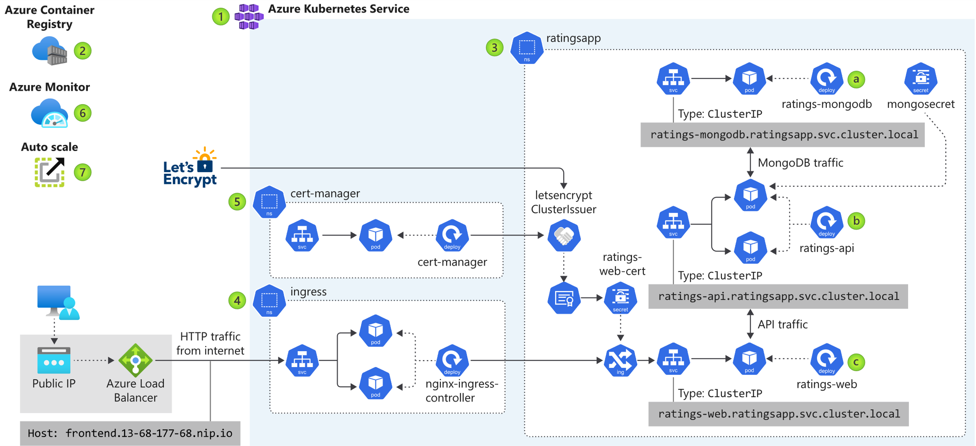
Azure AKS Example

Slide 10
CNF Control Loop, Change Management and Service Assurance Use Cases
Comments from Lukasz
Scaling
  Increase or reduce number of deployed applications, requiring solution to access number of application instances/replicas in inventory: DeploymentSpec.replicas.
Software Update
  Change application image, requiring solution to access container image info in inventory: Container.image.
Configuration Update
  Update application configuration data post-instantiation, requiring solution to access configuration data: ConfigMap.[data:key-value].
Healthcheck
  Run pre- and post-configuration health-checks on application endpoints, requiring solution to access service endpoints: DeploymentSpec, ServiceSpec.
Replace/Recreate
  Replace/re-create existing application with existing or new assignments: DeploymentSpec, ServiceSpec, ConfigMap.
Volume Detachment and Re-attachment
  Failover scenarios may require volumes to be detached from a failed application and re-attached to the stand-by application, requiring solution to access volume info (complex CL vMME scenario): Volume, PersistentVolume, PersistentVolumeClaim, Storage Class.
Test Management and Diagnostics
  Turn-up testing, diagnostics, test monitoring and other test management solutions, requiring solution to access application endpoints and network routing info: DeploymentSpec, ServiceSpec, Network-Interface, Network.
Fault/Trouble Management
  Application event enrichment with inventory info for populating and routing trouble tickets: Cloud-Region, Complex, Owning-Entity, etc.
  Application event correlation with infrastructure alarms, requiring physical server (node) and infrastructure info: Pserver, P-Interface, Lag-Interface, etc.
Performance Management
  Collected logs and performance metrics information needs to be normalized and stored requiring additional inventory info: tbd.

Slide 11
K8splugin v2 Information Model
https://wiki.onap.org/display/DW/V2+API+Specification#V2APISpecification-ProjectsAPI
Project
project-name
Cluster-Provider
Provider-name
Composite Application
composite-app-name
version
Cluster
cluster-name
[label], [key-value]
Deployment Intent Group
name, profile, version,
override-values, status
Generic Placement Intent
Intent-name
logical-cloud
Composite-Profile
composite-profile-name
Deployment Intent
Intent-name,
Generic-placement-intent
App Intent
Intent-name, app-name,
[prov-name, cluster-name]
Application
app-name
helm-chart-tar.gz
Profile
profile-name, app-name,
helm-override-tar.gz
Questions:
V2 a lot more cumbersome than v1 requiring many interactions.
My understanding is that a single deployment intent (as per ‘Deployment Intent Group’) deploys a single profile with same application in multiple clusters. Not clear why does the Deployment Intent Group have multiple application names override values?
How is configuration being managed.
How are persistent volumes being managed?

Slide 12
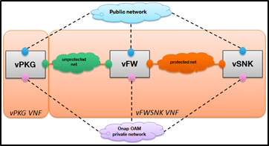
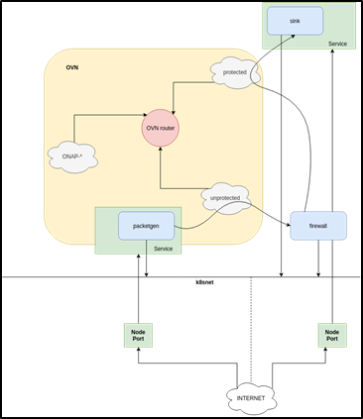
ONAP Frankfurt vFirewall CNF Use Case Data Model (proposed/TechM)
service-instance
CNF (generic-vnf)
Base (vf-module)
Chart
vFW Resource Bundle (vf-module)
Deployment
vPKG Resource Bundle (vf-module)
Deployment
vSN Resource Bundle (vf-module)
Deployment
Config Map
Config Map
Config Map
Service
Service
Network (l3-network)
vFW POD (vserver)
vPKG POD (vserver)
vSN POD (vserver)
Pod Port (l-interface)
Pod Port (l-interface)
Pod Port (l-interface)
https://github.com/onap/multicloud-k8s/blob/master/src/inventory/api/aaipushapi.go
Notes:
TechM links:
https://ind01.safelinks.protection.outlook.com/?url=https%3A%2F%2Fwiki.onap.org%2Fdisplay%2FDW%2FAAI%2BUpdate%2Bafter%2BResource%2BInstantiation&amp;data=02%7C01%7Cmilindj%40TechMahindra.com%7C825474b486a6469db0df08d7f19fe740%7Cedf442f5b9944c86a131b42b03a16c95%7C0%7C0%7C637243541395374607&amp;sdata=Bo3nEOEl86Zja%2F9wpDljrqBmE%2BO7hCCI6DLqdbj66WM%3D&amp;reserved=0
https://ind01.safelinks.protection.outlook.com/?url=https%3A%2F%2Fgithub.com%2Fonap%2Fmulticloud-k8s%2Ftree%2Fmaster%2Fsrc%2Finventory&amp;data=02%7C01%7Cmilindj%40TechMahindra.com%7C825474b486a6469db0df08d7f19fe740%7Cedf442f5b9944c86a131b42b03a16c95%7C0%7C0%7C637243541395384604&amp;sdata=GPemagzlAWB3hUaNmGNhBp0sCttjA7bM1LEiPNrvD9s%3D&amp;reserved=0

