Slide 1
Topology-based configuration update for DCAE MS
Wen Shang (ws4361@att.com)
Vijay Venkatesh Kumar (vv770d@att.com)

Slide 2
Background and Rationale
Network Topology can evolve over time, so there is a need for platforms to be able to receive these updates and take appropriate actions.
From a DCAE standpoint, as new xNF gets instantiated, DCAE MS may need to be reconfigured to poll data from new sources.

Slide 3
Proposal
Introduce new DCAE platform components – ONAP Topology Interface (OTI).
OTI will listen on external topology updates and determine MS to be reconfigured/instantiated and trigger updates via other DCAE platform components.

Slide 4
DCAE Architecture with OTI
DMAAP
DCAE Services
Consul Cluster
TCA-Gen2
DCAE Platform
Holmes
TCA
Heartbeat
SON-Handler
PRH
Cloudify Manager
Dashboard
OTI
PM-Mapper
VES Mapper
BBS Event Processor
Config Binding Service
Inventory API
PostGres DB
GPB->JSON
Deployment Handler
Service Change Handler
Policy Handler
DataFile Collector
HV-VES
VESCollector (JSON)
SNMP Trap Collector
RESTConf
DMAAP
DMAAP
xNF
xNF
CLAMP
SDC
Policy
AA&I
External sources
Event Data flow
Deployment
Inventory Updates
Policy Changes & Configuration flow
Service distribution

Slide 5
Proposed High level Capabilities of ONAP Topology Interface (OTI)
OTI can provide a generic topology event handling function to process different xnf-type topology events from different vendors or a common event format across different vendors. OTI can generate dcae-collection-event used by different collector microservices (e. g. snmp-poller, file-oriented interfaces, status-poller, gRPC_collector, cli_collector) for data collection.
OTI can support real-time data collection when a xNF is added or deleted from cloud. OTI is a key component to support policy-driven or configuration-driven of automatic data collection.
OTI can also support Resiliency and load Balancing across multiple sites.

Slide 6
Terminology
event-handler-template – a configuration template that provides parsing rules for OTI to parse and process incoming different types of topology events supported by ONAP, e.g. AAI-Event, VES.notification etc. (slide 8)
dcae-collection-event – OTI generates dcae monitoring event based on the topology event or notification event that is used by different dcae-collector microservices for data collection. A “dcae-collection event” includes xNF_name, xNF oam_IP or loopback IP, and the collection tasks associated to the xNF. (slide 9)
CollectionTask – a DCAE CollectionTask is performed by a specific DCAE microservice to collect PM or FM data from network xNF using a different protocol. For instance, MIB data collection ( via snmp-poller ms), File Transfer (via sftp/scp FOI mS), Ping (via StatusPoller mS), API collection (via http-api mS), telemetry collection ( via grpc_collector mS), etc.
CollectionTaskID – a Collection Task Identifier indicates a unique collection task, e.g. snmp_100 is for polling standard CPU MIB-group via snmp.

Slide 7
ONAP Topology Interface (OTI) Components
OTI-event-proc :
  Subscribe topology events ( vendor-based-format or common-format-event) from DMaaP-MR.
  Parse and process the event based on event-handler-template defined in Policy.
  Look up the xnf associated data collection tasks defined in policy.
  Generates ‘dcae-collection-event’ that includes xNF instance topology and associated collection tasks. The ‘dcae-collection-event’ will be in VES like standard format.
  POST the ‘dcae-collection-event’ to OTI-Handler via API.
  Store the ‘dcae-collection-event’ into ONAP-PG DB.
OTI-handler : POST/Dispatch the ‘dcae-collection-event’ to a defined Kubernetes Cluster in a DCAE region based on xNF location. There is a LB in each K8s cluster sends this xNF collection request to a corresponding collector mS based on the LB algorithm.
This will be useful for legacy microservices dependent on notification on OTI configuration change.

Slide 8
OTI Data Flow via API (Option 1)
Topology source
(common-event,
aai, VES fileReadynotification, external notif )
Policy
event-handling-template
xNF_type and CollectionTask association
1) xNF Topology -EVENT
Policy-1), 2)
Task-Design
Standardized CollectionTask-Config
DMaaP-MR
xNF_cloud_region - DCAE Region mapping
OTI-event-proc
OTI
OTI-Handler
1) standard ‘dcae-collection-event’
1a) List of active
‘dcae-collection-event’
1) ‘dcae-collection-event’
(cloud1, snmp-layer3)
1) ‘dcae-collection-event’
( cloud1, cli-layer3)
DCAE Region 1
Kubernetes Cluster
DCAE Region 2
Kubernetes Cluster
DCAE Region N
Kubernetes Cluster
LB
DMaaP-DR
cli-coll
mS
FOI
mS
gRPC_coll
mS
DFC
mS
DMaaP-DR
cli-coll
mS
snmp_poller
mS
snmp_poller
mS
2) Cli output
2) snmp pm data
cloud3
cloud4
…
Cloud1
cloud2
…
vNF
…
Notes:
Note1: OTI can be treated as platform component. The interface to policy could be build directly rather than going through Policy-Handler interface.
Note 2 – Where does OTI get information on which regional DCAE the message has to be sent into? Also list of MS noted is okay for eCOMP review, but should be updated to reflect onap services when we take it to community

Slide 9
OTI Data Flow with DMaaP (Option 2)
Topology source
(common-event,
ecomp-aai, ecomp-narad,
VES fileReadynotice, )
Policy
event-handling-template
xNF_type and CollectionTask association
1) xNF Topology -EVENT
Policy-1), 2)
Task-Design
Standardized CollectionTask-Config
DMaaP-MR
OTI-event-proc
OTI
OTI-Handler
1) standard ‘dcae-collection-event’
1a) List of active
‘dcae-collection-event’
1) ‘dcae-collection-event’
( Cloud1, cli-layer3)
1) ‘dcae-collection-event’
(Cloud1 , snmp-layer3)
DMaaP-MR
DCAE – Region 1
DMaaP-DR
cli-coll
mS
FOI
mS
gRPC
mS
DFC
mS
snmp_poller
mS
DMaaP-DR
2) Cli output
2) snmp pm data
Cloud 1
…
vNF
Notes:
Note1: OTI can be treated as platform component. The interface to policy could be build directly rather than going through Policy-Handler interface.
Note 2 – Where does OTI get information on which regional DCAE the message has to be sent into? Also list of MS noted is okay for eCOMP review, but should be updated to reflect onap services when we take it to community

Slide 10
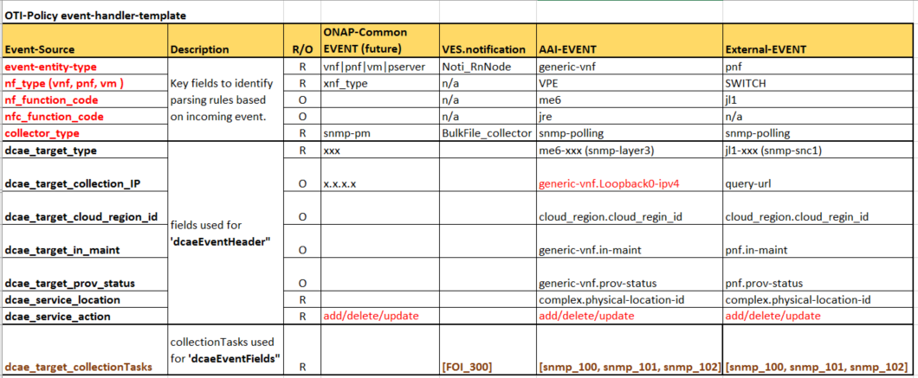
event-handler-template
Input: multiple event sources with different format.
Output: unified VES like standard ‘dcae-collection-event’.

Slide 11
dcae-collection-event (standard VES like format) w/ defined standard collection-task
dcae-collection-event (for ONAP OTI )
"event": {
"dcaeEventHeader":{
"dcae_target_name": "vnf_name",
"dcae_target_type": "vnf_type",
"dcae_service_action": "ADD",
"dcae_service_location": "vnf_clli",
"dcae_target_prov-status":"PROV",
"dcae_target_in-maint":"false",
"dcae_target_collection_ip": "vnf_oam_ip",
},
"dcaeEventFields": {
"TasksItems": {
"vnf_name_FOI_200": {
"taskId": "FOI_200",
"collectionType": "FOI",
"protocol": "sftp",
"collectionInterval": "300",
"location": "…./log/loc1"
"fileNamePattern": '*app*.log
"description": "xxx application log ",
}
"vnf_name_FOI_201": {
"taskId": "FOI_201",
"collectionType": "FOI",
"protocol": "sftp",
"location": "…./data/loc2"
"fileNamePattern": '*app*.dat
"collectionInterval": "600",
"description": "xxx application data Bulk",
}
}
}
CollectionTask Definition
TableName | Column Name | Null Option | PK | Column description
DCAE-CollectionTask-Info | collection_taskID | Not Null | PK | collectionTask identifier, e.g. snmp_100, FOI_200
 | task_description |  |  | task description, e.g snmp CPU MIB collection
 | domain |  |  | Mobilty, VoIP, Infrasture
 | service |  |  | supported service
 | network |  |  | Mobility, Layer3 ..
 | vendor |  |  | Juniper, Cisco, ..
 | protocol |  |  | sftp, sftp
 | collectionType |  |  | FOI
 | collectionGroup |  |  | KPI
 | collectionInterval |  |  | collection interva in second , e.g. 300
 | … …
 | FOI-Collection-Properties
 | FOI_Source_Directory |  |  | /opt/data
 | FOI_Source_Filename_pattern |  |  | *KPI_*
 | FOI_*
 | SNMP-Collection-Properties
 | snmp_MIB_Group |  |  | IF-MIB
 | snmp_*
 | HTTP-Collection-Properties
 | http_URL
 | http_*
CollectionTaskID
snmp_100: snmp-poller w/ standard-mib-group=CPU
snmp_101: snmp-poller w/ standard-mib-group=Memory
snmp_102: snmp-poller w/ standard-mib-group=IF-MIB
snmp_200: snmp-poller w/ Cisco-mib-group=x1
snmp_201: snmp-poller w/ Cisco-mib-group=x2
snmp_300: snmp-poller w/ Juniper-mib-group=y1
snmp_301: snmp-poller w/ Juniper-mib-group=y2
FOI_100: FOI-sftp w/ property 1, property 2, …
FOI_200: FOI-camel w/ property 1, property 2, …
FOI_300:BulkFileCollector w/ property 1, property 2, …
CLI_100: CLI-collector w/ cli="show-config"
CLI_101: CLI-collector w/ cli="show version"
gRPC_100: gPRC w/ propert 1, …
… …
Notes:
Note1: The definition of TaskID is still sketchy to me. Will this be set during design time (when new service type is added) or is this handled dynamically via policy when new collector function is added? Or is it both?

Slide 12
Proposed OTI Use Cases
UC# | Usecase Name | Description
UC1 | Add xNF_TYPE Configuration | Collection Task & xNF Configuration-driven for automatically data collection
UC2 | Add VNF instance | Support Real-time Data Collection for New VNF Instance
UC3 | MS registration | DCAE Collector Microservice Registration
UC4 | Resilency | Collector Resiliency Across Multiple Sites
UC5 | Loadbalancing | Support Load Balance Across Multiple Sites for polling based collectors
UC6 | DFC Integration | Integration with 5G BulkPM usecase (synthetic FileReady and distributed MR/DR )
UC7 | Delete VNF instance | Suspend data-collection for deleted VNF instance
R6 Scope
R6 Strech goal

Slide 13
OTI Supports Configuration-Driven Topology Handling and Collector Orchestration
OTI supports the following capabilities:
Configuration-driven data collection
One xNF instance mapping to multiple mS collectors (e.g vPE -> snmp-polling + statusPolling)
One mS collector used for multiple xnf_type monitoring (e.g snmp-polling ->vCE, vPE, Leaf …)
Support multiple types of topology and collection events:
  ONAP-topology-common-event
  aai-event, external-topology event
  VES fileReady notification event
Design-Time Configuration
define xNF Type specific topology-event-handling-template;
define Collection Task with properties: task ID, collection type, measurement object (PG table: collection_task);
add xNF Type to Collection Task mapping (PG table: nf_type_collection_task)
Run-Time Configuration
xNF location to dcae-collector location mapping, sourcing from ONAP Policy (PG table: xnf_dcae_collector_mapping)
dcae-collector mS instances, sourcing from ONAP Controller (PG table: dcae_collector_mS_instance)
xNF instance information from various topology sources (e.g., ONAP AAI, VNF) (PG table: xnf_instance)

Slide 14
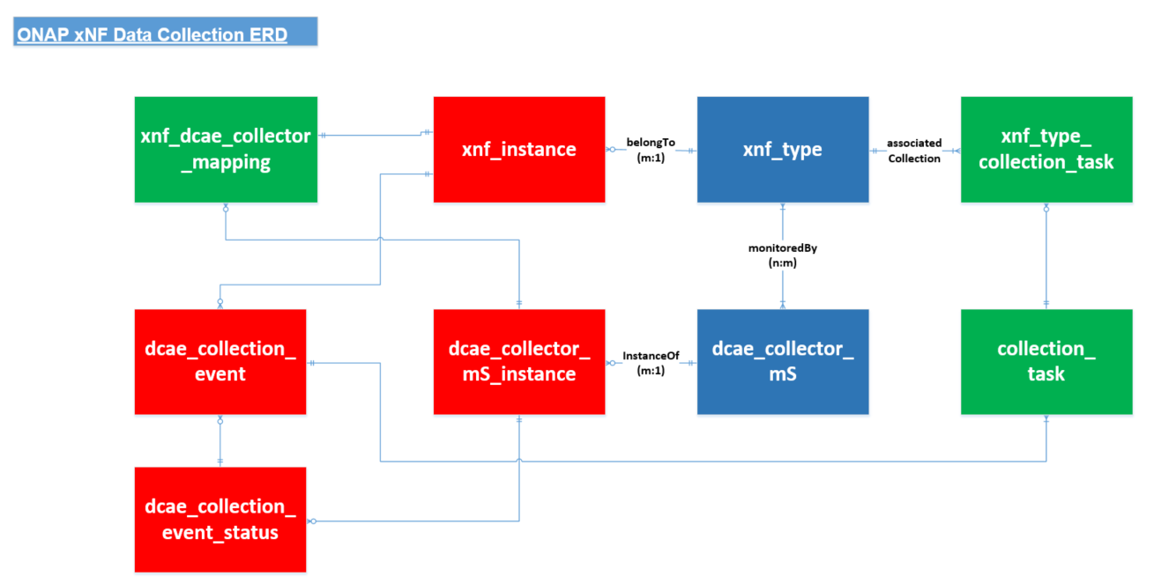
OTI Data Table ERD
template object
instance object
Config object

Slide 15
OTI Use Case 1: Collection Task & xNF Configuration
Add xNF_type with associated Topology-Event-Handling-Template (TEHT)
PG table: xnf_type and TEHT
  vNF (func), onap-comm-event(generic-vnf, oam_ipv4)
  vPE (me6), aai-event (generic-vnf, loopback0_ipv4)
  Leaf(jl1,jl2), external-event(pnf, oam_ipv4)
  Ericsson_vnf, ves-event(“notification”, …)
Add standardized collection. Specify properties of Collection Task including task ID, collector type, PM object:
PG table: collection_task
  TaskID:snmp_100: snmp-poller w/ standard-mib-group=CPU
  TaskID:snmp_101: snmp-poller w/ standard-mib-group=Memory
  TaskID:snmp_103: snmp-poller w/ standard-mib-group=IF
  TaskID:snmp_110: snmp-poller w/ Cisco-mib-group=xxx
  TaskID:foi_200: FOI-sftp w/ property 1, property 2, …
  TaskID:foi_201: FOI-camel w/ property 1, property 2, …
  TaskID:statusPoller_500: status-poller
Assign collectionTask list to the specific xnf_type
  PG table: xnf_type_collection_task
  vPE(me6), Tasks[: snmp_100, snmp_101 …]
  Leaf(jl1, jl2), Tasks[ snmp_100, snmp_101, snmp_110, stastusPoller_500]
Add service xnf cloud-region and dcae-collector mS region mapping
  PG table: vnf_dcae_collector_mapping
  vnf-cloudregion:cloud1, dcae_K8sCluster_ID:1A:active, DR_K8sCluster: 1B:inactive
  vnf-cloudregion:cloud2, dcae_K8sCluster_ID:1A:active, DR_K8sCluster: 1B:inactive
  vnf-cloudregion:cloud3, dcae_K8sCluster_ID:2A:active, DR_K8sCluster: 2B:inactive
OTI Policy Configuration Flow
VES
Collector
Designer
ONAP
Policy
ONAP
Controller
OTI
Postgre DB
Collector mS
1
Add xNF Type to TEHT Mapping
2
Define CollectionTask
3
Assign collectionTask to VNF Type
4
Add xNF cloud region to mS Region Mapping

Slide 16
Use Case 2: Support Real-time Data Collection for New VNF Instance
OTI subscribes xNF instance topology-event from DMaaP and processes the event based on NF designed configuration
  xnf instance (nf_name, nf_cloud_region, nf_prov-status, ip …)
  xnf_type
Example: xxxnj451jl1, leaf-jl1, 10.x.x.x, PROV, …
OTI looks up the xNF associated collection_task in PostgreSQL database
Example: xxxnj451jl1, leaf-jl1, 10.x.x.x, PROV, …, Tasks[snmp_100, snmp_101,stastusPoller_500]
OTI identifies the dcae-collector ms instances that needs to perform the collection task based on the xNF instance location and the dcae-collector mapping information
OTI publish an ‘add’ dcae-collection-event’ to DMaaP-MR ( or sends request to K8s cluster LB) and store the information in dcae_collection_event PG table
Example:
xxxnj451jl1, leaf-jl1, 10.x.x.x, PROV, …, Tasks[snmp_100, snmp_101], dcae-cluster1-snmp-poller-layer3
xxxnj451jl1, leaf-jl1, 10.x.x.x, PROV, …, Tasks[statusPoller_500], dcae-cluster1-statuPoller-1
OTI updates dcae collection event status and store the information in dcae_collecton_event_status PG table
OTI Real-time Process Flow (add VNF)
VES
Collector
xNF Topology Source
DMaaP
OTI
(w/ OTI-handler)
PostgreSQL DB
Collector mS
1
VNF Instance Event (add)
Look up xNF Design Config.
2
Look up Collection Task Info.
3
Look up mS collector Info.
4
dcae-collection-event API (add)
5
Store dcae-collection-event status

Slide 17
Use Case 7: Stop Data Collection for Deleted VNF Instance
OTI subscribes xNF instance topology-event from DMaaP and processes the event based on VNF designed configuration
  xnf instance (nf_name, nf_cloud_region, nf_prov-status, ip …)
  nf_type
Example: xxxnj451jl1, leaf-jl1, 10.x.x.x, PROV, …
OTI looks up the xNF instance associated dcae-collection-event records and status in dcae_collection_event and dcae_collection_event_status PG tables
Example:
xxxnj451jl1, leaf-jl1, 10.x.x.x, PROV, …, Tasks[ snmp_100, snmp_101], dcae-cluster1-snmp-poller-layer3, add, sent:true, 0-succ
For each matching dcae-collection-event sent previously, OTI publishes a ‘delete’ dcae-collection-event to DMaaP-MR ( or POST request event to K8s cluster LB via API) and store the information in dcae_collection_event PG table
OTI updates dcae collection event status and store the information in dcae_collecton_event_status PG table
Example:
xxxnj451jl1, leaf-jl1, 135.x.x.x, PROV, …, Tasks[snmp_100, snmp_101], dcae-cluster1-snmp-poller-layer3, delete, sent:true 0-succ
OTI Real-time Process Flow (delete VNF)
VES
Collector
xNF Topology Source
DMaaP
OTI
PostgreSQL DB
Collector mS
1
xNF Instance Event (delete)
2
Look up dcae_collection_event Info.
3
dcae-collection-event API (delete)
4
Store dcae-collection-event status

Slide 18
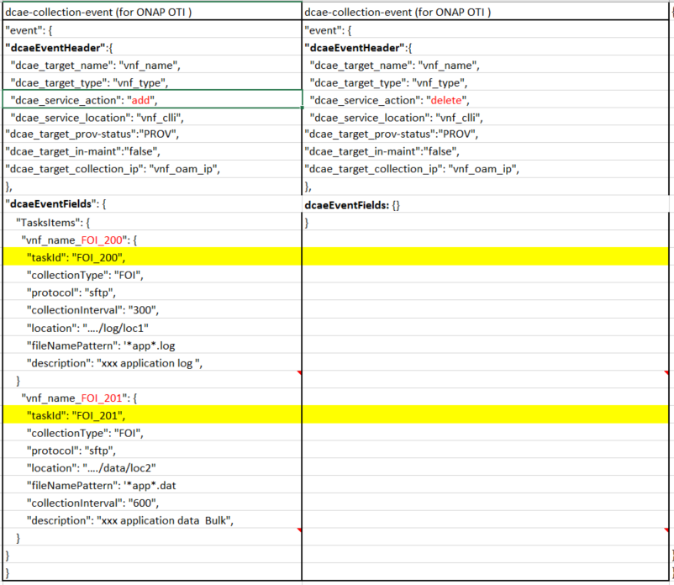
dcae-collection-event (UC7)
Notes:
Note1: The definition of TaskID is still sketchy to me. Will this be set during design time (when new service type is added) or is this handled dynamically via policy when new collector function is added? Or is it both?

Slide 19
  User Case 6a: Integration with ONAP 5G RAN Bulk PM Collector (DFC)
DFC rely on VES File Ready notification being generated by xNF.
As not all xNF will be VES Complaint or generating file-ready notification, OTI can be used as trigger to notify DFC.
The notification could be dcae-collection-event (in which case DFC needs to be enhanced) or by OTI generating a synthetic file-ready notification*
OTI
OTI-event-proc
OTI-Handler
dcae_collection_event update
2) dcae-collection- event
DMaaP-MR
1) VNF instantiation update
2) dcae-collection- event
DCAE Region 1
MS
AAI
VES Collector
Bulkfile Collector_1
(DFC-1)
3) Data follection/file retrieval
xNF
  Reference: https://wiki.onap.org/display/DW/5G+-+Bulk+PM

Slide 20
  User Case 6b: Resiliency across different site Bulk PM Collector (DFC) with multi-region with distributed MR/DR
VNF sends to VESCollector
VESCollector publishes to Local-Dmaap MR1
DFC-1 in Region 1 is down
OTI gets File-ready notification and as DFC-1 is down, it will publish the notification event to DFC-2 (simulating as if from VNF)
DFC2 collects data from VNF
Pre-requisite
Deployment pair across primary/secondary needs to be preconfigured
Manual/Operation step required to notify DFC-1 status and trigger#3 (Healthcheck can be used for automating)
OTI
OTI-event-proc
3) VES fileReady notification event
OTI-Handler
dcae_collection_event update
4) VES File ready notification event
L-DMaaP-MR-1
L-DMaaP-MR -2
2) VES fileReady notification event
Region 2
2) VES fileReady notification event
Region 1
VES Collector
Bulkfile Collector
(DFC-1)
Bulkfile Collector
(DFC-2)
5) PM data
1) VNF fileReady notification event
VNF
  Reference: https://wiki.onap.org/display/DW/5G+-+Bulk+PM

Slide 21
Summary
OTI will listen on external/topology update and determine MS to be reconfigured/instantiated and trigger them.
OTI addresses current ONAP functional gap to evolve based on network topology changes.
OTI is operational and productionized in ECOMP/DCAE handling several polling MS configuration.
AT&T ready to contribute seed-code to ONAP; seeking community support for making code/components complaint with ONAP requirement and deployments needs.

