Slide 1
OVP Automation - DevOps
Agile Test Automation in VNF based Network Service Industry
@twitter

Slide 2
NFV Testing: Reality
The NFV testing process is usually divided into four steps: test topology design, test environment setup, task execution and result analysis and certification.
At least 6 months are required for an NF to get a new or renewed network access permit.
Test Topology Design
Test Environment Setup
Test Task Execution
Test Result Analysis & Certification
The tester, the network
element manufacturer
support personnel, and
the test instrument
engineer negotiate the
test topology on site.
Deploy the test env
Configure the NE
•Configure the tester
•Monitoring and
recording.
Manually record test
results, and confirm
the test results by
concern parties.
Manually troubleshoot
instrument and
network element
failures.
Weeks
Months
Months
Weeks
Automate
Testing
Complexity involved after the introduction of NFV
Introduction of open source components
Introduction of software component disaggregation
The frequency for software upgrades
Introduction of new function and service

Slide 3
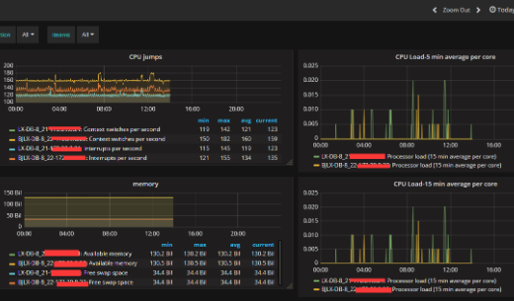
NFV Testing: Vision
Objectives :
Common NFV automated test platform
Self-service certification NFV stores
Open ecosystem of 5G + AI and 5G + edge
NFV Test Automation DevOps
Test Topology
Auto Design
Test Environment
Auto Deploy
Test Task
Auto Execution
Test Result
Auto Analysis & Certification
Design Tool
Deploy Engine
Testing Framework
Certification Portal&Store
a
b
c
workflow
NFVO
Test execution
test script integration
Test tools integration
template
VNFM
VIM
Infra
Infra
result
Days-Weeks
Minutes-Hours
Minutes-Hours
Weeks

Slide 4
NFV Testing: Automation with OVP+ONAP
Function mapping with ONAP components
  Test Topology Design - ONAP SDC
  Test Environment Deploy - ONAP Orchestrator(SO、VF-C、APPC , etc)
  Test Task Execution - ONAP VTP(VNFSDK, VVP, CLI)
  Test Result Certificate - OPNFV OVP
NFV Test Automation DevOps
Test Topology
Auto Design
Test Environment
Auto Deploy
Test Task
Auto Execution
Test Result
Auto Analysis & Certification
ONAP SDC
ONAP Orchestrator
ONAP VTP
OVP
a
b
c
workflow
NFVO
Test execution
test script integration
Test tools integration
template
VNFM
VIM
Infra
Infra
result
Days-Weeks
Minutes-Hours
Minutes-Hours
Weeks

Slide 5


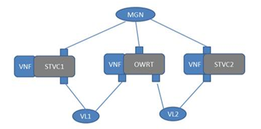





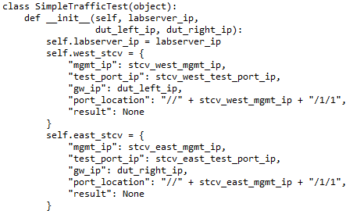

Role-based VNF Testing Workflow
Step1 Test topology design
Step3 Test Case Execution
a. Test env/tools/objects registration
b. Test specification definition
c. Test job management
SDC
Test Management System
Upload VNF passed the test to VNF store
VNF Marketplace
Test Designer
Execute test job
Test designer either uses the existing test case models from VTP or create new test cases model and uses them for creating test flow, finally upload them to VTP with NS ID tag
Test Executor
Test execution
Report test result
Upload test topology to orchestrator
Step2 Test Case Model Definition and Development
VF-C
VTP
a
b
c
Import Test Case to VTP
Test Case Developer
VIM
3rd party test instrument
Test developer implements the required test cases based model designed by test designer. And maintain it with VTP

Slide 6
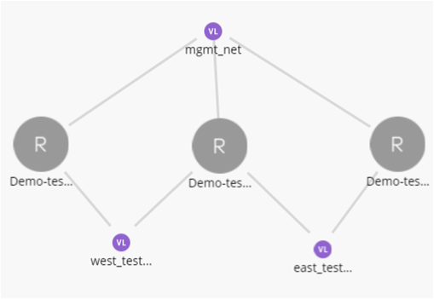
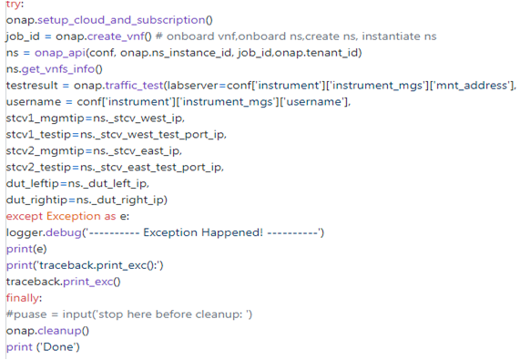
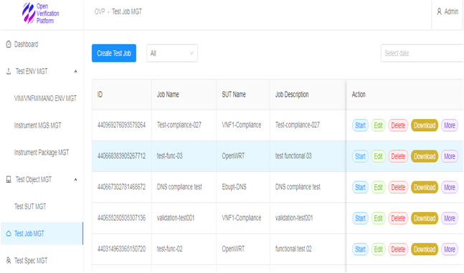
Demo: Role-based VNF Testing Workflow
SUT : Open source VNF - Openwrt
Test Instrument : Spirent virtual STCv
Step1
Step2
Step3
Test Designer
Test Case Developer
Test Executor

Slide 7




“To learn more, welcome join us!” yangyanyj@chinamobile.com kanagaraj.manickam@huawei.com

Slide 8
Thank You ☺

