Slide 1
ONAP ETSI IFA011 2.7.1 updates from 2.5.1
July 6th, 2020
Presented by: Fred Oliveira (Verizon)
Participating Companies
Ericsson
Verizon
AT&T
CMCC/ZTE
Huawei
Samsung
Intel
Others

Slide 2
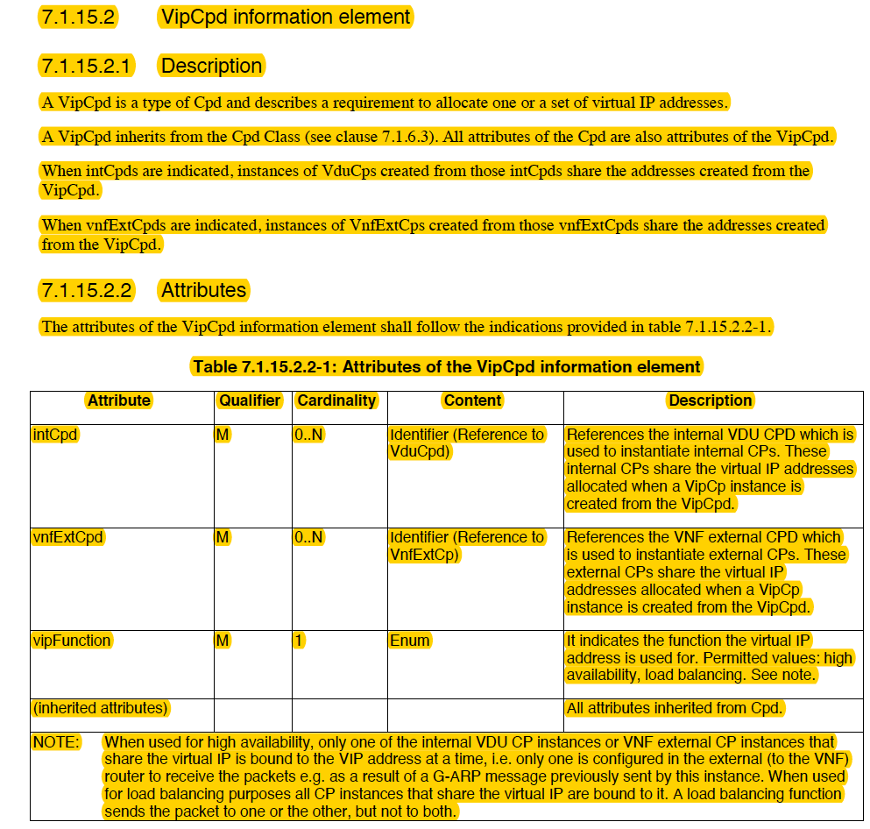
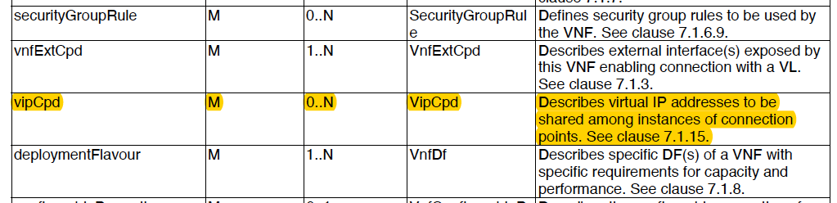
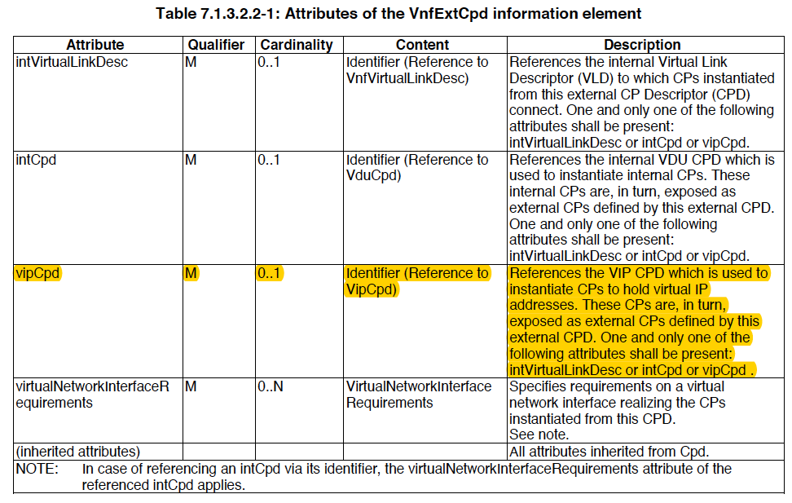
VNFD vipCpd
VNFD Attributes

Slide 3
ONAP IM VNFD vipCpd
New VNF object class for vipCpd
New element in Vnfd class to describe vipCpd [0..N]
New element in VnfExtCpd to reference vipCpd [0..1]

Slide 4
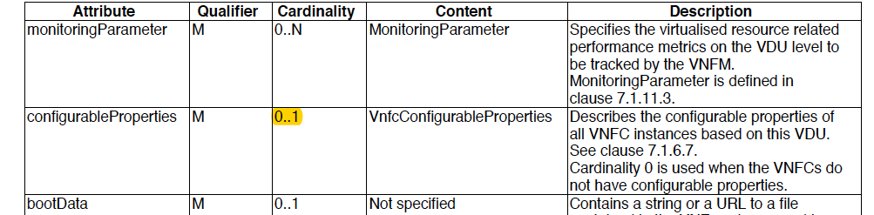
VNFD VDU configurableProperties
VDU Attributes

Slide 5
ONAP IM VNFD:VDU configurableProperties
Minor change to allow cardinality 0

Slide 6
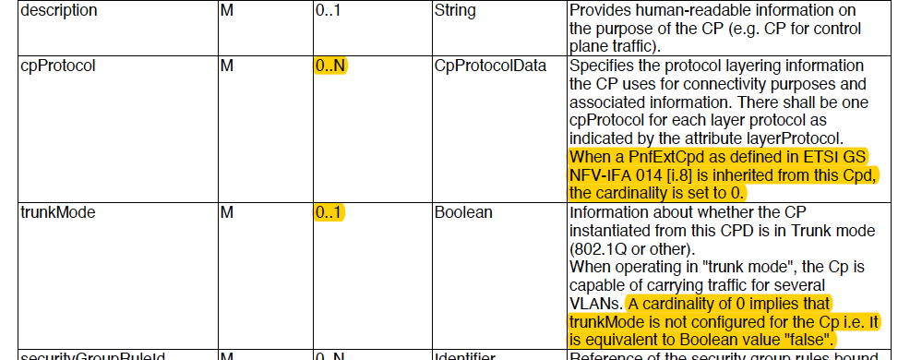
VNFD cpProtocol & trunkMode
CPD Attributes

Slide 7
ONAP IM Common:Cpd cpProtocol & trunkMode
cpProtocol needs change to allow cardinality 0
trunkMode needs change to allow cardinality 0

Slide 8
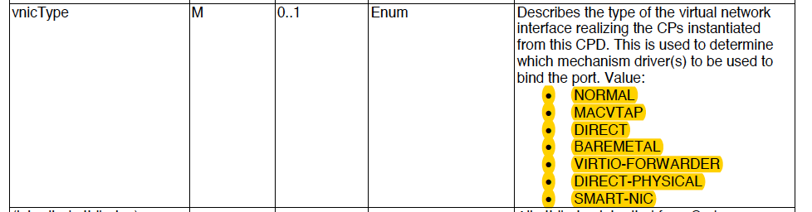
VNFD VduCpd vnicType
VduCpd Attributes

Slide 9
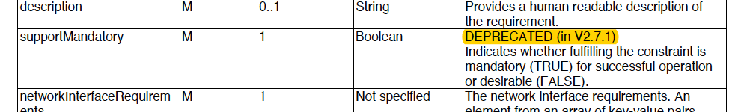
VirtualNetworkInterfaceRequirements: supportMandatory

Slide 10
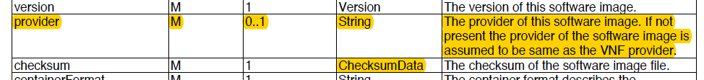
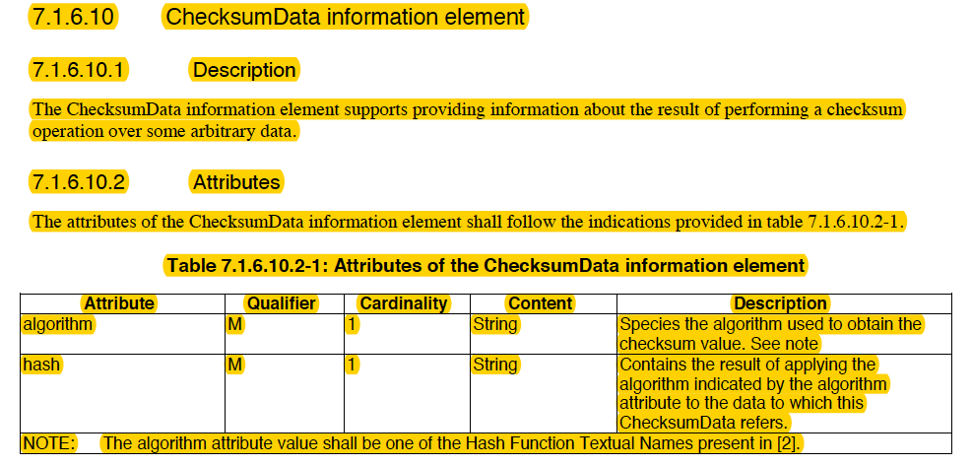
SwImageDesc provider & checksum

Slide 11
ONAP IM Vnf:SwImageDesc provider & checksum
Needs new element for provider-string[0..1]
Needs class for checksumData (algorithm-string, hash-string)
Needs new element for checksum containing checksumData

Slide 12
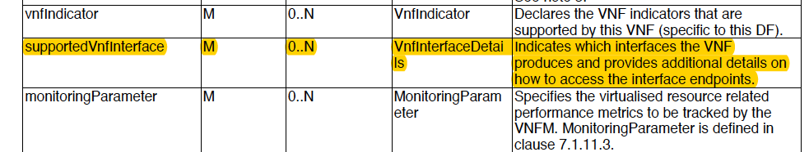
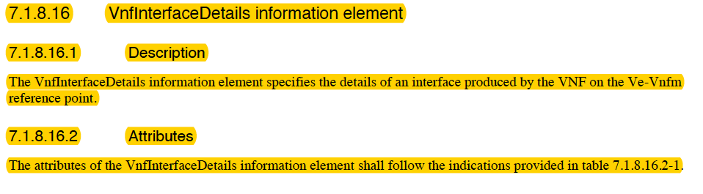
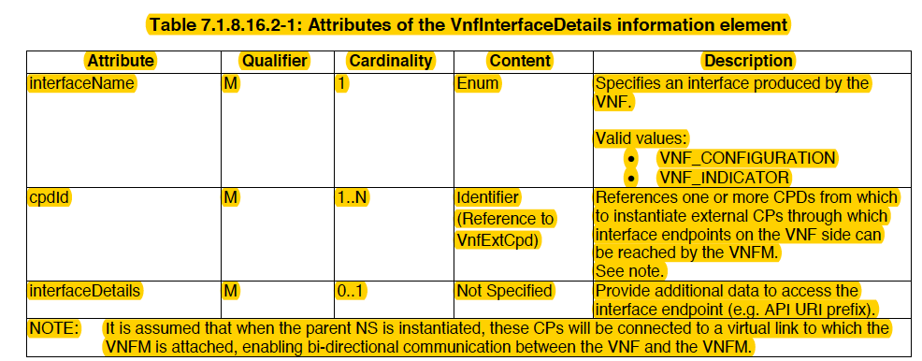
VnfDf: supportedVnfinterface

Slide 13
ONAP IM VnfDf: supportedVnfinterface
New class for vnfInterfaceDetails
  interfaceName
  cpdId
  interfaceDetails
New element supportedVnfinterface in VnfDf that contains vnfInterfaceDetails

Slide 14
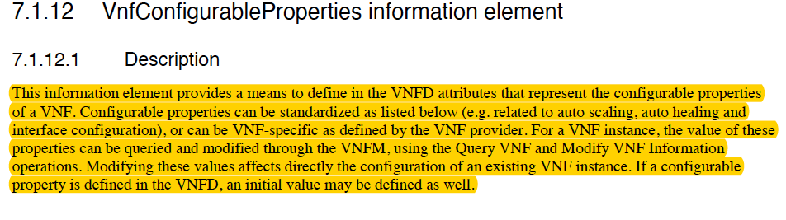
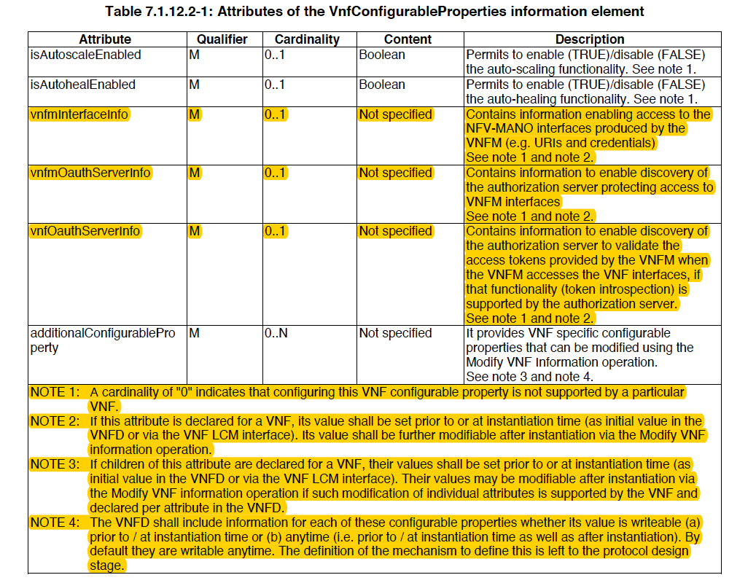
VnfConfigurableProperties

Slide 15
ONAP IM VnfConfigurableProperties
Add new elements
  vnfminterfaceinfo
  vnfmOauthServerinfo
  vnfOauthServerinfo

Slide 16
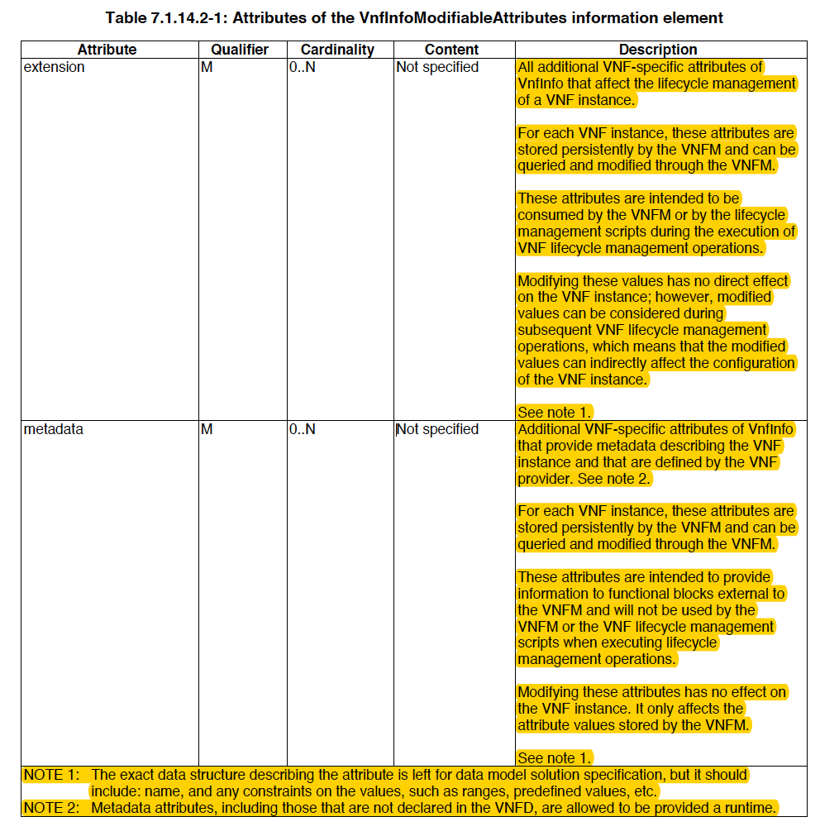
VnfInfoModifiableAttributes

Slide 17
References
ETSI IFA011 v2.7.1 https://www.etsi.org/deliver/etsi_gs/nfv-ifa/001_099/011/02.07.01_60/gs_nfv-ifa011v020701p.pdf
ETSI IFA011 v2.5.1 https://www.etsi.org/deliver/etsi_gs/nfv-ifa/001_099/011/02.05.01_60/gs_nfv-ifa011v020501p.pdf

Slide 18
Thank you!

