Slide 1
5G Self-Organizing Network (SON)
using ONAP Optimization Framework (OOF):Guilin Demo & Roadmap
Collaborators : AT&T, Wipro, IBM, highstreet technologies, Tech Mahindra, Ericsson, Nokia, Reliance Jio, Rutgers Winlab, Verizon
Presenters: N.K. Shankaranayaranan, Swaminathan S, Krishna Moorthy
Demo: Niranjana Y

Slide 2







Introduction to ONAP-based SON
Optimization (OOF)
Co-ordination, Decisions
(Policy)
SON ⬄ Control Loop (CL)
ONAP: Open-source platform, with basic open-source code
Companies can use framework to add proprietary SON solutions, including optimization algorithms, etc.
Data Collection,
& Analysis
(DCAE)
RIC (non-RT)
Action
(SDN-R)
OOF-SON use case has built a foundation for ONAP/O-RAN integration
Radio network uses common netconf/yang model
Data flows
SDN-R to RAN: netconf-based configuration
RAN to DCAE: VES format for FM alarms, PM KPI, CM Notification
RAN to SDN-R: Netconf ack
Control loop
Data, FM, PM
RIC (near RT)
A-1/O-1
A-1/O-1
O-RAN Radio Network
Config ack
Config notify
2

Slide 3
Release Roadmap
R6 Frankfurt
R7 Guilin
R8 Honolulu
R9 Istanbul & beyond
CM-Notify handling
Control Loop Co-ordination (CLC) first steps
Introduced Adaptive SON functionality
Checked in RAN-Sim into ONAP repo
ML-based SON – first steps (training done offline), additional input from ML-model for PCI optimization (based on PM data)
Preparation work for 3GPP/O-RAN yang model
O-RAN alignment (O1 for configuration and CM notification)
CPS - RAN config data base (first steps), cell models, initial alignment with 3GPP NRM
SON coordination (preparation/initial steps)
CLC interaction (stretch)
O-RAN alignment (FM/PM over O1)
CPS – Full-fledged RAN data base, full alignment with 3GPP NRM
Control Loop Co-ordination, SON function co-ordination
New SON use cases & interaction with Network Slicing
SON in context of LCM, SON function deployment
3

Slide 4
Guilin recap

Slide 5
ONAP SON aligning with O-RAN:
Release 7 POC
Network yang model update based on 3GPP/O-RAN (to prepare for Rel. 8)
Config DB (RCDB) Rel 6
Key enhancements done in Guilin release
DMaaP
Simulated RAN
~2000 Cells
Nbrlist, PCI
4d
13
9
10
12
4a
4c
10
12
9
4c
13
OOF
ML-based
DCAE
Policy
SDN-R
(SDN-C)
Config Change
O1 - Netconf interface
1c
8
SON Handler MS
1d
11b
6
1b
2
1a
5
4b
11a
O-RAN O1
interface
4e
ConfigDB
Cells/GNBs
RIC
Yang model
7a
4d
1f
7b
4f
DCAE
[3a] 4a
DES MS
FM/PM DB
CM
VES Collector
O1 - VES
outputs
Offline-training
for ML-based
SON function
1e
3d
O-RAN O1 interface
FM/PM Collector and Database
FM/PM KPIs
n
Interface enhancements
New interface
Note: DES MS is a new MS introduced in Release 7.
m
REST API
DMaaP Control Loop messages
CM-FM-PM messages from RAN
Config updated to RAN (netconf)

Slide 6
ML-based SON: Approach
ML training should be done outside ONAP – use “offline training”, and then onboard the ML models on to ONAP.
  Future enhancement can include updating the model after it is onboarded to ONAP (interface, mechanism, etc. to be worked out)
SON function applying an ML model can be incorporated in OOF or DCAE. Since it is a SON use case, possible scenarios include:
  ML providing additional ‘inputs’ to the SON optimization algorithm in OOF
  ML techniques can be employed for the optimization, and consider Policy-based decision to pick from multiple ML models
  Detection of need for optimization (e.g., hidden neighbors)
  Multi-step optimization, with one or more steps involving ML
  Etc.
  So, we considered it is more appropriate to have an offline-trained SON model hosted in OOF.
Approach chosen in Guilin
6

Slide 7
Remarks
ML model will get invoked when OOF is invoked for PCI optimization by SON-Handler.
ML sub-component will invoke DES APIs to fetch last ‘n’ PM samples (HO).
It is assumed that the historical PM samples are stored in the MongoDB by DL Feeder.
In Guilin, the ML model will be very simple (just illustrative).
Beyond Guilin, we will also consider aspects such as the following:
  A way to “update” the model later?
  Should we consider training/re-training also to happen inside ONAP?
  ML used in detection of hidden neighbors, PCI collision, etc.
  ML-based optimization
  Other SON use cases
  …
7

Slide 8
OOF Architecture: Guilin
Container/POD
Container/POD
Container/POD
Container/POD
Container/POD
Policy Models
APP-X APP
PCI APP
APP-Y APP
CM APP
Placement API
App data plugins
Data transform
Data transform
Data Transform
Data transform
App user
OSDF lib base
OSDF lib SDK
data APIs
OSDF lib base
data APIs
OSDF lib base
data APIs
OSDF lib base
data APIs
data APIs
Policy
solve
(model-id, data-json)
Allows interfacing with custom optimizers
placementAPI(json)
pciAPI(json)
CRUD(mzn)
Container/POD
Platform component
Generic Solver API
OSDF lib base
App user
CRUD(mzn)
Container/POD
Placement Solver
InvokeSolver
(model, data, solver_params, timeout)
Mini Zinc
PCI heuristic Solver
Platform Data APIs
Model repos
App component
Mini zinc
ML model (SON)
Layered container images:
Allows use of base image from ONAP
  Push common data interfaces/transforms into common base
Build secret sauce as
  Models going into model repo
  API/data enhancements built on top of base image
Provides App users direct access to model repo:
No development needed for model changes that do not change data i/f
Tighter access control to model DB – better security
Triggers for validation when models get inserted into DB
Version control for models
Compile time (API/Data) separated from the runtime (Gen-solver):
Enables common interface to generic & custom solvers
Allows Generic solver to scale independently (vs for each optimization)
Allows user to on-board models during runtime (provided data APIs remain same)
Enhancement in Guilin
8

Slide 9
ML-based SON: Flows
OOF
a
b
c
PM data flow (collection)
Minizinc
10
Existing CL flow
Config DB
OSDF
New CL flow/action
4
5
New flow for use case, but
Implemented in ONAP
Offline Trained SON ML model
9
6
8
3
11
Simulated RAN
O1 - Netconf interface
DCAE
DES
DL-Feeder
SON-Handler MS
Policy
12
Cells/GNBs
RIC
Yang model
PG
7
c
b
2
13
Mongo DB
VES Collector
14
O1 – VES outputs
SDN-R
a
PM data over O1
1
FM data over O1
REST API
DMaaP Control Loop messages
FM-PM messages from RAN
Config updated to RAN (netconf)
DB R/W
9

Slide 10
Flow details
Step | Description
1 | PCI collision/confusion alarm from RAN to VES collector
2 | PCI collision/confusion alarm posted on DMaaP by VES Collector
3 | SON-Handler triggers OOF for PCI optimization
4 | OOF (OSDF) queries ConfigDB to obtain cells, PCI and neighbor details
5 | OSDF invokes the ML function for any additional inputs to the optimization
6 | ML function queries DES for PM data samples from MongoDB
7 | DES fetches PM data samples from MongoDB
8 | DES provides the PM data samples to ML function
9 | ML function provides updated ‘fixed PCI cell’ list based on the ML model
10 | Optimizer is invoked along with additional inputs from ML model
11 | OOF returns PCI optimization result to SON-Handler MS
12 | SON-Handler MS triggers a Control Loop towards Policy
13 | Policy invokes SDN-R as the actor of the CL to update PCI values
14 | SDN-R sends updated PCI values to the RAN
ML model working
Based on HO PM data reported from the RAN, and by looking at the trend (last ‘n’ samples), ML model shall provide a list of cells whose PCI values shall not be changed during PCI optimization (FixedPCI cells). This shall be considered by Minizinc during PCI optimization.
Notes
DES can provide last ‘n’ samples of PM data. No additional functional impact in DES or its APIs.
The ML model will be hosted in OOF. In Guilin release, it will be quite simple.
Format of PM data reported by RAN – no changes are foreseen in G-release.
DL-feeder configuration to be considered.
Blue – New step
10

Slide 11
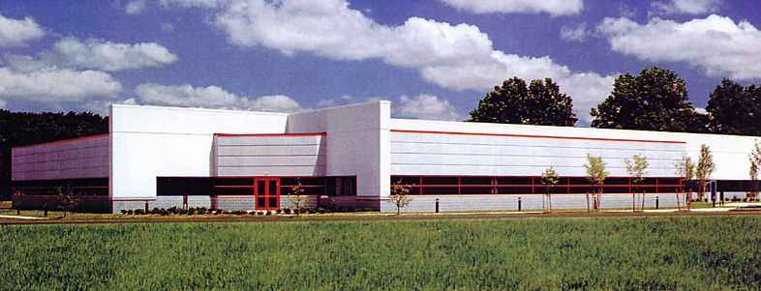

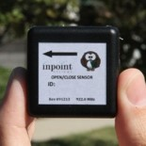
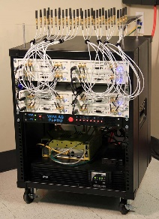
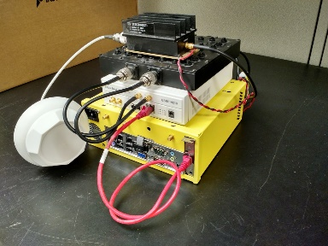
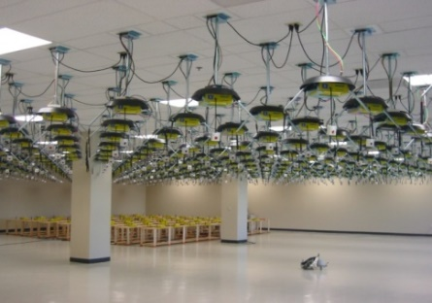
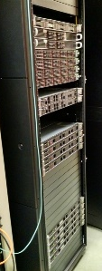
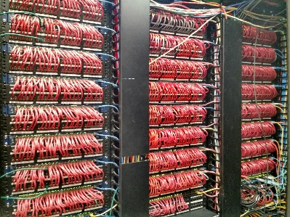
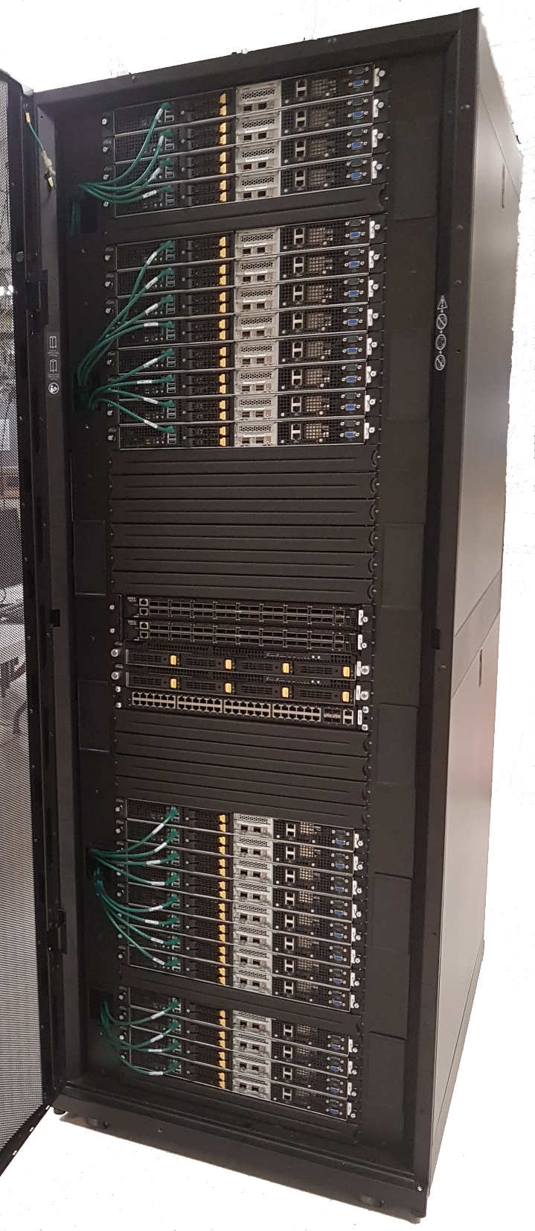
WINLAB at Rutgers University
WINLAB founded in 1989 as a collaborative
industry-university research center with
specialized focus on wireless networking
~25 faculty/staff, most from the ECE and CS departments at Rutgers
~40-50 grad students (80% PhD, 20% MS)
WINLAB Tech Center Facility
Center’s research portfolio spans information theory, radio technology, wireless systems, mobile networks and computing
Extensive experimental research infrastructure including ORBIT & GENI testbeds, SDR, SDN, …
Low Power IoT Device
Massive MIMO
SDR
ORBIT Radio Grid Testbed
GENI Rack
SDN
CloudLab Rack
Selected as an ONAP integration and testing laboratory for North America

Slide 12
Guilin demo

Slide 13
PCI Optimization: Pre-Guilin
OOF
a
PM data flow (collection)
Minizinc
5
Config DB
Steps illustrated in demo
OSDF
4
Step 3
6
Step 5
3
Simulated RAN
Step 2
O1 - Netconf interface
DCAE
DES
DL-Feeder
SON-Handler MS
Policy
7
Cells/GNBs
RIC
Yang model
PG
2
8
Step 4
Mongo DB
VES Collector
9
O1 – VES outputs
SDN-R
a
PM data over O1
1
FM data over O1
Step 1
REST API
DMaaP Control Loop messages
FM-PM messages from RAN
Config updated to RAN (netconf)
DB R/W
13

Slide 14
Demo Sequence: Pre-Guilin
Step 3: Logs
Step 4: Logs
Step 5: UI
Step 2: Logs
Step 1: UI
Show OOF response (PCI optimization result)
Show Policy triggering SDN-R (Actor)
Show SON-Handler MS triggering OOF
Show that the PCI optimization has solved the problem
Trigger PCI alarm (collision/confusion) from RAN-SIM UI

Slide 15
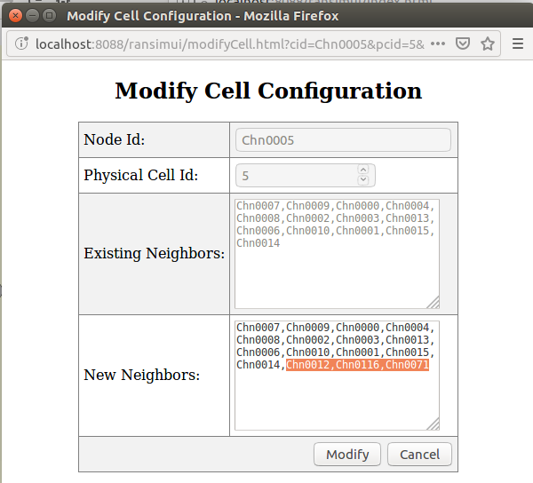
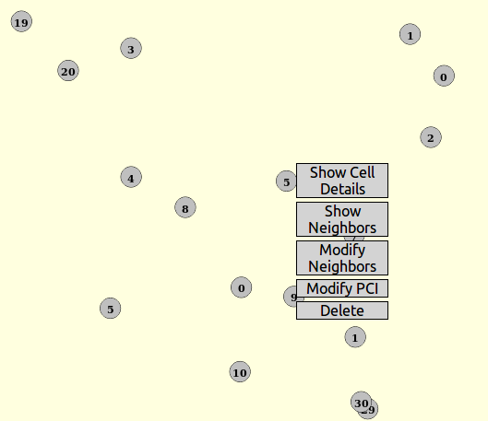
Step 1: Modify Neighbors (Chn0005)
Modify neighbors for Chn0005

Slide 16
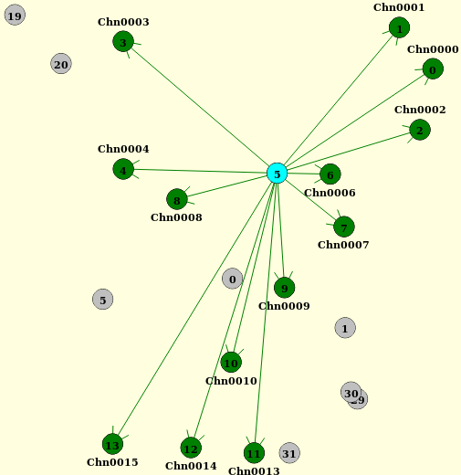
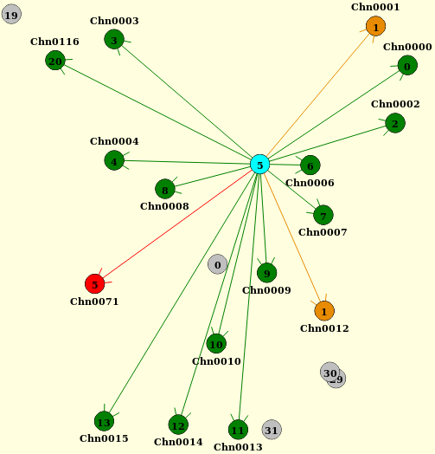
Step 1: Modify neighbors for Chn0005
Original neighbors for Chn0005
After addition of 3 neighbors

Slide 17
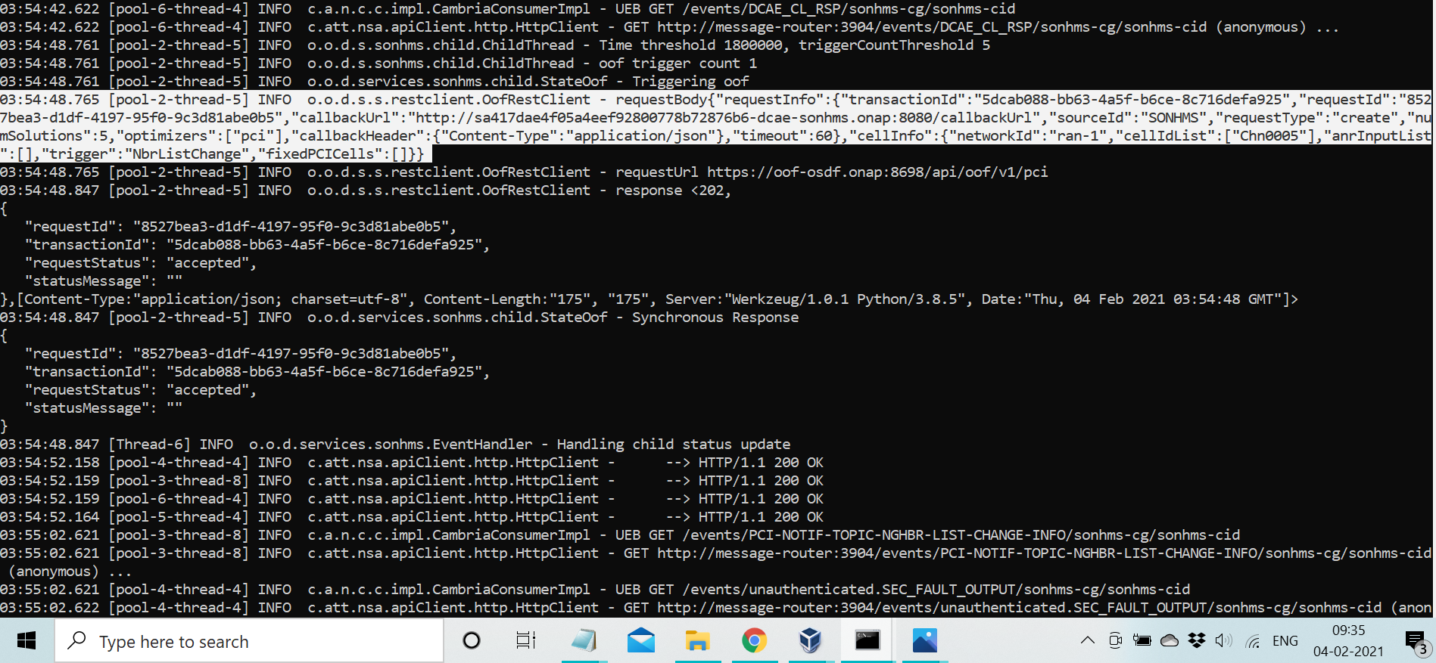
Step 2: SON-Handler MS -> OOF trigger
No “fixedPCI cells”

Slide 18
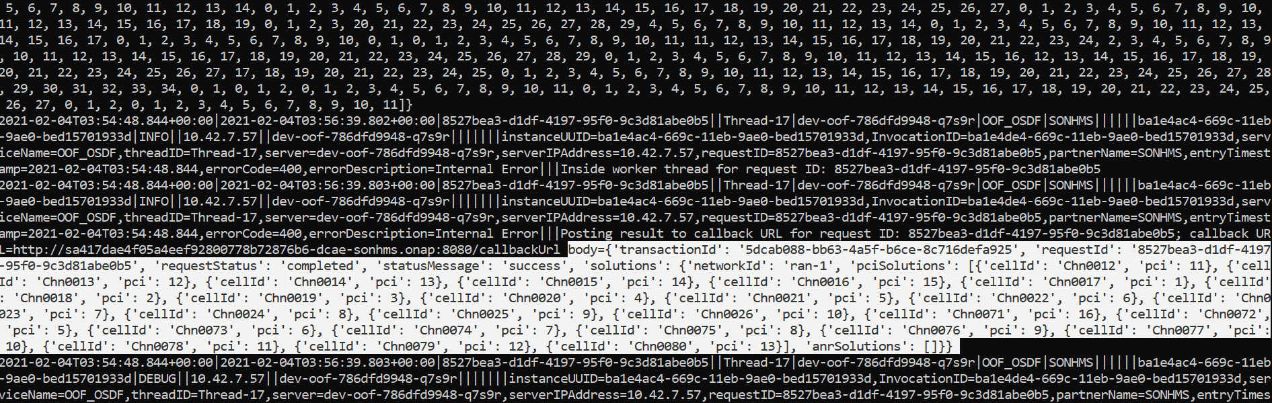
Step 3: Optimization Result
PCI of Chn0012 is changed

Slide 19
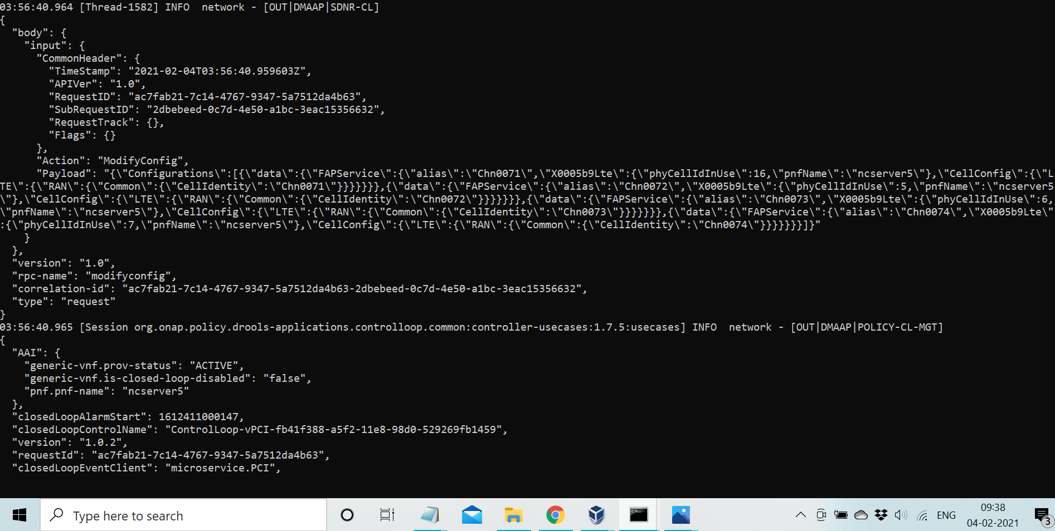
Step 4: Policy -> SDN-R (Actor)

Slide 20
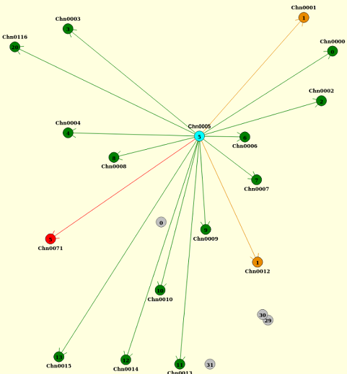
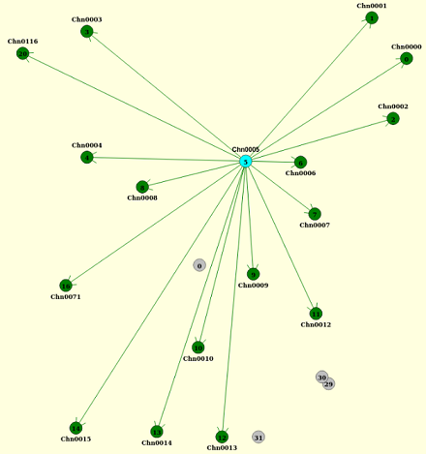
Step 5: PCI optimization completed
Before optimization
After optimization

Slide 21
ML-based PCI Optimization: Guilin Demo
OOF
a
b
c
PM data flow (collection)
Minizinc
10
Config DB
Existing CL flow
OSDF
4
New CL flow/action
5
New flow for use case, but
Implemented in ONAP
Offline Trained SON ML model
9
Step 6
6
8
11
Step 8
3
Simulated RAN
Step 5
Step 4
O1 - Netconf interface
DCAE
DES
DL-Feeder
SON-Handler MS
Policy
12
Cells/GNBs
RIC
Yang model
PG
7
c
b
2
13
Step 7
Mongo DB
Step 2
VES Collector
14
O1 – VES outputs
SDN-R
a
PM data over O1
Step 1
1
FM data over O1
Step 3
Steps illustrated in demo
REST API
DMaaP Control Loop messages
FM-PM messages from RAN
Config updated to RAN (netconf)
DB R/W
21

Slide 22
Demo Sequence: Guilin
Guilin enhancement
Step 5: Logs
Step 6: Logs
Step 8: UI
Step 4: Logs
Step 1: UI
Step 2: Logs
Step 3: UI
Step 7: Logs
Show OOF response (PCI optimization result)
Show Policy triggering SDN-R (Actor)
Show SON-Handler MS triggering OOF
Show that the PCI optimization has solved the problem
PM data (with high HO for 1 cell) stored in Data Lake
Trigger PM data reporting (with high HO for some cells)
Trigger PCI alarm (collision/confusion) from RAN-SIM UI
OOF<->DES interaction for fetching HO data
While keeping PCI unchanged for a cell with high HO

Slide 23
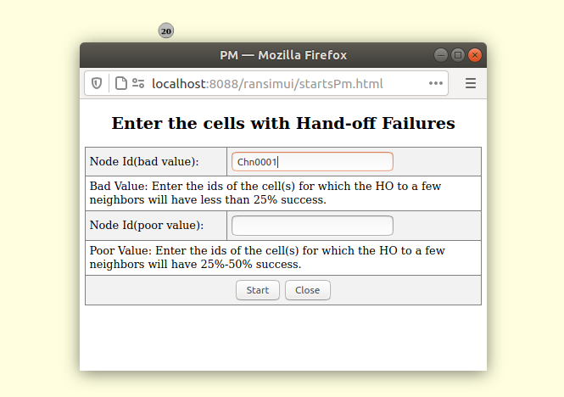
Step 1: Generate PM data
This is to initiate PM data generation from RAN-Sim.
In RAN-Sim, we pre-configure that the handovers for Chn0012 is very high.

Slide 24
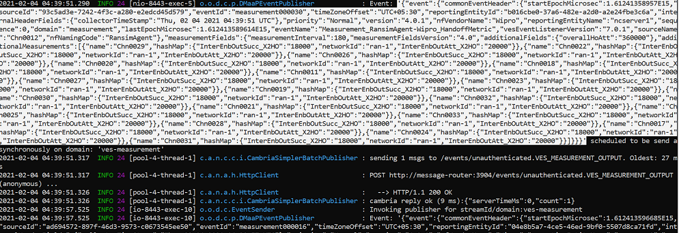
Step 2: High Handovers for Chn0012
Handovers for Chn0012 is very high (compared to other cells)

Slide 25
Step 3: Modify Neighbors (Chn0005)
Modify neighbors for Chn0005

Slide 26
Step 3: Modify neighbors for Chn0005
Original neighbors for Chn0005
After addition of 3 neighbors

Slide 27
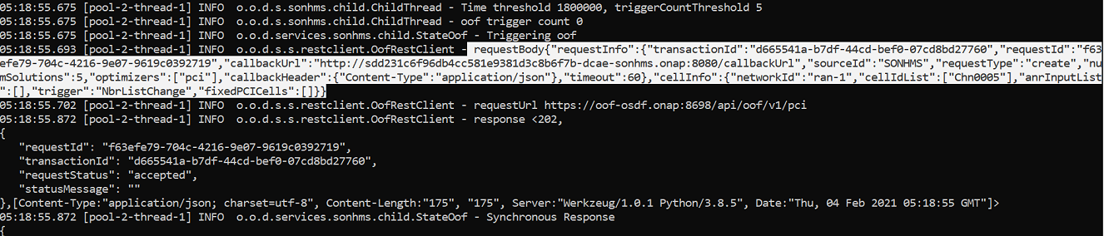
Step 4: SON-Handler MS -> OOF trigger
No “fixedPCI cells”

Slide 28
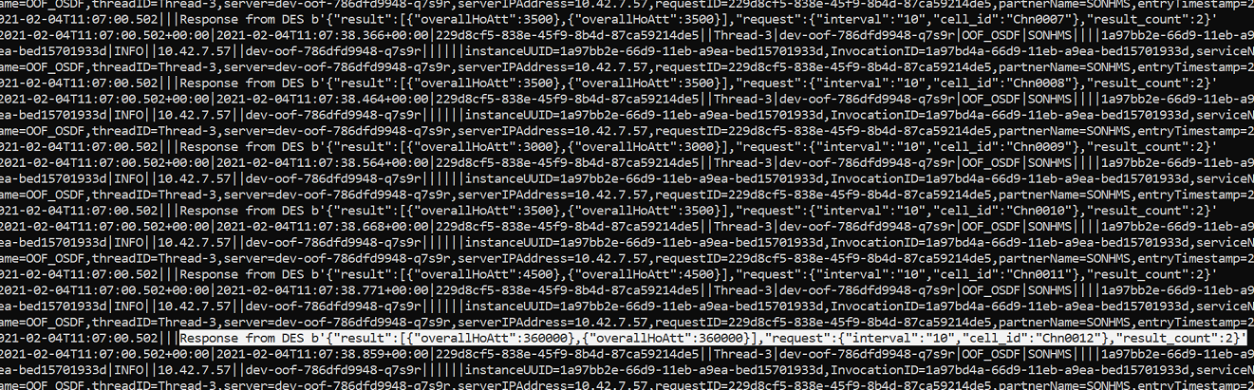
Step 5: OOF<->DES interaction for HO data

Slide 29
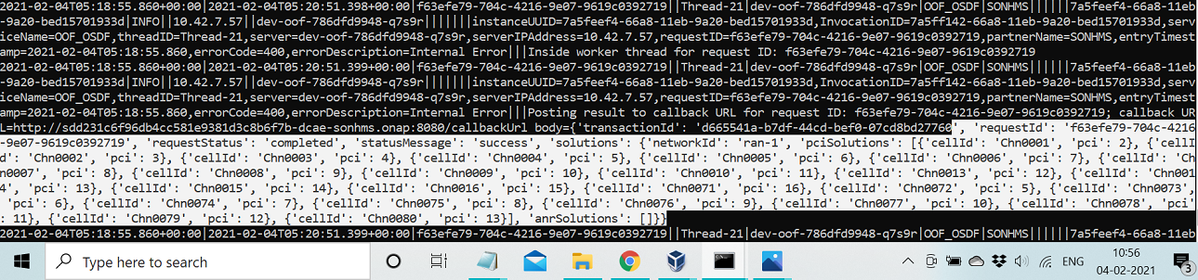
Step 6: Optimization Result
PCI of Chn0012 is not changed (fixed), but PCI of Chn0001 is changed to solve the confusion.

Slide 30
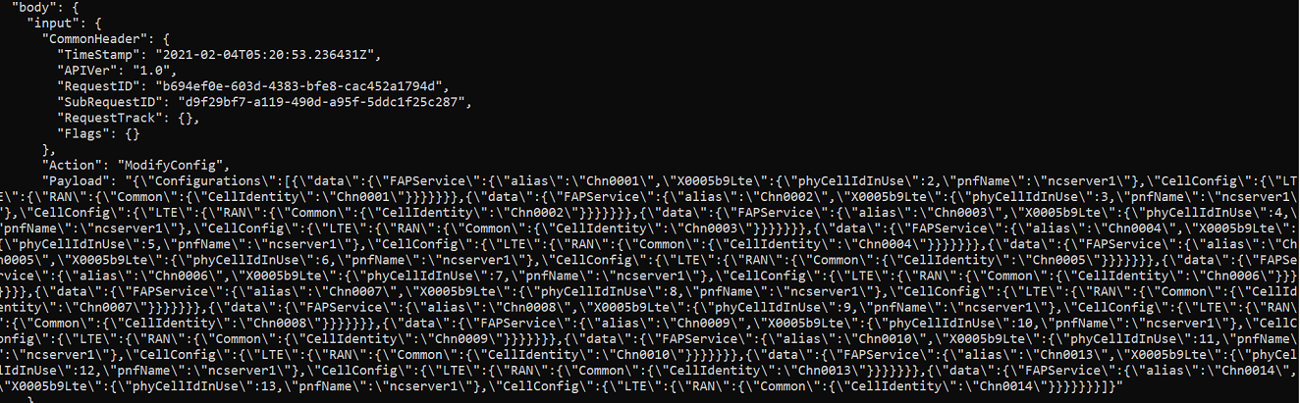
Step 7: Policy -> SDN-R (Actor)

Slide 31
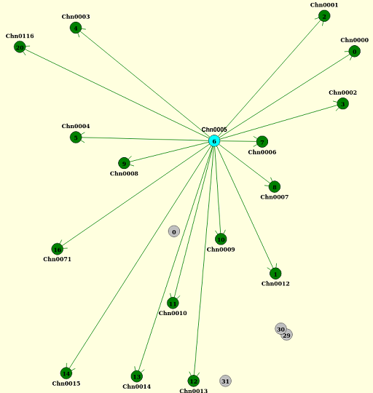
Step 8: PCI optimization completed
Before optimization
After optimization

Slide 32
Recap
ML-based SON takes additional inputs (cells whose PCI values should remain unchanged) from ML models during PCI optimization and then performs the optimization
Solution without ML-SON
Solution with ML-SON

Slide 33
Honolulu release & future roadmap

Slide 34
Release Roadmap
R6 Frankfurt
R7 Guilin
R8 Honolulu
R9 Istanbul & beyond
CM-Notify handling
Control Loop Co-ordination (CLC) first steps
Introduced Adaptive SON functionality
Checked in RAN-Sim into ONAP repo
ML-based SON – first steps (training done offline), additional input from ML-model for PCI optimization (based on PM data)
Preparation work for 3GPP/O-RAN yang model
O-RAN alignment (O1 for configuration and CM notification)
CPS - RAN config data base (first steps), cell models, initial alignment with 3GPP NRM
SON coordination (preparation/initial steps)
CLC interaction (stretch)
O-RAN alignment (FM/PM over O1)
CPS – Full-fledged RAN data base, full alignment with 3GPP NRM
Control Loop Co-ordination, SON function co-ordination
New SON use cases & interaction with Network Slicing
SON in context of LCM, SON function deployment
34

Slide 35
Summary of Requirements
Category | Requirement | Content | Priority
Interoperability | O-RAN alignment (VES, O1 interface) | Receive Configuration Management (CM) notifications over VES Align with relevant aspects of O-RAN O1 interface (netconf configuration, PM and FM notifications) | HIGH
Functional | RAN Database (CPS DB), including new RAN models (stretch goal) | Data models/DB schema & APIs to be generated from yang models Details of cells to be stored with PNF reference in AAI Modeling of RAN functions and objects (align with NRM) | HIGH
Platform | Control Loop Coordination (CLC) extensions | Collaborate on CLC extensions (queueing, priority, …) (stretch goal) | HIGH
Functional | SON co-ordination | Co-ordination across SON functions – initial steps | MEDIUM
Functional | SON function to evolve ONAP platform | (New) SON use case based on data/KPI analysis Machine Learning (ML) SON aspects in DCAE (enhancements) Interaction with Network Slicing (stretch goal) CLC interaction (stretch goal) | MEDIUM
Functional | SON in the context of LCM | Role of SO (e.g., new cell discovery/addition) (beyond H-release) | LOW
Platform | SON function deployment | SDC & CLAMP (for SON service/feature deployment) (beyond H-release) | LOW
Interoperability | Real gNB interaction | Interaction with real gNodeB in lab (over O1 interface) | LOW
Blue Topics for which there is commitment in R8, other topics will be taken up based on resource availability, timelines & PTL agreement.

Slide 36
ONAP SON aligning with O-RAN:
Release 7 POC
Network yang model update based on 3GPP/O-RAN (to prepare for Rel. 8)
CM notification msg – Rel 6 “pre-standard” msg ,Config DB (RCDB) Rel 6
DMaaP
Simulated RAN
~2000 Cells
Nbrlist, PCI
4d
13
9
10
12
4a
4c
10
12
9
4c
13
OOF
ML-based
DCAE
Policy
SDN-R
(SDN-C)
Config Change
O1 - Netconf interface
1c
8
SON Handler MS
1d
11b
6
1b
2
1a
5
4b
11a
O-RAN O1
interface
4e
ConfigDB
Cells/GNBs
RIC
Yang model
7a
4d
1f
7b
4f
[3a] 4a
DES MS
CL setup
FM/PM DB
CM
Offline-training
for ML-based
SON function
VES Collector
O1 - VES
outputs
1e
3d
O-RAN O1 interface
FM/PM KPIs
FM/PM Collector and Database
n
Interface enhancements
New interface
Note: DES MS is a new MS introduced in Release 7.
m
REST API
DMaaP Control Loop messages
CM-FM-PM messages from RAN
Config updated to RAN (netconf)
36

Slide 37
ONAP SON aligning with O-RAN:
Release 8 target
CM via VES collector
CPS DB model based on O-RAN network yang model
5G use case for CPS, intention is to have an API mapper that maps existing APIs to appropriate Xpath queries
DMaaP
Simulated RAN
~2000 Cells
Nbrlist, PCI
4d
13
9
12
4a
10
9
4c
10
4c
12
13
OOF
ML-based
DCAE
Policy
SDN-R
(SDN-C)
Config Change
O1 - Netconf interface
1c
8
SON Handler MS
1d
11b
1b
2
1a
6
5
4b
11a
O-RAN O1
interface
4e
Cells/GNBs
RIC
Yang model
TDMT
7
CPS
1f
7b
4f
4d
DES MS
4a
CL setup
Offline-training
for ML-based
SON function
FM/PM DB
3a
CM
O1 - VES
outputs
VES Collector
O-RAN O1 interface
1e
3d
FM/PM KPIs
FM/PM Collector & DB
TDMT = Template-based Data Model Transformer
n
Interface enhancement
Functional enhancement
REST API
DMaaP Control Loop messages
CM-FM-PM messages from RAN
Config updated to RAN (netconf)
37

Slide 38
Rel 8 OOF-SON dependency on
ONAP CPS and O-RAN
OOF-SON use case created ConfigDB in Rel 5/Rel6/Rel7 which was the seed for CPS
OOF-SON has a strong dependency on, and is an early adopter of, working instance of CPS
REQ: Identify/support RAN yang model aligned with O-RAN/3GPP – can be a very small sub-graph for Rel.8. SON use case with cellid, pci, neighbor cell relation – (mostly DONE)
REQ: Support database API similar to existing Rel.7 ConfigDB API
  Use a mapper service (TDMT) which maps the existing APIs to Xpath queries to CPS
Dependency | Mitigation
Availability of O-RAN yang models. | Use 3GPP TS 28.541 NRM based attribute definitions and yang from https://forge.etsi.org/rep/3GPP/SA5/data-models/tree/master/yang-models.
Availability of CM_Notify VES Spec, and confirmation that VES Collector will be updated to receive this. | Continue to use custom-defined CM_Notify, however, there will be no additional value for Honolulu release.
CPS readiness | Continue to use ConfigDB APIs if CPS is not ready Use Xpath queries of CPS if the mapper service is not ready
Our understanding is this will be available for H-release.

Slide 39
Yang model for R8
For Rel 5/6/7, OOF-SON used a sub-tree from Broadband Forum RAN model based on 3GPP
For Rel 8 of OOF-SON, we have identified a yang model based on the ORAN/3GPP (TS 28.541 Rel. 16) model for SON and Network Slicing
Basic ids for GNB and cell: gNBDUId, nCI etc
PCI property: nRPCI
Neighbor Relations – for PCI and ANR functions
SON use case has prior work (MS, OOF, SDNR, RAN-Sim) using Rel 6 APIs and model. Non-trivial effort to map the existing API/model to the CPS-DB based on New Yang model
Consensus is to rely on model/api mapping (TDMT)
RAN-Sim will also need to be modified to support new Yang model
Yang model update has impacts in SDN-R and RAN-Sim, and this work may take I-release to be completed.
39

Slide 40
FM (alarms) support in ONAP-SON
RAN-SIM sends single FM alarm message, e.g., PCI-Conflict (step 3d)
DCAE Collector places FM message on DMaaP (step 4d)
SON-Handler MS processes FM message and stores in FM/PM DB – (step 4f)
Goal: Release 8/9: ONAP-SON should align with ORAN model for FM
What is appropriate scope in ONAP to handle alarms?
  What are the FM message formats / types as per ORAN
  What are the assumptions for single v. repeated alarms
  How does the SON loop determine that an alarm has been addressed?
40

Slide 41
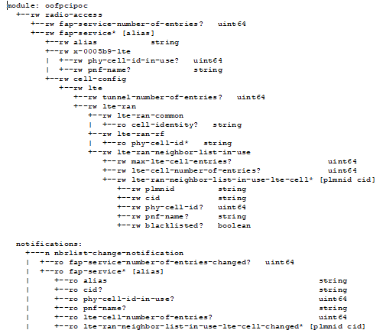
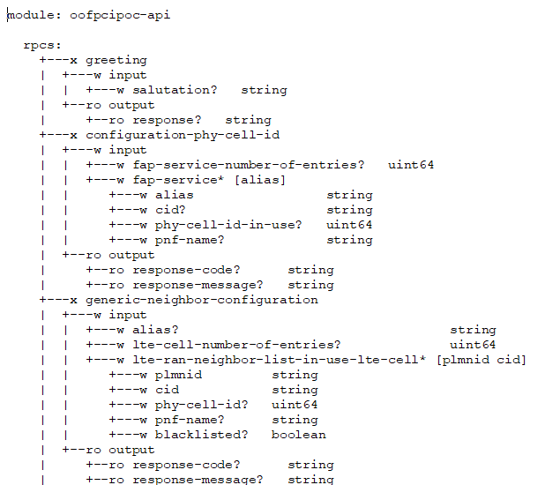
YANG Model Tree Used for Rel. 5/6/7 OOF PCI/ANR POC¹
The platform ready to support any YANG Model
Number & List of Cells
PCI and PNF-NAME for a Cell
List of Neighbors
RPC
RPC
Netconf Notification
¹ https://gerrit.onap.org/r/gitweb?p=ccsdk/features.git;a=tree;f=sdnr/northbound/oofpcipoc/model/src/main/yang;h=5b3ef2c03cf516ba716f69076a780a95e96fadc2;hb=refs/heads/dublin

Slide 42
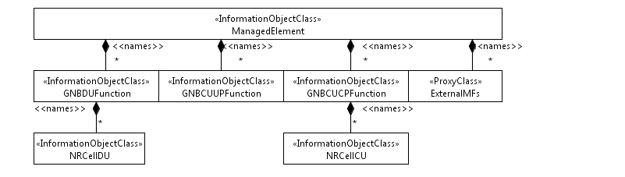
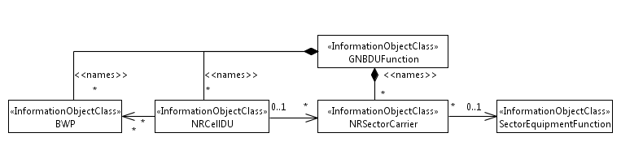
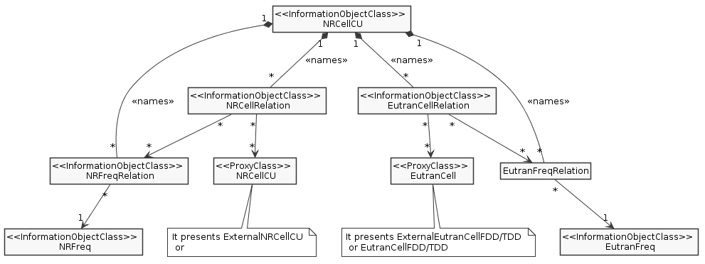
Network Resource Models (NRM):
3GPP 28.541 Rel 15
Figure 4.2.1.1-1: NRM for all deployment scenarios
Figure 4.2.1.1-3: NRM for <<IOC>>NRSectorCarrier and <<IOC>>BWP for all deployment scenarios
Figure 4.2.1.1-4: Cell Relation view for all deployment scenarios

Slide 43
Network yang models & ONAP DB models/API – Rel 6 & 7
“Data model”
used at interfaces:
ConfigDB
RAN
DMaaP
Simulated RAN
~2000 Cells
Nbrlist, PCI
10
Netconf
Configuration
Read network
configuration
DB-Update
4a
12
4c
Config
DB
4b
SDN-R
(SDN-C)
Config Change
O1 - Netconf interface
SON-H MS
OOF
4e
1f
1d
11
Network
Yang
Model
7
ORAN O1 CM
interface
Database
Schema
API
Model Mapping
Cells/GNBs
RIC
Yang model
4a
“PCI” value:
BBF Yang model
lte-ran-rf-g/
phy-cell-id
3a
“PCI” value:
ONAP Rel 4 implementation
Cell.pciValue
1e
ORAN O1 interface
O1 - VES
outputs
VES Collector
CM Notification

Slide 44
Network yang model & CPS DB models/API – Rel 8/9
Maps DB API calls to suitable yang-based Xpath queries
“Data model”
used at interfaces:
CPS DB
RAN
DMaaP
Simulated RAN
~2000 Cells
Nbrlist, PCI
4b
10
Netconf
Configuration
DB-Update
12
1f
4c
TDMT
CPS-DB
SDN-R
(SDN-C)
Config Change
O1 - Netconf interface
SON-H MS
OOF
4e
11a
1d
11b
Network
Yang
Model
7
ORAN O1 CM
interface
Cells/GNBs
RIC
Yang model
Database
Schema
Xpath API
4a
“PCI” value:
(ORAN or 3GPP Yang model) NRCellDU/nRPCI
3a
1e
ORAN O1 interface
O1 - VES
outputs
VES Collector
“PCI” value:
ONAP Rel 8 implementation
NRCellDU/nRPCI
CM Notification
44

Slide 45
CPS overview
SON-Handler MS
Data/API normalization (if needed) happens in the Application space
xNF proxy is the owner and single point of entry for native xNF data
xNF proxy interacts with mediation/controllers and keeps the CPS data up-to-date
Data model/API normalization
SON normalizer
OOF
xNF Proxy
CPS
<core>
DB
Template-based Data Model Transformer
SDN Controller
DCAE VES collector
1
3
2
xNF

Slide 46
SON co-ordination: Stretch Goal
CLC in Policy is currently designed to co-ordinate actions AFTER individual micro-services (components) have decided to take an action and trigger Policy.
SON co-ordination involves the impact of one SON function on another before or during the determination of action (e.g., optimization)
  For example, when a cell outage is being compensated, coverage and capacity optimization should be deferred or should take cell outage into consideration.
  SON co-ordination could be viewed as a platform enhancement => Policy and/or SO shall do the co-ordination.
Note: We will start with initial steps w.r.to SON co-ordination, actual implementation may happen beyond R8.
46

Slide 47
Control Loop Co-ordination: Stretch Goal
Interaction between Target lock and CLC
Definition of target – PNF, VNF, cell, service, NSI, etc.
Queueing/de-queuing of CL messages by CLC logic
Separate DMaaP topic for each CL response (e.g., DCAE-CL-RSP)
We are working with Policy Team to address these enhancements.
All consequent updates in SON-Handler MS and SDN-C will be handled by our SON use case team.
47

