Slide 1
ONAP / O-RAN / O-RAN-SC Collaboration
Swaminathan S, Martin Skorupski, John Keeney
Mar 25, 2021

Slide 2
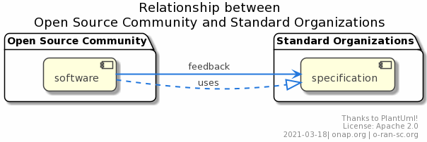
Closed loop: Open Software and Standardization
Intel Confidential ewerfferr
The open-source community uses the specifications and documents of SDOs and produces software to provide functionality
At the same time experience and trends are feedback and contributed to SDOs. In most of the cases it will lead to updates of existing specifications or triggers the creation of new specifications.

Slide 3
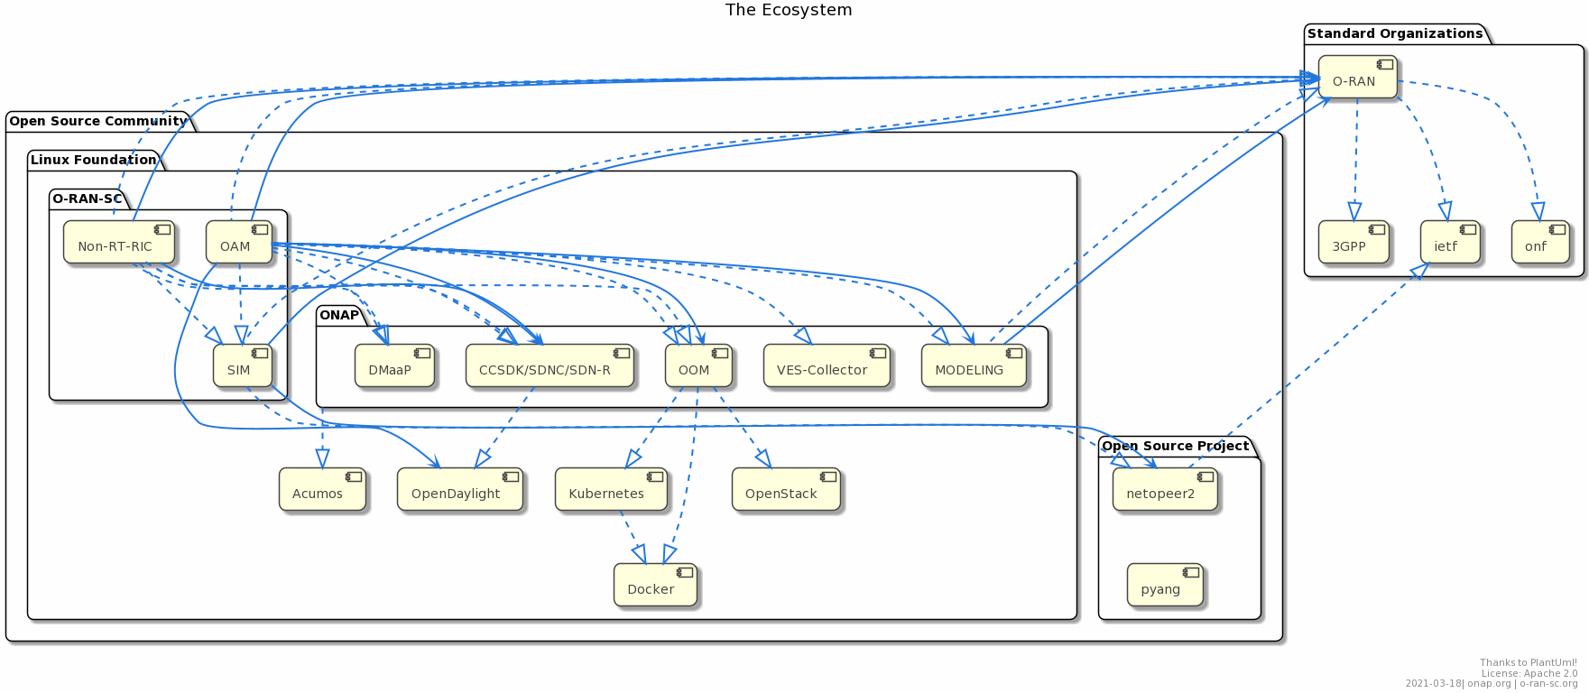
The Ecosystem (a simplified view ☺)
There are strong relations and dependencies between ONAP and O-RAN-SC creating a SMO and adding the NON-RT-RIC functions.

Slide 4
ONAP<->O-RAN Collaboration: Updates since Jan 2021
Continuation of discussions related to Network Slicing (RAN, and FH/MH Transport aspects
  Regular meetings between ONAP and O-RAN community
  Occasionally Transport folks are also invited for joint RAN <-> Transport meeting
  Jointly identified 2 Closed Loop scenarios for Guilin release (1 with AI/ML), which is further refined in Honolulu
  Expected to continue with first O-RAN Slicing specs expected later this year
Continuing discussions regarding use of O-RAN yang models for 5G SON use case, and in general for any RAN use case in ONAP
Intel Confidential ewerfferr

Slide 5
ONAP<->O-RAN-SC Collaboration: Updates since Jan 2021
Weekly calls on Wed with ONAP members and O-RAN-SC PTLs
  Quick status update by O-RAN-SC PTLs
  Topics of common interest being discussed, including interfaces (O1, A1), modelling aspects, control loops, FM/PM reporting, yang models, 5G use cases
  Functionality reuse and synergy is also in focus (e.g., simulators, SMO, Non-RT RIC, A1 adaptor) though only limited progress has been made so far
  Discussions on Modeling aspects (Abstract Topology Model)
Sharing resources and teams OpenLab activities in OWL (since 2019)
More formal interactions required at Requirements Sub-committee & ArchCom level
For SMO, there hasn’t been any formal discussion yet (to our knowledge) between ONAP and O-RAN-SC.

Slide 6
SMO – Current O-RAN-SC view
SMO-MVP “Minimum Viable Product” (current)
  A light-ware SMO instance mainly used for module testing. It should include O-RAN-SC simulators to show and validate the entire O-RAN functions
  (Note: if appropriate, artifacts (code, doc) could move from Non-RT-RIC and OAM project to SMO)
SMO-full (future releases)
  A full functional O-RAN-SC SMO instance as reference implementation for commercial products, including “one-click” deployment, geo-redundancy, ...)
Source: https://wiki.o-ran-sc.org/pages/viewpage.action?pageId=20875862

Slide 7
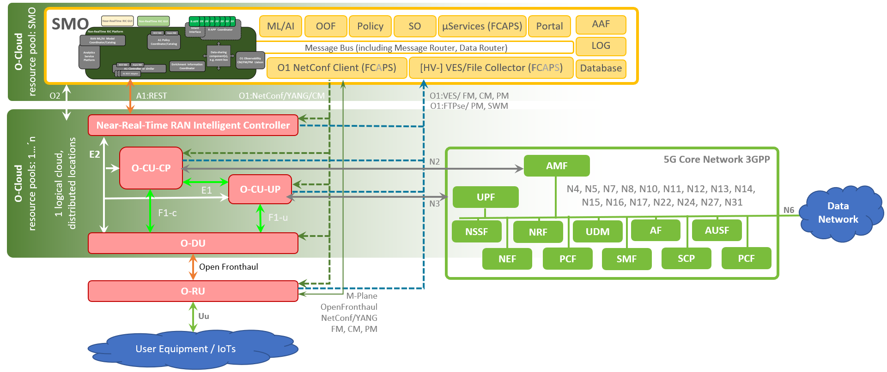
O-RAN-SC SMO Environment (draft)
UE/IoT applications
Non-RT-RIC
Supervision
Control
Limited Support in ONAP today
Supported in ONAP today
Not supported in ONAP at present
Source: https://wiki.o-ran-sc.org/pages/viewpage.action?pageId=20875862

Slide 8
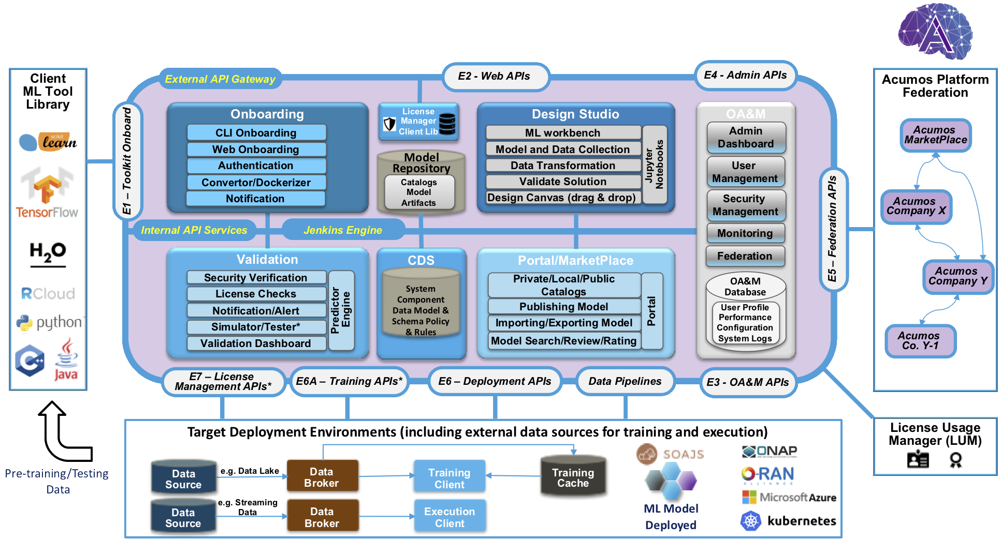
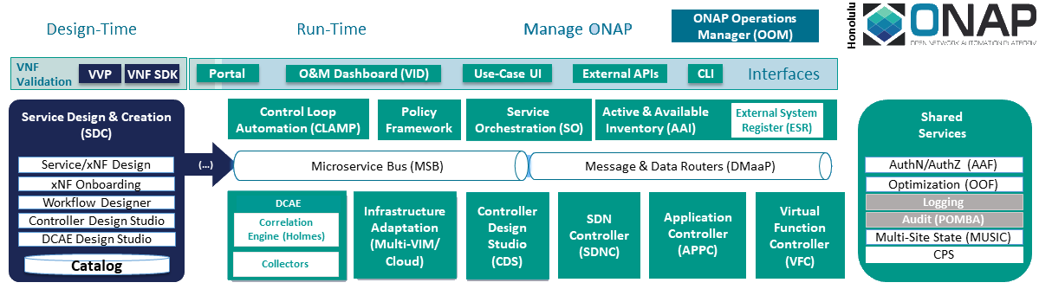



O-RAN-SC OAM: Cloud stack for ONAP and Acumos
docker engine
Sandboxes for dev and tests
(OOM, TIFG, OTIC)
control nodes bare metal compute nodes

Slide 9
SMO components and its mapping to existing open-source projects
SMO component | Protocol | Category | O-RAN-SC | ONAP | others
A1 Policy Mgmt Service | REST / DMaaP | mandatory | Non-RT-RIC | CCSDK
A1 Adaptor | RESTConf/YANG (Internal interface) | mandatory | Non-RT-RIC | CCSDK/SDNC
A1 Control Panel | Web application | mandatory | (near-rt)RIC Dashboard NONRTRIC Control Panel
O1 NetConf/YANG termination | NetConf/YANG client | mandatory | (As per ONAP) | ODL/CCSDK/SDNC | ODL Apache Karaf
O1 VES termination | VES server | mandatory | (As per ONAP) | VES collector HV-VES collector
O1 dashboard | Web application | preferred |  | ODLUX
Message bus | REST or Kafka | mandatory | (As per ONAP) | DMaaP | Apache Kafka
Persistent database | database cluster (no-sql, sql) | mandatory | (As per ONAP) | ElasticSearch for FCAPS mariaDB | ElasticSearch MariaDB Mongo DB MySQL
Service provisioning |  | preferred |  | SO
Optimization |  | preferred |  | OOF
Decision Policy |  | preferred |  | ONAP Policy Frmwk

Slide 10
SMO components and its mapping to existing open-source projects
SMO component | Protocol | Category | O-RAN-SC | ONAP | others
Data analytics |  | preferred |  | DCAE | Acumos Standalone uServices
Inventory |  | preferred |  | A&AI | ElasticSearch
Certification server |  | preferred |  | AAF | keystore
Logging |  | preferred |  | Elastic | ElasticSerach, Kibana
Logging dashboard | Web app | preferred |  | Kibana
PM file collection |  | preferred |  | DCAE-PMSH & DCAE-DFC
Service Design |  | to study |  | SDC
App / Control loop management |  | to study |  | CLAMP
RAN & SMO Orchestration |  | to study | OTF (tests only) | SO
CM Database |  | preferred |  | CPS
Source: https://wiki.o-ran-sc.org/display/OAM/SMO+-+Service+Management+and+Orchestration

Slide 11
SMO: Collaboration between ONAP & O-RAN-SC
 | Current |  | Target
Architecture | Reuse of ONAP components for O-RAN-SC PoCs No formal collaboration |  | Formal interaction at Architecture Sub-committee and Requirement Sub-committee level. e.g.: PNF onboarding using NETCONF call home -> SDN-R converts into VES:pnfRegistration Inputs from O-RAN-SC for new ONAP component/functional requirements. e.g.: A1 Policy Functions in ONAP CCSDK, SMO Service exposure to rApps, O-RAN UE topology, etc. More flexible ONAP (interim/custom) “releases” to support component reuse and avoid issue of release cadence mismatches (& vice versa).
Interfaces | O1 alignment – VES format requirement O1 alignment – 3GPP yang for CM (use case driven) A1 alignment – Common A1 Adaptor |  | No major change needed except some guidelines to ONAP requirements/use cases involving interaction with (O-)RAN network functions For FH M-Plane and O2, interactions have yet to start
Modelling | Recently started with Abstract Topology Model |  | Closer alignment needed especially when using ONAP components for SMO functions. e.g.: DCAE collectors, DMaaP settings, CCSDK interfaces (NETCONF, RESTCONF RFC8040) Joint discussions needed with Modelling and use case teams of both communities. e.g.: Abstract Topology Model – across technologies and SDOs:
Rqmts and use cases | No real collaboration as such except perhaps A1-related work as of now. Perception of “loss of control” and “long turnaround” of functional requirements from OSC to ONAP then back to OSC. |  | Start discussing potential “joint” use cases resulting in e2e demos being realized. e.g.: PCI resolution, CNF onboarding, RAN Slicing, QoS assurance, Traffic steering Streamlined process to inject O-RAN-SC requirement for ONAP functions (specs, features) pre-M1 in ONAP release cycle This could also be a trigger/motivation for greater collaboration across the above tracks. e.g.: interfacing with Acumos

Slide 12
SMO: Proposed steps for better alignment
Forum | ONAP | O-RAN-SC | Frequency
Requirements Sub-committee | Present potential SMO requirements from O-RAN-SC and how it can leverage existing ONAP functionality Input for new ONAP features/use cases leading to joint PoCs/Demos with O-RAN-SC Dedicated proactive check-ins to/from ONAP & O-RAN-SC prior to M0/M1 milestones to ensure alignment, reuse of functionality, requirements exchange |  | Bi-monthly
Architecture Sub-committee | Discuss/present SMO architecture, ensure alignment in ONAP where-ever feasible, and differences reconciled (bi-monthly?) |  | Bi-monthly
Modelling Sub-committee | Share common models particularly those relevant to O1/A1 (and in future O2) interfaces, and aligned functionality (e.g., Network Slicing) |  | Monthly
Use cases/requirements | Weekly ONAP/O-RAN/O-RAN-SC discussion calls |  | On need basis
 | Use case realization calls with O-RAN-SC participants invited | SMO meetings with ONAP participants invited | On need basis (or) bi-monthly?
Info sharing sessions | LFN vF2F | O-RAN PlugFest
 | Dedicated periodic info-sharing sessions |  | Quarterly?

Slide 13
Request to ONAP TSC
O-RAN-SC
Request a community alignment discussion with O-RAN-SC TOC
  Identify blockers/challenges to alignment in SMO/OAM areas.
Request O-RAN-SC-SC TOC for a ‘Single Point of Contact’ to collaborate with ONAP and regularly report to/from O-RAN-SC
Add checks in ONAP M0/M1 milestones to ensure alignment & reuse of functionality for (O)RAN use cases/requirements
Discuss further joint use case – implementation, testing and demo: e.g.:
  Overall definition and governance
  How will we ensure alignment of timelines for testing.
  Who will “own” the test cases – specification & execution.
  Will such a use case be demonstrated in OWL, which is used by both ONAP & OSC?
O-RAN
Request for a formal SPOC from O-RAN Alliance
Other aspects to be discussed further (e.g., Closed Loop alignment with ETSI ZSM, etc.)

Slide 14
Questions, comments, suggestions, feedback???

Slide 15
Thank You!

