Slide 1
DCAE ON-BOADRING
Presenter: Krystian Kędroń
29 July 2020
Yes

Slide 2
Agenda
DCAE Overview
  Architecture
  Cloudify
  Blueprint example
Onboarding flows:
  By using DCAE MOD
  By using DCAE DASHBOARD
R-APP Onboarding example
Consul
DCAE MS vs cNF

Slide 3
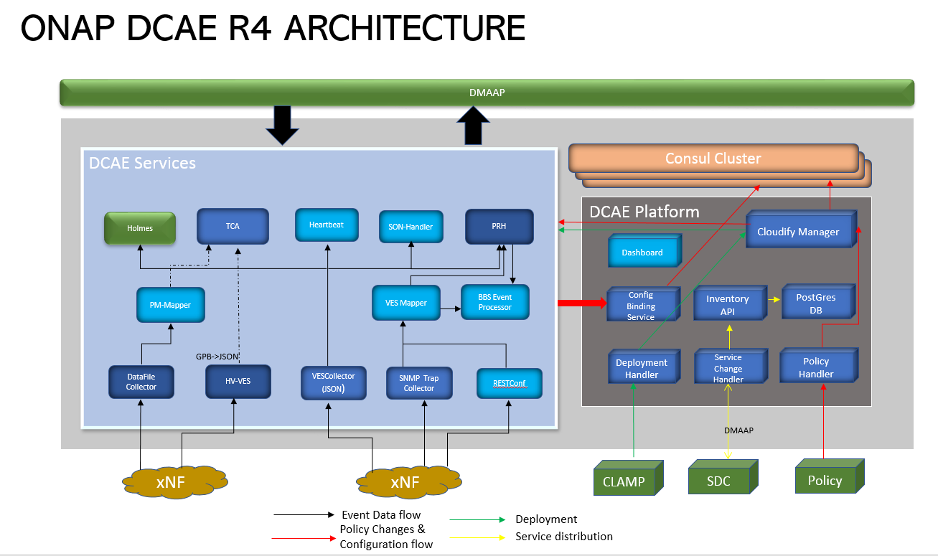
Architecture
Data Collection Analytics and Events
This is a framework providing the platform to deploying and constructing intelligent and automated control loops to ONAP and distributing it.
Platform
Sets of components that allows to deploy and modify MicroServices in the Kubernetes
Is base on Cloudify framework
Use k8s plugin to communicate with Kubernetes
Use Consul to store the MicroServices runtime configuration
MicroServices (MS)
They are the functional components that realize the collection and analytics needs e.g. for ONAP control loops
We can define 3 category of the MS:
  Static
  On-demand (standalone)
  “Custom” on-demand (bound to SDC service)

Slide 4
Cloudify
Cloudify - is an open source cloud orchiestration framework. Cloudify enables you to model applications and services and automate their entire life cycle, including deployment, monitoring all aspects of a deployed application, changing the configuration.
The most imported (from DCAE point of view) elements:
Blueprints - is a model of the application’s topology and its operations implementation. Described using TOSCA.
Inputs – overwrite values for specific prams per instance
bash-4.2$ cfy blueprints list
Listing all blueprints...
Blueprints:
+----------------------------------------------------------------------------------------------------------------------+
|id |description |main_file_name |created_at|updated_at|availability|tenant_name |created_by |
+----------------------------------------------------------------------------------------------------------------------+
|pgaas_initdb|This blueprint is .. |k8s-pgaas-initdb.yaml|2020-07-24|2020-07-24|tenant |default_tenant|admin |
+----------------------------------------------------------------------------------------------------------------------+
...
Deployment – DCAE MS blueprint instance (created with selected inputs). In fact this is a pod in the Kubernetes.
bash-4.2$ cfy deployments inputs pgaas_initdb
Retrieving inputs for deployment pgaas_initdb...
- "blueprint_version":
Value: 2018-04-27T00:31:38+0000
- "k8s_pgaas_instance_fqdn":
Value: dcae-pg-primary.onap
…

Slide 5
Blueprints example
DCAE MS defined are as Cloudify Blueprints
DCAE MS types k8splugin-types.yaml
Datacollector k8s-datacollector.yaml
node_types:
dcae.nodes.ContainerizedComponent:
# Base type for all containerized components
# Captures common properties and interfaces
derived_from: cloudify.nodes.Root
properties:
image:
type: string
description: Full uri of the Docker image
...
dcae.nodes.ContainerizedServiceComponent:
derived_from: dcae.nodes.ContainerizedComponent
properties:
service_component_name_override:
type: string
...
dcae.nodes.ContainerizedServiceComponentUsingDmaap:
derived_from: dcae.nodes.ContainerizedServiceComponent
properties:
streams_publishes:
...
streams_subscribes:
...
tosca_definitions_version: cloudify_dsl_1_3
imports:
- https://www.getcloudify.org/spec/cloudify/4.5.5/types.yaml
- https://nexus.onap.org/service/local/repositories/raw/content/org.onap.dcaegen2.platform.plugins/R6/k8splugin/1.7.2/k8splugin_types.yaml
inputs:
image:
...
database_host/database_username/database_password:
...
dmaap_host/dmaap_port/ves_measurements_topic_name:
...
node_templates:
rapp-datacollector:
type: dcae.nodes.ContainerizedServiceComponent
interfaces:
cloudify.interfaces.lifecycle:
start:
inputs:
envs:
DMAAP_HOST: { get_input: dmaap_host }
...
properties:
image:
get_input: image

Slide 6
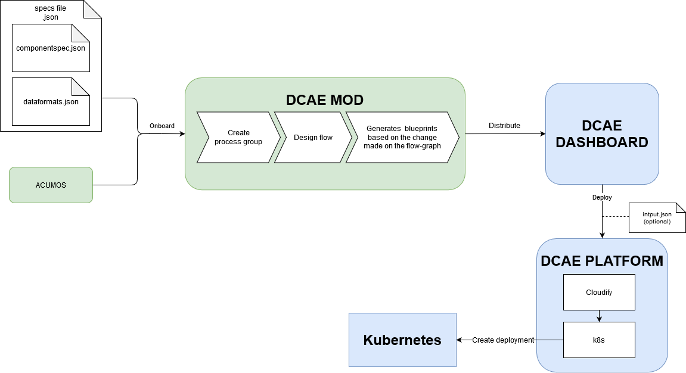
Onboarding flows 1/2
DCAE-MOD DCAE MS On-boarding flow
More details: DCAE MOD User Guide

Slide 7
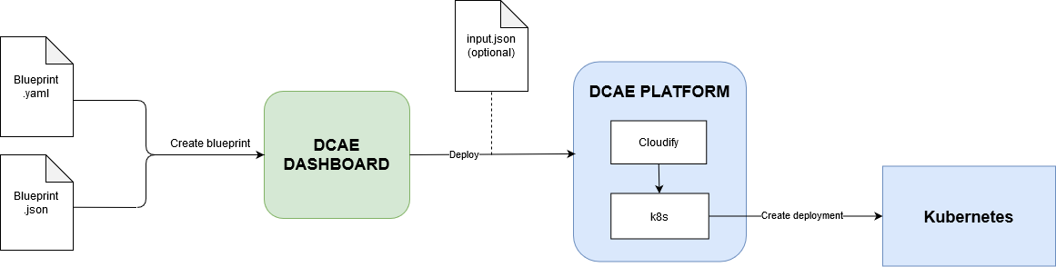
Onboarding flows 2/2
DCAE-DASHBOARD DCAE MS On-boarding flow
All those onboarding request are also available over the DCAE Dashboard API <- can be automated

Slide 8
R-APP Onboarding example
ONAP
LCM through DCAE Dashboard API
Samsung developped CLI to enable automation on product deployments and in CI/CD
dcae-cli.py Implements operations:
'list_blueprints’
'create_blueprint’
'get_blueprint’
'delete_blueprint’
'list_deployments’
'get_deployment’
'get_deployment_inputs’
'get_deployment_input’
'create_deployment’
'update_deployment’ NOTE update not working!
'delete_deployment’
'executions_status’
Also, we created few helper scripts on top which are used for deploying all Samsung R-APP
deploy-rapps.sh
    undeploy-rapps.sh
Use pod
onap-dcae-bootstrap-{{id}}
To create deployment for blueprints
from specific mounted directory:
bash-4.2$ ls blueprints/
k8s-ves-mapper.yaml k8s-pgaas-initdb.yaml
k8s-tca.yaml k8s-ves.yaml
By using the define inputs
bash-4.2$ ls inputs/
k8s-pgaas-initdb-inputs.yaml k8s-ves-inputs.yaml
k8s-ves-mapper-inputs.yaml k8s-tca-inputs.yaml

Slide 9
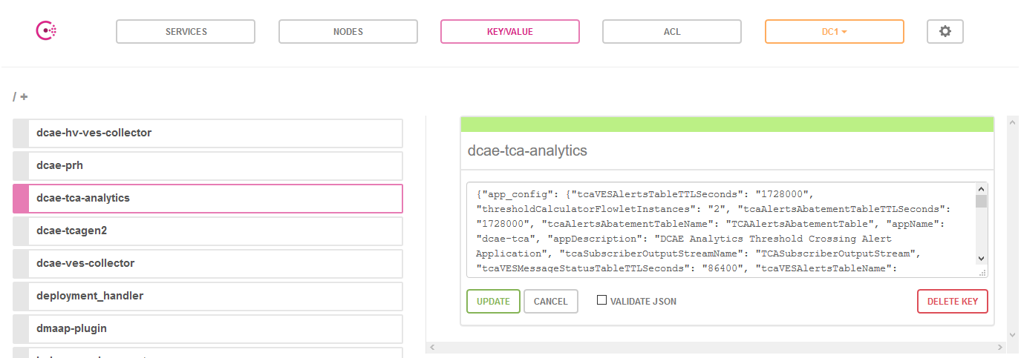
Consul
Consul is a tool for service discovery and configuration although health checking is the primary use for OOM.
Blueprint properties store in the CONSUL ->
properties:
application_config:
param: value
Using this configuration from the DCAE Ms application is done with ONAP provided libraries: https://wiki.onap.org/display/DW/DCAE+SDK

Slide 10
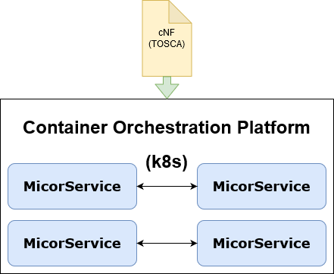
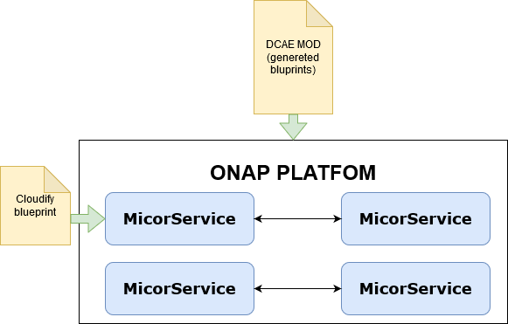
DCAE MS vs cNF
DCAE MOD is used to design a set of DCAE Microservices
One Microservice equals to one Cloudify blueprint
Deployed in the ONAP Platform
cNF is a set of MSs described in the TOSCA format
Deployed in the Container Orchestration Platform (eg. k8s)

Slide 11






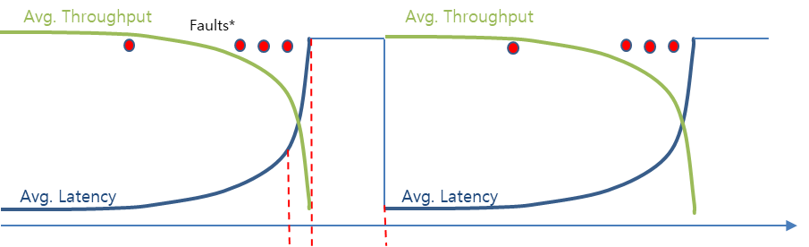


Hendover Demo/Simulation scenario for A1 policy close loop
Cell2: Chn0002
Cell 2
Cell 1
Cell 1
Predicted Sleeping Cell 1
in X minutes
High priority UE (ambulance)
proactively switched
from Cell 1 to Cell
Cell 3
Cell 3

Slide 12
Handover use case – current architecture
JDBC
Community Todo:
Porting A1 Policy
Agent (and other
dependent components) to ONAP
Replacing OSC
controller with
SDN-R
NonRT RIC
ONAP
O1 Event Storage
Docker compose
REST API
A1 Policy Actor
SlippingCellDetector
ML Model
DataCollector
ONAP RT
DMaaP
A1 Policy Agent
AAI
OSC A1 Policy Controller
REST API
SO
A1
O1
Deployment
SDN-C
O-RAN Simulator VNF
Netconf Server
A1 Simulator BE
OSC A1 Simulator
CDS
REST API
Shared file system
A1 Simulator FE
REST API (VES Events)
Netconf
HTTP/HTTPs

Slide 13
Handover use case – final architecture
REST API
REST API (R1?)
NonRT RIC
JDBC (?)
ONAP
DCAE apps/R-APPs Layer
Pluggable Storage
Data
Collector
(a placeholder for C&PS, R1 API)
REST API
A1 Policy Actor
SlippingCellDetector
ML Model
ONAP RT
DMaaP
A1 Policy Agent
AAI
SDN-R
REST API
REST API (VES Events)
VID
SO
A1
O1
Deployment
SDN-C
O-RAN Simulator CNF (an O-RAN-like CNF in future)
A1 Simulator BE
OSC A1 Simulator
CDS
HTTP/HTTPs
A1 Simulator FE

Slide 14
THANK YOU!
ANY QUESTION?

