Slide 1


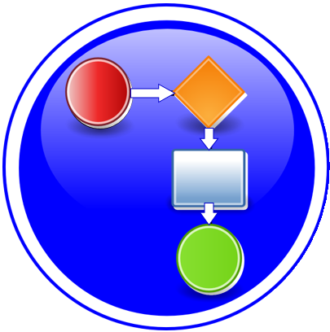




PNF Pre-Onboarding / Onboarding & Modeling to Support 5G RAN
ONAP Modeling
PNF Onboarding
Benjamin Cheung, PhD
Michela Bevilacqua
Zu Qiang
Mar 18, 2019 version 6 / 3:45PM Pythagore, Nozay, France

Slide 2


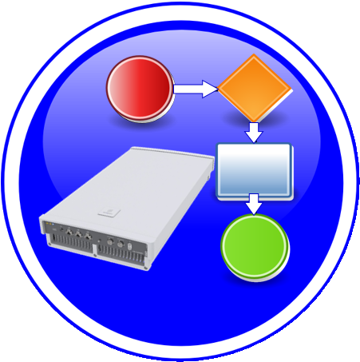













Onboarding and Design Time
Onboarding Package
Onboarding Descriptor
Platform ONAP Model
SDC CSAR Artifacts
NF Instance
WHAT
PNF Package Artifacts (CSAR)
PNF Descriptor Model
Platform Information Model
Platform Data Model
CSAR (VSP, VF, Service)
NF Discovery, Instantiation
Run time Catalog
Package Delivery
Pre-Onboarding
Onboarding
Design Time
Run Time
WHEN
Vendor
Technology Specialist
Asset Manager
Technology Specialist
Asset Manager
Service Designer
Operations Specialist
Operations Specialist
WHO
SOL 004 Package
SOL 001 PNFD
-
-
-
-

Slide 3
Onboarding and Design Time
xNF Package
Validation
Resource Creation
Service Creation
Service Instantiation
WHAT
xNF Package Artifacts (CSAR)
xNF Descriptor Model
Validating xNF Package
Platform Information Model
Platform Data Model
Service CSAR
(VSP, VF, Service)
NF Discovery, Instantiation
Run time Catalog
Package Delivery
Pre-Onboarding
Onboarding
Design Time
Run Time
WHEN
Vendor
Technology Specialist
Asset Manager
Technology Specialist
Asset Manager
Service Designer
Operations Specialist
Operations Specialist
WHO
SOL 004 Package
SOL 001 xNFD
SOL 004 Package
-
-
-

Slide 4
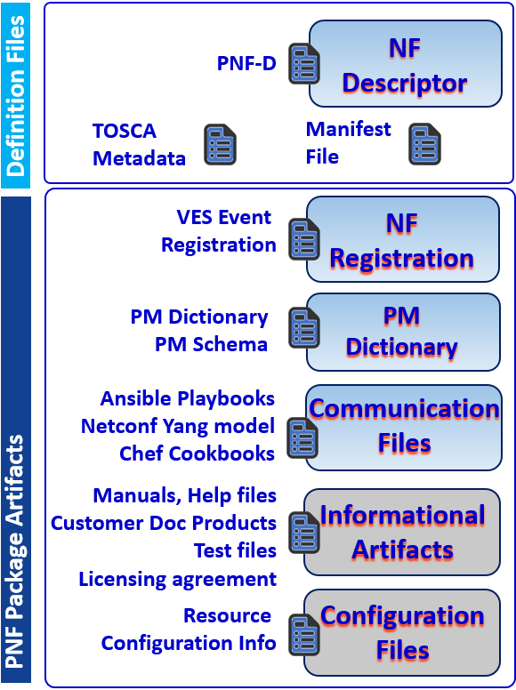
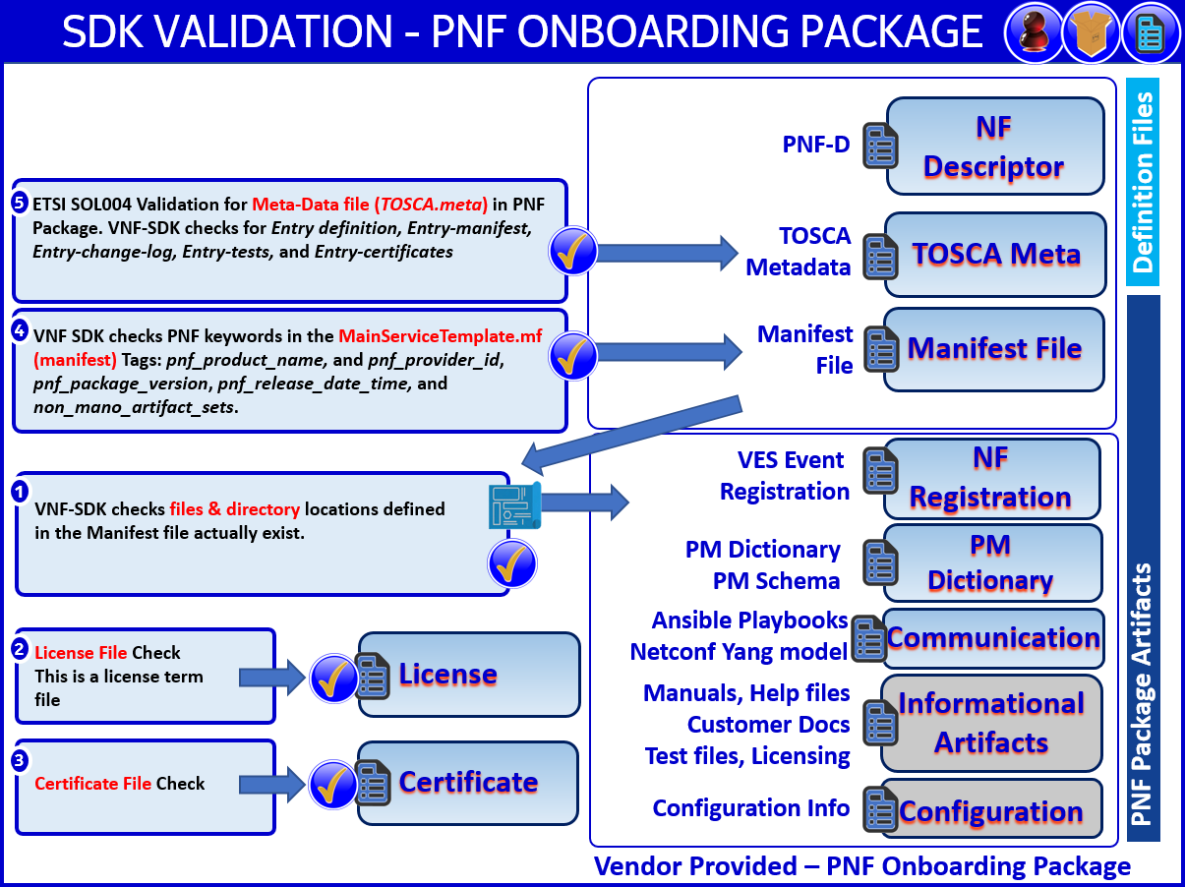
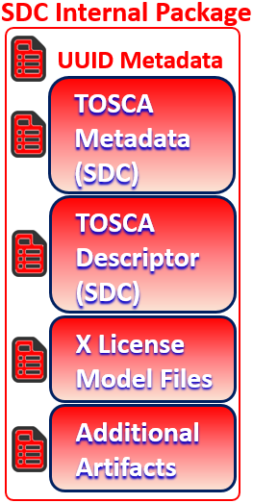
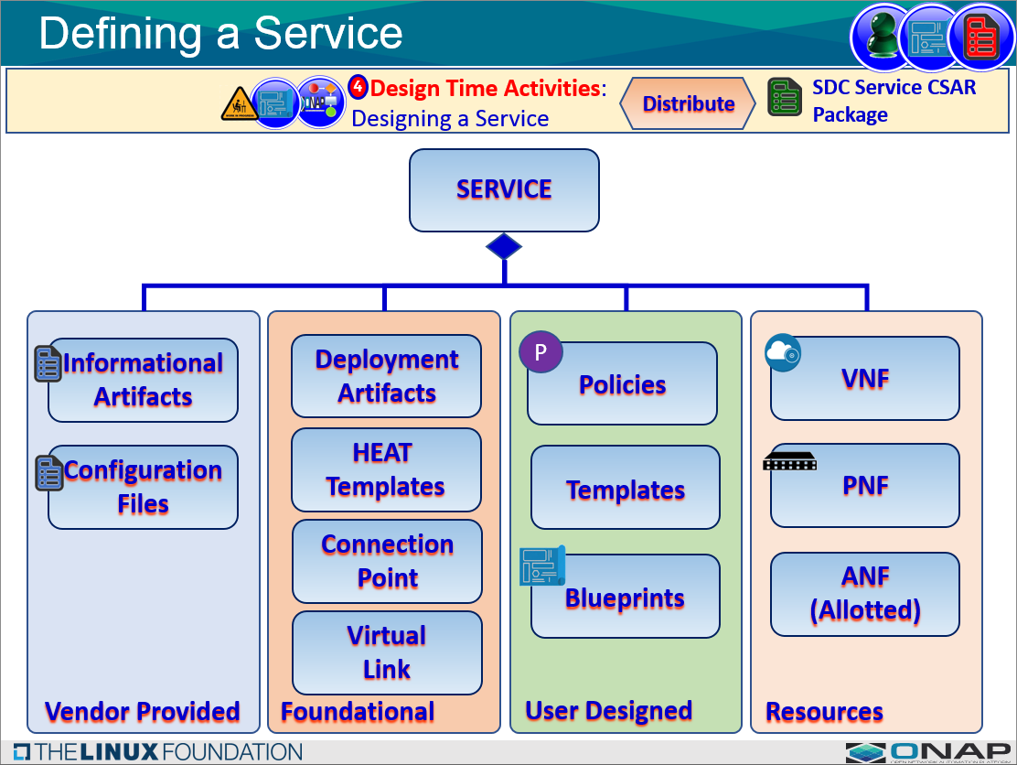
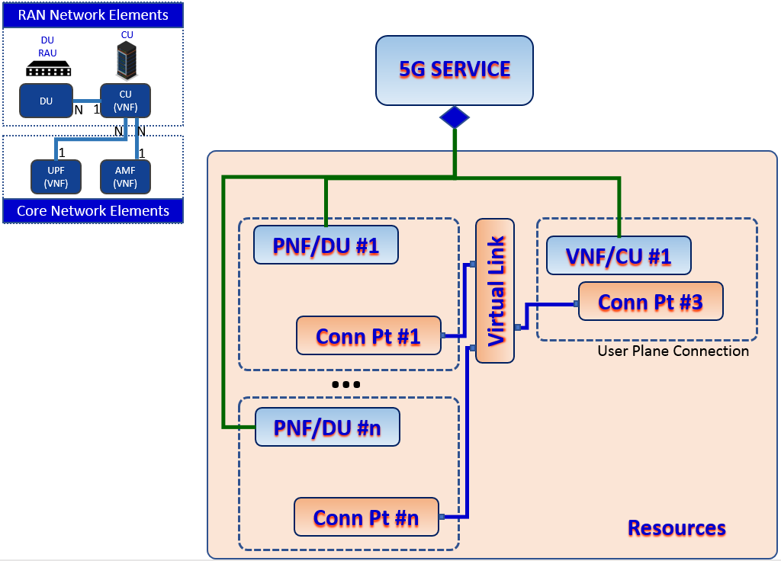
Pre-onboarding/Onboarding in Design Time
xNF Package
Validation
Resource Creation
Service Creation
Service Instantiation
WHAT
xNF Package Artifacts (CSAR)
PNF Descriptor Model
Platform Information Model
Platform Data Model
Service CSAR
(VSP, VF, Service)
NF Discovery, Instantiation
Run time Catalog
Validating xNF Package
Package Delivery
Pre-Onboarding
Onboarding
Design Time
Run Time
WHEN
Onboarding Package
VNF-SDK Validation
Resource CSAR
Service CSAR Creation
Service Instantiation
KEY INFO
SOL 004 Package
SOL 001 xNFD
SOL 001 PNFD
TOSCA/AID model
AID Model
-

Slide 5
Pre-onboarding/Onboarding in Design Time
xNF Package
Validation
Resource Creation
Service Creation
Service Instantiation
WHAT
VNF Package Artifacts (CSAR)
VNF Descriptor Model
Platform Information Model
Platform Data Model
Service CSAR
(VSP, VF, Service)
NF Discovery, Instantiation
Run time Catalog
Validating VNF Package
Package Delivery
Pre-Onboarding
Onboarding
Design Time
Run Time
WHEN
Onboarding Package
VNF-SDK Validation
Resource CSAR
Service CSAR Creation
Service Instantiation
KEY INFO
-
-
TOSCA/AID model
AID Model
-

Slide 6




Onboarding and Design Time
Onboarding Package
NF Descriptor
Platform Model
NF Instance
Pre/Onboarding
Pre/Onboarding
Design Time
Run Time
Vendor
Asset Manager
Service Designer
Operations
NF
Descriptor
Current Platform Data Model
Vs. Target Platform Data Model
TOSCA
Root
Node
NF
Registration
A&AI
Service
PM Dictionary
PM Schema
1
1
PNF
Instance
N
N
Connect
Point
1
1
PNF
Device
Network
Function
Virtual
Link
Communication
Files
Ports / NICs
Connectivity
PNF
Onboarding
Package
Informational
Artifacts
Complex
NF
Comp
Configuration
Files
SDC
Catalog

Slide 7


PNF PRE-ONBOARDING/ONBOARDING U/C OVERVIEW
1. PNF Package Delivery: Vendor creates & delivers PNF Package with PNF artifacts
1
Dublin Priority
2. PNF Pre-Onboarding (optional): VNF-SDK ( ) can create or validate PNF Onboarding Package
PNF
Descriptor
2
Dublin Priority
NF
Registration
3. PNF Onboarding: PNF Package is loaded
3
VNF
SDK
SDC Service
CSAR Package
PM Dictionary
Schema (YAML)
SDC
Pre
Onboarding
SDC
Catalog
SO, AAI,
DCAE etc.
Informational
Artifacts
Onboarding
Distribute
PNF
Onboarding
Package
+Vendor Meta-data
VF Model Information
VF Model
Configuration
Files
SDC Internal CSAR Package
(derived from the Vendor PNF Onboarding Package)
5. ONAP RT Components:
Ingest and use CSAR package
5
Communication
Files
4 Design Time Activities: NF Onboard Package > SDC catalog
4
Package Delivery
Onboarding
Design Time
Run Time
Onboarding Package
NF Descriptor
Platform Model
NF Instance

Slide 8
DUBLIN DEVELOPMENT STATUS
COMPONENT | IMPACTS DESCRIPTION | JIRA TICKETS
SDC | PNF PACKAGE FORMAT Identify current VNF package format constraints in SDC Propose a PNF Package format Evaluate VNF and PNF package alignment PACKAGE MAPPING - Onboarding PNF package to internal PNF package mapping PNFD MAPPING - Onboarding PNFD to internal PNFD mapping A new flow to map ETSI SOL001 PNFD in SDC AID model. ARTIFACT MANAGEMENT Design-time catalog update to associate artifacts to a PNF Run-time catalog update to associate artifacts to a PNF | SDC-1970, SDC-1973, SDC-1974, SDC-1975, SDC-1976, SDC-1977, SDC-1978, SDC-1979, SDC-1980
VNF SDK | PACKAGE VERIFICATION - PNF package format verification PNF PACKAGE FORMAT PACKAGE USAGE - Package for PNF Onboarding Package for use in VNF SDK | VNFSDK-337, VNFSDK-338, VNFSDK-339, VNFSDK-340, VNFSDK-341, VNFSDK-342, VNFSDK-343
Modelling | PNFD MAPPING – Mapping Onboarded PNFD to platform PNFD mapping SDC SW task but PNFD mapping & part of ONAP Resource Data Model.
VNF Requirements | PACKAGE, DESCRIPTOR, ARTIFACTS - VNF requirements to cover PNF package contents and directory structures and mandatory elements. PNF DESCRIPTOR - Requirements for the PNF Descriptor ARTIFACTS - Requirements for Artifacts of PNF and PNF Package | VNFRQTS-506, VNFRQTS-496, VNFRQTS-497, VNFRQTS-498, VNFRQTS-499, VNFRQTS-505, VNFRQTS-507, VNFRQTS-508
RT Comp | Grant backward compatibility use cases on ONAP RT Components

Slide 9
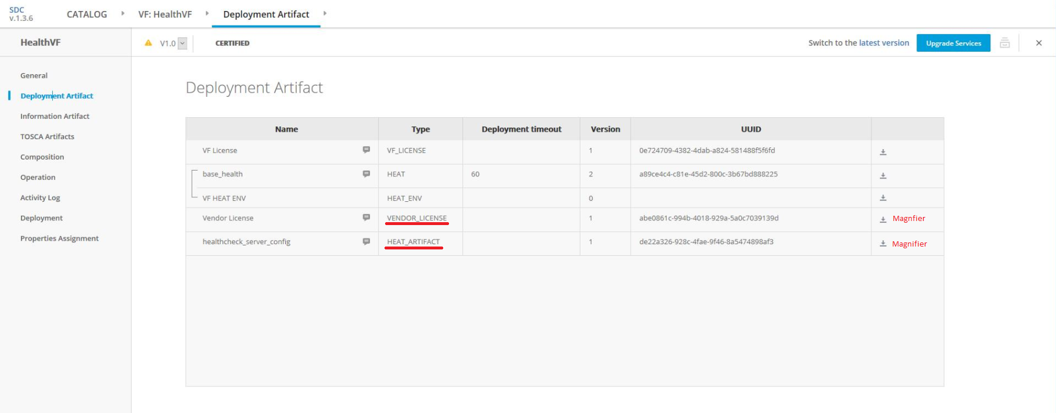

Slide 10
PNF PACKAGE CREATION & DELIVERY
Onboarding Package
Onboarding
Vendor

Slide 11
PNF ONBOARDING PACKAGE
PNF Onboarding Package
NF
Descriptor
PNF-D
Definition Files
UUID Metadata
TOSCA
Metadata
Manifest
File
TOSCA
Metadata
(SDC)
SDC Service
CSAR
Package
VES Event
Registration
NF
Registration
PM Dictionary
PM Schema
PM
Dictionary
TOSCA
Descriptor
(SDC)
Ansible Playbooks
Netconf Yang model
Chef Cookbooks
Communication
Files
SDC
Design
Time
X License
Model Files
Manuals, Help files
Customer Doc Products
Test files
Licensing agreement
Informational
Artifacts
PNF Package Artifacts
Additional
Artifacts
Resource
Configuration Info
Configuration
Files
SDC Added Files
Vendor Provided

Slide 12
Controller Blueprint Archive file (manually in R4 only manual, or incorporated into a package? [FUTURE])
Jinja (Python-based dynamic content) Template
Velocity Template
Schema vendor specific/agnostic
Generic or Per PNF type (customized)

Slide 13
VNF (TOSCA format) ONBOARDING PACKAGE
VNF Onboarding Package
NF
Descriptor
VNF-D
Definition Files
UUID Metadata
TOSCA
Metadata
Manifest
File
TOSCA
Metadata
(SDC)
SDC Service
CSAR
Package
VES Event
Registration
NF
Registration
PM Dictionary
PM Schema
PM
Dictionary
TOSCA
Descriptor
(SDC)
Ansible Playbooks
Netconf Yang model
Chef Cookbooks
Communication
Files
SDC
Design
Time
VNF Package Artifacts (not SOL004 based)
X License
Model Files
Manuals, Help files
Customer Doc Products
Test files
Licensing agreement
Informational
Artifacts
Additional
Artifacts
Resource
Configuration Info
Configuration
Files
SDC Added Files
Vendor Provided

Slide 14
VNF (HEAT Template) ONBOARDING PACKAGE
VNF Onboarding Package
#x HEAT
Template
Heat
Template
Definition Files
UUID Metadata
Environment
file
Proprietary
Manifest
File
AID
Model
(SDC)
SDC Service
CSAR
Package
VES Event
Registration
NF
Registration
PM Dictionary
PM Schema
PM
Dictionary
Ansible Playbooks
Netconf Yang model
Chef Cookbooks
Communication
Files
SDC
Design
Time
X License
Model Files
Manuals, Help files
Customer Doc Products
Test files
Licensing agreement
Informational
Artifacts
PNF Package Artifacts
Additional
Artifacts
Resource
Configuration Info
Configuration
Files
SDC Added Files
Vendor Provided

Slide 15
SDC INTERNAL PACKAGE
SDC Internal Package
SDC Additions
UUID Metadata
TOSCA
Metadata
(SDC)
SDC Service
CSAR
Package
TOSCA
Descriptor
(SDC)
SDC
Design
Time
X License
Model Files
SDC Internal PNF Package Artifacts
Additional
Artifacts
SDC Added Files

Slide 16
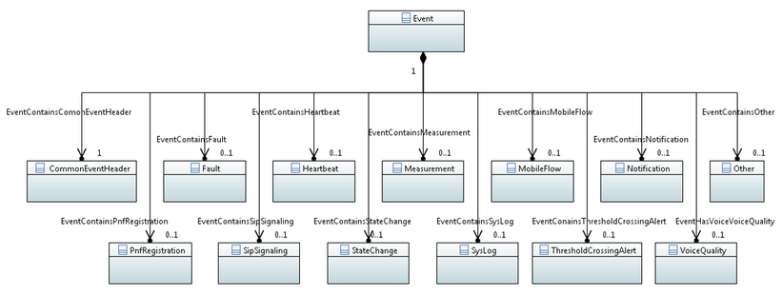










R4: Modelling VES Events

Slide 17

SDK VALIDATION - PNF ONBOARDING PACKAGE
NF
Descriptor
PNF-D
Definition Files
5
ETSI SOL004 Validation for Meta-Data file (TOSCA.meta) in PNF Package. New checks for "Entry definition, Entry-manifest, Entry-change-log, Entry-tests, Entry-certificates" is VNF SDK development work.
TOSCA
Metadata
TOSCA Meta
4
Manifest
File
VNF SDK to check the PNF keywords in the MainServiceTemplate.mf (manifest) New tags are pnf_product_name and pnf_provider_id, pnf_package_version, pnf_release_date_time and non_mano_artifact_sets.
Manifest File
VES Event
Registration
NF
Registration
1
VNF-SDK Checks that files defined in the Manifest file (specify files & directory locations) actually exist where they have been specified in the Manifest File.
PM Dictionary
PM Schema
PM
Dictionary
Ansible Playbooks
Netconf Yang model
Communication
2
License File Check
This is a license term file
License
Manuals, Help files
Customer Docs
Test files, Licensing
Informational
Artifacts
PNF Package Artifacts
3
Certificate
Certificate File Check
Configuration Info
Configuration
Vendor Provided – PNF Onboarding Package

Slide 18
SDK VALIDATION - PNF ONBOARDING PACKAGE
NF
Descriptor
PNF-D
Definition Files
6
ETSI SOL004 Validation for Meta-Data file (TOSCA.meta) in PNF Package. VNF-SDK checks for Entry definition, Entry-manifest, Entry-change-log, Entry-tests, and Entry-certificates
TOSCA
Metadata
TOSCA Meta
5
VNF SDK checks PNF keywords in the MainServiceTemplate.mf (manifest) Tags: pnf_product_name, and pnf_provider_id, pnf_package_version, pnf_release_date_time, and non_mano_artifact_sets.
Manifest
File
Manifest File
VES Event
Registration
NF
Registration
4
VNF-SDK checks files & directory locations defined in the Manifest file actually exist.
PM Dictionary
PM Schema
PM
Dictionary
Ansible Playbooks
Netconf Yang model
Communication
2
License File Check
This is a license term file
License
Manuals, Help files
Customer Docs
Test files, Licensing
Informational
Artifacts
PNF Package Artifacts
3
Certificate
Certificate File Check
Configuration Info
Configuration
Vendor Provided – PNF Onboarding Package

Slide 19
PNF PACKAGES
SDC
Catalog
SDC
Catalog
Deployment Section
To Attach Artifacts
VNF
SDK
SDC
Design Studio
Deployment
Studio
SDC Internal CSAR
PNF Package
PNF CSAR Package
(Vendor onboarded)
VSP [vendor s/w product]
SDC Service
CSAR Package
VNF 1. TOSCA / 2. AID Model
NF
Registration
PM
Dictionary

Slide 20
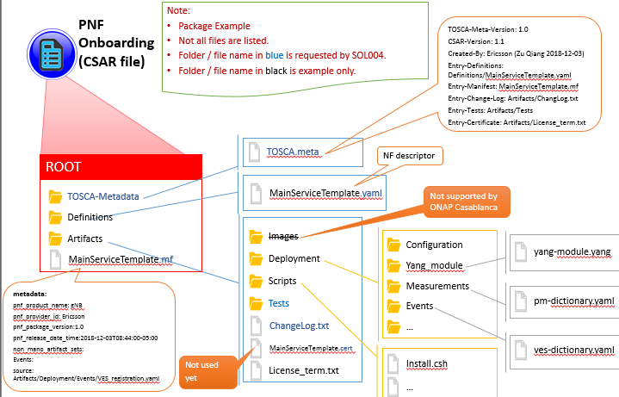
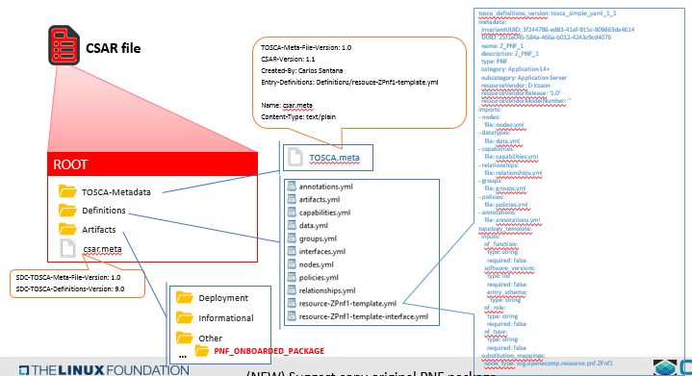
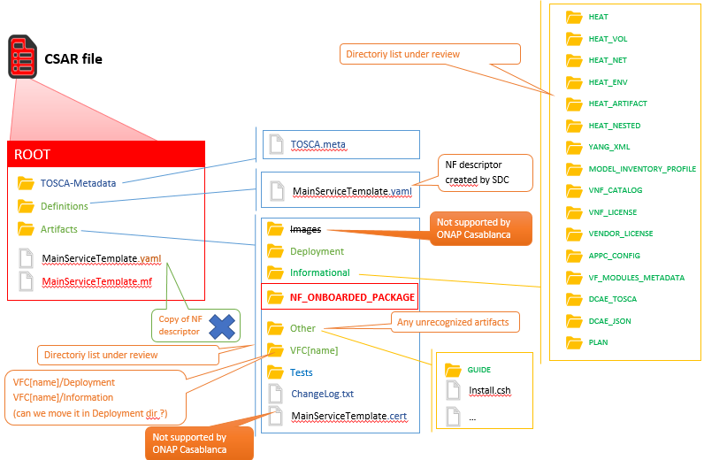
PNF PACKAGES
SDC
Catalog
SDC
Catalog
VNF
SDK
SDC
Design Studio
Deployment
Studio
PNF Package
(Vendor onboarded)
VSP [vendor s/w product]
SDC Internal CSAR
PNF Package
SDC Service
CSAR Package

Slide 21


PNF Onboarding Package (CSAR)
Note:
Package Example
Not all files are listed.
Folder / file name in blue is requested by SOL004.
Folder / file name in black is example only.
PNF
Onboarding
(CSAR file)
TOSCA-Meta-Version: 1.0
CSAR-Version: 1.1
Created-By: Ericsson (Zu Qiang 2018-12-03)
Entry-Definitions: Definitions/MainServiceTemplate.yaml
Entry-Manifest: MainServiceTemplate.mf
Entry-Change-Log: Artifacts/ChangLog.txt
Entry-Tests: Artifacts/Tests
Entry-Certificate: Artifacts/License_term.txt
TOSCA.meta
NF descriptor
ROOT
TOSCA-Metadata
MainServiceTemplate.yaml
Not supported by ONAP Casablanca
Definitions
Artifacts
Images
Configuration
MainServiceTemplate.mf
Deployment
yang-module.yang
Yang_module
metadata:
pnf_product_name: gNB
pnf_provider_id: Ericsson
pnf_package_version:1.0
pnf_release_date_time:2018-12-03T08:44:00-05:00
non_mano_artifact_sets:
Events:
source: Artifacts/Deployment/Events/VES_registration.yaml
Scripts
Measurements
Tests
Events
pm-dictionary.yaml
ChangeLog.txt
…
MainServiceTemplate.cert
ves-dictionary.yaml
Not used
yet
License_term.txt
Install.csh
…

Slide 22
R4: Modelling VES Events
SOL004 required PNF manifest file
PNF ONBOARDING FILES – Manifest file Example
metadata: ######################### New key Name to be supported by SDC
pnf_product_name: gNB
pnf_provider_id: Ericsson
pnf_package_version:1.0
pnf_release_date_time:2018-12-03T08:44:00-05:00
######################### non mano artifact sets to be supported by SDC
non_mano_artifact_sets:
Events:
source: Artifacts/Deployment/Events/VES_registration.yaml
Measurements:
source: Artifacts/Deployment/Measurements/PM_Dictionary.yaml
Yang_module:
Source: Artifacts/Deployment/Yang_module/Yang_module.yaml
Others:
Source: Artifacts/Informational/scripts/install.sh
Source: Artifacts/Informational/user_guide.txt
Source: Artifacts/Other/installation_guide.txt
Source: Artifacts/Other/review_log.txt

Slide 23
R4: Modelling VES Events
VNFSDK #4 Manifest file: new PNF tags
PNF ONBOARDING FILES – Main Service Template manifest (.mf) file
metadata:
pnf_product_name: gNB
pnf_provider_id: CompanyXYZ
pnf_package_version: 1.0
pnf_release_date_time: 2019-02-11T09:10:00-05:00
non_mano_artifact_sets:
Events:
source: Artifacts/Deployment/Events/VES_registration.yaml
Measurements:
source: Artifacts/Deployment/Measurements/PM_Dictionary.yaml
Yang_module:
Source: Artifacts/Deployment/Yang_module/Yang_module.yaml
Others:
Source: Artifacts/Informational/scripts/install.sh
Source: Artifacts/Informational/user_guide.txt
Source: Artifacts/Other/installation_guide.txt
Source: Artifacts/Other/review_log.txt
VNF SDK to check the PNF keywords in the MainServiceTemplate.mf New tags are pnf_product_name and pnf_provider_id, pnf_package_version, pnf_release_date_time and non_mano_artifact_sets.

Slide 24
R4: Modelling VES Events
SOL004 required TOSCA.meta file
PNF ONBOARDING FILES – Tosca Metadata File
TOSCA-Meta-File-Version: 1.0
CSAR-Version: 1.1
Created-By: Ericsson
Entry-Definitions: Definitions/resource-Ericssongnodeb-template.yml
Entry-Manifest: resource-Ericssongnodeb-template.mf
Entry-Certificate: Artifacts/resource-Ericssongnodeb-template.cert
Entry-Tests: Artifacts/Tests
Entry-Licenses: Artifacts/Licenses/license_term.txt
Entry-Change-Log: Artifacts/ChangeLog.txt

Slide 25
R4: Modelling VES Events
VNFSDK Task #5 TOSCA Meta file checks
PNF ONBOARDING FILES – TOSCA Meta File Checks
TOSCA-Meta-Version: 1.0
CSAR-Version: 1.1
Created-By: CompanyXYZ (User123 2019-02-11)
Entry-Definitions: Definitions/MainServiceTemplate.yaml
Entry-Manifest: MainServiceTemplate.mf
Entry-Change-Log: Artifacts/ChangLog.txt
Entry-Tests: Artifacts/Tests
Entry-Certificate: Artifacts/License_term.txt
"TOSCA-Meta-Version" and "CSAR-Version" and "Created by" checks are already supported.
ETSI SOL004 Validation for Meta-Data file & Manufacturer file (TOSCA.meta file) in PNF Package. New checks for "Entry definition, Entry-manifest, Entry-change-log, Entry-tests, Entry-certificates" would be new VNF SDK development work.

Slide 26
VSP CSAR File
VF/Resource CSAR file
PNF/Resource CSAR file
SDC Service CSAR file >1 Resource file
SDC Service CSAR Package
HEAT
HEAT_VOL
CSAR file
Directoriy list under review
HEAT_NET
HEAT_ENV
HEAT_ARTIFACT
HEAT_NESTED
ROOT
TOSCA.meta
YANG_XML
NF descriptor
created by SDC
MODEL_INVENTORY_PROFILE
TOSCA-Metadata
MainServiceTemplate.yaml
VNF_CATALOG
Definitions
VNF_LICENSE
Artifacts
Images
Not supported by ONAP Casablanca
VENDOR_LICENSE
MainServiceTemplate.yaml
Deployment
APPC_CONFIG
MainServiceTemplate.mf
Informational
VF_MODULES_METADATA
NF_ONBOARDED_PACKAGE
DCAE_TOSCA
Copy of NF descriptor
Other
Any unrecognized artifacts
DCAE_JSON
Directoriy list under review
VFC[name]
PLAN
VFC[name]/Deployment
VFC[name]/Information
(can we move it in Deployment dir ?)
Tests
GUIDE
ChangeLog.txt
Install.csh
MainServiceTemplate.cert
…
Not supported by ONAP Casablanca

Slide 27
SDC adds files
SDC add vendor meta-data
Internal CSAR file
Structure change
Information missing
Metadata file changed (generated by SDC) not have info on left side
Manufactured metafile is lost
Certain artifacts is lost.
CSAR.meta (added by SDC) … what is it for?
Definition File (define policies) added by SDC
Resource UUID
WHAT WOULD BE A PROBLEM
WHAT DOES THE VENDOR NEEDS TO PROVIDE
WHAT DOES SDC need
Today in PNF descriptor more than 3 properties
In SDC PNF CSAR only 3 properties NF function, NF role, NF type, SWVersions
PNF onboarding package from SOL001 MANY properties
ARTIFACTS SOL004 MANY artifacts add
In Current PNF CSAR file no place to hold it.
Heat File
OPENO TOSCA
SDC
Catalog
PNF Package Version 2019-1.1
Resource CSAR File (PNF) onboarded
Vendor provided
SDC

Slide 28
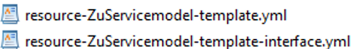
SDC
Catalog
NF Descriptor
Descriptor (Interface connections)
Artifacts (incl. Onboarded Package)
Resource CSAR File (VF) generated from VSP
Resource CSAR File (VF) generated from VSP
SDC Service Package Version 1.5
SDC Service CSAR File
SDC PNF Package Version 2.6
(SDC distributes to other ONAP RT components)
PNF Package Version 2019-1.1
Resource CSAR File (PNF) onboarded (SDC)
Resource CSAR File (PNF) onboarded (SDC)
Resource CSAR File (PNF) onboarded (SDC)
SDC doesn’t recognized SOL001 Modeling vs Platform Data Model
SOL004 artifacts some artifacts dropped by SDC
name NF (naming policy)
TOSCA API to ingest CSAR package > same APIs to have clients ingest PNFs > onboarding of PNF packages.
NETWORK ASSIGNMENTS VLAN tag assignment,, IP assignments > Plug & play

Slide 29

Onboarded Package to SDC Internal Mapping
PNF Onboarding Package (Vendor CSAR)
SDC Service CSAR
ROOT
ROOT
Manifest File
(SDC created)
Vendor Manifest File
MainServiceTemplate.mf *
MainServiceTemplate.mf
TOSCA-Metadata
TOSCA-Metadata
TOSCA Meta-data file
(SDC created)
TOSCA.meta
TOSCA.meta
TOSCA Meta-data file
Artifacts
NF_ONBOARDED_PACKAGE
Performance Measure
PM Dictionary & Schema
(Vendor Provided)
* Paths defined by manifest file
Artifacts/Deployment
Artifacts/Deployment
Measurements
Performance Measure
Dictionary & Schema
Measurements
pm-dictionary.yaml
pm-dictionary.yaml
Artifacts
Performance Measure
PM Dictionary & Schema
(SDC Internal)
Deployment
pm-dictionary.yaml
Artifacts
NF_ONBOARDED_PACKAGE
PNF Registration File
VES Event definitions
(Vendor Provided)
Artifacts/Deployment
Artifacts/Deployment
Events
VES Dictionary
(YAML)
Events
ves-dictionary.yaml
ves-dictionary.yaml
Artifacts
Events
PNF Registration File
VES Event definitions
ves-dictionary.yaml

Slide 30
PRE-ONBOARDING PROCESSES
NF Descriptor
ONBOARDING PROCESSES
Pre Onboarding
Asset Manager
Platform Model
Onboarding
Asset Manager

Slide 31
PRE-ONBOARDING: VNF SDK DEVELOPMENT
Dublin Priority
NF
Descriptor
PNF-D
2. PNF Pre-Onboarding (optional): VNF-SDK ( ) can create or validate PNF Onboarding Package
2
VES Event
Registration
Specification
Dublin Priority
NF
Registration
PM Dictionary
PM Schema
PM Dictionary
PM Schema
VNF
SDK
Manuals, Help files
CustDoc Products
Test files
Licensing agreement
Informational
Artifacts
Package
creation
WinZIP
Validating Content
Configuration
Files
PNF
Onboarding
Package
Configuration Info
Ansible Playbooks
Netconf Yang model
Chef Cookbooks
Communication
Files

Slide 32
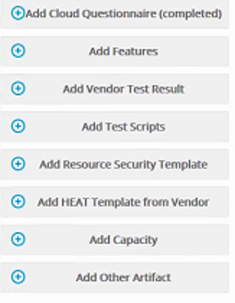
PNF ONBOARDING: SDC Catalog
Dublin Priority
NF
Descriptor
PNF-D
VES Event
Registration
Specification
Dublin Priority
NF
Registration
3. PNF Onboarding: PNF Package is loaded
3
PM Dictionary
PM Schema
PM Dictionary
PM Schema
xNF
SDK
SDC
Manuals, Help files
CustDoc Products
Test files
Licensing agreement
Package
creation
Informational
Artifacts
Onboarding
SDC
Catalog
PNF
Onboarding
Package
+VENDOR
META DATA
Configuration Info
Configuration
Files
WinZIP
Validating Content
Ansible Playbooks
Netconf Yang model
Chef Cookbooks
Communication
Files

Slide 33
xNF ONBOARDING Dependencies R3
Pre-onboarding
Onboarding
Design Time
SDNC/APPC
Multi-VIM
VNF SDK
SDC
SO
VFC
VNF
SOL001
VOLTE workflow
VNFD ETSI SOL001 based
Vendor VNF CSAR
Heat template
AI
vCPE CreateVcpeWorkflow
VNF heat template
TOSCA AID VNF
PNF defined by UI
vCPE Create&ActivateWorkflow
TOSCA AID PNF
AID

Slide 34
xNF ONBOARDING Dependencies R4
Pre-onboarding
Onboarding
Design Time
SDNC/APPC
Multi-VIM
VNF SDK
SDC
SO
VFC
PNF SOL001
VNFD, PNFD ETSI SOL001
VNF
SOL001
VOLTE workflow
Vendor VNF CSAR
Vendor PNF CSAR
Heat template
AI
vCPE CreateVcpeWorkflow
VNF heat template
TOSCA AID VNF
PNF defined by UI
vCPE Create&ActivateWorkflow
TOSCA AID PNF
AID

Slide 35
DESIGN TIME & SDC
SDC CSAR Pkg
Design Time
Service Designer

Slide 36
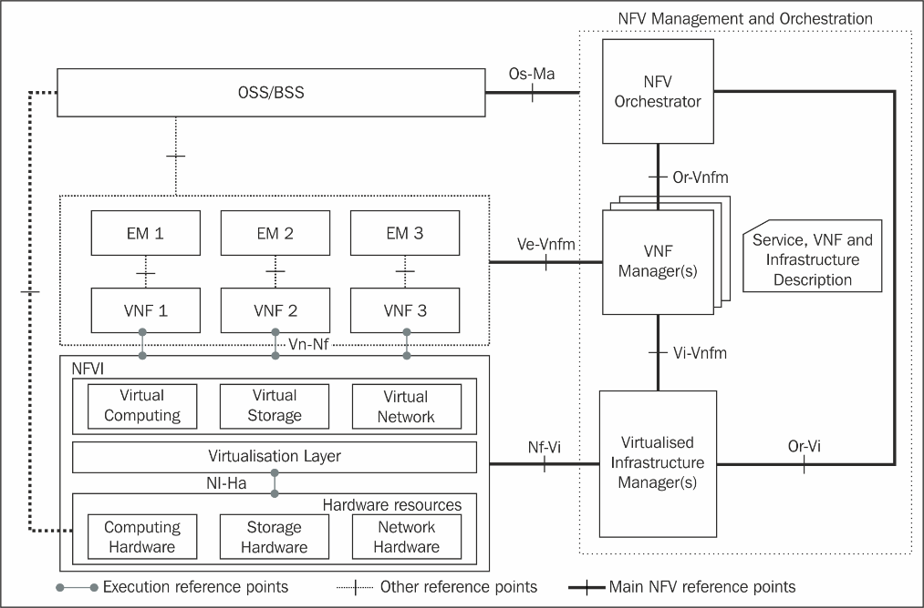
NFV Release 2: stage 2 and stage 3 specification summary
(*) Release 2 Stage 3 work items in “green”
Status as of Apr. 2018
NFV-SOL007 (NSD file structure)
PNF Descriptor impacts
NFV-IFA 015
(NFV Information Model Report)
+
NFV-IFA 016 (Papyrus Guidelines),
NFV-IFA 017 (UML Modeling Guidelines),
NFV-IFA 024 (NFV Information Model External Touchpoints)
NFV-IFA 013
NFV-IFA 010
(NFV-MANO Functional Reqs)
NFV-SOL005
SOL004
(VNF Packaging)
NFV-SOL 001
NFV-SOL 006
(VNF and NS
Descriptors)
NFV-IFA 011
(VNF Pkg)
NFV-IFA 014
(NS templates)
PNF package impacts
NFV-IFA 007
NFV-SOL 003
NFV-IFA 008
NFV-SOL 002
NFV-IFA 006
NFV-IFA 005
NFV-TST 008
(NFVI metrics)
NFV-IFA 004
(Acceleration)
Published!
NFV-IFA 002
(Acceleration)
NFV-IFA 003
(Acceleration)

Slide 37
NF Registration (YAML) Onboarding
PNF Descriptor (ETSI SOL 001)
PNFD Service Template
Substituted by
PNF
PNFD
Abstract
Properties:
NODE
Application (NF)
Infrastructure (H/W)
DependsOn
NsVirtualLink
VirtualLinkable
VirtualLinkable
PnfExtCp
NODE
LEGEND:
VirtualLinkable
Capabilities
Requirements

Slide 38
NF Registration (YAML) Onboarding
DsnTm: PNFD > ONAP Platform Model
4 Design Time Activities: NF Onboard Package > SDC catalog
4
PNFD DESCRIPTOR
PLATFORM MODEL (INTERNAL MODEL)
PNF
TOSCA Root
Node
Properties:
NODE
Service
Ns Virtual
Link
1
1
DependsOn
N
N
VirtualLinkable
Connection
Point
PNF
Device
1
1
Network
Function
Virtual
Link
PnfExtCp
Ports / NICs
Connectivity
NODE
LEGEND:
NF
Component
VirtualLinkable
Capabilities
Complex
Requirements

Slide 39
NF Registration (YAML) Onboarding
DsnTm: PNFD > SDC AID
4 Design Time Activities: NF Onboard Package > SDC catalog
4
SDC AID (Architecture Integration Document) Internal Model
PNFD DESCRIPTOR
PNF
Properties:
NODE
Ns Virtual
Link
DependsOn
VirtualLinkable
PnfExtCp
NODE
LEGEND:
VirtualLinkable
Capabilities
Requirements

Slide 40
Design-Time Process
DESIGN-TIME (SDC)
ONAP
RUN-TIME
Descriptor
Onboarding
SDC
Catalog
NF Registration
Vendor MetaData
NF
Onboarding Package
Certification
Studio
DCAE Inventory
Policy
Designer
P
Add
Policies
DCAE
Policy
Database
Deployment
Studio
Analytics
Workflow
Studio
Add
Workflows
SO
SDC
Service Orchestration
CLAMP
Designer
Add Control
Loops
Distribute
CSAR
Controller
CSAR
Package
APP-C, SDN-C
Service
Designer
Define
Services
A&AI
DCAE
Design Studio
Define
Templates
Inventory, Listener

Slide 41

Defining a Service
4 Design Time Activities: Designing a Service
SDC Service CSAR
Package
4
Distribute
SERVICE
Informational
Artifacts
Deployment
Artifacts
P
Policies
VNF
HEAT
Templates
Configuration
Files
Templates
PNF
Connection
Point
ANF
(Allotted)
Blueprints
Virtual
Link
Vendor Provided
Foundational
User Designed
Resources

Slide 42

R4: 5G Base Station (gNodeB)
RAN Network Elements
DU
RAU
CU
5G SERVICE
DU
1
CU
(VNF)
N
N
N
1
1
UPF
(VNF)
AMF
(VNF)
Core Network Elements
PNF/DU #1
VNF/CU #1
Virtual Link
Conn Pt #3
Conn Pt #1
…
User Plane Connection
PNF/DU #n
Conn Pt #n
Resources

Slide 43
VNF Requirements
NF Descriptor
Onboarding
Asset Manager

Slide 44
VNF Requirement extension for PNF
VNFRQTS-506: Supporting PNF package onboarding
  VNFRQTS-507: Project scope to include PNF
  VNFRQTS-508: Add PNFD requirements
  Section 5.1.6:
    VNFRQTS-499: PNF onboarding CSAR package structure based SOL004
    VNFRQTS-497: Adding package security requirements
  Section 7.2:
    Clarifications on the documentation requirements
    VNFRQTS-505: PNF onboarding package artifacts
    VNFRQTS-498: Add VES Event Registration requirement to PNF package
    Clarifications on artifacts structure requirements
    VNFRQTS-496: supporting Ansible protocol in PNF

Slide 45
ONAP VNF Descriptor (5.1.9) Requirements
R number | Description | Comments
R-35854 | The VNF Descriptor (VNFD) provided by VNF vendor MUST comply with TOSCA/YAML based Service template for VNF descriptor specified in ETSI NFV-SOL001. | Shall applicable to PNFD
R-65486 | The VNFD MUST comply with ETSI GS NFV-SOL001 document endorsing the above mentioned NFV Profile and maintaining the gaps with the requirements specified in ETSI GS NFV-IFA011 standard. | Shall applicable to PNFD
R-17852 | The VNFD MAY include TOSCA/YAML definitions that are not part of NFV Profile. If provided, these definitions MUST comply with TOSCA Simple Profile in YAML v.1.2. | Shall applicable to PND
R-46527 | A VNFD is a deployment template which describes a VNF in terms of deployment and operational behavior requirements. … including topology, deployment aspect, and VNF lifecycle management (LCM) operations | PNF LCM is not defined yet
R-15837 | The major TOSCA Types specified in ETSI NFV-SOL001 standard draft
R-54356 R-54876 | VNF Data Types | CpProtocolData AddressData L2AddressData L3AddressData LocationInformation CivicAddressElement
R-67895 | VNF Capability Types | VirtualLinkable
R-95321 | VNF Relationship Types | VirtualLinksTo
R-32155 | VNF Interface Types
 |  | PNF Node Types: PNF, PnfExtCp, Cp
 |  | PBF Policy Types

Slide 46
ONAP VNF CSAR Package (5.1.6) Requirements
R number | Description | Comments
R-51347 | The VNF package MUST be arranged as a CSAR archive as specified in TOSCA Simple Profile in YAML 1.2. | Shall applicable to PNF package
R-87234 | The VNF package provided by a VNF vendor MAY be either with TOSCA-Metadata directory (CSAR Option 1) or without TOSCA-Metadata directory (CSAR Option 2) as specified in ETSI GS NFV-SOL004. On-boarding entity (ONAP SDC) must support both options. Note: SDC supports only the CSAR Option 1 in Casablanca. The Option 2 will be considered in future ONAP releases, | Shall applicable to PNF package
R-10087 | The VNF package MUST contain all standard artifacts as specified in ETSI GS NFV-SOL004 including Manifest file, VNFD (or Main TOSCA/YAML based Service Template) and other optional artifacts. CSAR Manifest file as per SOL004 - for example ROOT\ MainServiceTemplate.mf | Shall applicable to PNF package
R-01123 | The VNF package Manifest file MUST contain: VNF package meta-data, a list of all artifacts (both internal and external) entry’s including their respected URI’s, an algorithm to calculate a digest and a digest result calculated on the content of each artifacts, as specified in ETSI GS NFV-SOL004. The VNF Package MUST include VNF Identification Data to uniquely identify the resource for a given VNF provider. The identification data must include: an identifier for the VNF, the name of the VNF as was given by the VNF provider, VNF description, VNF provider, and version. | Shall applicable to PNF package With new valid names/values pnf_provider_id pnf_product_name pnf_release_date_time pnf_package_version
R-21322 | The VNF provider MUST provide their testing scripts to support testing as specified in ETSI NFV-SOL004 - Testing directory in CSAR | Should applicable to PNF package
R-26885 | The VNF provider MUST provide the binaries and images needed to instantiate the VNF (VNF and VNFC images) either as: Local artifact in CSAR: ROOT\Artifacts\ VNF_Image.bin externally referred (by URI) artifact in Manifest file (also may be referred by VNF Descriptor) Note: Currently, ONAP doesn’t have the capability of Image management, we upload the image into VIM/VNFM manually. | May applicable to PNF package Not supported with current release
R-40820 | The VNF provider MUST enumerate all of the open source licenses their VNF(s) incorporate. CSAR License directory as per ETSI SOL004. for example ROOT\Licenses\ License_term.txt | May applicable to PNF package
R-xxxxx | VNF Package Authenticity | May applicable to PNF package

Slide 47
PNF on-boarding requirements (7.2)
R number | Description | Comments
R-77707 | The xNF provider MUST include a Manifest File that contains a list of all the components in the xNF package | OK. Overlapped with R-10087 in section 5.1.6.3
R-66070 | The xNF Package MUST include xNF Identification Data to uniquely identify the resource for a given xNF provider. The identification data must include: an identifier for the xNF, the name of the xNF as was given by the xNF provider, xNF description, xNF provider, and version. | Part of the descriptor
R-98617 | The xNF provider MUST provide information regarding any dependency (e.g., affinity, anti-affinity) with other xNFs and resources. | Part of the descriptor
R-22346 | The VNF package MUST provide VES Event Registration for all VES events provided by that xNF. | VES event Registration Should be applicable to PNF
R-89571 | The xNF MUST support and provide artifacts for configuration management using at least one of the following technologies; a) Netconf/YANG, b) Chef, or c) Ansible.
R-30278 | The xNF provider MUST provide a Resource/Device YANG model as a foundation for creating the YANG model for configuration. This will include xNF attributes/parameters and valid values/attributes configurable by policy.
R-27711 | The xNF provider MUST provide an XML file that contains a list of xNF error codes, descriptions of the error, and possible causes/corrective action | Not the proposed FM dictionary
R-74763 | The xNF provider MUST provide an artifact per xNF that contains all of the xNF Event Records supported. The artifact should include reference to the specific release of the xNF Event Stream Common Event Data Model document it is based on. (e.g., VES Event Listener) | VES event Listener
R-35851 | The xNF Package MUST include xNF topology that describes basic network and application connectivity internal and external to the xNF including Link type, KPIs, Bandwidth, latency, jitter, QoS (if applicable) for each interface. | Part of the descriptor?
R-26881 | The xNF provider MUST provide the binaries and images needed to instantiate the xNF (xNF and VNFC images). | Not supported by Casablanca
R-96634 | The xNF provider MUST describe scaling capabilities to manage scaling characteristics of the xNF. | Not supported by PNF
R-04298 | The xNF provider MUST provide their testing scripts to support testing. | Testing Requirements.
R-58775 | The xNF provider MUST provide software components that can be packaged with/near the xNF, if needed, to simulate any functions or systems that connect to the xNF system under test. This component is necessary only if the existing testing environment does not have the necessary simulators.
R-85653 | The xNF MUST provide metrics (e.g., number of sessions, number of subscribers, number of seats, etc.) to ONAP for tracking every license. | Only if Licensing is needed
R-40827 | The xNF provider MUST enumerate all of the open source licenses their xNF(s) incorporate.
R-85991 | The xNF provider MUST provide a universal license key per xNF to be used as needed by services (i.e., not tied to a VM instance) as the recommended solution. The xNF provider may provide pools of Unique xNF License Keys, where there is a unique key for each xNF instance as an alternate solution. Licensing issues should be resolved without interrupting in-service xNFs.
R-47849 | The xNF provider MUST support the metadata about licenses (and their applicable entitlements) as defined in this document for xNF software, and any license keys required to authorize use of the xNF software. This metadata will be used to facilitate onboarding the xNF into the ONAP environment and automating processes for putting the licenses into use and managing the full lifecycle of the licenses.

Slide 48
Q&A

Slide 49
REFERENCES / APPENDIX / BACKUP SLIDES
Benjamin Cheung, PhD

Slide 50
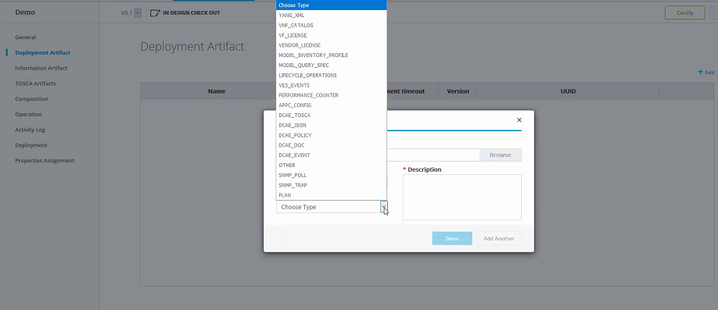
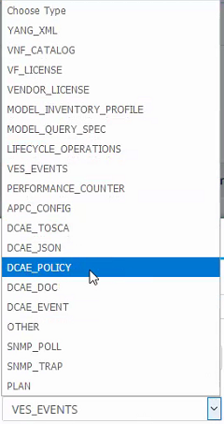
NF ONBOARDING ARTIFACTS
DEPLOYMENT ARTIFACT

Slide 51
INFORMATIONAL ARTIFACTS
INFORMATION
ARTIFACT
(SDC Design Studio)
Cloud Questionnaire
Features
Vendor Test Scripts
Resource Security Template
HEAT Template (Vendor)
Capacity Descriptive
Other Informational Artifacts

Slide 52
VNF SDK Updates
NF Descriptor
Onboarding
Benjamin Cheung, PhD
Asset Manager

Slide 53
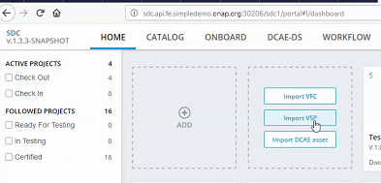
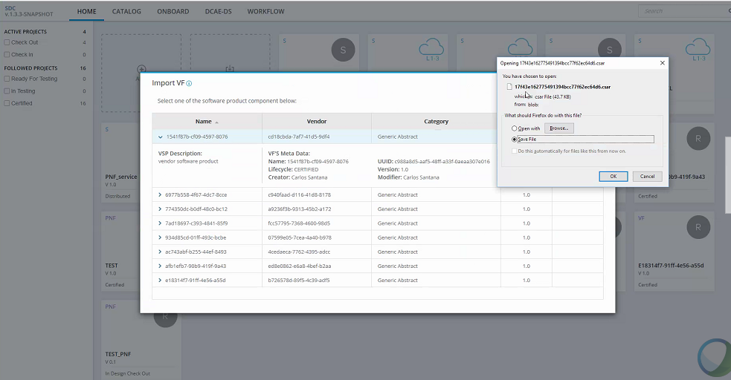
SDK ENHANCEMENTS

Slide 54
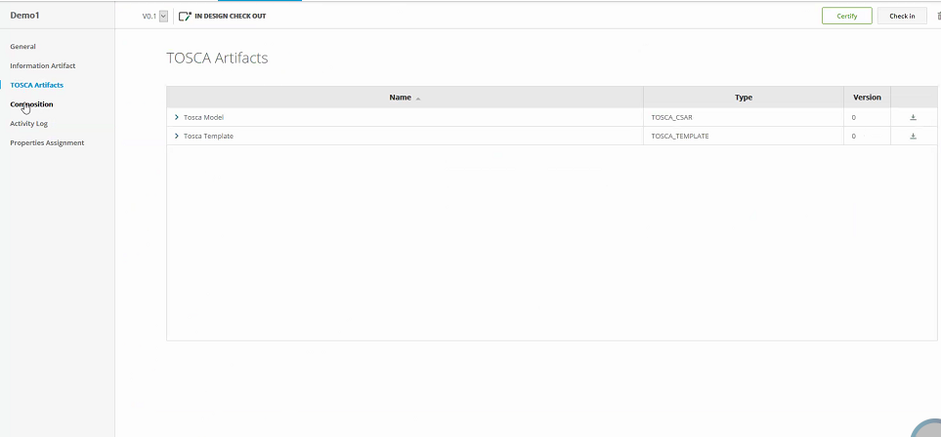
SDK ENHANCEMENTS

Slide 55
VNF SDK Impacts
VNFSDK-337: Supporting PNF package onboarding
  VNFSDK-338: Project scope to include PNF
  VNFSDK-339: PNF CSAR structure based SOL004
  VNFSDK-340: PNF manifest file
  VNFSDK-341: PNFD validation based on SOL001
  VNFSDK-342: Support packaging security
  VNFSDK-343: Enhancement of the test on PNF package

Slide 56
PLATFORM MODEL / MODELING A SERVICE
Platform Model
Design Time
Benjamin Cheung, PhD
Service Designer

Slide 57
Platform Data Model
TOSCA Root
Node
Service
1
1
N
N
Connection
Point
1
1
Virtual
Link
PNF
VNF
Ports / NICs
Connectivity
Compute Host
NF
Component
Complex
Design time view of a service
Internal representation of a model
Onboarding Model > SDC produces

Slide 58
Platform (Internal) Information Model
NF
ANF
PNF
VNF
Capabilities
Requirement
Capabilities
Requirement
Create “PNF”
Assign (registers)/connpts
Configure
Assign [connections pts]
Create
Configure

Slide 59
NF Registration (YAML) Onboarding
PNF Descriptor > ONAP Platform Model
PNFD DESCRIPTOR
PLATFORM MODEL (INTERNAL MODEL)
PNF
Properties:
NF
NODE
DependsOn
ANF
PNF
VNF
Ns Virtual
Link
VirtualLinkable
PnfExtCp
NODE
VirtualLinkable
LEGEND:
Capabilities
Requirements

Slide 60
Policy Example
DESIGN-TIME (SDC)
DCAE
(Run Time)
Descriptor
Onboarding
SDC
Catalog
NF Registration
SDC
PNF
Onboarding Package
Distribute
CSAR
DCAE
Service Change
Handler
Policy
Designer
P
Add
Policies
P
Policy
Database
P
DCAE
Inventory
CLAMP
Designer
Add Control
Loops
CSAR
Package
DCAE
Controller
DCAE
Design Studio
Define
Templates
P
P
Ticketing
P
PNF
VNF
VES
Event
DCAE
Collector
Micro
Service
P
DMaaP
DMaaP
Controller
Fault Domain
Policy
Engine
P
A&AI

Slide 61
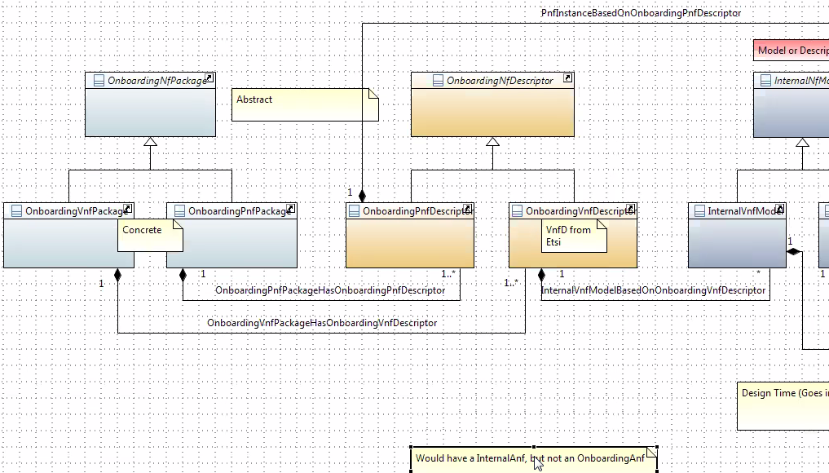
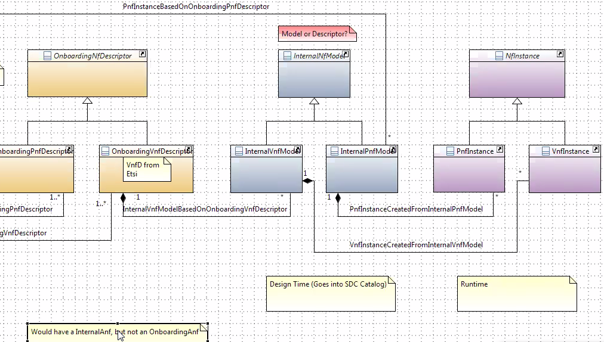
Onboarding and Design Time

Slide 62
5G RAN Wireless Systems
Benjamin Cheung, PhD

Slide 63
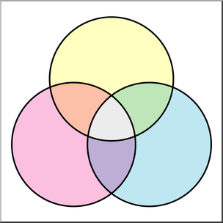












3GPP Release 15, IMT-2020 = 5G
eMBB (enhanced Mobile Broadband)
Media Anywhere
Broadband Experience Everywhere Anytime
Smart
Virtual and Augmented Reality
Connected
Remote Surgery and Examination
Smart Infrastructure
Collaborate
Smart City
Access
Interactive
Factory Automation
Industry 4.0
Smart Automated Vehicle Control
Internet of Things (IoT)
M2M communications
Aware
Remote Device Control
Geographically spread devices
URLLC (Ultra Reliable Low Latency Communications)
mMTC (massive Machine Type Communications)

Slide 64





5G Key Technology Components
New Spectrum (Rel 15, 52.6 GHz/39 GHz, Rel 16 > 52.6 GHz)
Software Defined Networking (SDN)
Advanced
Beamforming
Network Functions Virtualization (NFV)
Multi-Connectivity (NSA, SA, Option 3, 4, 7)
Network Slicing
Fog Computing (FC)
Mobile Edge Computing (MEC)
Edge Computing

Slide 65
5G RAN Wireless Systems & ONAP
Benjamin Cheung, PhD

Slide 66




5G RAN Wireless Network
SO – Service Orchestrator
SDN-C – Service Design Network Controller
DCA&E – Data Collection Analytics & Events
A&AI – Available & Active Inventory
APP-C – Application Control
ONAP Run Time Management
OSS
BSS
SO
SDN-C
DCAE
A&AI
APP-C
5G
Application
Ecosystem
RAN Network Elements
Core Network Elements
Disaggregated Core
Antenna
CU-CP (ONAP)
CU-UP
UPF
SMF
UDM
AUSF
AMF
DU
RAU
Back Haul
RF
RU
DU
CU
Edge
Cloud
Centralized
Cloud
Internet
CPRI
Mid Haul
External Content
RAP
UE
RU – Remote Radio Unit
DU – Distributed Unit (5G Base Unit)
CU – Centralized Unit
UPF – User Plane Function
SMF – Session Management Function
UDM – Unified Data Management Function
AUSF – Authentication Service Function

Slide 67
R4: Modeling a 5G Service
5G SERVICE
Informational
Artifacts
Deployment
Artifacts
P
Network
Function (VNF)
Policies
Configuration
Files
HEAT
Templates
Network
Function PNF
Templates
Connection
Point
PNF
Device
Blueprints
Virtual
Link
Vendor Provided
Foundational
User Designed
Resources

Slide 68
R4: 5G Base Station (gNodeB)
RAN Network Elements
DU
RAU
CU
5G SERVICE
DU
CU
(VNF)
N
1
N
N
1
1
UPF
(VNF)
AMF
(VNF)
Core Network Elements
PNF/DU #1
NF/CU #1
Virtual Link
Conn Pt #3
Conn Pt #1
…
PNF/DU #n
ANF
Conn Pt #n
Resources

Slide 69
Configurations
Benjamin Cheung, PhD

Slide 70
MODELING WITHIN A PNF (DU)
5G DU
(PNF)
NF PNF – “Application” S/W does 5G voice/data
N/F Node Type
Hardware PNF - Modem (5G DU) [Hardware]
H/W Node Type
Software Function of a DU
Network
Function
“Hardware Aspects of a PNF”
Connection
Point
PNF
Device
Sub-Component #1
Ports / NICs
Sub-Component #2
The hardware Ports
(e.g. SFP/Backhaul Ports)
FUTURE
Sub-Component #n
NF
Component
SFP #1 = Port #1
Sub-components within PNF
SFP #n = Port #n

Slide 71
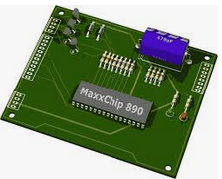
DU Configurations
DRIVE PARTITIONS
MULTI-PNF
DAISY CHAIN CONFIG
5G DU
(PNF)
TANDEM CHASSIS CONFIGURATIONS
Version 2018-09A
Partition1 (Active)
DU
Version 2018-09B
Version 2018-09A
PNF
DU
Version LTE2018-09A
Partition2 (Inactive)
4G PNF
Sub-Frame DU#1
SUBCOMPONENTS (R4+)
DU
Version 2018-09A
5G PNF
Version 2018-09B
PNF
Version 2018-09A
DU
DU
Sub-Frame DU#2
5G PNF
Sub-Component-1
Version 2018-09B
DU
Sub-component
(e.g. Circuit Pack)
Version 2018-09B
Sub-Frame DU#2
Sub-Component-2

Slide 72
ETSI (SOL 001, SOL 004, SOL005, SOL 007)
Benjamin Cheung, PhD

Slide 73
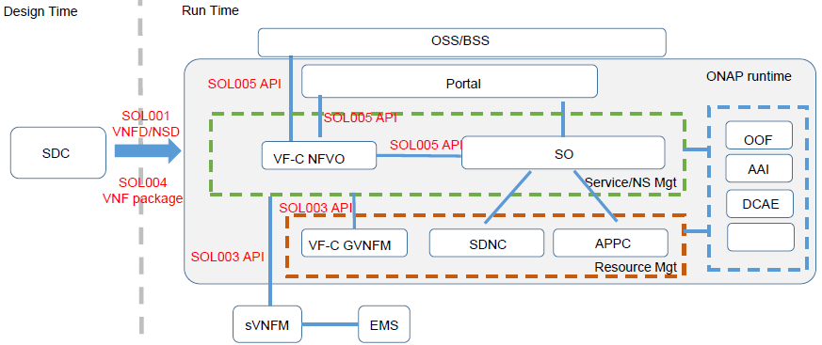
ETSI SOL Standards

Slide 74
ETSI SOL Standards Alignment
Legacy OSS
SOL001 NS-D
SOL 005
SOL004 CSAR
SOL001 VNF-D & NS-D
Onboarding
SDC
SO
App-C / GNF-C
NFVO
SOL001
NS-D
SOL005
SOL002
SOL003 & SOL001
VNF-D
Legacy NFV-O
SOL003
VNFM
VNFM
VNF
SOL002
VNF
SOL002
VNF
VNF
VNF
VNF
VNF
VNF
VNF
VNF

Slide 75
VNFD/PNFD/NSD properties alignment
On-going ETSI discussion
PNFD | VNFD | NSD | Comments
descriptor_id | descriptor_id | descriptor_id
version | descriptor_version | descriptor_version | Proposed new name in PNFD: descriptor_version
provider | provider | provider
name | product_info_name | name | Better to be aligned. Proposed new name in VNFD: name
- | software_version | software_version | New in PNFD 1. Better to align with VNFD. VNFD uses software_version for only software change. descriptor_id might be changed only due to descriptor evolution itself like security adding. 2. Long-term view, it would be useful to upgrade PNF software. 3. It is also useful for service provider to get such information for OAM view like trouble-shooting, service checking, PNF packability checking and so on 4. Align with ONAP model
function_description | product_info_description | - | Proposed new name in VNFD: function_description. Add function_description into NSD
descriptor_invariant_id | product_name | invariant_id | Proposed new name in VNFD / PNFD: invariant_id
geographical_location_info | - | -

Slide 76
SOL004 expanded scope option
On-going ETSI discussion
Tentative updated SOL004 title :
“Network Functions Virtualisation (NFV) Release 2; Protocols and Data Models; VNF Package specification and PNF file specification”
Tentative updated scope:
The present document specifies the structure and format of a VNF package file and its constituents, fulfilling the requirements specified in ETSI GS NFV-IFA 011 [1] for a VNF package and in ETSI GS NFV-IFA 014 [x] for a PNFD.
Working schedule:
Milestone name | Target date
CR approval with expanded scope of 2.6.1 | 2018/12/07
Functional CRs approved | 2018/12/13
WG approval | 2018/12/31
TB approval | 2019/01/31

Slide 77
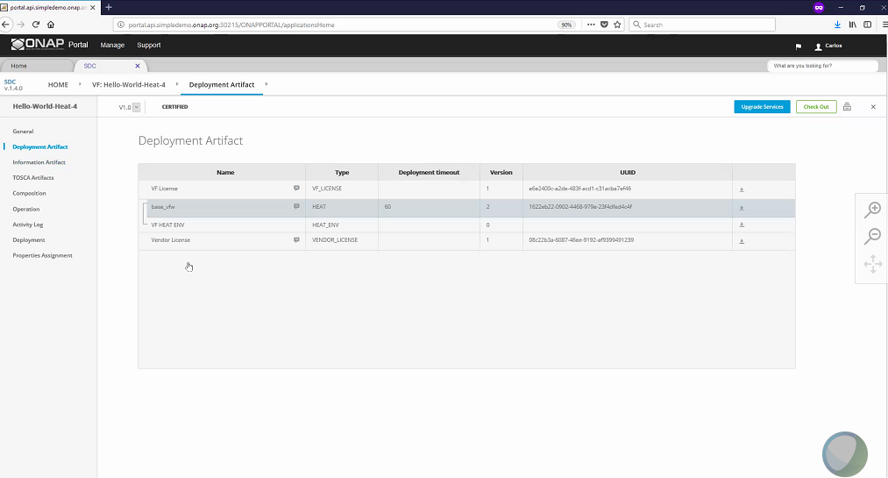

Slide 78
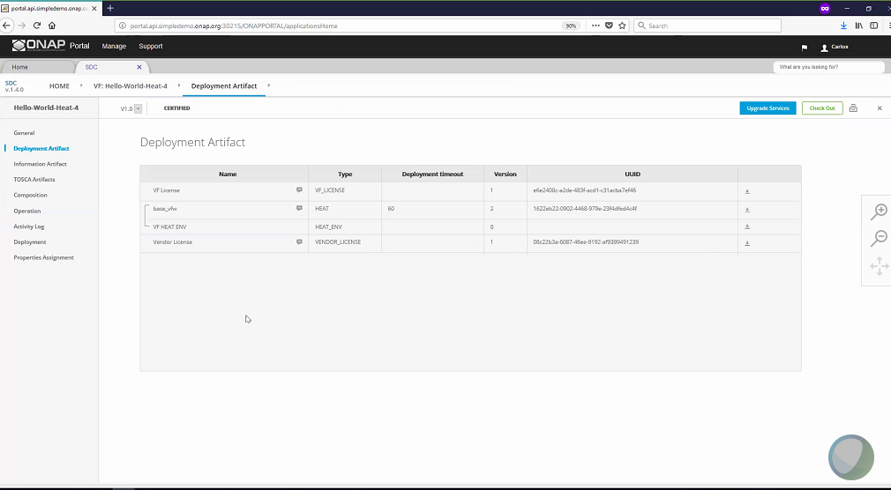

Slide 79
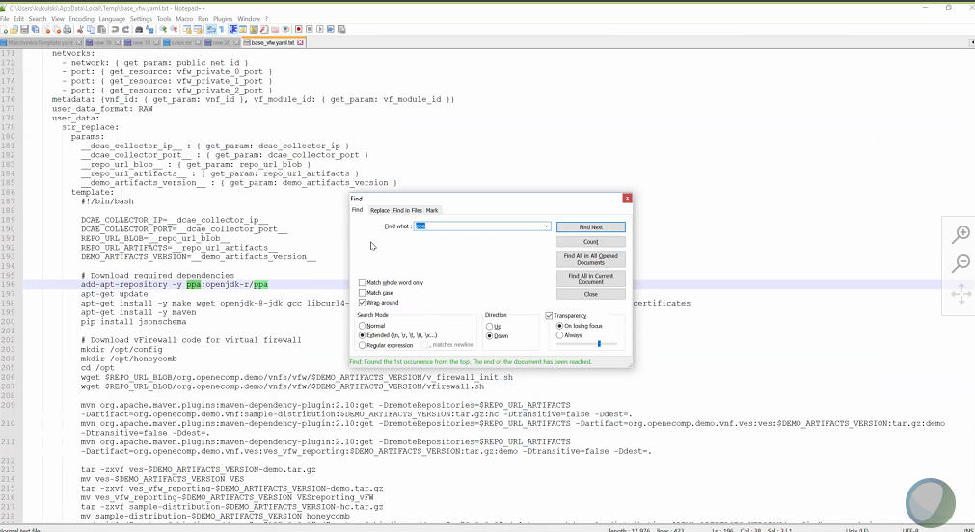

Slide 80
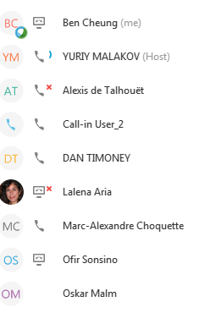
Just in time instantiation of resources
VNFD
U/C deploy VNFC in K8S dynamically provision the platform.
NFIaaS
Inventory; order, capacity
RACK of H/W
redfishAPI, RestFUL API envelope of specification (TOSCA)
Declarative,
Physical infrastructure manager
Multicloud layer
IaaS , Service based style-guide
Aws azure
PNF Box, NF, composition API dynamically created.
Scarce res composable infrastructure multi-tenacy. Compose/resize.

Slide 81
SDC Internal Package
UUID Metadata
TOSCA
Metadata
(SDC)
TOSCA
Descriptor
(SDC)
X License
Model Files
Additional
Artifacts

