Slide 1





Byung-Woo Jun (Ericsson),Fred Oliveira(Verizon)
Seshu Kumar (Huawei), Yuanhong Deng (CMCC)
ONAP ETSI-Alignment Architecture
for Honolulu & Istanbul Releases

Slide 2
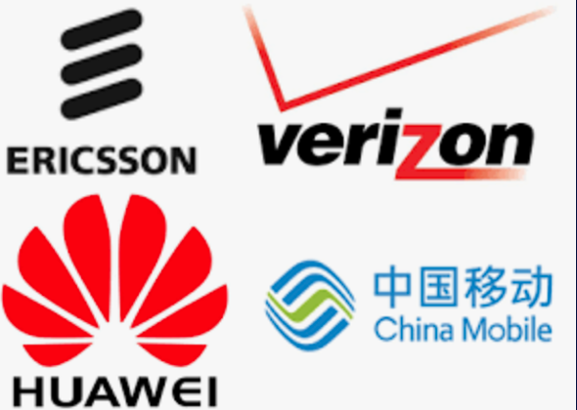
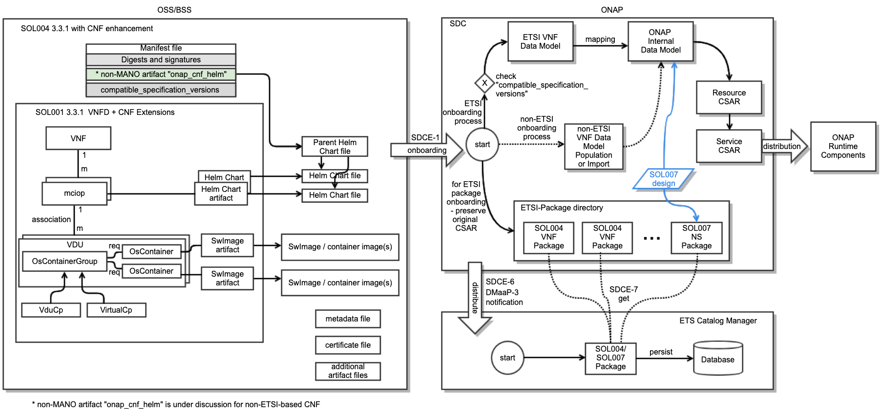
ETSI SOL004 Onboarding and SOL007 Design
ONAP SDC supports onboarding of ETSI SOL004 v3.3.1 compliant VNF / CNF packages
  In ONAP Honolulu release, it supports v3.3.1 VNF with minimum enhancements for CNF; v4.2.1 is considered in the future
  ONAP data model corresponding to SOL001 VNF/CNF is defined
  Handling large-size container image is under discussion
ONAP SDC supports design of ETSI SOL007 v3.3.1 compliant NS packages
  ONAP data model corresponding to SOL001 NS is defined
  SOL007 onboarding is under discussion

Slide 3
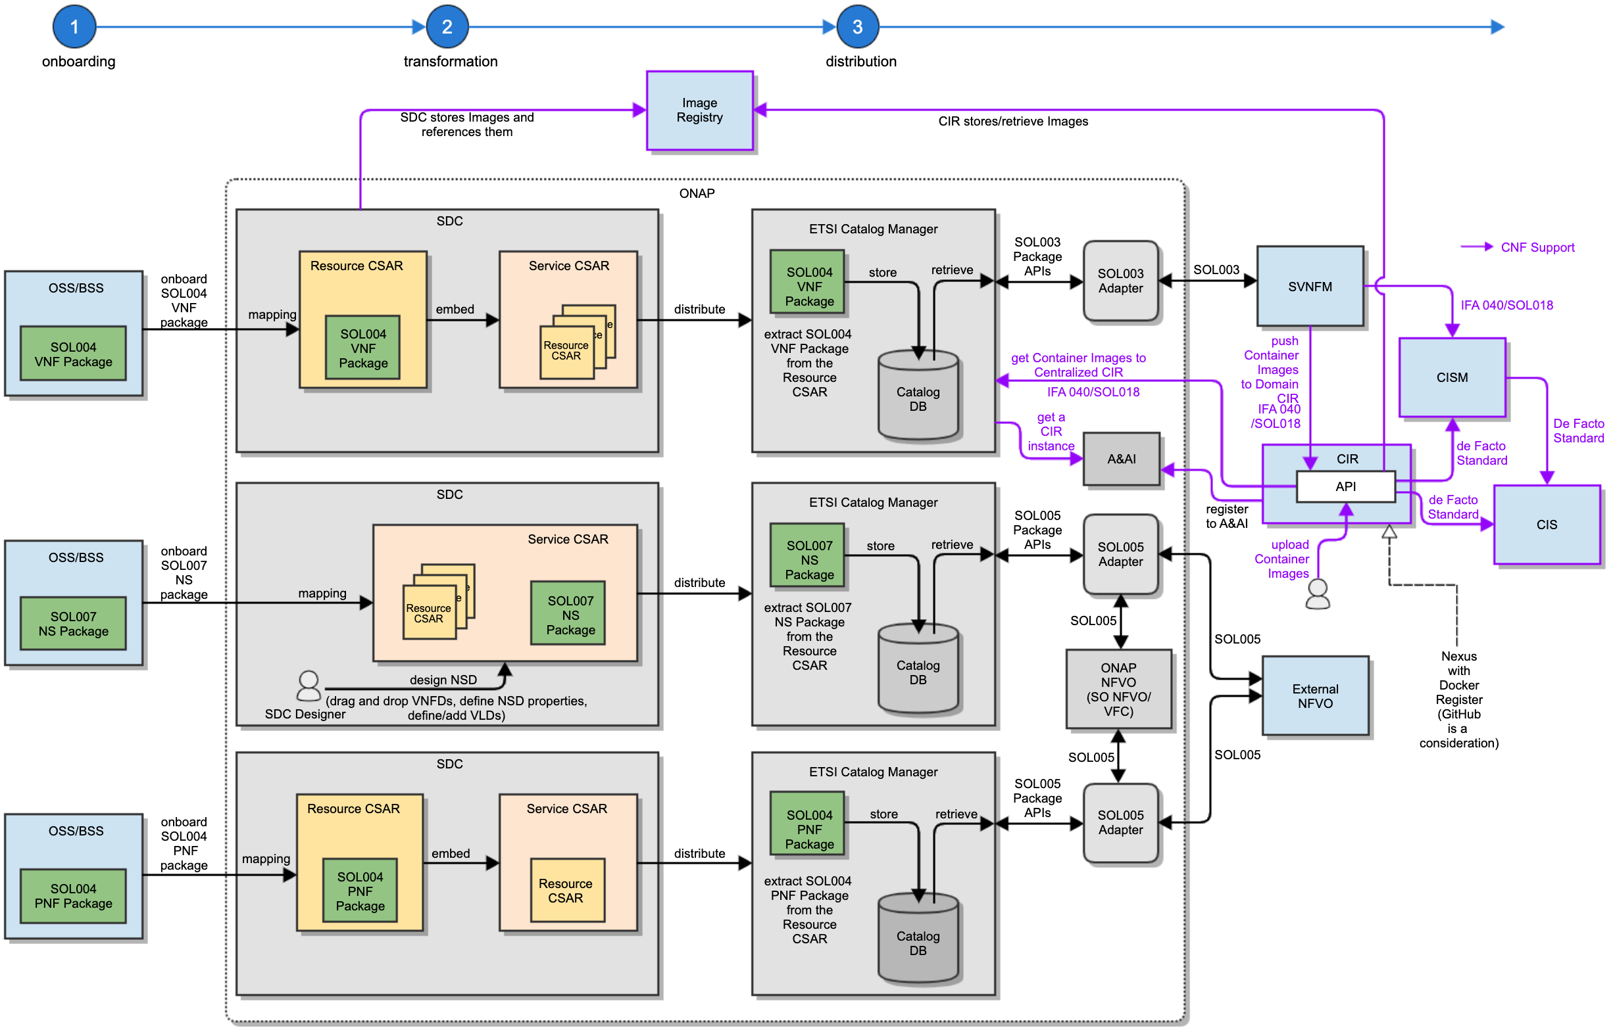
ONAP ETSI-Alignment Package Distribution
ONAP supports automated end-to-end SOL007 and SOL004 packages (v.3.3.1)
  SDC (Design time) onboards and distributes the ETSI packages to ONAP ETSI Catalog Manager (ONAP Runtime component)
  SOL005 and SOL003 Package Management APIs including notification are used
  For CNF, Container Images are pushed to Image Registry, and CIR provides access thru Docker Registry API
CIR component(s) can be set up by operators
  Operators register CIR(s) to ONAP AAI
  ETSI Catalog Manager/others use CIR instance(s) for Images
PNF pkg use by the ETSI-alignment component is under discussion

Slide 4
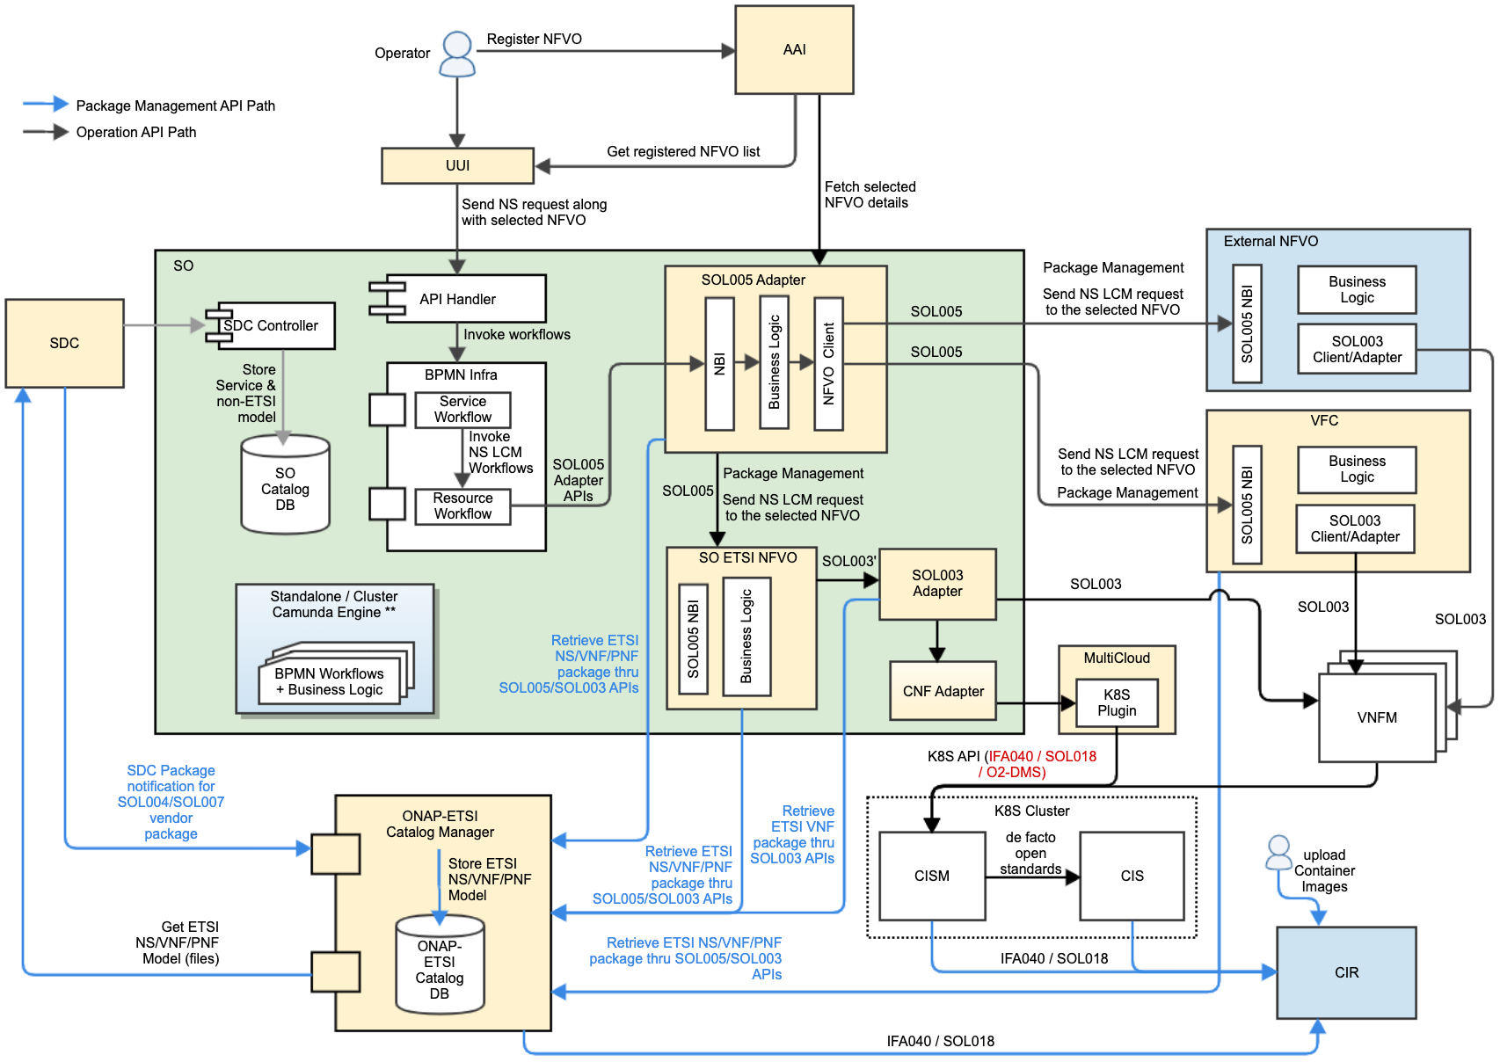
ONAP SOL005/SOL003 Alignment
ONAP NFVO (SO NFVO, VFC) supports ETSI SOL005 for NS package management and LCMs
  NFVO(s) will be registered to ONAP AAI
  SOL005 Adapter triggers an NFVO instance, leveraging SOL005 APIs (v.2.7.1)
SOL003 Adapter supports ETSI SOL003 APIs (v2.7.1) for VNF packages and LCMs
  Participating SVNFM(s) must support ETSI SOL003 APIs
  SVNFM(s) will be registered to ONAP AAI
ETSI Catalog Manager supports ETSI SOL005 and SOL003 Package Management APIs

Slide 5
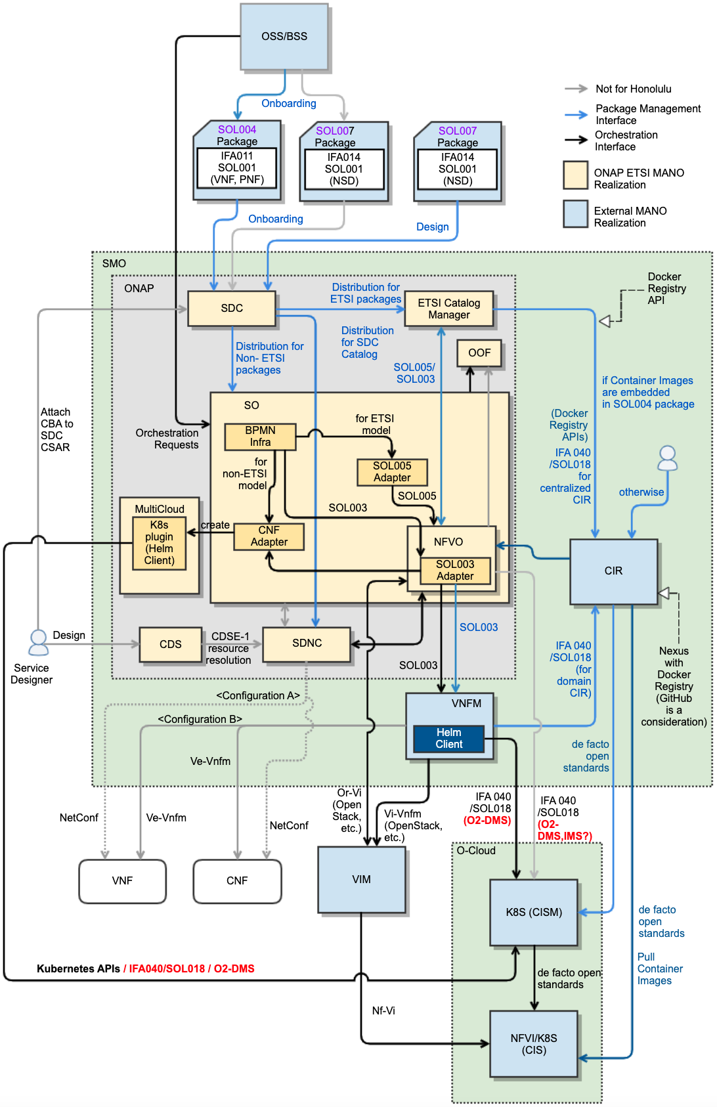
ONAP CNF Support
- Roadmap
In ONAP, there are two CNF orchestration tracks: ETSI-based & non-ETSI-based CNF handling
  There could be collaboration effort between the ETSI-aligned CNF and non-ETSI-based CNF handling, by sharing common models & components for onboarding, packaging, distribution and K8S interactions
In the case of ETSI-NFV based, ONAP interacts with K8S cluster for CNF orchestration thru SOL018-based communications, via either with/without VNFM
  It is a possible option that ONAP interacts with K8S directly without going thru SVNFM(s)
  In that case, CNF Adapter is used for both ETSI-based and non-ETSI-based CNF orchestration
Future ONAP releases can consider O-RAN O2-DMS support
ONAP supports SEC021 for secure communication with SVNFM/external NFVOs/K8S

Slide 6

Further Questions?
Contact me
Byung-Woo Jun: byung-woo.jun@est.tech
Fred Oliveira: fernando.oliveira@Verizon.com
Seshu Kumar: seshu.kumar.m@Huawei.com
Yuanhong Deng: dengyuanhong@chinamobile.com

