Slide 1
CNF Model, Package and Orchestration Architecture
Title / Subtitle Here
@Fred Oliveira (Verizon)
@Byung-Woo Jun, Marian Darula, Cristina Badulescu (Ericsson)
@Thinh Nguyenphu, Marge Hills, Martins, Joao (Nokia)
@Seshu Kumar (Huawei)
@twitter

Slide 2
CNF Model and Package Options
ETSI SOL001 VNFD/CNFD Model and Package
  Proposal: ETSI NFV SOL004 Packaging &
  SOL001 CNFD Models for ONAP and ORAN
Application Service Descriptor (ASD) Model and Package
  Mission Statement
  Proposals
Two model Analysis and Recommendations

Slide 3
ETSI NFV SOL004 Packaging &
SOL001 CNFD Models for ONAP and ORAN

Slide 4
Proposal: ETSI NFV SOL004 Packaging &
SOL001 CNFD Models for ONAP and ORAN
ETSI SOL001 Aligned Proposal
ETSI SOL004 Containerized VNF Packaging
SOL001 Descriptor Proposal for Containerized RAN NFs, xApps and rApps
ETSI Aligned Container VNFD Changes
  Mciop
  Vdu.OsContainerDeployableUnit
  Vdu.OsContainer
  VirtualCp

Slide 5
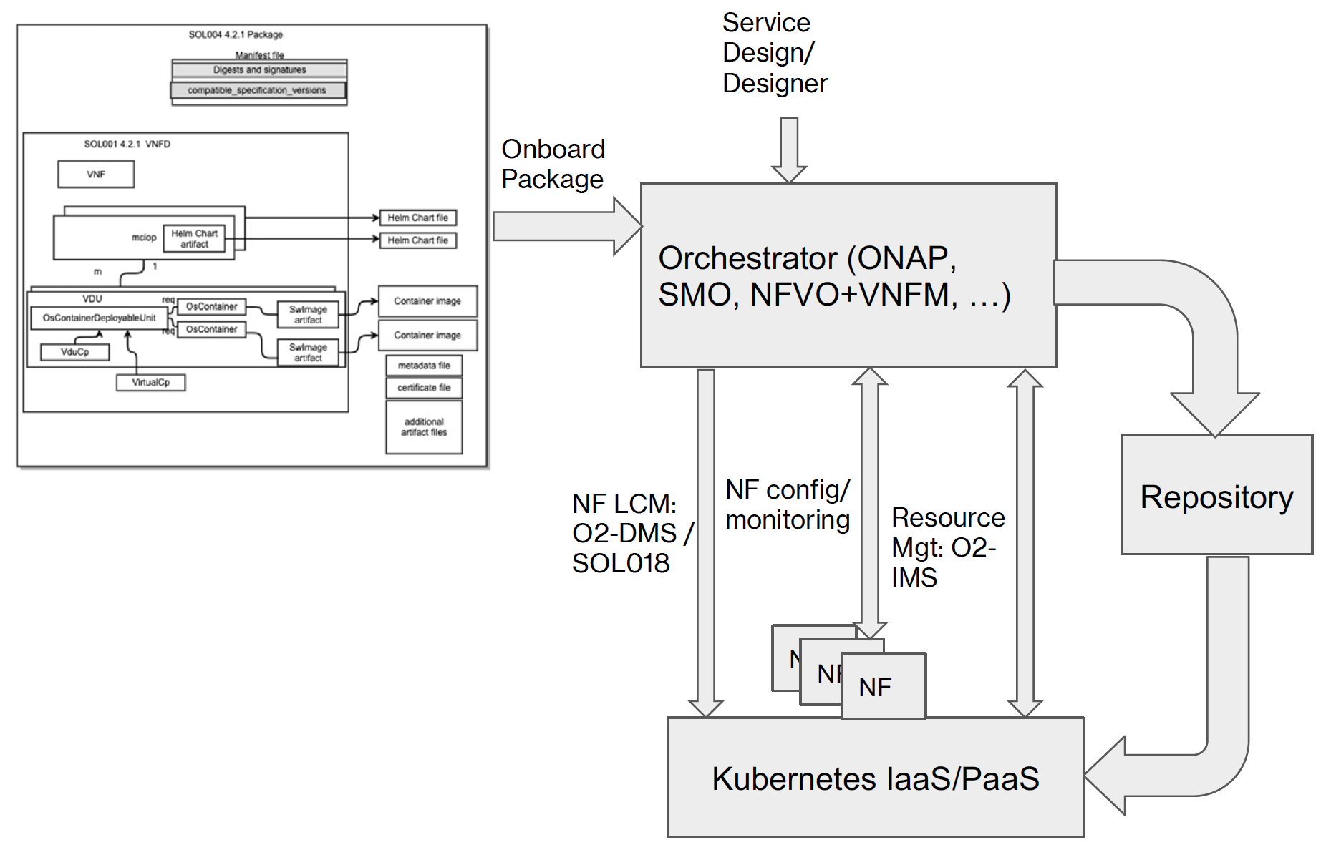
ETSI SOL001 Aligned Proposal
ETSI NFV SOL004 CSAR Packaging
ETSI SOL001 (4.2.1) TOSCA VNF Descriptor with container support
Leverage same Orchestrator as for VM based VNFs
Leverage industry standard Helm and/or K8S for NF LCM/SOL018
Provide enough information in the Descriptor for the Orchestrator to:
  Enable Network Service Design
  LCM Images/Artifacts
  Evaluate xNF deployability
  Select IaaS/Paas instance(s)
  Allocate Resource quotas
  Deploy xNFs in appropriate IaaS
  Configure and Monitor xNFs
  Upgrade xNFs
Standard packaging format (based on TOSCA CSAR)
Enhanced SOL001 VNF Descriptor supporting containers
Support for Helm Chart Artifacts
Container Images can be included in the package
Additional Artifacts

Slide 6
SOL001 Descriptor Proposal for Containerized
RAN NFs, xApps and rApps
What is available today in ETSI:
  TOSCA based VNF descriptors
  Yang based VNF descriptors
What is being added in SOL001 v4.2.1 specs:
  TOSCA based CNF (ETSI term: containerized VNF) descriptors
  Corrections and enhancements from SOL001 v3.5.1
  Major contributors: Verizon, Ericsson, Orange, Huawei, Nokia, Docomo
Justification to use SOL001 TOSCA VNF descriptors:
  Alignment with ETSI Industry Standard
  Abstract definition for isolation from execution environment
  Common Orchestration enablement for VM and container-based Network Functions
  Easier integration into Service Design framework for design of Network Services

Slide 7
ETSI Aligned Container VNFD Changes
Container based VNF descriptor includes:
mciop(Managed Container Infrastructure Object Package)
Vdu.OsContainerDeployableUnit
Vdu.OsContainer
VirtualCp (uService Connection Points)

Slide 8
VNFD Change Details
Mciop describes deployment artifacts
References the Helm Charts (in package or external)
Identifies the VDUs/Pods affected by each Chart
Indicates the Deployment Order for the Charts
VirtualCp describes IP:Port to Service mapping
List of Ports/uServices
Target references the service VDU(s)
Link to External CP (Ingress Gateway IP)
Vdu.OsContainerDeployableUnit describes a Deployment Unit (K8S Pod)
Describes monitoring parameters and scaling
Describes configurable parameters (Substituted
Values.yaml)
Describes Persistent Storage
List of the constituent OsContainers
Vdu.OsContainer describes each Container
CPU, Memory, Storage Requests and Limits
SwImage artifact that references the container image

Slide 9
Application Service Descriptor (ASD)

Slide 10



ASD Models
Rationale
  ETSI SOL001 VNFD/CNFD includes duplicated attributes/properties which are defined in Helm Charts.
  The VNFD/CNFD definitions could conflict with the Helm Chart definitions, which can cause orchestration confusion and/or failure
  Non-ETSI-based CNF model and orchestration desire simplified CNF descriptor
Objective
  Remove duplicated attributes/properties between ASD and Helm Charts
  Define functional purposes between ASD and Helm Charts
    ASD focuses on Service/Resource level models and
    ASD delegates Cloud-Native CNF orchestration description to Helm Charts
Open Issues
  Format/language of descriptor (Simple YAML, TOSCA, YANG, etc.)?
  How much does NFVO/SMO need to read and understand the Helm Charts?
    Do we allow some minimum attributes/properties duplications to minimalize impacts to NFVO and SMO?
    How do we handle failure in Kubernetes environment due to inaccurate resource descriptions?

Slide 11
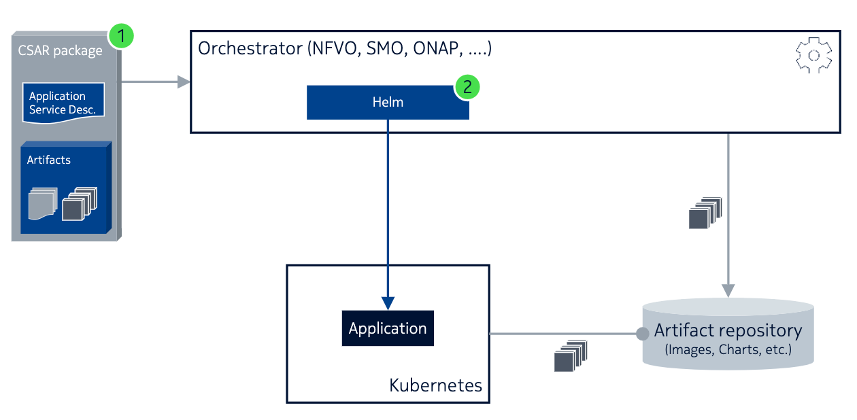
ASD Model and Packaging
The proposed solution:
Use CSAR packaging for bundling metadata and cloud-native artifacts in a single package. Describe the application using a lightweight, ETSI-compatible Application Service Descriptor.
Choose Helm v3 as the primary cloud-native tool to embed in the orchestrator.

Slide 12
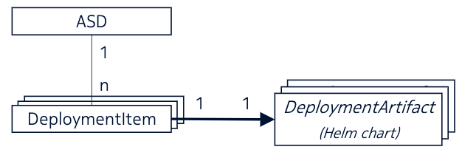
ASD Proposal
Attribute | Qualifier | Cardinality | Content | Description
asdId | M | 1 | Identifier | Identifier of this ASD information element. This attribute shall be globally unique. The format will be defined in the data model specification phase.
asdSchemaVersion | M | 1 | Version | Specifies the version of the ASD’s schema (if we modify an ASD field definition, add/remove field definitions, etc.).
asdProvider | M | 1 | String | Provider of the AS and of the ASD.
asdApplicationName | M | 1 | String | Name to identify the Application Service. Invariant for the AS lifetime.
asdApplicationVersion | M | 1 | Version | Specifies the version of the Application (so, if software, DeploymentArtifacts , ASD values, ... change, this changes).
asdApplicationInfoName | O | 0..1 | String | Human readable name for the Application service. Can change during the AS lifetime.
asdInfoDescription | O | 0..1 | String | Human readable description of the AS. Can change during the AS lifetime.
asdExtCpd | O | 0..N | Tbd | Describes external interface(s) exposed by this AS enabling connection with a VL. (Similar to VnfExtCpd on VNF-D, but only describing L3 and above interfaces, since K8S can’t do <L3
extraServiceRequirements | O | 0..N | Tbd | (include here Kubernetes NFDs) < - a flat list from Helm charts
enhancedClusterCapabilities | O | 0..N | Tbd | Describes expected capabilities of the target Kubernetes cluster to aid placement of the application service on a suitable cluster. Examples of capabilities are required networking characteristics, Kubernetes API extensions or quantifiable node specific resources. This attribute can contain information complementing information provided in the referenced DeploymentArtifacts. Note: Modeling of enhancedClusterCapabilities is subject to standardization but is ffs. Alignment between O2-IMS and O2-DMS of these values is required.
deploymentItems | M | 1..N | DeploymentItem | Deployment artifacts (see next slide)
As an alternative to “parent” or “umbrella” charts, we propose a means to structure and sequence multiple Helm charts that is easily expressed inside the ASD, using the DeploymentItem construct (see also next slide).

Slide 13
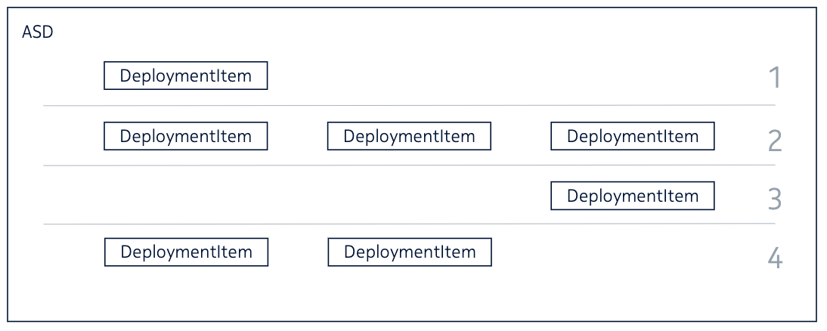
DeploymentItem Proposal
Attribute | Qualifier | Cardinality | Content | Description
deploymentItemId | M | 1 | Identifier | The identifier of this deployment item
artifactId | M | 1 | Identifier | Reference to a DeploymentArtifact
deploymentOrder | O | 0..1 | Integer | Specifies the deployment stage that the DeploymentArtifact belongs to. A lower value specifies that the DeploymentArtifact belongs to an earlier deployment stage, i.e., needs to be installed prior to DeploymentArtifact with higher deploymentOrder values.
lifecycleParamerters | Tbd | tbd | tbd | list of parameters that can be overridden at deployment time (e.g., values for values.yaml in the chart this item references)
In order to support complex applications that require multiple artifacts (like Helm charts) to be installed in a particular order, the orchestrator must support an easy method of chaining these artifacts – including dependency relationships.
As show, items are given a deployment order. Items with the same order are deployed in parallel; items in different orders are deployed in sequence.

Slide 14
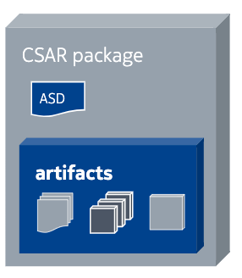
ETSI-Compliant Packaging
The proposal for packaging is to continue to rely on CSAR.
Recommend to standardize:
The Packaging of containerized applications, the ASD itself, and the usage of ASD as a top-level artifact for a CSAR.
The use of Helm as the cloud-native artifact for describing (pieces of) the application
Adopt SOL004, adding the possibility to include an ASD instead of a VNFD as a top-level artifact

Slide 15
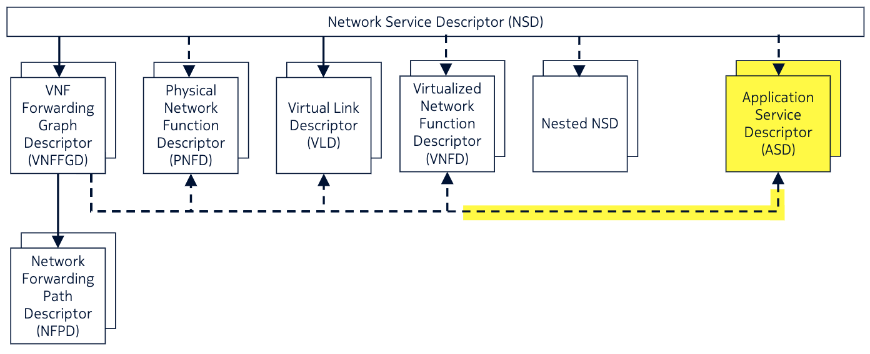
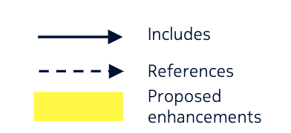
ASD with NSD (Optional)
Containerized Application Service Descriptor
The ASD is a descriptor with the minimum information for the NFVO, and pointers to K8S-native tooling for the LCM implementation. Can describe a complete NF, or parts of a NF.
If needed, NSDs can be used to perform this composition, by referring to multiple ASDs; just like they are used today to describe complex multi-VNF services today.

Slide 16
References
x

