Slide 1
Dynamic CNF Migration w/ Control-Loop
Jan. 26, 2021
Satoshi Fujii
Fujitsu Ltd.

Slide 2
Background
Expecting CNF will become common in NFV and more CNF use cases will be introduced
ONAP: Need to enrich CNF related features to support the use cases
  Fault control, Stabilization, etc...
Proposal:
Dynamic CNF Migration w/ Control-Loop

Slide 3

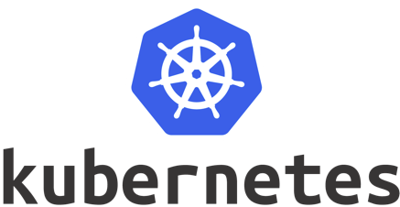


Concept
Case1:
Migration in Single k8s Cloud
Case2:
Migration across k8s Clouds
Migrate CNF
Migrate CNF
to another cloud
Collect
metrics
(CPU, Memory,
network
etc)
Collect
metrics
(CPU, Memory,
network
etc)
CNF
CNF
CNF
CNF
CNF
CNF
CNF
CNF
CNF
CNF
CNF
overloaded
overloaded

Slide 4
Concept – Migrating CNF to another node in single cluster
Because CPU, network and IO resources are shared in pods on the same node, container’s high load is affective to other CNF containers.
Container load is unpredictable and can be temporarily high, it is difficult to schedule pods properly at service creation time.
Dynamically migrating CNF to another worker node is one possible solution to stabilize service quality.
Migrate CNF
Collect
metrics
(CPU, Memory,
network
etc)
CNF
CNF
CNF
CNF
CNF
Not much valuable -
This migration can be done by Kubernetes itself
overloaded

Slide 5
Concept - Migrating CNF to another K8s cloud
Assumption: two (or more) K8s clouds registered to ONAP
Worker node fault may happen in K8s cluster and the cluster will be overloaded
or the entire cluster down
ONAP detects the k8s is down or overloaded from collected KPI/metrics, then execute migrating CNF to another available cloud
Case2:
Migration across k8s Clouds
Migrate CNF
to another cloud
Collect
metrics
(CPU, Memory,
network
etc)
CNF
CNF
CNF
CNF
CNF
CNF
fault
overloaded

Slide 6
Day 0/1 Flow Details
Operator
Trigger service creation
5
Designer
Designer
SO
Distribute
CSAR & CBA
Onboard&Design
cnf-
adapter
bpmn-
infra
1
helm
Add policy
10
2
SDC
policy
rule
14
CLAMP UI?
Policy
OOF
-HAS
6
Homing
7
Assign
service
template
SDNC
DCAE-MOD
DCAE
A&AI
11
DCAE
artifact
Instantiate
CNF
8
Assign
CBA
13
Design & Distribute
CDS
Populate
k8s cloud
& node info
Multicloud
4
9
Enrich?
k8s
plugin
CNF
artifact
broker
12
Deploy CNF
(from helm chart)
Register
K8s cloud
3
Admin

Slide 7
Day 0/1 Flow Details
No. | Component | Action
1 | (Designer) SDC | Onboard CNF package & design service
2 | SDC | Distribute the service template & CBA (to CDS)
3 | K8s plugin | Register target Kubernetes cloud
4 | K8s plugin | Populate Kubernetes nodes info to A&AI
5 | (Operator) | Start service creation by calling SO
6 | SO | Ask OOF-HAS to decide which cloud to deploy the CNF on
7 | SDNC | Assign CNF
8 | CDS | Assign CNF / Generate CNF configuration from template
9 | CDS | Enrich CNF configuration to k8s plugin
10 | SO | Call cnf-adapter to instantiate CNF
11 | SO (cnf-adapter) | Call k8s plugin Instantiate API
12 | K8s plugin | Deploy CNF from helm chart to target Kubernetes cloud
13 | DCAE | Design DCAE and distribute
14 | Policy | Design policy and distribute

Slide 8
Closed Loop Flow Details
Trigger
CNF migration
SO
4
cnf-
adapter
bpmn-
infra
update
cloud/node
status
Policy
OOF
5
Generate TCA
if node/cluster is
overloaded or down
3
Query available
node / cloud
2
6
SDNC
DCAE
A&AI
deploy CNF
on new cluster
8
7
reconfigure
CNF
9
Update CNF
info
uninstall CNF
from orig. cluster
9
CDS
1
Multicloud
7
Collect
KPI / metrics
(CPU, Mem, Network etc)
k8s
plugin
9
uninstall
CNF
artifact
broker
CNF
CNF
8
deploy CNF
Notes:
BPMNフローのなかのcnf-adapterのところは調べておく必要あり。
CPUとかmemoryとか見る

Slide 9
Closed Loop Flow Details
No. | Component | Action
1 | DCAE | Collect metrics (CPU, Memory, Storage, Network I/O) from Kubernetes
2 | DCAE to Policy | If exceed the threshold or detect down, generate TCA and notify Policy
3 | Policy | Receive TCA and update node / cluster ‘status’ in A&AI Query A&AI to get affected CNFs; Decide which CNF to be moved
4 | Policy to SDNC | Call SDNC Migration API
5 | SDNC to OOF | Query OOF-HAS to decide destination node / cloud
6 | OOF to AAI/DCAE | Get available k8s nodes / cloud (by seeing ‘status’ attribute) Get KPI/metrics from DCAE
7 | CDS, k8s plugin | Reconfigure CNF to be suitable to destination k8s cloud
8 | SDNC to k8s plugin | Instantiate CNF on new OOF-suggested k8s cloud
9 | SDNC to k8s plugin | Delete the CNF from the original k8s cloud
12 | SDNC to AAI | Update CNF info in A&AI

Slide 10
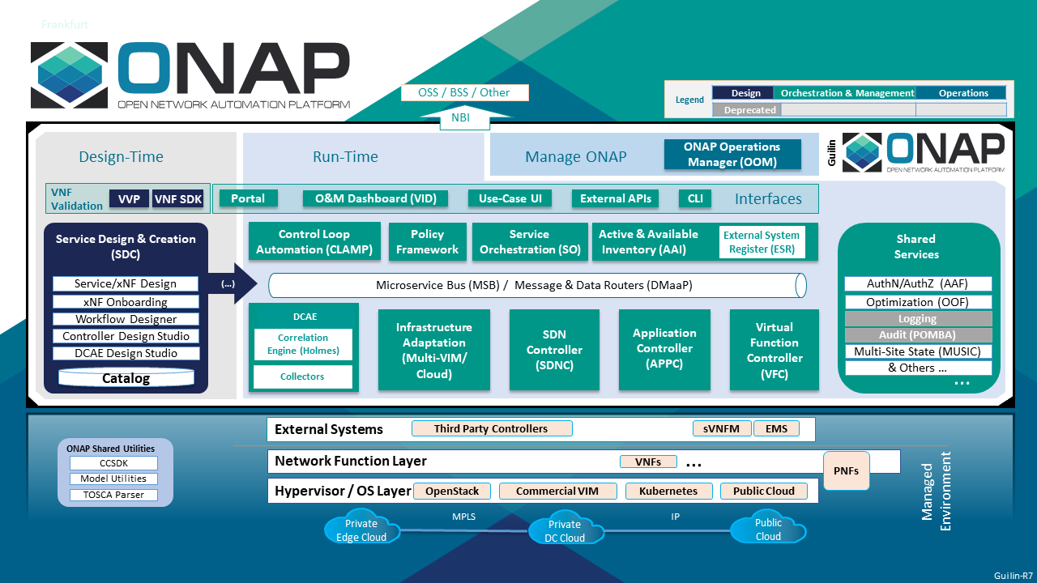
Impacted Components
CDS

Slide 11
Impacted Components
SDNC
  Migration API
    Called from Policy
    Call OOF-HAS to decide where to move the CNF to
    Call k8splugin instantiation/deletion api to move CNF across clouds
k8s plugin
  Upgrade API
    Called from SO cnf-adapter
    Upgrade the existing instance
      equivalent to ‘helm upgrade’
OOF-HAS
  K8s node suggestion based on resource (CPU, Memory, Network etc) usage (new)
    Called from SO/SDNC
    Return node candidates which is suitable to move CNF to

Slide 12
Impacted Components
A&AI
  New schema for storing k8s info
    k8s worker nodes (←pserver / vserver?)
    relationship between CNF and node
      to know which CNFs are affected when node down detected
DCAE
  Collect k8s metrics
    Connect with target k8s cluster and continuously collect node metrics
  Generate TCA ← use existing
Policy
  Update A&AI node info
    TCA raised / cleared → update ‘status’ attribute

Slide 13
Other Considerations
How to detect if a node / cloud is overloaded
  Basically leverage metrics collected from k8s: CPU, memory, network usage
  which metrics is important depends on the application
    e.g. packet forwarding app → CPU & network
    database app → Disk I/O
How to decide which CNF to move?
  and who decides that? (policy?)
Migration without suspending services

