Slide 1

Open Source Networking
ONAP’s Honolulu Release anchoring 5G end to end solutions across industries beyond Telecom
Arpit Joshipura GM, Networking, Edge & IOT, The Linux Foundation
Notes:
ONAP 8th release and cross project community work is impacting industry direction beyond Telecom
Multiple Verticals banking on Network Automation defacto OSS - ONAP (Cloud Service Providers, Enterprises, Energy and Governments)
ONAP Honolulu with Cloud Native Modularity + 5G NW slicing enhancement + end to end SDO/Alliance integration (O-RAN, ETSI, 3GPP and now NGMN)
Anchor for LFN’s 5G SBP initiative
Major momentum and community support (2X participating in less than 4 weeks)

Slide 2



























Vertical Market Adoption of End to End Open Source Software
OPEN NETWORKING, EDGE AND IOT MARKET ADOPTION
Industrial
Manufacturing
Energy (Oil,
Gas Utilities)
Commerce & Retail
Home
Automotive
Fleet & Transportation
Logistics
Building Automation
Cities & Government
Healthcare
ENTERPRISE
NETWORKING
SERVICE PROVIDERS
END USERS, GOVERNMENTS
1. Private Networks 5G/LTE
2. Workloads across Multi-clouds
3. End to end visibility and monitoring
1. Built on end to end open source 5G & edge
2. Developing countries with 5G and edge
3. Global connectivity
Built on Open Source projects
Open Solutions and Blueprints
Unified Cloud, Enterprise, Telco
5G SUPER BLUEPRINTS BUILT ON END TO END OPEN SOURCE PROJECTS

Slide 3

































End to End Open Source Software Collaboration
NETWORK FUNCTIONS & APPS
VNFs
CNFs
Cloud Nati Core
Apps/Internet /
Web
Mobile
Carrier
Access
MANAGEMENT
ORCHESTRATION & ANALYTICS
Private Cloud
NETWORK
CONTROL
Residential
Carrier Core
INFRASTRUCTURE
SMB/ROBO
Public Cloud
Enterprise & IIOT
eg Google, Microsoft, AWS, IBM, Huawei, Alibaba, Baidu, Tencent..
Enterprise
User Edge
Service Provider Edge
Core & Cloud
* Sample projects only
Notes:
Collaboration has led to a much simpler stack!
Eg NFVi, Dataplane, I/O abstraction, NOS, PNFs

Slide 4

Introducing
ONAP’s 8th Release
Honolulu
Arpit Joshipura
GM, Networking, Edge & IOT
The Linux Foundation
Catherine Lefèvre
ONAP TSC Chair
AVP AT&T

Slide 5
ONAP Refresher
ONAP is a comprehensive platform for orchestration, management, and automation of network and edge computing services for network operators, cloud providers, and enterprises. Real-time, policy-driven orchestration and automation of physical and virtual network functions enables rapid automation of new services and complete lifecycle management critical for 5G and next-generation networks.

Slide 6
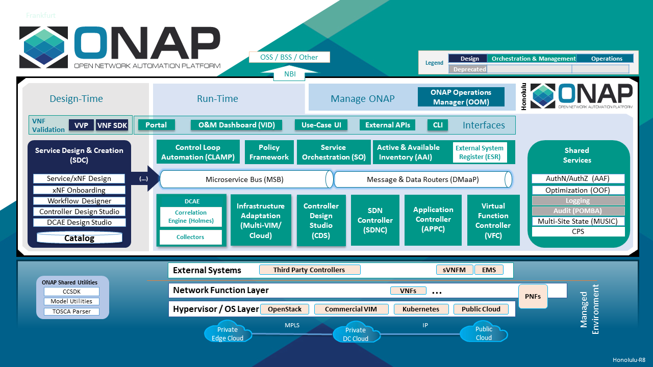
Honolulu Architecture
Notes:
Architecture Message for Honolulu? No changes
Examples of modules relevant to Cloud Native ONAP implementations:

Slide 7
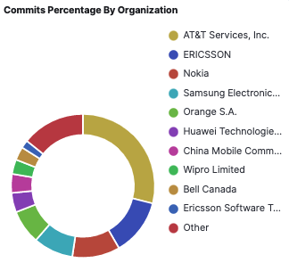
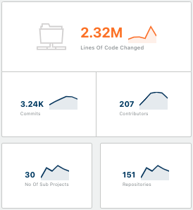
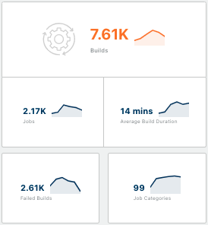
The ONAP Community - Highly Active, Highly Engaged
4 End User Operators in Top 10 contributors!
3,230 Commits
207 Code Authors
151 Repositories
24 Projects
30 Organizations
Stats YTD: Source https://insights.lfx.linuxfoundation.org/projects
Notes:
Missing Tata Consultancy if you consider Data from Oct 24th to June 8th => 35 !
If you consider data from Nov 7th (M1) to June 11th (Sign-Off): 34 org including Tata but no more ENEA AB

Slide 8

ONAP Honolulu, Cloud Native 5G Network Automation
May 2021
Increased Cloud Native Functionality
  Configuration of Helm based CNFs and seamless day 1, 2 operations
  New functionality in Controller Design Studio (CDS) component, Swagger documentation / API for the K8s plugin component in the Multi-Cloud project
Deeper 5G Support & SDO implementation
  3 internal Network Slice Subnet Management Function (NSSMF) components for RAN, core, and transport domains
  Slice optimization with closed loop automation and intelligent slicing testing, enhancements in NST, NSI, and NSSI selection for network and transport slicing
  Enhanced Service Ordering for slicing support; defined by YANG models
  Better compliance to 3GPP TS28.540/541 5G NRM driven xNF models; and more
Further O-RAN Integration
  Some ONAP components are part of the Service Management and Orchestration (SMO) choice in O-RAN use cases with broader support for the non-RT RIC functionality
  O-RAN A1 standard, enhanced A1 interface controller, A1 policy capabilities now usable in ONAP with a Near-Real-Time Radio Intelligent Controller (nRTRIC)
  DCAE project includes VES 7.2.1 integration for both O-RAN and 3GPP and there is a new CPS interface to query RAN configuration data
Expanded Modularity & Functionality
  DCAE simplified microservice deployment via Helm with new KPI microservice
  VES-OpenAPI-Manager allows easier validation of new xNF types
  Multi tenancy support; IPv4 & IPv6, ETSI standards SOL001, SOL004 & SOL007
New Verticals, New technology groundwork, E2E Solution with Enterprise Use Cases
  ONAP increasing value for the enterprise (new ONAP for Enterprise Work Group)
  Intent Based investigation and groundwork & LFN 5G Super Blueprint integration
ONAP, The De Facto Open Network Automation Platform, Goes Cloud-Native in Honolulu
ONAP’s Honolulu release adds even more cloud native and modular capabilities, and robust integration with O-RAN
ONAP is an Instrumental component of Linux Foundation Networking’s 5G Super Blueprint, enabling orchestration, management and automation across the entire 5G end-to-end stack
Over 200 developers from 30 organizations collaborated to produce Honolulu, ONAP’s eighth release
SAN FRANCISCO – May 11, 2021 – LF Networking (LFN), which facilitates collaboration and operational excellence across open source networking projects, today announced the availability of the ONAP Honolulu release. The most integrated ONAP release to date, the arrival of Honolulu coincides with the new 5G Super Blueprint, which works end-to-end across the open source 5G stack enabling easier deployments and automation with Magma 5G Core, ORAN SC & LF Edge Akraino.
LFN ONAP: Adoption & Compliance of Network Automation Platform
Notes:
Honolulu - Key call outs?
Cloud Native, Modular by choice, Deeper 5G, ORAN SC, Enterprise Focus

Slide 9
ONAP Honolulu Use Cases + Requirements
Cloud Native
  Modular Approach to Cloud Native ONAP
5G Service Modeling
  Defining and modeling a 5G Service (in Design Time) and the associated Modeling (Platform information & data model). This is driven by 3GPP TS28.540 and TS28.541, the 5G NRM.
5G SON Use Case
  Optimization and SON functions for 5G RAN which provide for self-optimization, self-healing and self-configuration
End to End Network Slicing
  5G Network Slicing defines slices to be used in 5G RAN systems. Network Slicing is a long-lead multi-release development.
ONAP/3GPP & O-RAN Alignment: Standard Defined VES
  The capability to receive, validate and process standards defined notifications encapsulated in VES events in ONAP. VES 7.2.
ONAP/3GPP & O-RAN Alignment: A1 Adapter and Policy Management Extension
  This requirement enhances the A1 interface capabilities provided in Rel 6 as part of 5G/ORAN & 3GPP Standards Harmonization requirement ( REQ-38) and extended in Rel 7 with the introduction of A1 policy management.
Smart Operator Intent Translation in UUI based on IBN - R8 5G Slicing Support
  A lightweight and high-cohesion Nature Language Processing (NLP) function is proposed to add in the UUI project
Support for Vertical Industry
  Intent framework is a system that helps to implement and operate networks that can improve network availability and agility
  End to End Network Slicing
Intent Based Networking
  Support for Intent Framework and Intent Modeling.
Learn More: https://wiki.onap.org/x/iwKLBQ

Slide 10
ONAP Honolulu Major Enhancements - Details
Increased Cloud Native Functionality
  Important updates to support cloud native network functions (CNF) including configuration of Helm based CNFs and seamless day 1, 2 operations, new functionality implemented in the Controller Design Studio (CDS) component, and Swagger documentation for the API of the K8s plugin component in the Multi-Cloud project.
Deeper 5G Support & SDO implementation
  Significant set of new functionalities around end-to-end 5G network slicing, including three internal Network Slice Subnet Management Function (NSSMF) components for RAN, core, and transport domains; slice optimization with closed loop automation and intelligent slicing testing; enhancements in NST, NSI, and NSSI selection in the OOF project and A&AI includes schema changes to accommodate network and transport slicing; Enhanced Service Ordering for additional service types and the UUI graphical user interface has improved slicing support; new Configuration Persistence Service (CPS) module that allows ONAP projects to store persistent state defined by YANG models, deploy YANG models at runtime, and share access to configuration management data; better compliance to standards such as 3GPP TS28.540/541 5G NRM driven xNF models; and OOF SON functionality supports offline trained ML-models providing additional inputs for Physical Cell Identity (PCI) optimization.
Further O-RAN Integration
  Some ONAP components are part of the Service Management and Orchestration (SMO) choice in O-RAN use cases with broader support for the non-RT RIC functionality and the O-RAN A1 standard, an enhanced A1 interface controller and A1 policy capabilities are now usable in ONAP with a Near-Real-Time Radio Intelligent Controller (nRTRIC), and the DCAE project includes VES 7.2.1 integration that improves integration with both O-RAN and 3GPP. Finally, there is a new CPS interface to query RAN configuration data.

Slide 11
ONAP Honolulu Major Enhancements - Details
Expanded Modularity & Functionality
  Includes a new functionality for DCAE that now simplifies microservice deployment via Helm charts and includes a new KPI microservice; the VES-OpenAPI-Manager allows easier validation of new xNF types against supported VES StndDefined domain improving compliance with 3GPP and O-RAN; A&AI includes support for multi tenancy; OOM now supports IPv4 and IPv6 for all components; SDC includes increased support for ETSI standards such as SOL001, SOL004, and SOL007 and allows users to choose unlicensed or externally licensed xNFs; and the CCVPN use case blueprint now supports 3+ network domains (increased from 2).
New Verticals, New technology groundwork, End to End Solution including Enterprise Use Cases
  While ONAP has primarily been used by Communication Service Providers (CSP), the project also recognizes the value of ONAP in the enterprise and the community has started a new ONAP for Enterprise Work Group. The group welcomes participation from new contributors that want to expand the applicability of ONAP.
  Intent Based investigation and groundwork
  LFN 5G Super Blueprint
  End to End Network Slicing – a key feature to support multiple use cases across markets (Enterprise Private Networks, enhanced mobile broadband, ultra low latency use cases, Fixed wireless access..)

Slide 12





Honolulu: Standards to Code
The Honolulu release supports ETSI SOL001, SOL002, SOL003, SOL004, SOL005, and SOL007 standards.
Additional TM Forum APIs implemented to support 5G network slicing.
The ONAP community supports MEF Legato and Interlude APIs.
Support for 5G network slicing standards and collaboration around VES specifications for fault management and performance management telemetry collection.
Support for the O1 interface for fault, performance, and configuration management and A1 interface to an external Near-Real-Time Radio Intelligent Controller
Notes:
Both ways: 3GPP and TMF pushing Code to Standards

Slide 13
Linux Foundation & NGMN collaboration
NEWS
Continued Harmonization leadership across SDO, Alliances & Open Source Software
Comprehensive areas of collaboration include:
  End to End 5G, 6G
  Automation & Autonomy with AI
  Edge & Cloud Native
  Security
  Service Based Architecture
Multiple LF Umbrellas participating including LF Networking, LF Edge, LF Energy
The Linux Foundation and NGMN Collaborate on End-to-End 5G and Beyond
SAN FRANCISCO, Calif. and FRANKFURT, GERMANY – May 10, 2021 – The Linux Foundation and the Next Generation Mobile Network Alliance (NGMN), today announce the signing of a Memorandum of Understanding (MoU) for formal collaboration regarding end-to-end 5G and beyond.
NGMN’s mission is to provide impactful industry guidance to achieve innovative and affordable mobile telecommunication services for the end user, placing a particular focus on Mastering the Route to Disaggregation, Sustainability and Green Future Networks, as well as on 6G and the continuous support of 5G’s full implementation.
Creating and providing open, scalable building blocks for operators and service providers is critical to the industry adoption of 5G and beyond. Therefore, the collaboration between NGMN and the Linux Foundation will focus on end-to-end 5G architecture and beyond 5G. Specific areas of alignment may include sustainability, network automation and network autonomy based on Artificial Intelligence, security, edge cloud, virtualization, disaggregation, cloud native, and service-based architecture, to name a few.
Under embargo 8 AM PST May 11, 2021

Slide 14

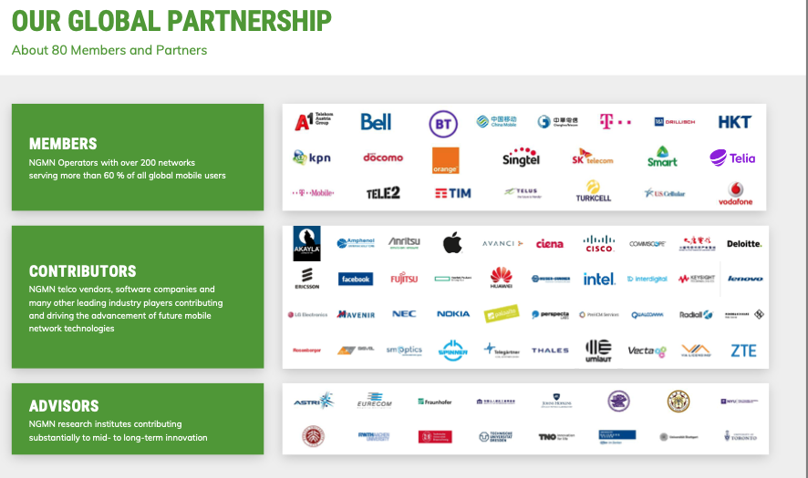

LF & NGMN with a global ecosystem
NEWS
+
Under embargo 8 AM PST May 11, 2021

Slide 15

What’s Next for ONAP?
Anchor Project in LFN 5G Super Blueprints
  Alignment API/Modules/Testing across Edge, RAN, Core
Virtual LFN Developer & Testing Forum (June 7-10)
  https://www.lfnetworking.org/event/lfn-developer-testing-forum-june/
Training
  Certified ONAP Professional Exam Now Available
  Four ONAP Training Courses
ONE Summit, October 11-12, 2020, Los Angeles, USA
  CFP Now Open
ONAP Istanbul (2H 2020)
  Istanbul will continue to innovate for 5G in the areas of network slicing and O-RAN integration, SDOs integration, Control Loop features,Cloud Native capabilities, and augment with Intent Based Networking

Slide 16

5G Super Blueprints
End to End Solutions across Open Source Projects

Slide 17




LFN Hosted E2E 5G Super Blueprint
JOIN THIS COMMUNITY/CROSS COMPANY EFFORT NOW!
Mailing List
Bi-Weekly Meeting Calendar
Slack Channel
Meeting Agenda/Minutes
End to End Super 5G Blueprint
Cloud Native 5G Demo
Private LTE/5G ICN Akraino
ONAP 5G Use Case
SOFTWARE COMMUNITY
THIS NEW BLUEPRINT is the community vehicle to collaborate and create end to end 5G solutions

Slide 18
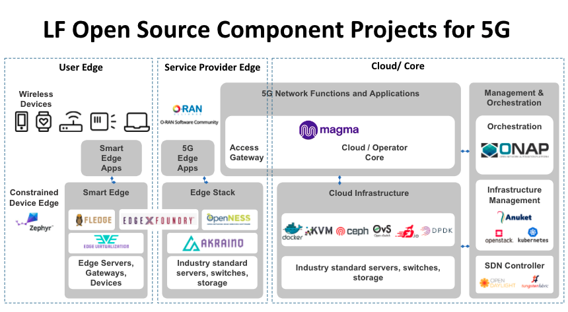
5G Super Blueprint
Learn more: https://www.lfnetworking.org/5g-super-blueprint/
Read the FAQ: https://wiki.lfnetworking.org/display/LN/5G+Super+Blueprint+FAQ
Notes:
Add Magma

Slide 19
5G Super Blueprint
Overall Roadmap, building on production ready projects
Calendar
Q2’21
Calendar
Q3’21
Calendar
Q4’21
5G Core + MEC
5G E2E + Slicing + MEC
5GC + Slicing + O-RAN + MEC
Components
Kubernetes + ONAP + Anuket + Magma + local breakout to MEC
5G Core demo + commercial 5G RAN
5G Core demo + O-RAN-SC + E2E network slicing
Value
Fully disaggregated open source 5G core stack with edge computing
E2E 5G network with fully disaggregated open source 5G core with edge computing
Fully disaggregated open source 5G with edge computing with O-RAN
Use Cases
5G FWA, Private 5G, Multi-Access Edge Computing, IoT
5G FWA, Private 5G, Network Slicing, Multi-Access Edge Computing, IoT, 5G Voice Services
Mobile Networks, 5G FWA, Private 5G, Network Slicing, Multi-Access Edge Computing, IoT, 5G Voice Services

Slide 20







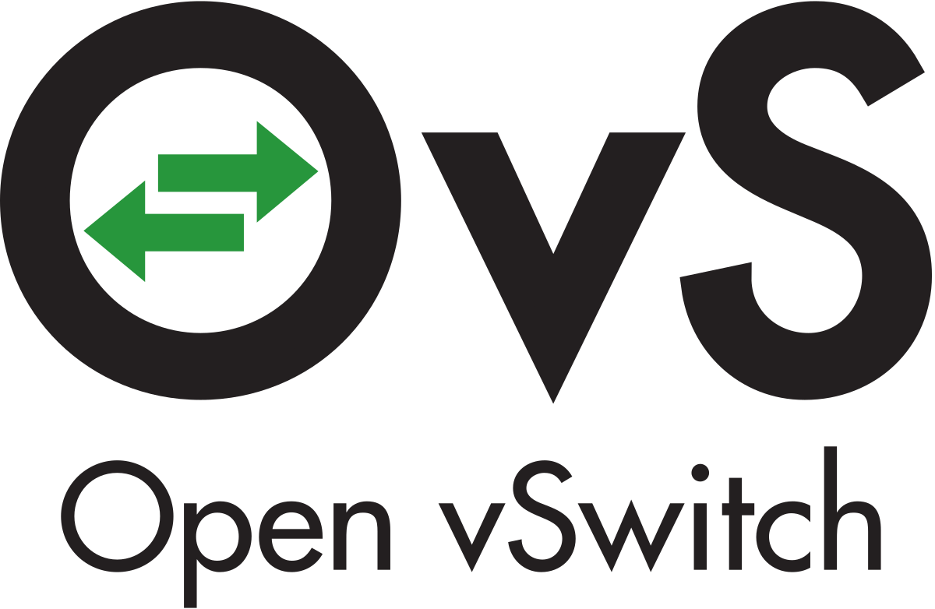




5G Core+MEC Phase
Orchestration, LCM, Closed Loop Automation
Magma Orchestrator
Access Gateway
ICN blueprint applications
N1
AMF
SMF
N2
5G UE Emulator
gNB Emulator
N3
UPF
Data Network
N6
NFVI (Edge/Cloud Layer)

Slide 21
5G E2E+MEC Phase
Orchestration, LCM, Closed Loop Automation, Network Slicing
Magma Orchestrator
Access Gateway
ICN blueprint applications
N1
AMF
SMF
N2
5G UE
Commercial gNB
N3
UPF
Data Network
N6
NFVI (Edge/Cloud Layer)

Slide 22

5G+Slicing+O-RAN-SC+MEC Phase
Orchestration, LCM, Closed Loop Automation, Network Slicing, NONRTRIC
O1, A1
O-RAN Software Community
Magma Orchestrator
nRTRIC
Access Gateway
ICN blueprint applications
O-CU-CP
N1
AMF
SMF
5GUE
5G Radio
O-RU
O-DU
N2
O-CU-UP
N3
Data Network
UPF
N6
NFVI (Edge/Cloud Layer)

Slide 23
Summary, LFN and ONAP
ONAP 8th release and cross project community work is impacting industry direction beyond Telecom
Multiple Verticals banking on Network Automation defacto OSS - ONAP (Cloud Service Providers, Enterprises, Energy and Governments)
ONAP Honolulu with Cloud Native Modularity + 5G NW slicing enhancement + end to end SDO/Alliance integration (O-RAN, ETSI, 3GPP and now NGMN)
Anchor for LFN’s 5G Super Blueprint initiative has major momentum and community support

Slide 24
www.linuxfoundation.org

Slide 25








5G Network Slicing - Quick Overview
RAN, core, transport slicing to create and end-to-end slice
ONAP includes:
  Communication Service Management Function (CSMF)
  Network Slice Management Function (NSMF)
  Adapter to per domain Network Slice Subnet Management Functions (NSSMF)
Work done on GUI, modeling, and slice instance selection
Slice 1: Optimized for low latency
Slice 2: Optimized for high bandwidth
Slice 3: Optimized for low power
Slice 4: Optimized for high reliability and low latency
Slice 5: Optimized for SLA
Notes:
PNF: DU, RU (Zero touch orchestration and lifecycle mgmt. of RAN pieces)

Slide 26

5G Network Slicing - Quick Overview
Template Design using SDC
Ext API
CSMF
(order new slices)
SO
NSMF
(choose slice instances, split request to specific domains)
A&AI
RAN NSSMF
Transport NSSMF
Core NSSMF
OOF & Policy
Network Slicing Implemented Using Above Projects
RAN Subnet
Fronthaul Subnet
Midhaul Subnet
Backhaul Subnet
Core Subnet
Design template ⇒ Create Slice ⇒ Activate Slice ⇒ KPI Monitoring ⇒ Deactivate Slice ⇒ Delete Slice
Notes:
PNF: DU, RU (Zero touch orchestration and lifecycle mgmt. of RAN pieces)

Slide 27
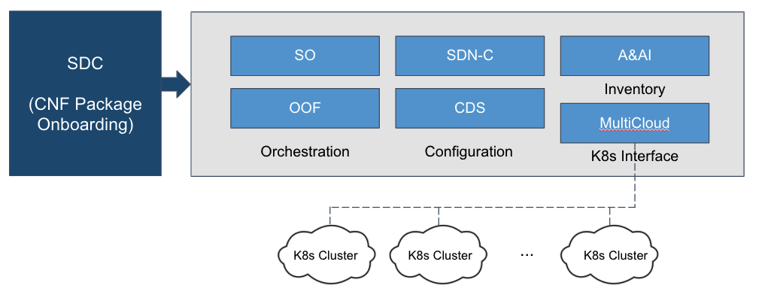
ONAP Modular Example: CNF Orchestration
Source: CNF Task Force, LFN Wiki

Slide 28
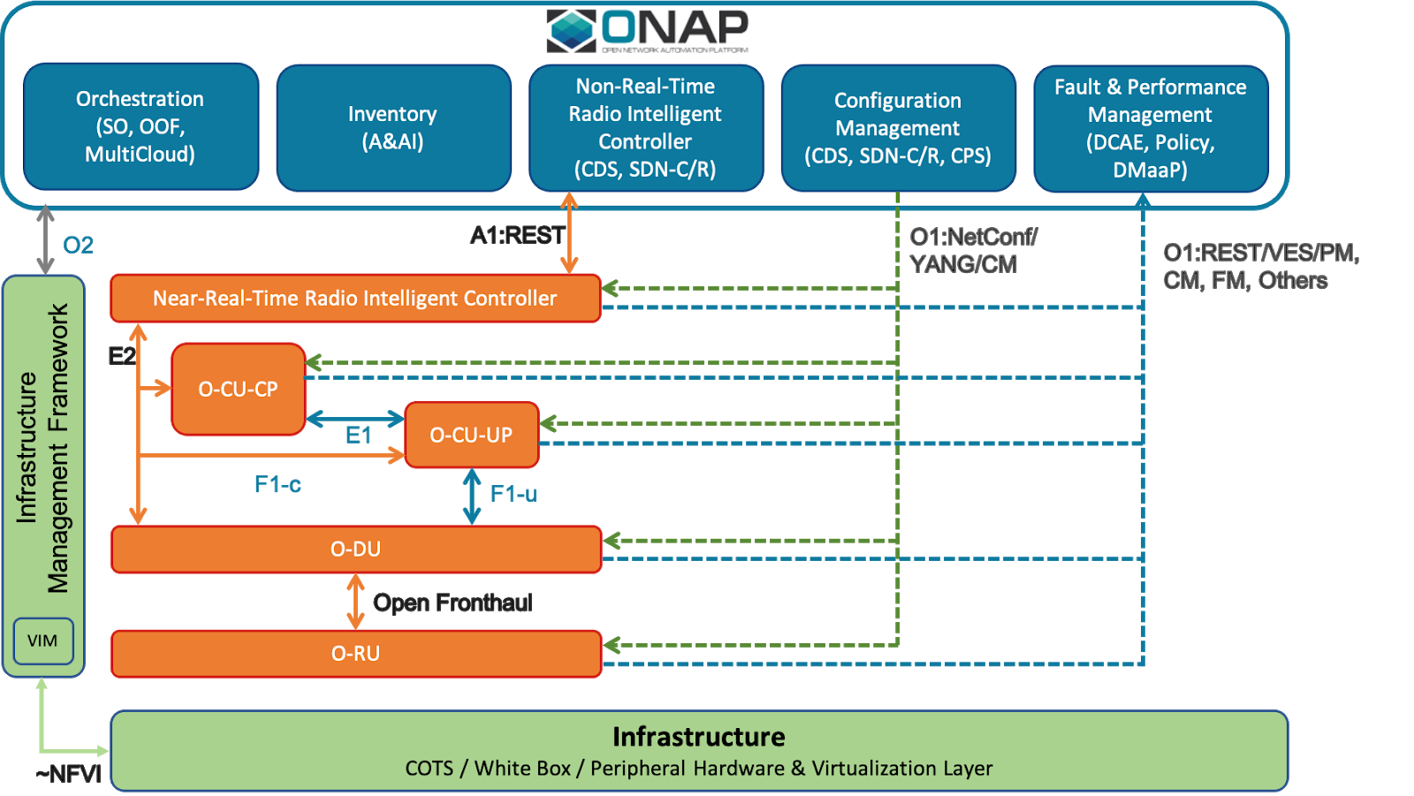
ONAP Modular Example: O-RAN SMO
(Service Management & Orchestration)

Slide 29
End User Adoption
& Commercial Ecosystem
Notes:
Past the tipping point of end user and commercial adoption

Slide 30




ONAP Deployment Updates
Honolulu
Honolulu
Honolulu
5G/LTE Automation in Production
Extended ONAP-Based Control Loop Use Cases to production in support of 5G and LTE Automation and Optimization: (e.g., 5G PCI/RSI automated optimization for 5G deployment at scale, Zero Touch LTE Carrier Deployment, Traffic Offloading to address chronic overload and improve user throughput.)
O-RAN Harmonization
Position ONAP as the O-RAN-SC Service Management and Orchestration Solution (O-RAN O1 and A1 Interfaces, ONAP/3GPP Standards Defined Notifications over VES)
Advancing Platform Maturity & Optimization
ONAP based SON for 5G. Leading Proof of Concepts to address the merger of Policy and CLAMP, and DCAE Simplification (e.g., Cloudify removal).
Accelerating Security as a Service
Embracing CII Badging as Security Best Practice; Eliminating Open-Source vulnerabilities by adoption of MTTU (Mean Time To Upgrade) and automated gating checks.
Deployment
The self-developed orchestrator based on ONAP core components integrates SDN and NFV orchestration to form an end-to-end service orchestration product, which has been piloted in Zhejiang and Shaanxi provinces, and has been tested to reach the level of similar commercial products.
Community Contribution Focus
Leading the successful transformation of EUAG, organizing multiple consumer-oriented industry surveys and in-depth analysis on technical topics such as ONAP deployment, 5G applications, NFV testing, and network intelligence, and guiding technical innovation collaboration both within and outside the community by publishing white papers and introducing CSP requirement priority.
ONAP mandatory for 5G and new xNF
  Required in RFP
Partners to harden the Orange ONAP solution
  Lighty.io integration by Pantheon
Field Trials
  L3-VPN in Q2
Proof of Concepts
  Control loop with ONAP and Orange OSS
  Micro-Wave transport automation
  5G E2E network
Community focus
  Leading Integration project
  Leading OOM project
  CNF Orchestration
OpenLab
  Full ONAP platform open to community (> 150 users)
  Supports 2 ONAP platform for CD

Slide 31




ONAP Deployment Updates
Honolulu
Honolulu
Honolulu
Focus on the research and development of Intent-based Network.
REQ-453 “Smart Operator Intent Translation in UUI based on IBN - R8 5G Slicing Support” has been proposed and developed:
Smart intent translation function is added to translate the operator’s audio/text to the -parameters of slicing by NLP algorithm.
A NLP model management module is added to manage the NLP models.
Organized a special session “Development and Evolution of Intent-based Network in ONAP” in DDF 2021 to discuss the development and evolution of IBN in further releases of ONAP.
Verizon is deploying E2E Service Orchestration Platform based on ONAP through supplier partnership.
Will deploy SDC, SO, RO, AAI, SA and DCAE components in the network as part of initial rollout.
Accelerating closed loop automation use cases to support 5G Core, vRAN operations
Will focus on extending the platform to drive early 5G slice use cases, edge cloud, design and orchestration
Frankfurt release in production since Q42020, with some components already upgraded to Guilin
ONAP used as the foundation of internal multi-tenant, cross-domain, self-service automation platform (NSO)
Continued involvement and leadership on several fronts:
Multi-tenancy support in AAI (done), CDS, and Policy (upcoming)
Configuration Persistence Service (CPS)
Service Orchestrator (SO), Controller Design Studio (CDS), Policy
Expanding use-cases across all domains: wireless, wireline, business markets, TV, data centers, etc.

Slide 32


ONAP Deployment Updates
Honolulu
Honolulu
Honolulu
Lab: ONAP Guilin Release installed
Functional evaluation: DT is currently investigating on 5G NW Slicing, 5G Core integration and SMO development for O-RAN.
Trial / MVP: Planned MVP in production for Q3 2021 to verify O-RAN technology and independent Management framework based on ONAP.
Upstream contribution/support: OOM, Python SDK, Documentation, CDS and Portal framework.
ONAP as a Telco/MNO orchestrator for enabling network slice extension into multi-cloud, multi-MEC environment for enterprise services.
LF Edge and LF Networking Collaboration: ONAP and Edge Use case for Public Cloud Edge Interface Blueprint (PCEI)
ONAP can be used to represent the MNO Orchestration Functions for Mobile Edge.
Deploying with Partners
Lab: Verified Guilin with some customizations;
- Full cloud-native
- SO codes modification (BPMN, NSSMF Adaptor)
- Use Free5GC and RAN simulator
Demo case: Management of 5G E2E NW slicing. Instantiate three different characteristic slices and measure delay and throughput over 4K video traffic
Expectation for Honolulu or later:
- Execution of full closed-loop scenario
- ML/AI use cases e.g., integration with O-RAN components

Slide 33


ONAP Deployment Updates
Based on ONAP component, such as VF-C/SDC-C/SO, China Unicom form a cross-network carrying solution on multi-service. In the solution, IPRAN and carrier A Network share one MANO which downwardly connects to different controllers and upwardly connects to service platform.
Built platform and interconnected the public network and the edge network by onap, realized the cloud-edge cooperation of the services.
Based on ONAP component, built 3-tiers Communication Cloud structure.
Telecom Strategy now an integral part of Public Cloud, 2 Acquisitions (Affirmed and Metaswitch) leading to an overall strategy to enable 5G, IOT and Edge
ONAP running on Azure - announced at MWC 2019. Strong vendor ecosystem support
Affirmed network one of the first to receive LFN OVP batch for CNTT/OPNFV compliance.

Slide 34

ONAP Deployment Updates
Honolulu
Telecom
Argentina
POC Status
- Overall maturity evaluation of ONAP framework carried out at TIM labs
- Major interest and focus on ONAP 5G E2E services orchestration with testing activities and contributions to bugs fixing
- Future tests are evaluating assurance aspects from data collection to consequent actions
TIM supports the alignment with standards specifications (e.g. ETSI MANO, 3GPP, TM Forum APIs) to ensure an interoperable ecosystem and to enable more adoption scenarios
ONAP lab
Testing in progress, focus on services and e2e service orchestration as part of digital transformation.
Use Cases
VPN, VNF/CNF onboarding
CNF in bare metal
Security
SD-WAN
Focus
OVP, OSS integration
Intent Based Workflows, API and Data Driven, Network and Apps controllers, Enable Faster TTM to New Services, facilitates the operation with a close loop vision, enable Data Analytics for operational and BI feedback
Avoiding vendor lock

Slide 35



ONAP Commercial Ecosystem
Honolulu
Honolulu
SES expands uses of Amdocs’ ONAP based automation platform for end-to-end service orchestration (https://bit.ly/3fthPpx), reflecting a growing need for end-to-end service orchestration for a new generation network services that span many domains, including physical, virtual and cloud network functions, as well as satellite access, radio access, fiber transport and core infrastructure
End-to-end 5G Network Slicing using ONAP use-case contribution by Amdocs, China Mobile, AT&T, Wipro (https://bit.ly/3m4mr6F)
Amdocs 5G Slice Manager part of Intel CERA architecture for optimal network function placement (https://intel.ly/3fnNecS), leveraging ONAP components and service modeling practices
Amdocs provides ONAP-based SDC and Systems Integration services for ONAP-based network management platform to north America Tier-1 service provider
Provider of open source product called the Aarna Networks Multi Cluster Orchestration Platform (AMCOP) for orchestration, lifecycle management, and real-time policy driven closed loop automation of cloud native 5G networks and edge computing applications
AMCOP utilizes and contributes to select ONAP components
Value-add components on top of AMCOP such as Network Slicing Manager, NONRTRIC, NWDAF
Targeting Private 5G, O-RAN SMO, E2E 5G, and PNF management use cases
Three community PoCs: LFN 5G Super Blueprint, Akraino Private LTE/5G ICN blueprint, and Akraino PCEI blueprint
Seven ongoing AMCOP PoCs
Accenture has developed a hybrid cloud orchestration capability for ONAP, delivering a multi-cloud plug-in for orchestrating VNFs on the AWS public cloud. Our plug-in supports existing infrastructure workload APIs from SO, enabling the seamless orchestration of workloads across hybrid cloud including OpenStack and AWS
Accenture has implemented a new proof of concept (PoC) for 5G and Edge Compute Hybrid Orchestration. Spanning virtualized 5G RAN running in OpenStack, edge applications running in AWS Outpost as the edge compute infrastructure, and 5G core components in the AWS public cloud, we continue to advance our PoC through the ongoing simulation and execution of new workloads.

Slide 36



ONAP Commercial Ecosystem
Honolulu
Honolulu
Honolulu
Contributed & released ONAP MDONS blueprint to automate service operations in multi-vendor, multi domain optical networks
Proposed contributions supporting CNF migration & dynamic configuration in multi-cloud ONAP environments, targeted for Istanbul rel.
Enabled ONAP alignment with standards – OpenROADM, ONF T-API, MEF, TMForum APIs and data models
Contributed towards 5G Transport Slicing implementation in ONAP as part of the 5G Network Slicing blueprint
Fujitsu’s Virtuora SDN controller (ODL-based) integrated with ONAP for E2E automation
Fujitsu’s ONAP MicroApps – Micro-services for targeted applications (Ex: Bandwidth-on-demand, slice qualification etc) enable closed-loop functionality within an ONAP environment
Fujitsu provides commercial support & services offerings for open-source projects
ONAP 5G slicing usecase is developed through standards-based interfaces and architectural framework (e.g., ETSI ZSM, IETF) in co-operation with CMCC.
ONAP Platform enhancements for production grade with plug and play capabilities through reduced footprint are worked and contributed back to the community.
ONAP CCVPN use case is further enhanced to demonstrate interoperability with SDN:Huawei
    NCE-FAN for Access
    NCE-T for Optical
    Agile Controller for SD-WAN
ONAP on IBM Cloud Private IBM Cloud Private is fully Kubernetes-based deployment for on-premise, bundled with capabilities from open source & IBM for core operational services¹
IBM Services for ONAP
Focus on SDN and NFV deployments & integrations worldwide, including work on ONAP for Operators. Services are augmented with IBM cloud and cognitive software and services

Slide 37



ONAP Commercial Ecosystem
Honolulu
Honolulu
Honolulu
Intel ONAP Lab Equipment: Intel & partners hosts community lab for deployment, VNF onboarding, integration testing.
Driving intelligent scheduling of workloads on edges based on platform capabilities (HPA)
Driving security of ONAP secrets, private keys w/ hardware root of trust. e.g. Trusted Platform Modules (TPM).
Update “K8s-based Cloud region support” to deploy CNFs & CNAs on edge clouds, adding single-click deploy of geo-distributed CNFs & CNAs across regions.
Driving AI based Distributed network analytics platform to allow dynamic deployments of AI analytics apps.
Ericsson continues to align its functional architecture and key interfaces with the ONAP architecture, via updates to ONAP interfaces, capabilities and robustness as well as integrating several components from ONAP into our OSS portfolio.
Ericsson provides ONAP services including integrations, enhancements, deployments on various virtualization platforms across multi-vendor environments.
As part of 5G network transformation, Ericsson is working with several global operators to increase their automation capabilities by leveraging ONAP paradigms.
Ericsson is leading development of the newest ONAP project, the Configuration Persistence Service (CPS), as well as leading the DMaaP project and taking the vice-chair role in the architecture subcommittee
Ericsson is driving the industry alignment between standards and opensource, such as the convergence of, and alignment between, ONAP, O-RAN, 3GPP, ETSI MANO, TMF
5G support for ONAP Multi-domain product support in core networks, 5G radio, edge cloud and fixed BB services building PNF/VNF/CNF readiness with support of selected ONAP interfaces and API’s
Nokia services for ONAP Services for ONAP integration into multi-vendor customer environments and use case implementation
Customer use-cases Use-case customer pilot implementations and use-case development (e.g. fixed BB, edge cloud, cloud-native core)

Slide 38



Honolulu
ONAP Adoption: Customized ONAP solutions & software engineering for service providers
Integrations: expertise and services in application development & support
ONAP Community Effort: Contributions towards ONAP components, CPS & CCSDK, 5G Adoption
Linux Foundation Networking: largest year-to-date contributor to LFN projects
ONAP Alignment
Ribbon is in full support and architecturally aligned with ONAP
ONAP Adoption
Ribbon is closely following the evolution of ONAP and particularly how it provides support for MANO compliant interfaces, so that we can provide our VNFs into the widest possible range of orchestration environments
RIFT Inc.’s Orchestration & Automation platform, RIFT.ware, delivers an open-sourced, standards-based product for multi-domain service orchestration, real-time service inventory, service assurance integration for real-time scaling and closed loop control
RIFT.ware automates the onboarding, VNF/NS validation and VNF/NS launch across any cloud. We automate LCM functions with closed loop control.
RIFT participates in all NFV MANO related open source and standards activities. RIFT is dedicated to contributing know-how and code via ETSI, ONAP, and other open-source communities

Slide 39



ONAP Commercial Ecosystem
Honolulu
Honolulu
Honolulu
In the Honolulu Release Cycle:
Samsung in the top 4 contributors to ONAP
10 authors active in 10 ONAP projects in 33 repos
317 Commits and 34K+ lines changed
Led scans for the community
Tech Mahindra is a founder and platinum member of ONAP and has consistently been contributing to the ONAP code base since it’s inception in 2017. Our focus is enhancing the orchestration and automation features within ONAP, providing design and integration services to operators for managing 4G and 5G networks comprising of both virtualized and cloud native workloads.
Our recent ONAP Platform contributions
Design and development of Core Network Slice Subnet Management Function (NSSMF) component. Contribution received an award by ONAP Community
Instantiation of cloud native 5G core elements such as AMF, SMF and UPF as part of the slice order workflow
Invoking Day 0, Day 1 and Day 2 configurations on the CNFs (Ex. S-NSSAI configurations in AMF / SMF / UPF) as part of Slice LCM Operations
Our plan for future contributions is to enable ONAP to be an O-RAN SMO along with enhancing it’s capabilities for tighter integration and support for Cloud Native Workload Orchestration and configurations.
Tech Mahindra along with support from our valued operator eco system aims to address all the feature sets and operational readiness aspects to make ONAP an opensource choice for the operators to design, deploy 5G services with E2E slicing support covering core, RAN and transport domains.
Wind River is leading the MultiCloud / VIM project and its evolution to enable ONAP to run and orchestrate service across multiple hybrid clouds. This include driving the contribution for OpenStack, & Kubernetes plugins to support distributed edge cloud solution.
Wind River provides and maintain the software part of the cloud infrastructure (ak.a NFVi+VIM) for the community lab for ONAP deployment, VNF/CNF onboarding and integration & testing. This based on Wind River Studio Cloud Platform, which is developed based on the StarlingX project.
Wind River Studio’s Operator includes three main parts: Studio Cloud Platform that is open source upstream first Cloud Platform (NFVI+VIM, and Studio Analytics which both works seamlessly with ONAP. It also includes Studio Conductor which is commercial grade ONAP compliant orchestration solution (NFVO + VNFM).

Slide 40


ONAP Commercial Ecosystem
Honolulu
Honolulu
Wipro Services using ONAP platform
  ONAP based Service Management and Orchestration solution of 5G Network (O-RAN, Core and Transport Networks)
  ONAP Productization services
  Development of DO, Inventory, Policy, Network Analytics, SDC Products for 5G networks based on ONAP open source
  ONAP System Integration Services to deploy ONAP based SMO for O-RAN
  ONAP-based Non-RT RIC, slice and slice sub-net orchestration functionality
  Integration with 3rd party slice orchestration and SON functions
Carrier-grade ONAP R&D services
  Customer-specific implementation and verification services to make ONAP open source ready for commercial deployment
ZTE CloudStudio provides a new network operating system and new service development platform for operators. Leveraging the advanced micro-service architecture and the new template-based service design, it realizes rapid service onboarding. Providing the end-to-end automatic orchestration, deployment and activation of services, it realizes rapid service fulfillment. Relying on intelligent closed-loop control based on big data and AI, it realizes automatic operation and maintenance of networks and services.
ZTE CloudStudio product aligned with ONAP architecture adopts VF-C, MSB, HOLMES projects.
ZTE is contributing etsicatalog project to drive ONAP and ETSI alignment.

Slide 41



ONAP Commercial Ecosystem
Honolulu
Honolulu
Orion 5G Security Suite
      Provides comprehensive control plane and data-plane security to 5G networks through high performance, cloud native network functions (NFs). These network functions cover NAT, firewall, traffic steering, roaming and signaling security for GTP and DNS functions and scalable mitigation against multi-layered DDoS attacks.
  Enables modularized services as a service layer with a set of connected technologies that employ automated intelligence, machine learning and centralized visibility and control.
Ecosystem Integration
  Actively participates in community and eco-system.
  Participated in Linux Foundation’s end-to-end 5G cloud-native network proof of concept (POC) in Nov 2019.
  Proven integration with major MANO systems through PoCs and interoperability testing with ETSI, ONAP.
Operator Engagements
A10’s NF’s are deployed at multiple tier 1 mobile operator for 5G and 5G-Ready launches, including SK Telecom.
In production VM’s at various Telco’s and is in early Interoperable with vEPC in MEC topology.
Cloud Native functions are in numerous on-going PoCs with tier 1 operators as they plan and deploy cloud-native and telco-cloud technology.
Robin MDCAP is a multi-cloud Orchestration & Automation platform. MDCAP provides metal to service orchestration on an open-sourced, standards-based platform for multi-domain service orchestration and closed loop automation at scale.
Robin CNP is a standard based Kubernetes distribution capable of supporting the entre network service both VNFs and CNFs on prem or in any cloud.
Robin.io participates in NFV MANO related open source and standards activities and is dedicated to contributing know-how and code via ETSI, ONAP, and other open-source communities.
Digital Commerce Platform (DCP)
MATRIXX DCP is built using CNFs (Cloud Native Network Functions) which allows service providers to harness cost-efficient scaling and resilience from our 5G Convergent Charging System (CCS). ONAP’s support for Kubernetes, and increasingly for CNFs with the Honolulu release, is helping to drive the industry adoption of Cloud Native.
MATRIXX CHF/CCS
MATRIXX has deployed our cloud native 5G CCS in service provider labs where ONAP components supporting Kubernetes can increasingly be utilized for deployment and life-cycle management of CNFs.

Slide 42



ONAP Commercial Ecosystem
SES teams with Amdocs to operationalise the first ONAP orchestration platform for scalable, automated delivery of satellite-enabled network services on Microsoft Azure
SES is a founding member of Linux Foundation Networking (LFN), which hosts the ONAP project, an initiative with widespread adoption as the preferred platform for open network automation and orchestration. By standardising on the same orchestration platform as leading telcos and mobile network operators, SES will make it easier and faster for its customers to deliver services over its high-performance satellite-based network.
Our vision is to make satellite-based networks a seamless and wholly integrated part of a global, cloud-scale network ecosystem
NFV MANO: We work with NFV providers and help them make their VNFs compatible with ONAP. We also investigate how to manage CNFs and how ONAP can support them in the future.
Ecosystem: Thanks to our experience with Tungsten Fabric we can identify potential gaps in the ONAP support for TF and find the way to fill them.
The University of New Hampshire InterOperability Laboratory hosts the LFN Lab as a Service (LaaS) community resources, providing developers with access to bare-metal resource where ONAP and other LFN projects can be deployed and tested.
The UNH-IOL is also working with LFN members to assist with testing their NFVI and VNF products for the OVP Badging Programs.
In May and September, the UNH-IOL participate in a number of demos, showing real usage of ONAP in a Cloud Native 5G environment and zero-touch broadband deployment.

Slide 43

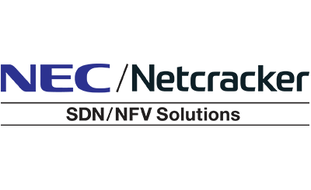

ONAP Commercial Ecosystem
Honolulu
PoC for End-to-end Service Orchestration
      Customized modeling design and ONAP alignment with ETSI MANO for cross-domain and automated provisioning and deployment of resources and services.
Prototype Development
  Integrated ONAP with CertusNet's SDN controller for a carrier's centralized, unified control prototype system across multi-manufacture.
CommScope, which recently acquired ARRIS and its Software Defined Services group, leverages best of breed and leading edge technologies and platforms, including ONAP, for Orchestration and Automation.
CommScope is committed to collaboration using open source and open standards to provide a high performing and stable platform for service providers.
CommScope provides multi-domain orchestration for the following key service provider domains: B2B services, Wireless (including 5G slice orchestration), Broadband Access Networks (including hybrid access) and Media Delivery include contribution and distribution networks.
Interoperability : Interoperability of Netcracker solutions with ONAP through standard interfaces and modeling artifacts defined by SDOs such as ETSI, TMF, 3GPP and MEF
O-RAN Reference Implementation : Capability analysis of the O-RAN-Software Community –ONAP reference implementation of SMO, Non-RT RIC and SDN-R.
Network Slicing : Feature parity with ONAP slicing implementation covering CSMF, NSMF, NSSMF. Harmonization of slice model and orchestration capability covering ONAP and SDO slice related artifacts
CNF Orchestration : Orchestration of containerized workloads and ONAP community recommended extensions to ETSI MANO IFA and SOL specifications
SDN-C: Deployed ONAP-SDNC with YANG model-driven management for connectivity services and 5G network slices among ​multiple NFVI-PoPs, where ONAP-SDNC with external SDN controllers manages L3/ L2VPN service/ network models and traffic engineering models.
Under embargo June 18 2020 9 AM PST,

Slide 44



ONAP Commercial Ecosystem
Honolulu
HONOLULU
Kubermatic Kubernetes Platform
Integrating and testing ONAP for Kubernetes run by KubeOne and Kubermatic.
R&D services
Kubermatic is the top corporate
contributor to the Kubernetes project. Supporting the deployment of VNFs and CNFs.
Linux Foundation Networking
Projects
Kubermatic helped guide OVP Phase 2 which is focused on adding Cloud Native Function support to OVP, now Anuket. At KubeCon 2019 in November, Kubermatic was central to the Cloud Native 5G demo & keynote.
5GIC is developing ONAP Plugins: rich and advance plugin for ETSI OSM and Ryu SDN Controller.
GSMA template descriptors: adaptation of GSMA template development.
AI-enabled Research: zero touch orchestrating for 3GPP network, non-3GPP network and NTN communication.
CAPIF functionality: Implementing east west communication for ONAP.
Business Platform Research: Secure service chaining support for different businesses and applications through intelligent network slicing and open APIs
ONAP adoption
Utilize ONAP as the automation and orchestration tool for ULAK 5G Core and New Radio products.
5G Core VNF onboarding & monitoring
Core Network VNFs successfully deployed and scaled on Guilin(2020H2)
VNF performance, configuration and alarm management operations has been tested on El Alto and Guilin(2020)
CNF Onboarding
CNF onboarding by using K8s as VIM has been performed by using Onapsdk on Guilin(2020Q4)
Testing & PoC
5G network slicing
Closed-loop and VNF day (0,1,2) operations

Slide 45
























LF Networking, 2021
Vision: LFN software & projects provide platforms and building blocks for Network Infrastructure & Services across Service Providers, Cloud Providers, Enterprises, Vendors, System Integrators that enable rapid interoperability, deployment & adoption
Projects
Platinum
Members

Slide 46



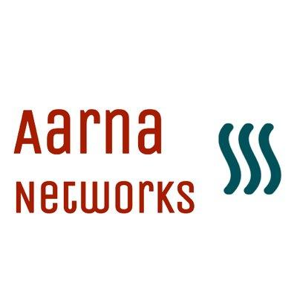






























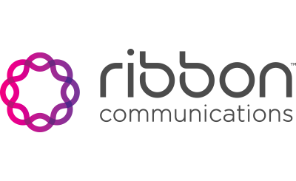






















LF Networking: Gold & Silver Members
Gold
Silver

Slide 47
www.onap.org

Slide 48
www.onap.org

