Slide 1
ONAP & Magma Architecture
April 29th,2021
Byung-Woo Jun (Ericsson)
Others to join

Slide 2
Initial Analysis about ONAP and Magma Integration
Study Topic: Magma architecture and interaction with ONAP
Deployment Architecture (how Magna is deployed along with ONAP)
Function Architecture
  Magma component functions
  Magma functional extension
Model and package distribution/storage
Interface Architecture (how Magma would interface with ONAP)
Security Architecture
Logging Architecture
Analytic data handling
Others…
2

Slide 3



Magma Architecture
Magma Controller (orc8R) NBI swagger: https://app.swaggerhub.com/apis/karthiksubraveti/magma/1.0.0#/Gateways/post_networks__network_id__gateways
ONAP sees Magma as EMS/Controller that manages wireless network (5G, 4G)
When Magma Controller is used, SDNC can delegate its operations to the Magma Controller (it is a near-term choice)
When Access Gateway exposes its NBI to ONAP, ONAP SDNC treats Access Gateway as a set of PNFs/VNFs/CNFs
Magma CNF model/package e2e distribution is TBD. Currently Magma self-contains all the necessary models/packages (short-term solution)
Supported API Operation
Alerts
Call Tracing
Carrier Wifi gateways
Carrier Wifi Networks
EnodeBs
Federated LTE Networks
Federation Gateways
Federation Networks
Gateways
LTE Gateways
LTE Networks
Metrics
Policies
Rating Groups
SMS
Supported API Operation
Tenants
Upgrades
Wifi Gateways
Wifi Meshes
Wifi Networks
baremetal
e2e
Events
Defaults
APNs
Subscribers
Network Probes
Commands
Logs
Models
SDNC
Magma has three major components
Orchestrator
  Provides configurations and monitoring of wireless network
  Its web UI provides analytics and traffic flows
Access Gateway
  Provides network services and policy enforcement
  Implements CNFs/VNFs/PNFs
Federation Gateway
  Integrates MNO core network by 3GPP interfaces
  Acts as a proxy between AGW and operator’s network (authentication, data plans, policy enforcement, charging)
orc8R
NBI
Magma Controller (orc8R)
Internal REST APIs
Access
Gateway
Federated
Gateway
5G UE
Emulator
N1
AMF
SMF
AGW NBI (REST)
gNB
Emulator
N2
UPF
N3
3

Slide 4
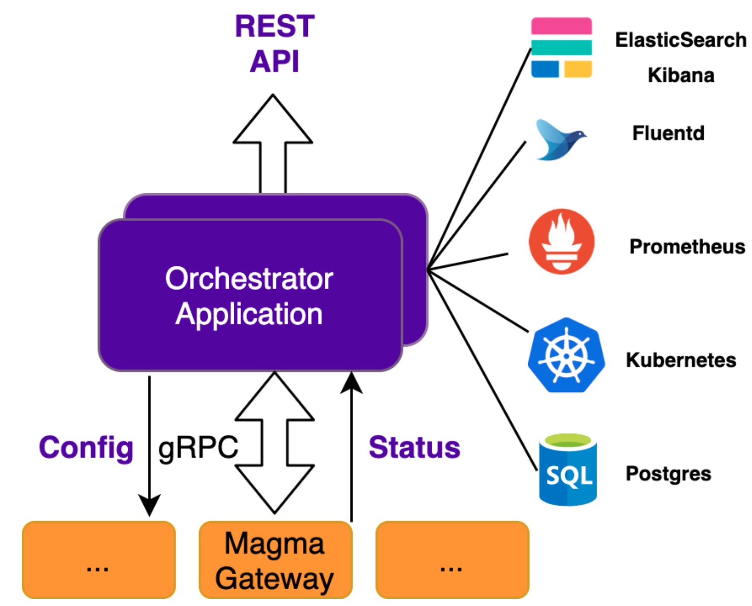
Magma Orchestrator (orc8R) Architecture and Interfaces
Northbound REST API: exposes configuration and metrics for network devices
  See the Orchestrator swagger: https://app.swaggerhub.com/apis/karthiksubraveti/magma/1.0.0#/Gateways/post_networks__network_id__gateways
Southbound Interface: applies device configuration and reports device status
  Currently, it is Magma internal interfaces
Orchestrator supports the following functionalities:
  Network entity configuration (networks, gateway, subscribers, policies, etc.)
  Metrics querying via Prometheus and Grafana
  Event and log aggregation via Fluentd and Elasticsearch Kibana
  Config streaming for gateways, subscribers, policies, etc.
  Device state reporting (metrics and status)
  Request relaying between access gateways and federated gateways
  Orchestrator deployment is manual. ONAP could orchestrate it in an automated fashion, as an external component
Magma Gateway deployment and scaling are manual-based
  There could be an opportunity for ONAP to automate Magma Gateway deployment, scaling and update
  Magma Gateway is registered to Oorc8R to be used
ONAP
NBI
SBI
4

Slide 5
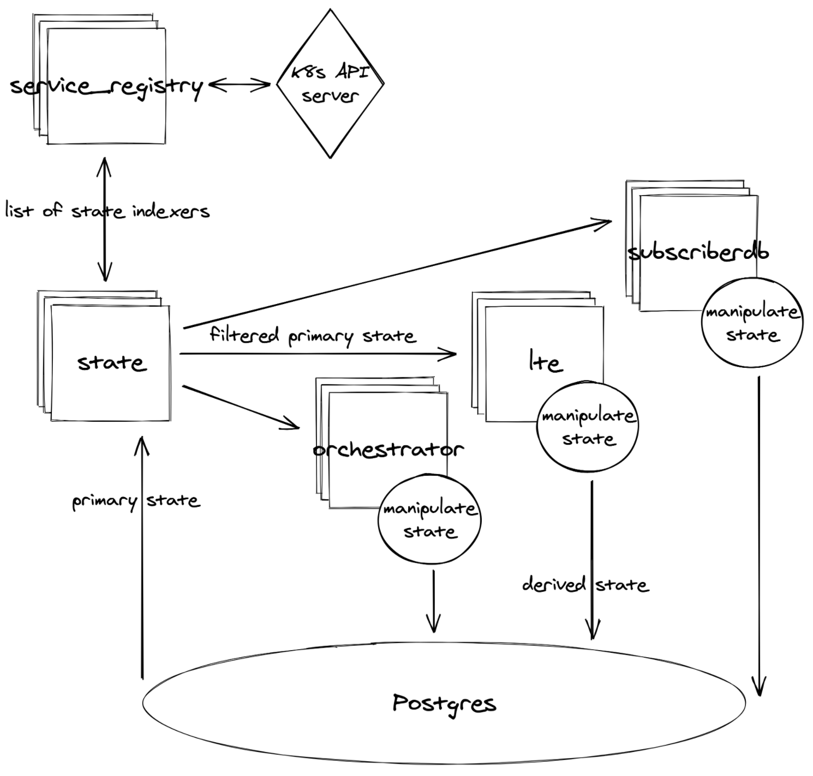
Magma Orchestrator Modularity and Extensibility
State Indexer example
Supports domain-specific application (purpose) under an extensible service mesh architecture
Provides a set of extensions for injecting functionality into the core services
Extensions (i.e., hooks) implement a per-extension gRPC servicer
Core Orchestrator services will handle making calls over-the-network to the servicer
Each service in the deployment can implement any of the extensions
Core services will automatically handle calling the extension implementation
Discovery is handled by assigning Kubernetes labels and annotations
There are two categories of extensions
  Producer extensions: export data to core services
  Consumer extensions: receive data from core services
Current extensions:
  Analytics collector, Mconfig builder, Metrics exporter, Obsidian handler, State indexer, Stream Provider, Swagger specifier
For the extensibility, see https://docs.magmacore.org/docs/orc8r/architecture_modularity#extending-orchestrator
Implementation extension
Define a service executable that implements the gRPC server definition
Include the relevant lables and annotation for the new service in Helm charts
5

Slide 6
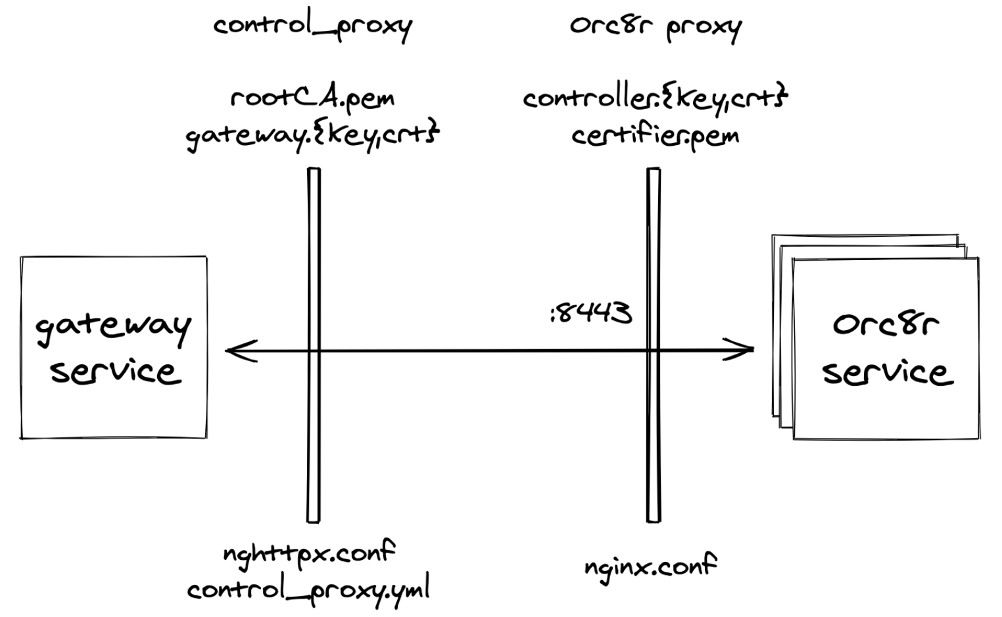
Magma Security
Orc8r security is enforced in a two-tiered approach
  mutual TLS termination at the Orc8r proxy
  application-level access enforcement
Every request to Orc8r is is mutually-authenticated via client-validated TLS (mTLS)
Validation occurs at the Orc8r proxy (it can be a sidecar)
Individual services can make application-level decisions on access enforcement (PEP) - authorization
Orc8r provides a mechanism for registered gateways to securely bootstrap their authentication process
NBI (NMS and direct usage of the REST API) requests must include a provisioned client certificate.
Certificate can be generated using the “accessc” CLI from any Orc8r pod
Once a request passes TLS termination at the Orc8r proxy, Orc8r supports finer-grained application-level access control
An ACL defines a mapping between identities
  each mapping includes read/write permissions
Three types of identities
  Gateway identities represent a gateway
  Operator identities represent a network operator
  Network identities represent access to a particular network
At the Orc8r proxy, client certificates are translated to trusted request metadata.
Middleware can then convert the metadata, via calls to the certifier service, to an identity.
At the southbound interface, only gateway identities are allowed to make requests. Unregistered gateways are blocked.
At the the northbound interface, only operator identities are allowed to make requests. Operators must have ACLs collectively covering the requested REST resources.
Gateways generate, or can be provisioned with, two pieces of identifying information
  hardware ID is the gateway's unique identifier
  challenge key is a long-term keypair used for the bootstrap process
Operators must include two additional pieces of information to allow the gateway to connect to Orc8r
  control_proxy.yml is a config file providing the location of the Orc8r
  rootCA.pem is a CA certificate providing the root of trust for validating Orc8r during TLS handshakes
For more security detail, see https://docs.magmacore.org/docs/orc8r/architecture , security#security-overview,
https://docs.magmacore.org/docs/orc8r/dev_security
6

Slide 7
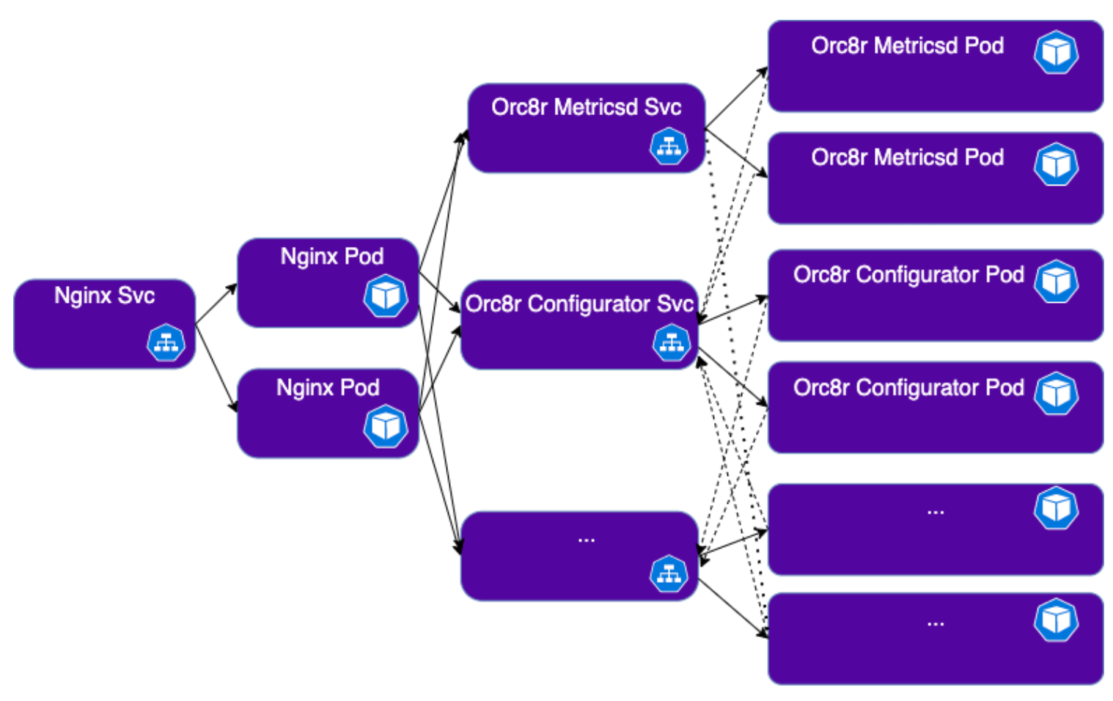
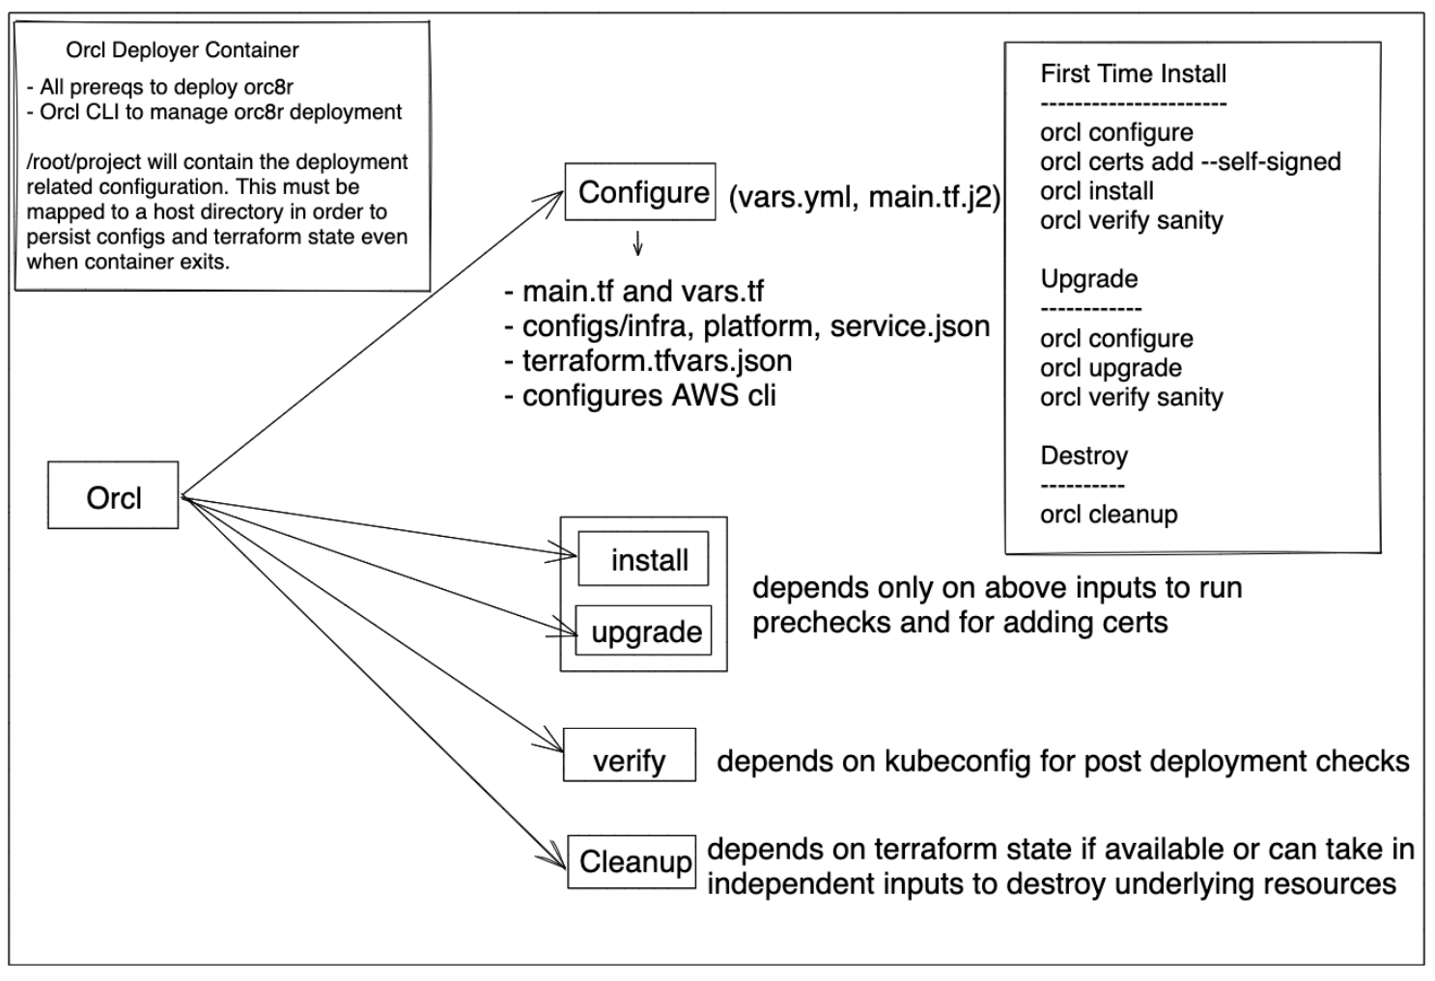
Magma Component and Package Deployment
Orchestrator is deployed as a service mesh.
Each orchestrator service is deployed with its own Kubernetes service and pod.
Magma AGW can be deployed and configured for HA support
Magma package deployment in AGW is manual-based
  Download packages from operators
  Upload packages to AGW
  Install packages in AGW
      E.g., sudo apt –f install <magma package>
  Restart the magma service (non-production quality)
      sudo service magma@* stop
      sudo service magma@magmad restart
  ONAP and Magma team can enhance the package distribution and installation
Orcl is an Orchestrator CLI. It is used for managing orc8r deployment
  Configure, Certs, Install, Upgrade, Verify, Cleanup, Debug
  Orcl is packaged within orc8r_deployer, which is a docker image which contains all the necessary prerequisites to deploy orc8r.
7

Slide 8
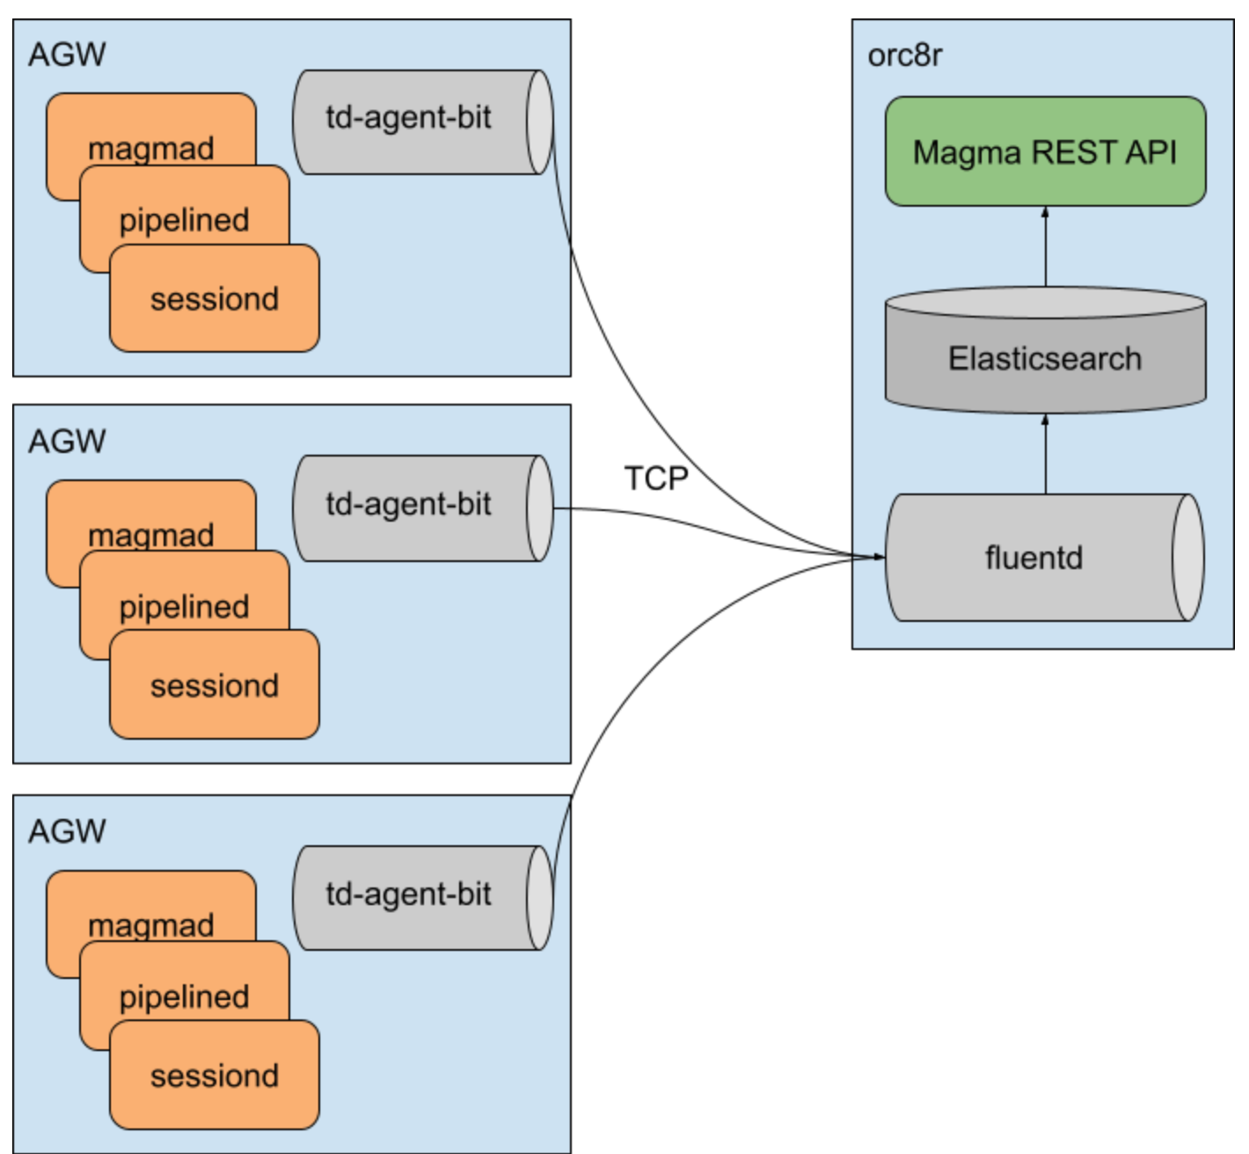
Magma Logging
Eventd is a structured logging service that unifies event-logs from Magma services.
Swagger 2.0 specifications are used to define events that services can emit, to keep track of a state machine or process.
Events are placed into streams, which are like logical buckets for events. They can be organized using a tag and must conform to a structure defined by its event_type.
AGWs generate logging events
fluentd collects logging events
Elsticsearch stores logging events
Orc8r provides log reports thru Magma REST API
  ONAP could leverage the REST API to view/filter log / security events
8

Slide 9
Action Points
(Amar) Confirm SDNC/Magma CNF interface - done
(Amar) Confirm Magma GW is a set of PNF/VNF/CNF - done
(Amar/Catharine) If we use 5G PNF Plug & Play, can FB confirm the parameters we will need to register it?
(Fred) If Magma GW = VNFs, how is it packaged? CSAR or something else? Based on Helm?
(Byung) Initial analysis about Magma integration - done
9

