Slide 1



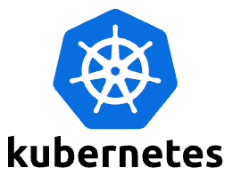
ONAP CNF Orchestration Journey
Hybrid services CNF/VNF/PNF, leveraging open-source
and standards
  Support Greenfield and Brownfield environment
  E.g., CNF on bare-metal, CNF on VM, VNF on VM, PNF
Day 0/1/2 configuration
  Not just infrastructure orchestration
  Configuration and Update
Standard alignment (ETSI, 3GPP) and beyond (ASD)
  Evolve existing investment, no need to start from scratch
  Common Infrastructure for model/package onboarding,
  design and distribution
  Support both ETSI-Aligned and Cloud Native Orchestration
  5G slicing use case – 3GPP compliant
  https://wiki.onap.org/display/DW/CNF+Orchestration+Functional+Architecture
SOL001,
SOL004, SOL007
ASD
Onboarding & Design
External Artefacts/
Repository
(image, helm charts, etc.)
Orchestration
Helm Client
Controller(s)
PaaS/IaaS/CaaS
CNF
VNF
k8s (CISM)
VIM
CIS
NFVI

Slide 2
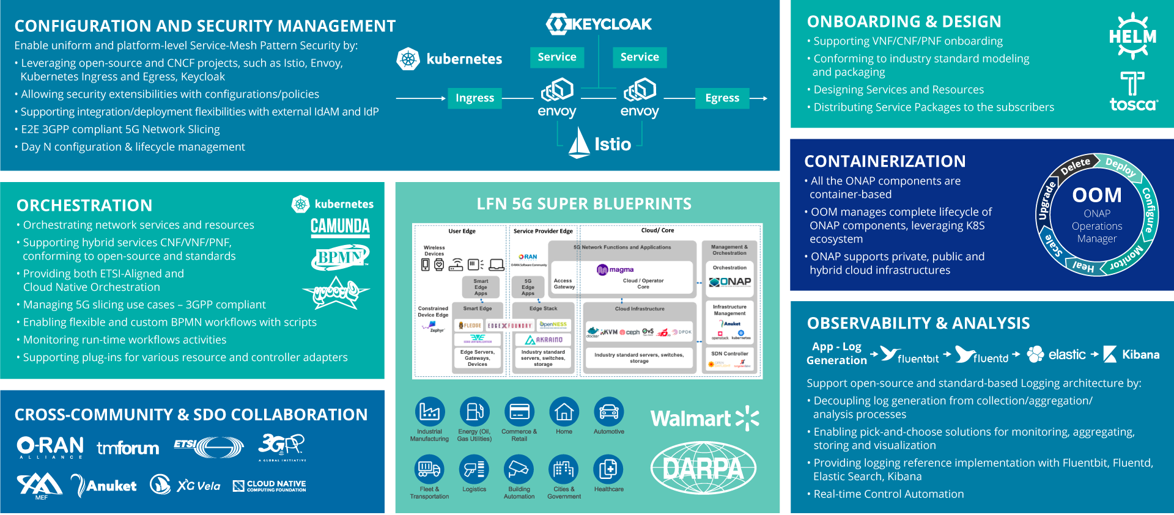
ONAP Cloud Native Evolution

Slide 3
Evolving from VNFs to CNFs
VNFs Architecture
CNF Architecture
VNFs/PNFs
OSS/BSS
CNFs
VNFs
OSS/BSS
MANO/SMO
KubeVirt / Airship SIP/ViNO /
OpenStack
MANO/SMO
Multi-Cloud and/or Bare Metal
Kubernetes
Bare Metal
Any Cloud
Notes:
Several variations of VNF implementation exists on multi-cloud with Standards based OSS/BSS integration through MANO frameworks like ONAP under LF Networking. Current implementations include ONAP running on K8s and a variety of Clouds including Openstack
CNF Architecture diagram is aligned to ETSI with VIM as K8s and options to run CNFs on K8s and Bare Metal as well as hybrid (brownfield) scenarios with VNF and CNF on any cloud while still utilizing the Standard de-facto implementation of OSS/BSS on MANO like ONAP.

