Slide 1
ONAP Cloud Native
(For LFN Cloud Native messaging)
Draft 0.2

Slide 2
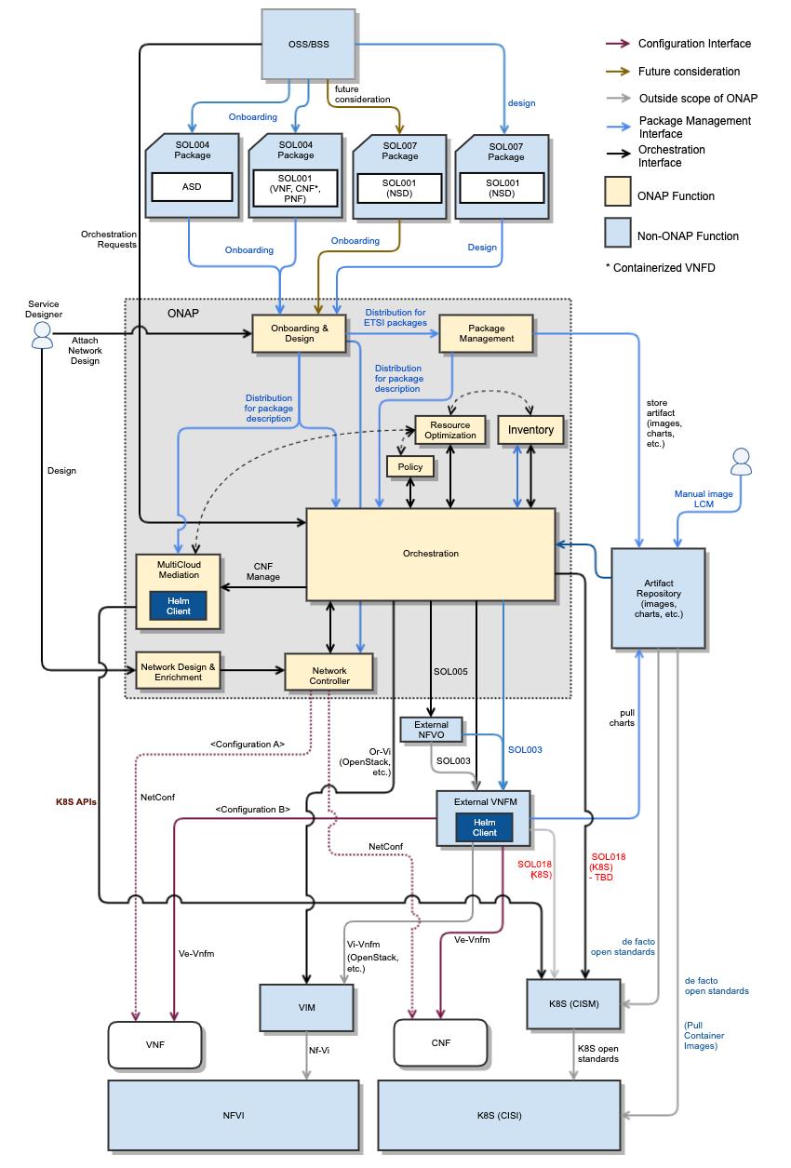
ONAP CNF Orchestration
Hybrid services CNF/VNF/PNF
  Brownfield environment
Day 0/1/2 configuration
  Not just infrastructure orchestration
Standard alignment (ETSI,3GPP) and beyond (ASD)
  Evolve existing investment, no need to start from scratch
  5G slicing use case – 3GPP compliant
  https://wiki.onap.org/display/DW/CNF+Orchestration+Functional+Architecture
We need the “Markitechture” version of this

Slide 3
ONAP Cloud Native transformation
Flexibility for deploying just the necessary modules on K8S infrastructure
  ONAP OOM simplifying deployment of ONAP Modules Helm charts
Leveraging functionality of the CNCF ecosystem
  AAF->Service mesh security
  Istio, Keycloak, Cert-Mgr, Ingress, Egress
  External idAM
  Logging?
Enterprise E2E use cases
  K8S is widely used in enterprise environment
  Application orchestration, not just network function orchestration.
Cross-community
  LFN
    Anuket CI2
    XGVela
    EMCO
  LF Edge
    Akraino – future plans
  O-RAN (SC)
  SDOs – TMForum, ETSI, 3GPP

Slide 4
ToDO
Create a block diagram
Add short description for the security/logging items in the second slide – re-group bullets in the list

