Slide 1
ONAP Cloud Native
(For LFN Cloud Native messaging)
This deck will be used for generic, industry talks/keynotes => ONS, LFN Webinar, press release,
etc. and re-used/re-adjusted by ourselves ;-)
Slides should be visual, punchlines – see Marketing Honolulu deck
Need to include speaker notes
Draft 0.5

Slide 2
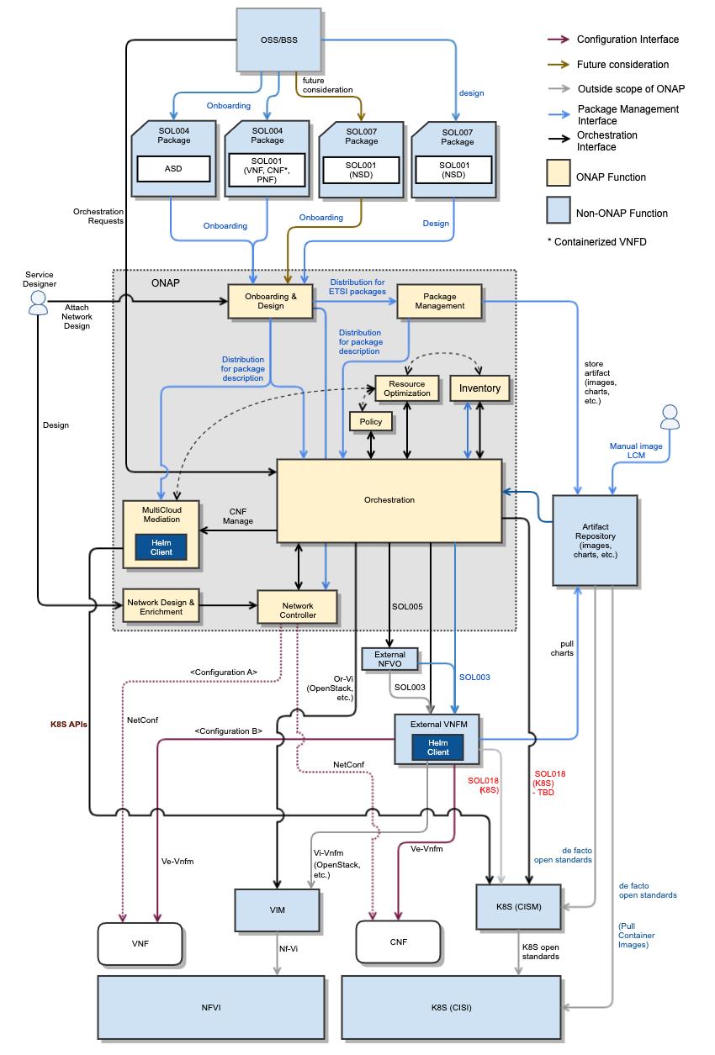


ONAP CNF Orchestration
Suggestion to remove all the arrows across all the boxes,
Rotate 90° the diagram, etc. + punch line/Keywords
about key features
<ETSI logo>
SOL001
SOL004, SOL007 + ASD
Hybrid services CNF/VNF/PNF
  Brownfield environment
Day 0/1/2 configuration
  Not just infrastructure orchestration
Standard alignment (ETSI,3GPP) and beyond (ASD)
  Evolve existing investment, no need to start from scratch
  5G slicing use case – 3GPP compliant
  https://wiki.onap.org/display/DW/CNF+Orchestration+Functional+Architecture
SO
We need the “Markitechture” version of this

Slide 3








ONAP Cloud Native transformation
Flexibility for deploying just the necessary modules on K8S infrastructure
  ONAP OOM simplifying deployment of ONAP Modules Helm charts (pick & choose)
Leveraging functionality of the CNCF ecosystem
  Enable uniform and platform-level Service-Mesh Pattern Security by = Service Proxy, Discovery and Mesh
    Leveraging open-source and CNCF projects, such as Istio, Envoy, Kubernetes Ingress and Egress, Keycloak
    Allowing security extensibilities with AuthN/AuthZ configurations/policies
    Supporting integration/deployment flexibilities with external IdAM and IdP
  Support open-source and standard-based Logging architecture by: == Observability & Analysis
    Decoupling log generation from collection/aggregation/analysis processes
    Enabling pick-and-choose solutions for monitoring, aggregating, storing and visualization
    Providing logging reference implementation with Fluentbit, Fluentd, Elastic Search, Kibana
Enterprise E2E use cases
  K8S is widely used in enterprise environment
  Application orchestration, not just network function orchestration.
Cross-community
  LFN
    Anuket CI2
    XGVela
    EMCO
  LF Edge
    Akraino – future plans
  O-RAN (SC)
  SDOs – TMForum, ETSI, 3GPP
CI/CD
Jenkins/Gihub/Sonar
Streaming/Messaging
DMaaP (?), MSB
Distributed DB &Storage
Etcd (OOF), etc

Slide 4
ToDO
Create a block diagram
Add short description for the security/logging items in the second slide – re-group bullets in the list
Add diagram to highlight the use of CNCF components (slide 3) – Get inspiration from the CNCF trail map - https://wiki.onap.org/pages/resumedraft.action?draftId=93004635&draftShareId=b4cf7c15-b975-4e3e-b25e-be3812e8c37b&
Add forward looking hints about future cloud-native roadmap

Slide 5
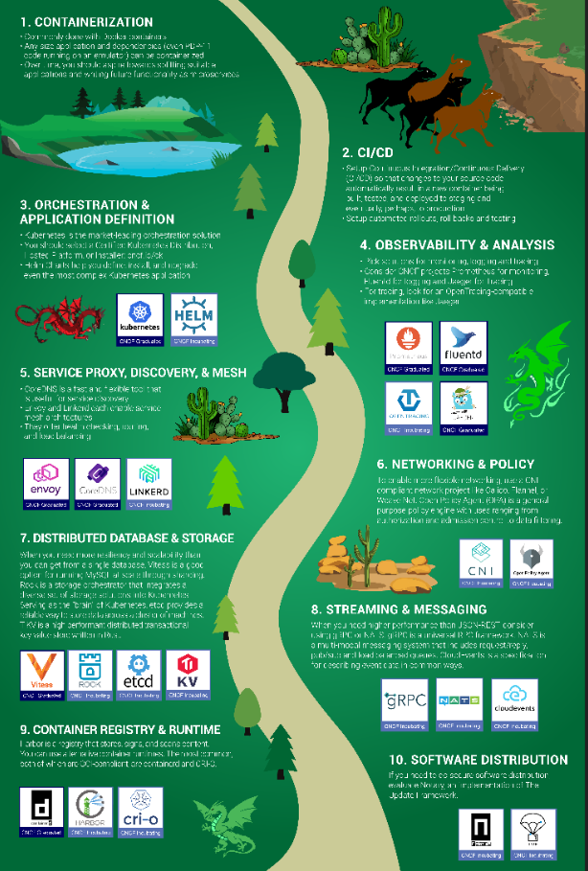

Slide 6
Punch lines slide including Logo and few words
Containerization
<xxxx>
OOM

